Slide 1
Fault-Tolerant Communication Runtime Support for Data-Centric Programming Models
Abhinav Vishnu¹, Huub Van Dam¹, Bert De Jong¹,
Pavan Balaji^{2,} Shuaiwen Song³
¹ Pacific Northwest National Laboratory
² Argonne National Laboratory
³ Virginia Tech

Slide 2
Faults Are Becoming Increasingly Prevalent
Many scientific domains have insatiable computational requirements
Chemistry, Astrophysics etc.
Many hundreds of thousands of processing elements are being combined
Hardware faults are becoming increasingly commonplace
Designing fault resilient systems and system stack is imperative
Large body of work with Checkpoint/Restart
Application driven and transparent (BLCR)
Message Logging
Matches very well with MPI semantics and fixed process model
System | #Cores | MTBF
ASCI/Q | 8192 | 6.5 hrs
ASCI White | 8192 | 8 hrs
Jaguar 4 Core | 150K+ | 37.5 hrs
Source: Mueller et al.,
ICPADS’ 2010

Slide 3

Quick Overview of Data Centric / Partitioned Global Address Space (PGAS) Models
Global Address Space view
Abstractions for arbitrary distributed data structures
Arrays, Trees etc
Fit for irregular global address space accesses
Natural mechanism for load balancing
Decouple of data and computation
We focus on Global Arrays
Fundamental building block for other structures
Uses one-sided communication runtime system for data transfer (ARMCI)
What are the requirements for fault tolerance from the runtime?
Applications
Global Arrays
Layer
Fault Tolerant
Runtime
Physically distributed data

Slide 4
Task-Based Execution using PGAS: Characteristic of Various Applications
Compute
Global Address Space (RO)
P₀
Each task
executed by any process
Reads/updates arbitrary global address space
Requirements for fault tolerance
Continue with available nodes
Recover data on fault
Recovery proportional to degree of failure
Get
Task Collection
Global Address Space (RW)
Put/Accumulate
P_{N-1}

Slide 5
Other Questions for Fault Tolerance
Interconnection Network
Node 1
Node 2
Node 3
Node 4
Power supply
Is Node 2 Dead?
What about the one-sided operations
to the failed node?
What should the process manager do?
What about the collective operations
and their semantics?
What about the lost data and
computation?
We answer these questions in this work

Slide 6
Provided Solutions
Problem
Solution
Is Node 2 Dead? .
What should the process manager do?
What about the lost data and computation?
One-sided operations to the failed node?
Collective communication operations and their semantics?
Design a Fault Tolerance Management Infrastructure
Continue execution with lost node
Application based redundancy and recovery
Fault resilient Global Arrays and ARMCI
Design a fault resilient barrier

Slide 7
Design of Fault Tolerant Communication Runtime System
Application
Data Redundancy/Fault Recovery Layer
Global Arrays Layer
Fault Resilient ARMCI
Fault Tolerant Barrier
Fault Resilient Process Manager
Fault Tolerance Management Infrastructure
Handling
Data
Redundancy
Network

Slide 8
ARMCI: underlying communication runtime for Global Arrays
Aggregate Remote Memory Copy Interface (ARMCI)
Provides one-sided communication primitives
Put, Get, Accumulate, Atomic Memory Operations
Abstract network interfaces
Established & available on all leading platforms
Cray XTs, XE
IBM Blue Gene L | P
Commodity interconnects (InfiniBand, Ethernet etc)
Further upcoming platforms
IBM Blue Waters, Blue GeneQ
Cray Cascade

Slide 9
FTMI Protocols (Example with InfiniBand)
Requires response from remote process,
Less Reliable
Reliable Notification,
Most
Reliable
No Response
No Response
Node 2 is
dead
Network Adapter
Ping Message
Node
RDMA Read

Slide 10
Fault Resilient Process Manager
Interconnection Network
Adaptation from OSU-MVAICH Process Manager
Provides MPI style (not fault tolerant) collectives
Based on TCP/IP for bootstrapping
Generic enough for any machine which has at least Ethernet control network
Ignores any TCP/IP errors
Layers rely on FTMI for higher accuracy fault information

Slide 11
Expected Data Redundancy Model: Impact on ARMCI
Expected Data Redundancy Model
Staggered data model
Simultaneous updates may result in both copies in an inconsistent state
Each copy should be updated one by one
Every Write based Primitive (Put/Acc) should be Fenced
WaitProc – Wait for all non-blocking operations to complete
Fence – Ensure all writes to a process have finished
Primary Copy
N1
N2
N3
N4
Data
Data
N1
N2
N3
N4
Shadow Copy

Slide 12
Fault Resilient ARMCI – Communication Protocols
Process
Asynchronous Agent
Multiple phases of communication in ARMCI
Put/Get/Acc are implemented as a combination of these phases
On Failures
Either process/thread may be waiting for data, while other process is dead
Use Timeout based FTMI to detect failures
If FTMI detects failure, return error, if necessary

Slide 13
Fault Resilient Collective Communication Primitives
Barrier is fundamental non-data moving collective communication operation
Ga_sync = Fence to all processes + Barrier
Used at various execution points in ARMCI
We have implemented multiple fault tolerant barrier algorithms
Fault tolerant version of based on high concurrency all-to-all personalized exchange
Fault tolerant version of hypercube based implementation

Slide 14
Usage of FTMI
General functionality for fault detection
Potential use as a component for fault tolerance backplane
ARMCI Layer
Different phases of one-sided communication protocols
Put, Get, Accumulate
Fault Resilient Barrier
Different steps of the fault tolerant algorithm
Potential use at application layer for designing recovery algorithm

Slide 15
Performance Evaluation Methodology
Comparisons of following approaches:
FT-ARMCI, No Fault
FT-ARMCI, One Node Fault (Actual)
Original
Testbed:
InfiniBand DDR with AMD Barcelona CPUs
Used 128 Nodes for performance evaluation

Slide 16
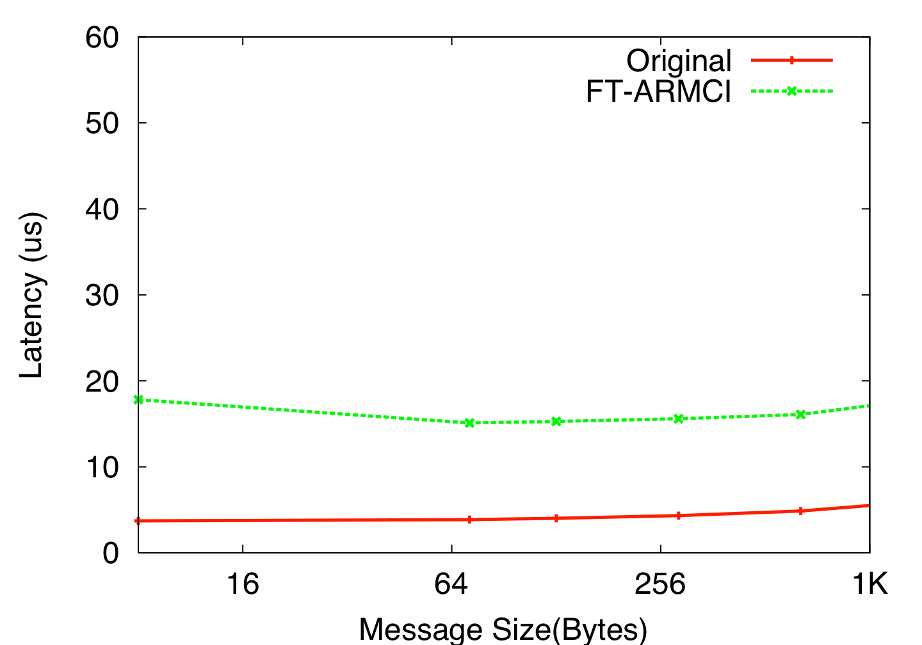
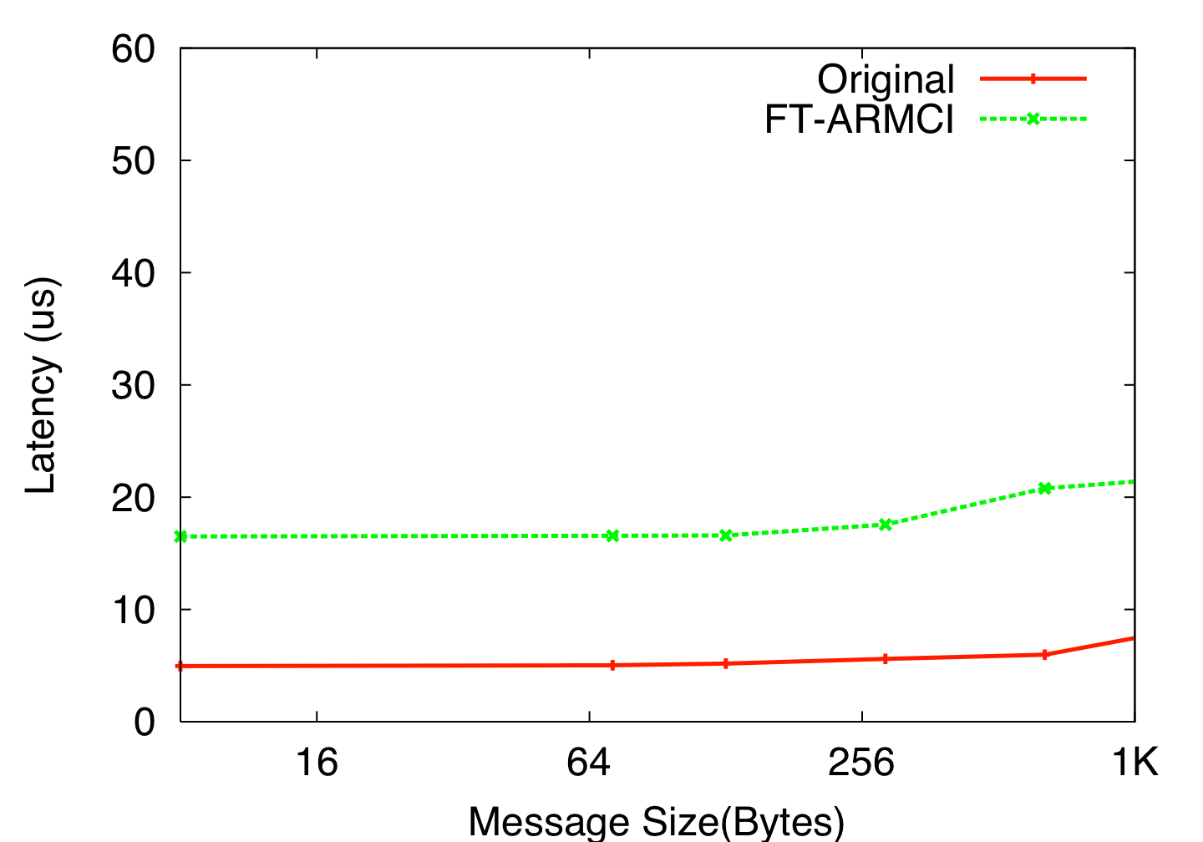
Overhead of FT-ARMCI (No Faults)
Latency comparisons for Original and FT-ARMCI implementation
Objective is to understand the overhead of pure communication benchmarks
Put and Accumulate primitives
Overhead is observed due to synchronous writes
Possible performance optimizations for future
Piggyback acknowledgement with data

Slide 17
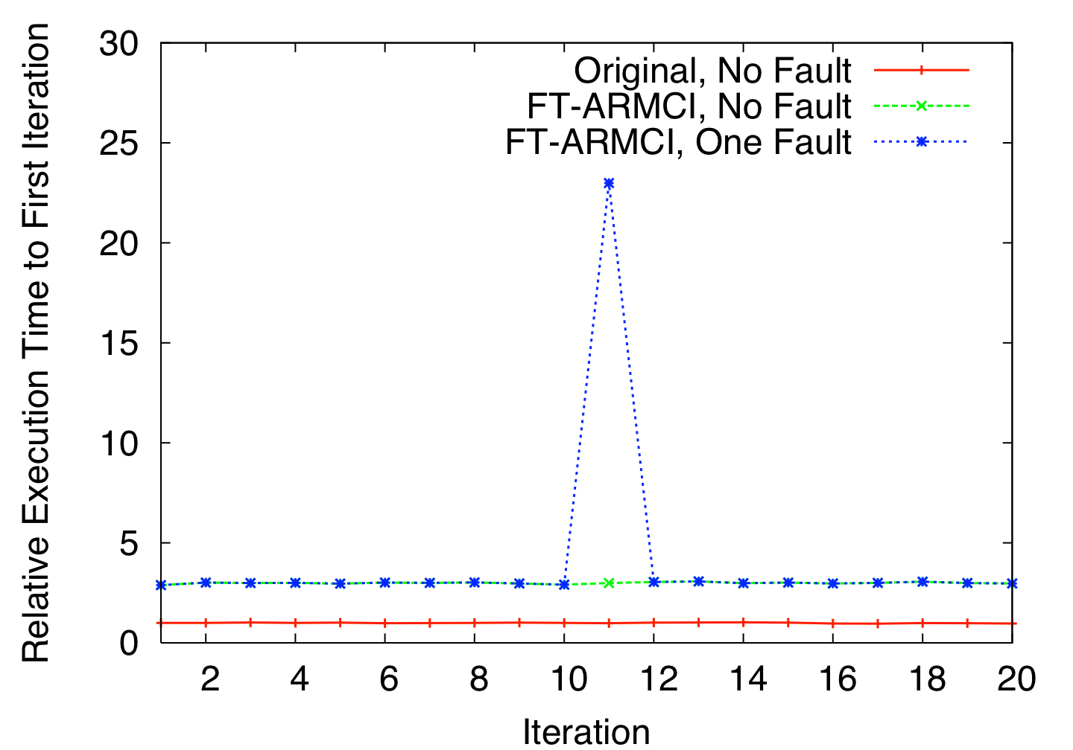
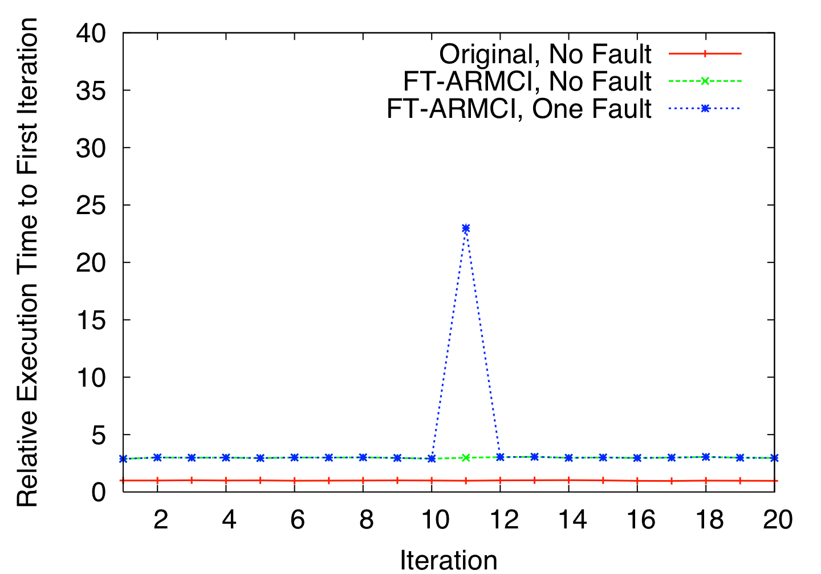
Performance Evaluation with Faults
Pure communication Benchmark
Real scientific application would have a combination of computation and communication
Objective is to understand the overhead when a fault occurs
The primary overhead is due to timeout by the hardware for fault detection
Test continues to execute, when actual faults occur

Slide 18
Conclusions
We presented the execution models of data centric programming models for fault tolerance
We presented the design for fault tolerant communication runtime system
Fault tolerance management infrastructure
Process manager and barrier collective operation
Fault tolerant communication protocols
Our evaluation shows
We can perform continued execution in presence of node faults
Improvable overhead is observed in absence of faults
Acceptable degradation in presence of node faults

Slide 19
Future Work
This is a part of active R&D:
Leverage infrastructure for Global Arrays
Significant application impact
Handling simultaneous and consecutive failures
Actively pursuing designs for upcoming high end systems
Blue Waters, Gemini etc
Our thanks to:
eXtreme Scale Computing Initiative (XSCI) @ PNNL
US Department of Energy
Molecular Science Computing Facility @ PNNL

