Slide 1
iWARP Redefined: Scalable Connectionless Communication Over High-Speed Ethernet
M. J. Rashti, R. E. Grant, P. Balaji and A. Afsahi

Slide 2
PRESENTATION OUTLINE
Background
Motivation for a Datagram-based iWARP
Datagram-iWARP Design & Implementation
Experimental Results
Summary & Future Works
Notes:
2

Slide 3
iWARP Ethernet Standard
Internet Wide-Area RDMA Protocol
RDMA-enabled Ethernet
Standardized by RDMA Consortium
Defined over Reliable Transports
TCP and SCTP
Benefits over Traditional TCP/IP
Low latency / high throughput
Protocol offload: lower host CPU/bus utilization
Zero-copy: lower latency and host CPU utilization
Critical for servers
User-level library: bypass OS involvement overhead
Message-oriented Protocol Stack

Slide 4
Queue-pair Communication
CPU posts WRs to QP
RNIC performs data transfer asynchronously and are Zero-copy
Completion events are put in CQ for polling
WRs can be:
Send
Receive
RDMA Write
RDMA Read
Consumer CPU
WR
CQ
QP
send
recv
iWARP and TCP/IP Stack
data packet
Port
iWARP RNIC

Slide 5
iWARP Stack compared to Host-based TCP/IP
User Applications
MPI,SDP, etc.
Socket Interface
Verbs Interface
Socket Buffer
Software
RNIC Driver
Kernel Processing
NIC Hardware
RDMAP
OS
TCP/IP proc.
DDP
Interrupt Handling
MPA
SCTP/IP
TCP/IP
NIC Driver
Software
Ethernet Link Layer
NIC Hardware

Slide 6
PRESENTATION OUTLINE
Background
Motivation for a Datagram-based iWARP
Datagram-iWARP Design & Implementation
Experimental Results
Summary & Future Works
Notes:
6

Slide 7
Motivation for Datagram-iWARP (1)
Widespread use of Ethernet:
HPC Clusters (~50% of Top500)
Data Services (media streaming, gaming, etc.)
Extensively use Ethernet for intra- and inter-networking
UDP-based Services and Applications
Currently cannot utilize iWARP
Datagrams Traffic Increase: 40% per year
91% of Internet traffic by 2014 (according to Cisco)

Slide 8
Motivation for Datagram-iWARP (2)
Memory-usage Scalability of iWARP
Future systems will be much more memory-tight
Connection memory usage is not scalable
At NIC / HW layer
Limited NIC cache need to utilize host memory
At application library (MPI / socket) layer
pre-allocated user- and/or kernel-level buffers
HW Complexity and Fabrication Cost
UDP is much simpler to offload
More room for offload-engine parallelism for multi-cores
More room for more offloaded functionality
For applications that only need datagrams

Slide 9
Motivation for Datagram-iWARP (3)
Performance Issues of the Current iWARP
TCP/SCTP performance barriers
Reliability / Flow control
Too much overhead for low-error-rate networks
Marking (MPA layer) costs: required for TCP
Hardware-level Multicast and Broadcast
Important for HPC and datacenters
Not supported in TCP
Can be efficiently supported in UDP

Slide 10
PRESENTATION OUTLINE
Background
Motivation for a Datagram-based iWARP
Datagram-iWARP Design & Implementation
Experimental Results
Summary & Future Works
Notes:
10

Slide 11
Datagram-iWARP: General Design at Different Layers
Verbs layer
Modify verbs & data structures to comply with datagram semantics.
RDMAP layer
Define datagram QPs & WRs
DDP layer
No streams/connections. No message segmentation. Use UDP sockets. Checksum moved here.
MPA layer
MPA layer is bypassed for datagrams.
Transport layer
(TCP/IP)
Use UDP for UD QPs and lightweight reliable UDP for RD QPs.

Slide 12
Design Considerations (1)
Addition of New Queue-pair (QP) Types
For reliable and unreliable datagrams
Current iWARP does not have QP types
QP Operations
QP Create: new input modifiers for datagram mode
QP Modify: need a pre-established datagram socket for RTS state
Work Requests
Need address-handles for individual datagrams
Completion of WRs
As soon as accepted by LLP

Slide 13
Design Considerations (2)
Completion Events
Need to report the source information
Datagram Error Management (reliable mode)
No connection to terminate
QP goes into Error state
Use MSN for notification into an “Error Queue”
Re-use after resetting QP
MPA Layer Removed
CRC moved to DDP layer
MTU-sized Message Segmentation
Not required anymore
Up to 64KB datagrams allowed

Slide 14
Software-based Datagram iWARP
MVAPICH-hybrid with Reliability Settings
Adapted to run over SW iWARP
OF Verbs Interface
Developed for SW iWARP
Native iWARP Verbs Interface
Extended for SW Datagram-iWARP
RDMAP Layer -RC & UD
DDP Layer - Untagged
Extended for SW Datagram-iWARP
MPA markers
TCP
UDP
Tuned Linux Kernel
Tuned for best performance
of MPI over SW Datagram iWARP
Tuned Ethernet Link Layer

Slide 15
Software Implementation
Based on the OSC SW-iWARP (TCP-based)
New Native Verbs to Support Datagrams
Implementing Standard OF-verbs
On top of UDP- and TCP-based native verbs
No new verbs at this layer
Using IO-Vectors for Low-latency SW-based Datagram Transfer
Utilizing UDP Offload-engine
Large Receive Offload
UDP checksum (optional)

Slide 16
PRESENTATION OUTLINE
Background
Motivation for a Datagram-based iWARP
Datagram-iWARP Design & Implementation
Experimental Results
Summary & Future Works
Notes:
16

Slide 17
Experimental Platform
Platform | Nodes | Processor | Memory/ Cache | Network | OS/ Software
C1 | 4 | Two quad-core 2GHz Opteron | RAM: 8GB L3: 8MB L2: 512K | NIC: NetEffect 10GE Switch: Fujitsu 10GE | Fedora 12/ MVAPICH 1.1
C2 | 16 | Two dual-core 2.8GHz Opteron | RAM: 4GB L2: 1MB | NIC: Myricom 10GE Switch: Fulcrum 10GE | Ubuntu/ MVAPICH 1.1

Slide 18
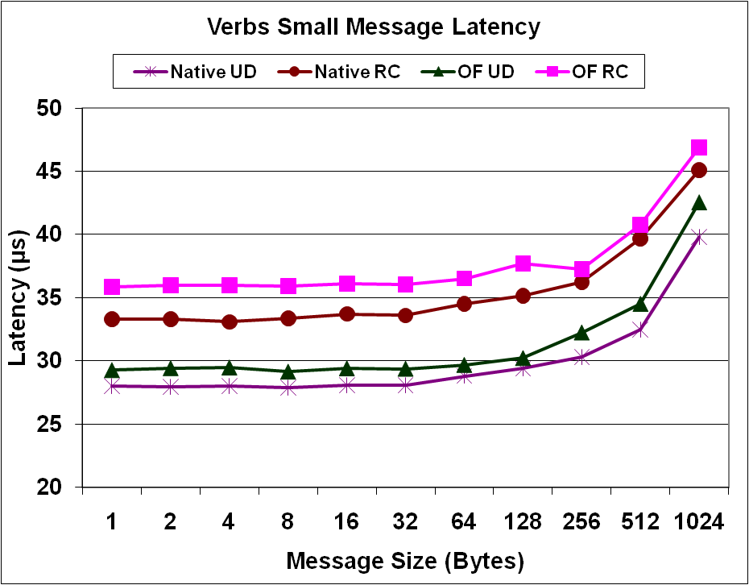
Verbs-level Latency - Small Messages

Slide 19
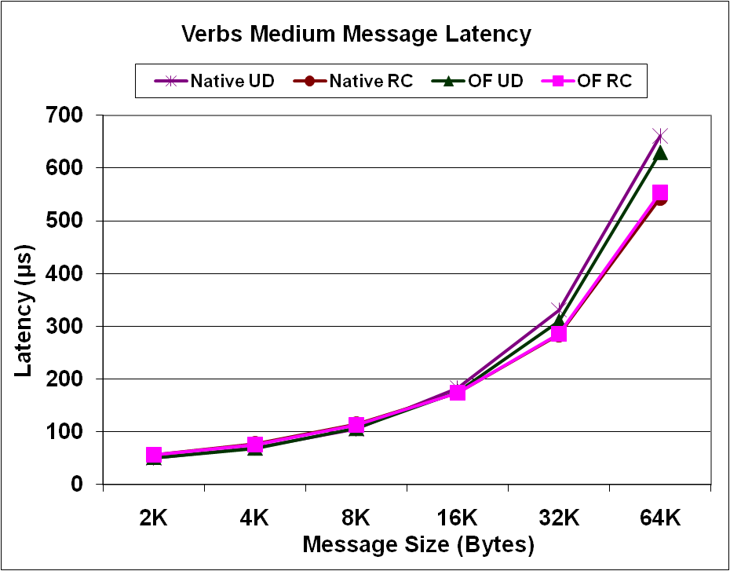
Verbs-level Latency - Medium Messages

Slide 20
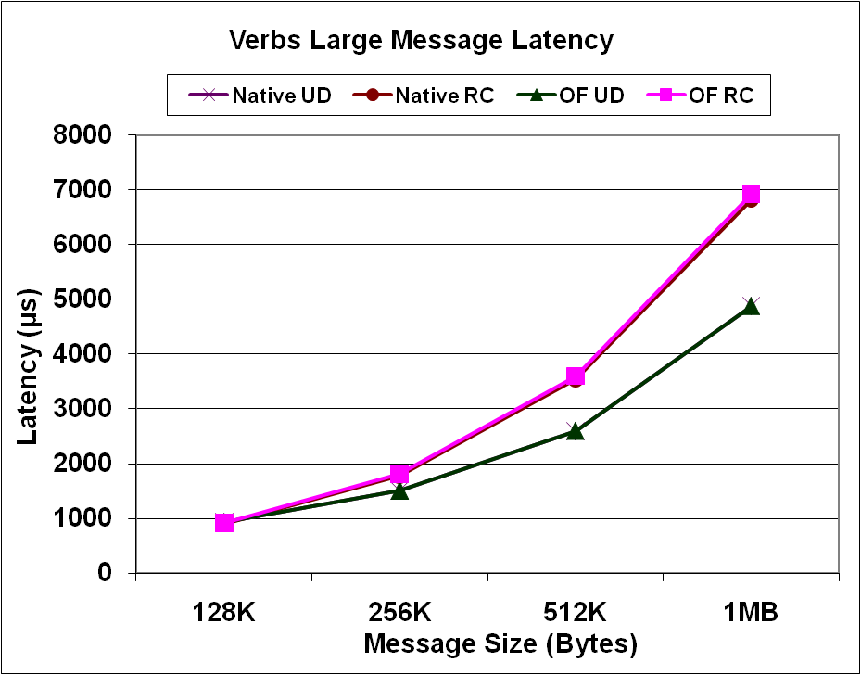
Verbs-level Latency - Large Messages

Slide 21
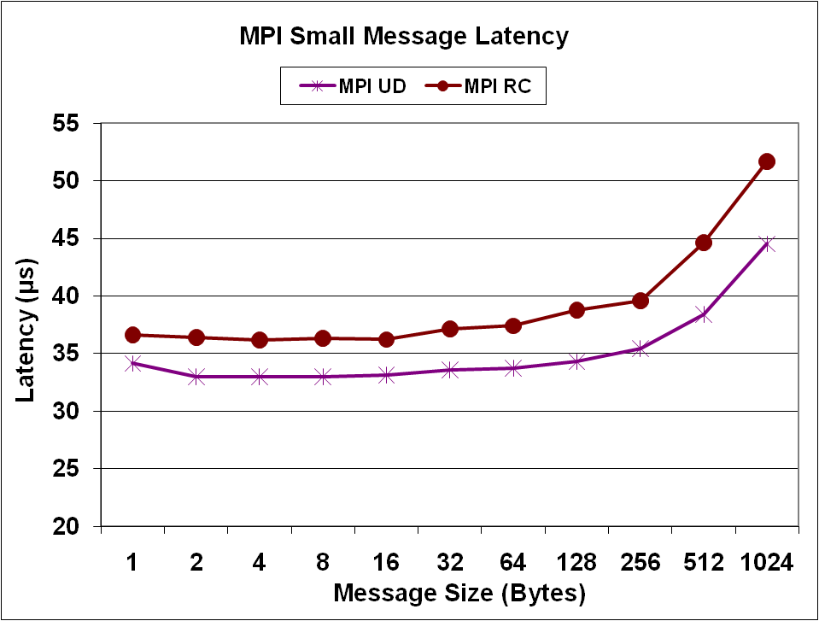
MPI-level Latency – Small Messages

Slide 22
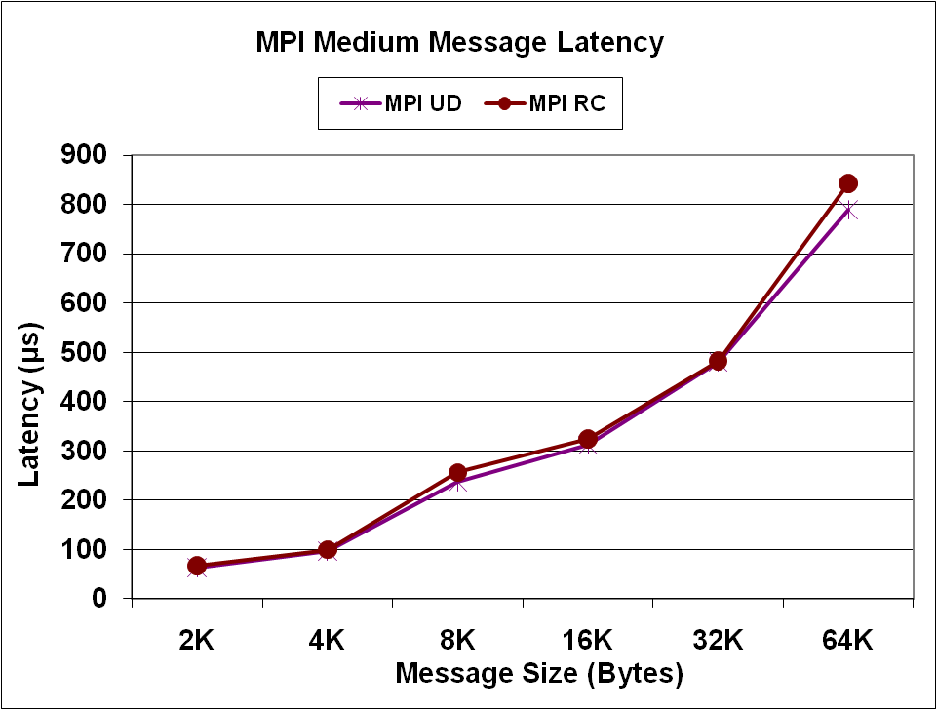
MPI-level Latency – Medium Messages

Slide 23
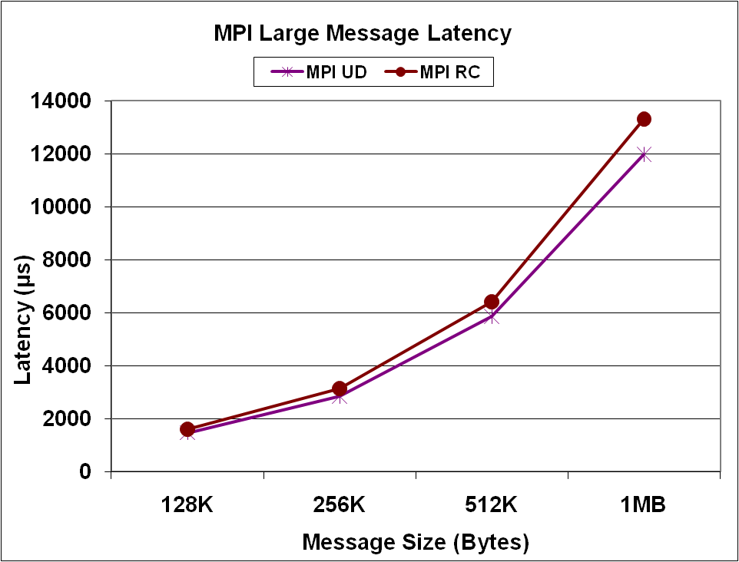
MPI-level Latency - Large Messages

Slide 24
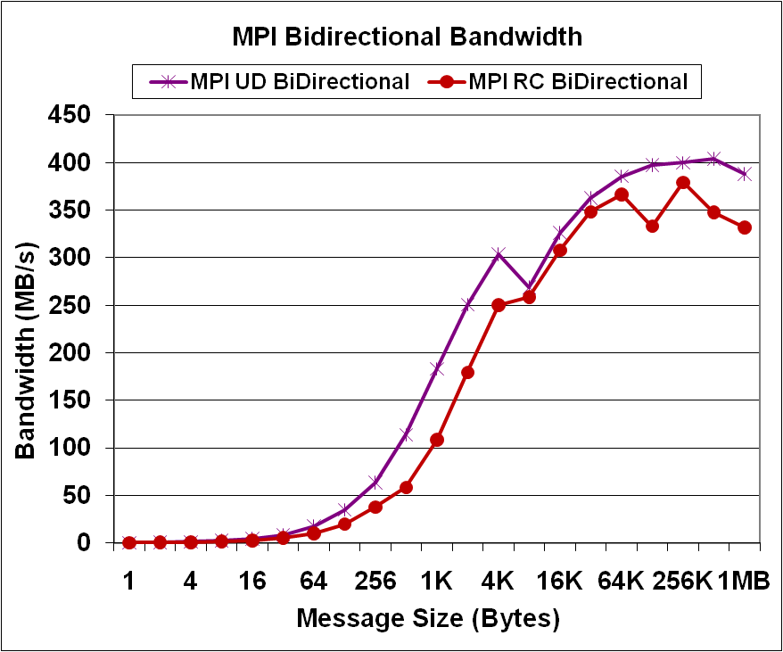
MPI Micro-benchmark Bandwidth Results

Slide 25
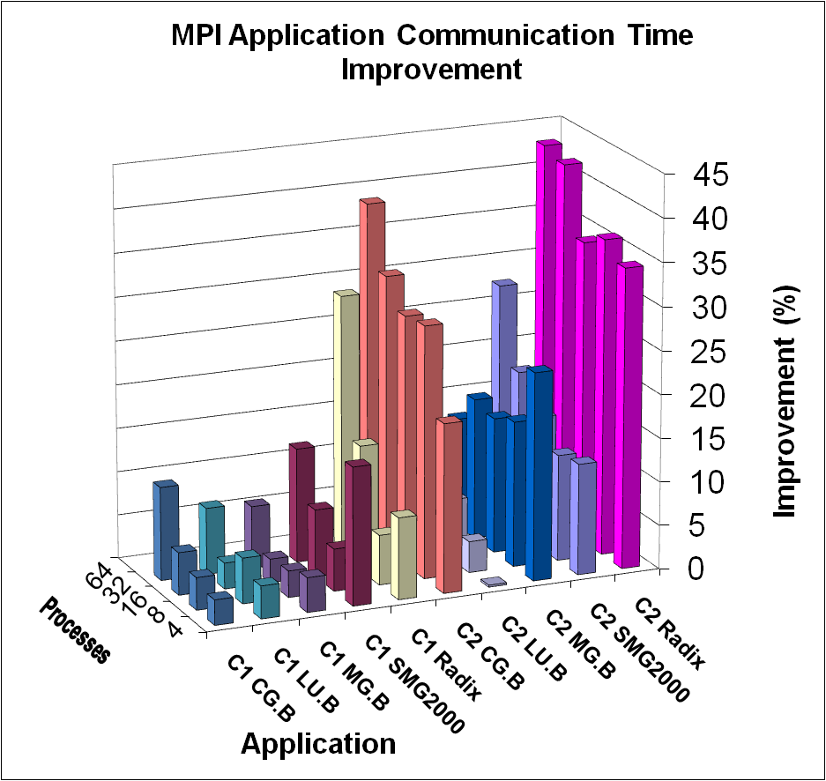
Application Performance Improvement (I)
Application
Communication-time
Improvement
exceeding 40% for Radix

Slide 26
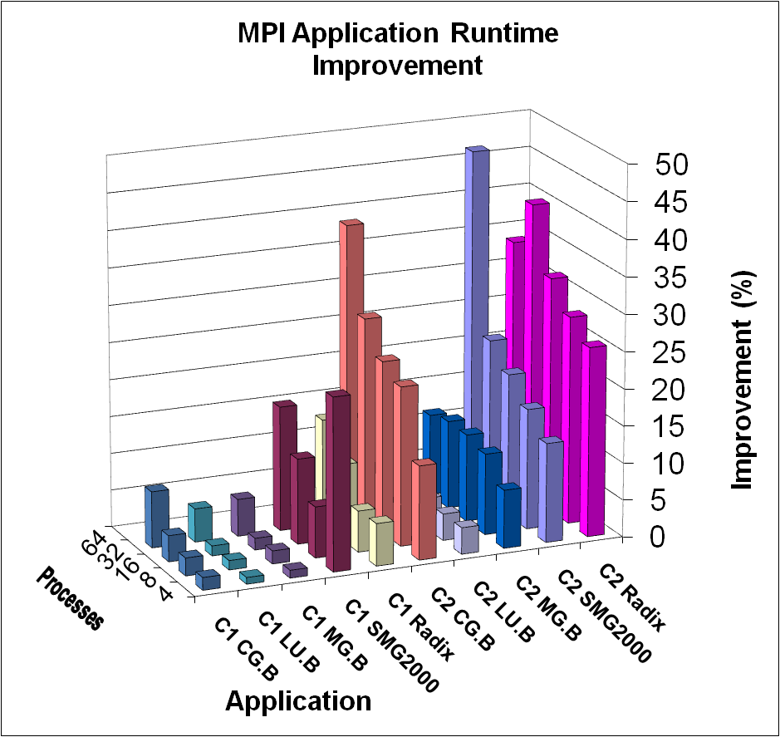
Application Performance Improvement (II)
Application Runtime
Improvement
exceeding 45% for
SMG2000

Slide 27
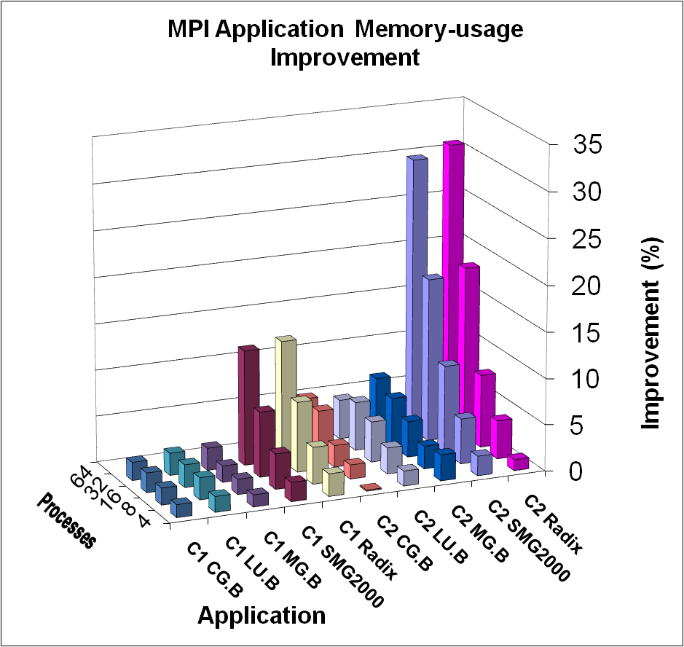
Application Memory-usage Reduction
Memory usage decrease
exceeding 30% for Radix
High savings for SMG, Radix which have complete connection graphs
Scalable improvement
trend
For both performance
and memory usage:
C2 cluster results are
better than C1 cluster

Slide 28
PRESENTATION OUTLINE
Background
Motivation for a Datagram-based iWARP
Datagram-iWARP Design & Implementation
Experimental Results
Summary & Future Works
Notes:
28

Slide 29
Summary
Proposed extension of iWARP over Datagrams
Over UDP (reliable & unreliable)
Implemented Untagged Model (send/recv) in Software
OF-verbs over SW Datagram-iWARP
MPI over OF-verbs using Datagram-iWARP
Results
Significant application memory usage reduction
High application performance increase
The benefits scale up with more #processes

Slide 30
Conclusions
Datagram-iWARP Complements the Current iWARP Standard
Extends Usability Domain of iWARP Standard
Can serve datagram-based applications
For both HPC and datacenter systems
Improves Performance
Offers Higher Scalability
Lower memory usage
Lower fabrication cost & power consumption
If implemented in HW

Slide 31

Future Directions
Tagged (RDMA Read/Write) Model
Define unreliable RDMA operations over UD
Integrate with socket-based applications
To appear in IPDPS 2011
Integrate with MPI
To be completed soon
Port Datagram-iWARP over Reliable UDP
No need for reliability at MPI layer
Much lighter weight than TCP/SCTP
Standardization of Datagram-iWARP

Slide 32




Acknowledgement

Slide 33



Slide 34
Extra Slides

Slide 35
Related Work
OSC Software iWARP (TCP-based)
Kernel-level
User-level: the base of our work
IBM Zurich SoftRDMA
SW iWARP stack for OFED package
Myricom MX over Ethernet
InfiniBand over Ethernet
RDMA over CEE
Notes:
iWARP and RDMAoE are in fact competing technologies, but iWARP is a more mature standard. It supports features such as WAN (IP), not supported in RDMAoE. Datagram-based applications which need IP compatibility cannot use RDMAoE and are currently unable to utilize iWARP either. Datagram iWARP will also be a more economical alternative to an IB based transport over Ethernet (i.e. RDMAoE). Considering these benefits, our paper is focused on increasing the scalability of iWARP, making it more suitable for both HPC and data centers.

Slide 36
iWARP Protocol Stack
Verbs: a set of descriptive user-level interfaces
User-level: bypass OS
RDMAP: supplies communication primitives for verbs layer
Send/Recv, RDMA Write, RDMA Read
QP-based semantics
DDP: directly transfers data between the user buffer and the RNIC
without intermediate buffering
MPA: inserts markers to distinguish iWARP messages in TCP stream

Slide 37
RDMA Technology – Zero copy
Data Source
Data Sink
User Buffer
CPU
User Buffer
CPU
RDMA
RDMA
Kernel Buffer
Kernel Buffer
DMA
DMA
NIC
NIC

