Slide 1
MPI at Exascale
Rajeev Thakur
Mathematics and Computer Science Division
Argonne National Laboratory

Slide 2
MPI on the Largest Machines Today
Systems with the largest core counts in June 2010 Top500 list
Juelich BG/P 294,912 cores
Oak Ridge Cray XT5 224,162 cores
LLNL BG/L 212,992 cores
Argonne BG/P 163,840 cores
LLNL BG/P (Dawn) 147,456 cores
(All these systems run MPICH2-based MPI implementations)
In a couple of years, we will have systems with more than a million cores
For example, in 2012, the Sequoia machine at Livermore will be an IBM Blue Gene/Q with 1,572,864 cores (~1.6 million cores)

Slide 3
Future Extreme Scale Platforms
Hundreds of thousands of “nodes”
Each node has large numbers of cores, including
Regular CPUs and accelerators (e.g., GPUs)
Login Nodes
Mgmt Nodes
Compute Nodes
I/O Nodes
Storage Targets

Slide 4
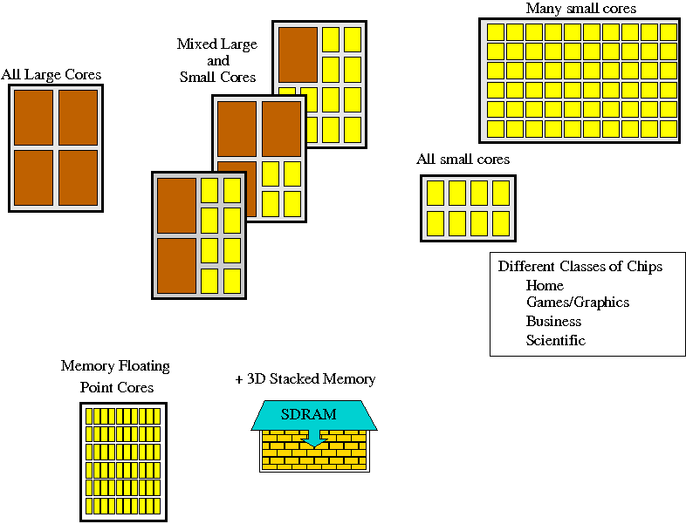
Multiple Cores Per Node

Slide 5
Scaling MPI to Exascale
MPI already runs on the largest systems today at ~300,000 cores
What would it take to scale MPI to exascale systems with millions of cores?
On exascale, MPI is likely to be used as part of a “hybrid programming” model (MPI+X), much more so than it is today
MPI being used to communicate between “address spaces”
With some other “shared-memory” programming model (OpenMP, UPC, CUDA, OpenCL) for programming within an address space
How can MPI support efficient “hybrid” programming on exascale systems?

Slide 6
Scaling MPI to Exascale
Although the original designers of MPI were not thinking of exascale, MPI was always intended and designed with scalability in mind. For example:
A design goal was to enable implementations that maintain very little global state per process
Another design goal was to require very little memory management within MPI (all memory for communication can be in user space)
MPI defines many operations as collective (called by a group of processes), which enables them to be implemented scalably and efficiently
Nonetheless, some parts of the MPI specification may need to be fixed for exascale
Being addressed by the MPI Forum in MPI-3

Slide 7
Factors Affecting MPI Scalability
Performance and memory consumption
A nonscalable MPI function is one whose time or memory consumption per process increase linearly (or worse) with the total number of processes (all else being equal)
For example
If memory consumption of MPI_Comm_dup increases linearly with the no. of processes, it is not scalable
If time taken by MPI_Comm_spawn increases linearly or more with the no. of processes being spawned, it indicates a nonscalable implementation of the function
Such examples need to be identified and fixed (in the specification and in implementations)
The goal should be to use constructs that require only constant space per process

Slide 8
Requirements of a message-passing library at extreme scale
No O(nprocs) consumption of resources (memory, network connections) per process
Resilient and fault tolerant
Efficient support for hybrid programming (multithreaded communication)
Good performance over the entire range of message sizes and all functions, not just latency and bandwidth benchmarks
Fewer performance surprises (in implementations)
These issues are being addressed by the MPI Forum for MPI-3 and by MPI implementations

Slide 9
Scalability Issues in the MPI Specification
Some functions take parameters that grow linearly with number of processes
E.g., irregular (or “v”) version of collectives such as MPI_Gatherv
Extreme case: MPI_Alltoallw takes six such arrays
On a million processes, that requires 24 MB on each process
On low-frequency cores, even scanning through large arrays takes time (see next slide)
Solution: The MPI Forum is considering a proposal to define sparse, neighborhood collectives that could be used instead of irregular collectives

Slide 10
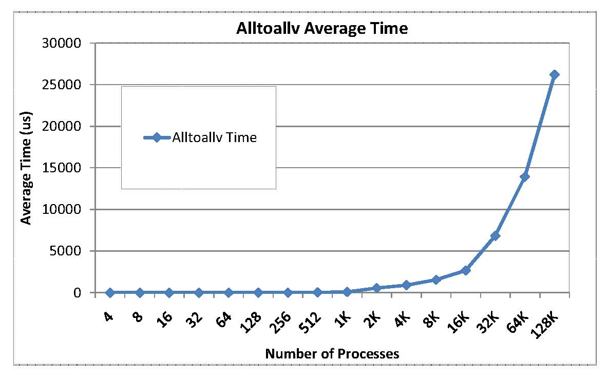
Zero-byte MPI_Alltoallv time on BG/P
This is just the time to scan the parameter array to determine it is all
0 bytes. No communication performed.

Slide 11
Scalability Issues in the MPI Specification
Graph Topology
In MPI 2.1 and earlier, requires the entire graph to be specified on each process
Already fixed in MPI 2.2 – new distributed graph topology functions
One-sided communication
Synchronization functions turn out to be expensive
Being addressed by RMA working group of MPI-3
Representation of process ranks
Explicit representation of process ranks in some functions, such as MPI_Group_incl and MPI_Group_excl
Concise representations should be considered

Slide 12
Scalability Issues in the MPI Specification
All-to-all communication
Not a scalable communication pattern
Applications may need to consider newer algorithms that do not require all-to-all
Fault tolerance
Large component counts will result in frequent failures
Greater resilience needed from all components of the software stack
MPI can return error codes, but need more support than that
Being addressed in the fault tolerance group of MPI-3

Slide 13
MPI Implementation Scalability
MPI implementations must pay attention to two aspects as the number of processes is increased:
memory consumption of any function, and
performance of all collective functions
Not just collective communication functions that are commonly optimized
Also functions such as MPI_Init and MPI_Comm_split

Slide 14
Process Mappings
MPI communicators maintain mapping from ranks to processor ids
This mapping is often a table of O(nprocs) size in the communicator
Need to explore more memory-efficient mappings, at least for common cases
More systematic approaches to compact representations of permutations (research problem)
See recent paper at HPDC 2010 by Alan Wagner et al. from the University of British Columbia

Slide 15
Communicator Memory Consumption
NEK5000 is a well-known fluid dynamics code developed by Paul Fischer and colleagues at Argonne
When they first tried to scale this code on the BG/P, it failed on as little as 8K processes because the MPI library ran out of communicator memory
NEK5000 calls MPI_Comm_dup about 64 times (because it makes calls to libraries)
64 is not a large number, and, in any case, MPI_Comm_dup should not consume O(nprocs) memory (it doesn’t in MPICH2)
We ran an experiment to see what was going on…

Slide 16
Communicator Memory Consumption with original MPI on BG/P
Run MPI_Comm_dup in a loop until it fails. Vary the no. of processes

Slide 17
What was going on --- and the fix
The default MPI_Comm_dup in IBM’s MPI was allocating memory to store process mapping info for optimizing future calls to collective communication (Alltoall)
Allocated memory was growing linearly with system size
One could disable the memory allocation with an environment variable, but that would also disable the collective optimizations
On further investigation we found that they really only needed one buffer per thread instead of one buffer per new communicator
Since there are only four threads on the BG/P, we fixed the problem by allocating a fixed buffer pool within MPI
We provided IBM with a patch that fixed the problem

Slide 18
Communicator Memory Consumption Fixed
NEK5000 code failed on BG/P at large scale because MPI ran out of communicator memory. We fixed the problem by using a fixed buffer pool within MPI and provided a patch to IBM.

Slide 19
MPI Memory Usage on BG/P after 32 calls to MPI_Comm_dup
Using a buffer pool enables all collective optimizations and takes up only a small amount of memory

Slide 20
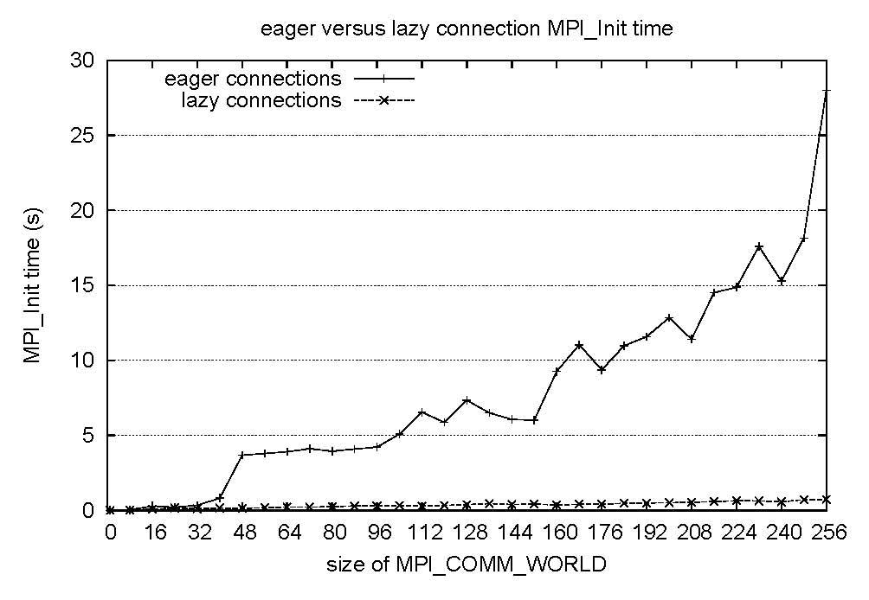
Scalability of MPI_Init
Cluster with 8 cores per node. TCP/IP across nodes
Setting up all connections at Init time is too expensive at large scale; must be done on demand as needed

Slide 21
Scalable Algorithms for Collective Communication
MPI implementations typically use
O(lg p) algorithms for short messages (binomial tree)
O(m) algorithms, where m=message size, for large messages
E.g., bcast implemented as scatter + allgather
O(lg p) algorithms can still be used on a million processors for short messages
However, O(m) algorithms for large messages may not scale, as the message size in the allgather phase can get very small
E.g., for a 1 MB bcast on a million processes, the allgather phase involves 1 byte messages
Hybrid algorithms that do logarithmic bcast to a subset of nodes, followed by scatter/allgather may be needed
Topology-aware pipelined algorithms may be needed
Use network hardware for broadcast/combine

Slide 22
Enabling Hybrid Programming
MPI is good at moving data between address spaces
Within an address space, MPI can interoperate with other “shared memory” programming models
Useful on future machines that will have limited memory per core
(MPI + X) Model: MPI across address spaces, X within an address space
Examples:
MPI + OpenMP
MPI + UPC/CAF (here UPC/CAF address space could span multiple nodes)
MPI + CUDA/OpenCL on GPU-accelerated systems
Precise thread-safety semantics of MPI enable such hybrid models
MPI Forum is exploring further enhancements to MPI to support efficient hybrid programming

Slide 23
MPI-3 Hybrid Proposal on Endpoints
In MPI today, each process has one communication endpoint (rank in MPI_COMM_WORLD)
Multiple threads communicate through that one endpoint, requiring the implementation to do use locks etc., which are expensive
This proposal (originally by Marc Snir) allows a process to have multiple endpoints
Threads within a process attach to different endpoints and communicate through those endpoints as if they are separate ranks
The MPI implementation can avoid using locks if each thread communicates on a separate endpoint

Slide 24
Fewer Performance Surprises
Sometimes we hear…
“I replaced
MPI_Allreduce
by
MPI_Reduce + MPI_Bcast
And got better results…”
Should not happen…

Slide 25
Or…
“I replaced
MPI_Send(n)
by
MPI_Send(n/k) + MPI_Send(n/k) + … + MPI_Send(n/k)
And got better results…”
Well, should probably not happen…

Slide 26
Or…
“I replaced
MPI_Bcast(n)
by
<this homemade algorithm with MPI_Send(n) and MPI_Recv(n)>
And got better results…”
Should not happen…

Slide 27
Self-Consistent MPI Performance Guidelines
Although MPI is portable, there is a lot of performance variability among MPI implementations
Lots of performance surprises
We (Traff, Gropp, Thakur) have defined some common-sense performance guidelines for MPI
“Self-Consistent MPI Performance Guidelines”, IEEE TPDS, 2010
Tools could be written to check for these requirements

Slide 28
General Principles
If there is an obvious way – intended by the MPI standard – of improving communication time,
a sound MPI implementation should do so!
- And not the user!

Slide 29
Sample Requirements
Subdividing messages into multiple messages should not reduce the communication time
MPI_Send(1500 bytes) <= MPI_Send(750 bytes) + MPI_Send(750 bytes)
Replacing an MPI function with a similar function that provides additional semantic guarantees should not reduce the communication time
MPI_Send <= MPI_Ssend
Replacing a specific MPI operation by a more general operation by which the same functionality can be expressed should not reduce communication time
MPI_Scatter <= MPI_Bcast

Slide 30
Example: Broadcast vs Scatter
Broadcast
Rank 0
Rank 1
Rank 2
Rank 3
Scatter
Rank 0
Rank 1
Rank 2
Rank 3
Scatter should be faster (or at least no slower) than broadcast

Slide 31
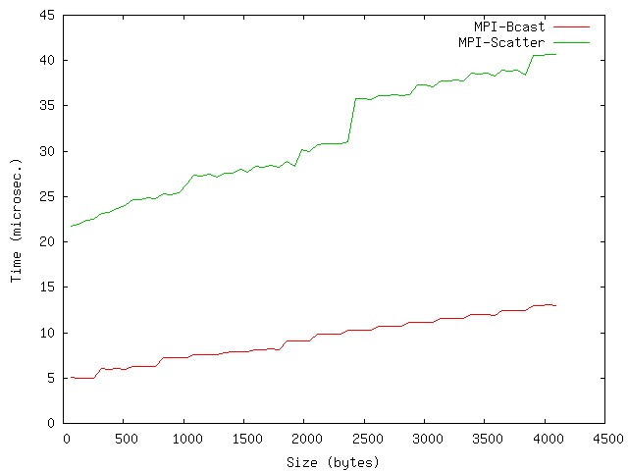
MPI_Bcast vs MPI_Scatter
64 processes
On BG/P, scatter is 3-4 times slower than broadcast
Broadcast has been optimized using hardware, scatter hasn’t

Slide 32
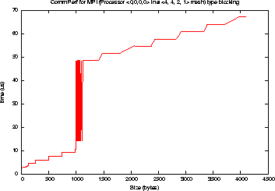
Eager vs Rendezvous Messages
Time (microsec)
Size (bytes)
Large jump in time when message delivery switches from eager to rendezvous
Sending 2 750-byte messages is faster than 1 1500-byte message

Slide 33
Recent Efforts of the MPI Forum
33
Notes:
33

Slide 34
MPI Standard Timeline
MPI-1 (1994)
Basic point-to-point communication, collectives, datatypes, etc
MPI-2 (1997)
Added parallel I/O, RMA, dynamic processes, C++ bindings, etc
---- Stable for 10 years ----
MPI-2.1 (2008)
Minor clarifications and bug fixes to MPI-2
MPI-2.2 (2009)
Today’s official standard
Small updates and additions to MPI 2.1. Backward compatible
MPI-3 (in progress, expected late 2011)
Major new features and additions to extend MPI to exascale
Organized into several working groups

Slide 35
New Features being considered in MPI-3
Note: All these are still under discussion in the Forum and not final
Support for hybrid programming (Lead: Pavan Balaji, Argonne)
Extend MPI to allow multiple communication endpoints per process
Helper threads: application sharing threads with the implementation
Improved RMA (Leads: Bill Gropp, UIUC, and Rajeev Thakur, Argonne)
Fix the limitations of MPI-2 RMA
New compare-and-swap, fetch-and-add functions
Collective window memory allocation
Test for completion of individual operations
Others…

Slide 36
New Features being considered in MPI-3
New collectives (Lead: Torsten Hoefler, UIUC)
Nonblocking collectives already voted in (MPI_Ibcast, MPI_Ireduce, etc)
Sparse, neighborhood collectives being considered as alternatives to irregular collectives that take vector arguments
Fault tolerance (Lead: Rich Graham, Oak Ridge)
Detecting when a process has failed; agreeing that a process has failed
Rebuilding communicator when a process fails or allowing it to continue in a degraded state
Timeouts for dynamic processes (connect-accept)
Piggybacking messages to enable application-level fault tolerance

Slide 37
New Features being considered in MPI-3
Fortran 2008 bindings (Lead: Craig Rasmussen, LANL)
Full and better quality argument checking with individual handles
Support for choice arguments, similar to (void *) in C
Passing array subsections to nonblocking functions
Many other issues
Better support for Tools (Lead: Martin Schulz, LLNL)
MPIT performance interface to query performance information internal to an implementation
Standardizing an interface for parallel debuggers

Slide 38
What are we doing in MPICH2

Slide 39
Goals of the MPICH2 project
Be the MPI implementation of choice for the highest-end parallel machines
7 of the top 10 machines in the June 2010 Top500 list use MPICH2-based implementations
Carry out the research and development needed to scale MPI to exascale
Optimizations to reduce memory consumption
Fault tolerance
Efficient multithreaded support for hybrid programming
Performance scalability
Work with the MPI Forum on standardization and early prototyping of new features

Slide 40
MPICH2 collaboration with vendors
Enable vendors to provide high-performance MPI implementations on the leading machines of the future
Collaboration with IBM on MPI for the Blue Gene/Q
Aggressive multithreaded optimizations for high concurrent message rates
Recent publications in Cluster 2010 and EuroMPI 2010
Collaboration with Cray for MPI on their next-generation interconnect (Gemini)
Collaboration with UIUC on MPICH2 over LAPI for Blue Waters
Continued collaboration with Intel, Microsoft, and Ohio State (MVAPICH)

Slide 41
Conclusions
MPI has succeeded because
features are orthogonal (complexity is the product of the number of features, not routines)
complex programs are no harder than easy ones
open process for defining MPI led to a solid design
programmer can control memory motion and program for locality (critical in high-performance computing)
precise thread-safety specification has enabled hybrid programming
MPI is ready for scaling to extreme scale systems with millions of cores barring a few issues that can be (and are being) fixed by the MPI Forum and by MPI implementations
41
Notes:
41

