Slide 1
Dynamic Time Variant Connection Management for PGAS Models on InfiniBand
Abhinav Vishnu¹, Manoj Krishnan¹
and Pavan Balaji²
¹Pacific Northwest National Laboratory
Richland, WA
²Argonne National Laboratory
Argonne, IL

Slide 2
Outline
Introduction
Background and Motivation
InfiniBand Connection Semantics
Global Arrays and ARMCI
Overall Design
Efficient Connection Teardown
Connection Cache Management
Performance Evaluation
Computational Chemistry
Sub-surface modeling
Conclusions and Future Work

Slide 3
Introduction
For runtime systems, scalable communication data structures is critical
Communication data structures
Buffers (data, control messages ..)
Connections
End-points (Gemini, Seastar, BG ..)
One-to-one mapping (IB))
Registration data structures (Local for MPI, Local + Remote for PGAS)
….
Efficient connection management is important
213 InfiniBand systems in TOP500
PGAS Models are becoming popular

Slide 4
InfiniBand Connection Management
On-demand pair-wise process creation
Cluster’02 (VIA), IPDPS’06, Cluster’08 (IB-MPI), CCGrid’10 (IB-PGAS)
Persistent through the application lifetime
Unreliable datagram based approaches (ICS’07)
Natural fit for two-sided communication (send/receive model)
Designing get and bulk data transfer is prohibitive
Software maintained reliability
eXtended Reliable Connection (XRC)
Connection memory increases with nodes and not processes (ICS’07, Cluster’08)

Slide 5
Use Cases for PGAS Models
Frequently combined with non-SPMD execution models
Task Based Computations
Dynamic load balancing and work stealing
Linear communication over the application execution lifetime
Time-Variance in execution
Little temporal reuse (SC’09)
Connection persistence is not useful

Slide 6
Problem Statement
Given low temporal locality for PGAS models and non-SPMD executions
What are the design choices for a disconnection protocol?
What are the memory benefits and possible performance degradations?

Slide 7
Outline
Introduction
Background and Motivation
InfiniBand Connection Semantics
Global Arrays and ARMCI
Overall Design
Efficient Connection Teardown
Connection Cache Management
Performance Evaluation
Computational Chemistry
Sub-surface modeling
Conclusions and Future Work

Slide 8
InfiniBand Transport Semantics
Reliable Connection
Most frequently used
Supports In-order delivery, RDMA, QoS ..
Reliable Datagram
Most RC features, but ..
Unreliable Connection
RDMA, requires dedicated QP
No ordering
Unreliable Datagram
Connectionless
limited message size to MTU
No ordering or reliability guarantees

Slide 9
Global Arrays
Global Arrays is a PGAS programming model
GA presents a shared view
Provides one-sided communication model
Used in wide variety of applications
Computational Chemistry
NWChem, Molcas, Molpro …
Bioinformatics
ScalaBLAST
Ground Water Modeling
STOMP
Physically distributed data
Global Address Space

Slide 10
Aggregate Remote Memory Copy Interface
Communication Runtime Systems for Global Arrays
Used in Global Trees, and Chapel
Provides one-sided communication runtime primitives
Currently Supported Platforms
Commodity Networks
InfiniBand, Ethernet ..
Leadership Class Machines
Cray XE6, Cray XTs
IBM BG’s
On-going -> BG/Q and BlueWaters
Upcoming features
Fault tolerant continued execution (5.1)
Energy Efficiency modes (5.2)

Slide 11
Outline
Introduction
Background and Motivation
InfiniBand Connection Semantics
Global Arrays and ARMCI
Overall Design
Efficient Connection Teardown
Connection Cache Management
Performance Evaluation
Computational Chemistry
Sub-surface modeling
Conclusions and Future Work

Slide 12
Connection Structure in ARMCI
Data Server thread
Client Process
Master Process

Slide 13
Connection Cache Management
Number of active connections
Model?
Dynamic behavior for task-based computations
Finding a victim connection
LRU
LRU insufficient with communication cliques
Multi-phase applications (use-case: Flow + Chemistry)
Modified-LRU (LRU-M)
Temporal locality of connections

Slide 14
Overlap Disconnection Protocol
Client
Master Process
Data Server
WaitProc
Flush
Time
Teardown Req
break
break
Acknowledgement

Slide 15
Outline
Introduction
Background and Motivation
InfiniBand Connection Semantics
Global Arrays and ARMCI
Overall Design
Efficient Connection Teardown
Connection Cache Management
Performance Evaluation
Computational Chemistry and Sub-surface Modeling
Conclusions and Future Work

Slide 16
Performance Evaluation
Evaluation Test Bed
160 Tflop system with 2310 Dual socket quad core Barcelona processor
InfiniBand DDR with PCI Express using DDR Voltaire switches
Original implementation is Global Arrays (GA) version 4.3
The presented design is available with GA-5.0
Methodologies
LRU, and LRU-M
Varying the number of connection entries in connection cache
Applications
Northwest Chemistry (NWChem)
Sub-surface Transport on Multiple Phases

Slide 17
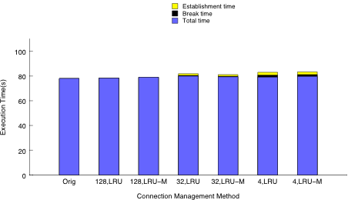
Performance Evaluation with NWChem
Evaluation with pentane input deck on 6144 processes
The connection cache has a total of 128, 32, and 4 entries
Negligible performance degradation for 128 and 32 cache size
Total connections created – 91-117
3-4 times for 32 cache size
~32 times for 4 cache size

Slide 18
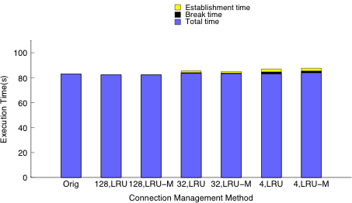
Performance Evaluation :NWChem (Contd)
Evaluation with siosi7 input deck on 4096 processes
The connection cache has a total of 128, 32, and 4 entries
Negligible performance degradation for 128 and 32 connection size
Total connections created – 93-121
3-4 times for 32 cache size
~32 times for 4 cache size

Slide 19
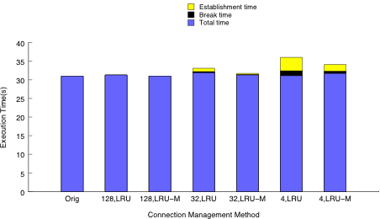
Performance Evaluation :STOMP
Evaluation on 8192 processes
The connection cache has a total of 128, 32, and 4 entries
LRU-M reduces the overall connection establishment and break time in comparison to LRU

Slide 20
Conclusions and Future Work
Persistent on-demand connection approaches are insufficient
Presented a design for connection management
Efficient connection cache management
A conducive protocol for PGAS Models
Memory benefits for two class of applications
Future Work:
Solve the problem for two-sided (pair-wise) connections
Apply the problem to other communication data structures (remote registration caches)

Slide 21

Questions
Global Arrays
http://www.emsl.pnl.gov/docs/global/
ARMCI
http://www.emsl.pnl.gov/docs/parsoft/armci/
HPC-PNL
http://hpc.pnl.gov

