Slide 1
Energy-aware Hierarchical Scheduling of Applications in Large Scale Data Centers
Gaojin Wen, Jue Hong, Chengzhong Xu et al.
Center for Cloud Computing, SIAT
2011.12.13

Slide 2
Outline
Introduction
Background
Motivation
Problem Formulation
Basic Idea
Algorithm
Evaluation
Conclusion

Slide 3
Introduction
Energy conservation has become an important problem for large-scale date center
Operating power of 2.98 petaflop Dawning Nebula: 2.55 MW
10-20 petaflop supercomputers like Livermore Sequoia, Argonne Mira and Kei require more cooling and operating power
One effective method: Application Scheduling
Consolidate running applications to a small number of servers
Make idle servers sleep or power-off

Slide 4
Background
Load-screw scheduling
Modeled as online bin-packing problem
server->bin, tasks->objects, requirements->dimensions
Migration cost-aware scheduling
Task scheduling usually involves energy-cost of virtual machine migration
Consider the task migration-cost between servers
Theoretical results:
approximation ratio of bin-packing problem (BPP):
First-Fir or Best-Fit: 17/10 OPT + 2
Best Fit Descending or First Fit Descending: 11/9 OPT +4

Slide 5
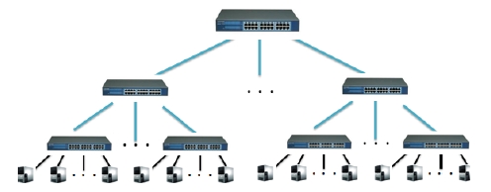
Motivation
Most of existing work do not consider the energy cost of network infrastructure
Different forwarding policies causes different network utilization, and thus different energy cost
Transferring task and data between two nodes connected directly to the same switch cost less energy than that of cross-switch nodes [1].
Goal:
Design an application scheduling algorithm considering energy-cost of network infrastructure , to further reduce total energy consumption.
Notes:
[1] Baliga, J.; Ayre, R.W.A.; Hinton, K.; Tucker, R.S.; , Green Cloud Computing: Balancing Energy in Processing, Storage, and Transport,
Proceedings of the IEEE , 99(1), 149-167 (2011)

Slide 6
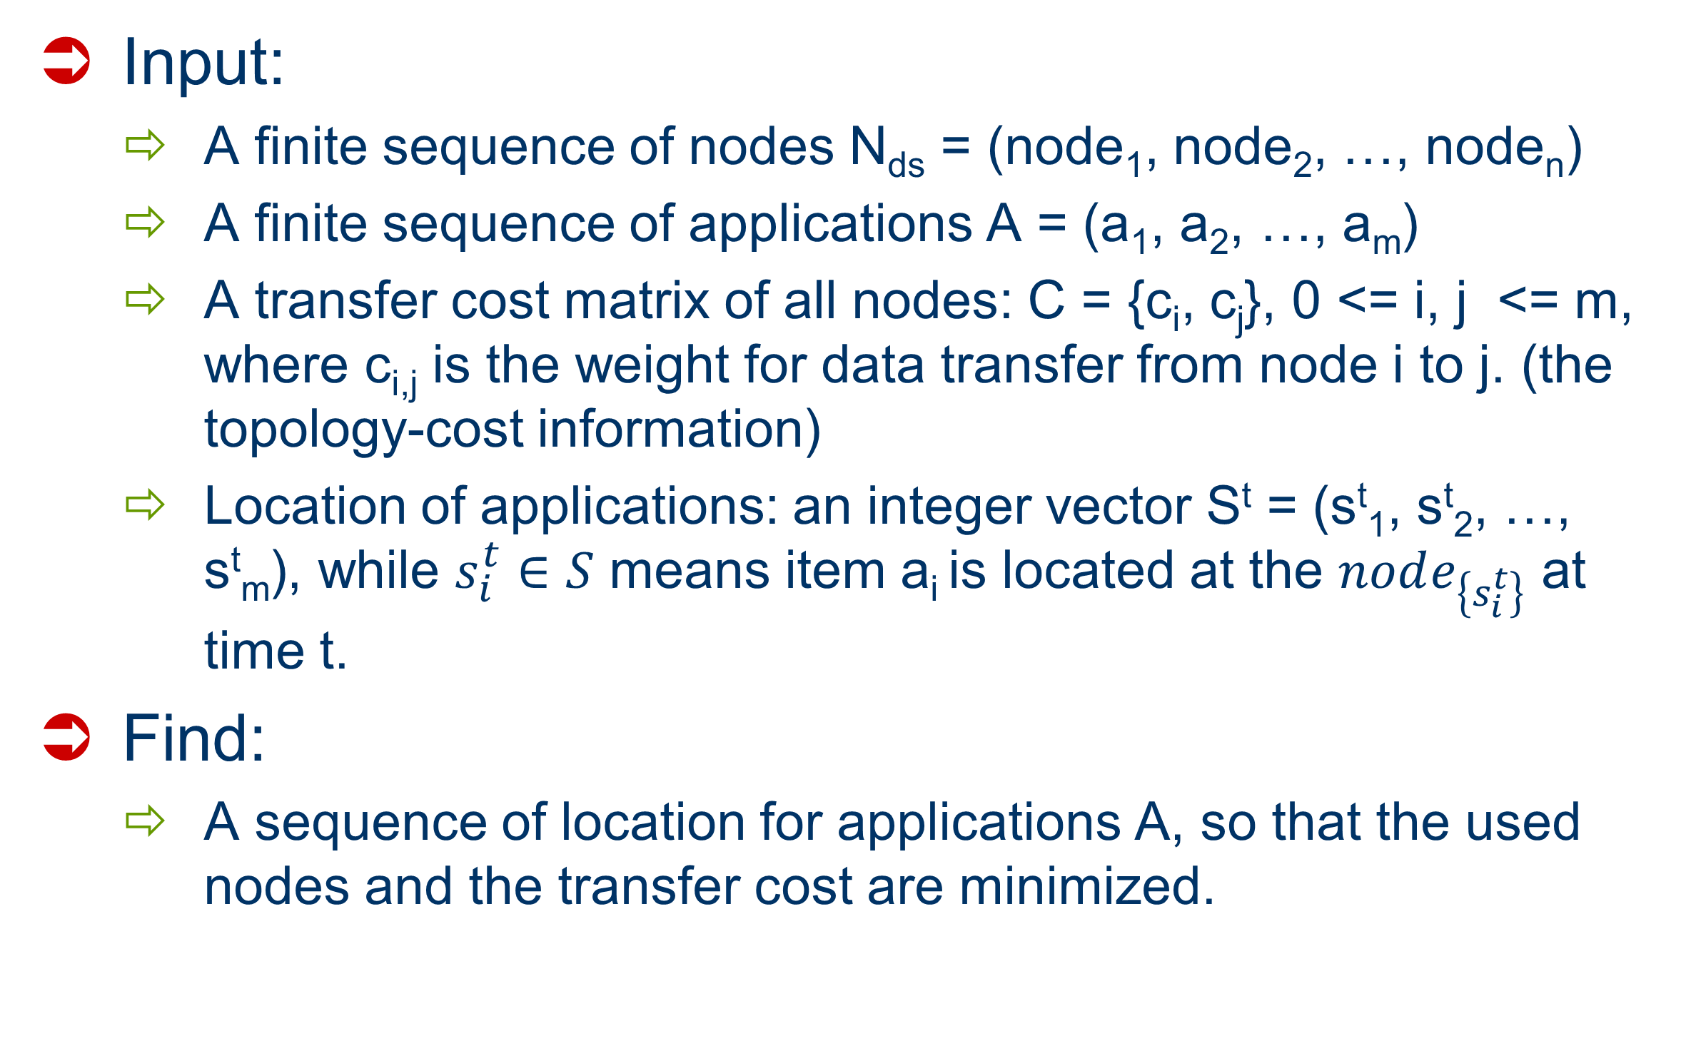
Problem Formulation
Input:
A finite sequence of nodes N_{ds} = (node₁, node₂, …, node_{n})
A finite sequence of applications A = (a₁, a₂, …, a_{m})
A transfer cost matrix of all nodes: C = {c_{i}, c_{j}}, 0 <= i, j <= m, where c_{i,j} is the weight for data transfer from node i to j. (the topology-cost information)
Location of applications: an integer vector S^{t} = (s^{t}₁, s^{t}₂, …, s^{t}_{m}), while $s_{i}^{t}∈S$ means item a_{i} is located at the $node_{\left\{s_{i}^{t}\right\}}$ at time t.
Find:
A sequence of location for applications A, so that the used nodes and the transfer cost are minimized.

Slide 7
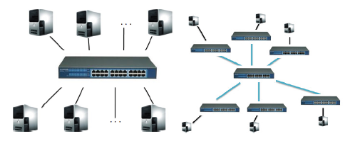
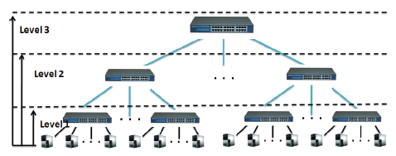
Basic Idea (I)
Contribution
A hierarchical scheduling algorithm using dynamic maximum node sorting and hierarchical cross-switch adjustment
Basic idea
Two concepts:
Node Subset: cost of data transfer between any two nodes are equal
Node Level: composed of subsets with the same transfer cost
1-subset
3-subset

Slide 8
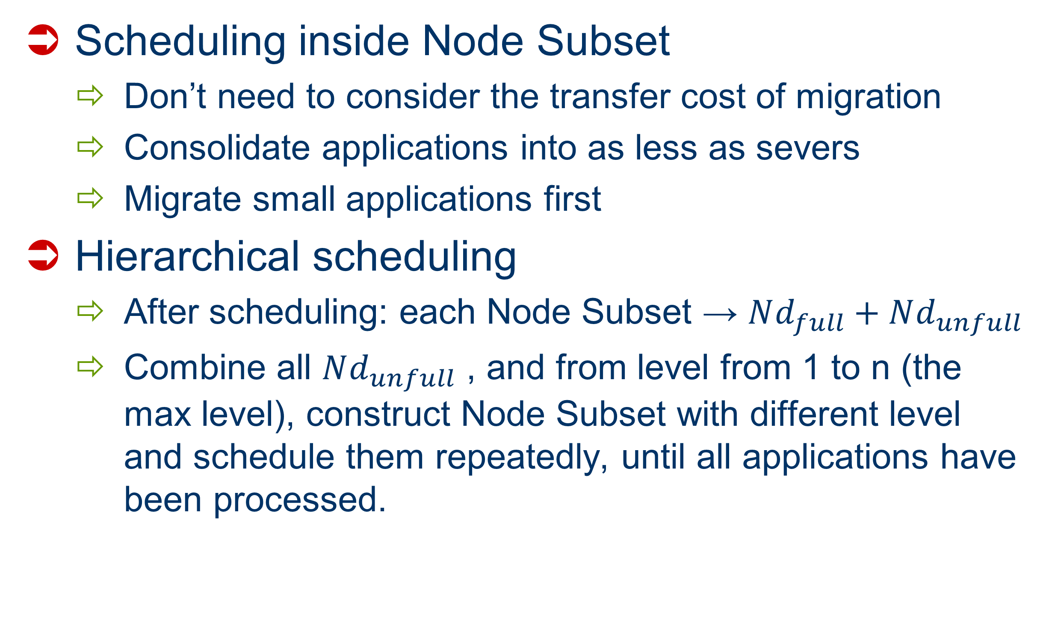
Basic Idea (II)
Scheduling inside Node Subset
Don’t need to consider the transfer cost of migration
Consolidate applications into as less as severs
Migrate small applications first
Hierarchical scheduling
After scheduling: each Node Subset → $Nd_{full}+Nd_{unfull}$
Combine all $Nd_{unfull}$ , and from level from 1 to n (the max level), construct Node Subset with different level and schedule them repeatedly, until all applications have been processed.

Slide 9
Algorithm (I)
Kernel algorithm 1:
The K-th Max Node Sorting Algorithm (KMNS)
Overview:
For each node subset, sort nodes according to the number of running applications in ascending order;
Given K, partition all N nodes into two sets: one with K nodes, and the other with N-K nodes;
Transfer applications from K-set to N-K set using DBF
Calculate the node cost and transfer cost
apps
K nodes
N-K nodes

Slide 10
Algorithm (II)
Kernel algorithm 2:
Dynamic Max Node Sorting Algorithm (DMNS)
Overview:
For each Node Subset wit N nodes, let K = 0 to N, run KMNS;
Update the minimum node cost the transfer cost;
Output the K and the corresponding schedule with minimum node and transfer cost;

Slide 11
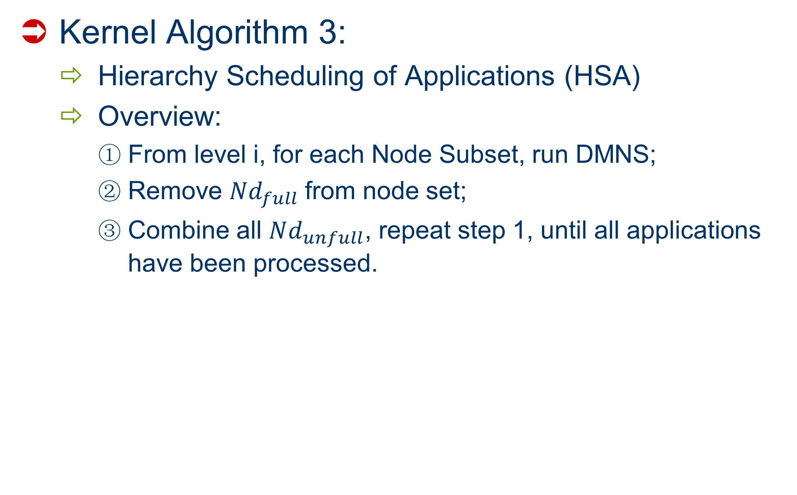
Algorithm (III)
Kernel Algorithm 3:
Hierarchy Scheduling of Applications (HSA)
Overview:
From level i, for each Node Subset, run DMNS;
Remove $Nd_{full}$from node set;
Combine all $Nd_{unfull}$, repeat step 1, until all applications have been processed.

Slide 12
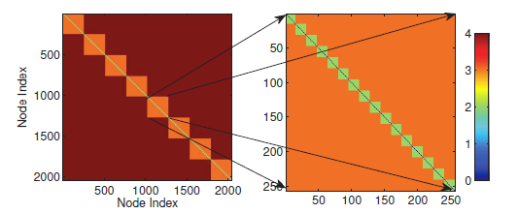
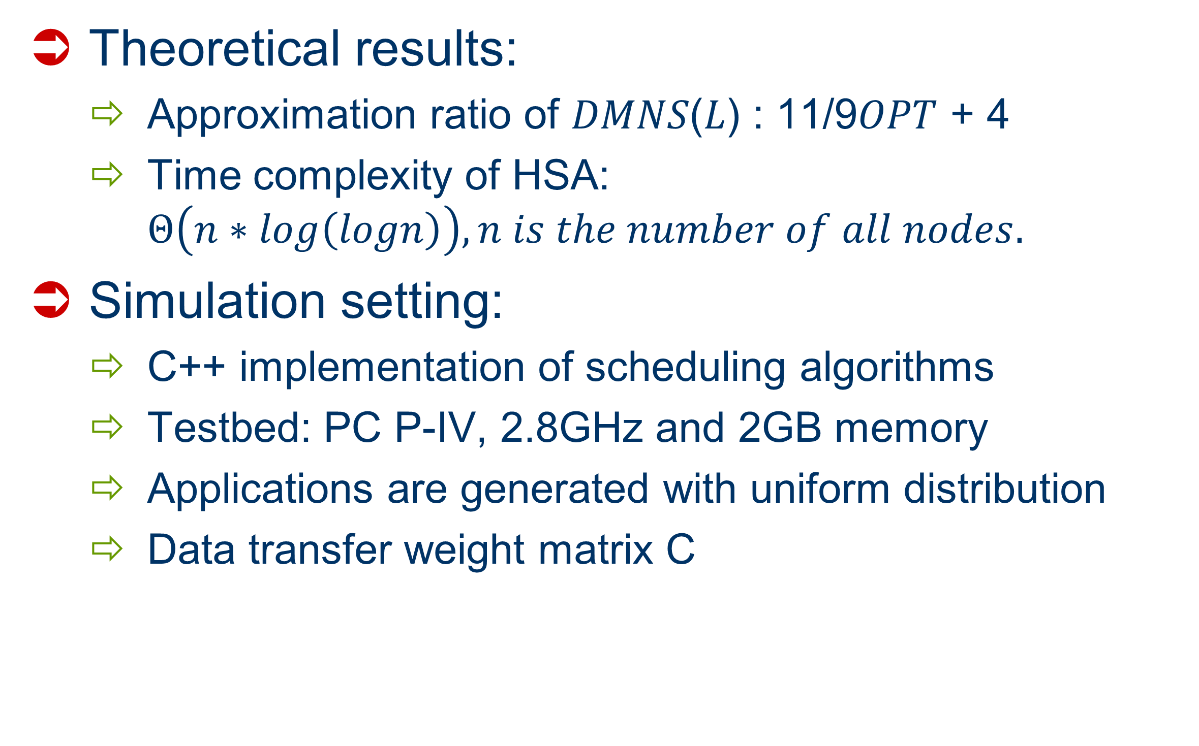
Evaluation (I)
Theoretical results:
Approximation ratio of 𝐷𝑀𝑁𝑆(𝐿) : 11/9𝑂𝑃𝑇 + 4
Time complexity of HSA: $Θ\left(n∗log\left(logn\right)\right), n is the number of all nodes.$
Simulation setting:
C++ implementation of scheduling algorithms
Testbed: PC P-IV, 2.8GHz and 2GB memory
Applications are generated with uniform distribution
Data transfer weight matrix C

Slide 13
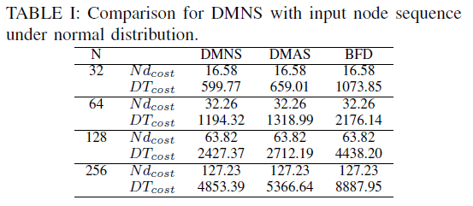
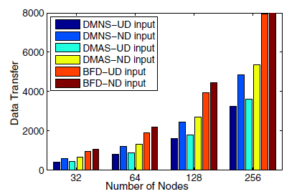
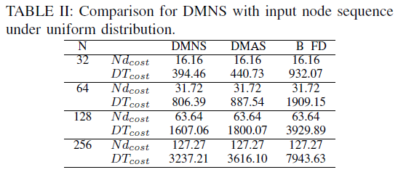
Evaluation (II)
Simulation results
Costs of DMNS:

Slide 14
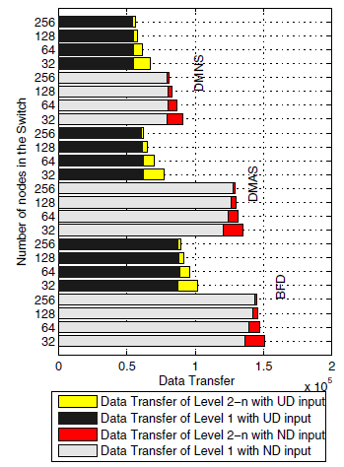
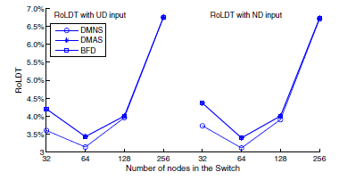
Evaluation (III)
Simulation results
Costs of HSA (4096 nodes)
Stability:
Ratio of Local Data Transfer

Slide 15
Future Work
Further reduce complexity
Consider more realistic scenarios

Slide 16


