Slide 1
Non-Collective Communicator Creation in MPI
James Dinan¹, Sriram Krishnamoorthy², Pavan Balaji¹, Jeff Hammond¹, Manojkumar Krishnan², Vinod Tipparaju², and Abhinav Vishnu²
¹ Argonne National Laboratory
² Pacific Northwest National Laboratory

Slide 2
Outline
Non-collective communicator creation
Result of Global Arrays/ARMCI on MPI one-sided work
GA/ARMCI flexible process groups
Believed impossible to support on MPI
Case study: MCMC Load Balancing
Dynamical nucleation theory Monte Carlo application
Malleable multi-level parallel load balancing work
Collaborators: Humayun Arafat, P. Sadayappan (OSU), Sriram Krishnamoorthy (PNNL), Theresa Windus (ISU)

Slide 3
MPI Communicators
Core concept in MPI:
All communication is encapsulated within a communicator
Enables libraries that doesn’t interfere with application
Two types of communicators
Intracommunicator – Communicate within one group
Intercommunicator – Communicate between two groups
Communicator creation is collective
Believed that “non-collective” creation can’t be supported by MPI

Slide 4
Non-Collective Communicator Creation
Create a communicator collectively only on new members
Global Arrays process groups
Past: collectives using MPI Send/Recv
Overhead reduction
Multi-level parallelism
Small communicators when parent is large
Recovery from failures
Not all ranks in parent can participate
Load balancing
☹

Slide 5
Intercommunicator Creation
Local
Remote
Intracommunicator
Intercommunicator
Intercommunicator creation parameters
Local comm – All ranks participate
Peer comm – Communicator used to identify remote leader
Local leader – Local rank that is in both local and peer comms
Remote leader – “Parent” communicator containing peer group leader
Safe tag – Communicate safely on peer comm

Slide 6
Non-Collective Communicator Creation Algorithm
0
1
2
3
4
5
6
7
MPI_COMM_SELF
(intracommunicator)
MPI_Intercomm_create
(intercommunicator)
MPI_Intercomm_merge
0
1
2
3
4
5
6
7
0
1
2
3
4
5
6
7
0
1
2
3
4
5
6
7
✓

Slide 7
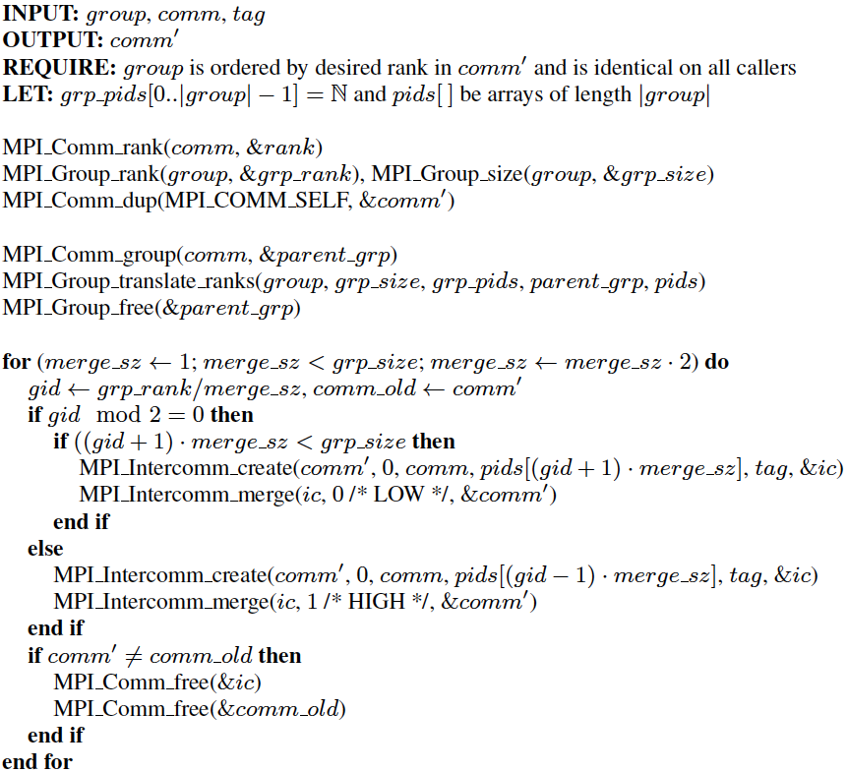
Non-Collective Algorithm in Detail
R
Translate group ranks to ordered list of ranks on parent communicator
Calculate my group ID
Left group
Right group

Slide 8
Experimental Evaluation
IBM Blue Gene/P at Argonne
Node: 4 Core, 850 MHz PowerPC 450 processor, 2GB memory
Rack: 1024 Nodes
40 Racks = 163,840 cores
IBM MPI, derived from MPICH2
Currently limited to two racks
Bug in MPI intercommunicators; still looking into it

Slide 9
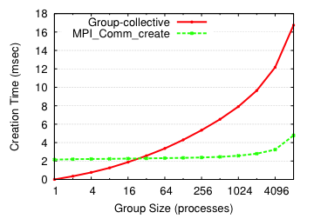
Evaluation: Microbenchmark
O(log² g)
O(log p)

Slide 10
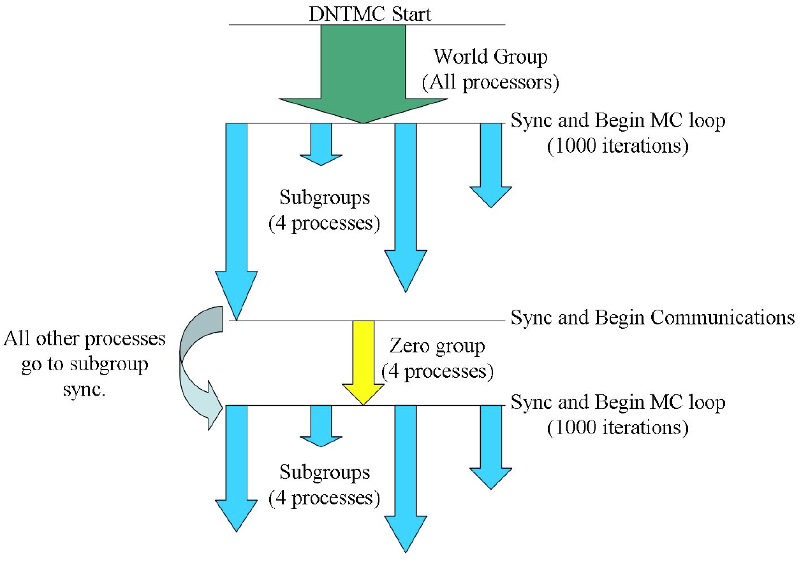
Case Study: Markov Chain Monte Carlo
Dynamical nucleation theory Monte Carlo (DNTMC)
Part of NWChem
Markov chain Monte Carlo
Multiple levels of parallelism
Multi-node “Walker” groups
Walker: N random samples
Concurrent, sequential traversals
Load imbalance
Sample computation (energy calculation) time is irregular
Sample can be rejected
T L Windus et al 2008 J. Phys.: Conf. Ser. 125 012017

Slide 11
MCMC Load Balancing
Inner parallelism is malleable
Group computation scales as nodes added to walker group
Regroup idle processes with active groups
Preliminary results:
30% decrease in total application execution time

Slide 12
MCMC Benchmark Kernel
Simple MPI-only benchmark
“Walker” groups
Initial group size: G = 4
Simple work distribution
Samples: S = (leader % 32) * 10,000
Sample time: t_{s} = 100 ms / |G|
Weak scaling benchmark
Load balancing
Join right when idle
Asynchronous: Check for merge request after each work unit
Synchronous: Collectively regroup every i samples
0 | 4 | 8 | 12 | … | 32 | 36 | 40 | 44 | …

Slide 13
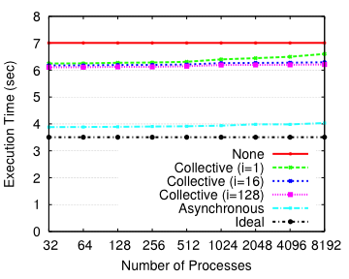
Evaluation: Load Balancing Benchmark Results

Slide 14
Proposed MPI Extensions
Local
Remote
Eliminate O(log g) factor by direct implementation
Multicommunicator
Multiple remote groups
Flatten into an intercommunicator
MPI_Group_comm_create(MPI_Comm in, MPI_Group grp, int tag, MPI_Comm *out)
Tag allows for safe communication and distinction of calls
Available in MPICH2 (MPIX), used by GA
Proposed for MPI-3

Slide 15
Conclusions
Algorithm for non-collective communicator creation
Recursive intercommunicator creation and merging
Benefits:
Support for GA groups
Lower overhead for small communicators
Recovering from failures
Load balancing (MCMC benchmark)
Cost is high, proposed extension to MPI
Multicommunicators
MPI_Group_comm_create(…)
Contact: Jim Dinan -- dinan@mcs.anl.gov

Slide 16
Additional Slides

Slide 17
Asynchronous Load Balancing
0 | 4 | 8 | 12 | … | 32 | 36 | 40 | 44 | …

Slide 18
Collective Load Balancing (i = 2)
0 | 4 | 8 | 12 | … | 32 | 36 | 40 | 44 | …

Slide 19
Number of Regrouping Operations on 8k Cores
Load Balancing | i | Average | Sandard Deviation | Min | Max
None |  | 0.00 | 0.00 | 0 | 0
Asynch. |  | 14.38 | 3.54 | 5 | 26
Collective | 1 | 5.38 | 2.12 | 2 | 8
Collective | 2 | 5.38 | 2.12 | 2 | 8
Collective | 4 | 5.38 | 2.12 | 2 | 8
Collective | 8 | 5.38 | 2.12 | 2 | 8
Collective | 16 | 5.38 | 2.12 | 2 | 8
Collective | 32 | 5.38 | 2.12 | 2 | 8
Collective | 64 | 3.75 | 1.20 | 2 | 5
Collective | 128 | 2.62 | 0.48 | 2 | 3

