Slide 1
Building Algorithmically Nonstop Fault Tolerant MPI Programs
Rui Wang, Erlin Yao, Pavan Balaji, Darius Buntinas, Mingyu Chen, and Guangming Tan
Argonne National Laboratory, Chicago, USA
ICT, Chinese Academy of Sciences, China

Slide 2
Hardware Resilience for large-scale systems
Resilience is a prominent becoming issue in large-scale supercomputers
Exascale systems that will be available in 2018-2020 will have close to a billion processing units
Even if each processing element fails once every 10,000 years, a system will have a fault once every 5 minutes
Some of these faults are correctable by hardware, while some are not
E.g., single bit flips are correctable by ECC memory, but double-bit flips are not
Even for cases where hardware corrections are technologically feasible, cost and other power constraints might make then practically infeasible

Slide 3
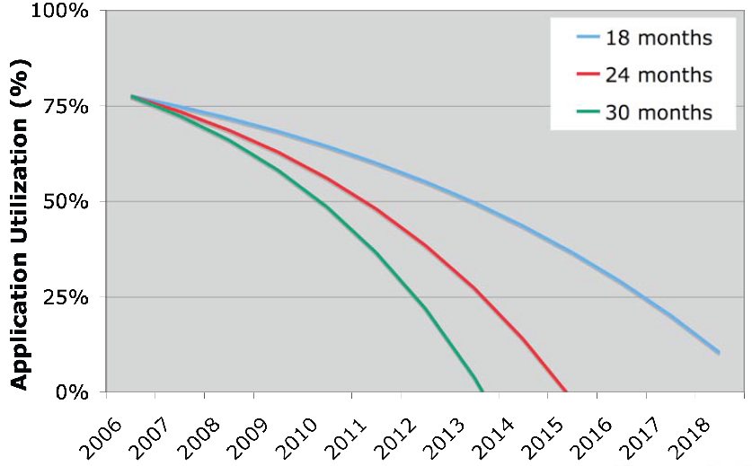
Software Resilience
Software resilience is cheaper with respect to cost investment, but has performance implications
The idea of most researchers working in this area is to understand this performance/resilience tradeoff
Classical software resilience technique: system checkpointing
Create a snapshot of the application image at some time interval and roll back to the last checkpoint if a failure occurs
Transparent to the user, but stresses the I/O subsystem
SystemsU | Perf. | Ckpt time | Source
RoadRunner | 1PF | ~20 min. | Panasas
LLNL BG/L | 500 TF | >20 min. | LLNL
Argonne BG/P | 500 TF | ~30 min. | LLNL
Total SGI Altix | 100 TF | ~40 min. | estimation
IDRIS BG/P | 100 TF | 30 min. | IDRIS
[Gibson, ICPP2007]

Slide 4
Algorithm-based Fault Tolerance
Recent research efforts in resilience have given birth to a new form of software resilience: Algorithmic-based Fault Tolerance (ABFT)
A.k.a. Algorithmic fault tolerance, application-based fault tolerance
Key idea is to utilize mathematical properties in the computation being carried out to reconstruct data on a failure
No disk I/O phase, so the performance is independent of the file-system bandwidth
Not 100% transparent – for most applications that use math libraries for their computation this can be transparent, but for others it’s not
This work has mostly been done in the context of dense matrix manipulation operations, but the concept is applicable to other contexts too

Slide 5
ABFT Recovery
First proposed in 1987 to detect and correct instant errors at the VLSI layer
Improved by Jack Dongarra to deal with node failures
Concept:
Add redundant nodes to store encoded checksum of the original data
Re-design algorithm to compute original data and redundancy synchronously
Recover corrupted data upon failure
D1
D2
D3
E
D2
E
D1
D3

Slide 6
Deeper Dive into ABFT Recovery
ABFT recovery pros:
Completely utilizes in-memory techniques, so no disk I/O is required
Utilizes additional computation to deal with node losses, so the amount of “extra nodes” required is fairly small (equal to the number of failures expected during the run)
Important difference compared to in-memory checkpointing which requires twice the number of nodes
ABFT recovery cons:
Failure “recovery” is non-trivial
Requires additional computation – no problem; computation is free
Requires all processes to synchronize every time there is a failure – synchronization is not free, especially when dealing with >100,000 processes

Slide 7
In this paper…
This paper improves on “ABFT Recovery” to propose a new methodology called “ABFT hot replacement”
Idea is to utilize additional mathematical properties to not require synchronization on a failure
Synchronization is eventually required, but can be delayed to a more natural synchronization point (such as the end of the program)
We demonstrate “ABFT hot replacement” with LU factorization in this paper, though the idea is relevant to other dense matrix computations as well
Might also work for sparse matrix computations, but is not as straightforward
Also demonstrate LINPACK with our proposed approach

Slide 8
Presentation Layout
Introduction and Motivation
Requirements from MPI and improvements to MPICH2
ABFT Hot Replacement
Experimental Evaluation
Concluding Remarks

Slide 9
Fault Tolerance in MPI
Minimum set of fault-tolerance features required
Node failure will not cause the entire job to abort.
Communication operations involving a failed process will not hang and will eventually complete.
Communication operations will return an error code when it is affected by a failed process. This is needed to determine whether to re-send or re-receive messages
The MPI implementation should provide a mechanism to query for failed processes.
MPICH provides all these features and two forms of fault notification
Asynchronous (through the process manager)
Synchronous (through the MPI communication operations)

Slide 10
Process Management and Asynchronous Notification
Node 0
Node 1
P1
P0
P2
MPI Library
MPI Library
MPI Library
Hydra proxy
Hydra proxy
SIGUSR1
SIGUSR1
FP List
SIGCHLD
FP List
NULL
P2
P2
NULL
mpiexec

Slide 11
Synchronous Notification: Point-to-point Communication
If a communication operation fails, an MPI_ERR_OTHER is returned to the application
A message is sent to or a receive is posted for a message from a failed process
For nonblocking operations, the error can be returned during the subsequent WAIT operation that touches the request
Wildcard receives, i.e., using MPI_ANY_SOURCE create a special case, since we don’t know who will send the data
In this case, all processes that posted a wildcard receive would get an error

Slide 12
Synchronous Notification: Collective Communication
Collective operation does not hang, but some processes may have invalid results
MPICH2 internally performs data error management
Mark the messages carrying invalid data by using a different tag value.
The process will continue performing the collective operation if a process receives a message marked as containing invalid data, but will mark any subsequent messages it sends as containing invalid data.
From the application perspective:
The collective operation will return an error code or if it had received invalid data at any point during the operation; otherwise, returns MPI_SUCCESS.

Slide 13
Presentation Layout
Introduction and Motivation
Requirements from MPI and improvements to MPICH2
ABFT Hot Replacement
Experimental Evaluation
Concluding Remarks

Slide 14
ABFT Hot Replacement
ABFT Hot-replacement
Before the replacement,
After the replacement,
Assume D’=DT，
D1
D2
D3
E
P1
P2
P3
P4
Notes:
Our method is inspired by the conventional ABFT Recovery technique, but handle failure in a different way.
Suppose we have 3 compute nodes, P1, P2 and P3, and we add another node P4 as the redundant nodes. And Di represents the data on Pi.
We suppose that at any time during the computation satisfies D1 + D2 + D3 = E
If the P2 failed, we replace it with the redundant node and continue the execution.
From the global view, the original data before the replacement is
D = (D1 · · ·Di−1DiDi+1 · · ·Dn);
and the transformed data after the replacement is D′ = (D1 · · ·Di−1EDi+1 · · ·Dn):
‘ :Prime
If we assume
D′ = D × T,
then T can be represented as an n×n matrix in this form.
At the end of computation, the original correct solution based on D can be algorithmically recovered using matrix T.

Slide 15
ABFT Hot Recovery in LINPACK
High Performance Linpack (HPL)
benchmark for ranking supercomputers in top500
solve Ax = b
CHECKSUM
CHECKSUM
CHECKSUM
→
→… →
Each process generates its local random matrix A
for i = 0, 1, …
LU factorization A_{i} = L_{i}U_{i} ; computation
Broadcast L_{i} right ; communication
Update the trailing sub-matrix U ; computation
solve upper-triangular Ux = L⁻¹b to obtain x ; back substitution phase
checksum relationship maintained
Notes:
To demonstrate the feasibility [,fi:zə'bɪlətɪ] of our method, we incorporate fault tolerance into … using the method.
HPL is a widely used benchmark for ranking …
it solves Ax = b using Gaussian Elimination.
The main algorithm of HPL consists of several iterations of computation phases and communication phases.
At the end, there is an back substitution phase, the solution x could be obtained by solving the upper-triangular system Ux = L-1 b
the inverse matrix of L times b
More importantly, we could prove that at the end of each iteration, the checksum relationship could be maintained. Based on this, we could adopt our ABFT hot-replacement technique to handle failures in computation.

Slide 16
Failure Handling in Computation
Hot-Replacement
Replace dead process column by redundant process column
Background Recovery
Recover the factorized data
Requires additional computation, but is only local
Matrix U is not upper-triangular any more！
Notes:
In practice, the input matrix A is usually very large, so we distributed the data onto different processes and they compute in parallel.
In this figure, we represent the data on different processes in different color. And these are the redundancies.
If the green process failed, we replace the dead process column with the redundant process column. And continue the execution.
But there is a problem that after the replacement the matrix U is not upper-triangular any more, and this will make us difficult to solve x in the back substitution phase.
Our solution is to recover the factorized data, and since these data will be used immediately. Actually it will only be used in the back substitution phase. To improve the performance, we could parallel the communication needed for the recovery with the succeeding computations.
In our implementation, we replace the whole column rather
than a single process upon process failure. Since processes
inside a column need to do some row swaps during the
computation, only replacing the dead process by a redundant
process will make the transformation matrix T difficult to
derive.
since the submatrix
that has been factorized before the failure occurrence is
replaced by redundancy. This will make it difficult to solve
Ux = L−1b. To overcome this issue, we do not replace
the already factorized data but, instead, recover them onto
the corresponding redundant processes.

Slide 17
Failure Handling in Computation (contd.)
Before hot-replacement
After hot-replacement
The correct solution x：
This phase requires a global synchronization, but can be done at the end of the application (or some natural synchronization point)

Slide 18
Failure Handling in Communication
Broadcast phase : message forwarding
Robust broadcast mechanism
None of the processes will block if a failure occurs (MPI provides this)
The error is notified to the application – at least one process will know if an error occurred anywhere (MPI provides this)
Either all non-failed processes receive the message successfully or none of them receive the message (MPI does not provide this yet)
Additional communication required to ensure the global view of the broadcast is consistent

Slide 19
Presentation Layout
Introduction and Motivation
Requirements from MPI and improvements to MPICH2
ABFT Hot Replacement
Experimental Evaluation
Concluding Remarks

Slide 20
Experimental Testbed
Platform1:
17 nodes each with 4 quadcore 2.2 GHz Opteron processors (16-cores per node)
Connected by Gigabit Ethernet
Platform II:
8 blades, 10 Intel Xeon X5650 processors per blade
Nodes in the same blade are connected by InfiniBand, while different blades are connected with each other by a single InfiniBand cable
MPICH2:
The work done was based on an experimental version of MPICH2 based on 1.3.2p1. The changes have been incorporated into MPICH2 releases as of 1.4 (and some more improvements incorporated into 1.5a1 and the upcoming 1.5a2)

Slide 21
Performance Comparison of LINPACK

Slide 22
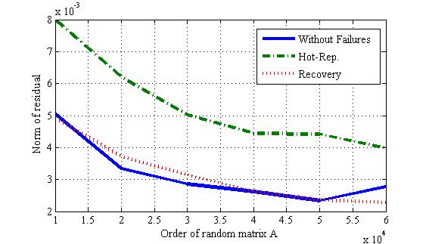
Correctness Comparison

Slide 23
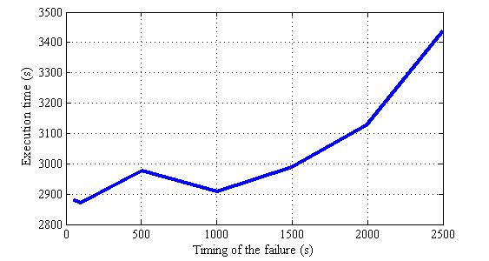
Impact of Failure Occurrence

Slide 24
Presentation Layout
Introduction and Motivation
Requirements from MPI and improvements to MPICH2
ABFT Hot Replacement
Experimental Evaluation
Concluding Remarks

Slide 25
Concluding Remarks
Resilience is an important issue that needs to be addressed
Hardware resilience can only go so far, because of technology, power and price constraints
Software resilience required to augment places where hardware resilience is not sufficient
System checkpointing was the “classical” resilience method, but hard to scale to very large systems
ABFT-based methods gaining popularity
Use mathematical properties to recompute data on failure
ABFT Recovery method previously proposed – problem is that it requires synchronization between all processes on failure
We proposed ABFT hot replacement, which deals with this problem

Slide 26
Thank You!
Email: balaji@mcs.anl.gov
Web: http://www.mcs.anl.gov/~balaji

