Slide 1
Optimizing SpMV for Diagonal Sparse Matrices on GPU
Sun Xiangzheng, Zhang Yunquan, Wang Ting, Xianyi Zhang, Liang Yuan and Li Rao
Institute of Software, Chinese Academy of Sciences
Email: zyq@mail.rdcps.ac.cn
Presented by: Pavan Balaji, Argonne National Laboratory

Slide 2
Outline
Background
CRSD Storage Format
SpMV OpenCL Kernel Based on CRSD Format
Evaluation
Conclusion

Slide 3
Sparse Matrix-Vector Product
y = A × x
Important computational kernel in many scientific applications
PDE solvers one of the primary use cases
Many approaches for Dense Matrix-Vector or Matrix-matrix multiplications
Sparse computations are different
Many zeros in the matrix: a very small fraction is non-zero elements
One example is diagonal matrices used in linear equation solvers when each equation only has a small number of variables
Challenge is to no waste space storing or parsing through zero elements

Slide 4
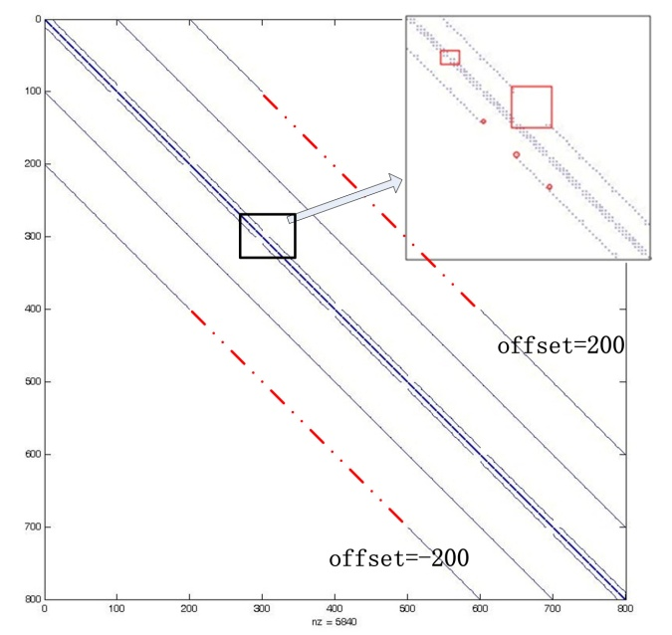
Challenges in Sparse Matrix manipulation
Primary method for storing sparse matrices is to find symmetric patterns and use a concise notation to save each pattern
Such representation is typically referred to as “matrix compression”
Many aspects that disrupt symmetry in real applications
Idle sections
Scatter points
Many applications do not care about exact data: changing some data to zero might be OK

Slide 5
Our Approach in a Nutshell
CRSD: Compressed Row Segment with Diagonal-pattern
Other approaches exist: CSR, DIA, ELL, HYB
Each approach tries to find symmetric segments
Different approaches use different models for finding symmetric segments
Idea is to minimize the number of “stand-alone” scatter elements that we need to store
Two primary differences in our approach
Two dimensional decomposition of blocks to find symmetric patterns (as opposed to 1D decomposition)
Application knowledge to zero-out some elements

Slide 6
Outline
Background
CRSD Storage Format
SpMV OpenCL Kernel Based on CRSD Format
Evaluation
Conclusion

Slide 7
CRSD Storage Format (1)
Compressed Row Segment with Diagonal-pattern (CRSD)
Diagonal Pattern
Describe the diagonal distribution
Diagonal adjacent
The absolute value of difference of two diagonals’ offset is 1
Groups the diagonals:
If two diagonals are adjacent, put them into an adjacent (AD) group;
After removing the diagonals within the adjacent groups, the original diagonal sequence is broken up into pieces. We assign the diagonals of each piece into a nonadjacent(NAD) group.
Group representation
(Group type AD/NAD, the number of diagonals)
{(NAD,1), (AD,2), (NAD,2), (AD,3), (NAD,1)}
（NAD，1）
（AD，2）
（NAD，1）
（NAD，2）
（AD，3）
Notes:
Animation is used to describe that how to group the diagonals for the diagonal pattern

Slide 8
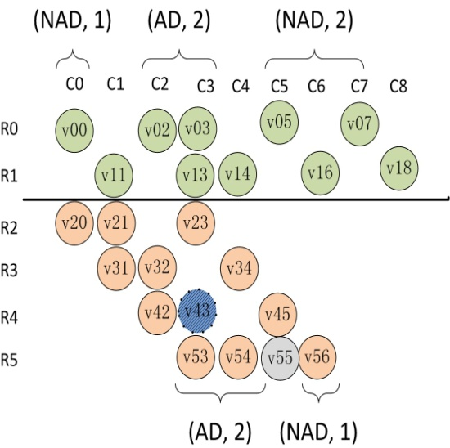
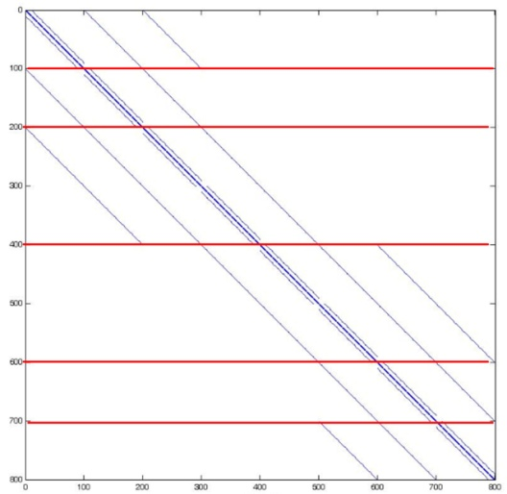
CRSD Storage Format (2)
Matrix representation using diagonal pattern
The queue of diagonal patterns
matrix = { {(NAD,1),{(AD,2),(NAD,2)}, {(AD,2), {NAD,1} }
Idle section process
Larger number of zeros should be filled
--- change the diagonal pattern
Little number of zeros in idle section
--- maintain the diagonal pattern
Notes:
The red line is mark where the diagonal pattern are modified for idle section

Slide 9

CRSD Storage Format (3)
Row segments
Matrix is split in row directions
mrows: the number of rows in each row segments
Matrix is split in two directions
(mrows = 2)
Diagonal groups in diagonal pattern
Row segments
Unit for storage and operation
Scatter points detection
Only one nonzero on the diagonal in one row segment(like point v55)
Unit for storage and operation
Notes:
The animation is used for two direction split.

Slide 10
CRSD Storage Format (4)
Storage Format
For nonzeros in diagonal patterns
matrix: diagonal pattern content
crsd _dia _index:
the start row number of each diagonal pattern;
the number of row segments in each diagonal pattern;
the column indices of diagonals.
crsd_dia_val: nonzero value
the nonzeros in each diagonal pattern are stored contiguously
the nonzeros locate on one diagonal are stored contiguously.
For scatter points
Extract entire row that contains the scatter points.
Stored in ELLPACK/ITPACK formats
num scatter rows=1
num dia patterns=2
matrix= {{ (NAD,1),(AD,2),(NAD,2) } , { (AS, 1) } }
crsd dia index = { R0, 1, C0, C2, C5, C7, | R2, 2, C0, C3 }
crsd dia val = {{ (v00,v11),(v02,v13,v03,v14),(v05,v16,v07,v18) } , { (v20,v31,v21,v32),(v23,v34) } ,
{ (v42,v53,0,v54),(v45,v56) } }
scatter index = { R5, 4, C3, C4, C5, C6 }
scatter val = { v53, v54, v55, v56 }
Notes:
Why scatter points are extracted with the entire row?
Do not change the float operation order for keeping precision
This slide can be quickly presented.
There are two mistakes in this paper, which are marked to be red.

Slide 11
Outline
Background
CRSD Storage Format
SpMV OpenCL Kernel Based on CRSD Format
Evaluation
Conclusion

Slide 12
SpMV OpenCL Kernel Based on CRSD Format (1)
Generate OpenCL Kernel based on CRSD
Work assignment:
Each work-item process one row
Work-items process nonzeros in one row segment are assigned to one work group
mrows is a multiple of the wavefront size.

Slide 13
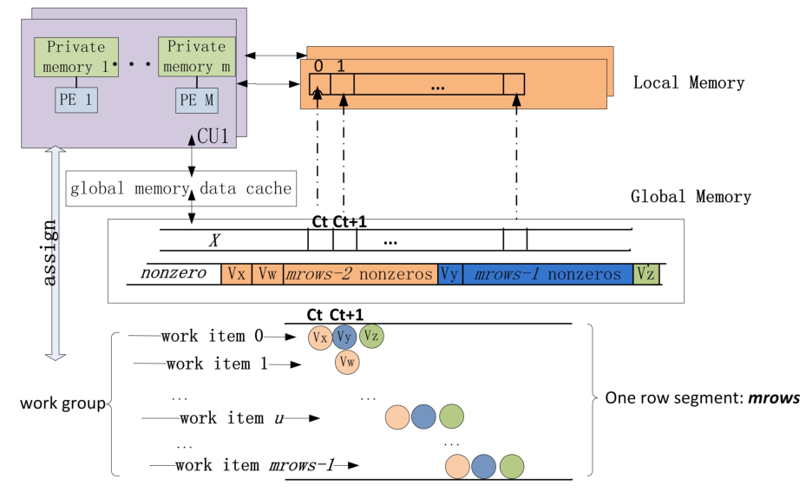
SpMV OpenCL Kernel Based on CRSD Format (2)
Optimizations:
Avoid thread divergence
Loop unrolling
Accesses to global memory are coalescing
The contiguous storage for nonzeros
Utilization of local memory for adjacent group
The reused x is loaded into local memory

Slide 14
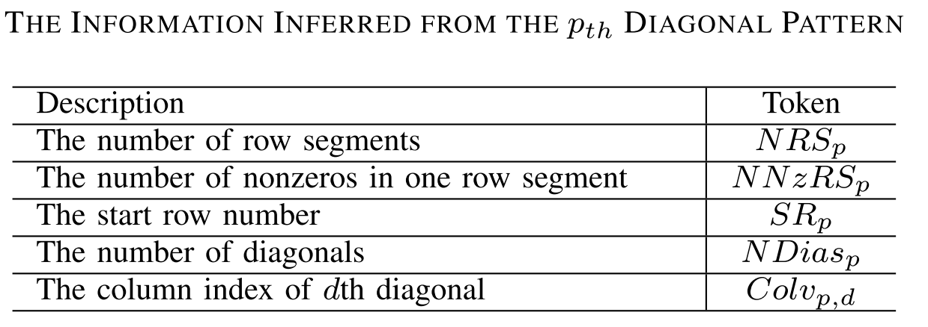
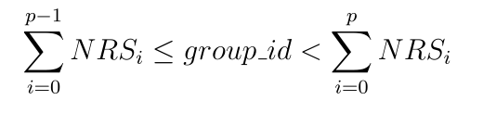




SpMV OpenCL Kernel Based on CRSD Format (3)
Optimizations :
Eliminate reading the index array and Calculate the nonzero index directly
Identify the diagonal pattern to process
Nonzero index on d_{th} diagonal
Correspond x index
Index for result

Slide 15
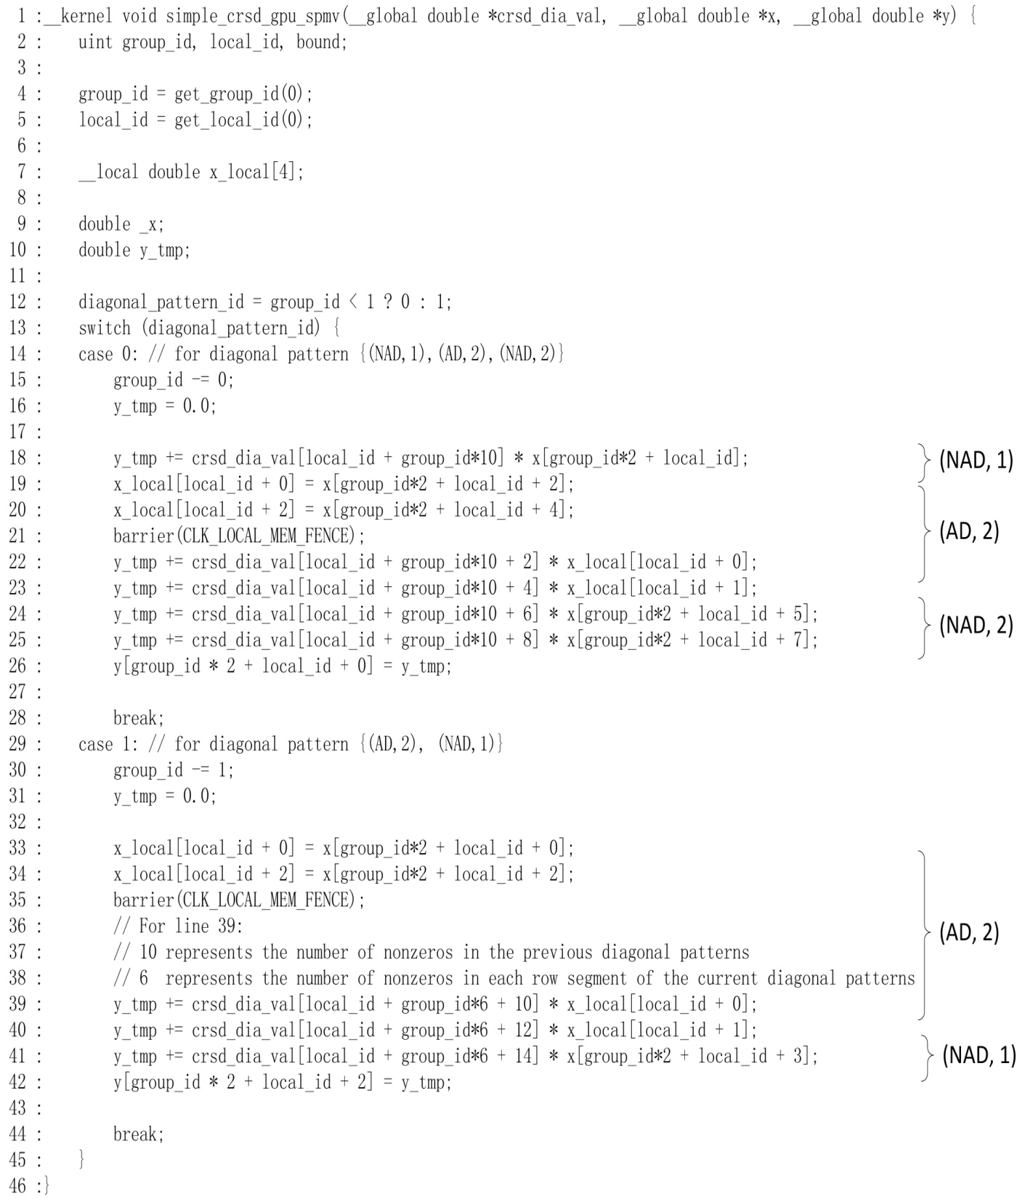

Generated SpMV OpenCL Kernel

Slide 16
Outline
Background
CRSD Storage Format
SpMV OpenCL Kernel Based on CRSD Format
Evaluation
Conclusion

Slide 17
Evaluation (1)
Platform information:
CPU: Intel Xeon X5550, 2.67GHz × 2
Compiler: GCC 4.4.3
GPU: Tesla C2050
Memory bandwidth: 144 GB/sec
Performance Comparison
CPU side:
Intel MKL 10.2.6.038
GPU side:
state-of-the-art implementations (Bell and Garland, 2009)
DIA, CSR, ELL and HYB(ELL+COO) formats

Slide 18
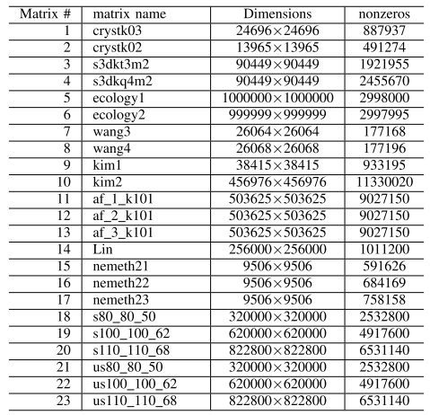
Evaluation (2)
1-17 from NIST Matrix Market
2D/3D problems
Structural problems
quantum chemistry problem
8-13 from an astrophysics application [*]
[*] Chana K. H., Li Ligang, Liao Xinhao. Modelling the core convection using ﬁnite
element and ﬁnite diﬀerence methods. Physics of the Earth and Planetary Interiors,
157(2): 124-138. (2006)

Slide 19
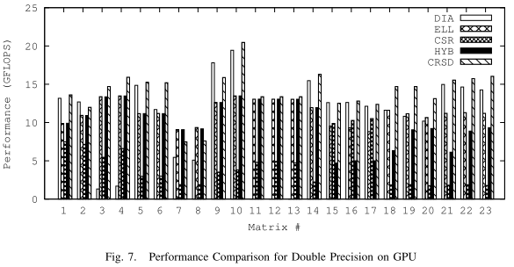
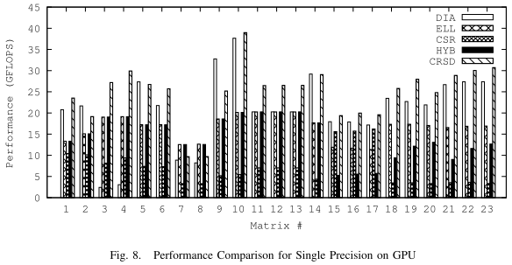
Evaluation(3)
GPU side
DIA performs poor on Matrix 3, 4
Nonzeros distributes on 655 diagonals
Nonzeros per row is 44
For DIA in double precision, No performance data for matrix 11, 12, 13
DIA format size exceeds the limited size on GPU
Speedup compared with different formats
 | Double precision |  |  |  | Single precision
format | DIA | ELL | CSR | HYB | DIA | ELL | CSR | HYB
Avg | 2.04 | 1.24 | 4.57 | 1.54 | 1.92 | 1.50 | 4.59 | 1.97
Max | 11.13 | 1.52 | 9.01 | 2.67 | 11.24 | 1.94 | 9.14 | 3.68

Slide 20
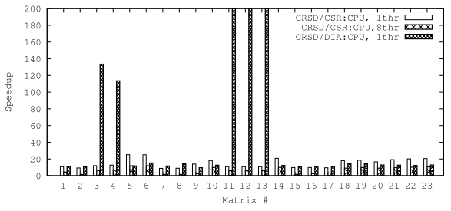
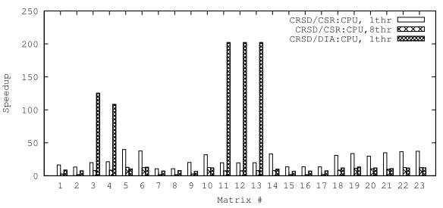
Evaluation (4)
CPU side
DIA performs poor on Matrix 3, 4, 11, 12, 13 on CPU
Speedup reaches 199.63 and 202.23 for double and single precision
Performance improvement
Fig.11 For double precision
Speedup |  | DIA | CSR, thr=1 | CSR, thr=8
Double precision | Max | 15.27 | 25.06 | 11.63
 | Avg. | 12.34 | 14.76 | 6.63
Single precision | Max | 13.25 | 39.81 | 12.79
 | Avg. | 9.87 | 24.25 | 7.18
Fig 12. For Single precision

Slide 21
Outline
Background
CRSD Storage Format
SpMV Kernel Based on CRSD Format
Evaluation
Conclusion

Slide 22
Conclusion
Diagonal pattern
Deal with idle section
X is reused in local memory for adjacent group
OpenCL kernel based on CRSD
Include index information
Work assignment is efficient
Improve performance

Slide 23
Thank You

