Slide 1


RDMA Capable iWARP over Datagrams
Ryan E. Grant¹, Mohammad J. Rashti¹, Pavan Balaji², Ahmad Afsahi¹
¹Department of Electrical and Computer Engineering
Queen’s University Kingston, ON, Canada K7L 3N6
²Mathematics and Computer Science
Argonne National Laboratory
Argonne, IL, USA

Slide 2
Introduction
Motivation
Background Information
Design
Experimental Framework and Results
Microbenchmarks
Applications
Conclusions
Future Work
Questions

Slide 3
Motivation
Existing RDMA designs do not provide support for RDMA write operations over unreliable datagram (UD) transports
Popular applications use datagrams
video on demand streaming
high-speed financial trading applications
Desirable to leverage RDMA technology to improve application performance
Improve performance of inter-node communication for Ethernet clusters

Slide 4
Motivation
Sandvine Inc. Report from Monday
Netflix consumes 29.7% of peak time bandwidth in North America
Real-time entertainment consumes 49.2%
Predicting entertainment will consume 55-60% of peak time bandwidth by the end of 2011
RTE and filesharing consume almost 70% of peak time bandwidth
Source: www.sandvine.com/news/pr_detail.asp?ID=312

Slide 5
Motivation
Why use UD?
Scalability, no need for connections
Speed, no TCP congestion control
Simplicity, less complex implementation for UD offloading than a TOE
Drawbacks to UD?
Unreliability
Potential packet loss from congestion
Notes:
Much less complex than SCTP

Slide 6
Outline
Motivation
Background Information
Design
Experimental Framework and Results
Microbenchmarks
Applications
Conclusions
Future Work
Questions

Slide 7
Background Information
iWARP
Remote Direct Memory Access over Ethernet
Standard built on TCP or SCTP lower layer
Queue pair based network
Untagged and tagged models
Untagged, sent data matched with a posted receive for local data placement
Tagged, sender aware of remote memory window and provides target memory location

Slide 8
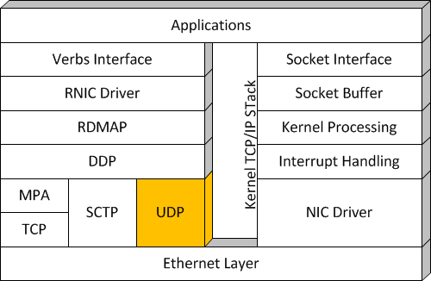
Background Information
iWARP (UD) Stack versus Kernel TCP/IP Stack
Notes:
Mention changes to Verbs/RDMAP/DDP and note lack of MPA

Slide 9
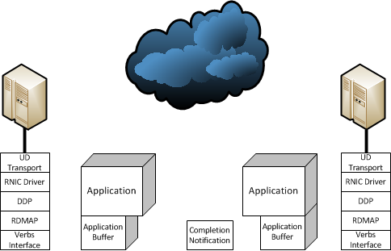
Background Information
Traditional iWARP RDMA Write
3. Data sent to target
8. Incoming data matched to Recv Request
7. Send request data sent to target
4. Data received
2. iWARP stack applies tagged header (STag and offset)
Alternatively, the application can poll a bit in memory to determine when write is complete
6. Send request posted
5. Data written into memory based on STag and offset
11. Application can access data
9. Recv request Handled
7. Poll on memory until valid
1. Verbs Request
10. RDMA Write valid after Recv

Slide 10
Background
Relies on the lower layer (TCP) for reliability
With a UD LLP:
If using UD, target buffer may not have complete message
Final send/recv lost in transit means complete iWARP message loss

Slide 11
Outline
Motivation
Background Information
Design
Experimental Framework and Results
Microbenchmarks
Applications
Conclusions
Future Work
Questions

Slide 12
Design - Challenges with UD Transports
UD Transports provide additional challenges over TCP
Unreliable!
No order guarantees
No connection information
But solves some problems as well
No middlebox fragmentation issues
No need for iWARP markers

Slide 13
Challenges with UD
RDMA functions like a local DMA, but Remote
For UD need to treat RDMA like an unreliable memory
Indicate which areas of memory are “bad” due to message loss
Ideally it should be compatible with socket semantics
Done through an intermediate interface or protocol

Slide 14
Challenges with UD
Allow for socket semantics compatibility
Each incoming message can result in a completion notification
Functions like traditional recvmsg but using user buffers
Similar to send/recv without posted recvs
Allow for DMA-like interface
Produce a validity map for all valid areas of memory in a defined memory region
Essentially an aggregate of many completion notifications, delivered at once

Slide 15
Background Information
Background Information
iWARP RDMA Write-Record
3. Data sent to target
4. Data received
2. iWARP stack applies tagged header (STag and offset)
5. Data written into memory based on STag and offset
8. Application can access data
7. Poll CQ for valid data
6. Location of valid data entered into CQ or Validity map
1. Verbs Request

Slide 16
Solving the Challenges of UD
Ordering
Small messages are typical of UD (< 64K)
Direct placement avoids ordering issues for small messages
Large messages – need to keep a message sequence number counter for each user of a memory region
No Connection Information
Pass sender’s IP/Port back to application upon application validity data fetch

Slide 17
Outline
Motivation
Background Information
Design
Experimental Framework and Results
Microbenchmarks
Applications
Conclusions
Future Work
Questions

Slide 18
Experimental Framework
Network Performance data collected using custom microbenchmark suite for software iWARP
Application results collected using a custom socket interface to software iWARP and the following software:
VideoLan’s VLC (http://www.videolan.org/vlc)
SIPp (http://sipp.sourceforge.net)
OS | Processors | NIC | Switch
Fedora Kernel 2.6.31 | 2 – 2.0 Ghz Quad-Core AMD Opteron | NetEffect 10GigE | Fujitsu 10GigE Switch
UD Send/Recv first proposed in: Mohammad J. Rashti, Ryan E. Grant, Pavan Balaji, and Ahmad Afsahi, "iWARP Redefined: Scalable Connectionless Communication over High-Speed Ethernet", 17th International Conference on High Performance Computing (HiPC 2010), Goa, India, December 19-22, 2010.

Slide 19
Microbenchmark Results
UD RDMA Write-Record has the lowest small message latency, similar to UD Send/Recv

Slide 20
Baseline Multi-Stream Performance
RDMA Write-Record also has higher bandwidth for larger message sizes, and outperforms at medium message sizes as well
Notes:
Point out excellent performance at 1K (near 1.5K MTU) , 45% advantage of RDMA Write over UD send/recv at 1K

Slide 21
Microbenchmark Results
RDMA Write-Record is more loss tolerant for large messages than Send/Recv as well, as it delivers partial messages (messages may span multiple 64K UDP messages)
Notes:
Multiple segmentation layers here, packets aggregated into UDP messages aggregated into iWARP segments aggregated into iWARP messages

Slide 22
Microbenchmark Summary
RDMA Write-Record provides good performance
Beats RC RDMA Write at the most important message sizes for latency and bandwidth
Improves upon UD Send/Recv
RDMA Write-Record fits well within existing socket semantics, enabling easy adoption
Removes MPA layer complexity as well as TCP bottlenecks to enhance performance and reduce overall stack complexity
Notes:
Send/recv vs RDMA write is mostly implementation dependent

Slide 23
Application Performance Results

Slide 24
Application Performance
Tested with Media Streaming and SIP phone applications for performance
Developed a sockets to verbs interface to allow existing applications to use software iWARP stack (UD/RC iWARP)
Lightweight interface to test functionality
Formally specified socket interface would be helpful in facilitating acceptance
Operates in one iWARP transport mode at a time only, RC or UD.
Sockets Direct Protocol is available for RC mode hardware (not compatible with software iWARP)

Slide 25
VLC Performance
VLC performance shows significantly less buffering time required for UD iWARP over RC iWARP, a 74% average improvement.
Notes:
Similar patterns on all results except for CG

Slide 26
SIP Performance
Sip shows a 43.1% improvement in response times using UD over RC (send/recv and RDMA Write (Record) are statistically tied in performance for this test)

Slide 27
Application Performance Discussion
Performance with UD is better than with RC
Software solution is still using TCP/IP and UDP stacks
OS related overhead in both cases is similar
Performance benefits from simpler UDP transport
Hardware solutions would show benefit from having no target CPU involvement required for data reception (no posted recvs)
Target system can receive information without local machine work request

Slide 28
Application Memory Usage
The memory usage of a UD solution for a SIP application can be significantly less than that of an RC solution (24.1% @ 10000 clients)

Slide 29
Application Memory Usage
Memory usage calculated using whole application memory usage as well as memory usage from the slab.
Improvement of 24.1% @10000 users contrasts to theoretical improvement of 28.1%
Difference is in SIP application’s requirement to store information on active UDP clients
Scalability and offloaded networking for iWARP UD hardware are promising for increasing server capacity and throughput

Slide 30
Outline
Motivation
Background Information
Design
Experimental Framework and Results
Microbenchmarks
Applications
Conclusions
Future Work
Questions

Slide 31
Conclusions
RDMA Write-Record is the first one-sided RDMA operation operable over UD on iWARP
RDMA Write-Record allows for data transfer that can tolerate packet loss
UD solution is more scalable than connection based one
Full specifications for a two-sided Send/Recv and one-sided RDMA Write-Record over iWARP are now available
Real applications show performance improvements using UD based iWARP

Slide 32
Future Work
Extend the work to include a reliable datagram transport, broadening the potential application space
MPI-RDMA Write-Record interface for HPC applications
Provide an SDP-like interface for UD iWARP

Slide 33

Questions?
Thank You
Questions?
This work was supported in part by: Natural Sciences and Engineering Research Council of Canada Grant #RGPIN/238964-2005, Canada Foundation for Innovation and Ontario Innovation Trust Grant #7154, Office of Advanced Scientific Computing Research, Office of Science, U.S. Department of Energy, under Contract DE-AC02-06CH11357, and the National Science Foundation Grant #0702182

