Slide 1
Mapping Communication Layouts to Network Hardware Characteristics on Massive-Scale Blue Gene Systems
Pavan Balaji*, Rinku Gupta*, Abhinav Vishnu⁺ and Pete Beckman*
* Argonne National Laboratory
⁺ Pacific Northwest National Laboratory

Slide 2
Power and Cost Constraints on Large-scale Machines
Massive scale machines available today
Machines with 500,000 cores already available
Upcoming machines expected to have a few million cores (e.g., the Sequoia BG/Q machine at LLNL is expected to have 1.6 million cores)
Exascale machines might have close to a billion cores
For machines of this scale, it is impractical to assume that all system resources will increase at the same rate
Caches, memory, floating point units, instruction decoders
Network is no exception:
Many of the largest machines in the world are moving away from fat-tree topologies to “scalable” topologies (typically torus topologies)
Lesser bisection bandwidth, but linearly increasing cost

Slide 3
Scalable Network Topologies
Many of the largest machines in the world are increasingly using linearly scaling topologies
IBM BG/L, BG/P and Cray XT machines utilized a 3D torus topology
Sandia RedSky InfiniBand cluster uses a 3D topology
IBM Blue Gene/Q will feature a 5D torus topology
The Japanese K supercomputer uses a 6D torus
Impact on communication:
Limited bisection bandwidth: Each node on a 3D torus connects directly to six other nodes
Forcing nodes to share network links during communication
Results in significant communication contention and performance loss
Locality of communication is absolutely critical for efficient usage of the network infrastructure → these networks are not at all well suited for random communication between all processes in the system

Slide 4
Locality Aware Process Mapping
Communication locality requires information about the application communication pattern and hardware topology
Traditional approach involves using the MPI virtual topology functionality, but unused for several reasons including lack of data locality
MPI virtual topology functions do not remap processes; instead they let the user create a new communicator with the appropriate communication characteristics
What happens to the data that is already present on the processes? Applications have to manually redistribute it to match the new communicator’s rank ordering

Slide 5
Data Layout Example for Domain-based Ray Tracing
Preprocessing step typically involves the application breaking the data into a regular Cartesian grid (and in some cases data exchange in a star stencil format)
Actual communication follows the processes that contain data on a given ray → the tracing library has to use the data layout given by the application which does not follow locality constraints to improve communication
Many other examples of such non-trivial communication patterns exist (box-stencil computations in many math libraries, dimension-wise communication in P3DFFT, etc.)

Slide 6
State of Practice
The key issue that needs to be addressed is that the data layout (which process has what data) is independent of and thus does not match the communication pattern
Currently application developers tediously try out different process layouts and decide on the best layout
This is impractical in many cases
BG/P’s 3D torus requires a large number of “trial runs” for each application developer to converge on a good mapping
BG/Q’s 5D torus is going to be a nightmare; try the 6D torus on the K-supercomputer
… and impossible in other cases
The best mapping many times depends on the actual partition layout in an allocation (8 x 8 x 8 is very different from 8 x 16 x 4)

Slide 7
This paper in a nutshell
Basic idea is to perform process mapping at application launch time, rather than within the MPI library
This allows the data placement to match the communication pattern of the applications
How this works:
Application specifies the communication pattern it wants to use offline
We allocate a partition of nodes for the application
We study different process layouts and the amount of contention they are expected to have
Pick the best layout and launch processes so as to minimize contention
We demonstrate that different mappings can show significant difference in overall performance for real applications on up to 128K cores of the Argonne BG/P system

Slide 8
Presentation Roadmap
Motivation
Understanding the Complexity in Process Mapping
Contention Analysis
Experiments and Analysis
Concluding Remarks

Slide 9
Complexity in Process Mapping
Most communication libraries (like MPI) hide physical layout of system from applications to improve portability
Applications form logical topologies on the processes available to match their problem
E.g: for climate modeling applications, data representation is typically 2D plane, 3D volume or multi-dimensional unstructured grid
Each process gets a part of the overall data
Local data computation depends on partially evaluated results from neighboring processes on the logical process grid formed by application
Applications rely on the logical process layout without any information about the physical placement or mapping of actual processes

Slide 10
1D Mapping for nearest neighbor communication on BG/P
Easiest scenario: For 1D logical nearest neighbor, most of application processes will get mapped next to each other in a sequential order
Y
Y
Z
Z
X
X
Logical Mapping
Physical Mapping (XYZ)
8 x 8 x 8 physical grid
Physical Mapping (YXZ)
8 x 8 x 8 physical grid

Slide 11
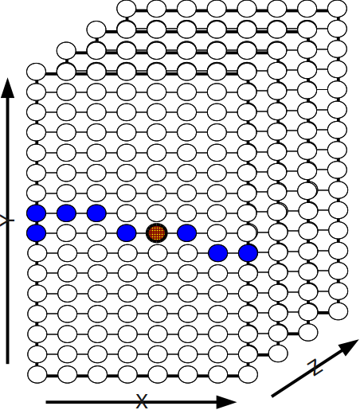
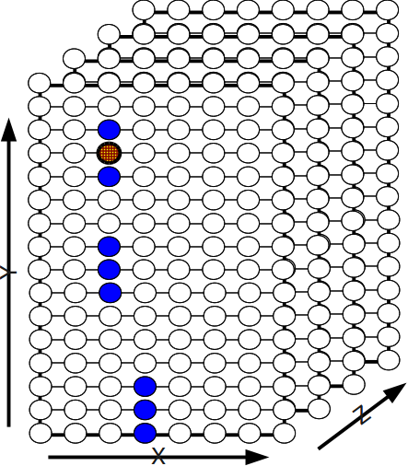
2D mapping for nearest neighbor communication
In 2D mapping, each process communicates with 8 other processes. Communicating groups are dispersed -> network overlap
Mapping type impacts extent of dispersal (XYZ < YXZ below)
Logical Mapping
Physical Mapping (XYZ)
8 x 16 x 8 grid
Physical Mapping (YXZ)
8 x 16 x 8 grid

Slide 12
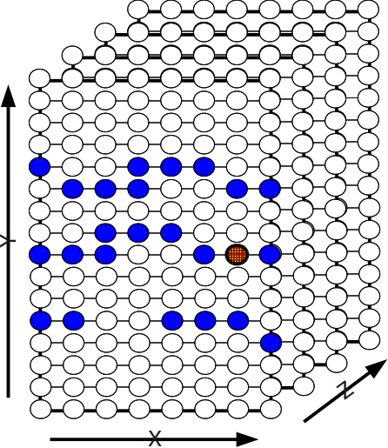
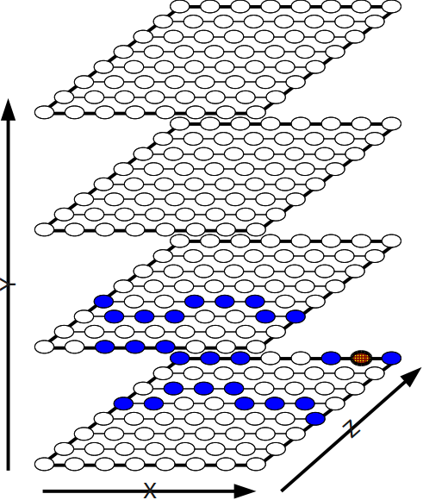
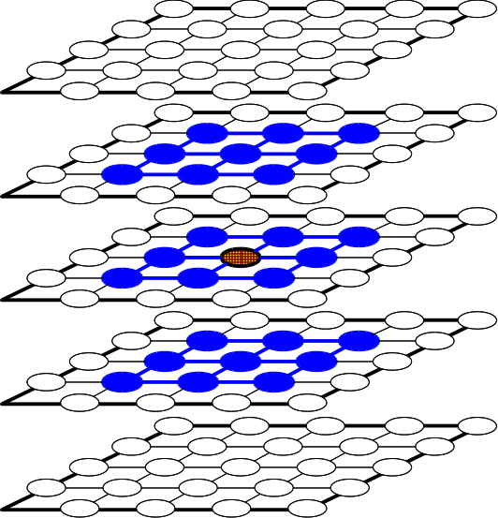
3D mapping for nearest neighbor communication
In 3D mapping, each process communicates with 26other processes. Mapping type significantly impact dispersal rate
Logical Mapping
Physical Mapping (XYZ)
8 x 16 x 8 grid
Physical Mapping (XZY)
8 x 16 x 8 grid

Slide 13
Presentation Roadmap
Motivation
Understanding the Complexity in Process Mapping
Contention Analysis
Experiments and Analysis
Concluding Remarks

Slide 14
Assumptions/Restrictions
We only consider symmetric topologies
BG/P (and the upcoming BG/Q) only support symmetric allocations
Cray XT and Sandia RedSky (IB) do not
We only consider symmetric communication patterns
This simplifies the routing analysis as described in the later slides
Irregular communication patterns exist in many applications and are very important, but is not the focus of this paper
The possible mappings we consider are restricted by the ones supported by the BG/P software stack
Process management framework of BG/P allows application processes to be mapped in several combination of X,Y,Z axis and T (i.e. 4 cores per node – which can be considered as 4th dimension)
IBM does not support all mappings; we did not make an attempt to improve this as finding an optimal mapping is NP-complete

Slide 15
Communication Contention Analysis
Aim is to provide a methodology for analyzing different communication patterns of applications and mapping them optimally on a given platform for best performance
Understand the communication pattern of the application by allowing the application to describe it
Understand the physical platform network topology and the routing algorithm behavior on the platform
Map these two categories of information to calculate the network contention for the given application pattern on the available network
Application communication pattern and its optimal mapping can then be integrated with the IBM BG/P launching system (our chosen platform)
Application, can then, simply specify their pattern during job submission time and optimal mapping will be automatically chosen by the run-time

Slide 16
Routing on BG/P
Our contention analysis model relies on routing algorithm used by BG/P
BG/P routes data in dimension-wide order
For large messages, BG/P uses destination-based adaptive routing
To avoid live-locks, BG/P picks one of the minimum distance routes
At each hop, the adaptive routing algorithm considers only the outgoing links that reduce hop count to destination
As a first-order approximation, we assume data packets are split equally among all possible paths at each hop of the network
Though not theoretically guaranteed, this is quite true in practice, but only for symmetric communication patterns (and hence our assumption that the communication pattern is symmetric)
Every partition on the BG/P is fully symmetric and form a torus on all dimensions

Slide 17
Intuition for Calculating Contention (TXYZ mapping)
To analyze optimal mapping for a given application and physical topology, we need to understand the network contention due to shared links
Map 64 x 256 2D grid on a 4,096 nodes on a BG/P system – with partition dimensions 8 x 16 x32
TXYZ mapping: Each 64 row of the process grid occupies 4 ‘X’ rows
16
64 x 256 2D
Process Grid
32
8
Each link is utilized 3 times by 1 center node
Total contention count: 24

Slide 18
Intuition for Calculating Contention (TZYX mapping)
To analyze optimal mapping for a given application and physical topology, we need to understand the network contention due to shared links
Map 64 x 256 2D grid on a 4,096 nodes on a BG/P system – with partition dimensions 8 x 16 x32
TZYX mapping: Each 64 row of the process grid occupies 1 ‘Z’ row
16
64 x 256 2D
Process Grid
32
8
Each link is utilized 3 times by 1 center node
Total contention count: 6

Slide 19
Calculating Contention
Calculate link usage for each peer communication
For each pair of processes, see how much data is sent over each link
The link with the maximum amount of data communication is our bottleneck and represents our measure of contention
Note that this is only valid when all processes communicate with their peers at the same time, but that is the common model applications use and is what this paper focuses on
Requires O(P²) computation with O(P) storage
For symmetric communication, however, this can be done in close to O(P) time
This is because of the similarity in link usage between processes
Data communication over links is similar, but shifted by one hop

Slide 20
Presentation Roadmap
Motivation
Understanding the Complexity in Process Mapping
Contention Analysis
Experiments and Analysis
Concluding Remarks

Slide 21
Experiments and Analysis
Study and analyze the impact of various mappings with varying system size
Micro-benchmarks
Applications
Demonstrates the performance achieved by our automatic process mapping model

Slide 22
Micro-benchmark-based Evaluation
2D logical nearest neighbor communication
3D logical nearest neighbor communication
Both use star stencils → each process has (3^{d}-1) neighbors, where d is logical process grid dimensionality
Nearest neighbor communication
Each process does point-to-point exchange of some data with its logical neighbors in 2D or 3D plane
In real applications, this data (typically) corresponds to ghost cells, bordering data points between two processes
Studied effects of varying data size on up to 128K cores with various mappings

Slide 23
2D Communication benchmark performance
7-fold performance difference →
due to increased contention count, O(N) link increase but O(N²) process increase
CDL model picks most optimal mapping

Slide 24
3D Communication benchmark performance
Performance difference
Increases with system size
Increases with message size
Same trends as 2D communication benchmarks

Slide 25
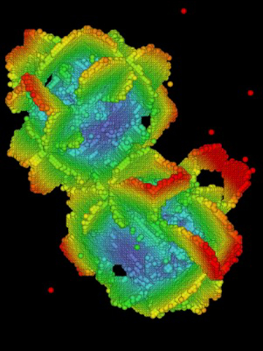
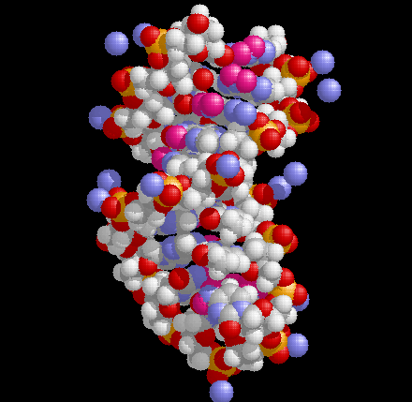
Application kernel evaluation – P3DFFT
P3DFFT: A popular implementation of parallel 3D FFT algorithm to compute Fast Fourier transform, when applied to 3D volume space
Computing 1D Fourier transform in each of the 3 dimensions
Communication pattern is dimension-wise
That is, each process communicates with all processes in its X and Y (logical) dimensions
Each process communications with √P processes

Slide 26
P3DFFT performance

Slide 27
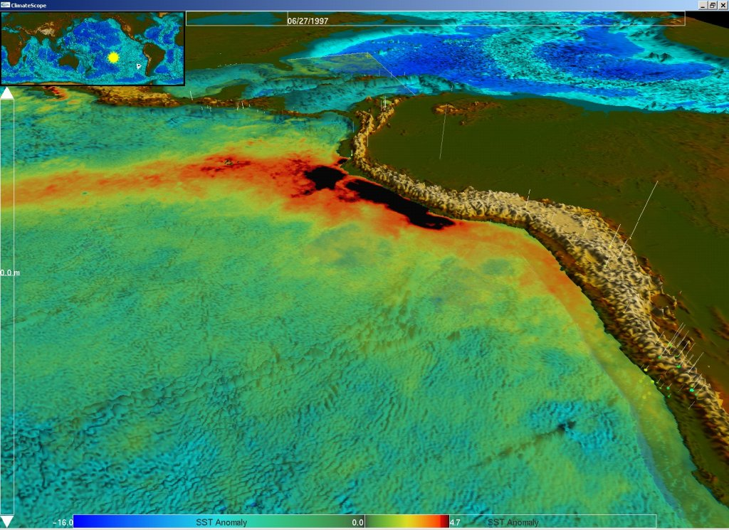
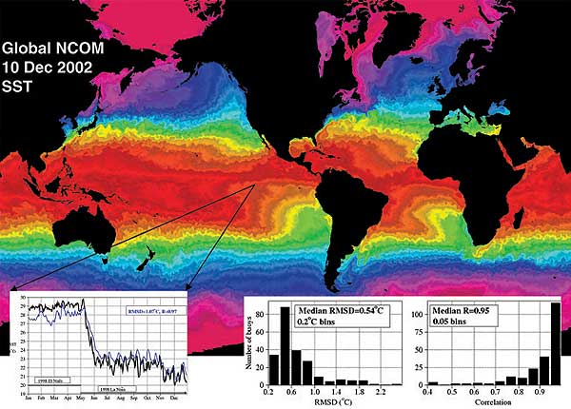
NLOM Ocean Modeling Application
NLOM application is used for ocean simulations; with focus on semi-enclosed seas, ocean basins and the global ocean
Bandwidth sensitive when run on large system size
We study it with varying system size and message size

Slide 28
NLOM Communication Performance
3-fold performance difference
CDL model does pick most optimal mapping

Slide 29
NLOM trends on varying system size
No single mapping performs best in all cases
Mapping becomes more important with increasing system sizes

Slide 30
Presentation Roadmap
Motivation
Understanding the Complexity in Process Mapping
Contention Analysis
Experiments and Analysis
Concluding Remarks

Slide 31
Concluding Remarks
Locality aware process mapping is critical in large-scale systems
We studied how mappings can significantly impact application performance and designed a contention model analysis tool to identify the mapping with the least contention
Experiments done on 128K cores of BG/P demonstrate significant impact on performance
Future work: Non-symmetric communication patterns require improved analysis, but form a big fraction of applications

Slide 32
Thank you!
Contact:
Email: balaji@mcs.anl.gov
Web: http://www.mcs.anl.gov/~balaji

Slide 33
Argonne BG/P system Torus Dimensions
Application on BG/P are run on a subset of node i.e. partition
Two different partitions can have the same number of cores; but have different partition dimensions
For a 4,096 job, partitions of both 8 x 16 x 32 and 16 x 16 x 16 can be used
Partition sizes can be configured by the administrator → determines network sharing
Nodes | Dimensions
512 | 8 x 8 x 8
1024 | 8 x 8 x 16
2048 | 8 x 8 x 32
4096 | 8 x 16 x 32
8192 | 8 x 32 x 32
16384 | 16 x 32 x 32
32768 | 32 x 32 x32

