Slide 1
JETS: Language and System Support for Many-Parallel-Task Computing
Justin M Wozniak and Michael Wilde
Argonne National Laboratory
Presented by: Pavan Balaji, Argonne National Laboratory
P2S2
Taipei – September 13, 2011

Slide 2
Outline
Scientific applications
Batches, ensembles, parameter studies,
Scientific scripting tools to construct studies
Use case: Replica Exchange Method (REM) in NAMD
Performance challenges
Many Parallel-Task Computing - JETS
Integration with Swift
Ongoing work: ExM- Many-task computing at the exascale
Summary

Slide 3
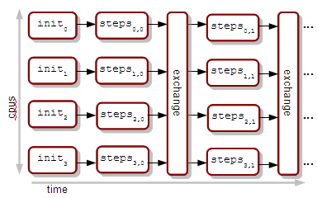
NAMD - Replica Exchange Method
Example application use case - sizeable batch of short parallel jobs with data exchange
Method extracts information about a complex molecular system through an ensemble of concurrent, parallel simulation tasks
Application parameters (approx.):
64 concurrent jobs x 256 cores per job = 16,384 cores
10-100 time steps per job = 10-60 seconds wall time
Requires 6.4 MPI executions/sec. → 1,638 processes/sec. over a 12-hour period = 70 million process starts

Slide 4
Parameter studies
Treat each application invocation as a function evaluation in a higher-level method
Run the same application with varying input parameters
Parameter sweep: cover a known range of inputs to obtain outputs and produce statistical information or visualization
Parameter search/optimization: find inputs that produce interesting/extreme outputs
Application script: evaluate arbitrary user script
REM is a form of parameter sweep with some relatively simple data exchange- easily expressed in a scripting language

Slide 5
Scientific scripting - SwiftScript
Support file/task model directly in the language
app (file output) sim(file input) { namd2 @input @output
}
Provide natural concurrency through automatic data flow analysis and task scheduling
file o11 = sim(input1);
file o12 = sim(input2);
file m = exchange(o11, o12);
file i21 = create(o11, m);
file o21 = sim(i21);
...
Separate application script from site configuration details
Support scientific data sets in the language through language constructs such as structs, arrays, mappers, etc.
script
sites
apps
Swift
Execution…
input1
o11
i21
sim
exchange
create
sim
o21
m
input2
sim
o12
create
i22
sim
o22

Slide 6
Task management
Task generation
Task distribution
Task execution
Tasks may be generated by a simple list or by a running program or workflow
Workflow execution produces “job specifications”- user tasks to be executed on the available infrastructure
We are currently investigating the following infrastructures:
Tradeoffs include performance, portability, and usability
Coasters
Falkon
JETS

Slide 7
Performance challenges for large batches
For small application run times, the cost of application start-up, small I/O, library searches, etc. is expensive
Existing HPC schedulers do not support this mode of operation
On the Blue Gene/P, job start takes 2-4 minutes
On the Cray, aprun job start takes a full second or so
Neither of these systems allow the user to make a fine-grained selection of cores from the allocation for small multicore/multinode jobs
Solution pursued by JETS:
Allocate worker agents en masse
Use a specialized user scheduler to rapidly submit user work to agents
Support dynamic construction of multinode MPI applications

Slide 8
JETS: Features
Portable worker agents that run on compute nodes
Provides scripts to launch agents on common systems
Features provide convenient access to local storage such as BG/P ZeptoOS RAM filesystem. Storing application binary, libraries, etc. here results in significant application start time improvements
Central user scheduler to manage workers: (Stand-alone JETS or Coasters discussed on following slides)
MPICH /Hydra modification to allow “launcher=manual”: tasks launched by the user (instead of SSH or other method)
User scheduler plug-in to manage a local call to mpiexec
Processes output from mpiexec over local IPC, launches resultant single tasks on workers
Single tasks are able to find the mpiexec process and each other to start the user job (via Hydra proxy functionality)
Can efficiently manage many running mpiexec processes

Slide 9
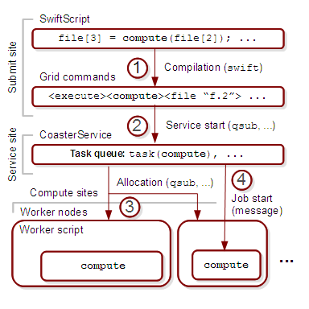
Execution infrastructure - Coasters
Coasters: a high task rate execution provider (Previously developed for the Swift system)
Automatically deploys worker agents to resources with respect to user task queues and available resources
Implements the Java CoG provider interfaces for compatibility with Swift and other software
Currently runs on clusters, grids, and HPC systems
Can move data along with task submission
Contains a “block” abstraction to manage allocations containing large numbers of CPUs
Originally only supported sequential tasks

Slide 10
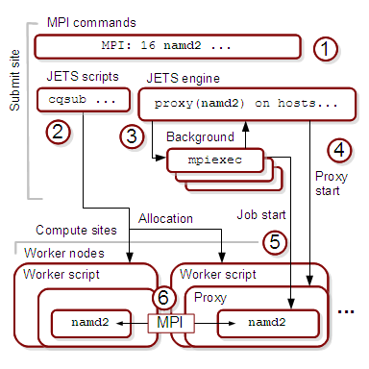
Execution infrastructure - JETS
Stand-alone JETS: a high task rate parallel-task launcher
User deploys worker agents via customizable, provided submit scripts
Currently runs on clusters, grids, and HPC systems
Great over SSH
Runs on the BG/P through ZeptoOS sockets- great for debugging, performance studies, ensembles
Faster than Coasters but provides fewer features
Input must be a flat list of command lines
Limited data access features

Slide 11
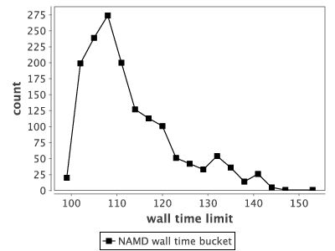
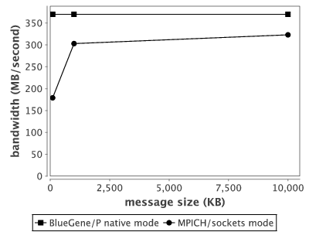
NAMD/JETS - Parameters
NAMD REM-like case: Tasks average just over 100 seconds
ZeptoOS sockets on the BG/P 90% efficiency for large messages 50% efficiency for small messages
Case provided by Wei Jiang

Slide 12
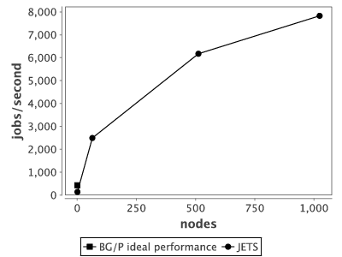
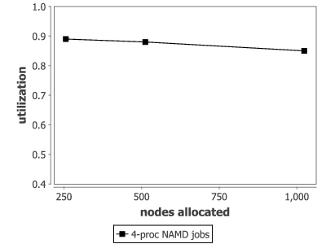
JETS - Task rates and utilization
Calibration: Sequential performance on synthetic jobs:
Utilization for REM-like case: not quite 90%

Slide 13
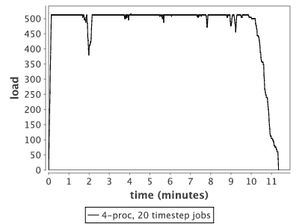
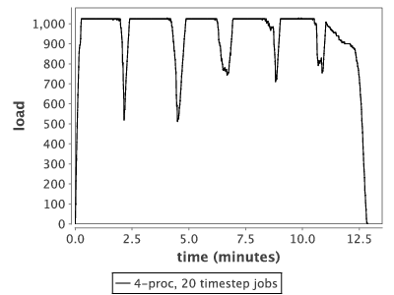
NAMD/JETS load levels
Allocation size: 512 nodes
Allocation size: 1024 nodes
Load dips occur during exchange & restart

Slide 14
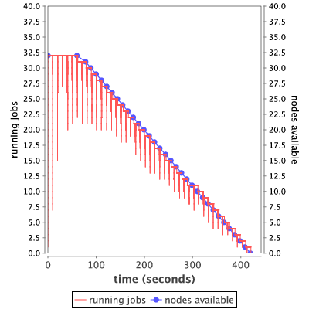
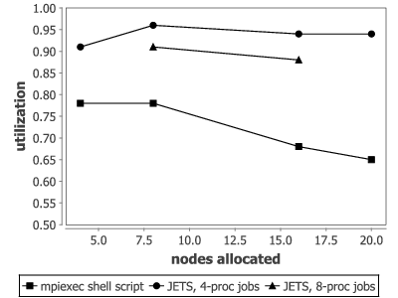
JETS - Misc. results
Effective for short MPI jobs on clusters
Single-second duration jobs on Breadboard cluster
JETS can survive the loss of worker agents (BG/P)

Slide 15
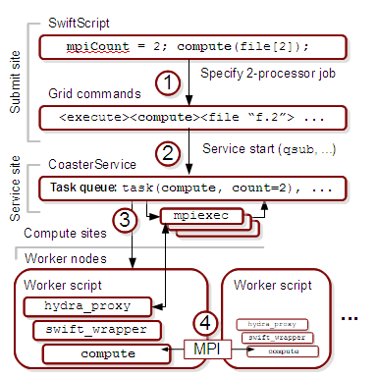
JETS/Coasters
JETS features were integrated with Coasters/Swift for elegant description of workflows containing calls to MPI programs
The Coasters service manages workers as normal but was extended to aggregate worker cores for MPI execution
Re-uses features from stand-alone JETS
Enables dynamic allocation of MPI jobs; highly portable to BG/P, Cray, clusters, grids, clouds, etc.
Relatively efficient but slower than stand-alone mode

Slide 16
NAMD REM in Swift
Constructed SwiftScript to implement REM in NAMD
Whole script is about 100 lines
Intended to substitute for multi-thousand line Python script (that is incompatible with the BG/P)
Script core structures shown to the right
Represents REM data flow from previous slide as Swift data items, statements, and loops
Performance runs are ongoing…
app (positions p_out, velocities v_out, energies e_out)
namd(positions p_in, velocities v_in)
{
namd @p_out @v_out @p_in @v_in stdout=@e_out;
}
positions p[]<array_mapper;files=p_strings>;
velocities v[]<array_mapper;files=v_strings>;
energies e[]<array_mapper;files=e_strings>;
// Initialize first segment in each replica
foreach i in [0:replicas-1] {
int index = i*exchanges; p[i] = initial_positions();
v[i] = initial_velocities();
}
// Launch data-dependent NAMDs…
iterate j {
foreach i in [0:replicas-1] {
int current = i*exchanges + j+1;
int previous = i*exchanges + j; (p[current], v[current], e[current]) =
namd(p[previous], v[previous]);
}
} until (j == exchanges);

Slide 17
Ongoing/Future work: ExM: Extreme-scale many-task computing
The JETS work focused on performance issues in parallel task distribution and launch
Task generation (dataflow script execution) is still a single node process
To run large instances of the script, a distributed memory dataflow system is required
Project goal: Investigate many-task computing on exascale systems
Ease of development – fast route to exaflop application
Investigate alternative programming models
Highly usable programming model: natural concurrency, fault-tolerance
Support scientific use cases: batches, scripts, experiment suites, etc.
Build on and integrate previous successes
ADLB: Task distributor
MosaStore: Filesystem cache
SwiftScript language: Natural concurrency, data specification, etc.

Slide 18
Task generation and scalability
In SwiftScript, all data items are futures
Progress is enabled when data items are closed, enabling dependent statements to execute
Not all variables, statements are known at program start
SwiftScript allows for complex data definitions, conditionals, loops, etc.
Current Swift implementation constrains the data dependency logic to a single node (as do other systems like Dryad, Ciel) - thus task generation rates are limited
ExM proposes a fully distributed, scalable task generator and dependency graph – built to express Swift semantics and more

Slide 19
Performance target
Performance requirements for distributing the work of Swift-like task generation for an ADLB-like task distributor on an example exascale system:
Need to utilize O(10⁹) concurrency
For batch of 1000 tasks per core
10 seconds per task
1 hour, 46 minute batch
Tasks : O(10¹²)
Tasks/s: O(10⁸)
Divide cores into workers and control cores
Allocate 0.01% as control cores, O(10⁵)
Each control core must produce O(10³) = 1000 tasks/second

Slide 20
Recap and further reading…
Task generation
Task distribution
Task execution
Swift, ExM, Turbine
Coasters, JETS
Collective Data Management
Case studies in storage access by loosely coupled petascale applications Petascale Data Storage Workshop at SC’09
Turbine: Parallel evaluation of dataflow programs for extreme-scale many-task computing Submitted to PPoPP: A preprint is available

Slide 21
Thanks
Thanks to the organizers
Swift team: Mihael Hategan , Ketan Maheshwari, Mike Wilde
ExM team: Ian Foster, Dan Katz, Rusty Lusk, Matei Ripeanu, Emalayan Vairavanathan, Zhao Zhang
Thanks to Wei Jiang (ANL) for providing the NAMD use case
Grants: This research is supported by the DOE Office of Science, Advanced Scientific Computing Research X-Stack program, under contracts DE-AC02-06CH11357 FWP 57810 and DE-FC02-06ER25777.

Slide 22
Questions

