Slide 1
Transparent Accelerator Migration in Virtualized GPU Environments
Shucai Xiao¹, Pavan Balaji², James Dinan², Qian Zhu³, Rajeev Thakur², Susan Coghlan², Heshan Lin⁴, Gaojin Wen⁵, Jue Hong⁵, Wu-chun Feng⁴
¹AMD
²Argonne National Laboratory
³Accenture Technologies
⁴Virginia Tech
⁵Shenzhen Institute of Advanced Technologies

Slide 2
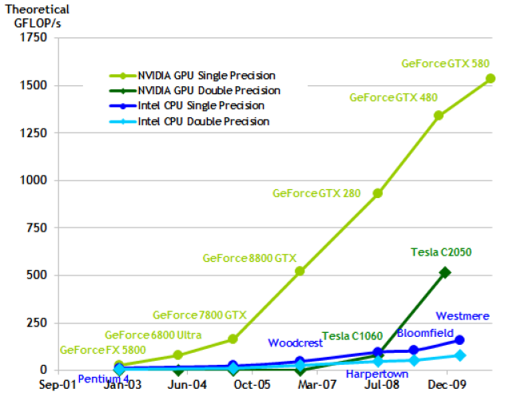
Trends in Graphics Processing Unit Performance
(Courtesy Bill Dally @ NVIDIA)

Slide 3
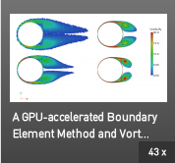

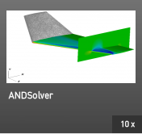
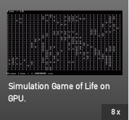
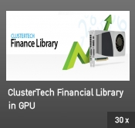
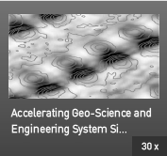
Graphics Processing Unit Usage in Applications
(From the NVIDIA website)

Slide 4
June 2011 Top5 Supercomputers (from the Top500 list)
Rank | Site | Computer
1 | RIKEN Advanced Institute for Computational Science (AICS) Japan | K computer, SPARC64 Vlllfx 2.0GHz, Tofu interconnect Fujitsu
2 | National Supercomputing Center in Tianjin China | Tianhe-1A – NUDT TH MPP, X5670, 2.93Ghz 6C, NVIDIA GPU, FT-1000 8C NUDT
3 | DOE/SC/Oak Ridge National Laboratory United States | Jaguar – Cray XT5-HE Opteron 6-core 2.6 GHz Cray Inc.
4 | National Supercomputing Center in Shenzhen (NSCS) China | Nebulae – Dawning TC3600 Blade, Intel X5650, NVidia Tesla C2050 GPU Dawning
5 | GSIC Center, Tokyo Institute of Technology Japan | TSUBAME 2.0 – HP ProLiant SL390s G7 Xeon 6C X5670, Nvidia GPU, Linux/Windows NEC/HP
(From the Top500 website)

Slide 5
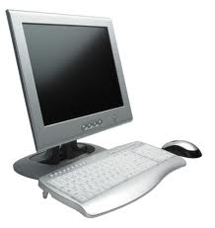
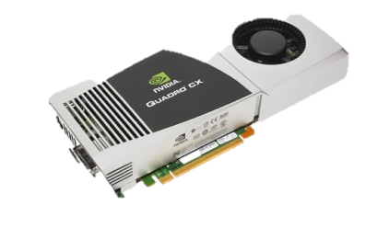
GPUs in Heterogeneous Environments
GPU programming environments today assume local access to GPUs
Two commonly used programming models: CUDA and OpenCL
Both follow the same assumption of locality of GPUs
Many supercomputers are not homogenous with GPUs
???

Slide 6
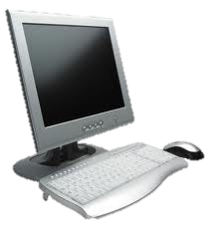
GPUs as a Cloud Service
Today, there is no model to provide GPU as a Cloud Service
What if a lot of GPUs are available in a cloud?
Can I access them remotely?
Or do I need to buy GPUs and plug them into my local computer to access them?

Slide 7
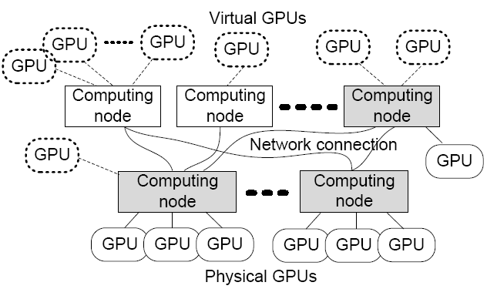
VOCL: A Virtual Implementation of OpenCL to access and manage remote GPU adapters
GPU Virtualization
Transparent utilization of remote GPUs
Remote GPUs look like local “virtual” GPUs
Applications can access them as if they are regular local GPUs
VOCL will automatically move data and computation
Efficient GPU resource management
Virtual GPUs can migrate from one physical GPU to another
If a system administrator wants to add or remove a node, he/she can do that while the applications are running (hot-swap capability)

Slide 8
Virtual OpenCL (VOCL) Framework
Compute Node
VOCL Proxy
Compute Node
OpenCL API
Application
Native OpenCL Library
Compute Node
MPI
Application
OpenCL API
Physical GPU
OpenCL API
VOCL Library
Native OpenCL Library
MPI
Virtual GPU
Virtual GPU
Compute Node
Physical GPU
VOCL Proxy
Traditional Model
OpenCL API
Native OpenCL Library
VOCL Model
Physical GPU

Slide 9
VOCL Infrastructure
VOCL Library
Implementation of the OpenCL Functionality
API Compatibility: API functions in VOCL have the same interface as that in OpenCL
ABI Compatibility with System Native OpenCL: No recompilation needed; relinking needed is statically built (runtime relinking in the common case)
The VOCL library calls MPI functions to send input data to and receive output data from remote nodes
VOCL service proxy
Located on Remote GPU nodes
Application processes can dynamically connect to proxy processes to use the GPUs associated with that proxy
Receives input from and sends output to the application process
Calls native OpenCL functions for GPU computation

Slide 10
VOCL Performance
“Transparent Virtualization of Graphics Processing Units”, S. Xiao, P. Balaji, Q. Zhu, R. Thakur, S. Coghlan, H. Lin, G. Wen, J. Hong and W. Feng. International Conference on Innovative Parallel Computing (InPar), 2012

Slide 11
Speedup with Multiple Virtual GPUs

Slide 12
Contribution of this paper
One of the advantages of virtual GPUs is that the physical GPU to which they are associated is transparent to the user
This mapping of virtual GPU to physical GPU can change dynamically
This paper: virtual GPU migration
Maintenance
Suppose a system administrator wants to take a machine down for maintenance, he/she should be able to migrate all virtual GPUs on that physical GPU to another physical GPU
Easy to add new nodes into the system; can be done while applications are running
Resource Management
Load Balancing: Depending on usage, virtual GPUs can be remapped to different physical GPUs so the load on any given physical GPU is low
Power Management: Scheduling multiple virtual GPUs to the same physical GPU can allow for power savings

Slide 13
Virtual GPU Migration with VOCL: Model
Compute Node
System administrator wants to take this node down for maintenance
VOCL Proxy
Compute Node
OpenCL API
Application
Native OpenCL Library
Suspend Communication
OpenCL API
Message to migrate virtual GPU
Physical GPU
VOCL Library
Virtual GPU
Remap virtual GPU to new physical GPU
Compute Node
Migrate physical GPU state to new physical GPU
VOCL Proxy
OpenCL API
Native OpenCL Library
Physical GPU

Slide 14
Using VOCL Migration for Resource Management
Compute Node
Compute Node
Application
Application
OpenCL API
OpenCL API
VOCL Library
VOCL Library
Virtual GPU
Virtual GPU
Virtual GPU
Virtual GPU
Virtual GPU
Virtual GPU
Virtual GPU
Compute Node
Compute Node
Compute Node
VOCL Proxy
VOCL Proxy
VOCL Proxy
OpenCL API
OpenCL API
OpenCL API
Native OpenCL Library
Native OpenCL Library
Native OpenCL Library
Physical GPU
Physical GPU
Physical GPU

Slide 15
Virtual GPU Migration Details: Queuing Command Issues
When a non-blocking operation is issued to the GPU, it is queued within the GPU runtime system and executed at a later time
Problem:
What happens to the non-blocking operations issued to the GPU, when a migration is triggered?
OpenCL provides no way to cancel these operations
Waiting for them to finish is an option, but can increase the migration overhead significantly (each kernel can take an arbitrarily long time)
Our solution: Maintian an internal queue of unposted operations
Restrict the number of non-blocking operations handed over to the GPU
Improve the responsiveness of virtual GPU migration
Can cause additional overhead, but can be controlled by queue depth

Slide 16
Virtual GPU Migration Details: Atomic Transactions
Atomic Transactions
Since a virtual GPU can migrate from one physical GPU to another, all transactions on the virtual GPU have to be atomic
E.g., we cannot transfer any data or kernel to a physical GPU while it is in the process of migrating
We emulate mutex behavior with MPI RMA operations
The VOCL library internally obtains a mutex lock before issuing any GPU operations
When migration is required, the proxy obtains this mutex lock thus blocking the VOCL library from issuing any additional calls
Once the migration is done, it updates all the appropriate data structures at the VOCL library with the remapped physical GPU information and releases the lock

Slide 17
Virtual GPU Migration Details: Target GPU Selection
Identifying which physical GPU to migrate to
VOCL records all transactions to the GPU and keeps track of the number of kernels that have been issued to the GPU and have not been completed
Whichever GPU has the least number of pending kernels is chosen as the target GPU
Not ideal, but can give some indication of load

Slide 18
Presentation Layout
Introduction and Motivation
VOCL: Goals, Design and Optimizations
VOCL: Virtual GPU Migration (Ongoing Work)
Performance Results and Analysis
Concluding Remarks
Other Research Areas

Slide 19
Impact of Internal Queue on Application Performance

Slide 20
Impact of Internal Queue on Migration Overhead

Slide 21
Migration Overhead with Regard to Problem Size
Matrix multiplication
N-body
Smith-Waterman
Matrix transpose

Slide 22
Impact of Load Rebalancing through Migration
N-body
Matrix multiplication
Smith-Waterman
Matrix transpose
Notes:
Nearly 2 times speedup is achieved for all four applications.

Slide 23
Presentation Layout
Introduction and Motivation
VOCL: Goals, Design and Optimizations
VOCL: Virtual GPU Migration (Ongoing Work)
Performance Results and Analysis
Concluding Remarks
Other Research Areas

Slide 24
Concluding Remarks
Current GPU programming environments do not allow us to use GPUs in heterogeneous environments
If all nodes on the system do not have GPUs
Or if GPUs are available on a cloud and customers want to use them
The VOCL framework bridges this gap to allow users to use remote GPUs transparently as if they were local virtual GPUs
Several optimizations to achieve the best performance
Almost no overhead for compute-intensive applications
Some future directions:
Fault tolerance: auto-redundancy, fault-triggered migration
Co-scheduling and resource management: how can we use virtual environments to co-schedule cooperating applications?
Elastic resources: Allowing applications to take advantage of increasing/decreasing number of GPUs

Slide 25
Personnel Acknowledgments
Current Students
Palden Lama (Ph.D.)
Yan Li (Ph.D.)
Ziaul Olive Haque (Ph.D.)
Xin Zhao (Ph.D.)
Past Students
Li Rao (M.S.)
Lukasz Wesolowski (Ph.D.)
Feng Ji (Ph.D.)
John Jenkins (Ph.D.)
Ashwin Aji (Ph.D.)
Shucai Xiao (Ph.D.)
Piotr Fidkowski (Ph.D.)
Sreeram Potluri (Ph.D.)
James S. Dinan (Ph.D.)
Gopalakrishnan Santhanaraman (Ph.D.)
Ping Lai (Ph.D.)
Rajesh Sudarsan (Ph.D.)
Thomas Scogland (Ph.D.)
Ganesh Narayanaswamy (M.S.)
Current Staff Members and Postdocs
James S. Dinan (Postdoc)
Jiayuan Meng (Postdoc)
Darius T. Buntinas (Assistant Computer Scientist)
David J. Goodell (Software Developer)
Jeff Hammond (Assistant Computational Scientist)
Past Staff Members and Postdocs
Qian Zhu (Postdoc)
External Collaborators
Wu-chun Feng, Virginia Tech
Heshan Lin, Virginia Tech
Laxmikant Kale, UIUC
William Gropp, UIUC
Xiaosong Ma, NCSU
Nagiza Somatova, NSCU
Howard Pritchard, Cray
Jue Hong, SIAT, CAS, Shenzhen
Gaojin Wen, SIAT, CAS, Shenzhen
Satoshi Matsuoka, TiTech, Japan
…. (many others)

Slide 26
Thank You!
Email: balaji@mcs.anl.gov
Webpage: http://www.mcs.anl.gov/~balaji

Slide 27
Data Movement Overhead

Slide 28
Real World Application Kernels
Computation and memory access complexities of four applications
In SEGMM/DGEMM and Matrix Transpose, n is the number of rows and columns in the matrix
In N-body, n is the number of bodies
In Smith-Waterman, n is the number of letters in the input sequences
Application Kernels | Computation | Memory Access
SGEMM/DGEMM | O(n³) | O(n²)
N-body | O(n²) | O(n)
Matrix Transpose | O(n²) | O(n²)
Smith-Waterman | O(n²) | O(n²)

Slide 29
Percentage of Kernel Execution Time

