Slide 1
Enabling Fast, Noncontiguous GPU Data Movement in Hybrid MPI+GPU Environments
John Jenkins, Nagiza Samatova
James Dinan, Pavan Balaji, Rajeev Thakur
- North Carolina State University
- Argonne National Laboratory
IEEE Cluster 2012
Contact: Pavan Balaji (balaji@mcs.anl.gov)

Slide 2
Motivating Example – Noncontiguous Message Passing
Enabled through MPI Derived Datatypes
Example: Halo exchange
GPU Matrix
GPU Matrix
PCIe communication
CPU
CPU
GPU, CPU memory distinct!
Network comm.
GPU Matrix
GPU Matrix
CPU
CPU

Slide 3
MPI-ACC
Multiple accel.
(OpenCL and CUDA)
Accelerator-aware Data Movement
Within MPI
Portably leverage system
and vendor-specific
optimizations
-Attribute-driven
-NUMA-aff. aware
-PCIe-aff. aware
-OpenCL handle caching
Inter-node¹
Intra-node^{2,3}
-I/O Hub Aware, -IPC handle reuse,
-Low overhead
Contiguous
Noncontiguous⁴
Aji et al. MPI-ACC: An Integrated and Extensible Approach to Data Movement in Accelerator-Based Systems. HPCC '12.
Ji et al. DMA-Assisted, Intranode Communication in GPU Accelerated Systems. HPCC '12.
Ji et al. Efficient Intranode Communication in GPU-Accelerated Systems. ASHES '12 Workshop.
Jenkins et al. Enabling Noncontiguous GPU Data Movement in Hybrid MPI+GPU Environments. Cluster '12.

Slide 4
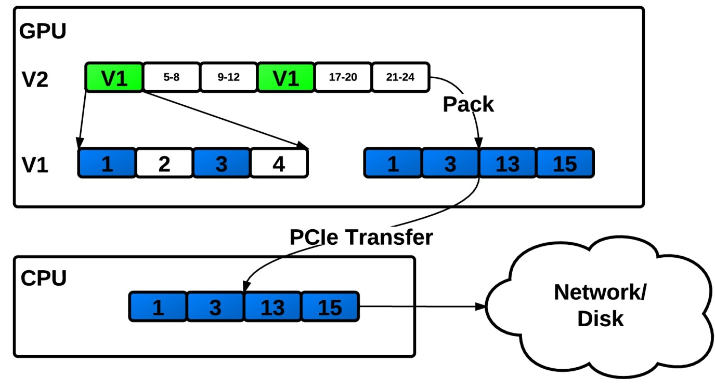
Contributions
MPI datatype processing algorithm for data in GPU memory
Generalized to any datatype
Fine-grained parallel, GPU-optimized
Investigate resource contention scenarios for packing on the GPU, for both DMA-based and kernel-based packing.

Slide 5
GPU Memory Spaces, Interconnect
SM
SM
SM
SM
shared mem.
shared mem.
shared mem.
shared mem.
L2 Cache
Global Memory (GDDR_)
PCIe Controller
NIC
RAM
CPU

Slide 6
Datatypes Example: Vector
Communication, I/O on noncontiguous data
MPI_Type_vector(count, blocklength, stride, oldtype, newtype) Parameters:
count – number of blocks
blocklength – number of contiguous oldtype per block
stride – distance between elements (wrt oldtype or bytes)
MPI_Type_vector(
4, 1, 3, v0, v1)
PCIe, network,
disk utilization
MPI_Type_vector(
3, 1, 2, DOUBLE, v0)
Pack
Extent
Size

Slide 7
GPU Datatype Processing Goals
Characteristic | CPU Processing Comparison
Fine-grain parallel | Inherently serial
No inter-thread dependencies | Stack-based packing state
Computation/transfer overlap | Same, but at network level
Compact datatype representation | Tree-based

Slide 8
Datatype Processing Algorithm
Key insight: we can determine where each element (double, int, etc.) is using only datatype encoding + number of primitive elements per datatype!
input: element (thread) ID, output: read, write offsets
read_offset = 0 write_offset = 0
load child type
read_offset += f(ID, type)
write_offset += g(ID,type)
No
How to compute f, g?
is type leaf?
End
Yes

Slide 9
Example Offset Computation - Vector
block
child
input buffer
offset_in
Same computation regardless of datatype composition!
output buffer
offset_out
child_offset = ID / type.child_elements
block_offset = child_offset / type.blocklength
offset_in += block_offset * type.stride
+ (child_offset%type.blocklength) * type.extent
offset_out += child_offset * type.size
ID = ID % type.child_elements
child need not know about parent!

Slide 10
GPU Datatypes Representation
Type | Fixed | Variable
Common | count, size, extent, #primitives
Contig
Vector | stride, blocklength
Indexed | lookaside offset | blocklengths, displacements
Struct | lookaside offset | blocklengths, displacements, types, child type IDs
Subarray | dimensions, lookaside offset | start offsets, sizes, subsizes
inorder buffer
lookaside buffer
cache in shared memory
cache if enough space

Slide 11
Datatype Processing Summary by Type
Datatype | Properties | Complexity | Notes
contiguous | “chunk” of datatypes | O(1)
vector | strided array of datatypes | O(1)
subarray | n-dimensional matrix | O(n) | compute flat array index
indexed, struct | b pairs of blocklengths, displacements | O(log(b)) | binary search

Slide 12
Benchmarking - Datatypes
Datatype | CUDA Impl. | Notes
2D-vector* | cudaMemcpy2D | Common
4D-subarray | Iterative cudaMemcpy3D | Cannot be represented by vector type
indexed* | cudaMemcpy per-block | Irregular, does not map to CUDA well
“C-style” struct | cudaMemcpy per-extent | Thread branch divergence on read/write
* aligned on CUDA-optimized byte-boundaries

Slide 13
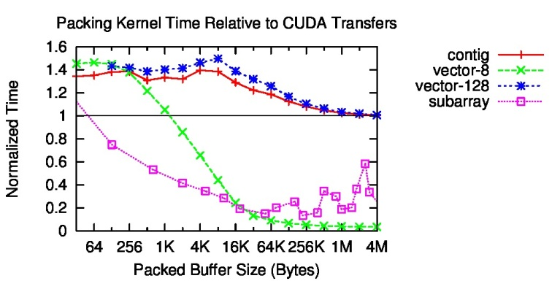
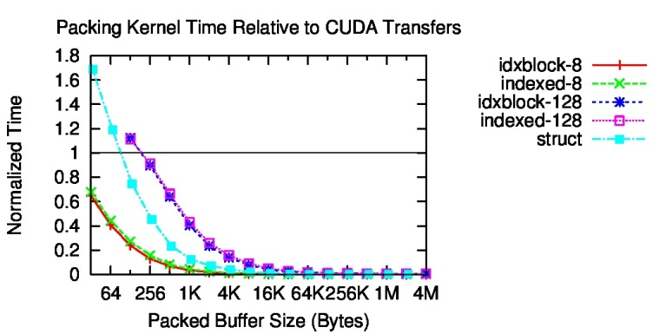
Comparison – CUDA DMA
Vector – depends on parameterization
Subarray – latency aggregated in CUDA calls
Irregular types – huge speedup (no reasonable CUDA equivalent)
Overhead – a few μs

Slide 14
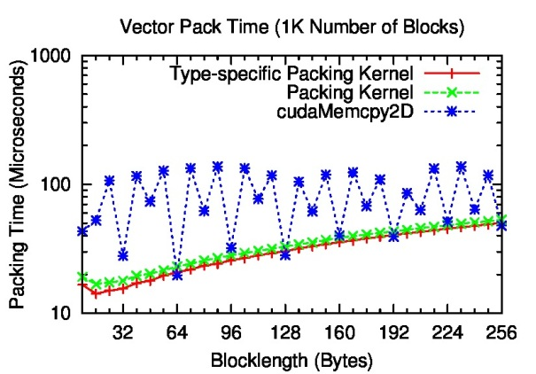
Comparison – Vector Parameterizations
CUDA performs best on multiples of 64 bytes
CUDA performs poorly otherwise
Same goes for vector stride (not shown)

Slide 15
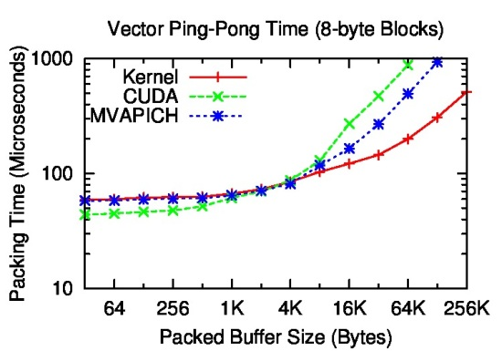
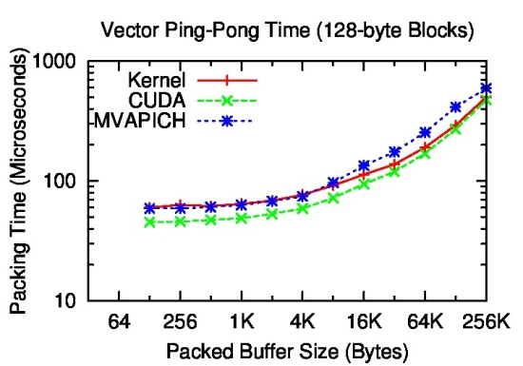
Comparison – Vector Communication (Ping Pong)
CUDA DMA best for small buffers, large blocks.
NOTE: data laid out to be CUDA-optimal
Packing kernel best for larger buffers, small blocks
MVAPICH – serialized packing, PCIe (ours fully pipelined through zero-copy)
Performance doesn’t carry over to other datatypes – tied to CUDA DMA

Slide 16
Resource Contention
Contention Point!
PCI-e (full duplex)
SMs
CPU
GPU
Contention Point???
Contention Point!

Slide 17
Resource Contention
 | SM | CPU -> GPU | GPU -> CPU
Packing kernel | Yes | Somewhat* | Yes**
CUDA | No | Somewhat* | Yes
* shouldn't happen (scheduler artifact?)
** PCIe transactions driven by SMs (zero copy) treated more favorably

Slide 18
Results Summary
Use packing for
irregular types (Order of Magnitude Speedup)
large sparse transfers (Order of Magnitude Speedup)
types which do not adhere to CUDA-optimized memory layouts
Use CUDA DMA for
small transfers,
2D, 3D arrays with large, contiguous chunks.
Use hand-coded packing kernels for small sized, simple types
Datatypes implementations can control for these cases!
Packing is complementary rather than competing

