Slide 1
Efficient Multithreaded Context ID Allocation in MPI
James Dinan, David Goodell, William Gropp, Rajeev Thakur, and Pavan Balaji

Slide 2
Multithreading and MPI Communicators
MPI_Init_thread(…, MPI_THREAD_MULTIPLE, …)
MPI-2 defined MPI+Threads semantics
One collective per comunicator at a time
Programmer must coordinate across threads
Multiple collectives concurrently on different communicators
Communicator creation:
Collective operation
Multiple can occur concurrently on different parent communicators
Requires allocation of a context id
Unique integer, uniform across processes
Matches messages to communicators

Slide 3
MPI-3: Non-Collective Communicator Creation
Communicator creation is collective only on new members, useful for:
Reduce overhead
Small communicators when parent is large
Fault tolerance
Not all ranks in parent can participate
Flexibility / Load balancing
Resource sharing barriers [IPDPS ’12], DNTMC application study
Asynchronous re-grouping in multi-level parallel computations
Implementable on top of MPI, performance is poor
Recursive intercommunicator creation/merging algorithm [IMUDI ‘12]
O(log G) create/merge steps – total O(log² G) cost
☹

Slide 4
MPI-3: MPI_COMM_CREATE_GROUP
MPI_COMM_CREATE_GROUP(comm, group, tag, newcomm)
IN comm intracommunicator (handle)
IN group group, which is a subset of the group of comm (handle)
IN tag “safe” tag (integer)
OUT newcomm new communicator (handle)
“Tagged” collective
Multiple threads can call concurrently on same parent communicator
Calls are distinguished via the tag argument
Requires efficient, thread-safe context ID allocation
 | 1 | 1 | 1
 | 1 | 1 | 1
 | 1 | 1 | 1
 | 1 | 1 | 1
 |  |  |  | 5 | 5 | 5
 |  |  |  | 5 | 5 | 5
 |  |  |  | 5 | 5 | 5

Slide 5
High-Level Context ID Allocation Algorithm
ctxid_mask[MAX_CTXID] = { 1, 1, … }
my_cid_avail = reserve( ctxid_mask )
cid_avail = Allreduce( my_cid_avail, parent_comm )
my_cid = select( cid_avail )
Rank 0, my_cid_avail
Rank 1, my_cid_avail
Allocation Result
0 | 1 | 0 | 1 | 0
&
0 | 0 | 0 | 1 | 1
->
0 | 0 | 0 | 1 | 0
Extending to support MPI_Comm_create_group
Use a “tagged,” group-collective allreduce
Tag is shifted into a tagged collectives tag space by setting a high bit
Avoids conflicts with point-to-point messages

Slide 6
Ensuring Successful Allocation
ctxid_mask[MAX_CTXID] = { 1, 1, … }
while (my_cid == 0)
my_cid_avail = reserve( ctxid_mask )
cid_avail = Allreduce( my_cid_avail, parent_comm )
my_cid = select( cid_avail )
Rank 0, my_cid_avail
Rank 1, my_cid_avail
Allocation Result
0 | 1 | 0 | 1 | 0
&
0 | 0 | 0 | 0 | 0
->
0 | 0 | 0 | 0 | 0
Deadlock avoidance:
Reserve( ) must be non-blocking, if mask is unavailable get dummy value
Avoid blocking indefinitely in Allreduce, may require multiple attempts
Livelock avoidance:
All threads in group must acquire mask to allocate – data race
MPI_CC: Prioritize based on parent communicator context id
MPI_CCG: Prioritize based on < context id, tag > pair

Slide 7
Full Context ID Allocation Algorithm (MPICH Var.)
Rank 0
Rank 1
Allocation Result
0 | 1 | 0 | 1 | 0
&
0 | 0 | 0 | 1 | 1
->
0 | 0 | 0 | 1 | 0
/* Input: my_comm, my_group, my_tag. Output: integer context ID */
/* Shared variables ( shared by threads at a each process ) */
mask[MAX_CTXID] = { 1 } /* Bit array, indicates if ctx ID is free */
mask_in_use = 0 /* Flag, indicates if mask is in use */
lowest_ctx_id = MAXINT, lowest_tag /* Indicates which thread has priority */
/* Private variables ( not shared across threads ) */
local_mask[MAX_CTXID] /* Thread private copy of the mask */
i_own_the_mask = 0 /* Flag indicating if this thread holds mask */
context_id = 0 /* Output context ID */
/* Allocation loop */
while ( context_id == 0 ) {
reserve_mask( )
MPIR_Allreduce_group ( local_mask, MPI_BAND, my_comm, my_group, my_tag )
select_ctx_id( )
}

Slide 8
Full Context ID Allocation Algorithm, reserve
reserve_mask( ) {
Mutex_lock( )
if ( have_higher_priority( ) ) {
lowest_ctx_id = my_comm->context_id
lowest_tag = my_tag
}
if ( !mask_in_use && have_priority( ) ) {
local_mask = mask, mask_in_use = 1, i_own_the_mask = 1
} else {
local_mask = 0, i_own_the_mask = 0
}
Mutex_unlock( )
}
mask[MAX_CTXID]
while (my_cid == 0)
Reserve( )
Allreduce( )
Select( )
local_mask =
0 | 1 | 0 | 1 | 0

Slide 9
Full Context ID Allocation Algorithm, Allreduce
mask[MAX_CTXID]
while (my_cid == 0)
reserve( )
Allreduce( )
select( )
Rank 0
Rank 1
0 | 1 | 0 | 1 | 0
&
0 | 0 | 0 | 1 | 1
Allocation Result
0 | 0 | 0 | 1 | 0
ctx_id = MPIR_Allreduce_group ( local_mask, MPI_BAND, my_comm,
my_group, my_tag )

Slide 10
Full Context ID Allocation Algorithm, Select
mask[MAX_CTXID]
while (my_cid == 0)
reserve( )
Allreduce( )
select( )
ctx_id = select(
0 | 0 | 0 | 1 | 0
)
select_ctx_id( ) {
if ( i_own_the_mask ) {
Mutex_lock ()
if ( local_mask != 0 ) {
context_id = location of first set bit in local_mask
mask[ context_id ] = 0
if ( have_priority( ) )
lowest_ctx_id = MAXINT
}
mask_in_use = 0
Mutex_unlock ()
}
}

Slide 11
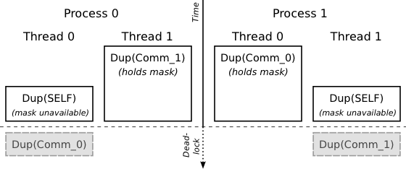
Deadlock Scenario
if( thread_id == mpi_rank ) MPI_Comm_dup( MPI_COMM_SELF, &self_dup );
MPI_Comm_dup( thread_comm, &thread_comm_dup );
Necessary and sufficient conditions
Hold: A thread acquires the mask at a particular process
Wait: Thread enters allreduce, waits for others to make matching calls
Meanwhile, matching calls can’t be made
A context ID allocation must succeed first, but mask is unavailable

Slide 12
Deadlock Avoidance
Basic idea: Prevent threads from reserving context ID until all threads are ready to perform the operation.
Simple approach, initial barrier
MPIR_Barrier_group( my_comm, my_group, my_tag )
Eliminates wait condition and breaks deadlock
Threads can’t enter Allreduce until all group members have arrived
Threads can’t update priorities until all group members have arrived
Ensures that thread groups that are ready will be able to eventually acquire highest priority and succeed
Cost: additional collective

Slide 13
Eager Context ID Allocation
Eager Mask
Base Mask
0 | 1 | 0 | 1 | 0 | 1 | 1 | 0 | 0 | 1 | 0
Basic idea: Do useful work during deadlock-avoiding synchronization.
Split context ID space into Eager and Base parts
Eager: used on first attempt (threads may hold-and wait)
Base: used on remaining attempts (threads can’t hold-and-wait)
If eager mask is not available, allocate on base mask
Allocations using base mask are deadlock free
Threads synchronize in initial eager Allreduce
All threads are present during base allocation
Eliminates wait condition

Slide 14
Eager Context ID Allocation Algorithm
ctxid_mask[MAX_CTXID] = { 1, 1, … }
my_cid_avail = reserve_no_pri( ctxid_mask[0..SPLIT-1] )
cid_avail = Allreduce( my_cid_avail, parent_comm )
my_cid = select_no_pri( cid_avail )
while (my_cid == 0)
my_cid_avail = reserve( ctxid_mask[SPLIT..] )
cid_avail = Allreduce( my_cid_avail, parent_comm )
my_cid = select( cid_avail )
No priority in eager mode
Threads holding the eager space, blocked in Allreduce don’t prevent others from entering base allocation
Deadlock is avoided (detailed proof in the paper)

Slide 15
Is OpenMPI Affected?
ctxid_mask[MAX_CTXID] = { 1, 1, … }
while (my_cid == 0)
my_cid_avail = reserve_one( ctxid_mask )
cid_avail = Allreduce( my_cid_avail, parent_comm, MPI_MAX )
success = Allreduce( cid_avil == my_cid_avail, MPI_AND )
If (success) my_cid = cid_avail
OpenMPI uses a similar algorithm
MPICH reserves full mask
OpenMPI reserves one context ID at a time
Requires a second allreduce to check for success
Hold-and-wait can still occur
When number of threads at a process approaches number of free context ids
Less likely than in MPICH
Same deadlock avoidance technique can be applied

Slide 16
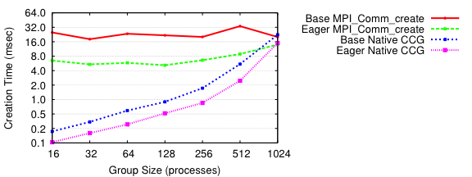
Comparison: Base vs Eager, CC vs CCG
Parent communicator is MPI_COMM_WORLD (size = 1024)
Eager improves over base by factor of two
One Allreduce, versus Barrier + Allreduce
MPI_Comm_create_group( ) versus MPI_Comm_create( )
Communication creation cost is proportional to output group size

Slide 17
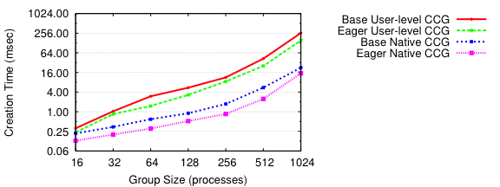
Comparison With User-Level CCG
User-level [IMUDI ‘11]: log(p) intercomm create/merge steps
Total communication cost is log²(p)
Direct: One communicator creation step
Eliminates factor of log(p)
P = 512, 1024 was more expensive that MPI_Comm_create

Slide 18
Conclusions
Extended context ID allocation to support multithreaded allocation on the same parent communicator
Support MPI-3 MPI_Comm_create_group routine
Identified subtle deadlock issue
Deadlock avoidance
Break hold-and-wait through initial synchronization
Eager context ID allocation eliminates deadlock avoidance cost in common case

Slide 19
Thanks!

