Slide 1
Leveraging MPI’s One-Sided Communication Interface for Shared-Memory Programming
Torsten Hoefler, James Dinan, Darius Buntinas, Pavan Balaji, Brian Barrett, Ron Brightwell, William Gropp, Vivek Kale, Rajeev Thakur

Slide 2
The Shared Memory Reality
Multi- and manycore is ubiquitous
They offer shared memory that allows:
Sharing of data structures
Reduce copies/effective memory consumption
NUMA accesses
Fast in-memory communication
May be faster than MPI
Performance model is very complex

Slide 3
State of the Art Programming
MPI offers shared memory optimizations
But real zero copy is impossible
MPI+X to utilize shared memory
X={OpenMP, pthreads, UPC …}
Complex interactions between models
Deadlocks possible
Race conditions made easy
Slowdown due to higher MPI thread level
Requirements are often simple
Switching programming models not necessary?

Slide 4

Why not just use OS tools?
One may use POSIX shm calls to create shared memory segments?
Several issues:
Allocation is not collective and users would have to deal with NUMA intricacies
Cleanup of shm regions is problematic in the presence of abnormal termination
MPI’s interface allows easy support for debuggers and performance tools
Notes:
- POSIX logo? Gibt’s sowas?

Slide 5

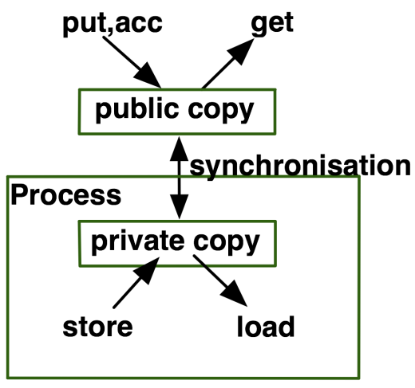
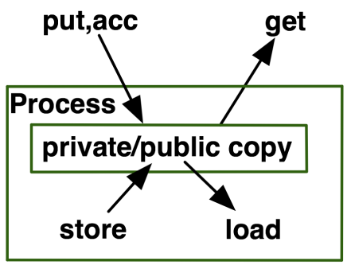
MPI-3.0 One Sided Memory Models
MPI offers two memory models:
Unified: public and private window are identical
Separate: public and private window are separate
Type is attached as attribute to window
MPI_WIN_MODEL
MPI_UNIFIED
MPI_SEPARATE

Slide 6

Creating a Shared Memory Window
MPI_WIN_ALLOCATE_SHARED(
size - in Bytes (of calling process)
disp_unit - addressing offset in Bytes
info - specify optimization hints
comm - input communicator
baseptr - returned pointer
win – returned window
)
The creation call is collective
Notes:
- Irgendwas mit “teilen” (shared)

Slide 7
How do I use it?
All processes in comm must be in shared memory
Fulfilling the unified window requirements
Each process gets a pointer to its segment
Does not know other processes’ pointer
Query function:
MPI_WIN_SHARED_QUERY(win, rank, size, disp_unit, baseptr)
Query rank’s size, disp_unit, and baseptr

Slide 8
Creating shared memory communicators
Or: “How do I know which processes share memory”?
MPI_COMM_SPLIT_TYPE(comm, split_type, key, info, newcomm)
split_type = MPI_COMM_TYPE_SHARED
Splits communicator into maximum shared memory islands
Portable

Slide 9
Schematic Overview

Slide 10
Memory Layout
“Principle of least surprise” (default)
Memory is consecutive across ranks
Allows for inter-rank address calculations
i.e., rank i’s first Byte starts right after rank i-1’s last Byte
“Optimizations allowed”
Specify info “alloc_shared_noncontig”
May create non-contiguous regions
Must use win_shared_query

Slide 11

Implementation Options I
Contiguous (default)
Reduce total size to rank 0
Rank 0 creates shared memory segment
Broadcast address and key
Exscan to get local offset
O(log P) time and O(P) total storage
Notes:
- options?

Slide 12
Implementation Options II
Noncontiguous (specify alloc_shared_noncontig)
Option 1:
Each rank creates his own segment
Option 2:
Rank 0 creates one segment but pads to page boundaries

Slide 13
Use Cases
Share data structures
Use hybrid programming where it is efficient
E.g., OpenMP at the loop level
Have MPI processes share common memory
Retain all MPI features, e.g., collective etc.
Improve communication performance
Enables direct access to “remote” data
No need for halo zones (but they often help!)
True zero copy in this sense

Slide 14
Fast shared memory Communication
Two fundamental benefits:
Avoid tag matching and MPI stack
Avoid expensive fine-grained synchronization
Full interface implemented in Open MPI and MPICH2
Similar implementation and performance
Evaluated on 2.2 GHz AMD Opteron
Six cores

Slide 15
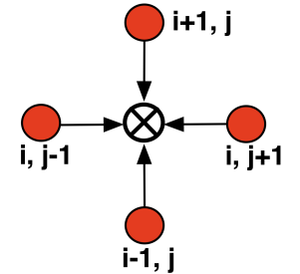
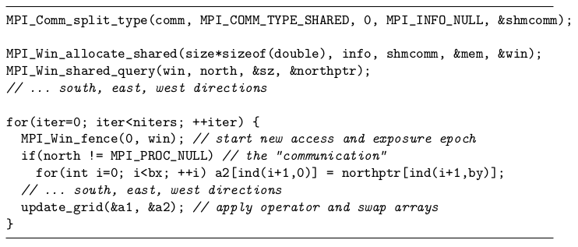
Five-Point Stencil Example
NxN grid decomposed in 2D
Dims_create, cart_create, isend/irecv, waitall

Slide 16
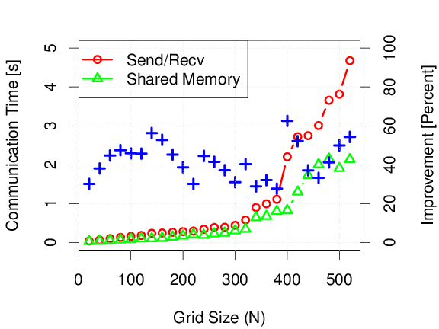
Communication Times
30-60% lower communication overhead!

Slide 17
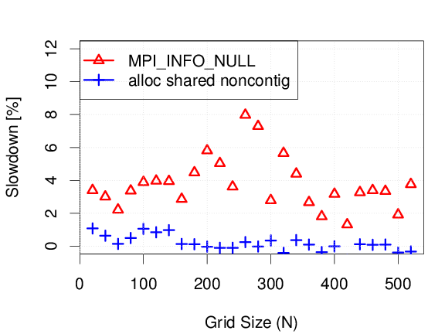
NUMA Effects?
The whole array is allocated in shared memory
Significant impact of alloc_shared_noncontig

Slide 18
Summary
MPI-3.0 offers support for shared memory
Ratified last week, standard available online
MPICH2 as well as Open MPI implement the complete interface
Should be in official releases soon
We demonstrated two use-cases
Showed application speedup for a simple code
Performance may vary (depends on architecture)

Slide 19


Conclusions & Future Work
MPI is (more) ready for multicore!
Supports coherent shared memory
Offers easy-to-use and portable interface
Mix&match with other MPI functions
We plan to evaluate
Different use-cases and applications
The Forum continues discussion
Non-coherent shared memory?
Notes:
- Conclusions etc. ☺

Slide 20





Acknowledgments
The MPI Forum
Especially the RMA working group!

