Slide 1


DMA-Assisted, Intranode Communication in GPU-Accelerated Systems
Feng Ji*, Ashwin M. Aji†, James Dinan‡, Darius Buntinas‡,
Pavan Balaji‡, Rajeev Thakur‡, Wu-chun Feng†, Xiaosong Ma*&
* Department of Computer Science, North Carolina State University
† Department of Computer Science, Virginia Tech
‡ Mathematics and Computer Science Division, Argonne National Laboratory
& Computer Science and Mathematics Division, Oak Ridge National Laboratory

Slide 2
Background: CPU-GPU Clusters
Graphics Processing Units (GPUs)
Many-core architecture for high performance and efficiency (FLOPs, FLOPs/Watt, FLOPs/$)
Prog. Models: CUDA, OpenCL, OpenACC
Explicitly managed global memory and separate address spaces
CPU clusters
Most popular parallel prog. model: Message Passing Interface (MPI)
Host memory only
Disjoint Memory Spaces!
GPU
CPU
Multiprocessor
MPI rank 0
MPI rank 1
MPI rank 2
MPI rank 3
Shared memory
Main memory
Global memory
PCIe, HT/QPI
NIC

Slide 3
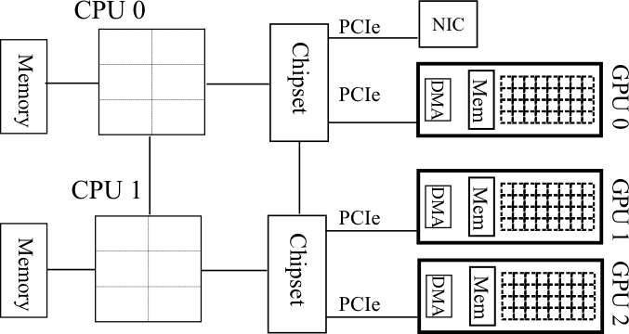
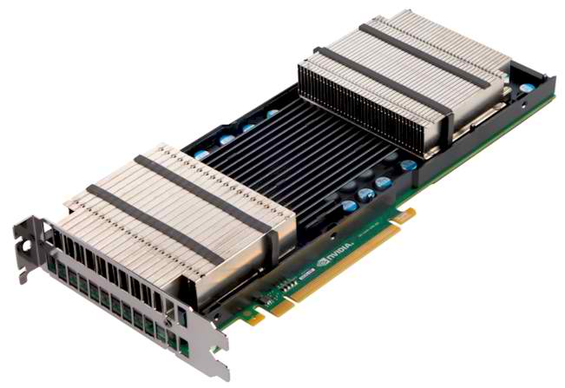
GPU-Accelerated High Performance Computing
Clusters with GPUs are becoming common
Multiple GPUs per node
Non-uniform node architecture
Node topology plays role in performance
New programmability and performance challenges for programming models and runtime systems

Slide 4
Programming CPU-GPU Clusters (e.g: MPI+CUDA)
GPU
device memory
GPU
device memory
PCIe
PCIe
CPU
main memory
CPU
main memory
HT/QPI
Rank = 0
Rank = 1
if(rank == 0)
{
cudaMemcpy(host_buf, dev_buf, D2H)
MPI_Send(host_buf, .. ..)
}
if(rank == 1)
{
MPI_Recv(host_buf, .. ..)
cudaMemcpy(dev_buf, host_buf, H2D)
}

Slide 5
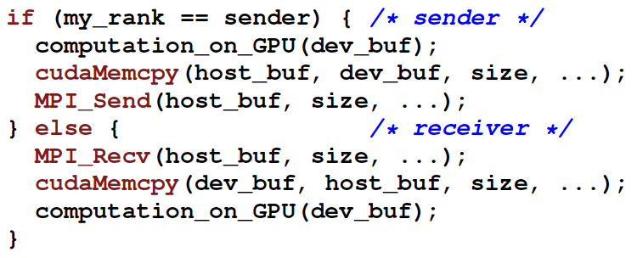
Current Limitations of Programming CPU-GPU Clusters (e.g: MPI+CUDA)
Manual blocking copy between host and GPU memory serializes PCIe, Interconnect
Manual non-blocking copy is better, but will incur protocol overheads multiple times
Programmability/Productivity: Manual data movement leading to complex code; Non-portable codes
Performance: Inefficient and non-portable performance optimizations

Slide 6
Goal of Programming CPU-GPU Clusters (e.g: MPI+Any accelerator)
GPU
device memory
GPU
device memory
PCIe
PCIe
CPU
main memory
CPU
main memory
HT/QPI
Rank = 0
Rank = 1
if(rank == 0)
{
MPI_Send(any_buf, .. ..);
}
if(rank == 1)
{
MPI_Recv(any_buf, .. ..);
}

Slide 7
MPI-ACC: A unified communication interface
MPIGPU_Send/Recv(user_buf, count, datatype, dest_rank, tag, comm, buftype);
Process 0
MPIGPU_Send(d_ptr, …, MPIGPU_BUF_GPU);
Process 1
MPIGPU_Recv(d_ptr, …, MPIGPU_BUF_GPU);
buftype flag
To tell MPI whether to use PCIe data copy or memcpy

Slide 8
MPI-ACC: Integrated and Optimized Data Movement
MPI-ACC: integrates accelerator awareness with MPI for all data movement
Programmability/Productivity: supports multiple accelerators and prog. models (CUDA, OpenCL)
Performance: allows applications to portably leverage system-specific and vendor-specific optimizations
GPU
GPU
GPU
GPU
…
…
…
…
…
CPU
CPU
Network
Notes:
Have a picture to explain the work….

Slide 9
MPI-ACC: Integrated and Optimized Data Movement
MPI-ACC: integrates accelerator awareness with MPI for all data movement
“MPI-ACC: An Integrated and Extensible Approach to Data Movement in Accelerator-Based Systems” [HPCC ‘12]
Intranode Optimizations
“DMA-Assisted, Intranode Communication in GPU-Accelerated Systems”, Feng Ji, Ashwin M. Aji, James Dinan, Darius Buntinas, Pavan Balaji, Rajeev Thakur, Wu-chun Feng and Xiaosong Ma [This paper]
“Efficient Intranode Communication in GPU-Accelerated Systems”, Feng Ji, Ashwin M. Aji, James Dinan, Darius Buntinas, Pavan Balaji, Wu-Chun Feng and Xiaosong Ma. [AsHES ‘12]
Noncontiguous Datatypes
“Enabling Fast, Noncontiguous GPU Data Movement in Hybrid MPI+GPU Environments”, John Jenkins, James Dinan, Pavan Balaji, Nagiza F. Samatova, and Rajeev Thakur. Under review at IEEE Cluster 2012.
Notes:
Have a picture to explain the work….

Slide 10
Intranode Optimizations: shared memory protocol [ASHES ’12]
Directly connect PCIe data copies into MPI internal shared memory
Transparently doing chunking and pipelining
Process 0
MPIGPU_Send(d_ptr, …, MPIGPU_BUF_GPU);
Process 1
MPIGPU_Recv(d_ptr, …, MPIGPU_BUF_GPU);
Process 0
Process 1
GPU Global Mem
Shared Mem
Host Main Mem

Slide 11
GPUDirect + CUDAIPC
GPUDirect: DMA-driven peer GPU copy
CUDAIPC: exporting a GPU buffer to a different process
Process 0
cudaIpcGetMemHandle(&handle, d_ptr);
Process 1
cudaIpcOpenMemHandl(&d_ptr_src, handle);
cudaMemcpy(d_ptr, d_ptr_src, …);
Direct copy
Device Mem
Main Mem
Handle

Slide 12
DMA-assisted Intranode GPU data transfer
Motivation
Eliminate going through MPI host-side shared memory
Reduce the complexity of doing the same thing in the application level
Need NOT re-invent synchronization mechanism
Process 0
cudaIpcGetMemHandle(&handle, d_ptr);
MPI_Send(handle, …);
MPI_Recv(Msg_done, …);
Process 1
MPI_Recv(handle, …);
cudaIpcOpenMemHandl(&d_ptr_src, handle);
cudaMemcpy(d_ptr, d_ptr_src, …);
MPI_Send(Msg_done, …);
Notes:
Note:
May still transparently goes through a host-side buffer in the GPU driver is GPUDirect is not supported.

Slide 13
DMA-assisted Intranode GPU data transfer
Challenges
GPUDirect requires GPU peer accessibility
Same IO/Hub: Yes
Different IO/Hub: Yes for AMD (HT); No for Intel (QPI)
Overhead of handle open/close
MPI is unaware of GPU device topology
GPU 0
GPU 0
GPU 1
GPU 2
GPU 1
Intel (with QPI)
AMD (with HT)
Notes:
Note:
May still transparently goes through a host-side buffer in the GPU driver is GPUDirect is not supported.

Slide 14
Extend Large Message Transport (LMT) protocol
LMT Protocol supports PUT/GET/COOP modes
Handles carried in packets/cookies
Sender passes GPU info (with handle) to Receiver
Sender always tries to get the handle
Getting a handle is a light-weight op. (according to NVIDIA)
Receiver can decide GPU peer accessibility
Receiver passes the decision in CTS to Sender
Fall back option: via shared memory [AsHES ‘12]
PUT mode
Sender
Receiver
Get Src handle
RTS
Decide accessibility
CTS
Get Dest handle
Open Dest handle
PUT
Done
Notes:
Note to Ashwin:
The text on this papge is general for PUT/GET/COOP.

Slide 15
Extend Large Message Transport (LMT) protocol
GET Mode
COOP Mode
Sender
Receiver
Sender
Receiver
Get Src handle
Get Src handle
RTS
RTS
Decide accessibility
Decide accessibility
Open Src handle
CTS
Open Src handle
Get Dest handle
CTS
Open Dest handle
GET
PUT/GET/COOP
Done
Done
Done

Slide 16
IPC Open/Close overhead
Getting a handle is light-weight operation
Open and close operations on the handle are NOT
Do not close a handle when a pair of MPI_Send/Recv is done
Many MPI program reuse buffers (including GPU buffers)
Lazy close option to avoid overhead
Cache opened handles & their addresses locally
Next time: try to find the handle in the local cache
If found, no need to reopen it, but use its address

Slide 17
Evaluation
Systems | Keeneland (@GaTech) | Magellan (@Argonne)
CPU | Intel | AMD
NUMA Nodes | 2 | 4
Interconnect | Intel QPI | AMD HT
GPUs | 3 | 2
GPU Topology | GPU 0: N0; GPU 1,2: N1 | GPU 0: N0; GPU 1: N3
GPU Peer accessibility | Only GPU 1 ~ 2 | Yes
Distance | same I/O Hub (Near) | 2 PCIe + 1 HT (Far)
GPU 0
GPU 0
GPU 1
GPU 2
GPU 1
Notes:
Note to Ashwin:
To emphasize the “Near” & “Far” terms after introduced the “Distance” row.
Small black boxes represent IO hub. On the right.
On Magellan IO hub are omitted. Since for each IO hub, only one CPU and one GPU device is connected – but physically they are there still.

Slide 18
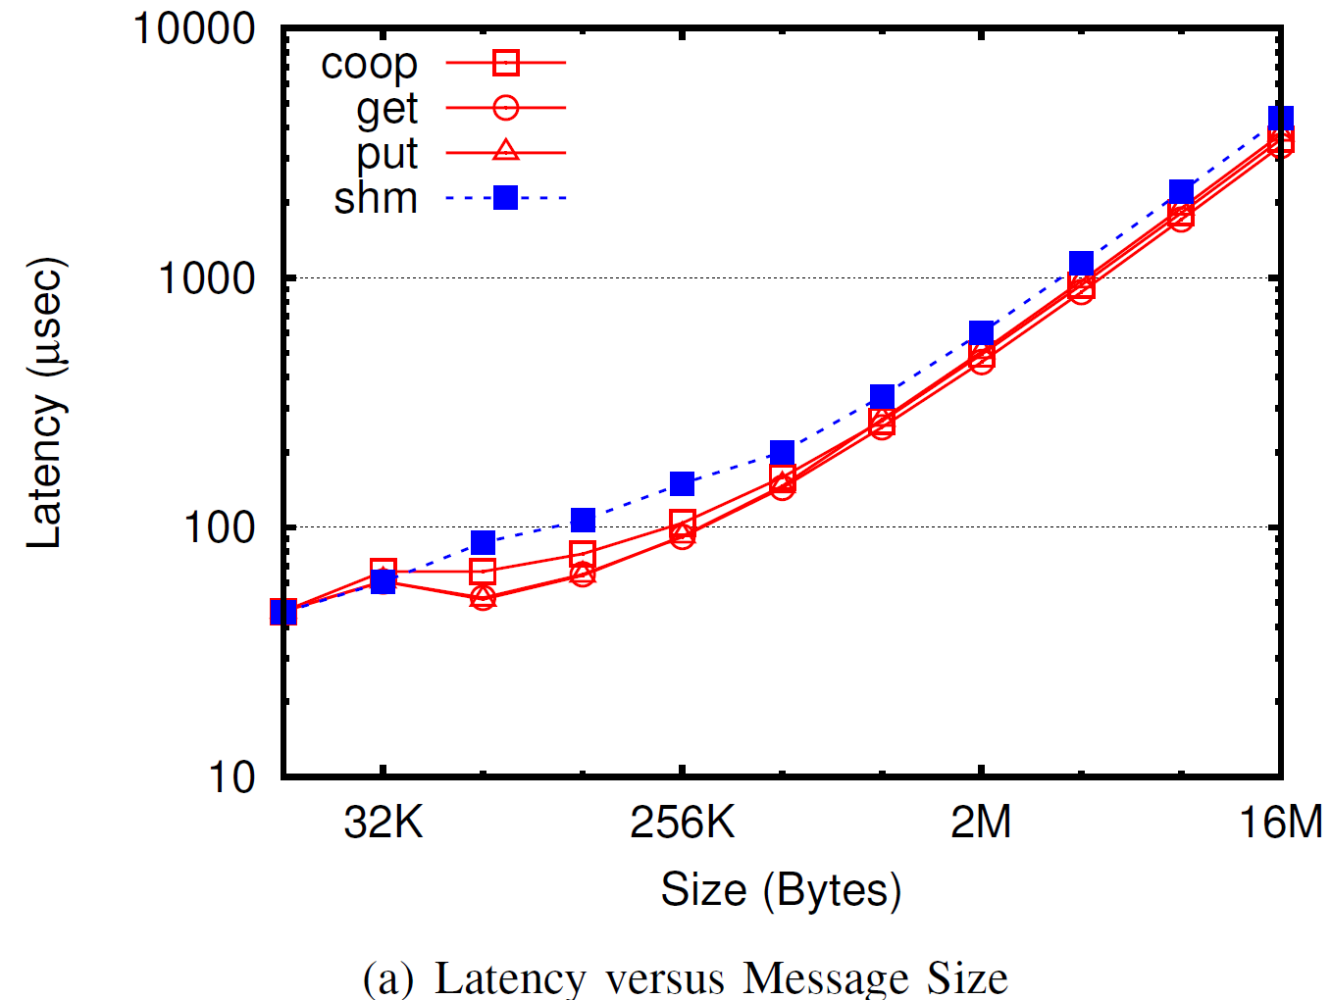
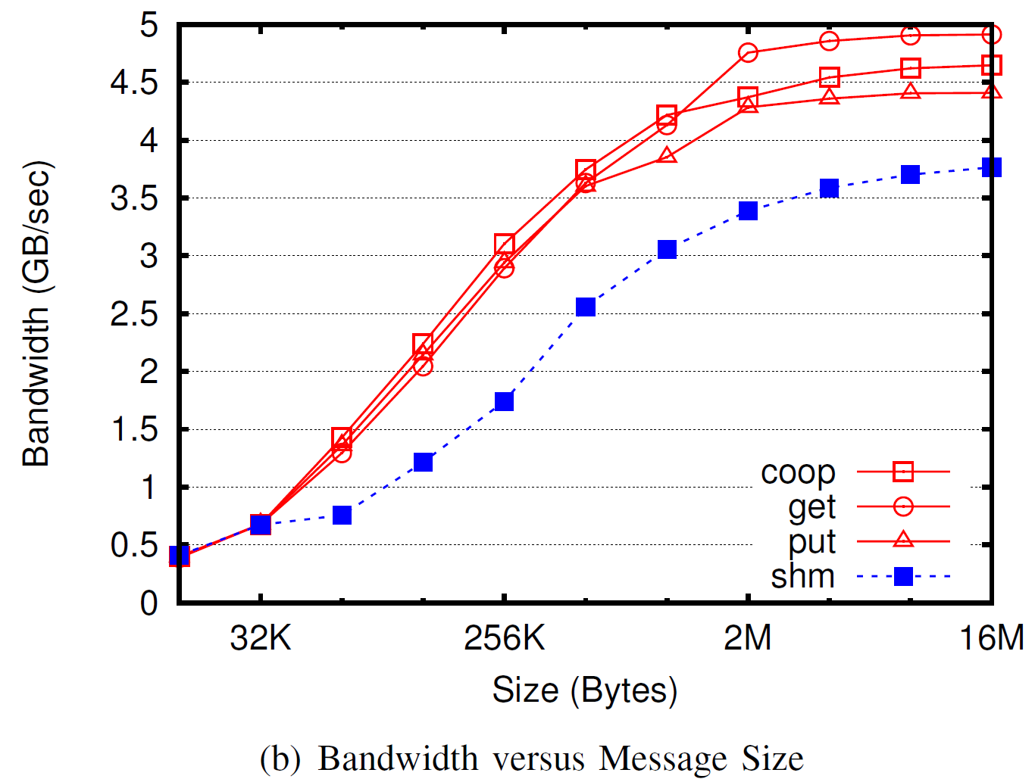
Near case: Intel @ Keeneland
GPU 0
Bandwidth nearly reaches the peak bandwidth of the system
GPU 1
GPU 2

Slide 19
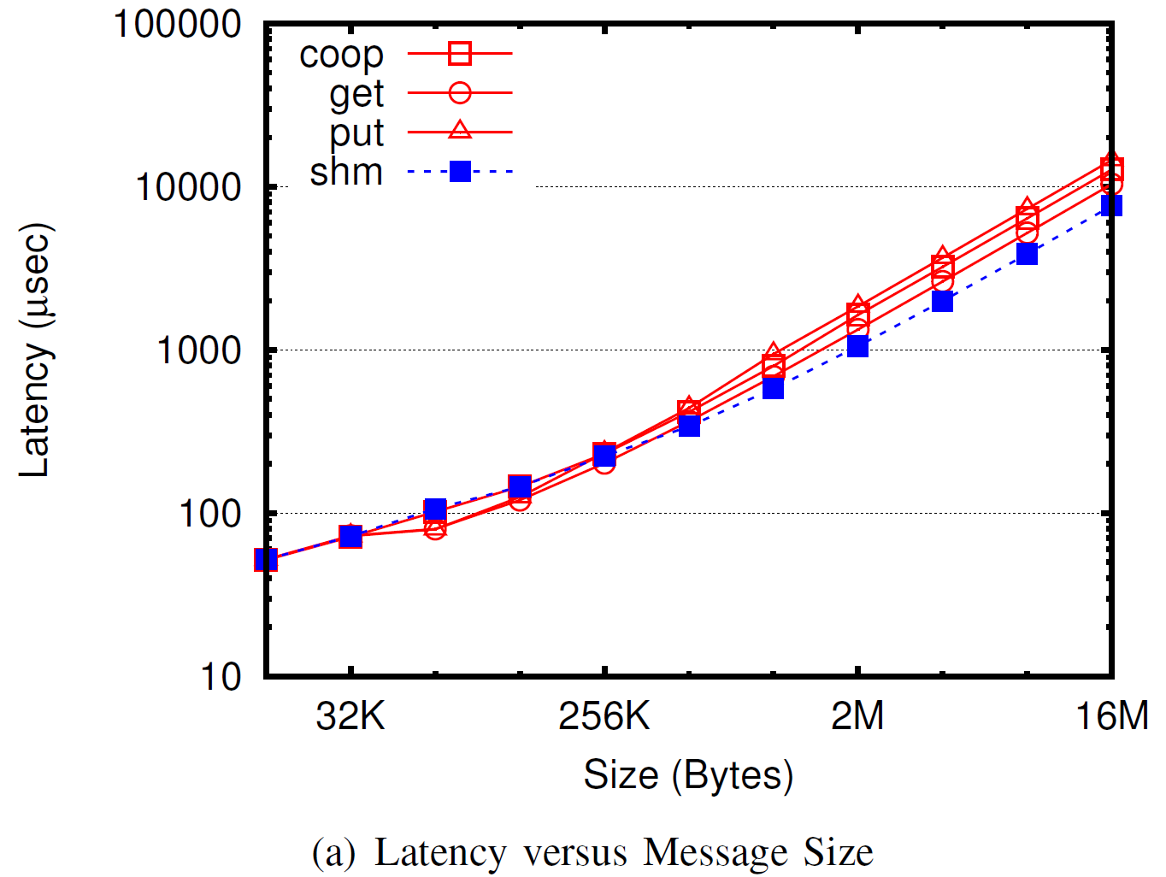
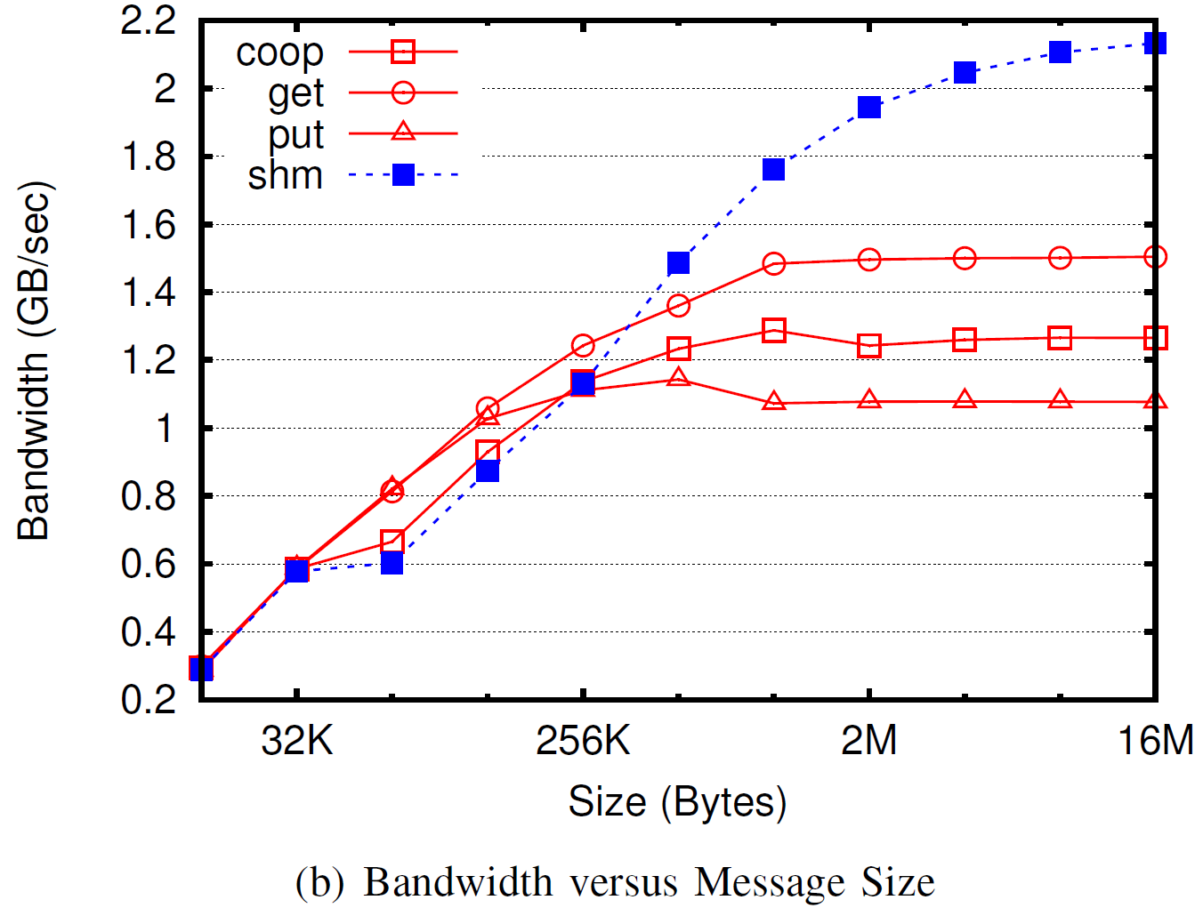
Far case: AMD @ Magellan
GPU 0
Better to adopt shared memory approach
GPU 1

Slide 20
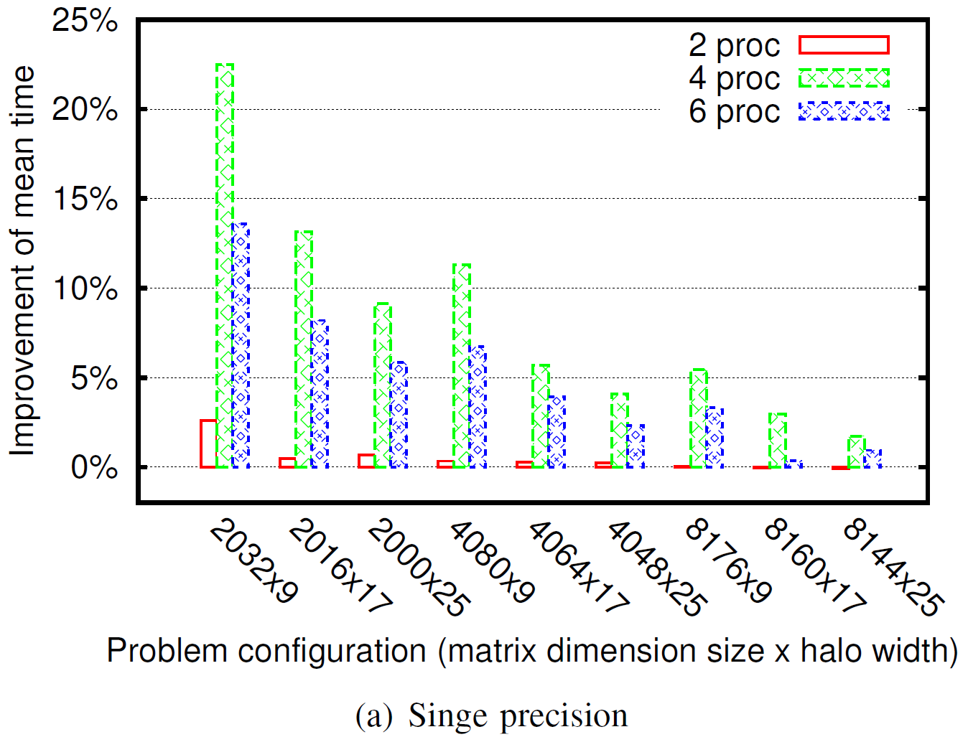
Stencil2D (SHOC) on Intel @ Keeneland
Compared against using previous shared memory based approach
Avg 4.7% improvement (single precision) & 2.3% (double precision)
Computation increases O(n²) with problem size, thus communication reduces
Notes:
1. amount of computation increases quadratically with problem
size, thus effectively reducing the fraction of time spent on
Communication
2. increase the halo widths within each matrix dimension:
reduces the total communication time

Slide 21
Conclusion
Accelerators are getting ubiquitous
Exciting new opportunities for systems researchers
Requires evolution of HPC software stack & more openness of GPU system stack
Integrated accelerator-awareness with MPI
Supported multiple accelerators and programming models
Goals are productivity and performance
Optimized Intranode communication
Utilized GPU DMA engine
Eliminated going through MPI main memory buffer
Questions?
Contact
Feng Ji (fji@ncsu.edu)
Ashwin Aji (aaji@cs.vt.edu)
Pavan Balaji (balaji@mcs.anl.gov)

Slide 22
Back up
Starts …

Slide 23
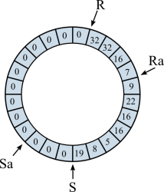
Far case: explanation
DMA
DMA
GPU 0
GPU 0
Mem
DMA
DMA
GPU 1
GPU 1
Notes:
Factors:
1. DMA utilizes only one DMA: less parallelism on the data path.
2. Data goes on the diagonal HT link, which has smaller bandwidth compared to other cases.
On the right, the HT links on the data path depends on the numa node place of the ring buffer.

