Slide 1



MPI-ACC: An Integrated and Extensible Approach to Data Movement in Accelerator-Based Systems
Presented by: Ashwin M. Aji
PhD Candidate, Virginia Tech, USA
Ashwin M. Aji, Wu-chun Feng | …….. | Virginia Tech, USA
James Dinan, Darius Buntinas, Pavan Balaji, Rajeev Thakur | …….. | Argonne National Lab., USA
Keith R. Bisset | …….. | Virginia Bioinformatics Inst., USA
synergy.cs.vt.edu

Slide 2
Summary of the Talk
We discuss the current limitations of data movement in accelerator-based systems (e.g: CPU-GPU clusters)
Programmability/Productivity limitations
Performance limitations
We introduce MPI-ACC, our solution towards mitigating these limitations on a variety of platforms including CUDA and OpenCL
We evaluate MPI-ACC on benchmarks and a large scale epidemiology application
Improvement in end-to-end data transfer performance between accelerators
Enabling the application developer to do new data-related optimizations

Slide 3

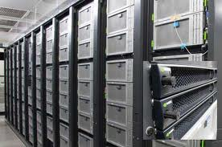
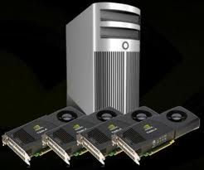
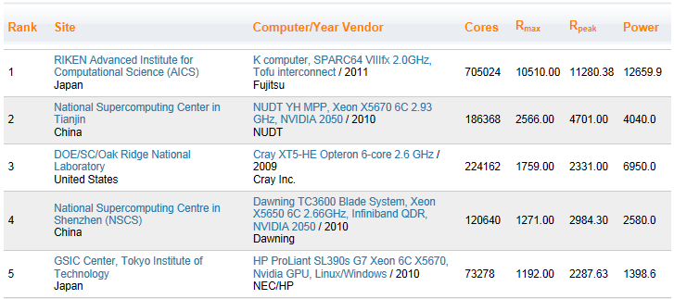
Accelerator-Based Supercomputers (Nov 2011)

Slide 4
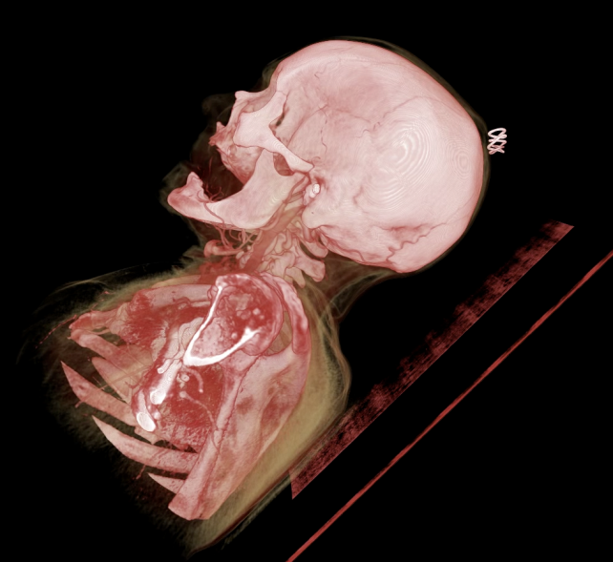
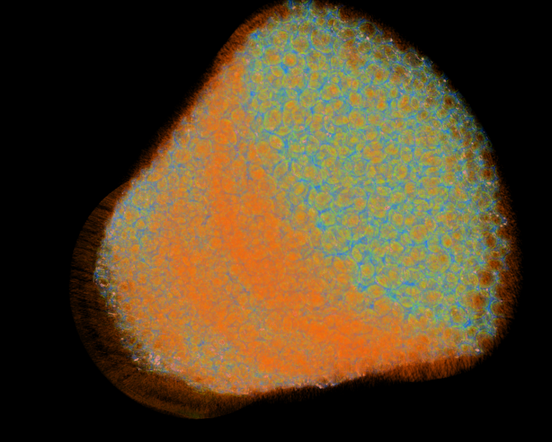
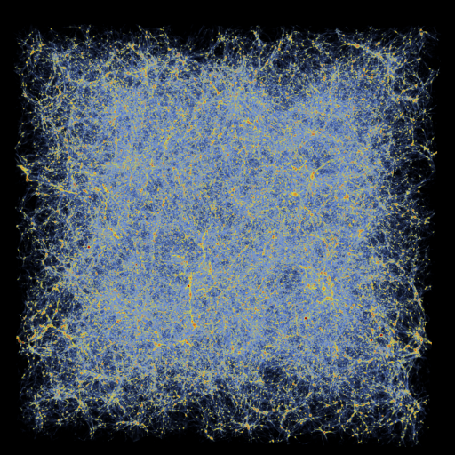
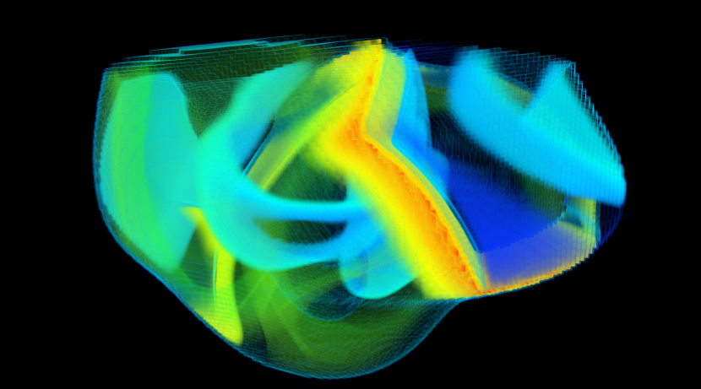
Accelerating Science via Graphics Processing Units (GPUs)
Courtesy: Argonne National Lab
Computed Tomography
Micro-tomography
Cosmology
Bioengineering
Notes:
Bioengineering - ALCF INCITE
Irregular heartbeats are one of the leading causes of death around the world. The treatment and prevention of cardiac rhythm disorders is extremely challenging as the electrical signal that control the heart's rhythm is controlled by a complex, multi-scale biological simulation. Jeff Fox (@ Cornell) is conducting large-scale simulations to model this.
Micottomography
This is experimental data from the Advanced Photon Source(APS) at ANL. THe data was generated by MSD researchers interested in understanding the internal structure of a foam material. This consisted of a stack of 2D slices and a total of 20GB of data.
Cosmology - INCITE
This simulation follows the growth of density perturbations in both gas and dark matter components in a volume 1 billion light years on a side beginning shortly after the Big Bang and evolved to half the present age of the universe. The animation illustrates the expansion of the universe over time, and highlights how individual structures (such as galaxy clusters) collapse due to gravity, while simultaneously being pushed further and further from each other.

Slide 5
Background: CPU-GPU Clusters
Graphics Processing Units (GPUs)
Many-core architecture for high performance and efficiency (FLOPs, FLOPs/Watt, FLOPs/$)
Prog. Models: CUDA, OpenCL, OpenACC
Explicitly managed global memory and separate address spaces
CPU clusters
Most popular parallel prog. model: Message Passing Interface (MPI)
Host memory only
Disjoint Memory Spaces!
GPU
CPU
Multiprocessor
MPI rank 0
MPI rank 1
MPI rank 2
MPI rank 3
Shared memory
Main memory
Global memory
PCIe
NIC

Slide 6
Programming CPU-GPU Clusters (e.g: MPI+CUDA)
GPU
device memory
GPU
device memory
PCIe
PCIe
CPU
main memory
Network
CPU
main memory
Rank = 0
Rank = 1
if(rank == 0)
{
cudaMemcpy(host_buf, dev_buf, D2H)
MPI_Send(host_buf, .. ..)
}
if(rank == 1)
{
MPI_Recv(host_buf, .. ..)
cudaMemcpy(dev_buf, host_buf, H2D)
}

Slide 7
Goal of Programming CPU-GPU Clusters (e.g: MPI+Any accelerator)
GPU
device memory
GPU
device memory
PCIe
PCIe
CPU
main memory
Network
CPU
main memory
Rank = 0
Rank = 1
if(rank == 0)
{
MPI_Send(any_buf, .. ..);
}
if(rank == 1)
{
MPI_Recv(any_buf, .. ..);
}

Slide 8
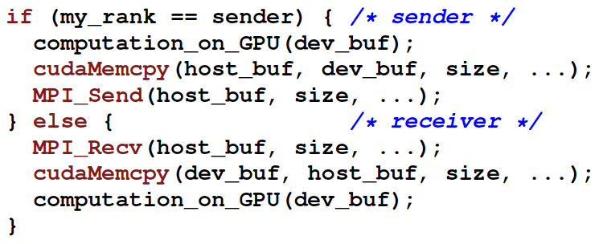
Current Limitations of Programming CPU-GPU Clusters (e.g: MPI+CUDA)
Manual blocking copy between host and GPU memory serializes PCIe, Interconnect
Manual non-blocking copy is better, but will incur protocol overheads multiple times
Programmability/Productivity: Manual data movement leading to complex code; Non-portable codes
Performance: Inefficient and non-portable performance optimizations

Slide 9
MPI-ACC: Integrated and Optimized Data Movement
MPI-ACC: integrates accelerator awareness with MPI for all data movement
Programmability/Productivity: supports multiple accelerators and prog. models (CUDA, OpenCL)
Performance: allows applications to portably leverage system-specific and vendor-specific optimizations
GPU
GPU
GPU
GPU
…
…
…
…
…
CPU
CPU
Network
Notes:
Have a picture to explain the work….

Slide 10
MPI-ACC: Integrated and Optimized Data Movement
MPI-ACC: integrates accelerator awareness with MPI for all data movement
“MPI-ACC: An Integrated and Extensible Approach to Data Movement in Accelerator-Based Systems” [This paper]
Intra-node Optimizations
“DMA-Assisted, Intranode Communication in GPU-Accelerated Systems”, Feng Ji, Ashwin M. Aji, James Dinan, Darius Buntinas, Pavan Balaji, Rajeev Thakur, Wu-chun Feng and Xiaosong Ma [HPCC ‘12]
“Efficient Intranode Communication in GPU-Accelerated Systems”, Feng Ji, Ashwin M. Aji, James Dinan, Darius Buntinas, Pavan Balaji, Wu-Chun Feng and Xiaosong Ma. [AsHES ‘12]
Noncontiguous Datatypes
“Enabling Fast, Noncontiguous GPU Data Movement in Hybrid MPI+GPU Environments”, John Jenkins, James Dinan, Pavan Balaji, Nagiza F. Samatova, and Rajeev Thakur. Under review at IEEE Cluster 2012.
Notes:
Have a picture to explain the work….

Slide 11
MPI-ACC Application Programming Interface (API)
How to pass the GPU buffers to MPI-ACC?
Explicit Interfaces – e.g. MPI_CUDA_Send(…), MPI_OpenCL_Recv, etc
MPI Datatypes attributes
Can extend inbuilt datatypes: MPI_INT, MPI_CHAR, etc.
Can create new datatypes: E.g. MPI_Send(buf, new_datatype, …);
Compatible with MPI and many accelerator models
Attributes
BUFTYPE=OCL
MPI Datatype
CL_Context
CL_Mem
CL_Device_ID
CL_Cmd_queue

Slide 12
Optimizations within MPI-ACC
Pipelining to fully utilize PCIe and network links [Generic]
Dynamic choice of pipeline parameters based on NUMA and PCIe affinities [Architecture-specific]
Handle caching (OpenCL): Avoid expensive command queue creation [System/Vendor-specific]
Case study of an epidemiology simulation: Optimize data marshaling in faster GPU memory
Application-specific Optimizations using MPI-ACC

Slide 13
Pipelined GPU-GPU Data Transfer (Send)
GPU Buffer
Host Buffer instantiated during MPI_Init and destroyed during MPI_Finalize
OpenCL buffers handled differently from CUDA
Classic n-buffering technique
Intercepted the MPI progress engine
GPU (Device)
Host side
Buffer pool
CPU (Host)
29% better than manual blocking
14.6% better than manual non-blocking
Without Pipelining
With Pipelining
CPU (Host)
Network
Time
Notes:
Choice of pipeline packet size is determined dynamically

Slide 14
Explicit MPI+CUDA Communication in an Epidemiology Simulation
PE₁
PE₂
PE₃
PE_{i-3}
PE_{i-2}
PE_{i-1}
………..
Asynchronous MPI calls
Network
PE_{i} (Host CPU)
Packing data
in CPU (H-H)
Copying packed data to GPU (H-D)
GPU_{i} (Device)

Slide 15
Communication with MPI-ACC
PE₁
PE₂
PE₃
PE_{i-3}
PE_{i-2}
PE_{i-1}
………..
Asynchronous MPI-ACC calls
Network
Pipelined data transfers to GPU
PE_{i} (Host CPU)
Packing data
in GPU (D-D)
GPU_{i} (Device)

Slide 16
MPI-ACC Comparison
Network
(Pipelining)
PE_{i} (Host CPU)
PE_{i} (Host CPU)
(H-H)
(D-D)
(H-D)
GPU_{i} (Device)
GPU_{i} (Device)
 | MPI+CUDA | MPI-ACC
D-D Copy (Packing) |  | Yes
GPU Receive Buffer Init |  | Yes
H-D Copy (Transfer) | Yes
H-H Copy (Packing) | Yes
CPU Receive Buffer Init | Yes
Data packing and initialization moved from
CPU’s main memory to the GPU’s device memory

Slide 17
Experimental Platform
Hardware: 4-node GPU cluster
CPU: dual oct-core AMD Opteron (Magny-Cours) per node
32GB memory
GPU: NVIDIA Tesla C2050
3GB global memory
Software:
CUDA v4.0 (driver v285.05.23)
OpenCL v1.1

Slide 18
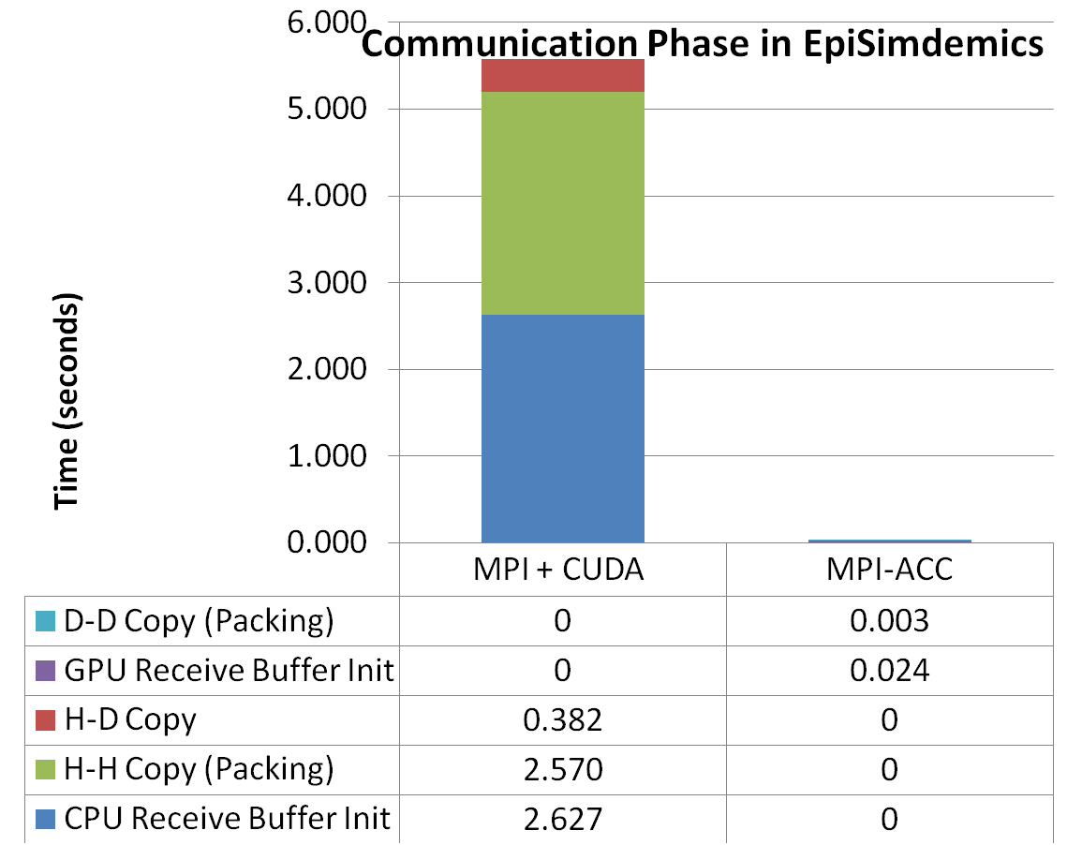
Evaluating the Epidemiology Simulation with MPI-ACC
GPU has two orders of magnitude faster memory
MPI-ACC enables new application-level optimizations

Slide 19
Conclusions
Accelerators are becoming mainstream in HPC
Exciting new opportunities for systems researchers
Requires evolution of HPC software stack
MPI-ACC: Integrated accelerator-awareness with MPI
Supported multiple accelerators and programming models
Achieved productivity and performance improvements
Optimized Internode communication
Pipelined data movement, NUMA and PCIe affinity aware and OpenCL specific optimizations
Optimized an epidemiology simulation using MPI-ACC
Enabled new optimizations that were impossible without MPI-ACC
Questions?
Contact
Ashwin Aji (aaji@cs.vt.edu)
Pavan Balaji (balaji@mcs.anl.gov)

Slide 20
Backup Slides

Slide 21
MPI-ACC Application Programming Interface (API)
How to pass the GPU buffers to MPI-ACC?
Explicit Interfaces – e.g. MPI_CUDA_Send(…), MPI_OpenCL_Recv, etc
MPI Datatypes attributes
Retain the existing MPI interface itself
Automatic Detection of device buffers via CUDA’s Unified Virtual Addressing (UVA)
Currently supported only by CUDA and newer NVIDIA GPUs
Query cost is high and added to every operation (even CPU-CPU)
MPI-ACC Interface Cost (CPU-CPU)

Slide 22
Results: Impact of Pipelined Data Transfers
29% better than manual blocking
14.6% better than manual non-blocking

Slide 23
MPI-ACC: Integrated and Optimized Data Movement
MPI-ACC: integrates accelerator awareness with MPI for all data movement
Programmability/Productivity: supports multiple accelerators and prog. models (CUDA, OpenCL)
Performance: allows applications to portably leverage system-specific and vendor-specific optimizations
Intra-node data movement optimizations [in collaboration with NCSU, ANL, VT]
Shared memory protocol [Ji AsHES’12]
Direct DMA protocol [Ji HPCC’12]
GPU
GPU
GPU
GPU
…
…
…
…
…
CPU
CPU
Network
Notes:
Have a picture to explain the work….

Slide 24
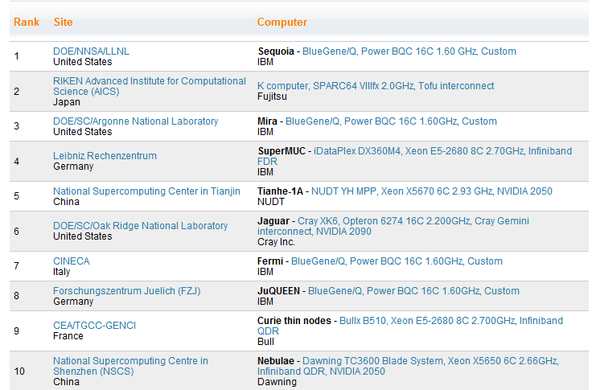
Accelerator-Based Supercomputers (June 2012)

Slide 25
Accelerator-Based Supercomputers
Accelerator Vendors/Models
NVIDIA 2050/2070/2090
IBM PowerXCell 8i
AMD/ATI GPU
Clearspeed CSX600
Intel MIC

Slide 26
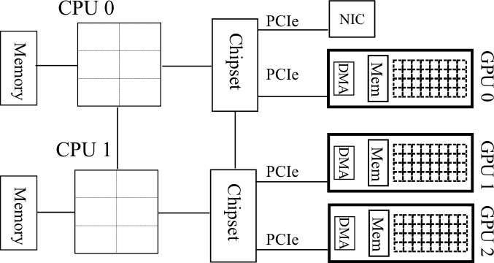
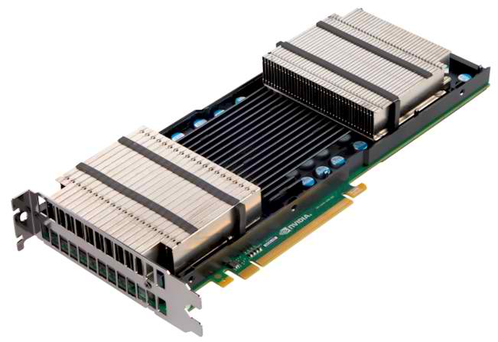
Background: CPU-GPU Clusters
CPU-GPU clusters
Prog. Models: MPI+CUDA, MPI+OpenCL, and so on…
Multiple GPUs per node
Non-uniform node architecture and topology
New programmability and performance challenges for programming models and runtime systems
Keeneland Node Architecture

