Slide 1
VOCL: An Optimized Environment for Transparent Virtualization of Graphics Processing Units
Shucai Xiao¹, Pavan Balaji², Qian Zhu³,
Rajeev Thakur², Susan Coghlan², Heshan Lin¹,
Gaojin Wen⁴, Jue Hong⁴, and Wu-chun Feng¹
1. Virginia Tech
2. Argonne National Laboratory
3. Accenture Technology Labs
4. Chinese Academy of Sciences

Slide 2


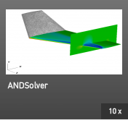
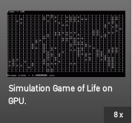


Motivation
GPUs are widely used as accelerators for scientific computation
Many applications are parallelized on GPUs
Speedup is reported compared to execution on CPUs

Slide 3

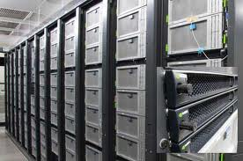
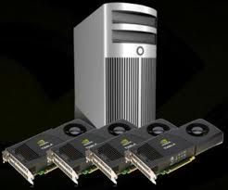
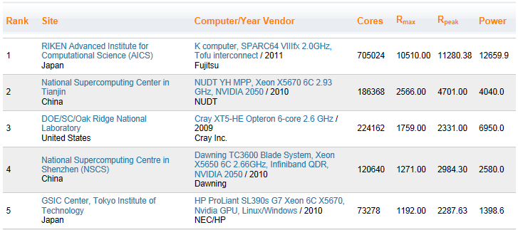
GPU-Based Supercomputers

Slide 4
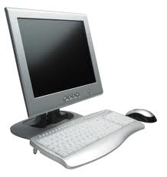
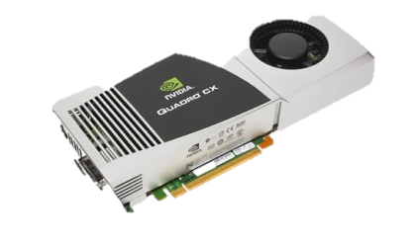
Challenges of GPU Computing
Provisioning Limitations
Not all computing nodes are configured with GPUs
Budget and power consumption consideration
Multiple stages of investment
Programmability
Current GPU programming models: CUDA and OpenCL
CUDA and OpenCL only support the utilization of local GPUs
4

Slide 5
Our Contributions
Virtual OpenCL (VOCL) framework for transparent virtualization of GPUs
Remote GPUs look like “virtual” local GPUs
A program can use non-local GPUs
A program can use more GPUs than that can be installed locally
Efficient resource management
Optimization of data transfer across different machines
MPI
MPI
VOCL
OpenCL
OpenCL
OpenCL

Slide 6
Outline
Motivation and Contributions
Related Work
VOCL Framework
VOCL Optimization
Experimental Results
Conclusion & Future work

Slide 7
Existing Frameworks for GPU Virtualization
rCUDA
Good performance
Relative performance overhead is about 2% compared to the execution on a local GPU (GeForce 9800)
Lack of support for CUDA C extensions
__kernel<<<….>>>()
Partial support for asynchronous data transfer
MOSIX-VCL
Transparent virtualization
Large overhead even for local GPUs
Average overhead: local GPU 25.95%; remote GPU 317.42%
No support for asynchronous data transfer
7

Slide 8
Outline
Motivation and Contributions
Related Work
VOCL Framework
VOCL Optimization
Experimental Results
Conclusion & Future work

Slide 9
Virtual OpenCL (VOCL) Framework Components
VOCL library and proxy process
Local node
Remote node
Application
Proxy
Proxy
MPI
OpenCL API
VOCL Library
Native OpenCL Library
GPU
GPU
9

Slide 10
VOCL Library
Located on each local node
Implements OpenCL functionality
Application Programming Interface (API) compatibility
API functions in VOCL have the same interface as that in OpenCL
VOCL is transparent to application programs
Application Binary Interface (ABI) compatibility
No recompilation is needed;
Needs relinking for static libraries
Uses an environment variable to preload the library for dynamic libraries
Deals with both local and remote GPUs in a system
Local GPUs: Calls native OpenCL functions
Remote GPUs: Uses MPI API functions to send function calls to remote nodes
10

Slide 11
VOCL Abstraction: GPUs on Multiple Nodes
OpenCL object handle value
Same node, each OpenCL object has a unique handle value
Different nodes, different OpenCL objects could share the same handle value
VOCL abstraction
VOCL object
Application
VOCL object
OCLH1 != OCLH2
VOCLH1
OCLH1
VOCLH3
OCLH3
struct voclObj {
voclHandle vocl;
oclHandle ocl;
MPI_Comm com;
int nodeIndex;
}
Each OpenCL object is translated to a VOCL object with a different handle value
VOCLH2
OCLH2 == OCLH3
OCLH2
VOCL Library
OCLH1
OCLH2
OCLH3
Native OpenCL Library
Native OpenCL Library
GPU
GPU
11

Slide 12
VOCL Proxy
Daemon process: Initialized by the administrator
Located on each remote node
Receives data communication requests (a separate thread)
Receives input data from and send output data to the application process
Calls native OpenCL functions for GPU computation
Remote node 1
Local node
Remote node 2
Proxy
App
Proxy
MPI
MPI
Native OpenCL Library
VOCL Library
Native OpenCL Library
GPU
GPU
GPU
GPU
12

Slide 13
Outline
Motivation and Contributions
Related Work
VOCL Framework
VOCL Optimization
Experimental Results
Conclusion & Future work

Slide 14
Overhead in VOCL
Local GPUs
Translation between OpenCL and VOCL handles
Overhead is negligible
Remote GPUs
Translation between VOCL and OpenCL handles
Data communication between different machines
VOCL
host
GPU
VOCL
OpenCL
OpenCL
OpencL
GPU
Local node
Remote node
14

Slide 15
Data Transfer: Between Host Memory and Device Memory
Pipelining approach
Single block, each stage is transferred after another
Multiple blocks, transfer of first stage of one block can be overlapped by the second stage of another block
Pre-allocate buffer pool for data storage in the proxy
Local node
Remote node
1
CPU and memory
CPU and memory
2
3
3
4
1
4
2
3
GPU and memory
Buffer pool
15

Slide 16
Environment for Program Execution
Node Configuration
Local Node
2 Magny-Cours AMD CPUs
64 GB Memory
Remote Node
Host: 2 Magny-Cours AMD CPUs (64GB memory)
2 Tesla M2070 GPUs (6GB global memory each)
CUDA 3.2 (OpenCL 1.1 specification)
Network Connection – QDR InfiniBand
Local node
Remote node
CPU2
CPU3
App
CPU0
CPU1
Proxy
PCIe
PCIe
PCIe
InfiniBand
GPU0
GPU1
InfiniBand

Slide 17
Micro-benchmark Results
Continuously transfer a window of data blocks one after another
Call the clFinish() function to wait for completion
CPU2
App
Proxy
for (i = 0; i < N; i++) {
clEnqueueWriteBuffer()
}
clFinish()
CPU3
CPU0
CPU1
PCIe
PCIe
InfiniBand
GPU0
GPU1
InfiniBand
Bandwidth increases from 50% to
80% of that of the local GPU
17
GPU memory write bandwidth

Slide 18
Kernel Argument Setting
Local node
Remote node
Overhead of kernel execution for aligning one pair of sequences (6K letters) with Smith-Waterman
clSetKernelArg()
__kernel foo(int a, __global int *b) {}
int a; cl_mem b;
b = clCreateBuffer(…,…);
clSetKernelArg(hFoo, 0, sizeof(int), &a);
clSetKernelArg(hFoo, 1, sizeof(cl_mem), &b)
clEnqueueNDRangeKernel(…,hFoo,…);
clSetKernelArg()
clSetKernelArg()
clEnqueueND-
RangeKernel()
Function Name | Runtime Local GPU | Runtime Remote GPU | Overhead | Number of Calls
clSetKernelArg | 4.33 | 420.45 | 416.02 | 86,028
clEnqueueNDRangeKernel | 1210.85 | 1316.92 | 106.07 | 12,288
Total time | 1215.18 | 1737.37 | 522.19
(Unit: ms)
42.97%
18

Slide 19
Kernel Argument Setting Caching
Local node
Remote node
Overhead of functions related to kernel execution for aligning the same pair of sequence
clSetKernelArg()
clSetKernelArg()
Store arguments locally
clSetKernelArg()
clEnqueueND-
RangeKernel()
Function Name | Runtime Local GPU | Runtime Remote GPU | Overhead | Number of Calls
clSetKernelArg | 4.33 | 4.03 | -0.30 | 86,028
clEnqueueNDRangeKernel | 1210.85 | 1344.01 | 133.71 | 12,288
Total time | 1215.18 | 1348.04 | 132.71
(Unit: ms)
10.92%
19

Slide 20
Outline
Motivation and Contributions
Related Work
VOCL Framework
VOCL Optimization
Experimental Results
Conclusion & Future work

Slide 21


Evaluation via Application Kernels
Three application kernels
Matrix multiplication
Matrix transpose
Smith-Waterman
Program execution time
Relative overhead
Relationship to time percentage of kernel execution
App
Proxy
CPU0
CPU1
PCIe
PCIe
InfiniBand
GPU
InfiniBand
21

Slide 22
Matrix Multiplication
Multiple problem instances are issued consecutively
for (i = 0; i < N; i++) {
clEnqueueWriteBuffer();
clEnqueueNDRangeKernel();
clEnqueueReadBuffer();
}
clFinish();
Time percentage of kernel execution
App
Proxy
CPU0
CPU1
PCIe
PCIe
InfiniBand
GPU
InfiniBand
Kernel execution time and performance overhead
22

Slide 23
Matrix Transpose
Multiple problem instances are issued consecutively
for (i = 0; i < N; i++) {
clEnqueueWriteBuffer();
clEnqueueNDRangeKernel();
clEnqueueReadBuffer();
}
clFinish();
Time percentage of kernel execution
Kernel execution time and performance overhead
23

Slide 24
Smith-Waterman
for (i = 0; i < N; i++) {
clEnqueueWriteBuffer();
for (j = 0; j < M; j++) {
clEnqueueNDRangeKernel();
}
clEnqueueReadBuffer();
}
clFinish();
Time percentage of kernel execution
Two Observations
SW needs a lot of kernel launches and large number of small messages are transferred
MPI in the proxy is initialized to support multiple threads, which supports the transfer of small messages poorly
24
Kernel execution time and performance overhead

Slide 25
Outline
Motivation and Contributions
Related Work
VOCL Framework
VOCL Optimization
Experimental Results
Conclusion & Future work

Slide 26
Conclusions
Virtual OpenCL Framework
Based on the OpenCL programming model
Internally use MPI for data communication
VOCL Framework Optimization
Kernel arguments caching
GPU memory write and read pipelining
Application Kernel Verification
SGEMM, n-body, Matrix transpose, and Smith-Waterman
Reasonable virtualization cost
26

Slide 27
Future Work
Extensions to the VOCL Framework
Live task migration (already done)
Super-GPU
Performance model for GPU utilization
Resource management strategies
Energy-efficient computing
27

Slide 28
For More Information
Shucai Xiao
Email -- shucai@vt.edu
Synergy
Website -- http://synergy.cs.vt.edu/
Thanks
Question?
28

