Slide 1
Supporting the Global Arrays PGAS Model Using MPI One-Sided Communication
James Dinan, Pavan Balaji, Jeff Hammond, Sriram Krishnamoorthy, and Vinod Tipparaju
Presented by: James Dinan
James Wallace Gives Postdoctoral Fellow
Argonne National Laboratory

Slide 2
Global Arrays, a Global-View Data Model
Proc₀ Proc₁ Proc_{n}
X[M][M][N]
Shared
Global address space
X[1..9]
[1..9][1..9]
Private
X
Distributed, shared multidimensional arrays
Aggregate memory of multiple nodes into global data space
Programmer controls data distribution, can exploit locality
One-sided data access: Get/Put({i, j, k}…{i’, j’, k’})
NWChem data management: Large coeff. tables (100GB+)
Notes:
Explain one-sided operations:
- Can’t operate in-place on data in the global address space
- One-sided get to copy into local address space
- Compute
- One-sided put to copy result back into global address space

Slide 3
ARMCI: The Aggregate Remote Memory Copy Interface
GA runtime system
Manages shared memory
Provides portability
Native implementation
One-sided communication
Get, put, accumulate, …
Load/store on local data
Noncontiguous operations
Mutexes, atomics, collectives, processor groups, …
Location consistent data access
I see my operations in issue order
GA_Put({x,y},{x’,y’})
ARMCI_PutS(rank, addr, …)
0
1
2
3

Slide 4


Implementing ARMCI
Native
ARMCI-MPI
ARMCI Support
Natively implemented
Sparse vendor support
Implementations lag systems
MPI is ubiquitous
Support one-sided for 15 years
Goal: Use MPI RMA to implement ARMCI
Portable one-sided communication for NWChem users
MPI-2: drive implementation performance, one-sided tools
MPI-3: motivate features
Interoperability: Increase resources available to application
ARMCI/MPI share progress, buffer pinning, network and host resources
Challenge: Mismatch between MPI-RMA and ARMCI

Slide 5
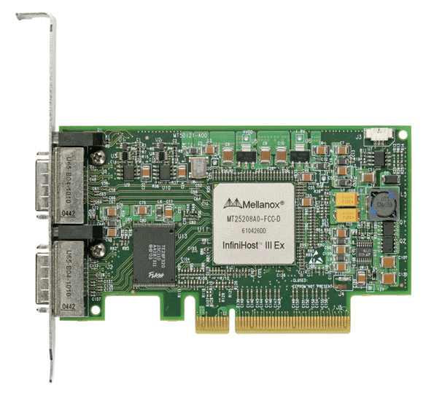
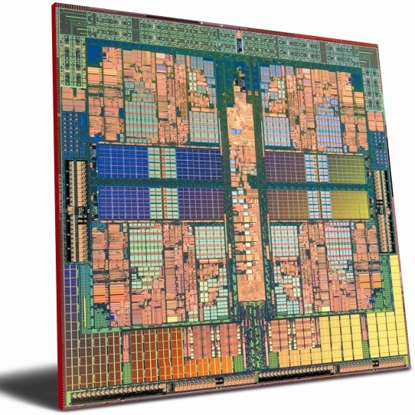
MPI Remote Memory Access Interface
Rank 0
Active and Passive target Modes
Active: target participates
Passive: target does not participate
Window: Expose memory for RMA
Logical public and private copies
Conservative data consistency model
Accesses must occur within an epoch
Lock(window, rank) … Unlock(window, rank)
Access mode can be exclusive or shared
Operations are not ordered within an epoch
Rank 1
Lock
Put(X)
Get(Y)
Public
Copy
Unlock
Completion
Private
Copy

Slide 6
MPI-2 RMA “Separate” Memory Model Concurrent, conflicting accesses are erroneous
Same source
Same epoch
Diff. Sources
Public
Copy
X
X
X
X
Private
Copy
load
store
Conservative, but extremely portable
Compatible with non-coherent memory systems

Slide 7
ARMCI/MPI-RMA Mismatch
Shared data segment representation
MPI: <window, displacement>, window rank
ARMCI: <address>, absolute rank
Perform translation
Data consistency model
ARMCI: Relaxed, location consistent for RMA, CCA undefined
MPI: Explicit (lock and unlock), CCA error
Explicitly maintain consistency, avoid CCA

Slide 8
Translation: Global Memory Regions
Absolute Process Id
Translate between ARMCI and MPI shared data segment representations
ARMCI: Array of base pointers
MPI: Window object
Translate between MPI and ARMCI ranks
MPI: Window/comm rank
ARMCI: Absolute rank
Preserve MPI window semantics
Manage access epochs
Protect shared buffers
Metadata | 0 | 1 | … | N
0 | 0x6b7 | 0x7af |  | 0x0c1
1 | 0x9d9 | 0x0 |  | 0x0
2 | 0x611 | 0x38b |  | 0x659
3 | 0xa63 | 0x3f8 |  | 0x0
Allocation Metadata
MPI_Win window;
int size[nproc];
ARMCI_Group grp;
ARMCI_Mutex rmw;
…

Slide 9
GMR: Shared Segment Allocation
Absolute Process Id
base[nproc] = ARMCI_Malloc(size, group)
All ranks can pass different size
Size = 0 yields base[me] = NULL
base[me] must be valid on node
Solution: Allgather base pointers
ARMCI_Free(ptr)
Need to find allocation and group
Local process may pass NULL
Solution: Allreduce to select leader
Leader broadcasts their base pointer
All can lookup the allocation
Metadata | 0 | 1 | … | N
0 | 0x6b7 | 0x7af |  | 0x0c1
1 | 0x9d9 | 0x0 |  | 0x0
2 | 0x611 | 0x38b |  | 0x659
3 | 0xa63 | 0x3f8 |  | 0x0

Slide 10
GMR: Preserving MPI local access semantics
Absolute Process Id
ARMCI_Put( src = 0x9e0, dst = 0x39b,
size = 8 bytes, rank = 1 );
Problem: Local buffer is also shared
Can’t access without epoch
Can we lock it?
Same window: not allowed
Diff window: can deadlock
Solution: Copy to private buffer
src_copy = Lock; memcpy; Unlock
xrank = GMR_Translate(comm, rank)
Lock(win, xrank)
Put(src_cpy, dst, size, xrank)
Unlock(win, xrank)
Metadata | 0 | 1 | … | N
0 | 0x6b7 | 0x7af |  | 0x0c1
1 | 0x9d9 | 0x0 |  | 0x0
2 | 0x611 | 0x38b |  | 0x659
3 | 0xa63 | 0x3f8 |  | 0x0
Allocation Metadata
window = win;
Size = { 1024, …};
Grp = comm;
…

Slide 11
ARMCI Noncontiguous Operations: I/O Vector
Generalized noncontiguous transfer with uniform segment size:
typedef struct {
void **src_ptr_array; // Source addresses
void **dst_ptr_array; // Dest. Addresses
int bytes; // Length of all seg.
int ptr_array_len; // Number of segments
} armci_giov_t;
Three methods to support in MPI
Conservative (one epoch): Lock, Put/Get/Acc, Unlock, …
Batched (multiple epochs): Lock, Put/Get/Acc, …, Unlock
Direct: Generate MPI indexed datatype for source and destination
Single operation/epoch: Lock, Put/Get/Acc, Unlock
Handoff processing to MPI
ARMCI_GetV(…)

Slide 12
ARMCI Noncontiguous Operations: Strided
ARMCI Strided Specification
Transfer a section of an N-d array into an N-d buffer
Transfer options:
Translate into an IOV
Generate datatypes
MPI Subarray datatype:
dim = sl+1
Dims[0] = count[0]
Dims[1..dim-2] = stride[i]/Dims[i-1]
Dims[dim-1] = Count[dim-1]
Index = { 0, 0, 0 }
Sub_dims = Count
src | Source pointer
dst | Destination pointer
sl | Number of stride levels (dim-1)
Count[sl+1] | Number of units in each dim.
src_stride[sl] | Source stride array
dst_stride[sl] | Destination stride array

Slide 13
Avoiding concurrent, conflicting accesses
Contiguous operations
Don’t know what other nodes do
Wrap each call in an exclusive epoch
Noncontiguous operations
I/O Vector segments may overlap
MPI Error!
Must detect errors and fall back to conservative mode if needed
Generate a conflict tree
Sorted, self-balancing AVL tree
Search the tree for a match
If (match found): Conflict!
Else: Insert into the tree
Merge search/insert steps into a single traversal
0x917 – 0xb10
0x917 – 0xb10
0x3f0 – 0x517
0x1a6 – 0x200
0x8bb – 0xa02
0x518 – 0x812
0xf37 – 0xf47

Slide 14
Additional ARMCI Operations
Collectives: MPI user-defined collectives
Mutexes
MPI-2 RMA doesn’t provide any atomic RMW operations
Read, modify, write is forbidden within an epoch
Mutex implementation: Latham, Ross, & Thakur [IJHPCA ‘07]
Does not poll over the network, space scales as O(P)
Atomic swap, fetch-and-add:
Atomic w.r.t. other atomics
Attach an RMW mutex to each GMR
Mutex_lock, get, modify, put, Mutex_unlock
Slow, best we can do in MPI-2
Non-blocking operations are blocking
Noncollective processor groups [EuroMPI ’11]

Slide 15
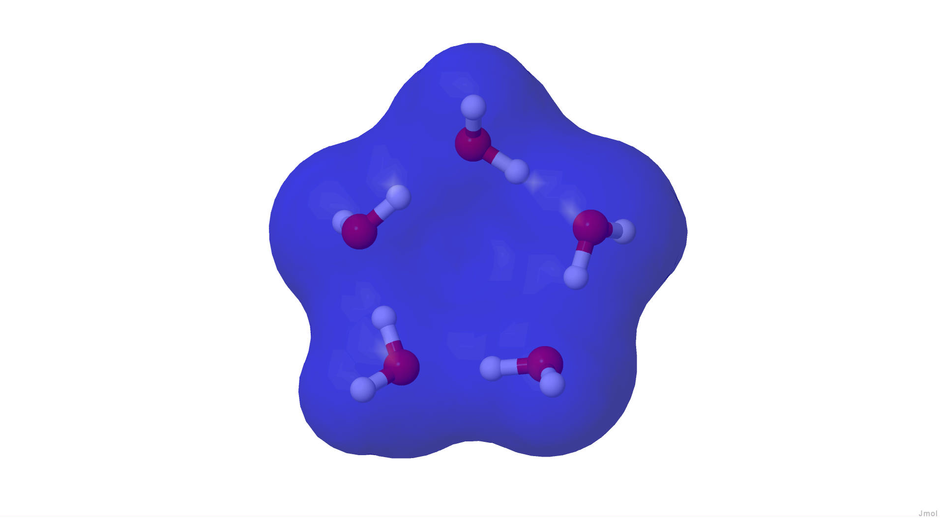
Experimental Setup
System | Nodes | Cores | Memory | Interconnect | MPI
IBM BG/P (Intrepid) | 40,960 | 1 x 4 | 2 GB | 3D Torus | IBM MPI
IB (Fusion) | 320 | 2 x 4 | 36 GB | IB QDR | MVAPICH2 1.6
Cray XT5 (Jaguar) | 18,688 | 2 x 6 | 16 GB | Seastar 2+ | Cray MPI
Cray XE6 (Hopper) | 6,392 | 2 x 12 | 32 GB | Gemini | Cray MPI
Communicaton Benchmarks
Contiguous bandwidth
Noncontiguous Bandwidth
NWChem performance evaluation
CCSD(T) calculation on water pentamer
IB, XT5: Native much better than ARMCI-MPI (needs tuning)

Slide 16
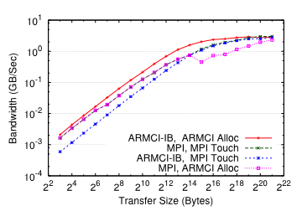
Impact of Interoperability
IB Cluster: ARMCI and MPI Get Bandwidth
ARMCI: lose performance with MPI buffer, unregistered path
MPI: lose performance with ARMCI buffer, on-demand reg.

Slide 17
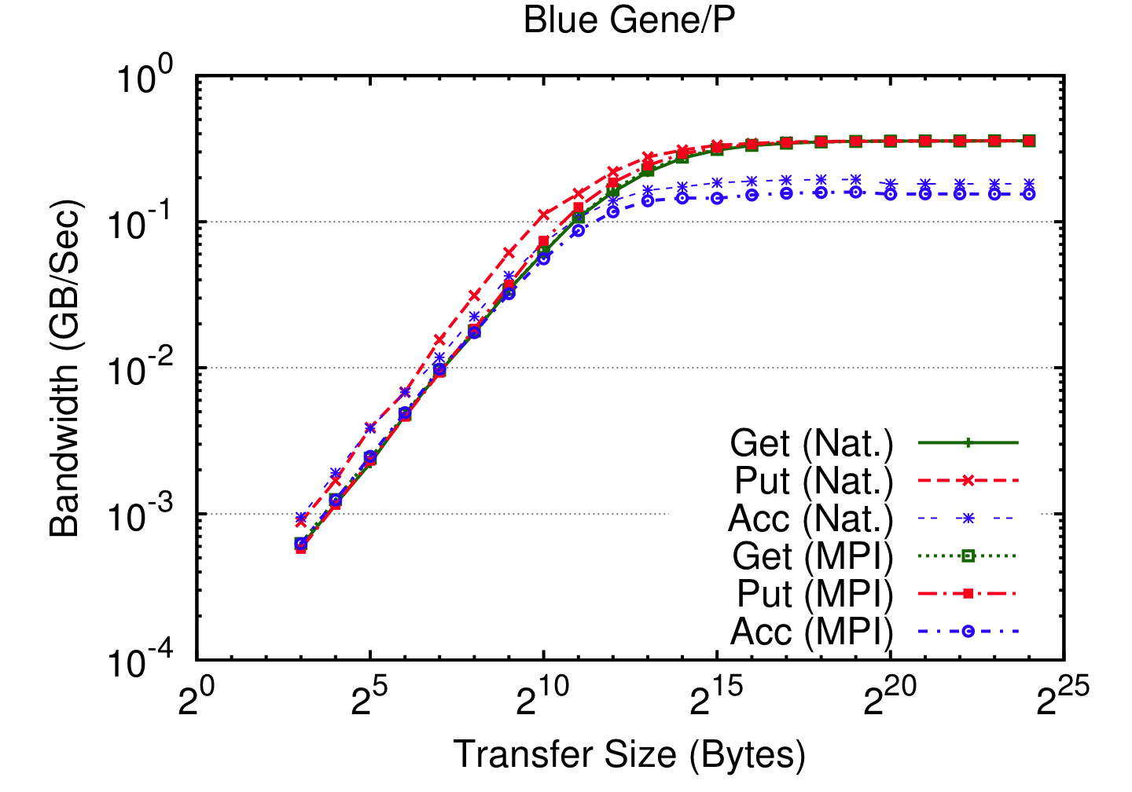
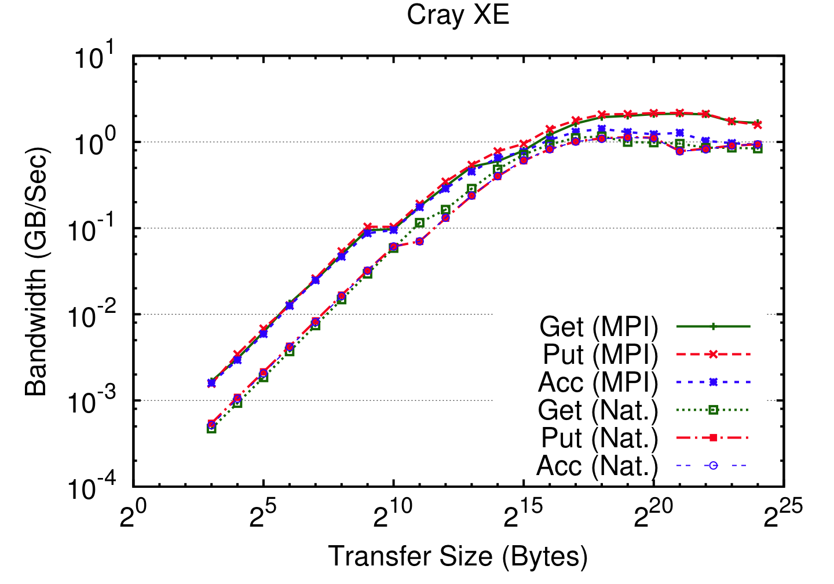
Contiguous Communication Bandwidth (BG/P & XE6)
BG/P: Native is better for small to medium size messages
Bandwidth regime: get/put are same and acc is ~15% less BW
XE: ARMCI-MPI is 2x better for get/put
Double precision accumulate, 2x better small, same large xfers

Slide 18
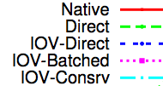
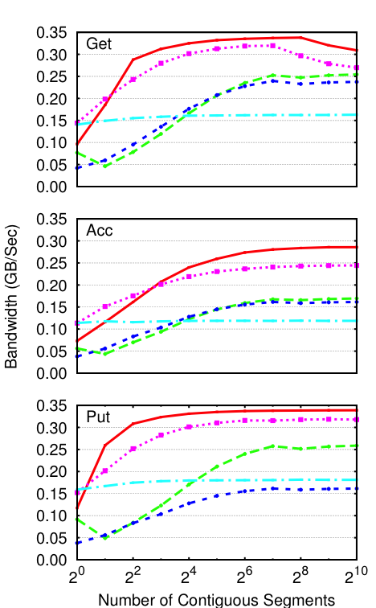
Strided Communication Bandwidth (BG/P)
Segment size 1 kB
Batched is best
Other methods always pack
Packing in host CPU slower than injecting into network
MPI implementation should select this automatically
Performance is close to native
Notes:
Small chunks:
Batched up to 8 segments, then direct
Large (1kB) chunks:
Batched is better
Why?
Direct and dtype generate MPI datatypes
MPI does pack/unpack
Processors are slow
Pack/unpack only helps for many small chunks
Tuning needed!

Slide 19
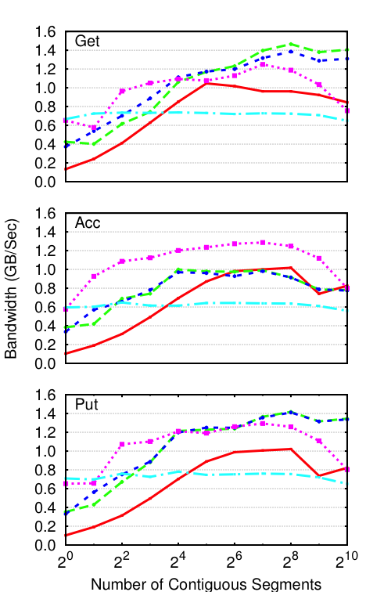
Strided Communication Benchmark (XE6)
Segment size 1 kB
Batched is best for Acc
Not clear for others
Significant performance advantage over current native implementation
Under active development
Notes:
Small chunks:
Batched up to 8-16 segments, then direct
Large (1kB) chunks:
Acc: Batched
Get/Put: Direct
Get/Put performance is better in MPI
Acc performance is similar for large number of segments

Slide 20
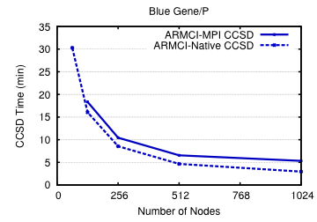
NWChem Performance (BG/P)

Slide 21
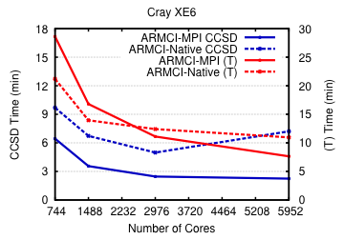
NWChem Performance (XE6)

Slide 22
Looking Forward to MPI-3 RMA
“Unified” memory model
Take advantage of coherent hardware
Relaxed synchronization will yield better performance
Conflicting accesses
Localized to locations accessed
Relaxed to undefined
Load/store does not “corrupt”
Atomic CAS, and Fetch-and-Add, and new accumulate operations
Mutex space overhead MPI-3: O(1)
Request-based non-blocking ops
Shared memory (IPC) windows
Public
Copy
Private
Copy
Unified
Copy

Slide 23
Conclusions
ARMCI-MPI Provides:
Complete, portable runtime system for GA and NWChem
MPI-2 performance driver
MPI-3 feature driver
Mechanisms to overcome interface and semantic mismatch
Performance is pretty good, dependent on impl. tuning
Production use on BG/P and BG/Q
MPI-2 won’t match native because of separate memory model
MPI-3 designed to close the memory model gap
Available for download with MPICH2
Integration with ARMCI/GA in progress
Contact: Jim Dinan <dinan@mcs.anl.gov>

Slide 24
Additional Slides

Slide 25
Mutex Lock Algorithm
Mutex is a byte vector on rank p: V[nproc] = { 0 }
Mutex_lock:
MPI_Win_lock(mutex_win, p, EXCL)
Put(V[me], 1)
Get(V[0..me-1, me+1..nproc-1])
MPI_Win_unlock(mutex_win, p, EXCL)
If (V[0..me-1, me+1..nproc-1] == 0)
Return SUCCESS
Else
I am enqueued for the mutex
Recv(NOTIFICATION)
Remote:
0
0
0
0
0
0
0
0
0
0
0
Local:
1
1

Slide 26
Mutex Unlock Algorithm
Mutex is a byte vector on rank p: V[nproc]
Mutex_unlock:
MPI_Win_lock(mutex_win, p, EXCL)
Put(V[me], 0)
Get(V[0..me-1, me+1..nproc-1])
MPI_Win_unlock(mutex_win, p, EXCL)
For i = 1..nproc
If (V[(me+i)%nproc] == 1)
Send(NOTIFICATION, (me+i)%nproc)
Break
Remote:
1
1
0
0
0
0
1
1
1
0
0
Local:
0
0
Notify

Slide 27
Additional Data

Slide 28
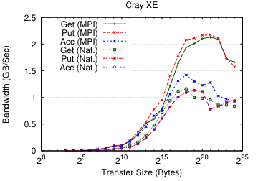
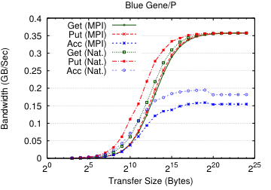
Contiguous Microbenchmark (BG/P and XE6)
BG/P: Native is better for small to medium size messages
Bandwidth regime: get/put are same and acc is ~15% less BW
XE: ARMCI-MPI is 2x better for get/put
Similar for double precision accumulate

Slide 29
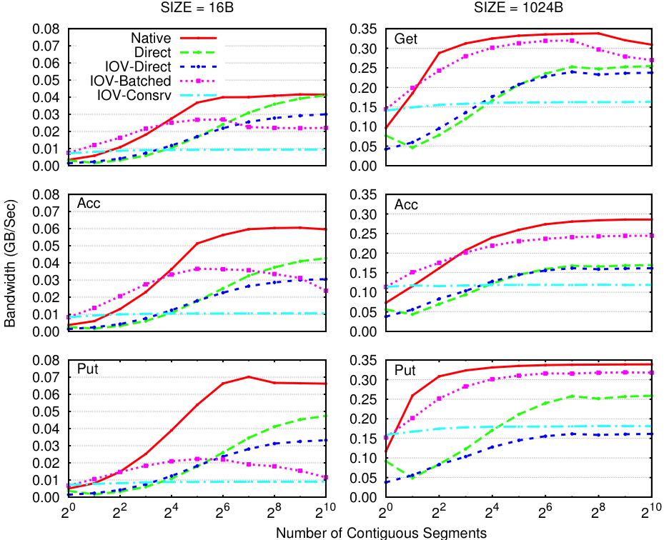
Strided Communication Bandwidth (BG/P)
Notes:
Small chunks:
Batched up to 8 segments, then direct
Large (1kB) chunks:
Batched is better
Why?
Direct and dtype generate MPI datatypes
MPI does pack/unpack
Processors are slow
Pack/unpack only helps for many small chunks
Tuning needed!

Slide 30
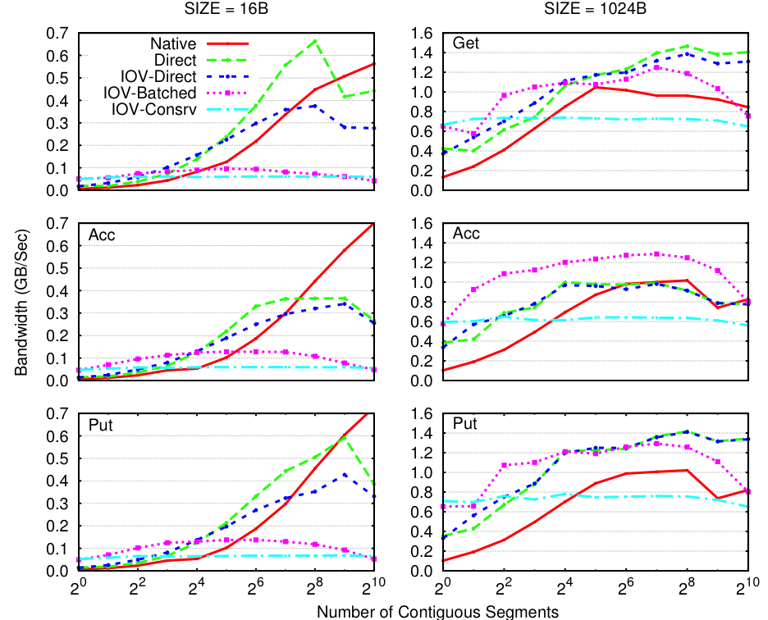
Strided Communication Benchmark (XE6)
Notes:
Small chunks:
Batched up to 8-16 segments, then direct
Large (1kB) chunks:
Acc: Batched
Get/Put: Direct
Get/Put performance is better in MPI
Acc performance is similar for large number of segments

Slide 31
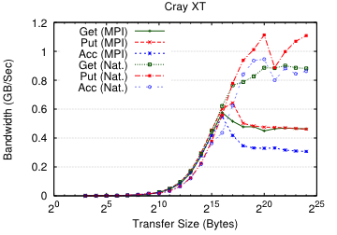
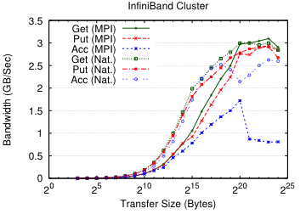
Contiguous Microbenchmark (IB and XT5)
IB: Close to native for get/put in the bandwidth regime
Performance is a third of native for accumulate
XE: Close to native for moderately sized messages
Performance is half of native in the bandwidth regime

Slide 32
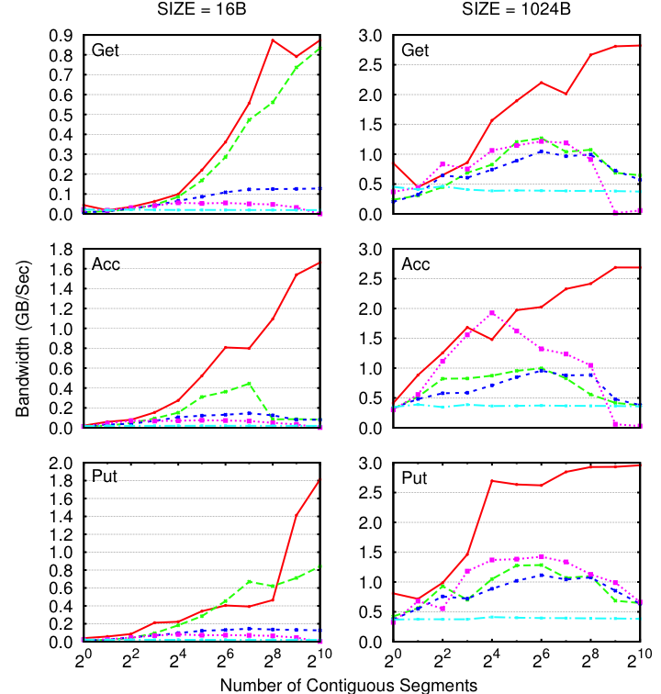

Strided Bandwidth (IB)
Direct is the best option in most cases
IOV-Batched is better for large message accumulate
Tuning needed!

Slide 33
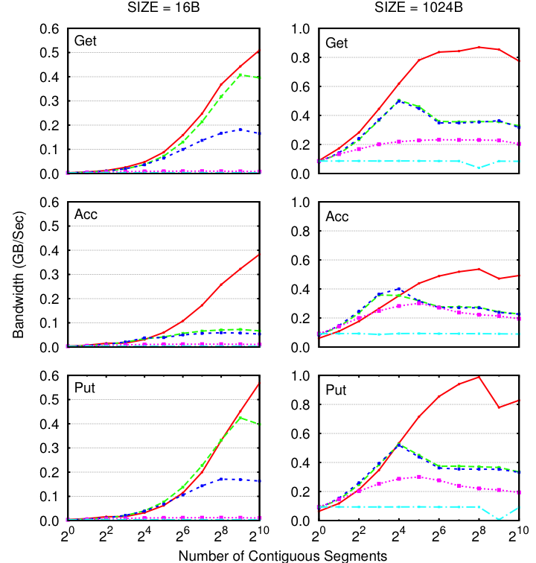
Strided Bandwidth (XT5)
Direct is best
It should be!
Tuning needed to better handle large messages and non-contiguous

Slide 34
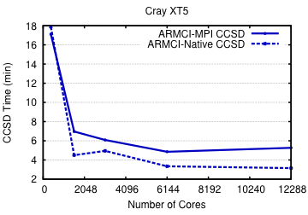
NWChem Performance (XT5)

Slide 35
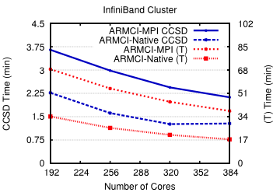
NWChem Performance (IB)

