Slide 1
Introspective Fault Tolerance for Exascale Systems
Rinku Gupta, Kamil Iskra, Kazutomo Yoshii, Pavan Balaji, Pete Beckman

Slide 2
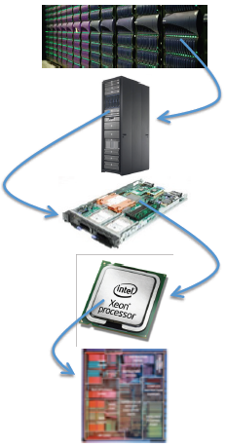
Motivation
Exascale systems will have faults
Power constraints, high-density silicon
Number of hardware/software components
Both hardware and software have a role to play
Hardware techniques
ECC checks, 2D error coding
Can get too expensive when bit rates increase (both cost and power)
Software techniques need to complement hardware resilience with clearly defined roles
Mechanisms are needed for lower-level hardware and operating system to interface with upper levels for end-to-end for resiliency and fault tolerance
Datacenter:
10⁹ threads
Rack: 10⁴ - 10⁵
threads
Socket: 500 -5000 threads
Die: 100 -1000 threads
Core/tile: 1 -10 threads
Image courtesy of Intel : SC’11 BOF on Resilience S/W on Exascale Computing

Slide 3
Introspective Fault Tolerance
Current fault exchange models are too simplistic:
OS kills the application on a hard error
OS/hardware returns an error code saying something bad happened
Hardware/OS/low-level runtime automatically corrects errors and hides it from the application
The fundamental concept of introspective fault tolerance: multi-way communication mechanism between operating system, runtime systems and applications
Hardware/OS/runtime should continue to give information to applications (like they currently do)
Applications/runtime systems should also pass down information (or hints) to the low-level runtime/OS on what they can “get away with”
Tuning tradeoffs based on application characteristics (e.g., OS can turn off ECC checks for some application specified memory regions)
Tradeoffs based on power, performance and resiliency (e.g., lesser voltage means lesser power, but more faults)

Slide 4
Challenges
Research focus for achieving this goal:
Understand what faults/system changes highly impact applications
Understand how to improve fault detection at OS- or system-level
What interfaces are required between operating system and upper-level software?
What techniques would allow upper level software to use information received from OS?
What mechanisms are needed in the OS to manipulate resilience, power and performance
Is hardware prepared for this?

Slide 5
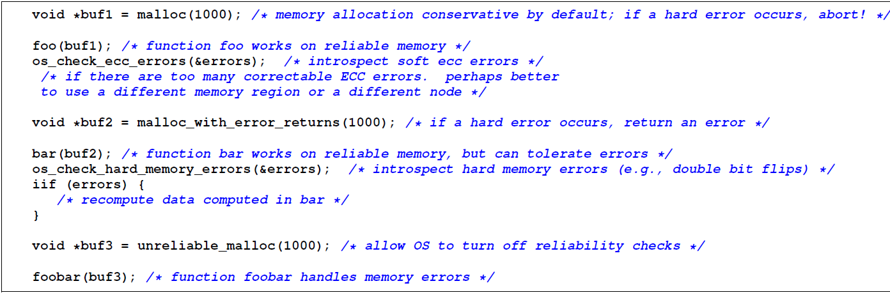
An Example Interface
Based on annotations and low-level interfaces/hooks
Allocate regular memory
Introspect soft ECC errors
Allocate memory with hard error returns
Introspect hard ECC errors
Allocate unreliable memory
Call routines for memory check
Application can query OS for soft/hard error information → decide whether to continue execution or migrate/terminate → better end-to-end fault tolerance

