Slide 1



Towards Asynchronous and MPI-Interoperable Active Messages
13th IEEE/ACM International Symposium on Cluster, Cloud and Grid Computing
Xin Zhao, Darius Buntinas, Judicael Zounmevo,
James Dinan, David Goodell, Pavan Balaji,
Rajeev Thakur, Ahmad Afsahi, William Gropp
University of Illinois at Urbana-Champaign,
Argonne National Laboratory,
Queen’s University

Slide 2
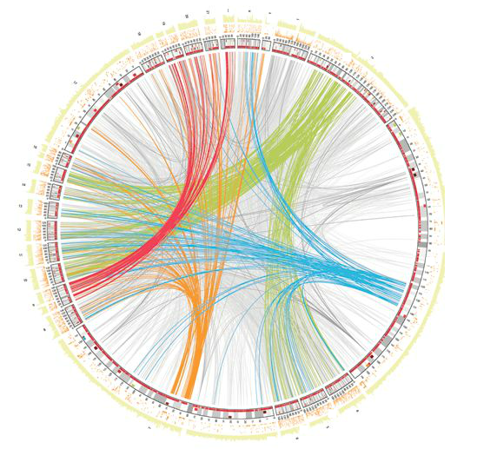
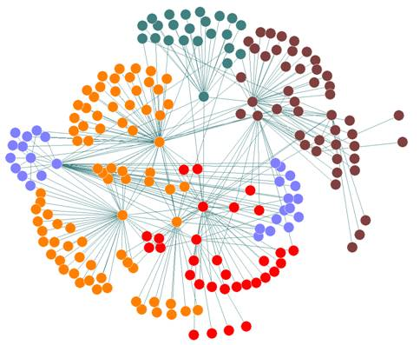
Motivation
Many new important large-scale applications
Bioinformatics, social network analysis

Slide 3
Motivation
Many new important large-scale applications
Bioinformatics, social network analysis
Different from “traditional” applications
Many small messages sent to random targets
Communication pattern is irregular
Computation is data-driven

Slide 4
Motivation
Many new important large-scale applications
Bioinformatics, social network analysis
Different from “traditional” applications
Many small messages sent to random nodes
Communication pattern is irregular
Computation is data-driven
Approaches for “traditional” applications are not well-suited

Slide 5
Breath-First Search
while any rank’s queue is not empty:
for i in ranks:
out_queue[i] ⟵ empty
for vertex v in my queue:
if color(v) is white:
color(v) ⟵ black
for vertex w in neighbors(v):
append w to out_queue[owner(w)]
rank 0
rank 1
rank 2
out
in
for i in ranks: start receiving in_queue[i] from rank i
for j in ranks: start sending out_queue[j] to rank j
synchronize and finish communications

Slide 6
Active Messages (AM)
Proposed by von Eicken et al
for Split-C in 1992
Sender explicitly sends message
Upon message’s arrival, message handler is triggered
Receiver is not explicitly involved
A suitable paradigm for data-driven applications
Data is sent immediately
Communication is asynchronous
rank 0
rank 1
Messages
Messages
handler
Reply
Reply handler

Slide 7
Breadth-First Search in Active Messages
while queue is not empty:
new_queue ⟵ empty
begin AM epoch
for vertex v in queue:
for vertex w in neighbors(v)
send AM to owner(w)
end AM epoch
queue ⟵ new_queue
rank 0
rank 1
rank 2
AM_handler (vertex v)
if color(v) is white:
color(v) ⟵ black
insert v to new_queue

Slide 8
Motivation
Most applications are MPI-based, but we don’t want to rewrite the entire application
An incremental approach is needed to modify the application

Slide 9
Motivation
Most applications are MPI-based, but we don’t want to rewrite the entire application
An incremental approach is needed to modify the application
This paper tackles the challenge of supporting Active Messages within MPI framework, so that both traditional MPI communication and Active Messages can be simultaneously utilized by applications

Slide 10
API design

Slide 11
Challenges
Active Messages should work correctly with other MPI messages
Memory consistency semantics
Consistency between two different active messages

Slide 12
Challenges
Active Messages should work correctly with other MPI messages
Memory consistency semantics
Consistency between two different active messages
Leverage MPI One-sided (RMA) Interface, which already address those challenges

Slide 13
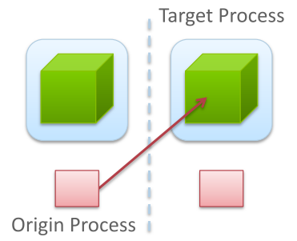
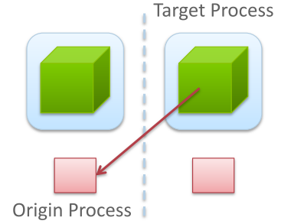
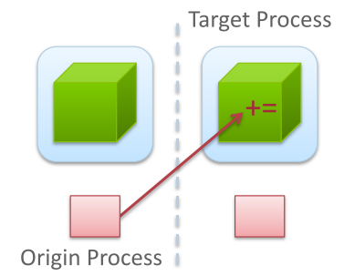
MPI RMA Interface
“One-sided” communication
Origin process specifies all communication parameters
Target process exposes memory (“window”) accessed by other processes
Three basic operations: Put / Get / Accumulate
Accumulate: simple updates on target process
MPI_Put
MPI_Get
MPI_Accumulate

Slide 14
API Design
Extend MPI_Accumulate to support user function
User-defined function
MPI_User_function (void *invec, void *inoutvec, int *len, MPI_Datatype *dtype)

Slide 15
API Design
Extend MPI_Accumulate to support user function
User-defined function
MPI_User_function (void *invec, void *inoutvec, int *len, MPI_Datatype *dtype)
Operation creation
MPI_Op_create (MPI_User_function *user_fn, int commute, MPI_Op *user_op)

Slide 16
API Design
Extend MPI_Accumulate to support user function
User-defined function
MPI_User_function (void *invec, void *inoutvec, int *len, MPI_Datatype *dtype)
Operation creation
MPI_Op_create (MPI_User_function *user_fn, int commute, MPI_Op *user_op)
Operation registration
MPIX_Op_register (MPI_Op user_op, int id, MPI_Win win)
Collective call on the window

Slide 17
Example
func0 and func1 have the same functionality
void func0 (void *in, void *inout,
int *len, MPI_Datatype *dtype);
void func1 (void *in, void *inout,
int *len, MPI_Datatype *dtype);
MPI_Win_create (…, &win);
MPI_Op_create (func0, ..., &user_op);
MPI_Win_lock (…, 1, …, win);
MPI_Accumulate (…, 1, …, user_op, win);
MPI_Win_unlock (1, win);
MPIX_Op_deregister (user_op, win);
MPI_Win_free (&win);
MPI_Win_create (…, &win);
MPI_Op_create (func1, ..., &user_op);
MPIX_Op_register (user_op, 0, win);
/* func1 is triggered at rank1 */
MPIX_Op_deregister (user_op, win);
MPI_Win_free (&win);
MPIX_Op_register (user_op, 0, win);
MPIX_Op_register (user_op, 0, win);
rank 0
rank 1

Slide 18
Asynchronous processing

Slide 19
Asynchronous execution models
“NON-ASYNC”
No asynchronous processing, messages are processed by single thread
Disadvantage: messages cannot be processed upon arrival

Slide 20
Asynchronous execution models
“NON-ASYNC”
No asynchronous processing, messages are processed by single thread
Disadvantage: messages cannot be processed upon arrival
“THREAD-ASYNC”
Asynchronous processing is provided by thread on top of MPI library
Disadvantage: “active polling” for intra-node messages

Slide 21
Asynchronous execution models
“NON-ASYNC”
No asynchronous processing, messages are processed by single thread
Disadvantage: messages cannot be processed upon arrival
“THREAD-ASYNC”
Asynchronous processing is provided by thread on top of MPI library
Disadvantage: “active polling” for intra-node messages
“INTEGRATED-ASYNC”
Asynchronous processing is supported internally from MPI library

Slide 22
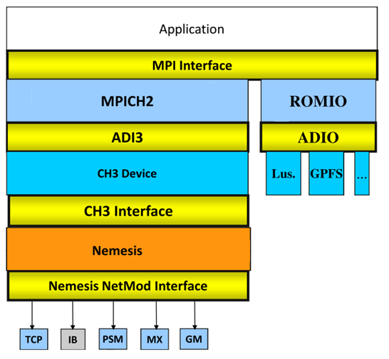
Inter-node Communication
Thread-based approach
Spawn thread in TCP network module
Block polling for AM
Separate sockets for MPI messages and AM
MPI
spawn AM thread
AM

Slide 23
Intra-node Communication
“Origin computation”
During window creation, processes on the same node allocate a shared-memory region
Origin process directly fetches data from target process, completes computation locally and writes data back to target process

Slide 24
Integrated Idea
Shared-memory
NODE 0
NODE 1
Network
rank 1
(origin)
rank 0
(target)
rank 2
(origin)

Slide 25
Integrated Idea
Shared-memory
NODE 0
NODE 1
Network
rank 1
(origin)
rank 0
(target)
rank 2
(origin)

Slide 26
Integrated Idea
Shared-memory
NODE 0
NODE 1
Network
rank 1
(origin)
rank 0
(target)
rank 2
(origin)

Slide 27
Integrated Idea
Shared-memory
NODE 0
NODE 1
Network
rank 1
(origin)
rank 0
(target)
rank 2
(origin)

Slide 28
Integrated Idea
Shared-memory
NODE 0
NODE 1
Network
rank 1
(origin)
rank 0
(target)
rank 2
(origin)

Slide 29
Integrated Idea
Shared-memory
NODE 0
NODE 1
Network
rank 1
(origin)
rank 0
(target)
rank 2
(origin)

Slide 30
Performance

Slide 31
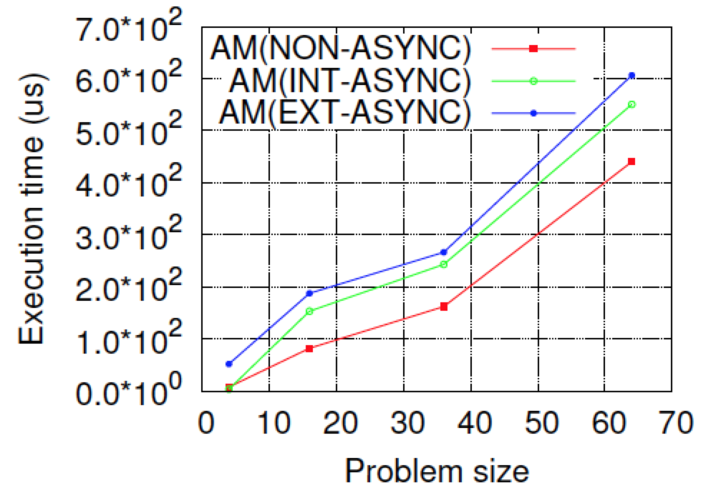
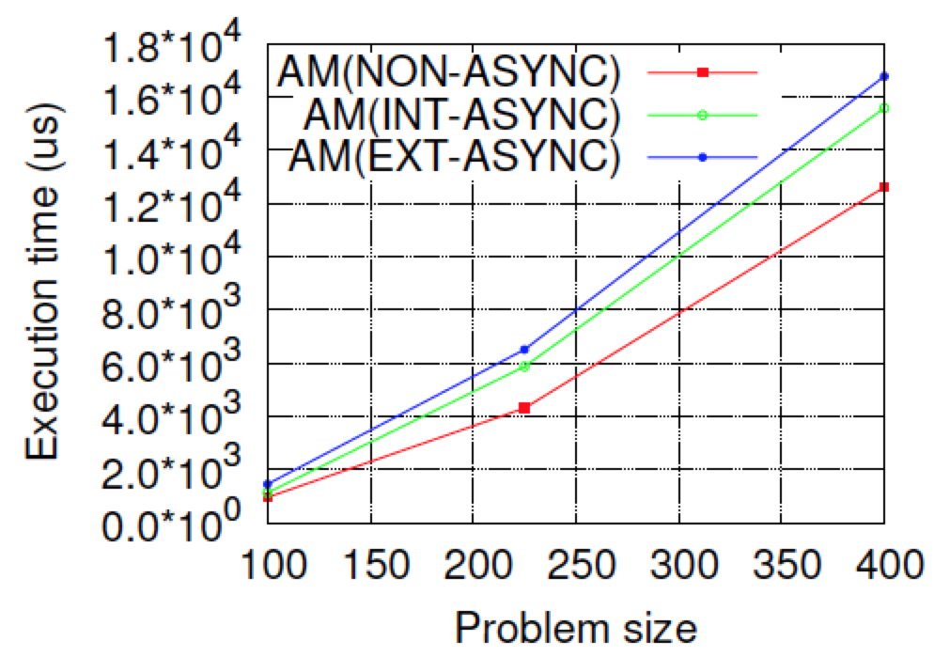
Stencil Benchmark
Number of processes: 2x2 to 20x20, 8 processes per node
(“Fusion” Cluster at ANL: 320 nodes, 8 cores per node, QDR Infiniband)

Slide 32
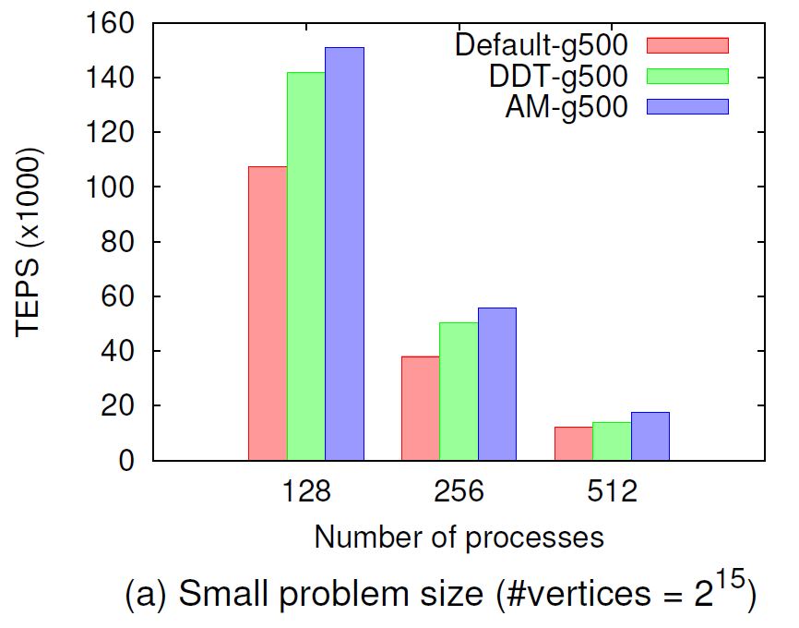
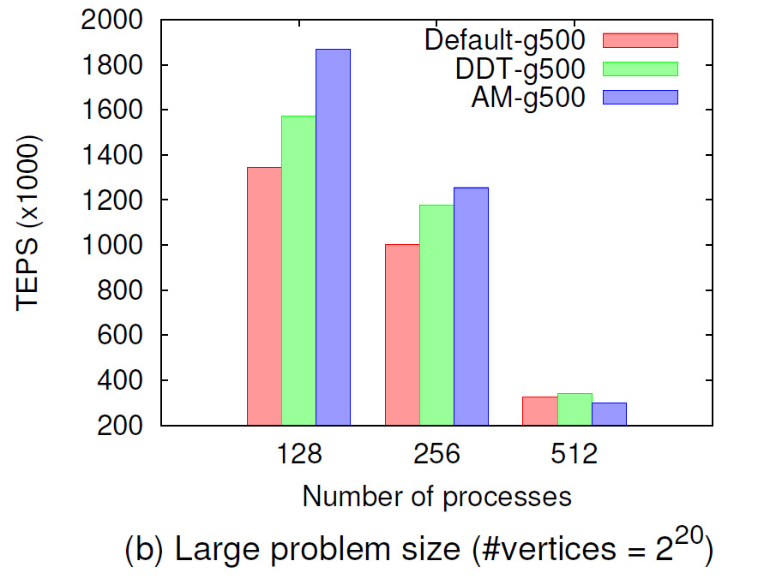
Graph500 Benchmark
Breadth-First Search (BFS)
Large number of small messages to random targets
Optimization: origin process accumulates local data and sends only one message to each target process
(TEPS: Traversed Edges Per Second, higher is better)

Slide 33
Conclusion
Why to support Active Messages in MPI
Leverage MPI RMA Interface
API Design
Asynchronous processing
Intra-node messages
Inter-node messages
Stencil benchmark and Graph500 benchmark

Slide 34
QUESTIONS

Slide 35
Backup slides

Slide 36
Message Passing Models
Two-sided communication
Explicit sends and receives
One-sided communication
Explicit sends, implicit receives
Simple operations on remote process
Active Messages
Explicit sends, implicit receives
User-defined operations on remote process

Slide 37
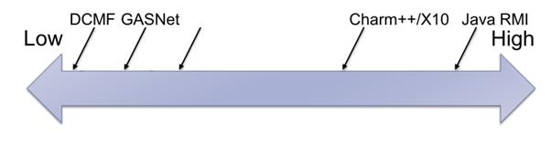
Active Message Models
Libraries and runtime systems
Low level: GASNet, IBM’s LAPI, DCMF and PAMI, AMMPI
High level: Charm++, X10
Middle: AM++
AMMPI
AM++

Slide 38
MPI RMA Interface
Two synchronization modes
origin
target
origin
target
Post
Lock
Start
PUT(Y)
PUT(Y)
epoch
epoch
ACC(X)
ACC(X)
Complete
Unlock
Wait
Active Target Mode
(PSCW, Fence)
Passive Target Mode
(Lock-Unlock)

Slide 39
Inter-node Communication
Separate sockets for Active Messages
main thread
origin_sc
rma_sc
AM
thread
origin_sc
rma_sc

Slide 40
Inter-node Communication
Separate sockets for Active Messages
main thread
AM thread
origin_sc
rma_send_sc
rma_recv_sc
rma_resp_sc
origin_sc
rma_send_sc
rma_recv_sc
rma_resp_sc

