Slide 1
Optimizing Burrows-Wheeler Transform-Based Sequence Alignment on Multicore Architectures
Jing Zhang¹, Heshan Lin¹, Pavan Balaji², Wu-chun Feng²
Virginia Tech¹
Argonne National Laboratory²

Slide 2
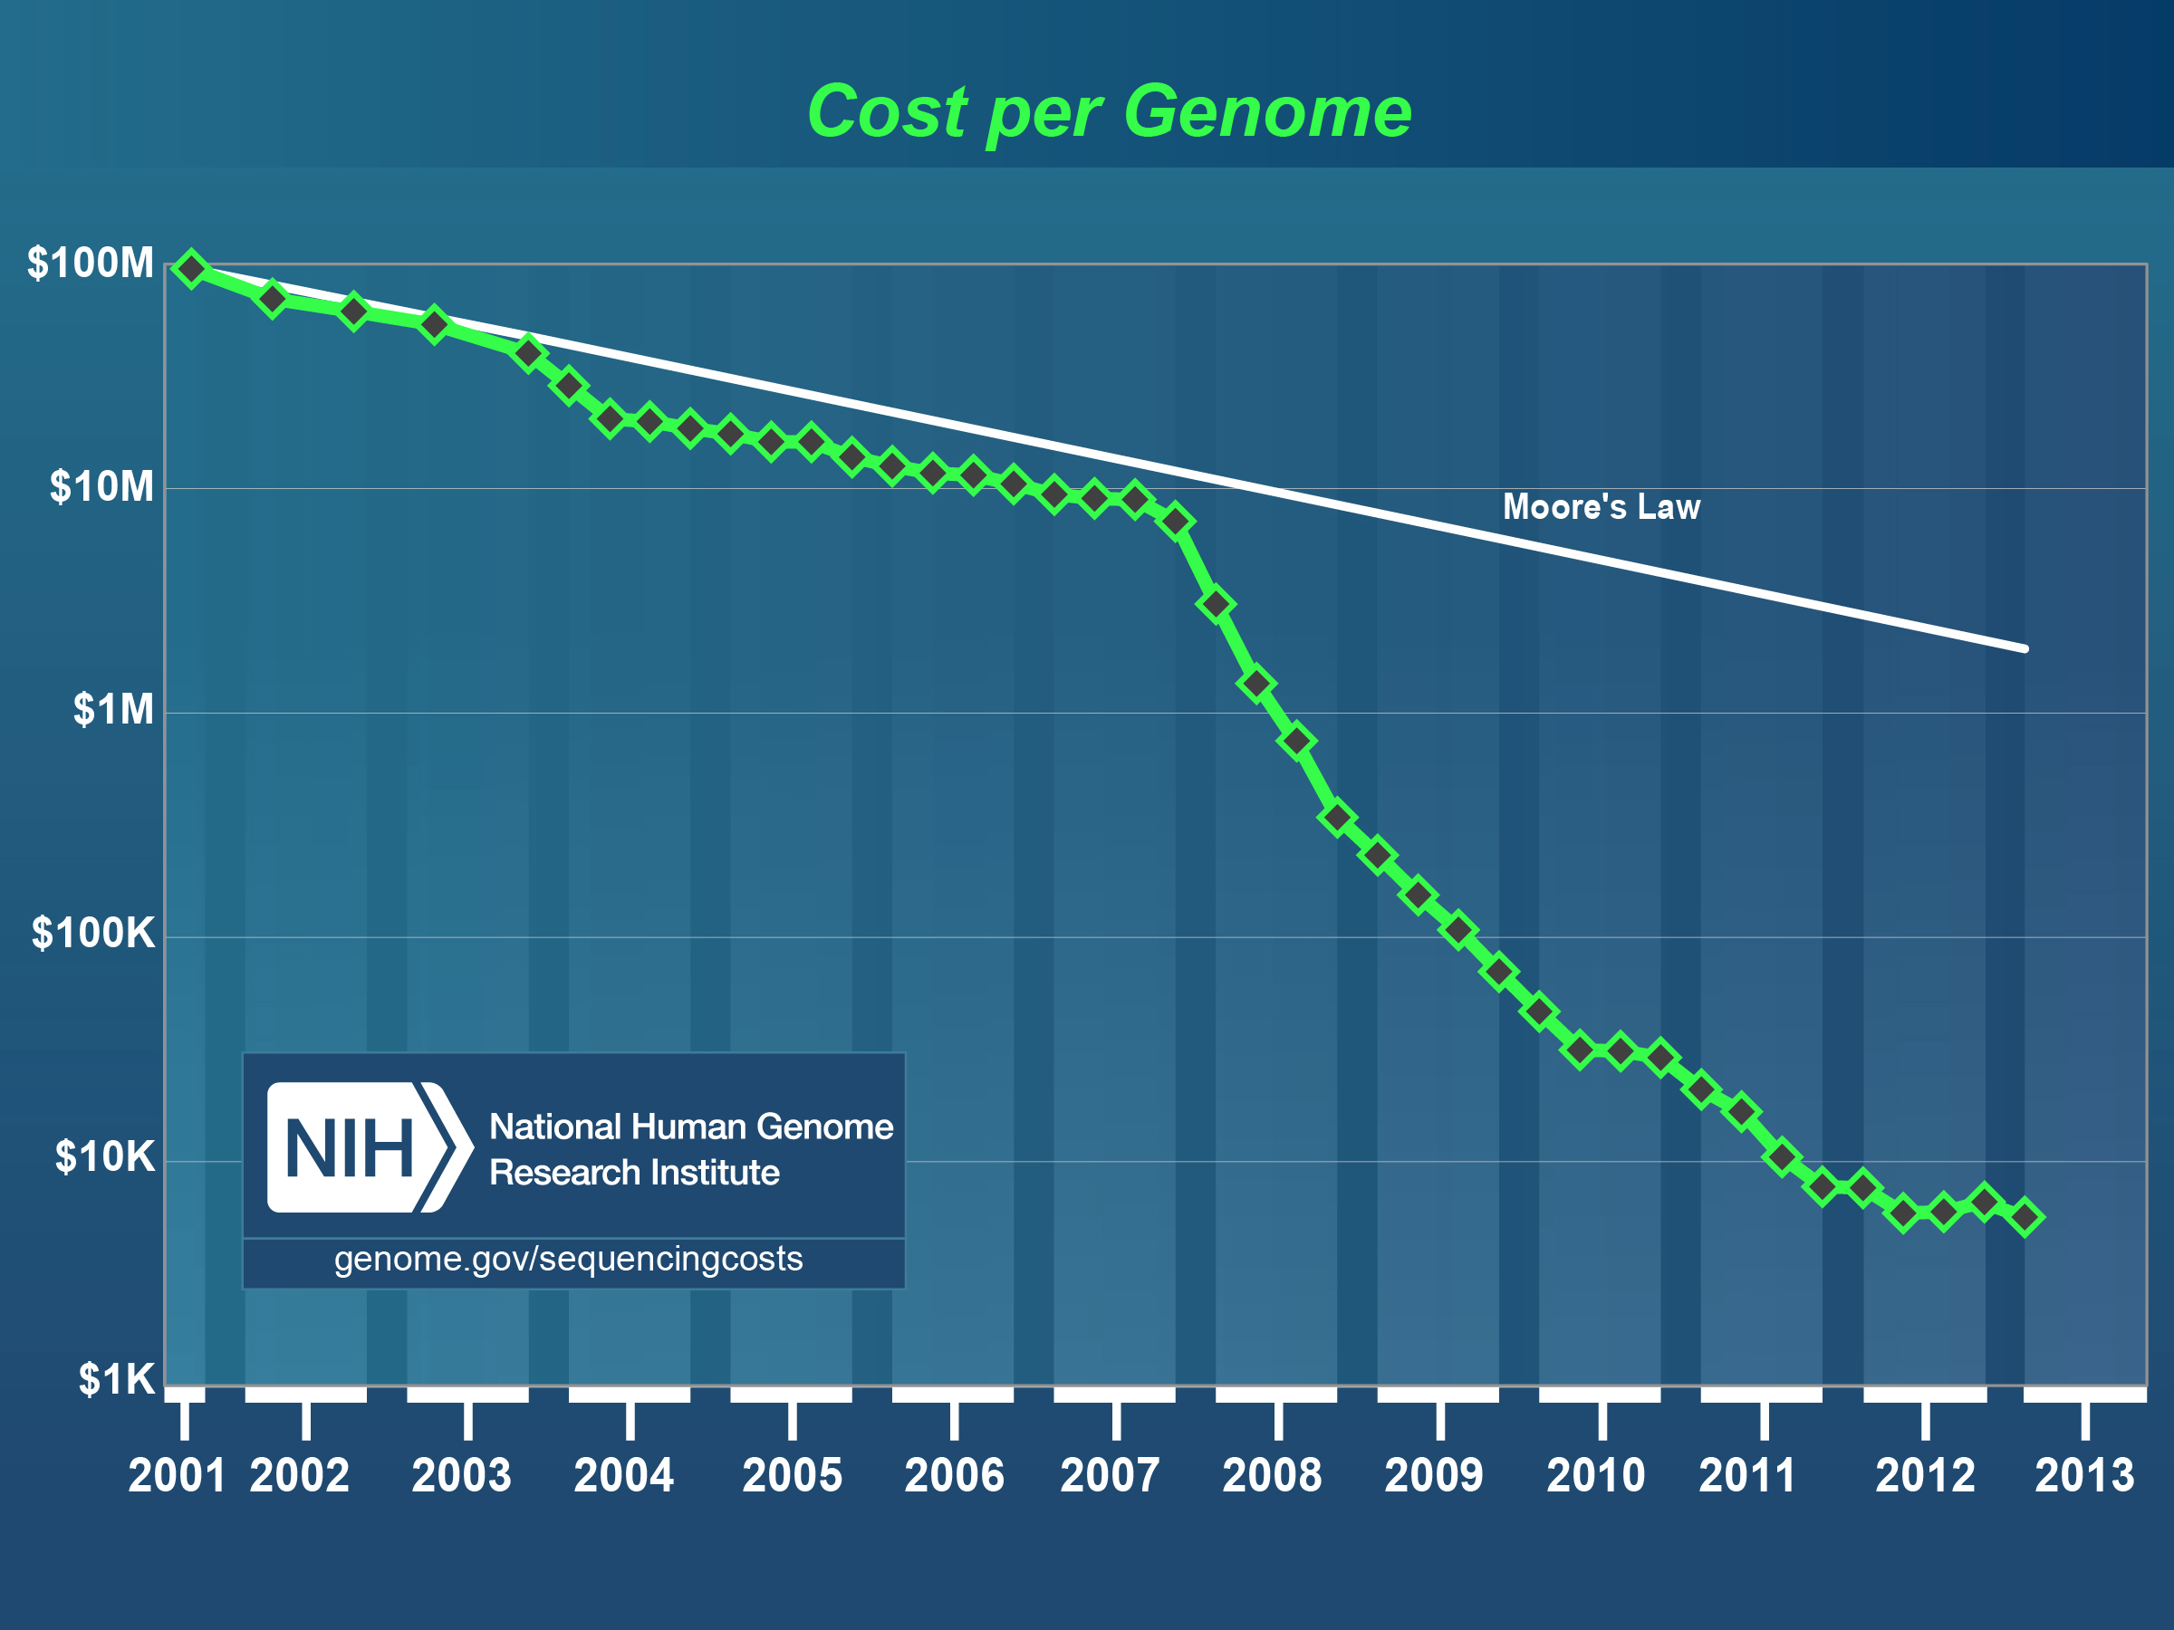
Democratization of Genome Sequencing
Since the introduction of next-generation sequencing (NGS), cost drops 800 times in 5 years.
Source: National Human Genome Research Institute

Slide 3
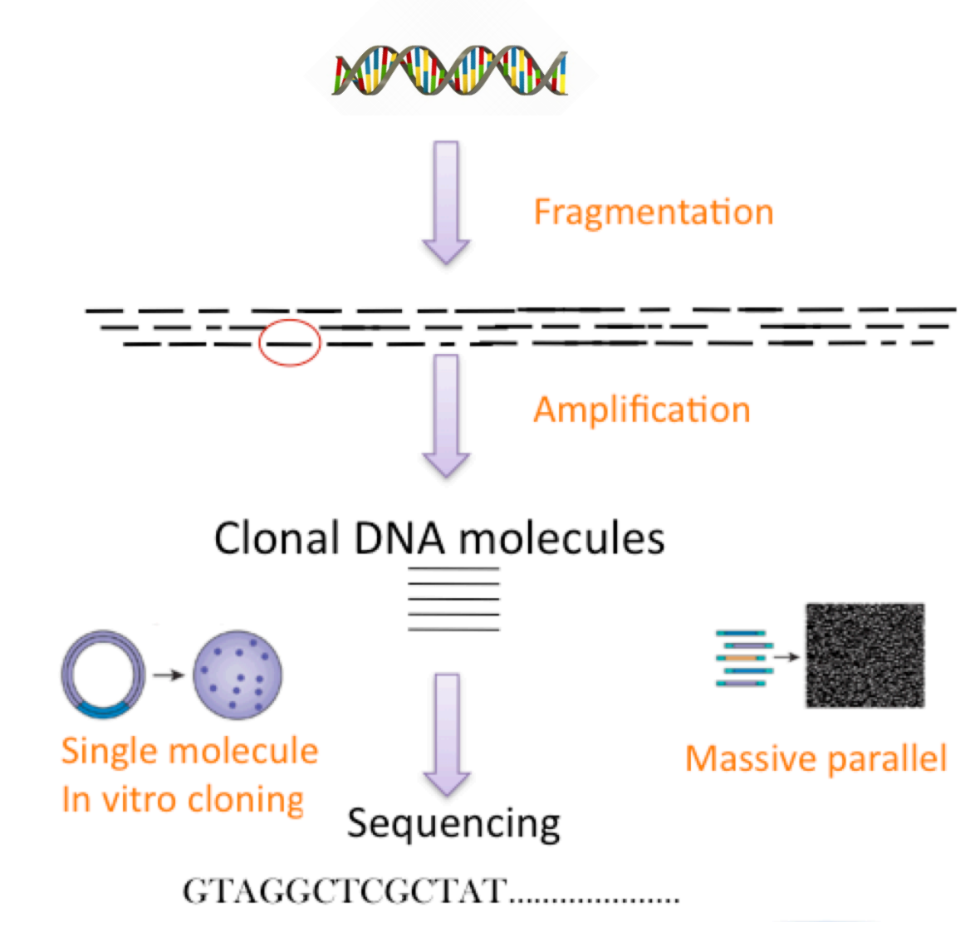
How Does NGS Work?
@SRR062634.1 HWI-EAS110_103327062:6:1:1092:8469/1
GGGTTTTCCTGAAAAAGGGATTCAAGAAAGAAAACTTACATGAGGTGATTGTTTAATGTTGCTACCAAAGAAGAGAGAGTTACCTGCCCATTCACTCAGG
+
@C'@9:BB:?DCCB5CC?5C=?5@CADC?BDB)B@?-A@=:=:@CC'C>5AA+*+2@@'-?>5-?C=@-??)'>>B?D@?*?A#################
@SRR062634.2 HWI-EAS110_103327062:6:1:1107:21105/1
ACCGTGAGCAATCAGCTGCCATCAACGTGGAGGTAAGACTCTCCACCTGCAAAAACATTACAACTTGCTGAAGGCTGAGATACTTGTTCGCACATTTTTA
+
FDEFF?DFEFE?BEEEEED=DB:DCEAEEB,CC=@B=5?B?CC5C?B+A??=>:CC<9-B2=@>-?:-<A@@A?9>*0<:'0%6,>:9&-:>?:>==B??
…
Header
Sequence Data
Quality Score
Source: Broad Institute

Slide 4
Read Mapping (Alignment)
Fundamental application in NGS analysis
Applications: genotyping, variant discovery, genome assembly …
Computational problem: matching huge amounts of short DNA strings to reference genome
Key design issue: Efficient indexing of reference genome
…CCATAG TATGCGCC ATCGGCAAT GCGGTATA …CCAT -ATATGCGC TATCGGCAA TTGCGGTAT C… …CCAT GC-ATATGCG CCTATCGGC ATTTGCGGT AC… …CCA AGGC-ATAT CCTATCGGC ATTTGCGGT TAC… …CCA AGGC-ATAT CCCTATCGG AATTTGCGG ATAC… …CC TAGGC-ATA CGCCCTATC GCAATTTGC GTATAC…
…CCATAGGCTATATGCGCCCTATCGCCAATTTGCGGTATAC…
Reads
Ref Genome

Slide 5
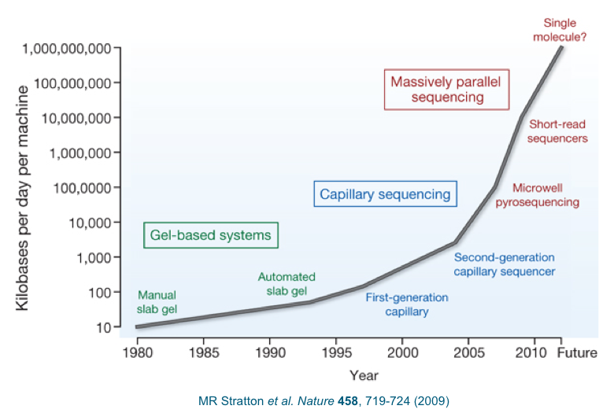
Why Important?
Sequencing throughput outstrips our ability to compute
Aligning standard human genome reads takes 13 CPU day
We need VERY FAST sequence alignment tools

Slide 6
What is this Talk about?
A core class of sequence alignment algorithms: Indexing reference genome based Burrows-Wheeler Transform (BWT) technique
Mainstream of state-of-art sequence alignment
Case study: BWA (Burrows-Wheeler Aligner)
Highly optimized implementation of BWT-based alignment approach
One of the most popular read mapping tools
Our focus: exact string-matching kernel
Contributions
In-depth performance characterization on BWA algorithm
Novel locality-aware mapping of BWT-based alignment on multicores
Performance results: up to 2.6-fold speedup

Slide 7
Road Map
Introduction
Background and performance characterization of BWA
Locality-aware BWA optimizations
Experimental results
Conclusion and future work

Slide 8
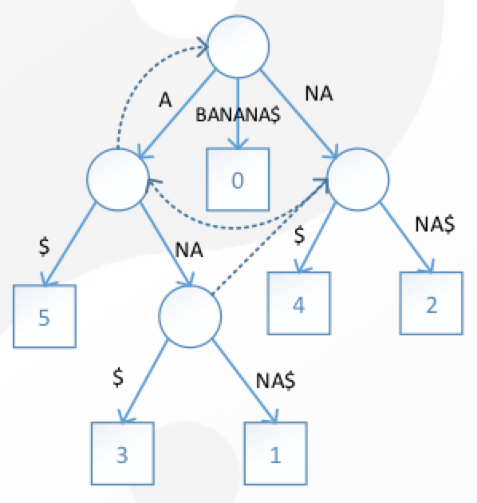
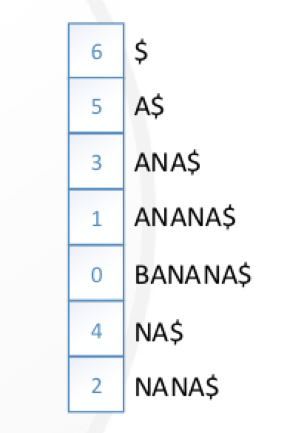
A Bit of Historical View – “Suffix” Indexing
Suffix Tree
>= 45 GB for human genome
Suffix Array
>= 12 GB for human genome

Slide 9
Burrows-Wheeler Transform
BWT(banana$) = annb$aa
$banana
a$banan ana$ban anana$b banana$ nana$ba
na$bana
$banana
a$banan ana$ban anana$b banana$ nana$ba
na$bana
banana$
anana$b nana$ba ana$ban
na$bana
a$banan $banana
BWT string can be used to reconstruct the suffix array
2-4 GB for human genome indexing
sort

Slide 10
Backward Search with BWT
for i = read_len-1 to 0 do
k = C[s[i]] + Occ(k – 1, S[i]) + 1
l = C[s[i]] + Occ(l – 1, S[i])
C[c]: # of characters which are alphabetically smaller than c
Occ[c]: # of occurrences of character c in the BWT prefix
i=2, s[i]=a
i=1, s[i]=n
i=0, s[i]=a
Done
Occ function is most time consuming component
k=0
ana
$banana a$banan ana$ban anana$b banana$ nana$ba na$bana
ana
$banana a$banan ana$ban anana$b banana$ nana$ba na$bana
ana
$banana a$banan ana$ban anana$b banana$ nana$ba na$bana
ana
$banana a$banan ana$ban anana$b banana$ nana$ba na$bana
k=1
k=2
l=3
l=2
k=5
l=6
l=6

Slide 11
Occ Implementation in BWA
Idea: Precomputing character counts for each bucket of BWT string
BWT table: BWT string plus precomputed counts
Problem? Access to BWT table highly irregular
Occ(k, ‘C’) = 31 + 2 = 33
BWT Table
k_{th} location in BWT string

Slide 12
Performance Profiling of BWA
Poor locality in Occ computation computation
Random walking on 3GB array (BWT table size)
Accessed Buckets of Mapping a Read
Cycles Beakdown
High cache and TLB misses

Slide 13
Road Map
Introduction
Background and performance characterization of BWA
Locality-aware BWA optimizations
Experimental results
Conclusion and future work

Slide 14
Exploiting Data Locality in BWT Table Access
struct Ri { Int64 k; Int64 l; Int32 r_id; };
for each read
for i = read_len-1 to 0 do
k = C[s[i]] + Occ(k – 1, S[i]) + 1
l = C[s[i]] + Occ(l – 1, S[i])
for i = read_len-1 to 0 do
for each read
k = C[s[i]] + Occ(k – 1, S[i]) + 1
l = C[s[i]] + Occ(l – 1, S[i])
R1
R2
R3
R4
R5
R6
i=len-1
Occ(k)
i=len-1
Occ(l)
i=len-2
Occ(k)
i=len-2
Occ(l)
R1
B1
B4
B2
B3
Bin 1
R2
B2
B3
B4
B1
Bin 2
R3
B1
B2
B4
B3
R4
B2
B4
B3
B1
Bin 3
R5
B1
B3
B2
B4
Bin 4
R6
B3
B4
B1
B2
Bin Set One
Bin Set Two

Slide 15
Will it Work?
Occ function is fine grained and can tolerate little overhead
Extra memory access caused by binning may pollute the cache
Cache likely can not hold the binning structure
Dilemma: Increased read batch size → more data reuse opportunity but also more cache consumption

Slide 16
What Goes Wrong?
Take a closer look at Occ function profile
Require highly efficient binning design that handles intricate interaction between cache hardware and application logic
 | LLC Misses (millions) | TLB Misses (millions) | Execution Time (sec)
Original | 70 | 27 | 3.60
Preliminary Binning | 56 | 59 | 3.28
Reduce LLC misses
But double TLB misses

Slide 17
Reduce TLB Misses
Problem: Binning improves locality of BWT-table access but destroys locality in reading sequence data
TLB cache has 64 entries for 4KB page
Read array > 100MB: 100MB / 4KB = 25600 pages
Solution: Preload read data and store them in binning structure
Accessed letter
Cache line
Original BWA
BWA with Binning

Slide 18
Reduce Space Overhead
Leveraging application knowledge
Max value of k is 6G (BWT string of forward and backward genome)
Distance between k and l is monotonically decreasing (suffix indexing)
Packing k and l into a single 64-bit integer: l is presented with Δl as increment of k
Using 4 bits to represent a letter instead of 1 byte
Δl = l – k
struct Ri { Int64 k; Int64 l; Int32 r_id; char seq_data[8]; };

Slide 19
Reduce Time Overhead
Leveraging application knowledge, again
k and l is converging and thus likely falls in the same BWT bucket
Optimization
Applying binning according to k only
Reducing binning overhead by a half

Slide 20
Multithreading
Reducing synchronization overhead
Using two sets of bins – only write bins need synchronization
Use atomic instruction instead of mutex
Read Bins
Write Bins
Thread 1
Thread 2
Thread 3
Thread 4

Slide 21
Road Map
Introduction
Background and performance characterization of BWA
Locality-aware BWA optimizations
Experimental results
Conclusion and future work

Slide 22
Impacts of Micro-Architectures
Cache size does not have significant impact
Higher frequency potentially benefits more from our optimizations

Slide 23
Performance Profile
 | LLC misses (milliions) | TLB misses (millions)
Original BWA | 70 | 27
Optimized BWA | 53 | 23

Slide 24
Scalability
Base line: single-thread original BWA

Slide 25
Conclusion & Future Work
In-depth performance characterization and optimization of a critical class of sequence alignment algorithms
Can be applied to text analytic applications that require very fast string matching
Application + hardware integrated approach is important
Future work
Extend to support inexact string match
Extend to support many-core architectures e.g., Intel MIC, GPGPUs

Slide 26
Backup Slides

Slide 27
Burrows-Wheeler Transform
C[]: # of characters which are alphabetically smaller than c
$ | a | b | n
0 | 1 | 4 | 5
BWT(banana) = annb$aa
$banana
a$banan ana$ban anana$b banana$ nana$ba
na$bana
Occ[]: # of occurrences of
character c in the BWT prefix
banana$
anana$b nana$ba ana$ban
na$bana
a$banan $banana
$ | a | b | n
0 | 1 | 0 | 0
0 | 1 | 0 | 1
0 | 1 | 0 | 2
0 | 1 | 1 | 2
1 | 1 | 1 | 2
1 | 2 | 1 | 2
1 | 3 | 1 | 2
sort
Cyclic rotations
LF(i) = c[s[i]] + Occ(i, s[i])

Slide 28
Memory-efficient static-allocation Part of Time Overhead
Simpler is better
Use static-allocation to avoid dynamic allocation overhead.
Using a spare pool to stored overflow items
Distribution of entries is quite uneven in first few iterations.

