Slide 1
Analysis of Topology-Dependent MPI Performance on Gemini Networks
Antonio J. Peña, Ralf G. Correa Carvalho, James Dinan,
Pavan Balaji, Rajeev Thakur, and William Gropp

Slide 2
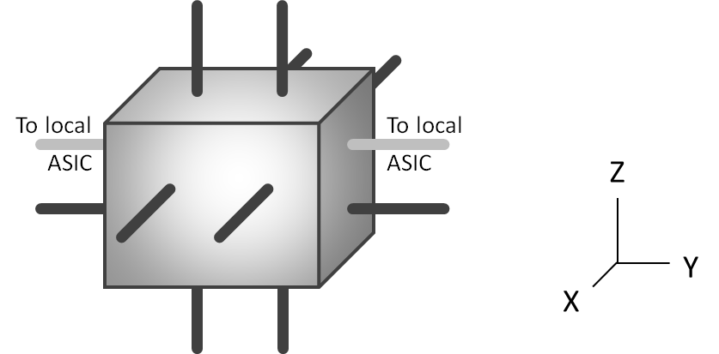
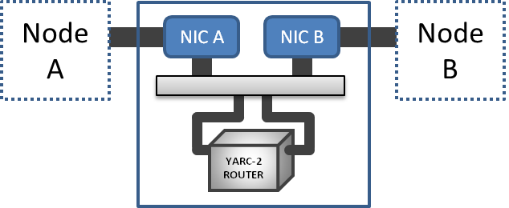
Motivation
Network properties can have a significant impact on application performance
BW uses a 3-dimensional Cray Gemini torus featuring anisotropic properties
Twice the Y-dimension bandwidth in the X and Z dimensions
A Gemini ASIC is shared by two nodes
Task placement considering these properties is highly beneficial

Slide 3
Outline
Background
Contributions
System:
Job Placement and Rank Ordering in BW
Network Layout
Experimental Evaluation
Basic Micro-benchmarks
Collective Communications
Stencil Communications
Conclusions

Slide 4
Contributions

Slide 5
Contributions
Characterization of the Gemini anisotropic behavior based in point-to-point micro-benchmarks
Prove Y-wise placement of the dual nodes per network Cartesian point to be highly beneficial
Demonstrate potential gains of MPI-network topology matching versus the available node placement

Slide 6
System: Job Placement / Rank Ordering Network Layout

Slide 7
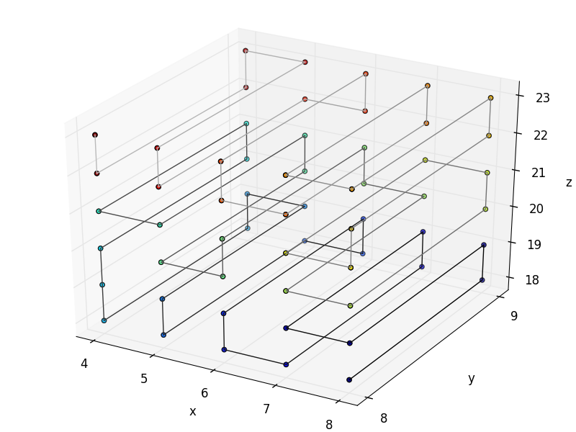
Job Placement and Rank Ordering in BW
Cray MPICH follows the node ordering assigned by the job scheduler
Ranks are ordered in a zigzag fashion
First and last ranks are adjacent
Decrease hop count
Increase bisection bandwidth
Given that:
XE6 routers contain two nodes
Z links are faster than X links
Every 5th link is crossing a cabinet (slower)
4 x 2 x 8 building blocks
Carl Albing, Norm Troullier, Stephen Whalen, Ryan Olson, Joe Glenski, Howard Pritchard, and Hugo Mills. Scalable node allocation for improved performance in regular and anisotropic 3D torus supercomputers. In Recent Advances in the Message Passing Interface, volume 6960 of LNCS, 2011.

Slide 8
Blue Waters Network Layout
Y dimension
Z dimension
X dimension
Notes:
Box is an “ASIC that has NICs from two nodes inside it”. Link within is faster.
Missing is Y link between the boxes. Note there is only one link. In X (and Z), there are two links between adjacent boxes. Link speed between cabinets is slower than within cabinet

Slide 9
Blue Waters Network Layout
Y dimension
X dimension
Notes:
Box is an “ASIC that has NICs from two nodes inside it”. Link within is faster.
Missing is Y link between the boxes. Note there is only one link. In X (and Z), there are two links between adjacent boxes. Link speed between cabinets is slower than within cabinet

Slide 10
Experimental Evaluation
Basic Micro-benchmarks

Slide 11
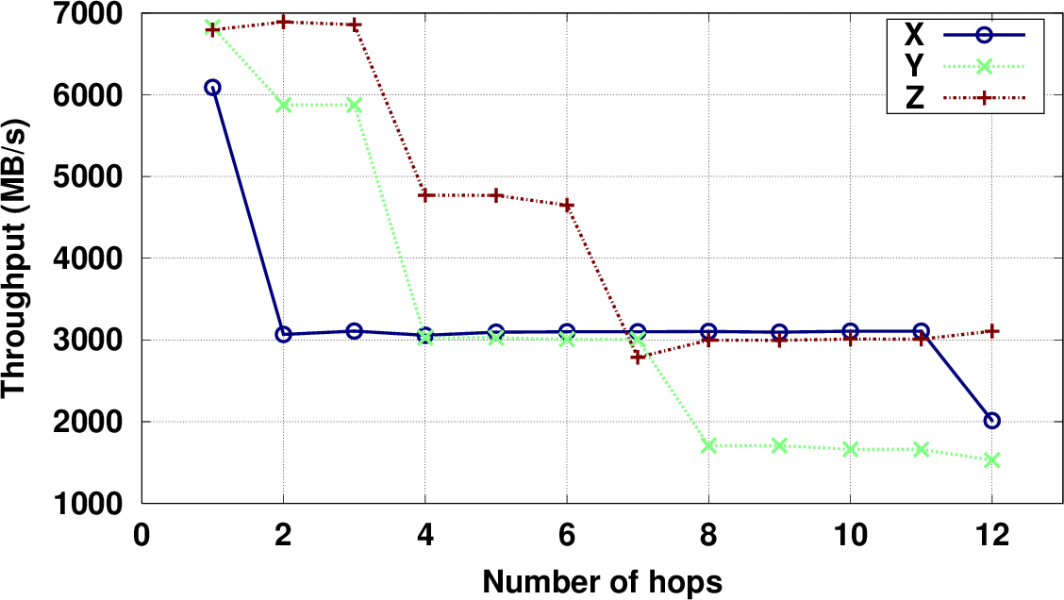
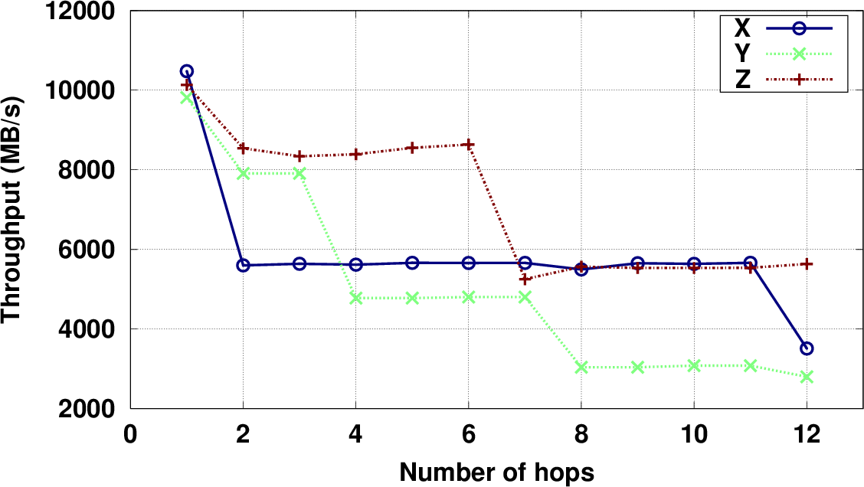
Point-to-Point Communication (single process)
Point-to-point benchmarking
Anisotropic behavior illustrated
Communications in the Y direction perform signifficantly lower: ½ links
Z links offer much higher TR than Y
X and Z: largely different behaviors
Latency per hop: ~0.1µs
Unidirectional
Bidirectional

Slide 12
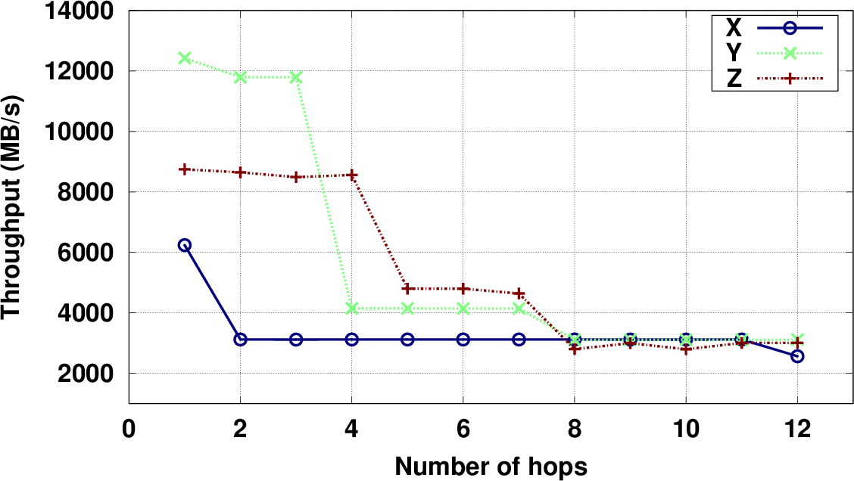
Point-to-Point Communication (multiple processes)
Internode aggregate transfer rate
2 parallel paths transfer concurrently
Optimal node ordering and matching between MPI ranks and network topo.
Collectives saturating links greatly improve performance on Y direction
Contiguous nodes in these experiments
Double X and Z links become shared
Aggregate TR increases for Y
Placement of dual nodes/ASIC along Y
Extra performance improvement

Slide 13
Blue Waters Network Layout
Y dimension
Z dimension
X dimension
Notes:
Box is an “ASIC that has NICs from two nodes inside it”. Link within is faster.
Missing is Y link between the boxes. Note there is only one link. In X (and Z), there are two links between adjacent boxes. Link speed between cabinets is slower than within cabinet

Slide 14
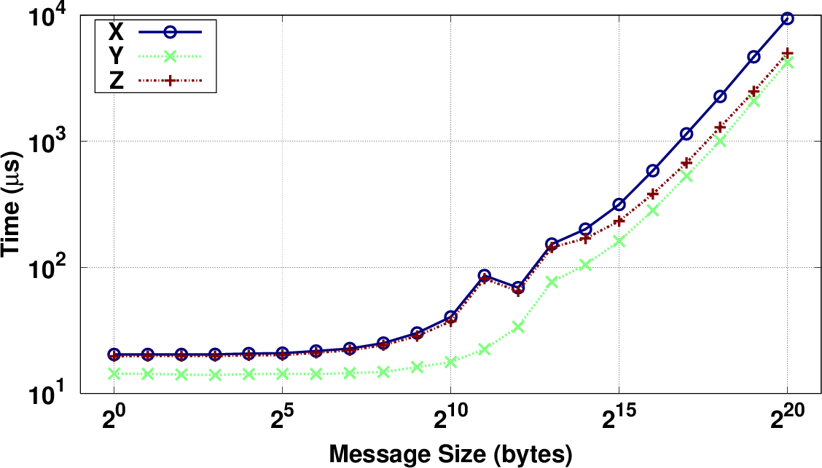
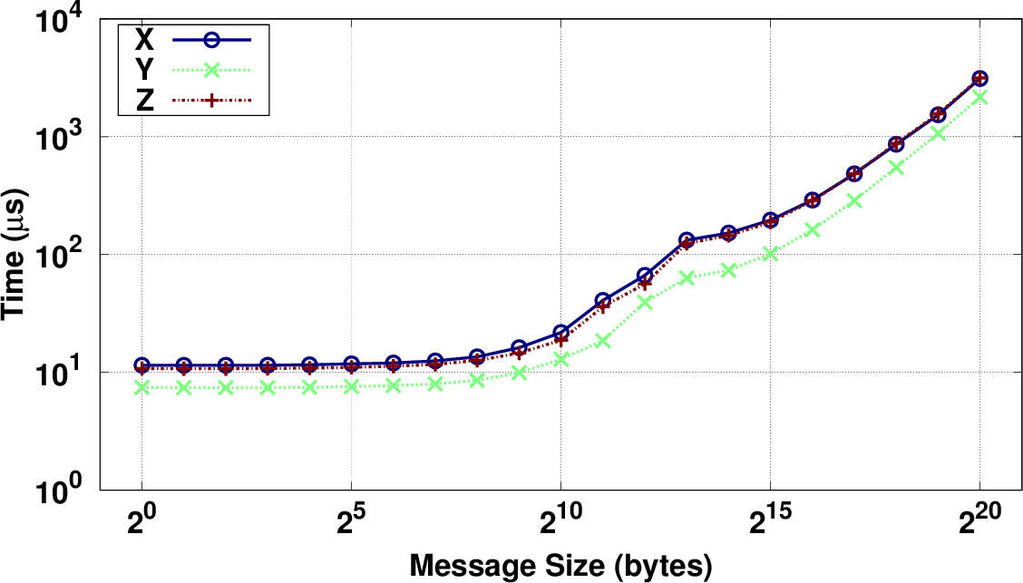
Collective Communications
Topology matching exploited by row-wise and plane-wise collectives
Y direction faster!
Row-wise: up to 74% (alltoall) and 54% (allgather)
Row-wise MPI_Alltoall
Row-wise MPI_Allgather

Slide 15
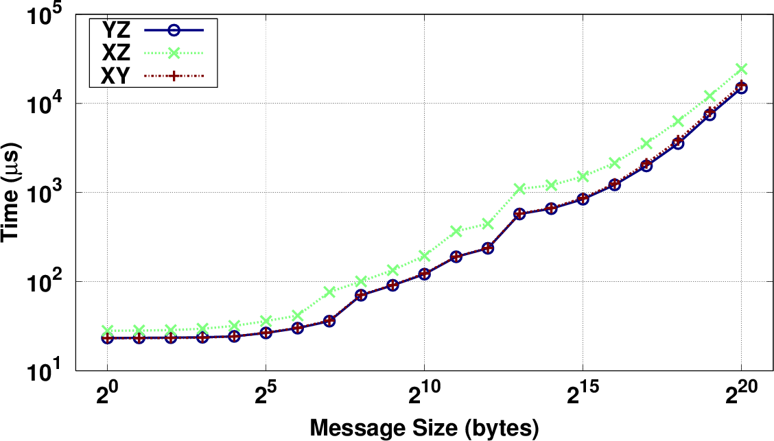
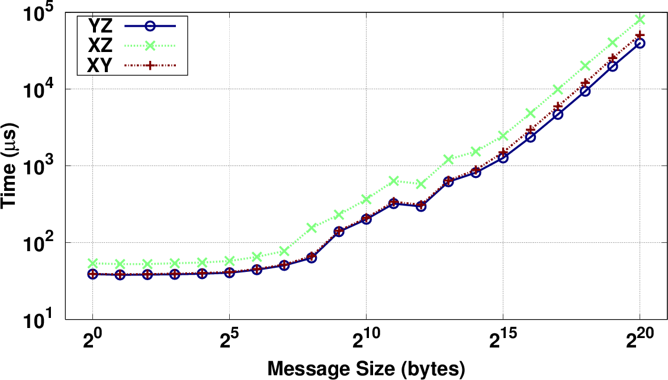
Collective Communications
Topology matching exploited by row-wise and plane-wise collectives
Y direction faster!
Row-wise: up to 74% (alltoall) and 54% (allgather)
Plane-wise: up to 59% (alltoall) and 53% (allgather)
Plane-wise MPI_Alltoall
Plane-wise MPI_Allgather

Slide 16
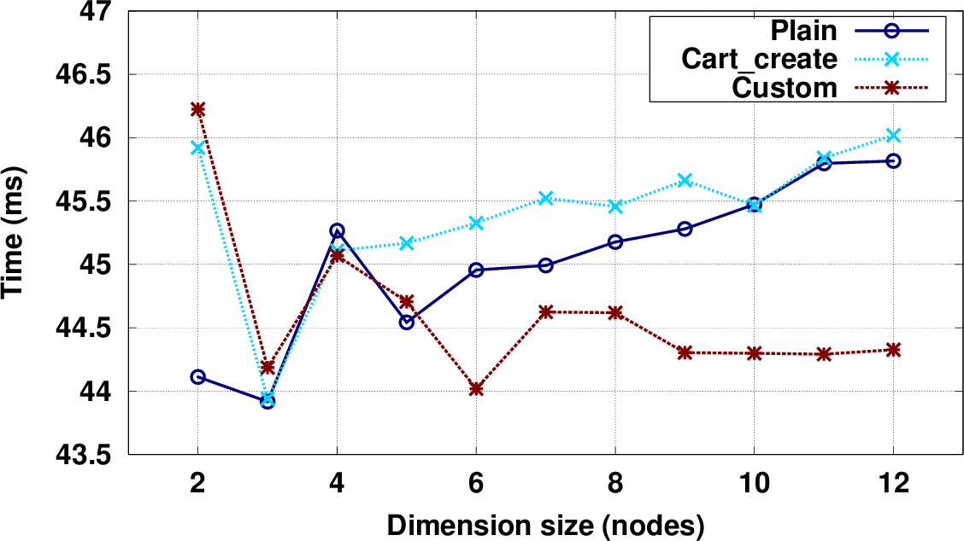
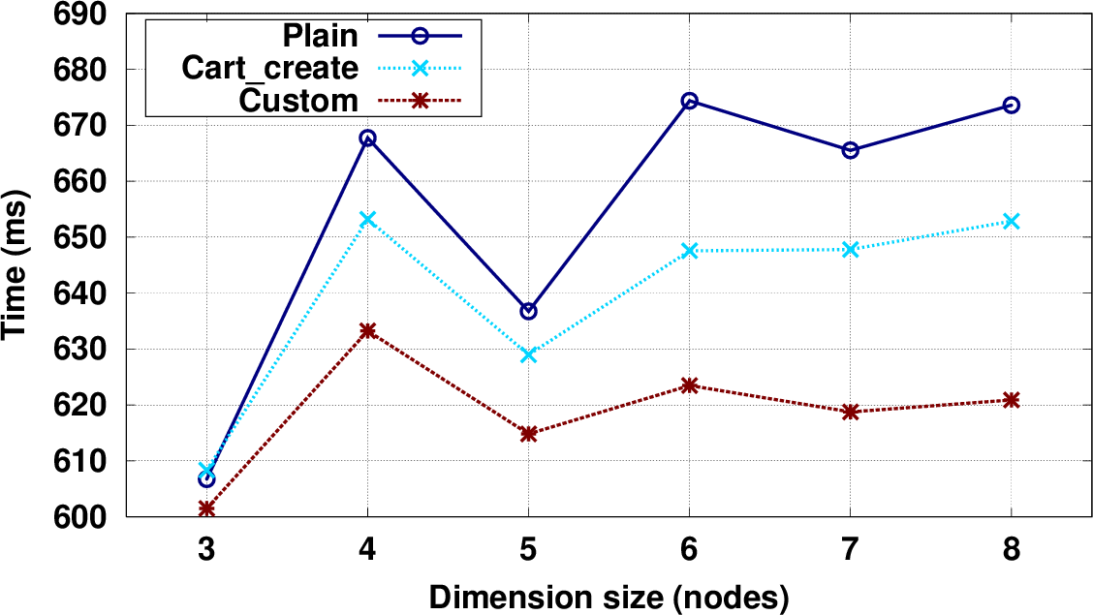
Stencil Communications
Cray MPICH ignores the reorder parameter in MPI_Cart_create
MPI topo. not matching network
2D & 3D halo exchange (contig. nodes):
Plain: Manual ordering X-Y-Z
Cart_create: Y-major / Z-Y-X
Custom: MPI-network matching
2D:
Cart_create worst performance
Plain up to 1.4%; Cart_create 4%
3D:
Topology matching outperforms MPI-assisted sorting up to 5%
Topology matching favors scalability
2D
3D

Slide 17
Conclusions

Slide 18
Conclusions
Studied the anisotropic implications of Cray Gemini networks on MPI comms.
Characterized this network be means of point-to-point micro-benchmarks
Studied the behavior of MPI collectives along the different dimensions / planes
Considering the nodes sharing a network Cartesian coordinate along the Y dimension is highly beneficial, maximizing the use of the network resources
Including awareness of the network topology in the MPI library outperforms the available heuristic-based rank ordering
Future work: non-contiguous allocations employing existing mapping libraries

Slide 19
Thank you!

