Slide 1
On the Efficacy of GPU-Integrated MPI for Scientific Applications
Ashwin M. Aji, Lokendra S. Panwar, Wu-chun Feng | … | Virginia Tech
Pavan Balaji, James Dinan, Rajeev Thakur | … | Argonne National Lab.
Feng Ji, Xiaosong Ma | … | N. C. State University
Milind Chabbi, Karthik Murthy, John Mellor-Crummey | … | Rice University
Keith R. Bisset Presenter: Ashwin M. Aji Ph.D. Candidate, Virginia Tech | … | Virginia Bioinformatics Inst.

Slide 2
Overview
We describe the hybrid design and optimization strategies of today’s MPI+GPU applications.
We show how GPU-integrated MPI helps to expand this design and optimization space.
We evaluate and discuss the tradeoffs of the new design and optimizations …
… using real application case studies from epidemiology and seismology domains.
… on HokieSpeed, a 212 TFlop CPU-GPU cluster at Virginia Tech.

Slide 3

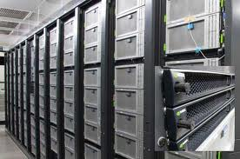
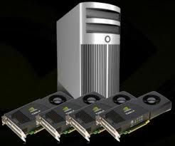
Accelerator-Based Supercomputers
Accelerator Vendors/Models
NVIDIA 2050/2070/2090/K20x
Intel Xeon Phi (MIC)
IBM PowerXCell 8i
AMD Firepro/Radeon
Notes:
It is important to understand how the accelerators, such as GPUs, inter-operate with CPUs in cluster environments. How easy is it to program them? What will be the performance?

Slide 4
Programming HPC Systems
CPU
CPU
CPU
MPI
Mantra: Overlap communication with computation
CPU

Slide 5
Programming HPC Systems
CPU
GPU
Mantra(s)
Overlap CPU-CPU communication with CPU computation
Overlap CPU computation with GPU computation
Overlap CPU-CPU communication with CPU-GPU communication
Overlap xPU-xPU communication with xPU computations
CPU
CPU
GPU
MPI
GPU
PCIe
PCIe
CPU
GPU

Slide 6
What is GPU-integrated MPI?
GPU
device memory
GPU
device memory
PCIe
PCIe
CPU
main memory
Network
CPU
main memory
MPI Rank = 0
MPI Rank = 1
if(rank == 0)
{
GPUMemcpy(host_buf, dev_buf, D2H)
MPI_Send(host_buf, .. ..)
}
if(rank == 1)
{
MPI_Recv(host_buf, .. ..)
GPUMemcpy(dev_buf, host_buf, H2D)
}

Slide 7
What is GPU-integrated MPI?
int processed[chunks] = {0};
for(j=0;j<chunks;j++) { /* Pipeline */
cudaMemcpyAsync(host_buf+offset, gpu_buf+offset,
D2H, streams[j], ...);
}
numProcessed = 0; j = 0; flag = 1;
while (numProcessed < chunks) {
if(cudaStreamQuery(streams[j] == cudaSuccess)) {
/* start MPI */
MPI_Isend(host_buf+offset,...);
numProcessed++; processed[j] = 1;
}
MPI_Testany(...); /* check progress */
if(numProcessed < chunks) /* next chunk */
while(flag) {
j=(j+1)%chunks; flag=processed[j];
}
}
MPI_Waitall();
GPU
device memory
GPU
device memory
PCIe
PCIe
Performance vs. Programmability tradeoff
Multiple optimizations for different...
…GPUs (AMD/Intel/NVIDIA)
…programming models (CUDA/OpenCL)
…library versions (CUDA v3/CUDA v4)
CPU
main memory
Network
CPU
main memory
MPI Rank = 0
MPI Rank = 1

Slide 8
What is GPU-integrated MPI?
GPU
device memory
GPU
device memory
PCIe
PCIe
Examples: MPI-ACC, MVAPICH, Open MPI
Programmability: multiple accelerators and prog. models (CUDA, OpenCL)
Performance: system-specific and vendor-specific optimizations (Pipelining, GPUDirect, pinned host memory, IOH affinity)
Performs great on benchmarks! How about in the context of complex applications?
CPU
main memory
Network
CPU
main memory
MPI Rank = 0
MPI Rank = 1
if(rank == 0)
{
MPI_Send(any_buf, .. ..)
}
if(rank == 1)
{
MPI_Recv(any_buf, .. ..)
}

Slide 9
Outline
What is GPU-integrated MPI?
Programming CPU-GPU systems using simple MPI and GPU-integrated MPI
Evaluating the efficacy of GPU-integrated MPI
Conclusion

Slide 10
Using GPU-integrated MPI
CPU
GPU
CPU
CPU
GPU
GPU-MPI
GPU
CPU
GPU

Slide 11
A Programmer’s View
CPU
CPU
GPU
GPU
GPU
Provides a clean and natural interface to communicate with the intended communication target
All the communication optimization details are hidden under the MPI layer
Computation model still remains the same – GPU kernel offload from the CPU
CPU
CPU
CPU
CPU
MPI
GPU-MPI
GPU
CPU
CPU
GPU
GPU

Slide 12
Using GPU-integrated MPI (2)
CPU
Preprocess
CPU
CPU
MPI
GPU
CPU

Slide 13
Using GPU-integrated MPI (2)
CPU
Preprocess
CPU
CPU
GPU-MPI
GPU
It enables the programmer to naturally consider even the GPU for preprocessing, which is usually against the norms.
GPU preprocessing need not always be a good idea, but at least that option can easily be explored and evaluated.
CPU

Slide 14
Using GPU-integrated MPI (2)
CPU
Preprocess
CPU
CPU
GPU-MPI
GPU
CPU
Notes:
This slide is to reiterate that it is possible to use GPU-MPI as a superset of MPI with same functionality as MPI

Slide 15
Capabilities of GPU-integrated MPI
Capabilities of MPI
Simultaneously execute multiple processes.
Overlap communication with computation.
Additional capabilities of GPU-integrated MPI
Overlap CPU-CPU communication with CPU-GPU communication (internal pipelining).
Overlap xPU-xPU communication with CPU computation and GPU computation.
Provides a natural interface to move data and choose CPU or GPU for the next task at hand.
Efficiently manages resources while providing optimal performance

Slide 16
Outline
What is GPU-integrated MPI?
Programming CPU-GPU systems using simple MPI and GPU-integrated MPI
Evaluating the efficacy of GPU-integrated MPI
Conclusion

Slide 17
Evaluation and Discussion
Case Studies
Epidemiology Simulation (EpiSimdemics)
Seismology Simulation (FDM-Seismology)
Experimental Setup
HokieSpeed: CPU-GPU cluster at Virginia Tech
Used up to 128 nodes, where each node has
two hex-core Intel Xeon E5645 CPUs
two NVIDIA Tesla M2050 GPUs
CUDA toolkit v4.0 and driver v270.

Slide 18
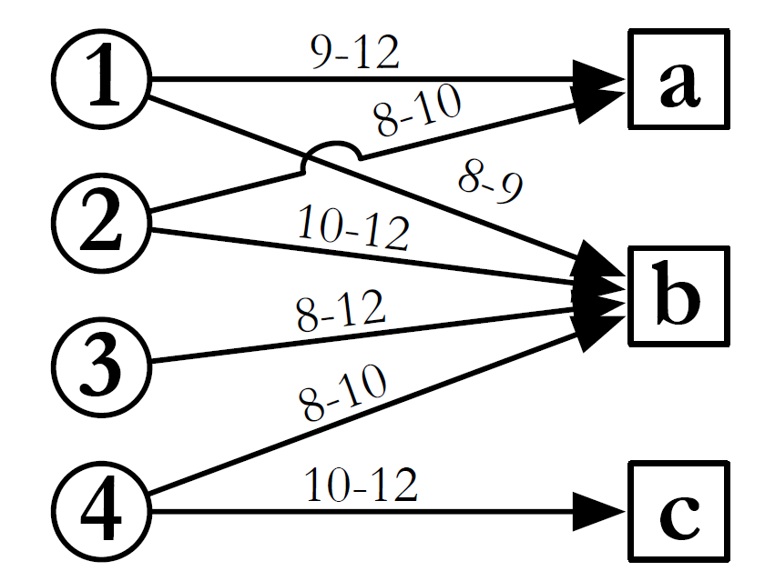
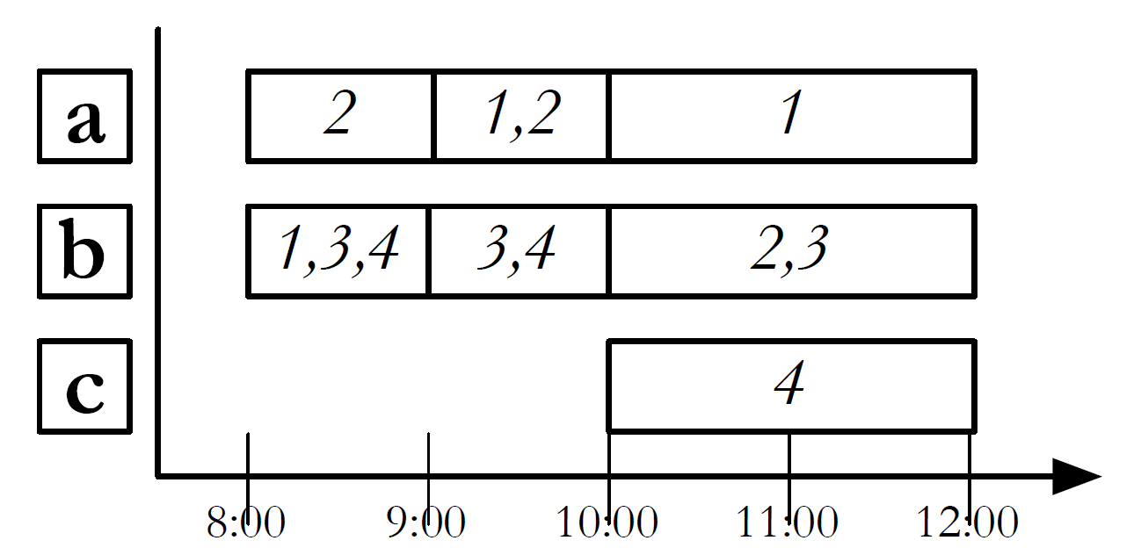
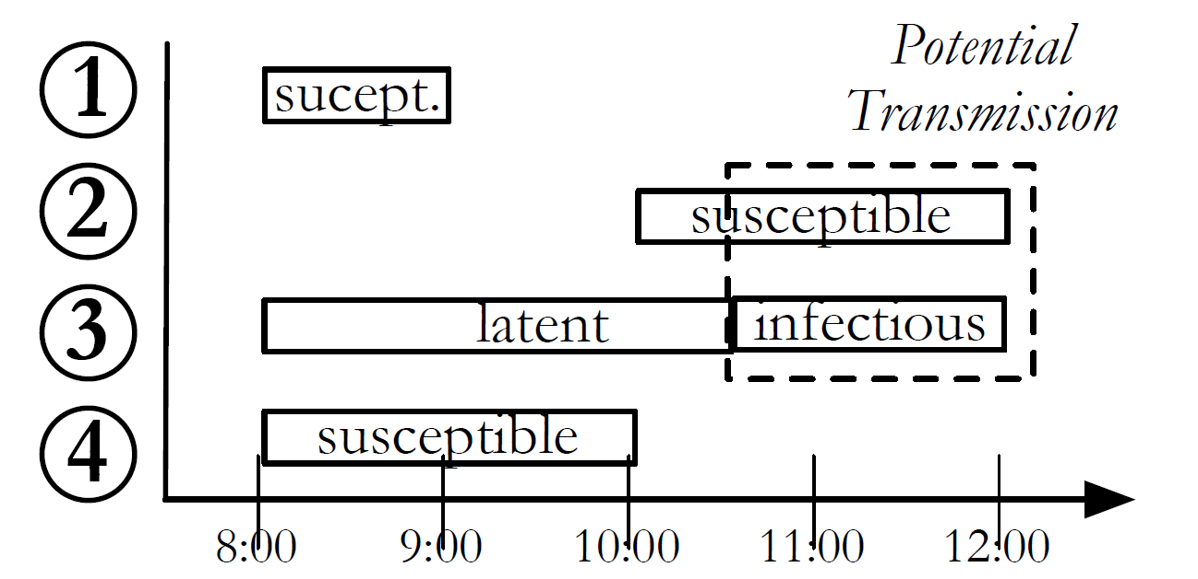
EpiSimdemics: Infection propagation simulator
Receive Visit Messages
Preprocess Data
Compute Interactions
(on GPU)
N
Person: N
Location: m
m
Location b

Slide 19
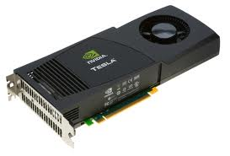
EpiSimdemics Algorithm
a
d
b
c
CPU 1
f
e
person computes visits
person sends visit messages
location receives visits
location computes infections
location sends outcomes
person receives outcomes
person combines outcomes
g
…
…
Offload
CPU n
Persons
MPI
Locations

Slide 20
Case Study for GPU-MPI: Epidemiology
Network
MPI+CUDA
PE_{i} (Host CPU)
for(j=0;j<chunks;j++) {
MPI_Irecv(host_chunk[j], ...);
}
MPI_Waitall();
gpuMemcpy (dev_buf, host_buf, H2D);
gpuPreprocess (dev_buf);
gpuDeviceSynchronize();
1. Copy to GPU
2. Preprocess on GPU
gpuMemcpy NOT an overhead here
gpuPreprocess is an overhead
can be pipelined
GPU_{i} (Device)
Notes:
Scheme III

Slide 21
Case Study for GPU-MPI: Epidemiology
MPI+CUDA (Advanced)
Network
allocate(host_chunks[N]); allocate(dev_chunks[N]);
for(j=0;j<chunks;j++) {
MPI_Irecv(host_chunk[j], ...);
}
while(condition) {
/* Pipeline ALL data transfers and
preprocessing kernels */
if( MPI_Testany(request[i], ...) ) {
gpuMemcpyAsync(dev_chunk[i], host_chunk[i], &event[i]);
}
if( gpuEventQuery(event[k]) ) {
gpuPreprocess (dev_chunk[k]);
}
}
gpuDeviceSynchronize();
Good
Overlapped CPU-CPU communication with CPU-GPU communication
Overlap communication with GPU Preprocessing
Bad
Pinned memory footprint increases with number of processes (unless you write your own memory manager as well…)
The data movement pattern in EpiSimdemics is nondeterministic
Code can get verbose
PE_{i} (Host CPU)
1a. Pipelined data transfers to GPU
1b. Overlapped Preprocessing with internode CPU-GPU communication
GPU_{i} (Device)
Notes:
Scheme III

Slide 22
Case Study for GPU-MPI: Epidemiology
GPU-MPI
Network
allocate(dev_chunks[N]); for(j=0;j<chunks;j++) {
MPI_Irecv(dev_chunk[j], ...);
}
while(condition) {
/* Pipeline data transfers and
preprocessing kernels */
if( MPI_Testany(request[i], ...) ) {
gpuPreprocess (dev_chunk[i]);
}
}
gpuDeviceSynchronize();
Good
Overlapped CPU-CPU communication with CPU-GPU communication
Overlap communication with GPU Preprocessing
Pinned memory that is used for staging has constant footprint
Memory manager is implemented within GPU-MPI
Created during MPI_Init and destroyed at MPI_Finalize
Code is almost like a CPU-only MPI program!
More natural way of expressing the computational and/or communication target
PE_{i} (Host CPU)
1a. Pipelined data transfers to GPU
1b. Overlapped Preprocessing with internode CPU-GPU communication
GPU_{i} (Device)
Notes:
Scheme III

Slide 23
Case Study for GPU-MPI: Epidemiology
Network
Network
PE_{i} (Host CPU)
PE_{i} (Host CPU)
1a. Pipelined data transfers to GPU
1. Copy to GPU
1b. Overlapped Preprocessing with internode CPU-GPU communication
Pipelined preprocessing
Memory management?
Preprocessing overhead
2. Preprocess on GPU
GPU_{i} (Device)
GPU_{i} (Device)
MPI+CUDA
MPI+CUDA Adv. & GPU-MPI
Notes:
Scheme III

Slide 24
EpiSimdemics: Experimental Results
6.3% better than MPI+CUDA on average
14.6% better than MPI+CUDA for lesser nodes
24.2% better than MPI+CUDA Adv. on average
61.6% better than MPI+CUDA Adv. for larger nodes
Notes:
WA

Slide 25
Cost of GPU Preprocessing (MPI+CUDA vs. GPU-MPI)
Preprocessing on GPU is completely hidden
Scope for optimization lessens for more nodes because of strong scaling

Slide 26
Cost of Pinned Memory Management (MPI+CUDA Adv. vs. GPU-MPI)

Slide 27
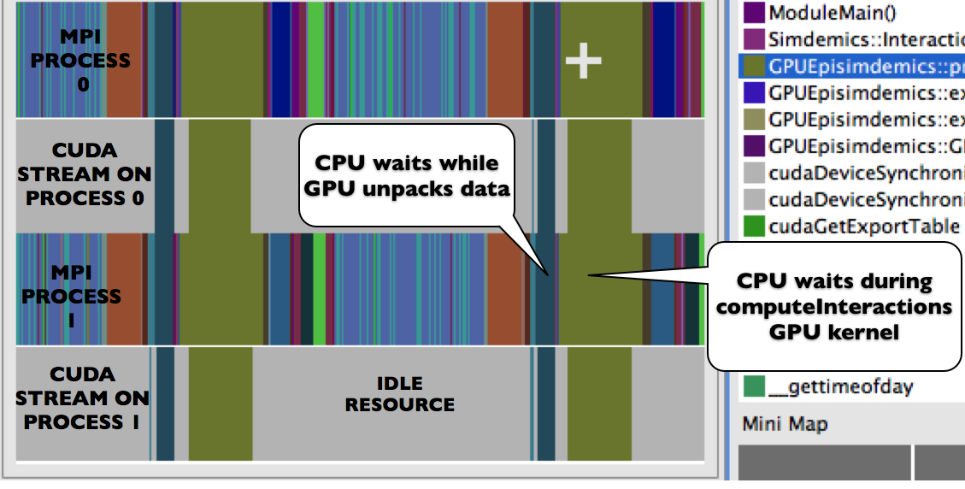
HPCToolkit Analysis: MPI+CUDA

Slide 28
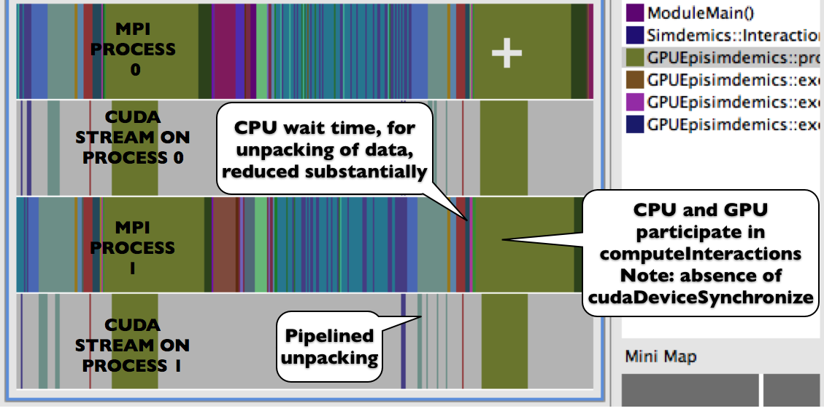
HPCToolkit Analysis: GPU-MPI

Slide 29
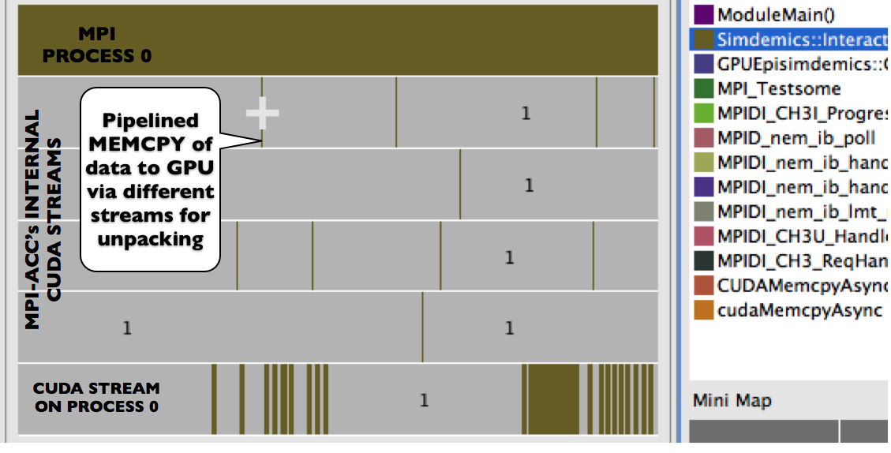
Overlapping CPU-GPU Communication with GPU Preprocessing

Slide 30
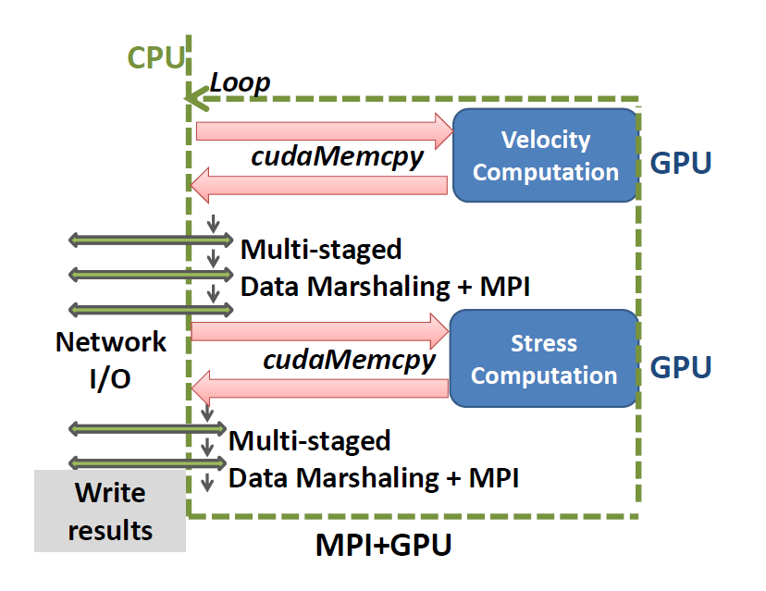
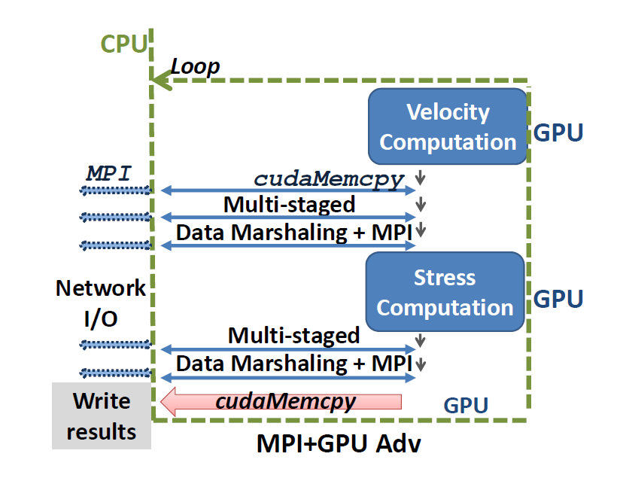
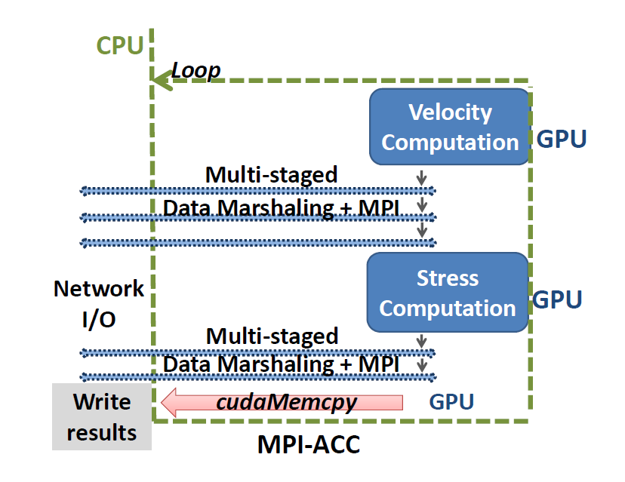
Case Study for GPU-MPI: FDM-Seismology
GPU-MPI

Slide 31
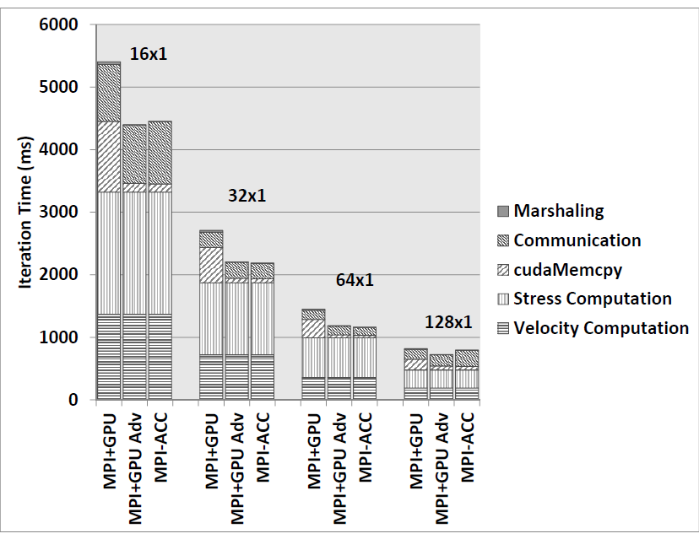
FDM-Seismology: Experimental Results
~43% overall improvement

Slide 32
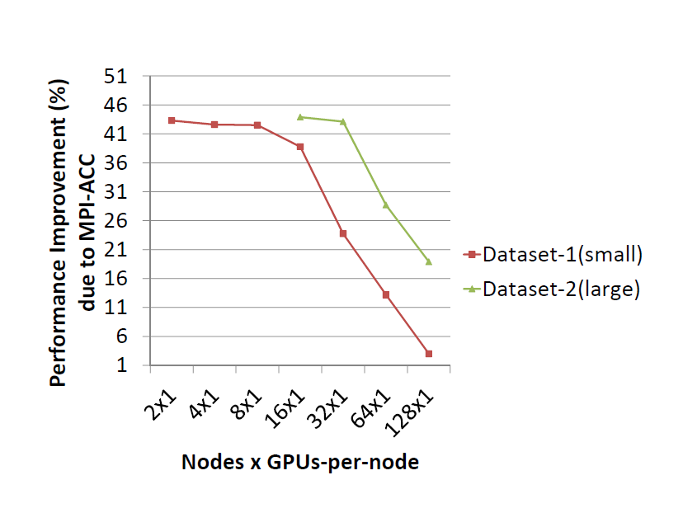
FDM-Seismology: Experimental Results
As the number of nodes increase (strong scaling)…
cudaMemcpy time decreases and benefits of hiding it also decreases (strong scaling)
xPU-xPU MPI communication becomes significant

Slide 33
Outline
What is GPU-integrated MPI?
Programming CPU-GPU systems using simple MPI and GPU-integrated MPI
Evaluating the efficacy of GPU-integrated MPI
Conclusion

Slide 34
Efficacy of GPU-integrated MPI
Natural interface to express communication/computation targets
Overlapped xPU-xPU communication with xPU computation for better resource utilization
Efficient buffer management techniques for improved scalability
Convenient for programmers to explore and evaluate newer design/optimization spaces
GPU-driven data partitioning (read the paper)
GPU-driven data marshaling
Questions?
Contact:
Ashwin Aji (aaji@cs.vt.edu)
Prof. Wu Feng (feng@cs.vt.edu)

Slide 35
BACKUP SLIDES

Slide 36
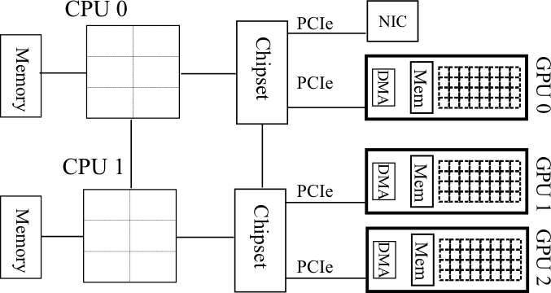
Intra-node Topology Awareness
Graphics Processing Units (GPUs)
Many-core architecture
Prog. Models: CUDA, OpenCL, OpenACC
Explicitly managed global memory and separate address spaces
CPU clusters
Most popular parallel prog. model: Message Passing Interface (MPI)
Host memory only
Disjoint Memory Spaces!
Keeneland Node Architecture

