Slide 1
pVOCL: Power-Aware Dynamic Placement and Migration in Virtualized GPU Environments
Palden Lama, Xiaobo Zhou, University of Colorado at Colorado Springs
Pavan Balaji, James Dinan, Rajeev Thakur, Argonne National Laboratory
Yan Li, Yunquan Zhang, Chinese Academy of Sciences
Ashwin M. Aji, Wu-chun Feng, Virginia Tech
Shucai Xiao, Advanced Micro Devices

Slide 2
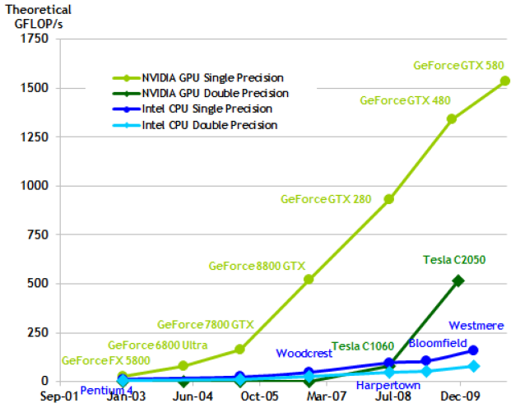
Trends in Graphics Processing Unit Performance
Performance improvements come from SIMD parallel hardware, which is fundamentally superior with respect to number of arithmetic operations per chip area and power
Notes:
Accelerator for compute intensive tasks
Significant speedup

Slide 3
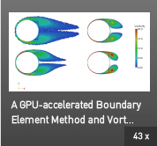

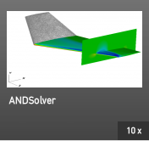
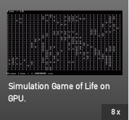


Graphics Processing Unit Usage in Applications
(From the NVIDIA website)
Programming models (CUDA, OpenCL) have greatly eased the complexity in programming these devices and quickened the pace of adoption
Notes:
popularity as accelerators for core computational kernels across a broad range of scientific, engineering, and enterprise computing applications

Slide 4
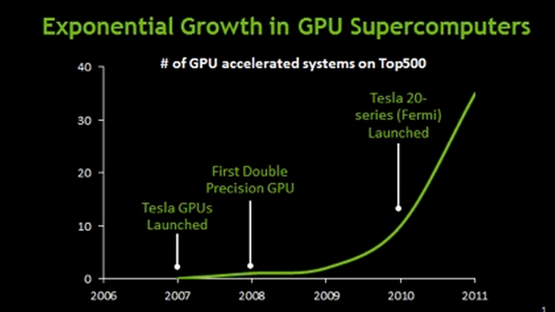
GPUs in HPC Datacenters
GPUs are ubiquitous accelerators in HPC data centers
Significant speedups compared to CPUs due to SIMD parallel hardware
At the cost of high power usage
GPU/CPU | TDP (Thermal Design Power)
512-core NVIDIA Fermi GPU | 295 Watts
Quad-core x86-64 CPU | 125 Watts

Slide 5
Motivation and Challenges
Peak power constraints
Power constraints imposed at various levels in a datacenter
CDUs equipped with circuit breakers in case of power constraint violation
A bottleneck for high density configurations, specially when power-hungry GPUs are used
Time-varying GPU resource demand
GPUs could be idle at different times
Need for dynamic GPU resource scheduling
Notes:
power delivery and cooling limitations in data centers impose peak power constraints at various levels

Slide 6
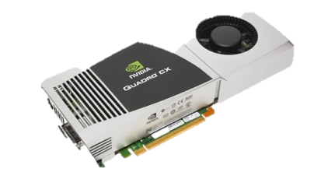
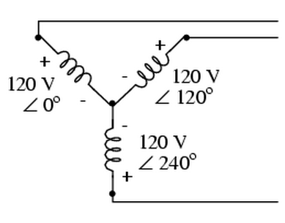

GPU clusters in 3-phase CDU
GPU1
Complex power consumption characteristics depending on the placement of GPU workloads across various compute nodes, & power-phases
Power drawn across the three phases needs to be balanced for better power efficiency and equipment reliability.
Power-aware placement of GPU workloads
Power Strip
GPU2
Phase 1
GPU3
Phase 2
GPU4
Phase 3
GPU5
3-phase power supply
GPU6
Cabinet
Notes:
Today data center cabinets equipped with 3-Phase power supply and distribution units (CDUs) TO cater for increased power demands, greater equipment densities
and cost reduction initiatives

Slide 7
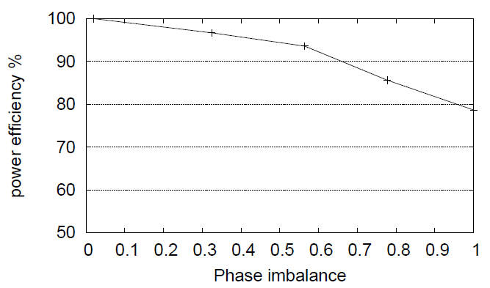
Impact of Phase Imbalance
Phase imbalance
(Power_{Ph1} – Avg. Power),
= max (Power_{Ph2} – Avg. Power),
(Power_{Ph3} – Avg. Power)
---------------------------------------
Avg. Power
Notes:
We compare the power consumption of several node configurations with a configuration where the load is balanced equally across all three phases
Six compute nodes are used and we measure the power consumed over several permutations of these nodes with respect to power phase.

Slide 8
pVOCL: Power-Aware Virtual OpenCL
Online power management of GPU-enabled server clusters
Dynamic consolidation and placement of GPU workloads
Improves energy efficiency
Control peak power consumption
Investigates and enables the use of GPU virtualization for power management
Enhances and utilizes the Virtual OpenCL (VOCL) library

Slide 9
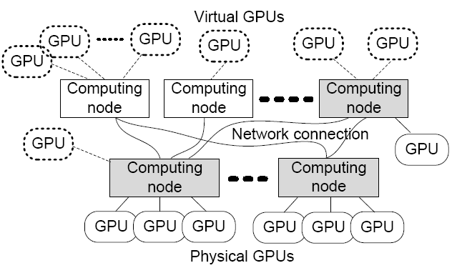
GPU Virtualization
Transparent utilization of remote GPUs
Remote GPUs look like local “virtual” GPUs
Applications can access them as if they are regular local GPUs
Virtualization will automatically move data and computation
Efficient GPU resource management
Virtual GPUs can migrate from one physical GPU to another
If a system administrator wants to add or remove a node, he/she can do that while the applications are running (hot-swap capability)
Notes:
Traditionally, GPU-accelerated application executions are tightly coupled to the physical GPU hardware, requiring each computational node to be equipped with one or more
local GPUs.
Recent efforts on GPU virtualization VOCL and rCUDA expose physical GPUs as decoupled virtual resources.
However, the potential use of GPU virtualization for power management in GPU-enabled server clusters is not well-explored.

Slide 10
VOCL: A Virtual Implementation of OpenCL to access and manage remote GPU adapters [InPar’12]
Compute Node
VOCL Proxy
Compute Node
OpenCL API
Application
Native OpenCL Library
Compute Node
MPI
Application
OpenCL API
Physical GPU
OpenCL API
VOCL Library
Native OpenCL Library
MPI
Virtual GPU
Virtual GPU
Compute Node
Physical GPU
VOCL Proxy
Traditional Model
OpenCL API
Native OpenCL Library
VOCL Model
Physical GPU
Notes:
VOCL runtime system consists of the VOCL library, which the application interfaces with, and a VOCL proxy process on each remote node, which manages connections to the node’s physical GPUs
Migration of VGPU: OpenCL resource used by an application on a physical gpu

Slide 11
pVOCL Architecture
VOCL Power Manager
VGPU migration
Power
Optimizer
Next
Migration
Manager
VOCL Proxy
nodes
Config.
Power ON/OFF
Current config.
Power
Model
Topology
Monitor
VGPU mapping
Cabinet Distribution
Unit (CDU)
Node-Phase mapping
Testbed Implementation:
- Each compute node has 2 NVIDIA Tesla C1060 GPUs.
- CUDA 4.2 toolkit
Switched CW-24VD/VY 3-Phase CDU
- MPICH2 MPI (Ethernet connected nodes)
GPU virtualization using VOCL library

Slide 12
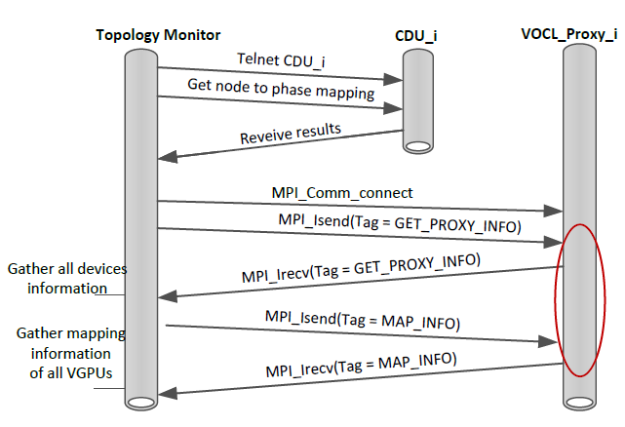
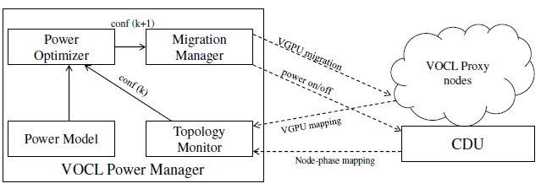
Topology Monitor
Notes:
Control messages:
PROXY INFO: number of available GPUs and the device Ids
MAP INFO: mapping VGPU – physical GPUs

Slide 13
GPU consolidation and placement: Optimization Problem
initial config.
c₀
c_{i} : configuration
p (c_{i}) : power usage
g (c_{i}) : number of GPUs
a_{i} : adaptation action
d (a_{i}) : length of adaptation
P : peak power budget
d (a_{n})
c_{n}
d (a₁)
c₁
p (c_{n}),
g (c_{n})
p (c₁),
g (c₁)
Finding a sequence of GPU consolidation and node placement actions to reach from configuration c₀ to c_{n}
The final config. should be the most power-efficient for the current GPU demand
Any intermediate config. must not violate the power budget
Each intermediate config. must meet the current GPU demand
In case of multiple final configs., find the one that can be reached in the shortest time
Dijkstra’s Algorithm
(single source shortest paths)

Slide 14
Optimization Algorithm
Current node configuration is set as source vertex in the Graph.
Apply Dijkstra’s algorithm to find single source shortest paths to remaining nodes such that
Each intermediate vertex does not violate power constraint
Each intermediate vertex satisfies the GPU demand
Optimization problem is reduced to a search problem from a list of target nodes.
Search criteria is defined by the optimization models.

Slide 15
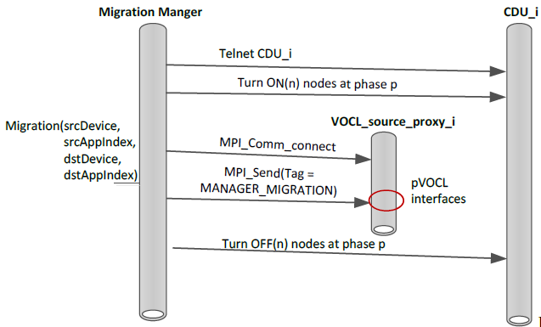
Migration Manager
Notes:
Based on the VGPU mapping information of the existing configuration and that of the target configuration,
identify the VGPUs that need to be migrated from one proxy node to another

Slide 16
Evaluation
Each compute node has Dual Intel Xeon Quad Core CPUs, 16 GB of memory, and two NVIDIA Tesla C1060 GPUs
CUDA 4.2 toolkit
Switched CW-24VD/VY 3-Phase CDU (Cabinet Power Distribution Unit).
MPICH2 MPI for Ethernet connected nodes
Application kernel benchmarks:
Matrix-multiplication, N-Body, Matrix-Transpose, Smith-Waterman

Slide 17
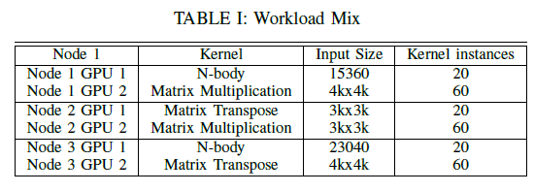
Impact of GPU Consolidation
43% & 18% improvement

Slide 18
Impact of GPU Consolidation (with various workload mixes)
Notes:
we study the impact of workload mix variations on the energy efficiency of the three power management techniques
measure the total energy usage of the system for a fixed period of time using eight variations of the workload mix
In each variation, we change the number of kernel instances so that the average program execution time remains unchanged while the standard deviation varies.

Slide 19
Power-phase Topology Aware Consolidation
Workload
3 compute nodes per phase
Each node has 2 GPUs
20 n-body instances in phase 1 GPUs
40 n-body instances in phase 2 GPUs
80 n-body instances in phase 3 GPUs
14% improvement

Slide 20
Peak Power Control (Power budget 2000 Watts)
Notes:
Three compute nodes in one of the power-phase circuits in the 3-phase CDU. We execute 100 instances of N-body kernel benchmarks with input sizes
it can turn on only one compute node power-phase 2 initially

Slide 21
Peak Power Control (Power budget 2600 Watts)
Notes:
the decrease in power consumption due to pVOCL occurs much earlier
turns on two compute nodes in power-phase 2 and one compute node in power-phase 1 without violating the power budget of 2600 Watts

Slide 22
Peak Power Control
Higher power budget allows distribution of the workloads across different power-phases to reach more power-efficient configurations much earlier.

Slide 23
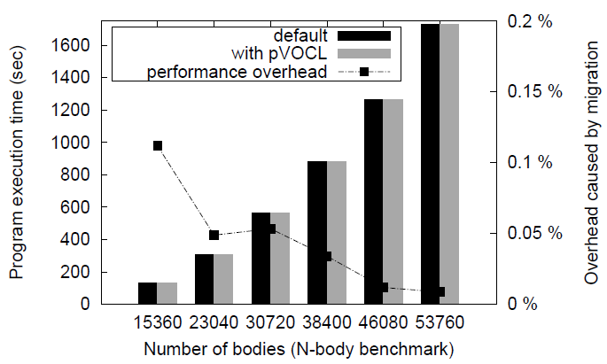
Overhead Analysis
Migration time very small compared to Computation time.
Time required to turn on compute nodes has no effect on performance.

Slide 24
Conclusion
We investigate and enable dynamic scheduling of GPU resources for online power management in virtualized GPU environments.
pVOCL supports dynamic placement and consolidation of GPU workloads in a power aware manner.
It controls the peak power consumption and improves the energy efficiency of the underlying server system.

Slide 25
Thank You !
Email: plama@uccs.edu
Webpage: http://cs.uccs.edu/~plama/

