Slide 1


MPI-Interoperable generalized Active Messages
Xin Zhao, Pavan Balaji, William Gropp, Rajeev Thakur
University of Illinois at Urbana-Champaign
Argonne National Laboratory
ICPADS’13
December 17, 2013
Notes:
30 minutes including Q&A time
21 real pages
Hello everyone, my name is Xin Zhao,
today I am going to present our work on MPI-interoperable generalized active messages,
It is done by UIUC and ANL,

Slide 2
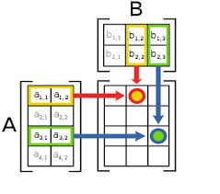
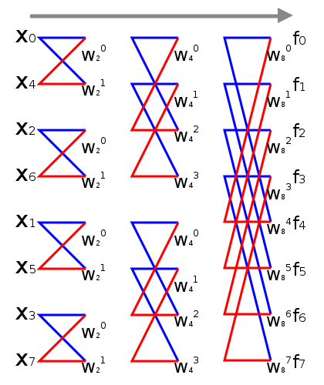
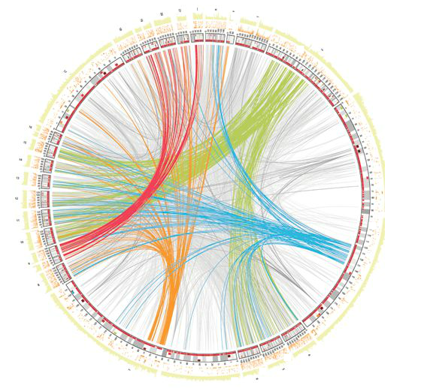
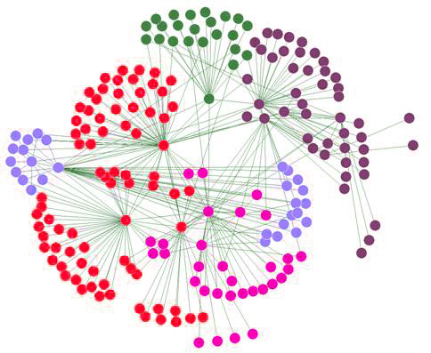
Data-Intensive Applications
“Traditional” applications
Organized around dense vectors or matrices
Regular communication, use MPI SEND/RECV or collectives
Communication-to-computation ratio is low
Example: stencil computation, matrix multiplication, FFT
Data-intensive applications
Organized around graphs, sparse vectors
Communication pattern is irregular and data-dependent
Communication-to-computation ratio is high
Example: bioinformatics, social network analysis
Notes:
In recent years, many new applications have become important in both research areas and academic areas,
These applications are very different with “traditional” applications in many aspects,
They are typically…
We call these new applications as data-intensive applications,
although it is a big word, here we refer it to the applications that have those characteristics.

Slide 3

Data-Intensive Applications
Graph algorithm (BFS)
DNA sequence assembly
remote node
ACGCGATTCAG
GCGATTCAGTA
ACGCGATTCAGTA
remote search
local node
DNA consensus sequence
Common characteristics
Organized around sparse structures
Communication-to-computation ratio is high
Irregular communication pattern
Notes:
One typical example of data-intensive application is graph algorithms,
which are widely used in social network analysis,
like breadth-first search,
In the application, vertexes are distributed to different processes,
in each level, the algorithm scans neighbors of vertexes,
For example, to find friend connections, recommendations, etc.
Another typical example is DNA assembly,
it is a sub-field of bioinformatics area,
In the application, database of short DNA sequences are stored on distributed memory,
One fundamental operation in this application is searching for overlapping of sequences,
All these data-intensive applications have common characteristics that …,

Slide 4
Massage Passing Interface (MPI)
Industry standard communication runtime for high performance computing
Process 0
Process 1
Process 0
Process 1
Send (data)
Put (data)
Receive (data)
Get (data)
Receive (data)
Send (data)
Acc (data)
+=
two-sided communication
(explicit sends and receives)
one-sided (RMA) communication
(explicit sends, implicit receives, simple remote operations)
remote node
ACGCGATTCAG
GCGATTCAGTA
ACGCGATTCAGTA
remote search
X
not sufficient
DNA consensus sequence
local node
Notes:
The Message Passing Interface is the industry standard communication runtime for high-performance computing,
It provide a very clear way for processes on different cores/nodes to communicate with each other,
An efficient and scalable MPI implementation is provided by the system vendor for virtually every parallel computing platform
In MPI, there are two kinds of communication:
One is two-sided, …
Another is one-sided, …
The communication pattern of one-sided is natural for data-intensive applications,
Which involves large amount of data send to random nodes,
But it still not sufficient for the applications,
For example, in DNA assembly application,…
One-sided cannot support such complex operation on the target side

Slide 5
MPI and Data-Intensive Applications
Use MPI two-sided with dedicated threads / processes for data-intensive applications
Waste cores to wait for incoming messages
Examples: SWAP / Kiki (DNA assembly), MADNESS (computational chemistry)
Process 0
Process 1
Process 2
Process N
…
application thread
service thread
J. Meng, J. Yuan, J. Cheng, Y. Wei, and S. Feng, “Small World Asynchronous Parallel Model for Genome Assembly,” Springer Lecture Notes in Computer Science, vol. 7513, pp. 145–155, 2012.
F. Xia and R. Stevens, “Kiki: Massively parallel genome assembly,” https://kbase.us/, 2012.
R. J. Harrison, “MADNESS: Multiresolution ADaptive NumErical Sci- entific Simulation,” https://code.google.com/p/m-a-d-n-e-s-s/, 2003.
Notes:
Therefore, because of the limitation of MPI one-sided,
Currently many applications still use MPI two-sided communication,
In those applications, dedicated threads/processes are needed to waiting for receiving messages,
For example, this figure shows SWAP application,
Which is a DNA assembly application,
Each process must …
Kiki and MADNESS are two other examples, they also need dedicated processes to receiving the data,
When no messages coming, the cores are wasted and cannot do any other work,

Slide 6
Active Messages Paradigm
Sender explicitly sends message
Upon message’s arrival, message handler is triggered, receiver is not explicitly involved
User-defined operations on remote process
A suitable paradigm for data-intensive applications
Data is sent immediately
Communication is asynchronous
origin
target
messages
messages
handler
reply
reply handler
Notes:
Active Messages is a different message passing model compared to MPI,
The communication pattern is similar to one-sided comm I talked before,
Only sender needs to explicitly send the message, receiver do not need to be explicitly involved,
However, sender side can specify a function to be executed on the received side,
Therefore, after message is arrived, corresponding function is triggered to process the data,
The function is defined by the user, so it can let user do whatever computations they want on the target side,
Much more flexible than MPI one-sided,

Slide 7
Motivation
MPI is the most widely used parallel programming model and many applications are written by MPI
Rewriting the entire application requires too much effort
Enable MPI-interoperable Active Messages
Applications can be modified incrementally to use AM only when necessary
Support different capabilities in one model, user can flexibly choose which one to use
7
Notes:
Therefore, we want to apply AM to existing MPI applications,
Most existing applications are written in MPI, and we want to avoid the effort of rewriting the entire applications,
In this work, we propose an framework of MPI-interoperable active messages,
And we explore how to make AM work correctly and efficiently with MPI messages,
By doing this, applications can be modified incrementally, to use AM only when necessary,
And we provide two different capacities within one framework, user can freely choose which which one to use,
not restricted to always use only one model,

Slide 8
Generalized Active Messages

Slide 9
Accumulate-style AM
Process 0
Process 1
Acc (data)
+=
Get_acc (data)
+=
Leverage MPI RMA interface
Extend Accumulate-style operations to support user function (originally for MPI_REDUCE)
User-defined function
MPI_User_function (void *invec, void *inoutvec, int *len, MPI_Datatype *dtype)
Operation creation
MPI_Op_create (MPI_User_function *user_fn, int commute, MPI_Op *user_op)
Operation registration
MPIX_Am_op_register (MPI_Op user_op, int id, MPI_Win win)
Collective call on the window
X. Zhao, D. Buntinas, J. Zounmevo, J. Dinan, D. Goodell, P. Balaji, R. Thakur, A. Afsahi, W. Gropp, “Towards Asynchronous and MPI-Interoperable Active Messages”, in proceedings of CCGrid’ 13
Notes:
Like I said before, MPI one-sided interface provide accumulate-style operations,
like…, to support simple computation on receiver side, its concept is very similar with AM,
Therefore, in our previous work, which is published in CCGrid 2013,
we extend accumulate operations to support user-defined function,
MPI provide user-defined function for MPI_REDUCE,
User can use it to defined the computation,
Then use … to attach the function to an MPI op,
Then use … to register this MPI op to an RMA window,
After that, ACC can use this MPI op to do the work,

Slide 10
Restrictions of Accumulate-style AM
Target input buffer and output buffer cannot be different count and datatype
Cannot return arbitrary data from AM handler
How to manage temporary buffers?
Streaming active messages is a problem: MPI does not know segmentation granularity
Memory consistency is not clear
origin process
AM
AM response
AM handler
target process
Notes:
However, this model of accumulate-style AM just provide a very simple functionality of AM,
It has several restrictions in real applications,
Suppose this is an working model of AM,……
……, remote search, remote histogram cannot be implemented,
Cannot return arbitrary data,
It needs temporary buffers to ……, how to manage those temporary buffers is a problem.
In MPI two-sided/one-sided communication, MPI runtime always cut messages into small blocks to send, depending on system and network, to get better performance,
However, how to stream active message is a problem, runtime cannot cut it freely, it data amount must meet the requirement of user-defined function,
Which is the minimum segmentation granularity, and this information must provided by user
(5)After we are done on the modification on target window, when the target process, or third-part party processes can seen it or modify it?
Memory consistency is not clear and should be carefully defined,

Slide 11
Streaming Active Messages
User level segmentation — “segment”
User defines the minimum number of input / output elements for the execution of AM handler (e.g. query sequence + result sequence)
System level segmentation — “pipeline unit”
Transparent to user
Each AM contains N segments, MPI can internally splits AM into multiple pipeline units , each with 1~N segments
Beneficial when: (1) no enough buffers on target
(2) pipeline effects
segment 1
segment 2
segment 3
segment 4
segment 5
segment 6
pipeline unit 1
pipeline unit 2
Notes:
First, we propose a new concept ---“segment”,
It is the minimum number of input / output elements for the execution of an AM handler, and it is defined by the user,
For example, in remote search of genome assembly application,
segment can be defined as one query sequence and one result sequence.
Each AM contains N segments, MPI can internally split AM into multiple pipeline units, each unit has 1~N segments
For example, …,
The concept of “segments” can benefit performance in two situations:
If there is no enough buffers on the target, we can allocate temporary buffer with one segment size to receive AM, no need to allocate memory space for the entire AM.
Because AM handler is triggered when each pipeline unit of AM is arrived,
with suitable size of pipeline unit, pipeline effect can be achieved so that the transmission of AMs and execution of AM handlers can be perfectly overlapped.
Note that pipeline units is transparent by the user and is set by the MPI runtime, depending on current available buffer on the target and pipeline effect.

Slide 12
Data Buffering Requirements
Who to allocate and maintain temporary buffers?
User buffers
Accommodate at least one AM segment
Shared by all processes
Rendezvous protocol, hand-shake operation is required
Internal buffers (system buffers)
Eager protocol
May be not enough or even exist
MPIX_Am_win_buffer_attach (void *buffer, int size, MPI_Win win)
MPIX_Am_win_buffer_detach (void *buffer, MPI_Win win)
Notes:
One option is to let MPI runtime to allocate and maintain temporary buffers, we call this “internal buffer” or “system buffer”
So that origin process knows beforehand that how much temporary buffer is available on the target, and it can send AMs with eager protocol.
However, because MPI runtime cannot know the upper bound of buffer space that AM requires, we cannot assume that internal buffers will always be enough,
Given an MPI implementation, if it is not explicitly specified, we cannot even assume that internal buffer exists,
Therefore, to guarantee the correctness, we let the user to provide temporary buffers to MPI implementation,
These two routines are used to attach user buffer to the window,
The user buffer should accommodate at least true extent of one segment data.
The user buffer is shared by all processes, therefore origin process needs to do hand-shake operation to reserve buffer before sending AMs
If MPI implementation must use user buffers, it must do communication with rendezvous protocol,
Even though user buffers are provided, MPI implementation may still choose to use internal buffers if possible,
In such situation communication can be optimized,

Slide 13
Correctness Semantics
Memory Consistency / Ordering / Concurrency / Atomicity
Notes:
To make AM work correctly with other MPI messages,
correctness semantics need to be carefully defined,
There are many subtle issues in semantics,
here we discuss four most important semantics:
memory consistency, ordering, concurrency, atomicity

Slide 14
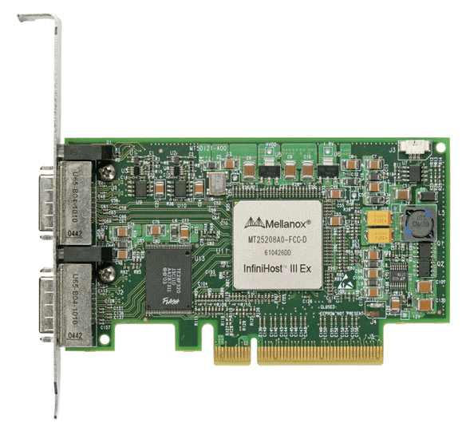
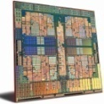
MPI-3 RMA Memory Model
MPI-3 provides two memory models: SEPARATE and UNIFIED
MPI-2: SEPARATE model
Logical public and private copies
MPI provides software coherence between window copies
Extremely portable to systems that don’t provide hardware coherence
MPI-3: new UNIFIED model
Single copy of the window
System must provide coherence
Superset of separate semantics
e.g. allows concurrent local/remote access
Provides access to full performance potential of hardware
Public
Copy
Unified
Copy
Private
Copy

Slide 15
Interoperability
AM vs. RMA – RMA operations access “public” window, whereas AM handlers access “private” window
In SEPARATE window model, if AM and RMA, or AM and AM, or AM and STORE, update on the same window, even on non-overlapping locations, result data is undefined
AM write
PUT
AM write
public copy
Invalid operation combinations
private copies
STORE
Notes:
This difference cause some issues when AM works with RMA operations.
When AM and other RMA operation working on the same window, even for non-overlapping locations, data is undefined, (cache line, false-sharing)

Slide 16
Maintaining Memory Consistency
In both SEPARATE and UNIFIED window models, MPI runtime should ensure the consistency of window
memory barrier
memory barrier
AM handler
AM handler
flush cache line back
memory barrier
memory barrier
SEPARATE window model
UNIFIED window model
Notes:
Do we need flush cache line back/memory barrier before AM begins?
===========
SEPARATE window: flush cache line back to make private window and public window consistent
UNIFIED window: perform memory barrier to prevent instruction reordering
For separate window models, MPI implementation should flush the data back to memory after AM finishes, whereas for unified window model,
MPI implementation should call a full memory barrier after execution of AM to ensure future reads from window memory return the updated data.

Slide 17
Ordering
By default three orderings are imposed:
AMs with different operations
AMs with the same operation
Segments within one AM
when AMs are from same origin, to same target, update on same window and overlapping memory locations
all orderings can be released using MPI info for better performance!
origin
target
AM 1
AM 2
window
Notes:
“as if” also apply to ordering
Think about some user cases?
====================================
Release ordering can benefit applications that only read the data but not update it, or don’t over write each other
The more relaxed semantics can allow MPI implementation to achieve better performance.
AMs are unordered to other RMA operations

Slide 18
Concurrency
By default, MPI implementation is “as if ” AMs are executed in some sequential order
If MPI implementation can know that concurrency is inconsequential (e.g. target data is non-overlapping), it can execute AMs concurrently
concurrency can be released using MPI assert for better performance!
strict ordering may force MPI implementation to disable concurrency
☹
Notes:
Benefits: (1) AMs do not overwrite each other (2) AMs only read data from target window
Strict ordering – might still disable concurrency

Slide 19
Other Considerations
Atomicity is not provided by MPI
It is OK if all accesses in AM are read-only ☺
If you don’t need concurrency, atomicity is not a concern
User can emulate atomic AM using exclusive window lock
AM handler is not allowed to call other MPI functions
MPI stack needs to be reentrant-safe
Require higher thread level of MPI runtime to guarantee thread-safety
Notes:
It is OK if all accesses in the AM function are read-only access,
the lack of atomicity will not effect that, it can still get the correct result,
Also, if you don’t need concurrency of AMs, lack of atomicity is not a problem
If you really need the atomic execution of AM function, you can always emulate it
By using exclusive window lock in MPI, which can give you the exclusive access to target window,

Slide 20
Evaluation

Slide 21
Experimental Settings
BLUES cluster at ANL: 310 nodes, with each consisting 16 cores, connected with QLogic QDR InfiniBand
Based on mpich-3.0.2
Micro-benchmarks: two common operations
Remote search of string sequences (20 chars per sequence)
Remote summation of absolute values in two arrays
(100 integers per array)
Result data is returned to origin

Slide 22
Streaming Active Messages
overlapping effect is best at unit size of 50
higher throughput is achieved when using more internal buffers
Notes:
In the first test, one process sends AM to another process, and we change the pipeline unit internally and measure the latency,
In the second test, one process sends 100,000 AMs to another process, and we measure the throughput,
As we increase the pipeline unit, an increasing large fraction of segments use the user buffer,

Slide 23
Impact of Internal Buffer
using and freeing of internal buffers are balanced
providing more system buffers brings 1.7 times improvement
Notes:
More internal buffer provided, better performance achieved,
Performance increased: because hand-shake is reduced,
A steady state is reached at this point, it is because … providing more internal buffers will not make a difference,

Slide 24
Impact of Ordering and Concurrency
epoch alternates between large AMs and small AMs
concurrent AMs is enabled by “local computation”
Notes:
These two example shows performance advantage when we disable ordering and enable concurrency,
In the first test, sender process always alternate between sending large AMs and small AMs,
When we enable ordering, small AMs must issued after large AMs, even though there are enough buffers on target for it,
When we disable ordering, small AMs can be reordered before large AMs to send, therefore when large AM waiting for availability of temporary buffers,
We can send small AMs,
The second example is done within one node,
All processes allocate the window in SHM region,
each process send messages to same target process,
When we disable concurrency, as process number grows, the overall throughput keeps the same,
When we enable concurrency,
we make each process to fetch the data from target process’s shared memory, do computation locally, and then push data back,
Therefore the throughput greatly increased when number of processes increases,

Slide 25
Conclusion
Data-intensive applications are increasingly important in many areas
Their characteristics make them very different with traditional applications
New parallel programming model is needed to achieve high performance and to avoid too much programming effort
Enabling Active Messages within MPI programming model and runtime system

Slide 26
Thanks! ☺

Slide 27
Backup slides

Slide 28
Active Message Trigger API
MPIX_Am
IN origin_input_addr
IN origin_input_segment_count
IN origin_input_datatype
OUT origin_output_addr
IN origin_output_segment_count
IN origin_output_datatype
IN num_segments
IN target_rank
IN target_input_datatype
IN target_persistent_disp
IN target_persistent_count
IN target_persistent_datatype
IN target_output_datatype
IN am_op
IN win

Slide 29
User-defined Handler API
origin output buffer
MPIX_Am_user_function
IN input_addr
IN input_segment_count
IN input_datatype
INOUT persistent_addr
INOUT persistent_count
INOUT persistent_datatype
OUT output_addr
OUT output_segment_count
OUT output_datatype
IN cur_num_segments
IN cur_segment_offset
origin input buffer
AM
AM response
private memory
private memory
target input buffer
target output buffer
AM handler
public window
target persistent buffer

Slide 30
Restrictions of Accumulate-style AM
origin process
remote node
ACGCGATTCAG
GCGATTCAGTA
ACGCGATTCAGTA
remote search
AM
AM response
DNA consensus sequence
local node
Restriction #1:
target input buffer and output buffer cannot be different count and datatype.
AM handler
target process
30
Notes:
First, because of the restriction of user-defined function,
Target input buffer and target output buffer must have the same data layout, they cannot be different,
It cannot handle remote search operation, where a single sequence needs to access the entire window on the target,
(other example: remote histogram, array of bins representing value ranges)

Slide 31
Restrictions of Accumulate-style AM
origin process
remote node
ACGCGATTCAG
GCGATTCAGTA
ACGCGATTCAGTA
remote search
AM
AM response
DNA consensus sequence
local node
AM handler
Restriction #2:
cannot return arbitrary data from AM handler
target process
31
Notes:
Explain what “same data layout” means.
==============
Second, runtime cannot return arbitrary data specified by the user
In MPI one-sided interface, get-accumulate can return data, but only returns origin data before computation starts on it,
In this application, we want to return the result data from AM handler

Slide 32
Restrictions of Accumulate-style AM
origin process
remote node
ACGCGATTCAG
GCGATTCAGTA
ACGCGATTCAGTA
remote search
AM
AM response
DNA consensus sequence
local node
Restriction #3:
who to provide buffers for input and output data?
AM handler
target process
32
Notes:
There should be temporary buffers that is used to place input and output data,
Is the user should provide such buffer beforehand? Or system should provide such buffer? Is not clear.
Third, the public window contains data storing on that process, but input and output buffer are
Used to stage temporary data from the origin and will return to the origin, their content
Is meaningful in the scope of handler, private to each handler,
who should be responsible to provide buffers for input and output data?

Slide 33
Restrictions of Accumulate-style AM
origin process
remote node
ACGCGATTCAG
GCGATTCAGTA
ACGCGATTCAGTA
remote search
AM
AM response
DNA consensus sequence
local node
?
Restriction #4:
MPI runtime cannot know segmentation granularity.
AM handler
target process
33
Notes:
Explain what “segmentation granularity” means.
That information should be provided from the user.
==========
Forth, in traditional MPI sometimes we segment the message to smaller units and send,
In order to achieve better performance,
but this cannot be done for AM, because MPI runtime cannot know how many elements needed for handler,
So it cannot decide the segmentation granularity.

Slide 34
Restrictions of Accumulate-style AM
origin process
remote node
ACGCGATTCAG
GCGATTCAGTA
ACGCGATTCAGTA
remote search
AM
AM response
DNA consensus sequence
local node
Restriction #5:
When result data can be seen by other processes? Memory consistency is unclear.
AM handler
target process
34
Notes:
Fifth, when result data on target window can be seen by other processes?
Suppose I first send one AM to target to trigger the computation, after that I send one GET operation to get some data back,
Does that GET operation returns the correct data?
This memory consistency issue is not clear.
According to these restrictions in our previous APIs, we propose a new AM model.

