Slide 1
Online Performance Projection for Clusters with Heterogeneous GPUs
Lokendra S. Panwar, Ashwin M. Aji, Wu-chun Feng (Virginia Tech, USA)
Jiayuan Meng, Pavan Balaji (Argonne National Laboratory, USA)

Slide 2
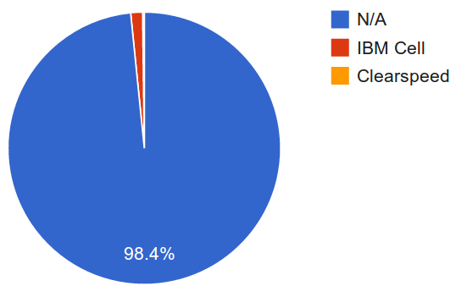
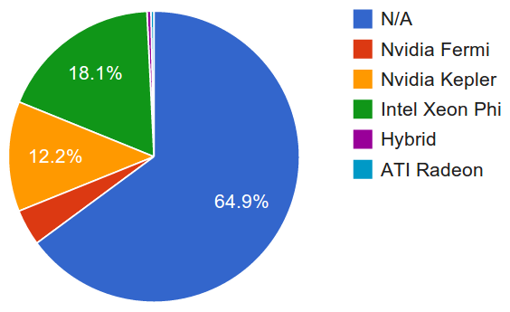
Diversity in Accelerators
Nov, 2008
Nov, 2013
Performance Share of Accelerators in Top500 Systems
Source: top500.org

Slide 3
Heterogeneity “Among” Nodes
Clusters are deploying different accelerators
Different accelerators for different tasks
Example clusters:
“Shadowfax” at VBI@VT: NVIDIA GPUs, FPGAs
“Darwin” at LANL: NVIDIA GPUs, AMD GPUs
“Dirac” at NERSC: NVIDIA Tesla and Fermi GPUs

Slide 4
Heterogeneity “Among” Nodes
Clusters are deploying different accelerators
Different accelerators for different tasks
Example clusters:
“Shadowfax” at VBI@VT: NVIDIA GPUs, FPGAs
“Darwin” at LANL: NVIDIA GPUs, AMD GPUs
“Dirac” at NERSC: NVIDIA Tesla and Fermi GPUs
However …
A unified programming model for “all” accelerators: OpenCL
CPUs, GPUs, FPGAs, DSPs

Slide 5
Affinity of Tasks to Processors
Peak performance doesn’t necessarily translate into actual device performance.
Reduction | GFLOPs | Global Memory BW (GB/s) | Actual Time(ms)
NVIDIA C2050 | 1030 | 144 | 0.13
AMD HD5870 | 2720 | 154 | 0.21

Slide 6
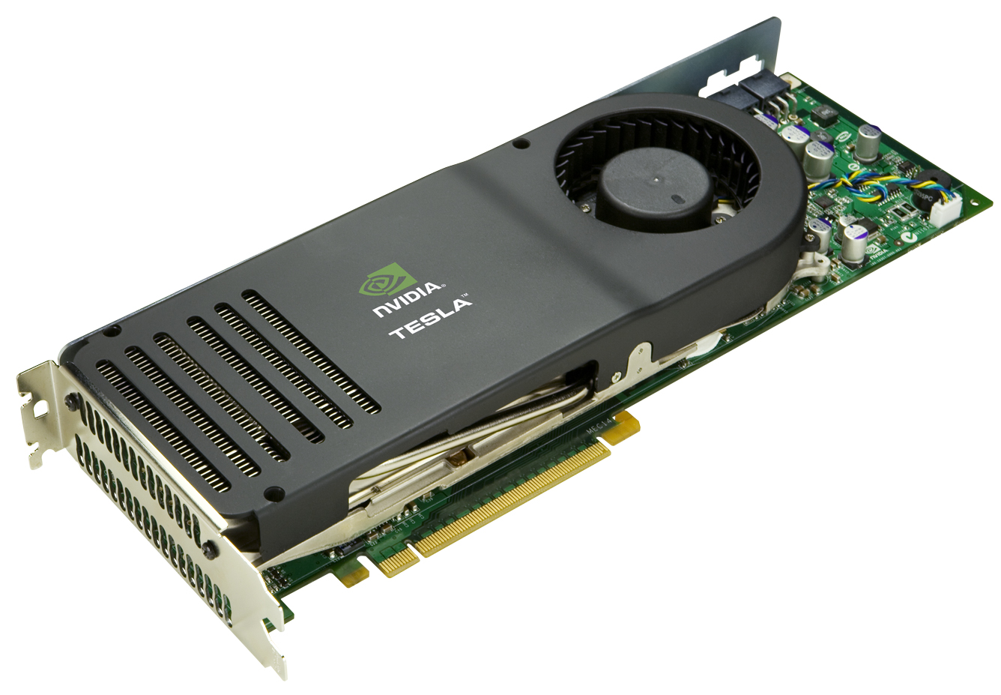
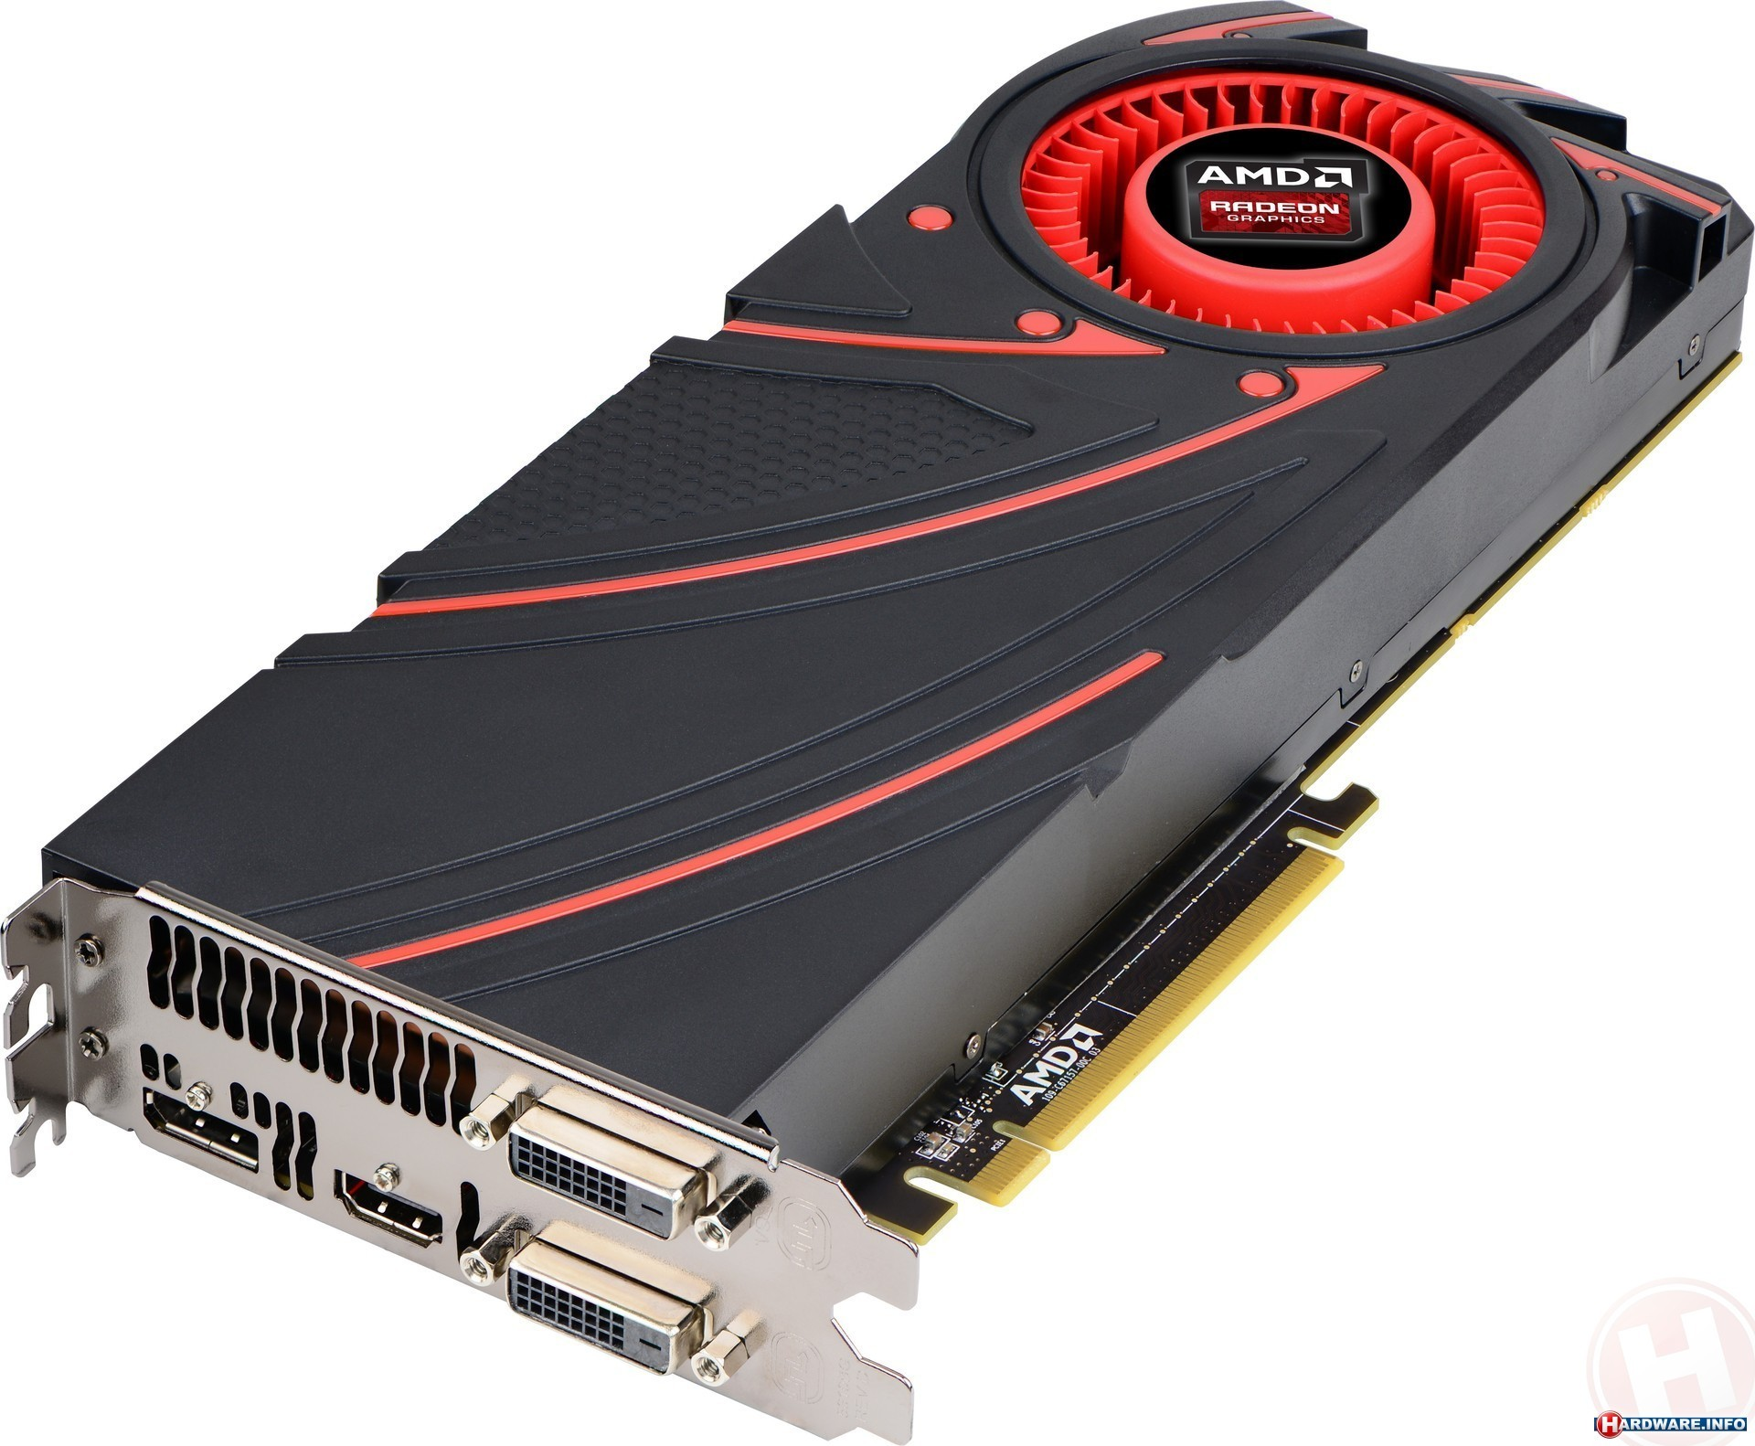
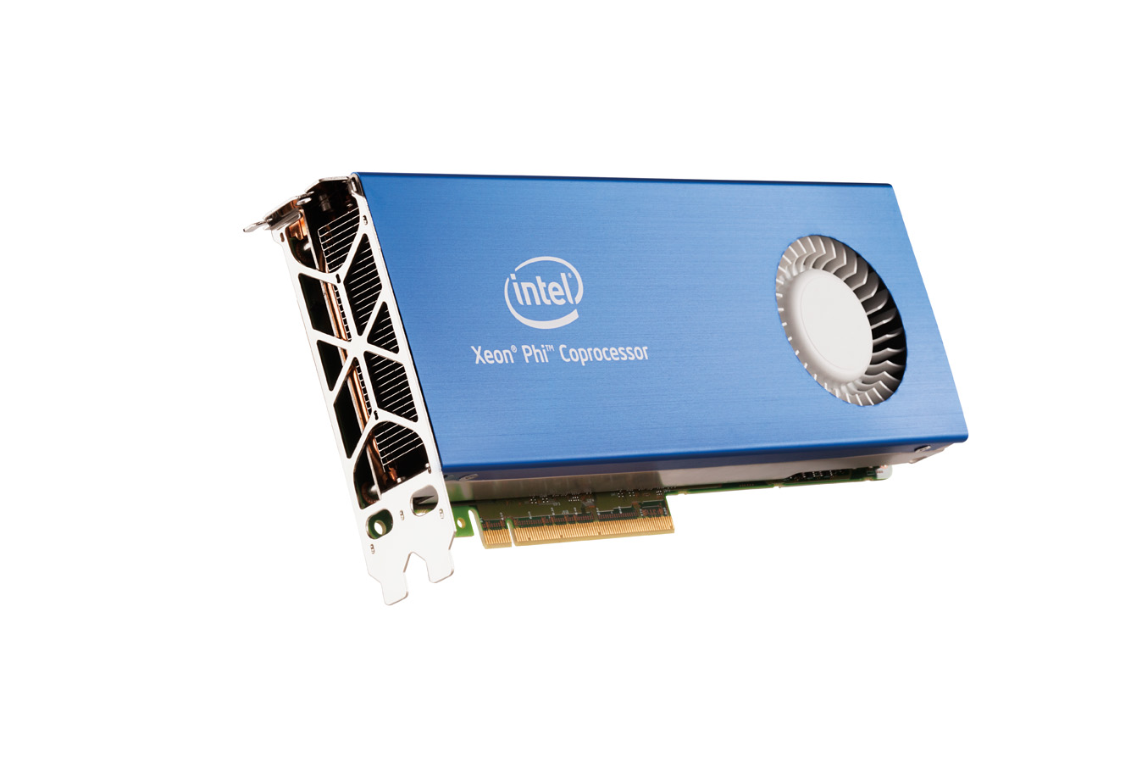
Affinity of Tasks to Processors
Peak performance doesn’t necessarily translate into actual device performance.
Reduction | GFLOPs | Global Memory BW (GB/s) | Actual Time(ms)
NVIDIA C2050 | 1030 | 144 | 0.13
AMD HD5870 | 2720 | 154 | 0.21
?
OpenCL Program

Slide 7
Challenges for Runtime Systems
It is crucial for heterogeneous runtime systems to embrace different accelerators in clusters w.r.t. performance and power
Examples of OpenCL runtime systems:
SnuCL
VOCL
SOCL
Challenges:
Efficiently choose the right device for the right task
Keep the decision making overhead minimal

Slide 8
Our Contributions
An online workload characterization technique for OpenCL kernels
Our model projects the relative ranking of different devices with little overhead
An end-to-end evaluation of our technique for multiple architectural families of AMD and NVIDIA GPUs

Slide 9
Outline
Introduction
Motivation
Contributions
Design
Evaluation
Conclusion

Slide 10
Design
Goal:
Rank accelerators for a given OpenCL workload
Accurately AND efficiently
Decision making with minimal overhead

Slide 11
Design
Goal:
Rank accelerators for a given OpenCL workload
Accurately AND efficiently
Decision making with minimal overhead
Choices:
Static Code Analysis:
Fast
Inaccurate, as it does not account for dynamic properties:
Input data dependence, memory access patterns, dynamic instructions

Slide 12
Design
Goal:
Rank accelerators for a given OpenCL workload
Accurately AND efficiently
Decision making with minimal overhead
Choices:
Static Code Analysis:
Fast
Inaccurate, as it does not account for dynamic properties:
Input data dependence, memory access patterns, dynamic instructions
Dynamic Code Analysis:
Higher accuracy
Execute either on actual device or through a “emulator”
Not always feasible to run on actual devices: Data transfer costs, Clusters are “busy”
Emulators are very slow

Slide 13
Design – Workload Profiling
Emulator
Instruction
Mix
OpenCL
Kernel
Memory Patterns
Bank Conflicts

Slide 14
Design – Workload Profiling
Mini
Emulator
Instruction
Mix
“Mini-emulation”
Emulate a single workgroup
Collect dynamic characteristics:
Instruction traces
Global and Local memory transactions and access patterns
In typical data-parallel workloads, workgroups exhibit similar runtime characteristics
Asymptotically lower overhead
OpenCL
Kernel
Memory Patterns
Bank Conflicts

Slide 15
Design – Device Profiling
GPU1
GPU 2
……
GPU N
Instruction and Memory
Microbenchmarks
Device Throughput Profiles

Slide 16
Design – Device Profiling
Build device throughput profiles:
Modified SHOC microbenchmarks to
Obtain hardware throughput with varying occupancy
Collect throughputs for instructions, global memory and local memory
Built only once
Global and Local memory profile of AMD 7970

Slide 17
Design – Find Performance Limiter
Device Profile
Instruction
Mix
Workload Profile
Memory Patterns
Bank Conflicts

Slide 18
Design – Find Performance Limiter
Single workgroup dynamic characteristics → Full kernel characteristics
Device occupancy as scaling factor
Compute projected theoretical times:
Instructions
Global memory
Local memory
GPUs aggressively try to hide latencies of components
Performance limiter =
max(t_{local}, t_{global}, t_{compute})*
Compare the normalized predicted times and choose best device
*Zhang et. al. A Quantitative Performance Analysis Model for GPU Architectures, HPCA’2011

Slide 19
Design
GPU 1
GPU 2
……
GPU N
Static Profiling
Instruction and Memory
Benchmarks
Device
Profile

Slide 20
Design
GPU 1
GPU 2
……
GPU N
Static Profiling
Instruction and Memory
Benchmarks
Device
Profile
Dynamic Profiling
Mini-Emulator (Single workgroup)
Instruction
Mix
GPU
Kernel
Memory
Patterns
Bank Conflicts

Slide 21
Design
GPU 1
GPU 2
……
GPU N
Static Profiling
Instruction and Memory
Benchmarks
Device
Profile
Dynamic Profiling
Effective
Instruction
Throughput
Performance Projection
Mini-Emulator (Single workgroup)
Instruction
Mix
GPU
Kernel
Effective
Global Memory
Bandwidth
Perf.
Limiter?
Memory
Patterns
Bank Conflicts
Effective
Local Memory
Bandwidth
Relative GPU
Performances

Slide 22
Outline
Introduction
Motivation
Contributions
Design
Evaluation
Conclusion

Slide 23
Experimental Setup
Accelerators:
AMD 7970 : Scalar ALUs, Cache hierarchy
AMD 5870: VLIW ALUs
NVIDIA C2050: Fermi Architecture Cache Hierarchy
NVIDIA C1060: Tesla Architecture
Simulators:
Multi2simv4.1 for AMD and GPGPU-Sim v3.0 for NVIDIA devices
Methodology agnostic to specific emulator
Applications:
Floyd Warshall | FastWalsh Trasnform | MatrixMul (global) | MatrixMul (local)
Num Nodes = 192 | Array Size = 1048576 | Matrix Size = [1024,1024] | Matrix Size = [1024,1024]
Reduction | NBody | AESEncrypt Decrypt | Matrix Transpose
ArraySize =1048576 | NumParticles=32768 | Width=1536, Height=512 | Matrix Size = [1024,1024]

Slide 24
Application Boundedness : AMD GPUs
Projected Time (Normalized)
compute
lmem
lmem
gmem
gmem
gmem
gmem
gmem
compute
compute
lmem
gmem
gmem
gmem
gmem
gmem

Slide 25
Application Boundedness Summary
Application | AMD 5870 | AMD 7970 | NVIDIA C1060 | NVIDIA C2050
FloydWarshall | gmem | gmem | gmem | gmem
FastWalshTransform | gmem | gmem | gmem | gmem
MatrixTranpose | gmem | gmem | gmem | gmem
MatMul(global) | gmem | gmem | gmem | gmem
MatMul(local) | local | local | gmem | compute
Reduction | gmem | gmem | gmem | compute
NBody | compute | compute | compute | compute
AESEncryptDecrypt | local | compute | compute | compute

Slide 26
Accuracy of Performance Projection
.

Slide 27
Accuracy of Performance Projection
Best Device | Fast Walsh | Floyd Warshal | Matmul (global) | Nbody | AES Encrypt Decrypt | Reduction | Matmul (local) | Mat Transpose
Actual | 7970 | 7970 | 5870 | 7970 | 2050 | 7970 | 7970 | 2050
Projected | 7970 | 7970 | 5870 | 7970 | 7970 | 7970 | 7970 | 2050
.

Slide 28
Accuracy of Performance Projection
Best Device | Fast Walsh | Floyd Warshal | Matmul (global) | Nbody | AES Encrypt Decrypt | Reduction | Matmul (local) | Mat Transpose
Actual | 7970 | 7970 | 5870 | 7970 | 2050 | 7970 | 7970 | 2050
Projected | 7970 | 7970 | 5870 | 7970 | 7970 | 7970 | 7970 | 2050
.

Slide 29
Emulation Overhead – Reduction Kernel

Slide 30
Outline
Introduction
Motivation
Contributions
Design
Evaluation
Conclusion

Slide 31

90/10 Paradigm -> 10x10 Paradigm
Simplify and specialized tools (“accelerators”) customized for different purposes (“applications”)
Narrower focus on applications (10%)
Simplified and specialized accelerators for each classification
Why?
10x lower power, 10x faster -> 100x energy efficient
Figure credit: A. Chien, Salishan Conference 2010

Slide 32
Conclusion
We presented a “Mini-emulation” technique for online workload characterization for OpenCL kernels
The approach is shown to be sufficiently accurate for relative performance projection
The approach has asymptotically lower overhead than projection using full kernel emulation
Our technique is shown to work well with multiple architectural families of AMD and NVIDIA GPUs
With the increasing diversity in accelerators (towards 10x10*), our methodology only becomes more relevant.
*S. Borkar and A. Chien, “The future of microprocessors,” Communications of the ACM, 2011

Slide 33
Thank You

Slide 34
Backup

Slide 35
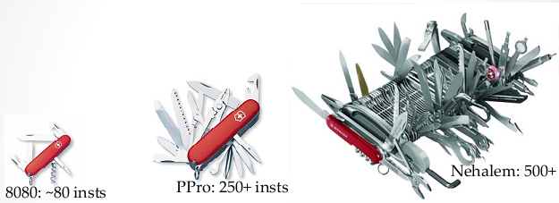
Evolution of Microprocessors: 90/10 Paradigm
Derive common cases for applications (90%)
Broad focus on application workloads
Architectural improvements for 90% of cases
Design an aggregated generic “core”
Lesser customizability for applications
Figure credit: A. Chien, Salishan Conference 2010

Slide 36
90/10 Paradigm -> 10x10 Paradigm
Simplify and specialized tools (“accelerators”) customized for different purposes (“applications”)
Narrower focus on applications (10%)
Simplified and specialized accelerators for each classification
Why?
10x lower power, 10x faster -> 100x energy efficient
Figure credit: A. Chien, Salishan Conference 2010

Slide 37
Application Boundedness : NVIDIA GPUs
compute
Projected Time (Normalized)
compute
gmem
gmem
gmem
compute
lmem
gmem
compute
compute
gmem
gmem
gmem
gmem
compute
gmem

Slide 38
Evaluation: Projection Accuracy (Relative to C1060)

Slide 39
Evaluation: Projection Overhead vs. Actual Kernel Execution of Matrix Multiplication
Notes:
Mini-emulation increases linearly because workload on each emulated thread increases linearly with the data size (for matrix multiply).
On the other hand, the actual execution time increases as O(n^3) per thread.

Slide 40
Evaluation: Overhead of Mini-emulation vs. Full Kernel Emulation of Matrix Multiplication

Slide 41
Evaluation: Overhead of Mini-emulation vs. Full Kernel Emulation of Reduction
Notes:
Mini-emulation is constant per emulated thread (for reduction).

