Slide 1
Inspector-Executor Load Balancing Algorithms for Block-Sparse Tensor Contractions
David Ozog*, Jeff R. Hammond†, James Dinan†, Pavan Balaji†, Sameer Shende*, Allen Malony*
*University of Oregon
†Argonne National Laboratory
2013 International Conference on Parallel Processing (ICPP)
October 2, 2013

Slide 2
Outline
NWChem, Coupled Cluster, Tensor Contraction Engine
Load Balance Challenges
Dynamic Load Balancing with Global Arrays (GA)
Nxtval Performance Experiments
Inspector/Executor Design
Performance Modeling (DGEMM and TCE Sort)
Largest Processing Time (LPT) Algorithm
Dynamic Buckets – Design and Implementation
Results
Conclusions
Future Work

Slide 3
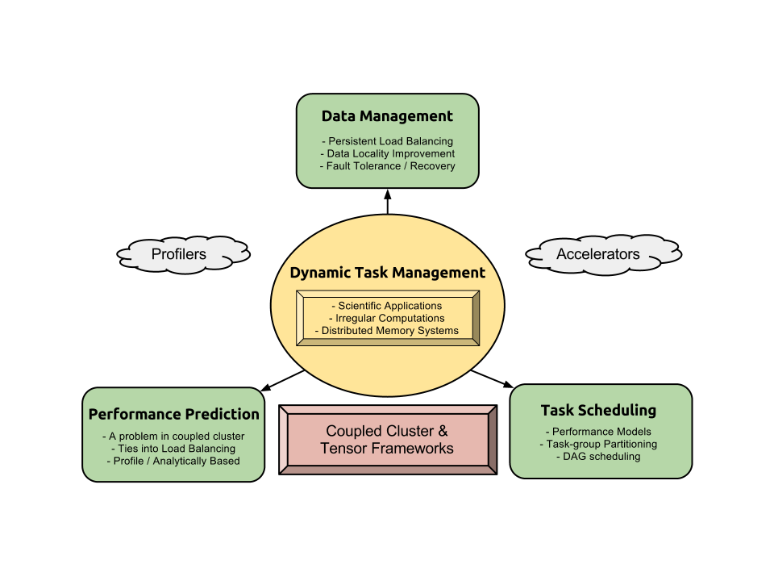
Potential PhD Foci

Slide 4
Potential PhD Foci
Dynamic Computational Task/App Management:
Task Scheduling
DAGs
With Accelerators (GPU, MIC)
Data Management
Optimizing locality in PGAS
Persistent load balancing
Fault tolerance and recovery (needed in NWChem)
Performance Prediction
Could be very useful for intelligently running NWChem jobs
Ties into making good load balancing decisions

Slide 5
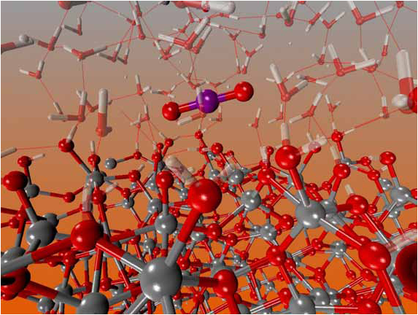
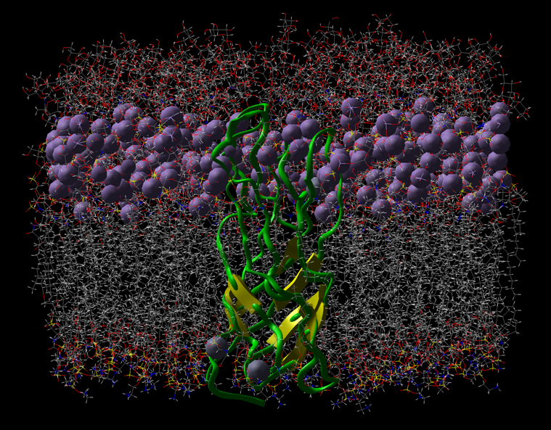
NWChem and Coupled Cluster
NWChem:
Wide range of methods, accuracies, and supported supercomputer architectures
Well-known for its support of many quantum mechanical methods on massively parallel systems.
Built on top of Global Arrays (GA) / ARMCI
Coupled Cluster (CC):
Ab initio - i.e., Highly accurate
Solves an approximate Schrödinger Equation
Accuracy hierarchy:
CCSD < CCSD(T) < CCSDT < CCSDT(Q) < CCSDTQ
The respective computational costs:
And respective storage costs:

Slide 6
NWChem and Coupled Cluster
NWChem:
Wide range of methods, accuracies, and supported supercomputer architectures
Well-known for its support of many quantum mechanical methods on massively parallel systems.
Built on top of Global Arrays (GA) / ARMCI
Coupled Cluster (CC):
Ab initio - i.e., Highly accurate
Solves an approximate Schrödinger Equation
Accuracy hierarchy:
CCSD < CCSD(T) < CCSDT < CCSDT(Q) < CCSDTQ
The respective computational costs:
And respective storage costs:
Distributed Memory Spaces
Global Address Space

Slide 7
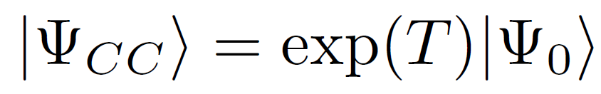

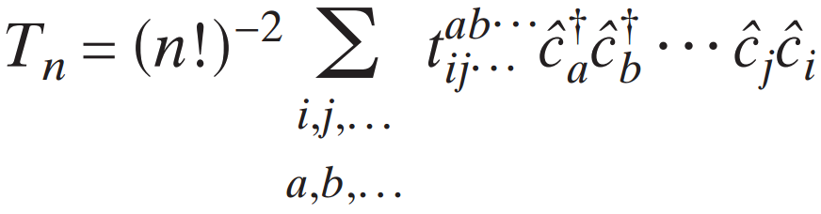
NWChem and Coupled Cluster
NWChem:
Wide range of methods, accuracies, and supported supercomputer architectures
Well-known for its support of many quantum mechanical methods on massively parallel systems.
Built on top of Global Arrays (GA)
Coupled Cluster (CC):
Ab initio - i.e., Highly accurate
Solves an approximate Schrödinger Equation
Accuracy hierarchy:
CCSD < CCSD(T) < CCSDT < CCSDT(Q) < CCSDTQ
The respective computational costs:
And respective storage costs:

Slide 8
Tensor Contraction Engine (TCE)
Example of an expanded term:
hbar[a,b,i,j] == sum[f[b,c] * t[i,j,a,c], c] - sum[f[k,c] * t[k,b] * t[i,j,a,c], k,c] + sum[f[a,c] * t[i,j,c,b], c] - sum[f[k,c] * t[k,a] * t[i,j,c,b], k,c] - sum[f[k,j] * t[i,k,a,b], k] - sum[f[k,c] * t[j,c] * t[i,k,a,b], k,c] - sum[f[k,i] * t[j,k,b,a] , k] - sum[f[k,c] * t[i,c] * t[j,k,b,a], k,c] + sum[t[i,c] * t[j,d] * v[a,b,c,d], c,d] + sum[t[i,j,c,d] * v[a,b,c,d], c,d] + sum[t[j,c] * v[a,b,i,c], c] - sum[t[k,b] * v[a,k,i,j] , k] + sum[t[i,c] * v[b,a,j,c], c] - sum[t[k,a] * v[b,k,j,i], k] - sum[t[k,d] * t[i,j,c,b] * v[k,a,c,d], k,c,d] - sum[t[i,c] * t[j,k,b,d] * v[k,a,c,d], k,c,d] - sum[t[j,c] * t[k,b] * v[k,a,c,i], k,c] + 2 * sum[t[j,k,b,c] * v[k,a,c,i], k,c] - sum[t[j,k,c,b] * v[k,a,c,i] , k,c] - sum[t[i,c] * t[j,d] * t[k,b] * v[k,a,d,c], k,c,d] + 2 * sum[t[k,d] * t[i,j,c,b] * v[k,a,d,c],k,c,d] - sum[t[k,b] * t[i,j,c,d] * v[k,a,d,c], k,c,d] - sum[t[j,d] * t[i,k,c,b] * v[k,a,d,c], k,c,d] + 2 * sum[t[i,c] * t[j,k,b,d] * v[k,a,d,c], k,c,d] - sum[t[i,c] * t[j,k,d,b] * v[k,a,d,c], k,c,d] - sum[t[j,k,b,c] * v[k,a,i,c], k,c] - sum[t[i,c] * t[k,b] * v[k,a,j,c], k,c] - sum[t[i,k,c,b] * v[k,a,j,c], k,c] - sum[t[i,c] * t[j,d] * t[k,a] * v[k,b,c,d], k,c,d] - sum[t[k,d] * t[i,j,a,c] v[k,b,c,d], k,c,d] - sum[t[k,a] * t[i,j,c,d] * v[k,b,c,d], k,c,d] + 2 * sum[t[j,d] * t[i,k,a,c] * v[k,b,c,d], k,c,d] - sum[t[j,d] * t[i,k,c,a] * v[k,b,c,d], k,c,d] - sum[t[i,c] * t[j,k,d,a] * v[k,b,c,d] , k,c,d] - sum[t[i,c] * t[k,a] * v[k,b,c,j], k,c] + 2 * sum[t[i,k,a,c] * v[k,b,c,j] , k,c] - sum[t[i,k,c,a] * v[k,b,c,j], k,c] + 2 * sum[t[k,d] * t[i,j,a,c] * v[k,b,d,c] , k,c,d] - sum[t[j,d] * t[i,k,a,c] * v[k,b,d,c], k,c,d] - sum[t[j,c] * t[k,a] * v[k,b,i,c] , k,c] - sum[t[j,k,c,a] * v[k,b,i,c], k,c] - sum[t[i,k,a,c] * v[k,b,j,c], k,c] + sum[t[i,c] * t[j,d] * t[k,a] * t[l,b] * v[k,l,c,d], k,l,c,d] - 2 * sum[t[k,b] * t[l,d] * t[i,j,a,c] * v[k,l,c,d], k,l,c,d] - 2 * sum[t[k,a] * t[l,d] * t[i,j,c,b] * v[k,l,c,d], k,l,c,d] + sum[t[k,a] * t[l,b] * t[i,j,c,d] * v[k,l,c,d], k,l,c,d] - 2 * sum[t[j,c] * t[l,d] * t[i,k,a,b] * v[k,l,c,d], k,l,c,d] - 2 * sum[t[j,d] * t[l,b] * t[i,k,a,c] * v[k,l,c,d] , k,l,c,d] + sum[t[j,d] * t[l,b] * t[i,k,c,a] * v[k,l,c,d], k,l,c,d] - 2 * sum[t[i,c] * t[l,d] * t[j,k,b,a] * v[k,l,c,d], k,l,c,d] + sum[t[i,c] * t[l,a] * t[j,k,b,d] * v[k,l,c,d] , k,l,c,d] + sum[t[i,c] * t[l,b] * t[j,k,d,a] * v[k,l,c,d], k,l,c,d] + sum[t[i,k,c,d] * t[j,l,b,a] * v[k,l,c,d], k,l,c,d] + 4 * sum[t[i,k,a,c] * t[j,l,b,d] * v[k,l,c,d] , k,l,c,d] - 2 * sum[t[i,k,c,a] * t[j,l,b,d] * v[k,l,c,d], k,l,c,d] - 2 * sum[t[i,k,a,b] * t[j,l,c,d] * v[k,l,c,d], k,l,c,d] - 2 * sum[t[i,k,a,c] * t[j,l,d,b] * v[k,l,c,d] , k,l,c,d] + sum[t[i,k,c,a] * t[j,l,d,b] * v[k,l,c,d], k,l,c,d] + sum[t[i,c] * t[j,d] * t[k,l,a,b] * v[k,l,c,d], k,l,c,d] + sum[t[i,j,c,d] * t[k,l,a,b] * v[k,l,c,d], k,l,c,d] - 2 * sum[t[i,j,c,b] * t[k,l,a,d] * v[k,l,c,d], k,l,c,d] - 2 * sum[t[i,j,a,c] * t[k,l,b,d] * v[k,l,c,d], k,l,c,d] + sum[t[j,c] * t[k,b] * t[l,a] * v[k,l,c,i], k,l,c] + sum[t[l,c] * t[j,k,b,a] * v[k,l,c,i], k,l,c] - 2 * sum[t[l,a] * t[j,k,b,c] * v[k,l,c,i], k,l,c] + sum[t[l,a] * t[j,k,c,b] * v[k,l,c,i], k,l,c] - 2 * sum[t[k,c] * t[j,l,b,a] * v[k,l,c,i] , k,l,c] + sum[t[k,a] * t[j,l,b,c] * v[k,l,c,i], k,l,c]+ sum[t[k,b] * t[j,l,c,a] * v[k,l,c,i] , k,l,c] + sum[t[j,c] * t[l,k,a,b] * v[k,l,c,i], k,l,c] + sum[t[i,c] * t[k,a] * t[l,b] * v[k,l,c,j], k,l,c] + sum[t[l,c] * t[i,k,a,b] * v[k,l,c,j], k,l,c] - 2 * sum[t[l,b] * t[i,k,a,c] * v[k,l,c,j], k,l,c] + sum[t[l,b] * t[i,k,c,a] * v[k,l,c,j], k,l,c] + sum[t[i,c] * t[k,l,a,b] * v[k,l,c,j], k,l,c] + sum[t[j,c] * t[l,d] * t[i,k,a,b] * v[k,l,d,c] , k,l,c,d] + sum[t[j,d] * t[l,b] * t[i,k,a,c] * v[k,l,d,c], k,l,c,d] + sum[t[j,d] * t[l,a] * t[i,k,c,b] * v[k,l,d,c], k,l,c,d] - 2 * sum[t[i,k,c,d] * t[j,l,b,a] * v[k,l,d,c] , k,l,c,d] - 2 * sum[t[i,k,a,c] * t[j,l,b,d] * v[k,l,d,c], k,l,c,d] + sum[t[i,k,c,a] * t[j,l,b,d] * v[k,l,d,c], k,l,c,d] + sum[t[i,k,a,b] * t[j,l,c,d] * v[k,l,d,c], k,l,c,d] + sum[t[i,k,c,b] * t[j,l,d,a] * v[k,l,d,c], k,l,c,d] + sum[t[i,k,a,c] * t[j,l,d,b] * v[k,l,d,c], k,l,c,d] + sum[t[k,a] * t[l,b] * v[k,l,i,j], k,l] + sum[t[k,l,a,b] * v[k,l,i,j] , k,l] + sum[t[k,b] * t[l,d] * t[i,j,a,c] * v[l,k,c,d], k,l,c,d] + sum[t[k,a] * t[l,d] * t[i,j,c,b] * v[l,k,c,d], k,l,c,d] + sum[t[i,c] * t[l,d] * t[j,k,b,a] * v[l,k,c,d] , k,l,c,d] - 2 * sum[t[i,c] * t[l,a] * t[j,k,b,d] * v[l,k,c,d], k,l,c,d] + sum[t[i,c] * t[l,a] * t[j,k,d,b] * v[l,k,c,d], k,l,c,d] + sum[t[i,j,c,b] * t[k,l,a,d] * v[l,k,c,d] , k,l,c,d] + sum[t[i,j,a,c] * t[k,l,b,d] * v[l,k,c,d], k,l,c,d] - 2 * sum[t[l,c] * t[i,k,a,b] * v[l,k,c,j], k,l,c] + sum[t[l,b] * t[i,k,a,c] * v[l,k,c,j], k,l,c] + sum[t[l,a] * t[i,k,c,b] * v[l,k,c,j], k,l,c]
The TCE automates the derivation and parallelization of these equations.
This talk analyzes the TCE’s strong scaling.
In TCE-CC codes, each tensor contraction consists of many 2D matrix multiplications (BLAS – Level 3).

Slide 9
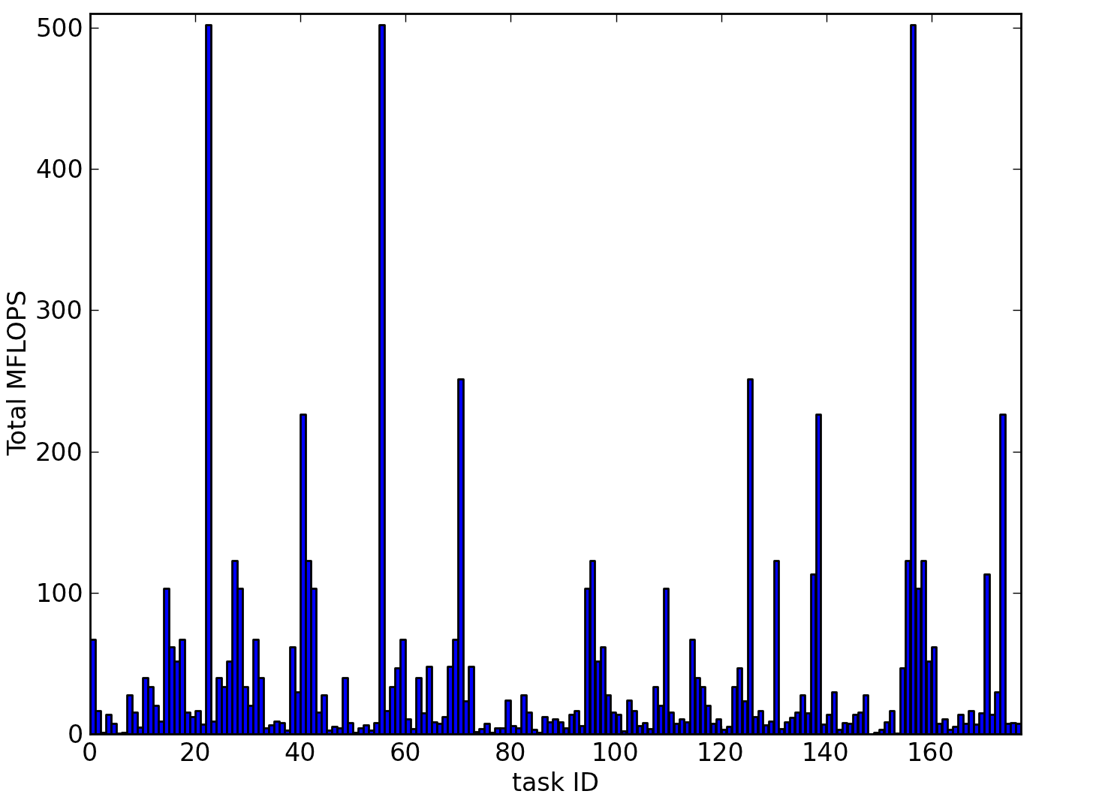
DGEMM Tasks - Load Imbalance
In CCSX (X=D,T,Q), 1 tensor contraction contains between 1 hundred and 1 million DGEMMs
MFLOPs per task depend on:
number of atoms
Spin and spatial symmetry
Accuracy of chosen basis
The tile size

Slide 10
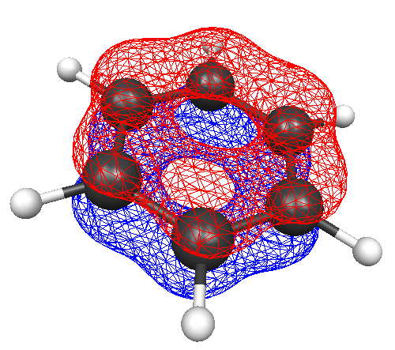
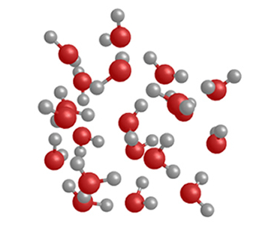
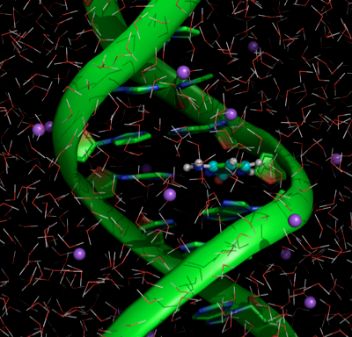
Computational Challenges
Benzene
Water Clusters
Macro-Molecules
Highly symmetric
Asymmetric
QM/MM
Load balance is crucially important for performance
Obtaining optimal load balance is an NP-Hard problem.

Slide 11
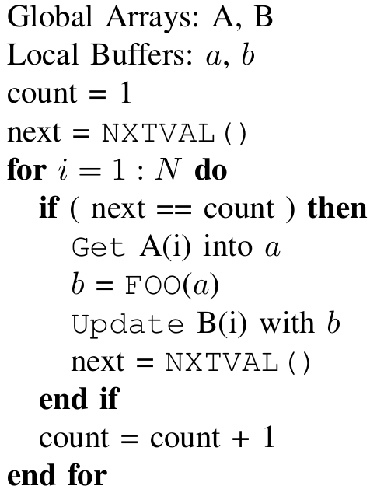
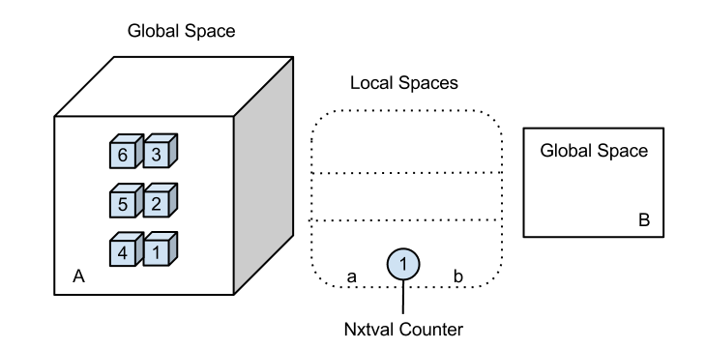
GA Dynamic Load Balancing Template

Slide 12
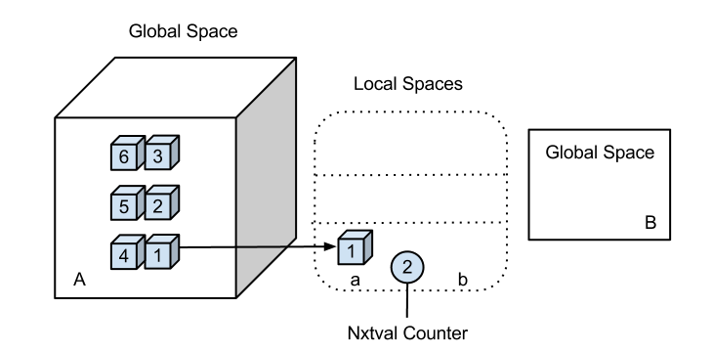
GA Dynamic Load Balancing Template

Slide 13
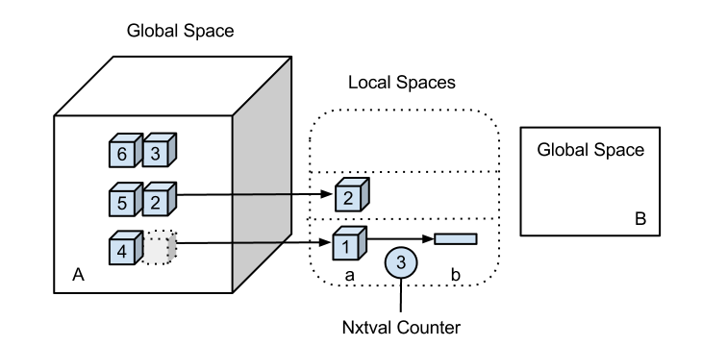
GA Dynamic Load Balancing Template

Slide 14
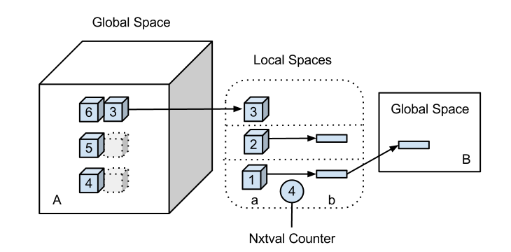
GA Dynamic Load Balancing Template

Slide 15
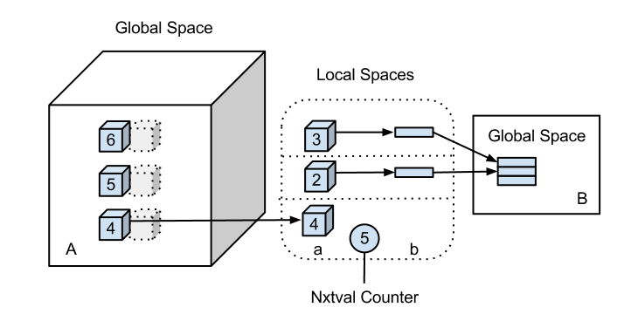
GA Dynamic Load Balancing Template

Slide 16
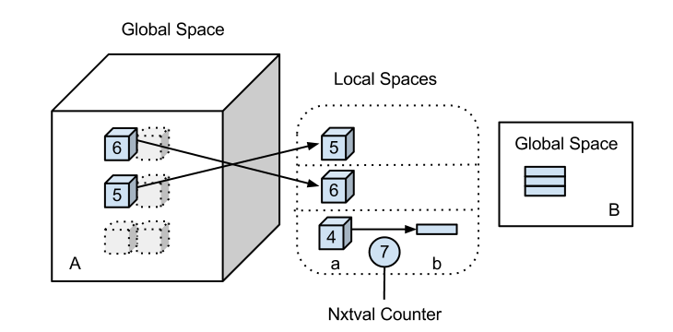
GA Dynamic Load Balancing Template

Slide 17
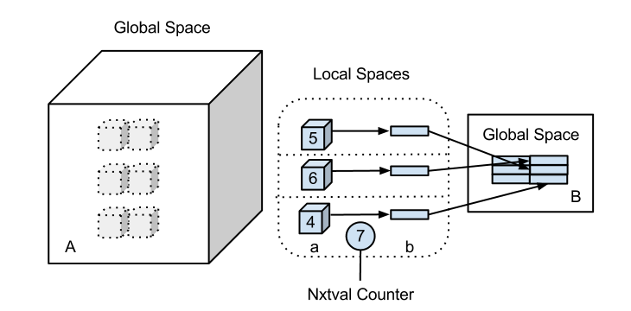
GA Dynamic Load Balancing Template

Slide 18
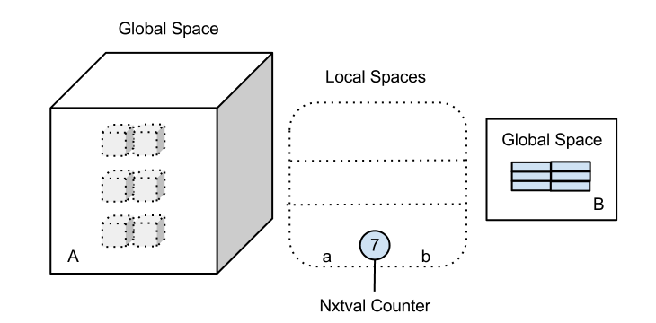
GA Dynamic Load Balancing Template

Slide 19
GA Dynamic Load Balancing Template
Works best when:
On a single node (in SysV shared memory)
Time spent in FOO(a) is huge
On high-speed interconnects
Number of simultaneous calls is reasonably small (less than 1,000).

Slide 20
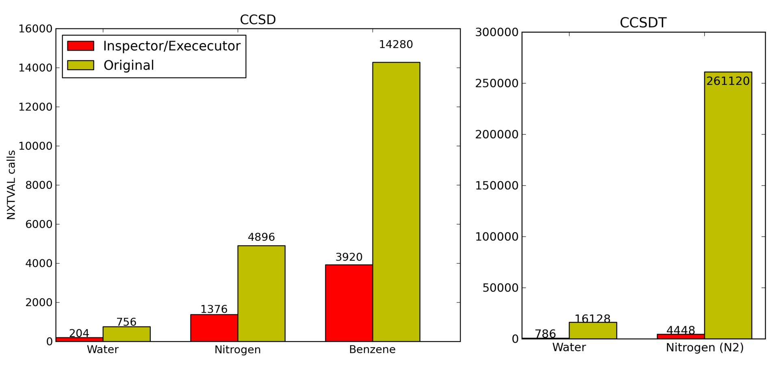
Nxtval - Number of Function Calls
1 contraction out of 37 for CCSD and 68 for CCSDT
Generally between 20 and 50 CC iterations per simulation
Tilesize affects these numbers

Slide 21
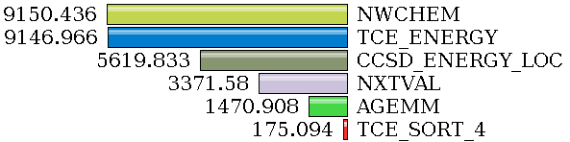
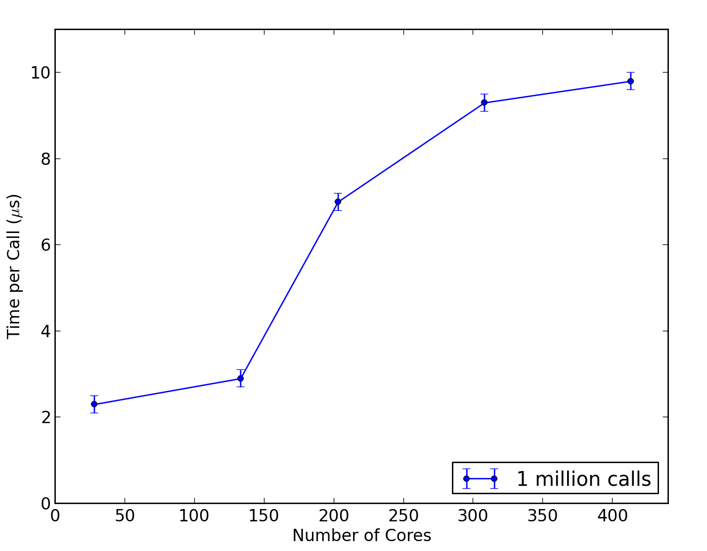
Nxtval - Performance Experiments
TAU Profiling
14 water molecules, aug-cc-PVDZ
123 nodes, 8 ppn
Nxtval consumes a large percentage of the execution time.
Flooding micro-benchmark
Proportional time within Nxtval increases with more participating processes.
When the arrival rate exceeds the processing rate, process hosting the counter must utilize buffer and flow control.

Slide 22
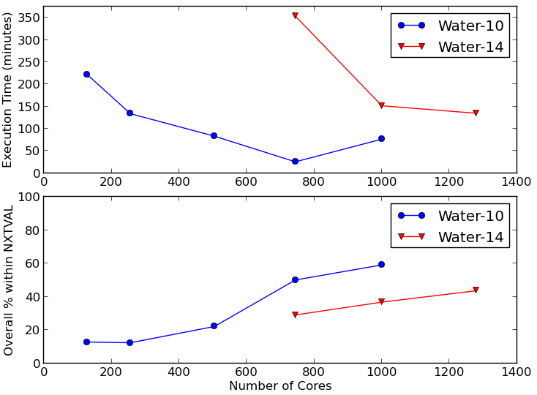
Nxtval Performance Experiments
Strong Scaling
10 water molecules, (aDZ)
14 water molecules, (aDZ)
8 processes per node
Percentage of overall execution time within Nxtval increases with scaling.

Slide 23
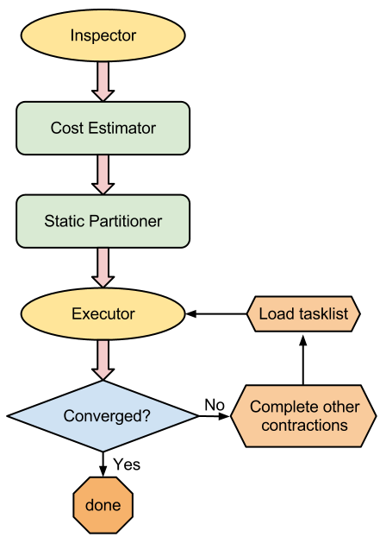
Inspector/Executor Design
Inspector
Calculate memory requirements
Remove null tasks
Collate task-list
Task Cost Estimator
Two options:
Use performance models
Load gettimeofday() measurement from previous iteration(s)
Deduce performance models off-line
Static Partitioner
Partition into N groups where N is the number of MPI processes
Minimize load balance according to cost estimations
Write task list information for each proc/contraction to volatile memory
Executor
Launch all tasks

Slide 24

Performance Modeling - DGEMM
DGEMM:
A_{(m,k)}, B_{(k,n)}, and C_{(m,n)} are 2D matrices
α and β are scalar coefficients
Our Performance Model:
(mn) dot products of length k
Corresponding (mn) store operations in C
m loads of size k from A
n loads of size k from B
a, b, c, and d are found by solving a nonlinear least squares problem (in Matlab)

Slide 25
Performance Modeling - DGEMM
DGEMM:
A_{(m,k)}, B_{(k,n)}, and C_{(m,n)} are 2D matrices
α and β are scalar coefficients
Our Performance Model:
(mn) dot products of length k
Corresponding (mn) store operations in C
m loads of size k from A
n loads of size k from B
a, b, c, and d are found by solving a nonlinear least squares problem (in Matlab)

Slide 26
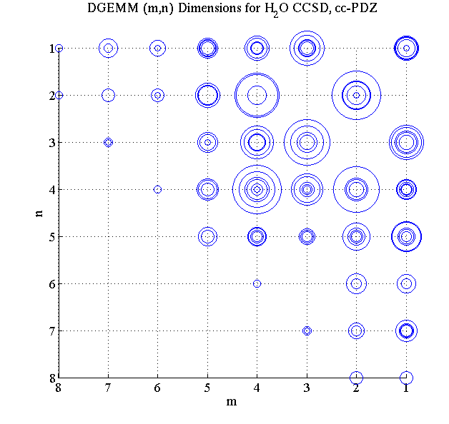
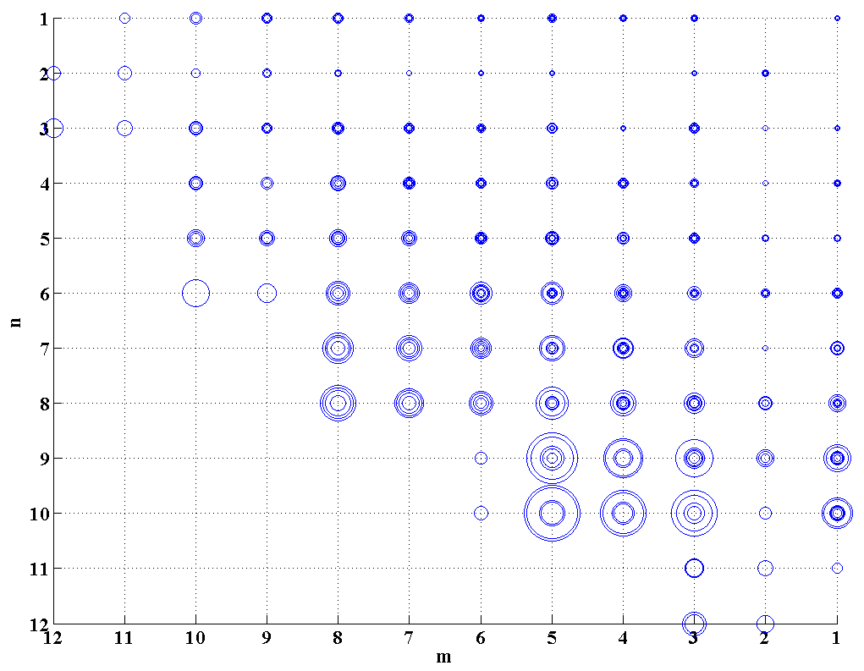
Performance Modeling - DGEMM
Data from the Inspector…
fed into the Model.
Mean number of tasks with dimensions (m,n,k)
Expected execution time for tasks with dimensions (m,n,k)

Slide 27
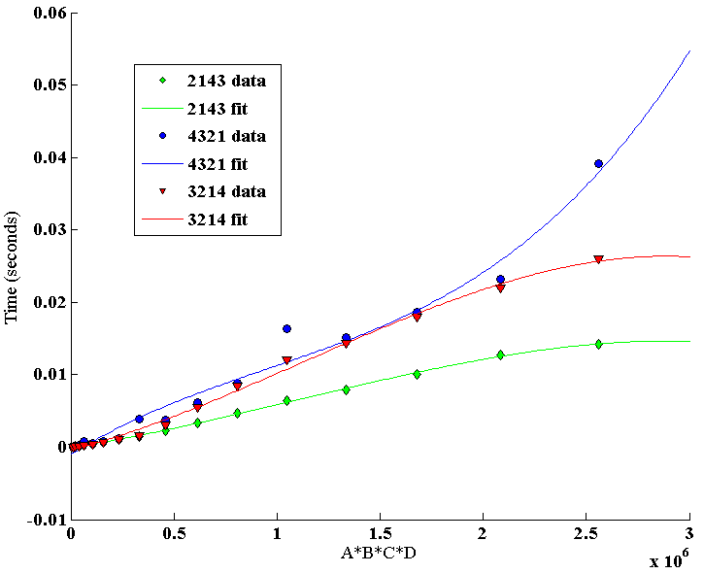
Performance Modeling – TCE “Sort”
Our Performance Model:
TCE “Sorts” are actually matrix permutations
3rd order polynomial fit suffices
Data always fits in L2 cache for this architecture
Somewhat noisy measurements, but that’s OK.
(bytes)

Slide 28
Zoltan Library
Parallel Partitioning
Define your own callbacks
Parallel Hypergraph capability
Highly customizable (user parameters)
My Initial Approach:
Round-Robin assignment
Zoltan Block partitioning
Save task-list on first iteration
Load task-list on subsequent iterations
Other options:
ParMetis / hMetis
PaToH

Slide 29
Zoltan Library
Parallel Partitioning
Define your own callbacks
Parallel Hypergraph capability
Highly customizable (user parameters)
My Initial Approach:
Round-Robin assignment
Zoltan Block partitioning
Save task-list on first iteration
Load task-list on subsequent iterations
Other options:
ParMetis / hMetis
PaToH

Slide 30
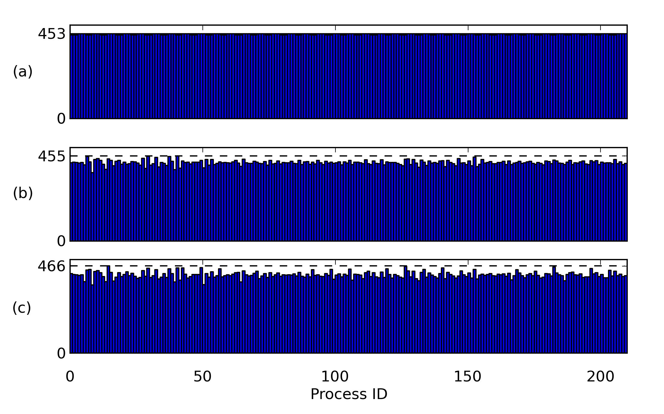
Zoltan Block Load Balance
Inspector/Executor
with Nxtval Measured
(b) Zoltan Block Predicted
(c) Zoltan Block Measured

Slide 31
Largest Processing Time (LPT) Algorithm
Polynomial time algorithm applied to an NP-Hard problem
Proven “4/3 approximate” by Richard Graham*
Sort tasks by cost in descending order
Assign to least loaded process so far

Slide 32
Largest Processing Time (LPT) Algorithm
Polynomial time algorithm applied to an NP-Hard problem
Proven “4/3 approximate” by Richard Graham*
Sort tasks by cost in descending order
Assign to least loaded process so far

Slide 33
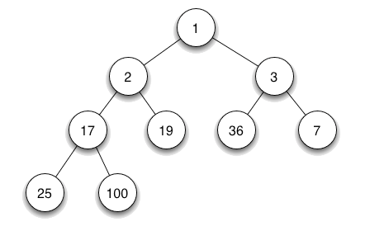
LPT - Binary Min Heap
Initialize a heap with N nodes (N = # of procs) each having zero cost.
Perform IncreaseMin() operation for each new cost from the sorted list of tasks.
IncreaseMin() is quite efficient because UpdateRoot() often occurs in O(1) time.
Far more efficient than the naïve approach of iterating through an array to find the min.
Execution time for this phase is negligible.

Slide 34
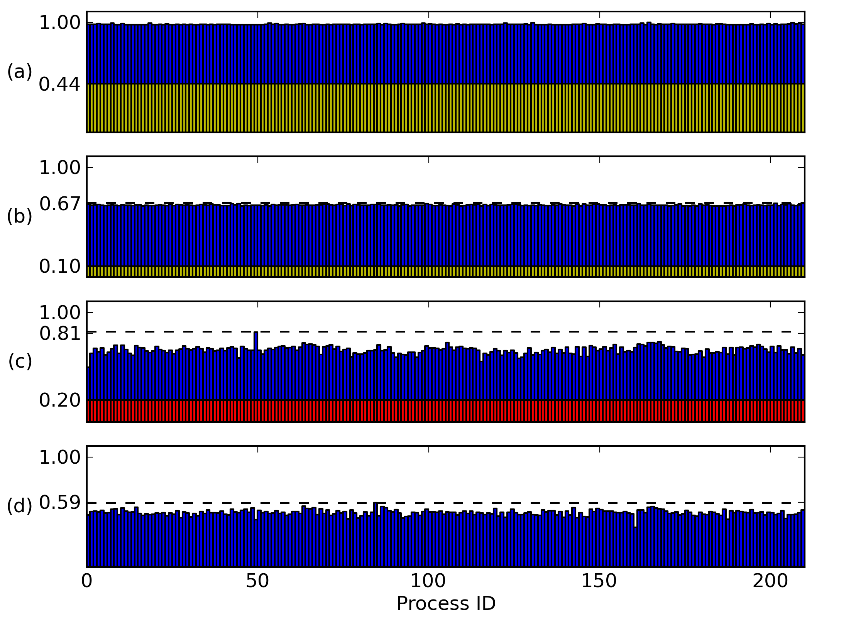
LPT - Load Balance
(a) Original with Nxtval Measured
(b) Inspector/Executor with Nxtval Measured
LPT – 1st iteration
LPT – subsequent iterations

Slide 35
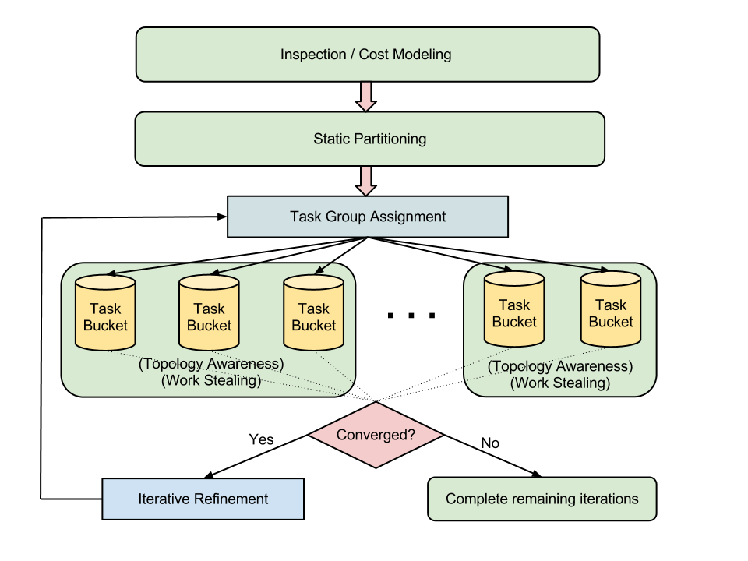
Dynamic Buckets Design

Slide 36
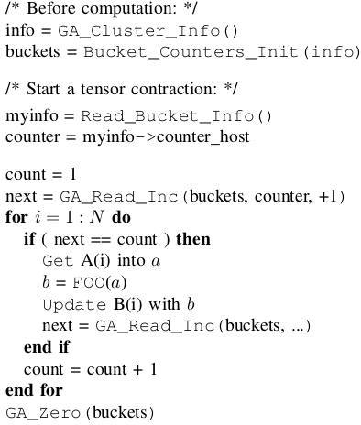
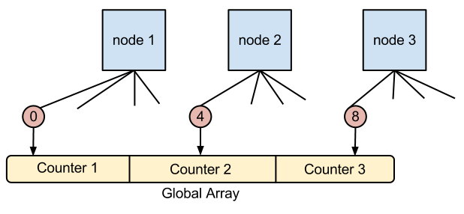
Dynamic Buckets Implementation

Slide 37
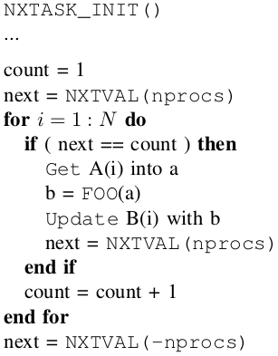
Dynamic Buckets Implementation

Slide 38
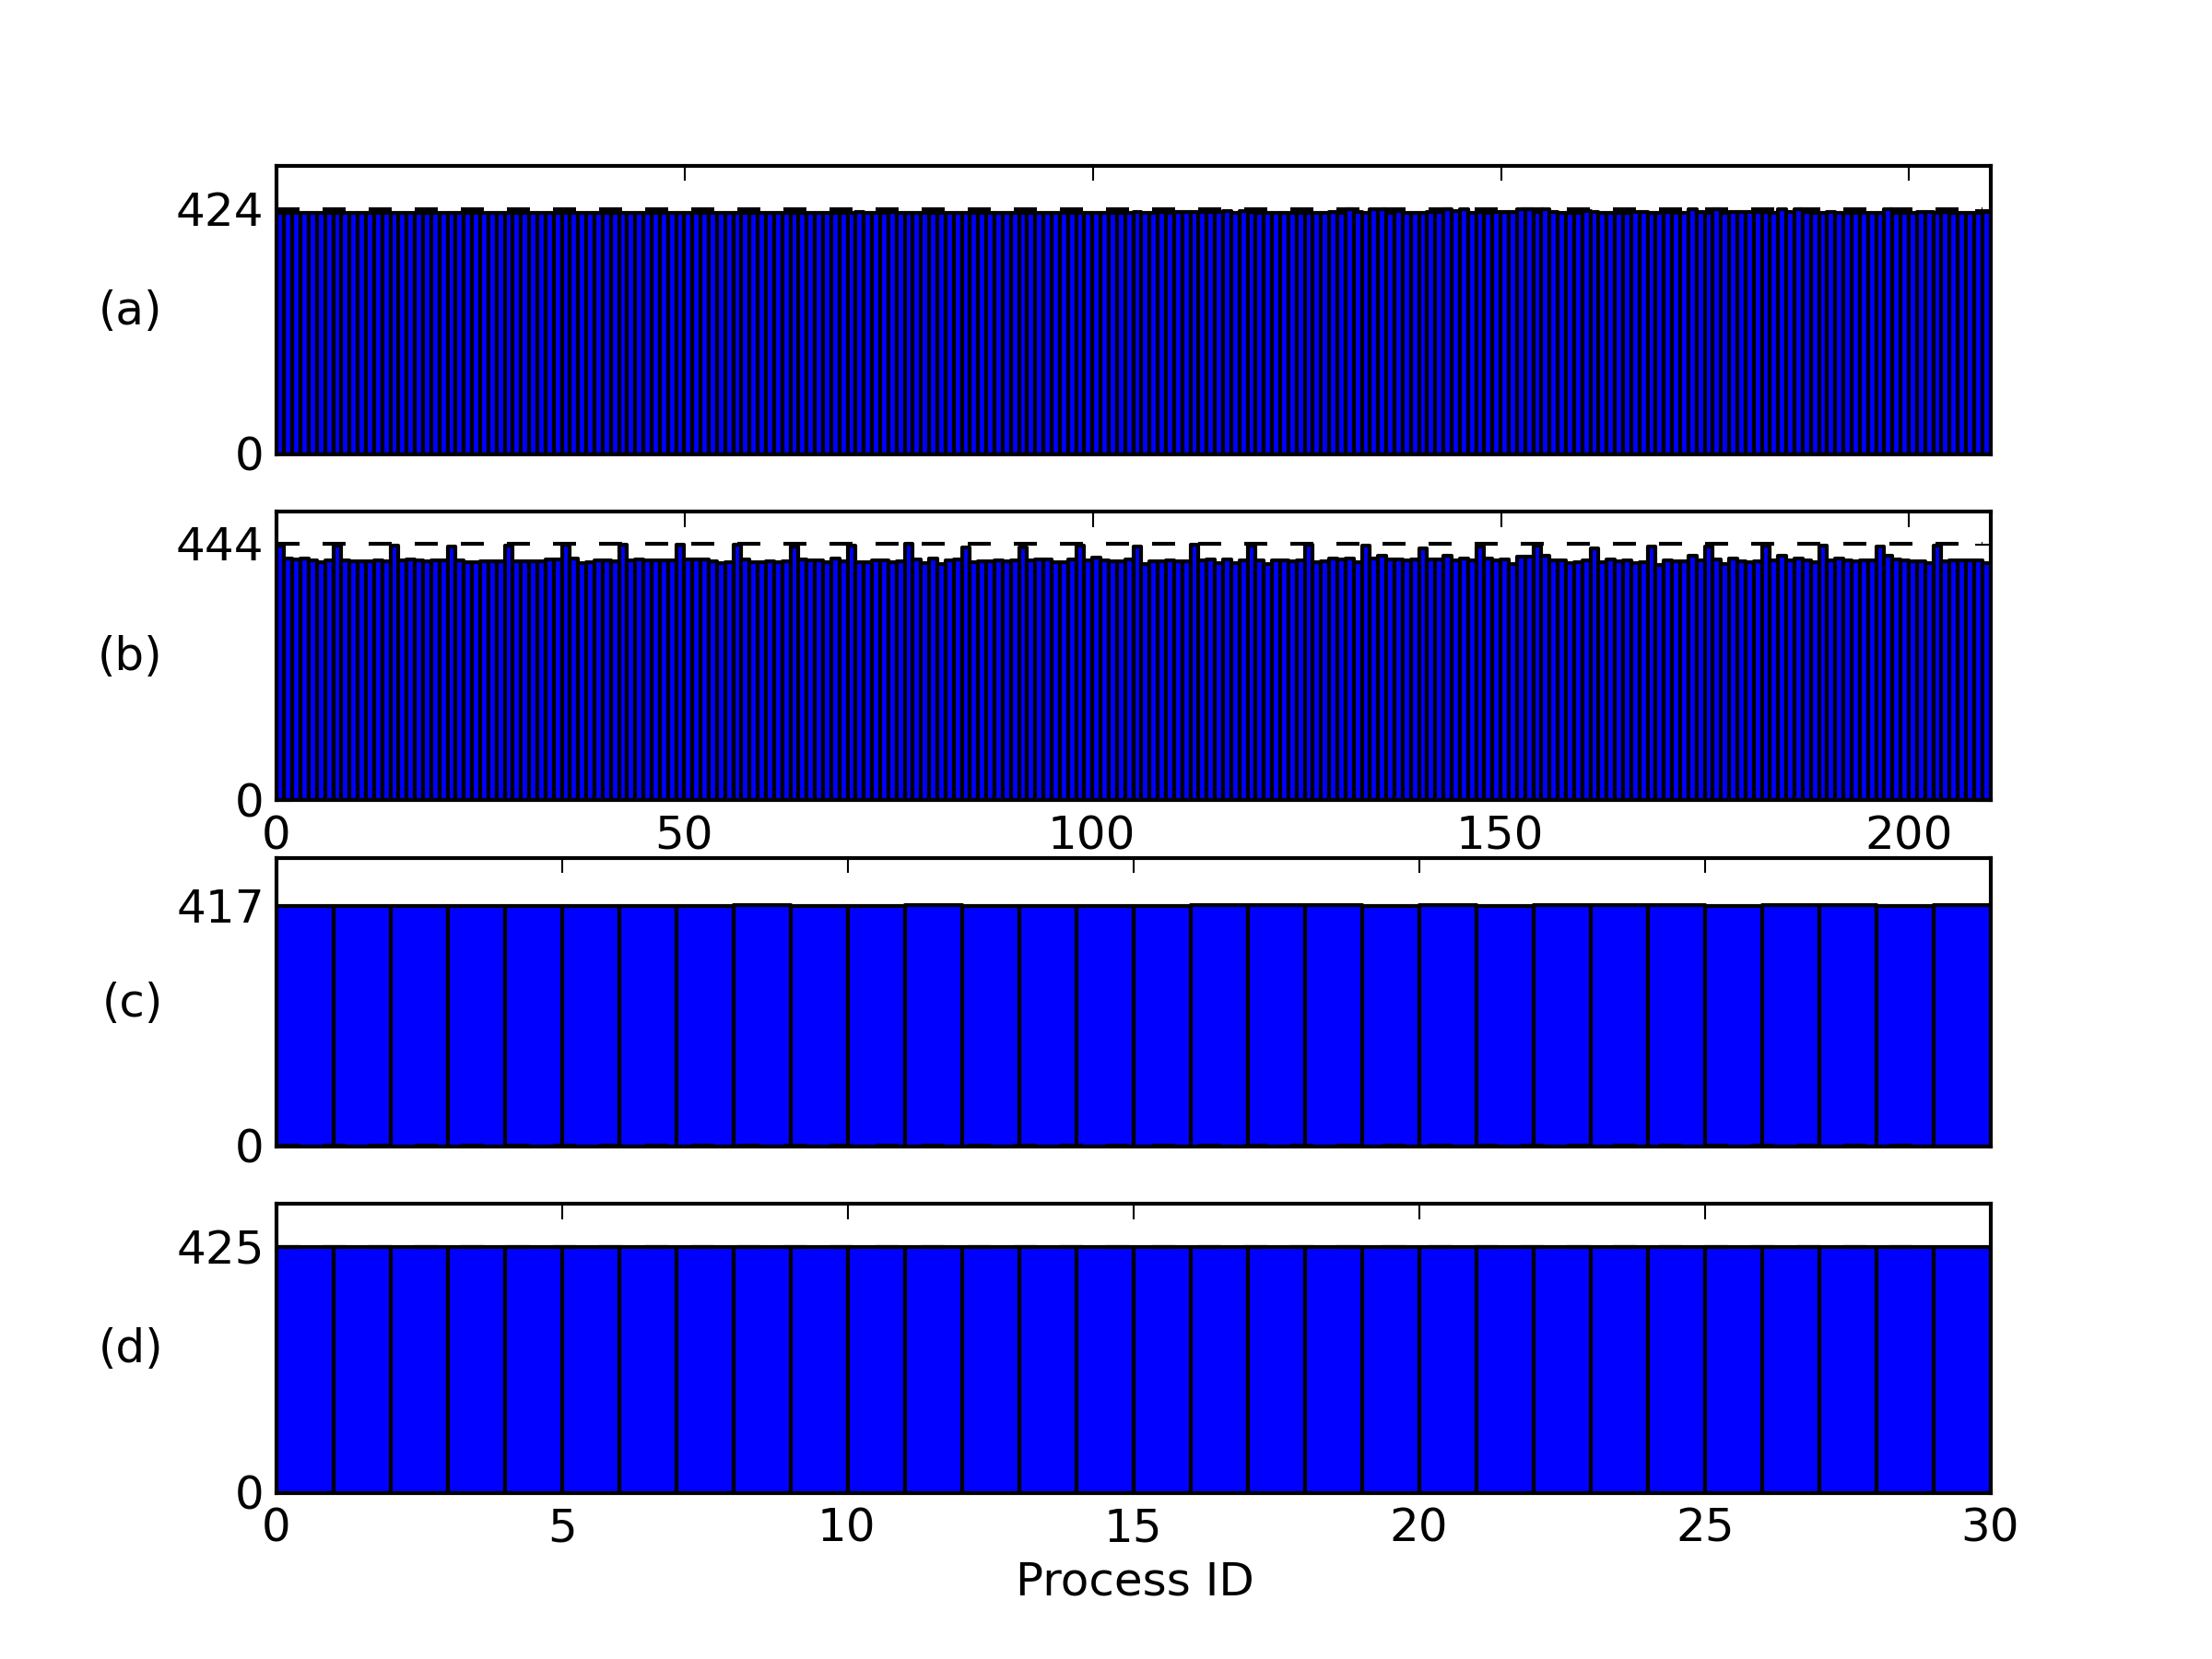
Dynamic Buckets Load Balance
(a) LPT Predicted
(b) LPT Measured
(c) Dynamic Buckets Predicted
d) Dynamic Buckets Measured

Slide 39
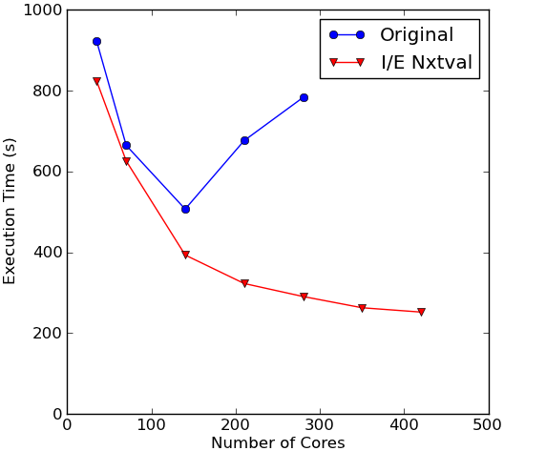
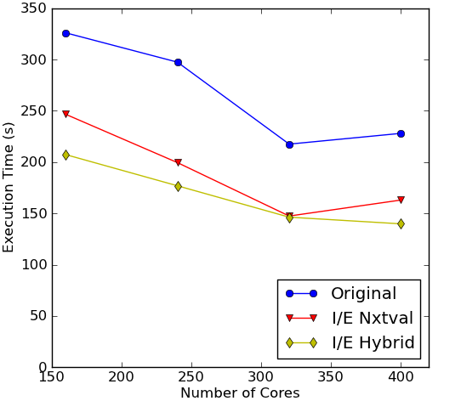
I/E Results
Nitrogen - CCSDT
Benzene - CCSD

Slide 40
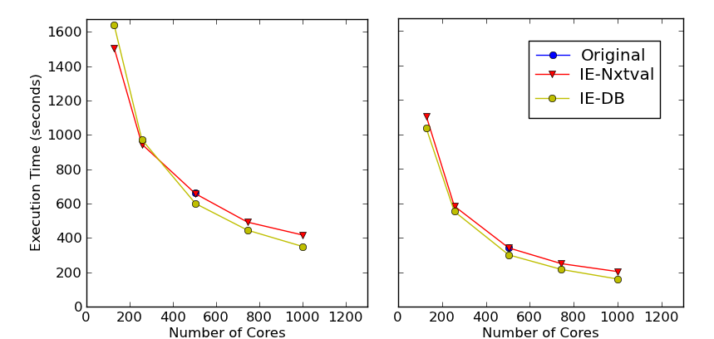
10-H₂O Cluster Results (DB)
CCSD_t2_7_3
CCSD_t2_7

Slide 41
Conclusions
Nxtval can be expensive at large scales
Static Partitioning can fix the problem, but has weaknesses:
Requires performance model
Noise degrades results
Dynamic Buckets is a viable alternative, and requires few changes to GA applications.
Solving load balance issues differs from problem to problem – work needs to be done to pinpoint why and what to do about it.

Slide 42
Future Work (Implementation)
Currently task lists stored as tmpfs file objects, should use POSIX shared memory (easy).
GA_Sort() would be really nice to have (easy).
Use Nxtval on the 1st iteration, then re-use (easy).
Hold a small group of “left-over” tasks for the end to account for imbalance due to noise (medium).
Iterative refinement (medium).
Hypergraph representation is feasible
(TCE_Hash makes this hard).
7. Choose tilesize dynamically (hard).

Slide 43
Future Work (Research)
Cyclops Tensor Framework (CTF)
DAG Scheduling of tensor contractions
What happens with accelerators (MIC/GPU)?
Performance model
Balancing load across both CPU and device
Comparison with hierarchical distributed load balancing, work stealing, etc.
Hypergraph partitioning / data locality

Slide 44
Bibliography
M. Valiev, E.J. Bylaska, N. Govind, K. Kowalski, T.P. Straatsma, H.J.J. Van Dam, D. Wang, J. Nieplocha, E. Apra, T.L. Windus, W.A. de Jong, “NWChem: A comprehensive and scalable open-source solution for large scale molecular simulations”, Computer Physics Communications, Volume 181, Issue 9, September 2010, Pages 1477–1489.
So Hirata, “Tensor Contraction Engine: Abstraction and Automated Parallel Implementation of Configuration-Interaction, Coupled-Cluster, and Many-Body Perturbation Theories”, The Journal of Physical Chemistry A 2003 107 (46), 9887-9897.
Karen Devine and Erik Boman and Robert Heaphy and Bruce Hendrickson and Courtenay Vaughan, Zoltan: Data Management Services for Parallel Dynamic Applications”, Computing in Science and Engineering, 2002, volume 4, number 2, pages 90—97.
Kleinberg, Jon and Éva Tardos (2006). Algorithm Design. Addison–Wesley, Boston. ISBN: 0-321-29535-8.
Yuri Alexeev, Ashutosh Mahajan, Sven Leyffer, Graham Fletcher, and Dmitri G. Fedorov. 2012. Heuristic static load-balancing algorithm applied to the fragment molecular orbital method. In Proceedings of the International Conference on High Performance Computing, Networking, Storage and Analysis (SC '12). IEEE Computer Society Press, Los Alamitos, CA, USA, , Article 56 , 13 pages.
Sriram Krishnamoorthy, Umit Catalyurek, Jarek Nieplocha, and Atanas Rountev., “Hypergraph partitioning for automatic memory hierarchy management”, Supercomputing (SC06), 2006.

