Slide 1
Container-Based Job Management for Fair Resource Sharing
Jue Hong, Pavan Balaji, Gaojin Wen, Bibo Tu, Junming Yan, Chengzhong Xu, and Shengzhong Feng
Oracle Corporation
Argonne National Laboratory
Chinese Academy of Sciences
Tencent Inc.

Slide 2
Resource Isolation Requirements
Resource contention is a big problem in multicore systems
Memory, network, shared caches
As systems become fatter (node core-count wise), this is going to continue to be a problem
Techniques to isolate each OS process into a virtual domain that has its own set of isolated resources can help with such contention
Idea is not that this will be helpful for all applications
Some applications can tolerate contention in order to deal with dynamic resource requirements between processes over time
For some applications, reduced contention can have a high impact

Slide 3
Current Resource Isolation Models
Virtual machine (VM)-level sharing
Good resource-isolation
High overhead for controlling, setting up, and program execution
Process-level sharing
Difficult to track multiple-process job
Lack of fine-granularity isolation of CPU, net, etc.
OS-level Virtualization: Resource Containers
LRP, Vserver, OpenVZ, Linux Container (LXC)
Fine-grained partitioning of resources in a single OS
Low overhead: runs instructions native to the core CPU
Some of them have been in mainstream Linux kernel (LXC)

Slide 4
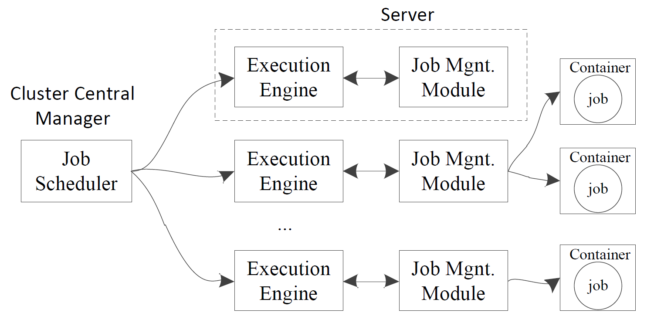
How Resource Containers Work

Slide 5
Concerns with Resource Containers
While resource containers provide the ability to provide resource isolation, they do not provide a mechanism to schedule jobs based on their resource requirements
What processes can be executed, what need to be delayed, what processes can be “admitted” on a node for execution
Resource containers are notoriously bad in interacting with external tools used in parallel programming
E.g., Debugger tools (e.g., Totalview or DDT) require PID access of each process – this is hidden in resource containers
Information with respect to resource usage is hidden inside each container and not exposed outside

Slide 6
Resource Container Interaction with Tools
totalview
100
126
100
mpiexec

Slide 7
Primary Contributions
Idea: Using Linux Container to Implement Server-level Resource Control
Goal: Make resource containers a potentially usable model in HPC environments
Contributions:
A general container-based job management module (CJMM)
A resource-aware management scheme showing how to apply the CJMM
Modifications to the resource container framework allowing it to expose information such as PIDs and resource usage, to better interact with external tools

Slide 8
Container-based Job Management (CJMM)
Architecture of a Typical Cluster Computing System
The CJMM is plugged into the execution engine, taking over the job execution, resource provisioning, and isolation

Slide 9
Container-based Job Management Design
Design of CJMM
JobManager:
Starts jobs and manages their containers
Assigns and accounts for the resource usage of server
Container
Represents the data structure and the operations of a real container
Obtain the real-time resource usage of the underlying container
Notes:
The JobManager is responsible for initializing a container for a job, starting the job inside the container, and then fetching the job’s pid for controlling. The container represents the underlying container in ths OS, including the data structure and operations.

Slide 10
Container-based Job Management
Implement Issues
Job-Startup Mechanism
Due the hierarchical PID of container, original LXC did not provide a direct way to get a job’s outside-container PID when it runs inside a container
Modify the starting mechanism to let CJMM get job’s top-level PID
Usage Information Retrieval
Implement methods to calculate the real-time resource usage of a container using with the help of CGroup

Slide 11
Exposing Resource Container Information
totalview
100
126
126
mpiexec

Slide 12
Applying CJMM
A Resource-aware Resource Management Scheme on TCluster
TCluster: a traditional cluster computing system without resource-aware feature
Integrate TCluster with CJMM: the CJMM-based executor enables the resource-aware scheduling and dispatching

Slide 13
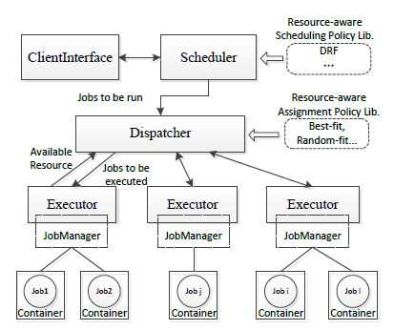
Applying CJMM
Architecture of Resource-aware TCluster
Notes:
This figure shows the architecture of resource-aware Tcluster, which includes the resource-ware scheduling, the resource-aware job assignment policy. The newly-added feature is enabled by the CJMM-based executor.

Slide 14
Applying CJMM
Implementation of Resource-aware Tcluster
Scheduling
Employ the DRF scheduling algorithm
Dispatching
Simply find the server whose available resource matches the job’s required resources most
Matching metric - Affinity Number, which is the Euclidean distance between two resource vector
Notes:
This simple policy works well in scenarios where short-lived jobs dominate and the scale of cluster is large (e.g., over 5,000 servers), reducing both computation complexity (e.g. the backlling with online bin-packing) and resource fragments .

Slide 15
Performance Evaluation: Experimental Setup
OS: SUSE Linux Enterprise 11-sp1 with kernel version of 2.6.32.29-x86_64
LXC toolkit: version 0.7.2
Network: 1G Ethernet, same rack
Server: 6 servers, each with 4 Intel 3 GHz Xeon CPUs and 2 GB memory
CPU workload: two CPU-intensive calculating programs, one with single-process and the other with multiple-process
Memory workload: a memory-intensive program that continuously allocates and touches memory

Slide 16
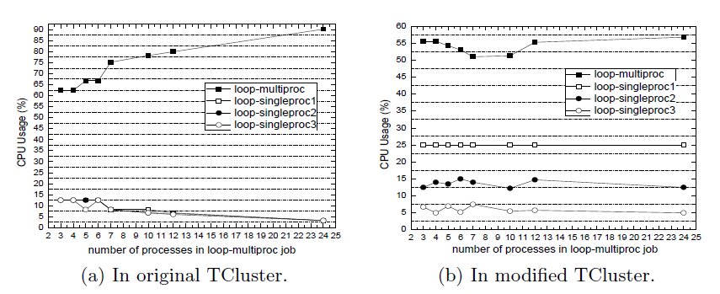
Performance Evaluation: CPU Usage
The CPU resource ratio set to the multi-process job, and the other three single-process jobs is 8:4:2:1
Number of processes in multi-process job: 3, 4, 5, 6, 7, 10, 12, and 24
Notes:
We can see the CPU times of the four jobs are approximately in accordance with the preset ratio of 8:4:2:1, which means the container-based approach helps guarantee fair sharing of the CPU.

Slide 17
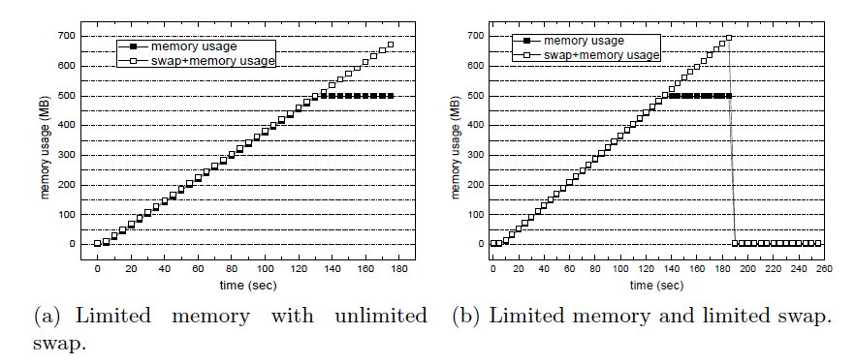
Performance Evaluation: Memory Usage
Notes:
We set the memory limit of the job to 500 MB with unlimited swap space, and then limit the total space of swap and memory to 700 MB. In both cases the used physical memory never exceed 500 MB. In second case the OOM triggered the killer and thus the job was terminated.

Slide 18
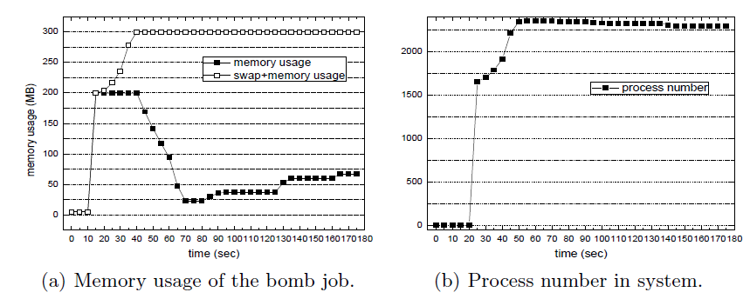
Performance Evaluation: Bomb-like Programs
Notes:
The bomb-like programs are to exhaust the system resource by keeping spawning new process fast. The container can help alleviate this threats by using the memory limitation feature of the cgroup system.

Slide 19
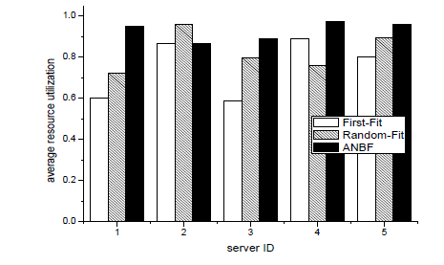
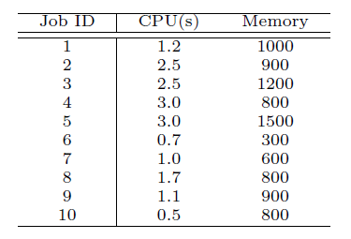
Performance Evaluation: Resource Utilization
We deploy 10 jobs with different resource requirements, and compare three policies: first-fit, best-fit, and Affinity-number based Best Fit
Average resource utilization of
each server with different policy.
Jobs’ resource requirements
Notes:
This result shows that the ANBF policy works well with the CJMM-integrated Tcluster.

Slide 20
Performance Evaluation: Overhead
We use an experimental IBM x3550 server with a quad-core Xeon E5504 2 GHz CPU and 15 GB memory
Workload: GeekBench and UnixBench to evaluate the overhead of CPU, memory, disk I/O, and system operations.
Notes:
We used a different server here since the corporation only provide such a machine which allows modifying the kernel and doing low-level performance comparison.
[8] Geekbench. http://www.primatelabs.ca/geekbench/
[9] byte-unixbench. http://code.google.com/p/byte-unixbench/

Slide 21
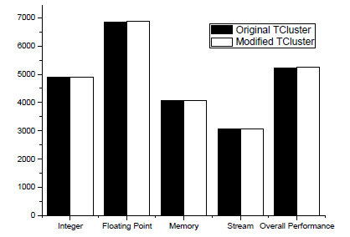
Performance Evaluation: Overhead – CPU & Memory
CPU and memory overhead (Higher score is better)
Notes:
We see no notable disparity on CPU and mem before and after using the CJMM.

Slide 22
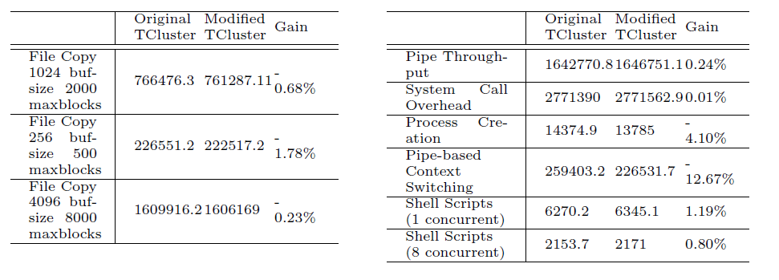
Performance Evaluation: Overhead – Disk I/O and System Operation
Disk I/O
System Operation
Notes:
We see tiny disparity on Disk I/O and System operation performance before and after using the CJMM.

Slide 23
Conclusion
To enable the on-server resource control for fair resource sharing, we propose:
A general container-based job management module (CJMM) , and
A resource-aware management scheme showing how to apply the CJMM
Experiments show our approach does good in controlling resource sharing and has very low overhead.

Slide 24
Personnel Acknowledgments
Current Staff Members
Antonio Pena (postdoc)
Wesley Bland (postdoc)
Junchao Zhang (postdoc)
Huiwei Lu (postdoc)
Yan Li (postdoc)
Ken Raffenetti (s/w developer)
Yuqing Xiong (visiting researcher)
Past Staff Members
James S. Dinan (postdoc)
Ralf Gunter (research associate)
David J. Goodell (developer)
Darius T. Buntinas (developer)
Argonne Collaborators (Partial)
Rajeev Thakur (deputy director)
Marc Snir (division director)
Pete Beckman (scientist)
Fangfang Xia (asst. scientist)
Jeff Hammond (asst. scientist)
Current and Past Students
Alex Brooks (Ph.D.)
Xiuxia Zhang (Ph.D.)
Chaoran Yang (Ph.D.)
Min Si (Ph.D.)
Huiwei Lu (Ph.D.)
Yan Li (Ph.D.)
David Ozog (Ph.D.)
Palden Lama (Ph.D.)
Xin Zhao (Ph.D.)
Ziaul Haque Olive (Ph.D.)
Md. Humayun Arafat (Ph.D.)
Qingpeng Niu (Ph.D.)
Li Rao (M.S.)
Lukasz Wesolowski (Ph.D.)
Feng Ji (Ph.D.)
John Jenkins (Ph.D.)
Ashwin Aji (Ph.D.)
Shucai Xiao (Ph.D.)
Sreeram Potluri (Ph.D.)
Piotr Fidkowski (Ph.D.)
James S. Dinan (Ph.D.)
Gopalakrishnan Santhanaraman (Ph.D.)
Ping Lai (Ph.D.)
Rajesh Sudarsan (Ph.D.)
Thomas Scogland (Ph.D.)
Ganesh Narayanaswamy (M.S.)
External Collaborators (Partial)
Ahmad Afsahi, Queen’s, Canada
Andrew Chien, U. Chicago
Wu-chun Feng, Virginia Tech
William Gropp, UIUC
Jue Hong, SIAT, Shenzhen
Yutaka Ishikawa, U. Tokyo, Japan
Laxmikant Kale, UIUC
Guangming Tan, ICT, Beijing
Yanjie Wei, SIAT, Shenzhen
Qing Yi, UC Colorado Springs
Yunquan Zhang, ISCAS, Beijing
Xiaobo Zhou, UC Colorado Springs

Slide 25
Thank You!
Email: balaji@mcs.anl.gov
Webpage: http://www.mcs.anl.gov/~balaji

