Slide 1


Optimization Strategies for MPI-Interoperable Active Messages
Xin Zhao, Pavan Balaji, William Gropp, Rajeev Thakur
University of Illinois at Urbana-Champaign
Argonne National Laboratory
ScalCom’13
December 21, 2013
Notes:
15 minutes, 12 minutes + 3 minutes Q&A
`

Slide 2

Data-Intensive Applications
Examples: graph algorithm (BFS), sequence assembly
remote node
ACGCGATTCAG
GCGATTCAGTA
ACGCGATTCAGTA
remote search
local node
DNA consensus sequence
Common characteristics
Organized around sparse structures
Communication-to-computation ratio is high
Irregular communication pattern
Remote complex computation

Slide 3
Message Passing Models
MPI: industry standard communication runtime for high performance computing
Process 0
Process 1
Process 0
Process 1
Put (data)
Send (data)
Receive (data)
Get (data)
Receive (data)
Send (data)
Acc (data)
+=
two-sided communication
(explicit sends and receives)
one-sided (RMA) communication
(explicit sends, implicit receives, simple remote operations)
✗
✗
✓
origin
target
Active Messages
Sender explicitly sends message
Upon message’s arrival, message handler is triggered, receiver is not explicitly involved
User-defined operations on remote process
messages
messages
handler
reply
reply handler
Notes:
----- 会议笔记(12/18/13 16:03) -----
don't mention why is not well-suitsble,
want to move computation close to data

Slide 4
Past Work: MPI-Interoperable Generalized AM
origin input buffer
origin output buffer
MPI-AM: an MPI-interoperable framework that can dynamically manage data movement and user-defined remote computation.
AM
input data
AM output data
Streaming AMs
define “segment”—minimum number of elements for AM execution
achieve pipeline effect and reduce buffer requirement
target input buffer
target output buffer
Explicit and implicit buffer management
user buffers: rendezvous protocol, guarantee correct execution
system buffers: eager protocol, not always enough
AM handler
target persistent buffer
MPI-AM workflow
Correctness semantics
Memory consistency
MPI runtime must ensure consistency of window
Three different type of ordering
Concurrency: by default, MPI runtime behaves “as if” AMs are executed in sequential order. User can release concurrency by setting MPI assert.
memory barrier
memory barrier
SEPARATE window model
AM handler
AM handler
UNIFIED
window model
memory barrier
memory barrier
flush cache line back
[ICPADS 2013] X. Zhao, P. Balaji, W. Gropp, R. Thakur, “MPI-Interoperable and Generalized Active Messages”, in proceedings of ICPADS’ 13
Notes:
----- 会议笔记(12/18/13 16:03) -----
look at data

Slide 5
How MPI-Interoperable AMs work
Leveraging MPI RMA interface
origin
target
process 0
process 1
process 2
lock
fence
fence
PUT(X)
GET (W)
PUT (X)
GET(Y)
PUT (N)
epoch
GET (Y)
epoch
epoch
ACC(Z)
AM (M)
AM(X)
AM (U)
unlock
fence
fence
passive target mode
(EXCLUSIVE or SHARED lock)
active target mode
(Fence or Post-Start-Complete-Wait)

Slide 6
Performance Shortcomings with MPI-AM
Synchronization stalls in data buffering
Inefficiency in data transmission
ORIGIN
TARGET
query DNA sequences
remote node 2
ACGCGATTCAG
GCGATTCAGTA
ACGCGATTCAGTA
remote node 1
segment 1
receive in system buffer
remote search
request for user buffer
stall
reserve user buffer
AM
acknowledgement
AM on system buffer is finished
segment 2
return output data
in system buffer
receive in user buffer
segment 3
receive in system buffer
local node
consensus DNA sequences
Effective strategies are needed to improve performance
System level optimization
User level optimization
Notes:
6 minutes
============
Output buffer allocated can be potentially large
Return unnecessary data
----- 会议笔记(12/18/13 16:03) -----
not mention user buffer/system buffer

Slide 7
Opt #1: Auto-Detected Exclusive User Buffer
MPI internally detects EXCLUSIVE passive mode
Optimization is transparent to user
origin
target
origin
target
lock
lock
hand-shake
EXCLUSIVE
☺
hand-shake
SHARED
☹
epoch
epoch
AM 1
AM 1
hand-shake
AM 2
AM 2
unlock
unlock
Only one hand-shake is required for entire epoch
Hand-shake is required whenever AM uses user buffer

Slide 8
Opt #2: User-Defined Exclusive User Buffer
User can define amount of user buffer guaranteed available for certain processes
Beneficial for SHARED passive mode and active mode
No hand-shake operation is required!
process 0
process 1
process 2
win_create
win_create
rank
size
win_create
0
20 MB
2
30 MB
fence
fence
AM 1
AM 1
AM 2
AM 3
AM 2
fence
fence

Slide 9
Opt #3: Improving Data Transmission
Two different models
AM
AM
pipeline unit #1
pipeline unit #2
pipeline unit #1
pipeline unit #2
segment #1
segment #2
segment #3
segment #4
segment #1
segment #2
segment #3
segment #4
TARGET
pack
pack
unpack
unpack
ORIGIN
segment #3
segment #4
segment #1
segment #2
segment #3
segment #4
segment #1
segment #2
Contiguous output data layout
Really straightforward and convenient?
Out-of-order AMs require buffering or reordering
Non-contiguous output data layout
Require new API — not a big deal
Must transfer back count array
Packing and unpacking
No buffering or reordering is needed
Data packing vs. data transmission
Controlled by system-specific threshold
Notes:
Not say in detail, just say what it can be done

Slide 10
Experimental Settings
BLUES cluster at ANL: 310 nodes, with each consisting 16 cores, connected with QLogic QDR InfiniBand
Based on MPICH-3.1b1
Micro-benchmarks: two common operations
Remote search of string sequences (20 characters per sequence)
Remote summation of absolute values in two arrays (100 integers per array)
Result data is returned
Notes:
12 minutes

Slide 11
Effect of Exclusive User Buffer
scalability:
25% improvement
Notes:
Communication latency is improved by 20%
user-defined buffer has no synchronization overhead!

Slide 12
Comparison between MPIX_AM and MPIX_AMV
system-specific threshold
helps eliminate packing
and unpacking overhead
MPIX_AMV(0.8) transmits
more data than MPIX_AM
due to additional counts array

Slide 13
Conclusion
Data-intensive applications are increasingly important, MPI is not a well-suited model
We proposed MPI-AM framework in our previous work, to make data-intensive applications more efficient and require less programming effort
There are performance shortcomings in current MPI-AM framework
Our optimization strategies, including auto-detected and user-defined methods, can effectively reduce synchronization overhead and improve efficiency of data transmission

Slide 14
Our previous work on MPI-AM:
Towards Asynchronous and MPI-Interoperable Active Messages. Xin Zhao, Darius Buntinas, Judicael Zounmevo, James Dinan, David Goodell, Pavan Balaji, Rajeev Thakur, Ahmad Afsahi, William Gropp. In proceedings of the 13th IEEE/ACM International Symposium on Cluster, Cloud and Grid Computing (CCGrid 2013).
MPI-Interoperable Generalized Active Messages Xin Zhao, Pavan Balaji, William Gropp, Rajeev Thakur. In proceedings of the 19th IEEE International Conference on Parallel and Distributed Systems (ICPADS 2013).
They can be found at http://web.engr.illinois.edu/~xinzhao3/
More about MPI-3 RMA interface can be found in MPI-3 standard (http://www.mpi-forum.org/docs/)
Thanks for your attention! ☺
Notes:
14 min
This work largely depends on our previous work,
Due to the time limit, I cannot introduce them in depth,
Related documents about our previous work can be found at …
I am happy for any questions.

Slide 15
BACKUP

Slide 16
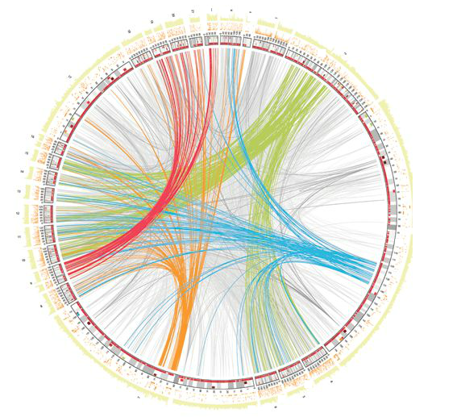
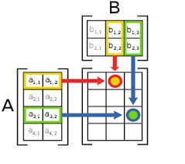
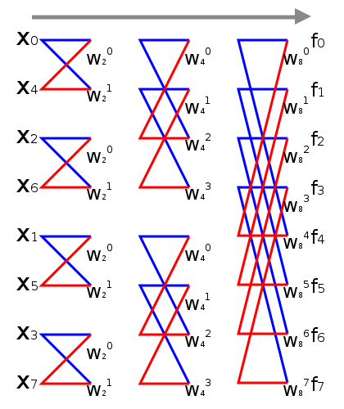
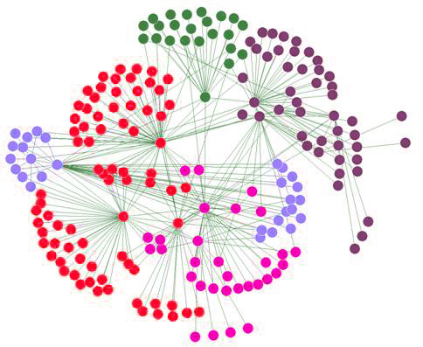
Data-Intensive Applications
“Traditional” applications
Organized around dense vectors or matrices
Regular communication, use MPI SEND/RECV or collectives
Communication-to-computation ratio is low
Example: stencil computation, matrix multiplication, FFT
Data-intensive applications
Organized around graphs, sparse vectors
Communication pattern is irregular and data-dependent
Communication-to-computation ratio is high
Example: bioinformatics, social network analysis

Slide 17
Vector Version of AM API
MPIX_AMV
IN origin_input_addr
IN origin_input_segment_count
IN origin_input_datatype
OUT origin_output_addr
IN origin_output_segment_count
IN origin_output_datatype
IN num_segments
IN target_rank
IN target_input_datatype
IN target_persistent_disp
IN target_persistent_count
IN target_persistent_datatype
IN target_output_datatype
IN am_op
IN win
OUT output_segment_counts
MPIX_AMV_USER_FUNCTION
IN input_addr
IN input_segment_count
IN input_datatype
INOUT persistent_addr
INOUT persistent_count
INOUT persistent_datatype
OUT output_addr
OUT output_segment_count
OUT output_datatype
IN num_segments
IN segment_offset
OUT output_segment_counts

Slide 18
Effect of Exclusive User Buffer
scalability:
25% improvement
providing more
exclusive buffer
greatly reduces
contention

Slide 19
Auto-detected Exclusive User Buffer
Handle detaching user buffers
One more hand-shake is required after MPI_WIN_FLUSH, because user buffer may be detached on target
User can pass a hint to tell MPI that there will be no buffer detachment, in such case, MPI will eliminate hand-shake after MPI_WIN_FLUSH
origin
target
lock
hand-shake
EXCLUSIVE
☺
AM 1
AM 2
flush
detach user
buffer
hand-shake
AM 3
AM 4
AM 5
unlock

Slide 20
Background —MPI One-sided Synchronization Modes
Two synchronization modes
origin
target
origin
target
post
lock
start
access epoch
PUT(Y)
PUT(Y)
exposure epoch
epoch
ACC(X)
ACC(X)
complete
unlock
wait
active target mode
(post-start-complete-wait/fence)
passive target mode
(SHARED or EXCLUSIVE lock/lock_all)

