Slide 1
Toward the Efficient Use of Multiple Explicitly Managed Memory Subsystems
Antonio J. Peña Pavan Balaji
Argonne National Laboratory Argonne National Laboratory
apenya@anl.gov balaji@anl.gov

Slide 2


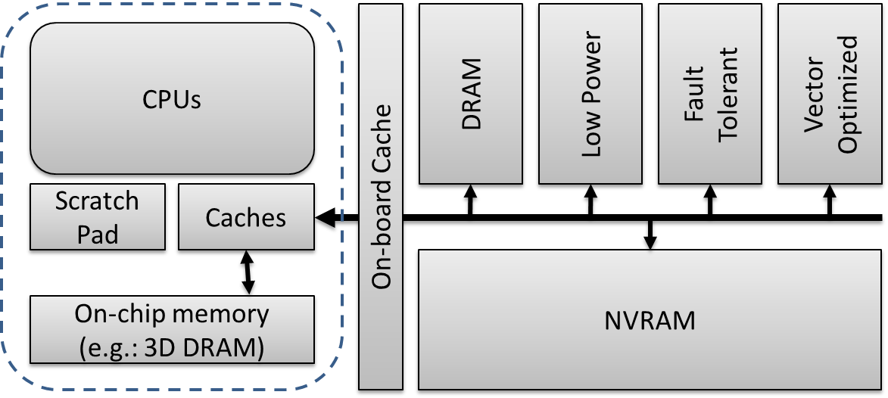
Motivation
Heterogeneity in computing explored:
Heterogeneus processing
Heterogeneous memory
Different memory technologies within computers already a reality
Scratchpad, 3D-stacked, I/O class, …
We expect more memory heterogeneity
Different features:
Size, resilience, access patterns, energy, …
Examples:
Scratchpad:
Cachelike speeds, small sizes
Vector-specialized (e.g.: GDDR)
High bandwidth if contiguous accesses
Low-power memory
Increased energy/speed ratio
ECC-enabled memory
Fault tolerance; speed & size overhead
I/O class (e.g.: NVRAM)
Large; reduced speeds & energy
Faster reading than writing
Notes:
3D: KNL

Slide 3
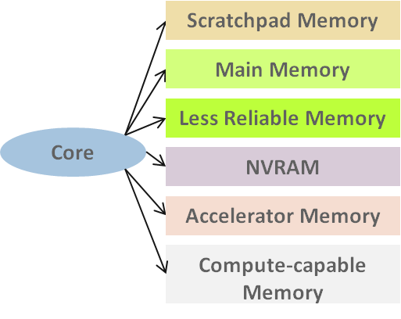
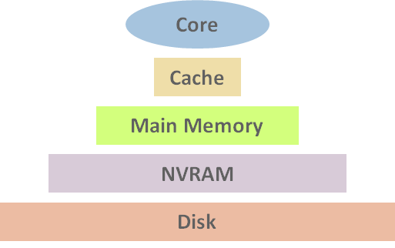
Motivation
To efficiently exploit heterogeneous memory:
Bring them as first-class citizens
Move from hierarchical to explicitly managed
Application’s data distribution?
OS? Heuristics? On-the-fly monitoring? Hardware-assisted? Historic data? User hints?
Need ecosystem to assist users/developers: tools
Profilers, libraries, runtime systems

Slide 4
Motivation
Goal:
Heterogeneous memory systems
Assess optimal data distribution
Methodology:
Data-oriented profiling
Memory object granularity
Solution:
Valgrind core and tools extensions
Distribution algorithm
DRAM
NVRAM
3D
SP

Slide 5
Outline
Background
Data-Oriented Profiling
Valgrind, Callgrind, & Extensions
Methodology
Analysis
Assumptions and Current Known Limitations
Test Cases
System Setup
Applications
Experimental Results
Summary & Future Work

Slide 6
Background

Slide 7
Background Data-Oriented Profiling
Today’s profiling techniques help developers focus on troublesome lines of code
Data-oriented profiling complements the traditional algorithm-oriented analysis:
a[i] = b[j] * c[k];
b[l] = a[m] * 2;
c[n] += b[o];
c[i] = a[j] * b[k] + c[l];
a[i] = b[j] * c[k]; b[l] = a[m] * 2; c[n] += b[o];
Traditional profiler
c[i] = a [j]* b [k]+ c[l]; ← 15%
Traditional profiler
a[i] = b[j] * c[k]; b[l] = d[m] * 2; c[n] += b[o]; ← 15%
Traditional profiler
a[i] = b[j] * c[k]; ← 5%
b[l] = d[m] * 2; ← 5%
c[n] =+ b[o]; ← 5%
Data-oriented profiler
a ← 0%
b ← 15%
c ← 0%

Slide 8
Background Valgrind & Callgrind
Valgrind
Callgrind
Generic instrumentation framework
Ecosystem: set of tools
Memcheck is just default
Virtual machine – JIT
Typically overhead around 4x-5x
Rich API to tools
Notify requested capabilities
Get debug information
Get information about thread status
Intercept memory management calls
Client request mechanism
Start / stop instrumentation from application’s code
Valgrind tool
“Call-graph generating cache and branch prediction profiler”
Purpose: profiling tool
By source line of code
Cache simulation:
Cache misses
Cache hierarchy modeled after the host’s one by default
Branch predictor
Hardware prefetcher
Kcachegrind integration: visualization

Slide 9
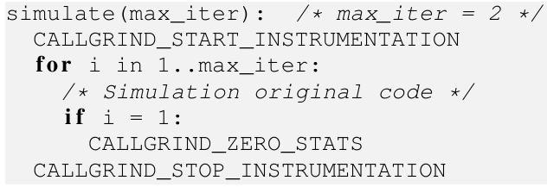
Background Valgrind & Callgrind Extensions
To enable the differentiation of memory objects:
Locate the memory object comprising a given memory address
Store its associated access data
Added support to be used from tools
During the execution of a profiled application:
Every data access causing a last-level cache miss is checked against matching object
To tackle profiling overhead for production-sized runs, limit to a region of interest
Modifying the code to be profiled
Output:
Per-object cache misses during the
profiled portion of interest
A. J. Peña and P. Balaji. "A framework for tracking memory accesses in scientific applications", in P2S2 2014 (ICPP Workshop), Minneapolis, MN, Sep. 2014.

Slide 10
Methodology

Slide 11
Methodology
Object-differentiated profiling + distribution algorithm (analysis):
Profile to determine per-object last-level cache misses
Assess the optimal distribution of the different objects among the memory subsystems
Minimize processor stall cycles
Compiler
Toolchain
Executable
Object
Memory
Profiler
2
3
1
4
Source
Code
Execution
Input
Profile
Data
7
5
Executable
Object
8
Compiler
Toolchain
7
Object
Distribution
6
Profile
Analyzer

Slide 12
Methodology Analysis
Maximize the value of the content of a (set of) knapsack(s) given a set of items of different values and sizes
Multiple knapsack problem:
Knapsacks: memory subsystems
Knapsack capacity: memory size
Items: memory objects
Item weight: size
Item value: number of load cache misses
CPU stall cycles
Not a textbook problem:
The different knapsacks modify the value of their items:
Multiply cache misses by a different factor: average read latency

Slide 13
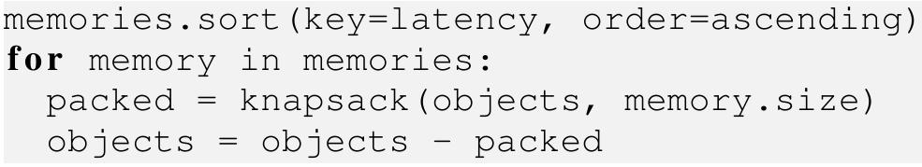
Methodology Analysis
Greedy approach solving separate 0/1 knapsack problems:
Target memories in ascending order of average access cycles
Prioritize the placement of the most “valuable” objects in the faster memories
In practice not divergent from the optimal global solution
Removes computational complexity (0/1 knapsack is weakly NP-hard)
4 KB page granularity
Obj #1
5k Cache Misses
Size: 6
Memory #1
Avg. Latency: 1
Size: 10
Obj #2
10k Cache Misses
Size: 5
Total Cost:
5k x 100 + (10k + 1k) x 10
Obj #3
1k Cache Misses
Size: 2
Memory #2
Avg. Latency: 10
Size: 100

Slide 14
Methodology Assumptions and Current Known Limitations
Write misses cause no stall cycles:
Buffered write-through with unlimited buffer size
In practice, stall cycles caused by read misses >> those of write misses
We don’t specially penalize memories w/ faster reads than writes (NVRAM)
Average latency estimations for the different memory subsystems
No memory migrations nor reuse of freed space
(other than by the same memory object)

Slide 15
Test Cases

Slide 16
Test Cases System Setup
8-core processor with set-associative cache:
Cache Configuration
Description | Total Size | Assoc. | Line Size
L1 Instruction | 32 KB | 8 | 64 B
L1 Data | 32 KB | 8 | 64 B
LL Unified | 8 MB | 16 | 64 B

Slide 17
Test Cases System Setup
Baseline system equipped with traditional DRAM-based main memory space
Target: two different heterogeneous memory configuration proposals
Scenario 1
Scenario 2
CPUs
CPUs
MAIN
DRAM
MAIN
DRAM
NVRAM
L1 Instr.
L1 Data
L1 Instr.
L1 Data
SP
L2
SP
L2
3D DRAM
3D DRAM

Slide 18
Test Cases System Setup
Estimations:
1 IPC
No stall cycles caused by hazards
Memory Configuration
Memory |  | Scenario
Description | Latency | Baseline | Scenario 1 | Scenario 2
L1 | 0 c | 32 KB + 32 KB
L2 | 20 c | 8 MB
SP | 20 c | 0 B | 8 MB | 8 MB
3D | 135 c | 0 B | 8 GB | 1 GB
Main | 200 c | 32 GB | 32 GB | 4 GB
NVRAM | 20,000 c | 0 B | 0 B | 32 GB

Slide 19
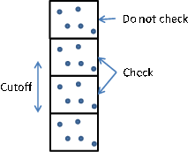
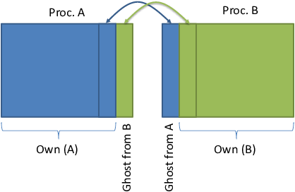
Test Cases Applications
MiniMD
HPCCG
“A simple proxy for the force computations in a typical molecular dynamics application”
Reduced version of the LAMMPS molecular dynamics simulator
Multiple large memory objects – different number of cache misses
Setup:
Reference implementation v1.2
LJ interactions among 2.9·10⁶ atoms
8 threads – 26 GB of memory
23% of cycles from cache misses
“A simple conjugate gradient benchmark code for a 3D chimney domain on an arbitrary number of processors”
Access pattern known to be highly memory demanding and sensitive to different memory architectures
Sensitivity to memory placement
Setup:
Reference version 1.0
400 x 400 x 400 node problem
8-threaded process – 24 GB memory
48% of cycles from cache misses

Slide 20
Experimental Results

Slide 21
Experimental Results
Compute unoptimized distribution as:
Invert the “value” of objects with nonzero cache misses
Those featuring fewer misses are preferably allocated in the fastest memory subsystem
Discard memory objects not presenting cache misses
Unoptimized case not the worst possible case because objects without cache misses do not populate the fastest memories
Worst Case
Our Unoptimized Case
Obj #1
5k Cache Misses
Memory #1
Very Fast
Obj #1
5k Cache Misses
Memory #1
Very Fast
Obj #2
10k Cache Misses
Memory #2
Regular Speed
Obj #2
10k Cache Misses
Memory #2
Regular Speed
Obj #3
0 Cache Misses
Memory #3
Slow
Obj #3
0 Cache Misses
Memory #3
Slow

Slide 22
Experimental Results MiniMD
99% of memory objects (21/26 GB) no cache misses during loop iteration
Scenario 1
21 objects < SP && fit in SP
3D > 9 objects > SP && fit in 3D
Trivial distribution
No opt. vs unopt. case
7.6% exec. time improvement w/ respect to baseline architecture
3D memory performance benefits
Scenario 2
Memory size restrictions
Choice at DRAM/NVRAM
4 obj. small enough for DRAM
But only room for 3 of them
Mem. | Obj. | Occup. | Cycles | Exec.
SP | 21 | 53% | -4M | 0.0%
3D | 5 | 21% | -18M | -0.2%
DRAM | 3 | 93%
NVRAM | 1 | 4% | +1G | +13.9%
TOTAL |  |  | +1G | +13.7%
Optimized
Mem. | Obj. | Occup. | Cycles | Exec.
SP | 21 | 53% | -4M | 0.0%
3D | 9 | 65% | -743M | -7.6%
DRAM | 0 | 0%
TOTAL |  |  | -747M | -7.6%
Mem. | Obj. | Occup. | Cycles | Exec.
SP | 21 | 53% | -4M | 0.0%
3D | 5 | 21% | -18M | -0.2%
DRAM | 3 | 94%
NVRAM | 1 | 4% | +130G | +1,330.5%
TOTAL |  |  | +130G | +1,330.3%
Unoptimized

Slide 23
Experimental Results HPCCG
742/760 mem. obj. no misses: 22 GB
9 mem. obj. < SP, but ↓ # cycles
9 other obj. give choices
Scenario 1
1 obj. > 3D → DRAM
8 obj. to be distr. DRAM & 3D
Scenario 2
2 obj. fit only in NVRAM
7 obj. to be distr. in 3D and DRAM
Mem. | Obj. | Occup. | Cycles | Exec.
SP | 9 | 0% | -2K | 0.0%
3D | 2 | 95% | -224M | -3.8%
DRAM | 5 | 54%
NVRAM | 2 | 60% | +193G | +3,236.7%
TOTAL |  |  | +193G | +3,232.9%
Optimized
Mem. | Obj. | Occup. | Cycles | Exec.
SP | 9 | 0% | -2K | 0.0%
3D | 4 | 98% | -497M | -8.3%
DRAM | 5 | 45%
TOTAL |  |  | -497M | -8.3%
Optimized
Mem. | Obj. | Occup. | Cycles | Exec.
SP | 9 | 0% | -2K | 0.0%
3D | 2 | 95% | -6M | -0.1%
DRAM | 5 | 54%
NVRAM | 2 | 60% | +193G | +3,236.7%
TOTAL |  |  | +193G | +3,236.6%
Mem. | Obj. | Occup. | Cycles | Exec.
SP | 9 | 0% | -2K | 0.0%
3D | 7 | 39% | -294M | -4.9%
DRAM | 2 | 60%
TOTAL |  |  | -294M | -4.9%
Unoptimized
Unoptimized

Slide 24
Experimental Results Discussion
SP: low occupancy & contributions to the overall performance
Most of the small objects do not present LL cache misses
Expected in highly-tuned code
TODO: explore splitting + migration
Overall performance improvement with respect to unoptimized distribution:
Nonnegligible in 2 out of the 4 cases
MiniMD, scenario 2: over 10x by avoiding placing a particular memory object in NVRAM
HPCCG, scenario 1: ~4% improvement by placing obj. w/ large misses in fast memories
Hardware | Test Case
 | MiniMD | HPCCG
Scenario 1 | 0.0% | 3.7%
Scenario 2 | 1,158.0% | 0.1%

Slide 25
Conclusions

Slide 26
Summary
Design of tools providing object-differentiated profiling on Valgrind
Provided methodology for optimized data distribution among memory subsystems
At object level granularity
Results based on 2 miniapps and 2 configurations of heterogeneous memory:
Object-differentiated profiling useful for memory distribution in heterogeneous memory systems
Future work:
Object migration?
Split objects?

Slide 27
Thank you
Questions?
apenya@mcs.anl.gov

Slide 28
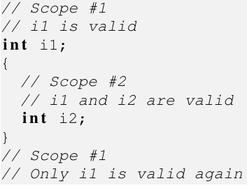
Background Valgrind’s Extensions
Statically-Allocated Memory Objects
Debug information (e.g. gcc -g)
Information distributed among the different binary objects of an application
including libraries
Different scopes determine whether the variables are valid or not
Asymptotic computational cost:
O(st x (dio + sao))
st is the maximum stack trace depth
dio is the number of debug information objects
sao is the max. # of statically allocated objects for a given IP
A. J. Peña and P. Balaji. "A framework for tracking memory accesses in scientific applications", in P2S2 2014 (ICPP Workshop), Minneapolis, MN, Sep. 2014.

Slide 29
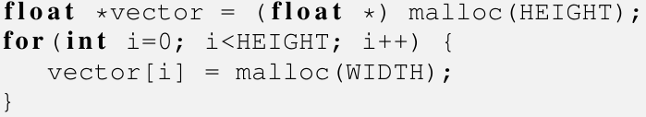
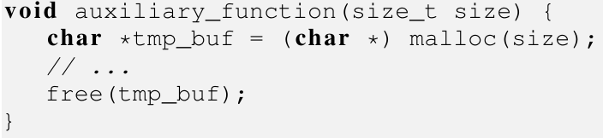
Background Valgrind’s Core Extensions
Dynamically-Allocated Memory Objects
Interception of application calls to memory management routines
Ordered set using starting memory address as sorting index:
Possible since dynamically allocated objects reside in the global scope
Binary searches:
O(log dao)
dao is # of dynamically alloc. objects
Merge objects
If they were created featuring a common stack trace
These are likely to be considered as a single one from application level
Examples:
Loop allocating an array of lists as part of a matrix
Temporary object in a function
TODO: linked list detection
A. J. Peña and P. Balaji. "A framework for tracking memory accesses in scientific applications", in P2S2 2014 (ICPP Workshop), Minneapolis, MN, Sep. 2014.

Slide 30
Background Memory Technologies
Cache
Levels of increasing size and latency
Small, hardware-managed, low-latency
Common CPU stall cycles:
Nonexistent for L1
~10 for L2
Keep increasing w/ distance to CPU
NVRAM
Does not require refresh (energy)
Limited write-erase cycles
Write speeds lower than reads
Non byte addressable (at low level)
High-level libraries
Usually I/O-based storage
But we adopt it as het. mem.
Scratchpad
Like cache, but explicitly managed
Common in embedded processors & GPUs, but not in compute nodes
High level of control; prevents issues caused by heuristic management
On-chip 3D-Stacked Memory
DRAM
Physically stacked in multiple layers
Within the microprocessor die
Low latency – high bandwidth
Energy dissipation is a problem
8-16 GB per chip
30% reduction in access latency
DRAM
… you know ;)

