Slide 1
Implementing the MPI 3.0 Fortran 2008 Binding
Junchao Zhang
Argonne National Laboratory
jczhang@anl.gov
Bill Long
Cray Inc.
longb@cray.com
Ken Raffenetti
Argonne National Laboratory
raffenet@anl.gov
Pavan Balaji
Argonne National Laboratory
balaji@anl.gov
09/10/2014
EuroMPI/Asia @ Kyoto, Japan

Slide 2
Motivations
MPI -- is the dominant programming model in high performance computing (HPC), why we are all here ☺
Fortran – the primary language in HPC, has been around for more than 50 years, is especially suitable for numerical analysis and technical calculations, and runs many mission critical codes today, which none of us can ignore despite having C/C++/Java/…
Have MPI and Fortran played well together?

Slide 3
MPI Fortran 77 binding (include ‘mpif.h’)
Defined as early as MPI-1.0
No type safety -- F77 compilers use implicit interfaces by inducing the interface of an external procedure from actual arguments at a call site
Delay errors from compile time to run time!
Non-standard naming convention for external symbols – F77 compilers generate them a bit arbitrarily, e.g., lower case plus 0/1/2 underscores such as mpi_send_, mpi_send__, …
No standard way to write hybrid code with procedures/variables declared in Fortran but defined in C, which is needed by MPI implementers since most MPI implementations are done in C

Slide 4
MPI Fortran 90 binding (use mpi)
Defined in MPI-2.0
F90 adopted concepts like explicit interfaces, but does not have a generic type like void * in C, which is common in MPI
How would one declare the type of choice buffers in MPI?
Overload a subroutine for all possible type-kind-rank (TKR) combinations
Not practical due to interface explosion – need > 6M interfaces and still not cover derived data type
Use non-standard compiler extensions to ignore type checking, e.g.,
GNU -- !GCC$ ATTRIBUTES NO_ARG_CHECK
IBM -- !IBM* IGNORE_TKR
Cray -- !DIR IGNORE_TKR
…
Notes:
Assuming the compiler supports CHARACTER, LOGICAL{1,2,4,8}, INTEGER{1,2,4,8},
REAL{4,8,16}, and COMPLEX{8,16,32}.
Not only must interfaces be defined for arrays of each intrinsic data type,
but for each array dimension as well. Depending on the compiler, there may be
approximately 15 type / size combinations.1 Each of these combinations can be
paired with up to a maximum of seven array dimensions. With approximately
50 MPI functions that have one choice buffer, this means that 5,250 interface
declarations must be specified (i.e., 15 types × 7 dimensions × 50 functions).
Note that this does not include the approximately 25 MPI functions with two
choice buffers. This leads to an additional 6.8M interface declarations (i.e., (15×
7 × 25)^2).

Slide 5
MPI Fortran 2008 binding (use mpi_f08)
Defined in MPI-3.0
Take advantage of new Fortran language features and better interoperability of Fortran with C; fixed all defects in F77/90 bindings
First Fortran support method that is consistent with the Fortran standard
Encouraged for all MPI Fortran programmers

Slide 6
Outline
MPI-3.0 Fortran 2008 (F08) binding overview
Implementing the F08 binding in MPICH
Design framework
Fortran wrappers and named constants
C wrappers
Testing and experiences
Conclusions and future work

Slide 7
MPI F08 binding : MPI_Recv as an example
C binding
int MPI_Recv(void* buf, int count, MPI_Datatype datatype, int source,
int tag, MPI_Comm comm, MPI_Status *status)
F77/F90 binding
MPI_RECV(BUF, COUNT, DATATYPE, SOURCE, TAG, COMM, STATUS, IERROR)
<type> BUF(*)
INTEGER :: COUNT, DATATYPE, SOURCE, TAG, COMM, STATUS(MPI_STATUS_SIZE), IERROR
F08 binding
MPI_Recv(buf, count, datatype, source, tag, comm, status, ierror)
TYPE(*), DIMENSION(..) :: buf
INTEGER, INTENT(IN) :: count, source, tag
TYPE(MPI_Datatype), INTENT(IN) :: datatype
TYPE(MPI_Comm), INTENT(IN) :: comm
TYPE(MPI_Status) :: status
INTEGER, OPTIONAL, INTENT(OUT) :: ierror
No standard way to declare BUF; compilers or impl. dependant
“Integer args everywhere”. If users mess them up, they live on their own. Compilers can not help.
“assumed-type, assumed rank” type defined in TS 29113
Each kind of MPI handles and MPI_Status now have a unique type; Compilers now enforce type checking
Optional ierror for users’ convenience

Slide 8
Assumed-type, assumed-rank dummy arguments
Defined in TS 29113 with syntax type(*), dimension(..)
Similar to void * in C, actual arguments can be of any type and any rank, e.g., a scalar, an array or an array section (subarray)
^{real :: x, y(5, 5), z(10)}
call MPI_Send(x, 1, MPI_REAL, …) ! Send a scalar
call MPI_Send(y(:, 2:3), 10, MPI_REAL, …) ! Send column 2 and 3
call MPI_Send(z(1:10:2), 3, MPI_REAL, …) ! Send z(1), z(3), z(5) using subscript triplets
The interoperable C type is CFI_cdesc_t*, defined in ISO_Fortran_binding.h, which also provides functions to query address, type, rank, stride etc. info about the actual arg. in Fortran. It is compilers’ duty to encode the info properly

Slide 9
New types for MPI handles and MPI_Status
Each kind of MPI handles (Comm/ Win/ Datatype/Op/…) has a unique derived type with only one integer field, MPI_VAL
type, bind(C) :: MPI_Comm
integer :: MPI_VAL
end type MPI_Comm
type, bind(C) :: MPI_Datatype
integer :: MPI_VAL
end type MPI_Datatype
MPI_Status also has a derived type with three public fields
type, bind(C) :: MPI_Status
integer :: MPI_SOURCE
integer :: MPI_TAG
integer :: MPI_ERROR
… ! Impl-dependant private parts
end type MPI_Status
Fields in above types must have the same value as their F77/90 counterpart.
Overloaded ==, /= operators are provided

Slide 10
New types for callbacks : MPI_Op_create as an example
C binding
int MPI_Op_create(MPI_User_function* user_fn, int commute, MPI_Op* op)
F77/F90 binding
F08 binding
MPI_Op_create(user_fn, commute, op, ierror)
external user_fn
logical commute
integer op, ierror
abstract interface
subroutine MPI_User_function(invec,inoutvec,
len, datatype)
type(c_ptr), value :: invec, inoutvec
integer :: len
type(MPI_Datatype) :: datatype
end subroutine
end abstract interface
MPI_Op_create(user_fn, commute, op, ierror)
procedure(MPI_User_function) :: user_fn
logical, intent(in) :: commute
type(MPI_Op), intent(out) :: op
integer, optional, intent(out) :: ierror
Basically saying users can pass in any functions
Users can only pass in functions with the given prototype

Slide 11
Implementing the F08 binding in MPICH
MPI Fortran 2008 interfaces
MPICH backend implemented in C
Implement the F08 interfaces through calling or wrapping the backend C interfaces
Need to properly convert between Fortran and C arguments, since they are not necessarily interoperable

Slide 12
Implement the wrappers in Fortran or C?
Both are possible, but choosing which is strategic
We chose to do it in Fortran, using one layer of wrappers for most MPI subroutines
Fortran intrinsically knows about both Fortran and C types (through module iso_c_binding), but C knows nothing about Fortran types
It is safer and much portable to use Fortran to write any code that involves a Fortran type
More efficient when the wrappers are inlined by Fortran compilers
We also add one more layer in C to decode the CFI_cdesc_t* for subroutines with choice buffers

Slide 13
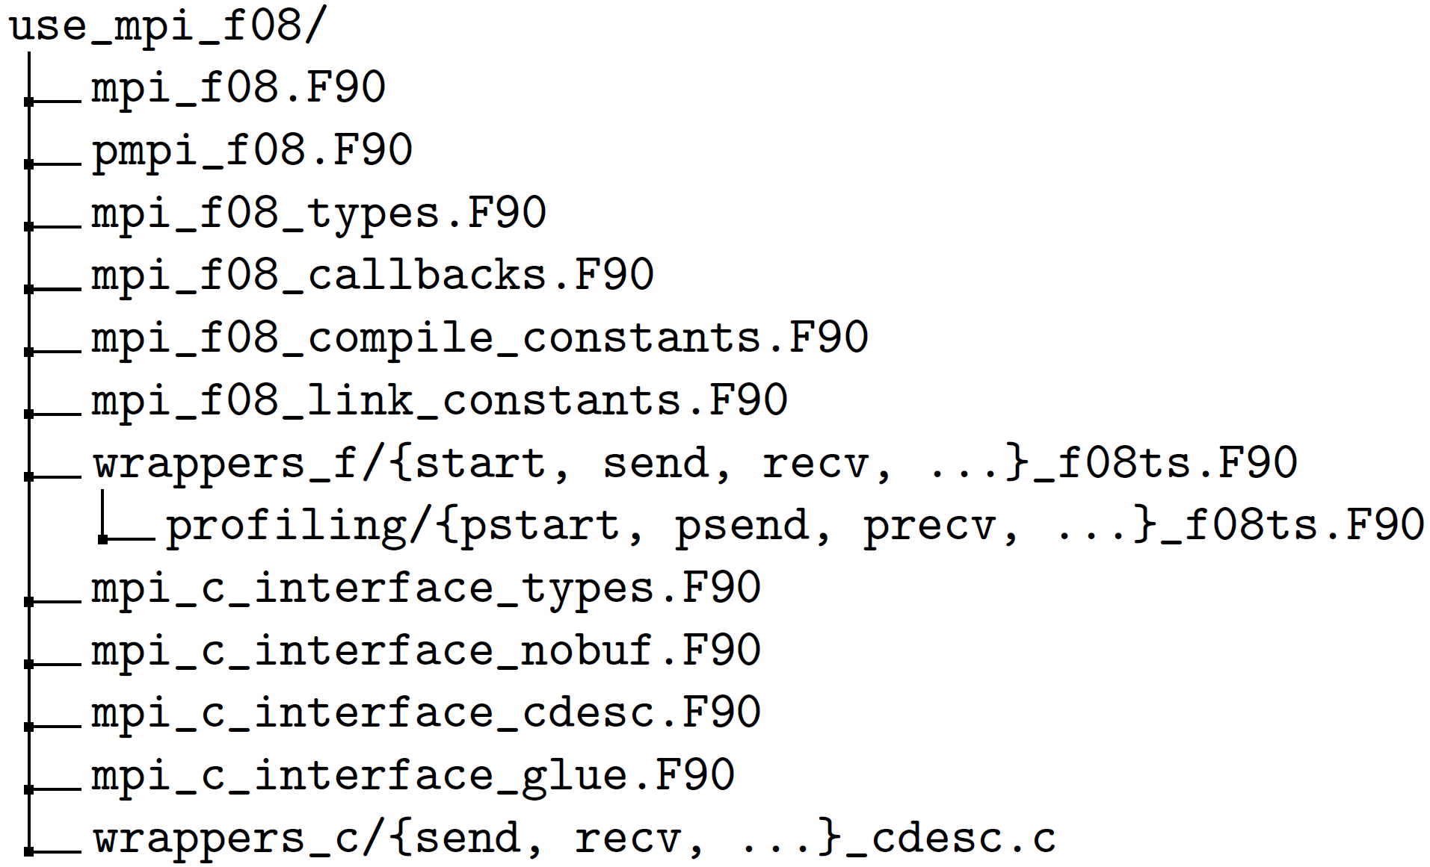
F08 binding Framework
Declare MPI F08 functions, types, constants
Wrappers in Fortran to call C
Declare MPI C interfaces and C wrappers in Fortran, so that they can be correctly called
Wrappers in C for functions with choice buffer arguments

Slide 14
F08 Binding Framework
MPI Fortran 2008 Bindings
Fortran Wrappers
C Wrappers
MPICH Backend C

Slide 15
Examples in mpi_f08.F90
interface MPI_Start
subroutine MPI_Start_f08 ( request , ierror )
use :: mpi_f08_types , only : MPI_Request
implicit none
type ( MPI_Request ), intent ( inout ) :: request
integer , optional , intent (out) :: ierror
end subroutine MPI_Start_f08
end interface MPI_Start
interface MPI_Send
subroutine MPI_Send_f08ts (buf , count , datatype, &
dest , tag , comm , ierror )
use :: mpi_f08_types , only : MPI_Datatype , MPI_Comm
implicit none
type (*) , dimension (..) , intent (in) :: buf
integer , intent (in) :: count , dest , tag
type ( MPI_Datatype ), intent (in) :: datatype
type ( MPI_Comm ), intent (in) :: comm
integer , optional , intent (out) :: ierror
end subroutine MPI_Send_f08ts
end interface MPI_Send
MPI_*_f08/f08ts are specific procedure names specified by MPI for profiling interface
Note the argument types are in Fortran
Notes:
f08 for routines without choice buffer args, f08ts for routines with choice buffer args

Slide 16
Examples in mpi_c_interface_types.F90
In MPICH backend C, all MPI handles except MPI_File are C int; MPI_File is a C pointer. We treat them uniformly as integers with different kind values
So in Fortran’s view, we define these constants / types
use , intrinsic :: iso_c_binding
integer , parameter :: c_Comm = c_int ! c_int is the kind value of C integer
integer , parameter :: c_Request = c_int
integer , parameter :: c_File = c_intptr_t
type :: c_Status
integer ( c_int ) :: MPI_SOURCE
integer ( c_int ) :: MPI_TAG
integer ( c_int ) :: MPI_ERROR
...
end type c_Status
Notes:
C_int, c_intprt_t are provided by iso_c_binding

Slide 17
Examples in mpi_c_interface_nobuf/cdesc.F90
MPI C interface
function MPIR_Start_c ( request ) &
bind (C, name =" PMPI_Start ") result ( ierror )
use , intrinsic :: iso_c_binding , only : c_int
use :: mpi_c_interface_types , only : c_Request
implicit none
integer ( c_Request ), intent ( inout ) :: request
integer ( c_int ) :: ierror
end function MPIR_Start_c
C wrapper interface
function MPIR_Send_cdesc (buf,count, datatype , …)&
bind (C, name =" MPIR_Send_cdesc ") result ( ierror )
use , intrinsic :: iso_c_binding , only : c_int
implicit none
type (*) , dimension (..) , intent (in) :: buf
integer ( c_int ), value , intent (in) :: count , dest , tag
integer ( c_Datatype ), value , intent (in) :: datatype
integer ( c_Comm ), value , intent (in) :: comm
integer ( c_int ) :: ierror
end function MPIR_Send_cdesc
Use bind(C, name=“…”) to specify the link name of a symbol, effectively avoiding the annoying underscore problem
Bind to PMPI_* if the function has no choice buffer args, otherwise binding to the C wrapper
Also note the argument types are in C

Slide 18
Implement Fortran wrappers
The critical part is converting between Fortran arguments and C arguments, i.e., type casting + some subtle issues
IN : Fortran → C
OUT : C → Fortran
INOUT : Fortran → C → Fortran
If the types are the same, a high quality implementation should have zero overhead !
Let’s see how we do the conversion for various data types

Slide 19
Integer & MPI handle – the most common MPI args
subroutine MPI_Start_f08 ( request , ierror )
use , intrinsic :: iso_c_binding , only : c_int
use :: mpi_f08 , only : MPI_Request
use :: mpi_c_interface , only : c_Request , MPIR_Start_c
type ( MPI_Request ), intent ( inout ) :: request
integer , optional , intent (out) :: ierror
integer ( c_Request ) :: request_c
integer ( c_int ) :: ierror_c
if ( c_int == kind (0)) then
ierror_c = MPIR_Start_c ( request % MPI_VAL )
else
request_c = request % MPI_VAL
ierror_c = MPIR_Start_c ( request_c )
request % MPI_VAL = request_c
end if
if ( present ( ierror )) ierror = ierror_c
end subroutine MPI_Start_f08
Fortran args passed in
Temp. C variables
kind(0), evaluated at compile time, returns the default Fortran integer’s kind value
Most likely case, w/ zero overhead
Less likely case, e.g., when users pass –i8 to compilers to change the default integer kind
Set ierror only when it is passed in

Slide 20
Integer & MPI handle(2) -- argument is an array
Use automatic temp arrays when array length is passed in
subroutine MPI_Cart_create_f08(…,ndims,dims, periods)
integer, intent(in) :: ndims
integer, intent(in) :: dims(ndims)
logical, intent(in) :: periods(ndims)
integer(c_int) :: dims_c(ndims)
integer(c_int) :: periods_c(ndims)
if (c_int == kind(0)) then
…
else
…= MPIR_Cart_create_c(…, ndims_c, dims_c) end if
end subroutine MPI_Cart_create_f08
Temp arrays are allocated on stack – super-efficient
Use allocatable temp arrays when array length is unknown
subroutine MPI_Scatterv_f08ts(…, sendcounts, displs, …)
integer, intent(in) :: sendcounts(*) ! assumed-size
integer, intent(in) :: displs(*)
integer(c_int), allocatable :: sendcounts_c(:)
integer(c_int), allocatable :: displs_c(:)
integer(c_int) :: err, length
if (c_int == kind(0)) then
...
else
comm_c = comm%MPI_VAL
err = MPIR_Comm_size_c(comm_c, length)
sendcounts_c = sendcounts(1:length)
displs_c = displs(1:length)
…
end if
end subroutine MPI_Scatterv_f08ts
Temp arrays are auto (de)allocated in the else branch

Slide 21
Integer & MPI handle(3) -- index arguments
Index arguments in MPI_{Wait, Test}{any, some} are 0-based in C, 1-based in Fortran; after calling the C routine, we need
If (index_c >= 0) index = index_c + 1
In type creation routines the displacement and index info, e.g., in MPI_Type_indexed(…,array_of_displacements,…), MPI_Type_create_subarray(…,array_of_starts,…), is 0-based in both C and Fortran
Do nothing
Notes:
Test is for possible negative value (MPI_UNDEFINED)

Slide 22
Logical / boolean
MPI C uses integer for boolean, while MPI Fortran uses logical
How to represent logical is implementation dependant, making it hard to portably do conversions in C
However, it is trivial in Fortran – a benefit of doing wrapping in Fortran. Let’s say
logical :: x
integer(c_int) :: x_c
or
logical :: x(len)
integer(c_int) :: x_c(len)
Fortran → C : x_c = merge(1, 0, x)
C → Fortran: x = (x_c / = 0)
Notes:
Merge is a Fortran intrinsic function. X can be a scalar or an array, but the converting statements keep unchanged

Slide 23
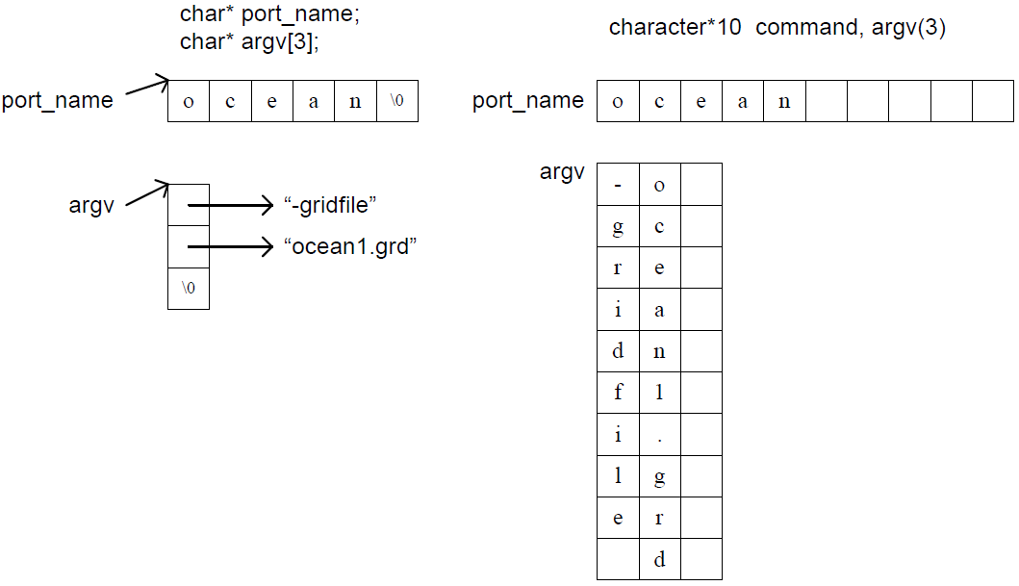
Character / string
1D strings in C are null-terminated, in Fortran are of fixed-length and padded with blanks
2D strings in C are array of pointers to strings, in Fortran are 2D character array
Need to jump forth and back between these two conventions. E.g., MPI_Comm_Spawn(command, argv,..)
Notes:
Note that Fortran array is column-major

Slide 24
MPI_Status
Fortran
C
type, bind(C) :: MPI_Status
integer :: MPI_SOURCE
integer :: MPI_TAG
integer :: MPI_ERROR
end type MPI_Status
type :: c_Status
integer (c_int) :: MPI_SOURCE
integer (c_int) :: MPI_TAG
integer (c_int) :: MPI_ERROR
end type c_Status
Even if c_int == kind(0), compilers think the two types are different, though in reality they are the same
subroutine MPI_Recv_f08ts(…, status, ierror)
type(MPI_Status) :: status
type(c_Status) :: status_c
if (c_int == kind(0)) then
ierror_c = MPIR_Recv_cdesc(..., status)
else
ierror_c = MPIR_Recv_cdesc(..., status_c)
status = status_c
end if
end subroutine MPI_Recv_f08ts
Compile error due to type mismatch
Have to always choose this branch, always do the redundant copy?
- No. See solutions later
Notes:
Will come back later

Slide 25
Named constants
MPI assigns a special meaning to a special value of a basic type argument. The value, with a name, called a named constant.
Implementations need to check input args to filter named constants and handle them specially
Special values but not special types -- type checking still applies
Quite different in Fortran and C: good objects vs. bad pointers
mpif.h in mpich F77/F90
mpi.h in mpich
INTEGER MPI_BOTTOM, MPI_IN_PLACE
INTEGER MPI_STATUS_IGNORE(MPI_STATUS_SIZE)
…
COMMON /MPIPRIV1/ MPI_BOTTOM, MPI_IN_PLACE,
MPI_STATUS_IGNORE
COMMON /MPIPRIV2/ MPI_STATUSES_IGNORE,
#define MPI_STATUS_IGNORE (MPI_Status *)1
#define MPI_STATUSES_IGNORE (MPI_Status *)1
#define MPI_ERRCODES_IGNORE (int *)0
#define MPI_ARGV_NULL (char **)0
#define MPI_ARGVS_NULL (char ***)0
#define MPI_IN_PLACE (void *) -1
#define MPI_BOTTOM (void *)0
Notes:
Good objects – really allocated

Slide 26
Named constants in MPICH F77/F90 bindings
During Fortran MPI_Init(), through some tricky mechanism, record the addresses of all Fortran named constants
Then, in C wrappers check the input Fortran args, basing on the fact Fortran passes args by reference. E.g.,
mpi_recv_ (…, MPI_Fint *status, MPI_Fint *ierr )
{ …
if (status == MPI_F_STATUS_IGNORE)
status = (MPI_Fint*)MPI_STATUS_IGNORE;
*ierr = MPI_Recv( …(MPI_Status *) status );
}
Drawbacks
Always need C wrappers for functions which accept named constants – conflict with the current goal to avoid C wrappers if possible
Need Fortran specific initialization (Just imagine what if C apps call Fortran libraries with MPI calls inside) – extra overhead & complexity

Slide 27
New design in MPICH F08 binding : as simple as 1,2,3
Make Fortran automatically know address of C named constants (except MPI_IN_PLACE, MPI_BOTTOM) . E.g.,
On Fortran side
On C side
type(MPI_Status), target :: MPI_STATUS_IGNORE
type(c_ptr), bind(C, name="MPIR_C_MPI_STATUS_IGNORE") &
:: MPIR_C_MPI_STATUS_IGNORE
MPI_Status *MPIR_C_MPI_STATUS_IGNORE;
MPI_Init(…) {
MPIR_C_MPI_STATUS_IGNORE =
MPI_STATUS_IGNORE;
…
}

Slide 28
In mpi_c_interface_cdesc.F90
function MPIR_Recv_cdesc(…, comm, status) &
bind(C, name="MPIR_Recv_cdesc") result(ierror)
integer(c_Comm), value, intent(in) :: comm
type(c_ptr), value, intent(in) :: status
integer(c_int) :: ierror
end function MPIR_Recv_cdesc
2. Declare related args of C functions as “C pointers passed by value”
In Fortran wrapper for MPI_Recv()
subroutine MPI_Recv_f08ts(…, comm, status, ierror)
type(c_ptr) :: status_ptr = c_loc(status)
type(c_ptr) :: ignore_ptr = c_loc(MPI_STATUS_IGNORE)
if (c_int == kind(0)) then
if (c_associated(status_ptr , ignore_ptr)) then
ierror_c= MPIR_Recv_cdesc(...,MPIR_C_MPI_STATUS_IGNORE)
else
ierror_c= MPIR_Recv_cdesc(...,c_loc(status))
end if
else
if (c_associated(status_ptr, ignore_ptr)) then
ierror_c= MPIR_Recv_cdesc(...,MPIR_C_MPI_STATUS_IGNORE)
else
ierror_c= MPIR_Recv_cdesc(...,c_loc(status_c))
status = status_c
end if
end if
end subroutine MPI_Recv_f08ts
3. In Fortran wrappers, check to see if an actual arg is a named constant;
-- Yes, pass the bad address
-- No, pass the arg’s address
Following the good tradition, copy only when c_int != kind(0)

Slide 29
Handling MPI_IN_PLACE, MPI_BOTTOM
They are used like a choice buffer. Since functions with choice buffer args always have a C wrapper, the design can be simpler
On Fortran side
integer(c_int), bind(C, name="MPIR_F08_MPI_IN_PLACE")&
:: MPI_IN_PLACE
Declare Fortran MPI_IN_PLACE as a bind(C) integer
On C side
int MPIR_F08_MPI_IN_PLACE;
Implement it in C as a global var.
int MPIR_Allgather_cdesc(CFI_cdesc_t*sendbuf, …)
{
void *buf = sendbuf->base_addr;
if (buf == &MPIR_F08_MPI_IN_PLACE) {
buf = MPI_IN_PLACE;
}
…
}
Take the address with &;
Replace Fortran MPI_IN_PLACE with C MPI_IN_PLACE
Notes:
These are easier because we always have C wrappers. Variables are defined in C and exposed to Fortran for direct use.

Slide 30
C wrappers
Only needed for functions with choice buffers, to decode info about assumed-type assumed-rank arguments
When the input buffer is contiguous, we use it as a normal C buffer
When the buffer is strided, we
Decode the stride info and create an MPI hindexed data type to describe it
Call the MPI C function with the new data type for this buffer
Free the data type

Slide 31
Testing and experiences
Tests ported to F08
Existing MPICH F90 test suite
A set of new tests for (non-) contiguous F08 subarrays
NASA NPB-3.3 (4 kernels + 3 apps) with the F77 binding
EPCC OpenMP/MPI Micro-Benchmark 1.0 from U. of Edinburgh, written with the F90 binding
F08 compilers tested
Cray Fortran compiler 8.3.0 on Edison@NERSC
GCC 4.10 fortran-dev branch : compilation is ok, but at run time it sometimes gives incorrect results for choice buffer args.
IBM XLF 15.1 : compilation failed due to minor compiler defects; IBM said they are expected to be fixed early next year
MPI F08 found a bug in MPICH F90 test suite that had gone undetected for years
MPI_Abort(1, MPI_COMM_WORLD, ierror) -- In F77/90, errcode and MPI_Comm are both integers and hence indistinguishable
Notes:
two minor issues of XLF:
c_funloc(x); in TS 29113, x is relaxed to be BIND(C) or not. But XLF still requires it must be BIND(C)
storage_size(): XLF lacks this intrinsic function

Slide 32
Conclusions and future work
We implemented the F08 binding in MPICH, which is neat, portable and efficient
It is fantastic at compile time argument checking, which greatly improves the quality of MPICH Fortran support
F08 strided subarray support looks like a convenient language construct. We internally create/free MPI data types in C wrappers for non-contiguous subarrays, which could be expensive, considering in e.g., stencil computing MPI_Send() is embedded in a loop body
Need some kind of data type caching to reduce the overhead to make it really useful for MPI programmers

Slide 33
Thanks!
Questions?

