Slide 1
Simplifying the Recovery Model of User-Level Failure Mitigation
Wesley Bland
ExaMPI ‘14
New Orleans, LA, USA
November 17, 2014

Slide 2
Why Process Fault Tolerance?
Two (main) kinds of resilience
Data resilience (full backups and silent errors)
Process resilience
Data resilience is handled outside of MPI
Checkpoint/Restart, FTI, SCR, GVR, Containment Domains, etc.
Process fault tolerance must be at least partially handled within MPI
Must recover communication channels

Slide 3
What has been done before?
Checkpoint/Restart
Requires restarting the entire job, waiting in job queue
FT-MPI (University of Tennessee)
Automatic communicator repair, no customization
Support dropped and never presented to the MPI Forum
FA-MPI (University of Alabama, Birmingham)
Try/catch semantics to simulate transactions
Detects errors via timeouts
Run-Through Stabilization (MPI Forum)
Similar to ULFM, but too big to not fail

Slide 4
User-Level Failure Mitigation (ULFM)
Handles (fail-stop) process failures
General resilience framework designed to support a wide range of recovery models
Encourages libraries to build more user-friendly resilience on top of ULFM
Failure notification via return codes and/or MPI_Errhandlers
Local failure notification to maintain performance

Slide 5
ULFM Continued
Failure propagation happens manually when necessary
MPI_COMM_REVOKE
All communication operations on a communicator are interrupted
New function call creates a replacement communicator without failed procs
MPI_COMM_SHRINK
Group of failed procs available via API calls
Failure Notification
Failure Propagation
Failure Recovery
0
MPI_Recv
1
MPI_ERR_PROC_FAILED
MPI_COMM_SHRINK()

Slide 6
FT Agreement
Collective over communicator
Allows procs to determine the status of an entire communicator in one call
Bitwise AND over an integer value
Ignores (acknowledged) failed processes
Provides notification for unacknowledged failures
Works on a revoked communicator
Useful for “validating” previous work
Communicator creation
Application iteration(s)

Slide 7
ULFM in MPICH
Experimentally available in 3.2a2, planned for full MPICH 3.2 release
Still some known bugs
www.mpich.org
Un-optimized implementation
Need to enable some setting for complete usage
Configure flag: --enable-error-checking
Environment variable: MPIR_CVAR_ENABLE_FT
Also available in Open MPI branch from UTK
www.fault-tolerance.org

Slide 8
Why is ULFM challenging?
Feedback from users and developers:
Challenging to track the state of an entire legacy application
Checking all return codes / using error handler requires lots of code changes
Much of this is not wrong
ULFM has been designed to be flexible, not simple
Eventually, applications should use libraries for FT, not ULFM itself
Similar to how MPI was originally envisioned
However…all is not lost

Slide 9
BSP Applications
Very common types of applications
Typically involve some sort of iterative method
Ends iterations with a collective operation to decide what to do next
Commonly already have checkpoint/restart built-in for current gen systems
Already protecting data and have functions to regenerate communicators

Slide 10
ULFM for BSP
Take advantage of existing synchrony
Perform agreement on the result of the ending collective
If there’s a problem, repair the communicator and data and re-execute
Avoid restarting the job
Sitting in the queue, restarting the job, re-reading from disk, etc.
while (<still working>) {
}
…
Application Code
…
rc = MPI_Allreduce(value)
if (rc == MPI_SUCCESS) success = 1
rc = MPI_Comm_agree(success)
if (!success || !rc) repair()

Slide 11
Recovery Model
Failure
Communication Recovery
Dynamic processes (+ batch support)
Shrink + Spawn
No-dynamic processes
Start the job with extra processes
Rearrange after a failure
Data Recovery
Full checkpoint restart
Already built into many apps
High recovery and checkpointing overhead
Application level checkpointing
Low overhead
Possible code modifications required
Shrink
Spawn
0
1
2
3
-
1
1
3
-
-
1
1
2
3

Slide 12
Code Intrusiveness
Add 2-3 lines to check for failures
Perform agreement to determine status
Add function to repair application
If the agreement says there’s a failure, call the repair function
Repair data and communicator(s)

Slide 13
Monte Carlo Communication Kernel (MCCK)
Mini-app from the Center for Exascale Simulation of Advanced Reactors (CESAR)
Monte-Carlo, domain decomposition stencil code
Investigates communication costs of particle tracking

Slide 14
ULFM Modifications for MCCK
Application Level Checkpointing
User Level Failure Mitigation
Checkpoint particle position to disk
On failure, restart job
No job queue to introduce delay
All processes restore data from disk together
Particle position exchanged with neighbors
On failure, call repair function
Shrink communicator
Spawn replacement process
Restore missing data from neighbor
No disk contention

Slide 15
Performance
Used Fusion cluster @ Argonne
2 Xeons per node (8 cores)
36 GB memory
QDR InfiniBand
Experiments up to 1024 processes
100,000 particles per process
Checkpoints taken every 1, 3, and 5 iterations

Slide 16
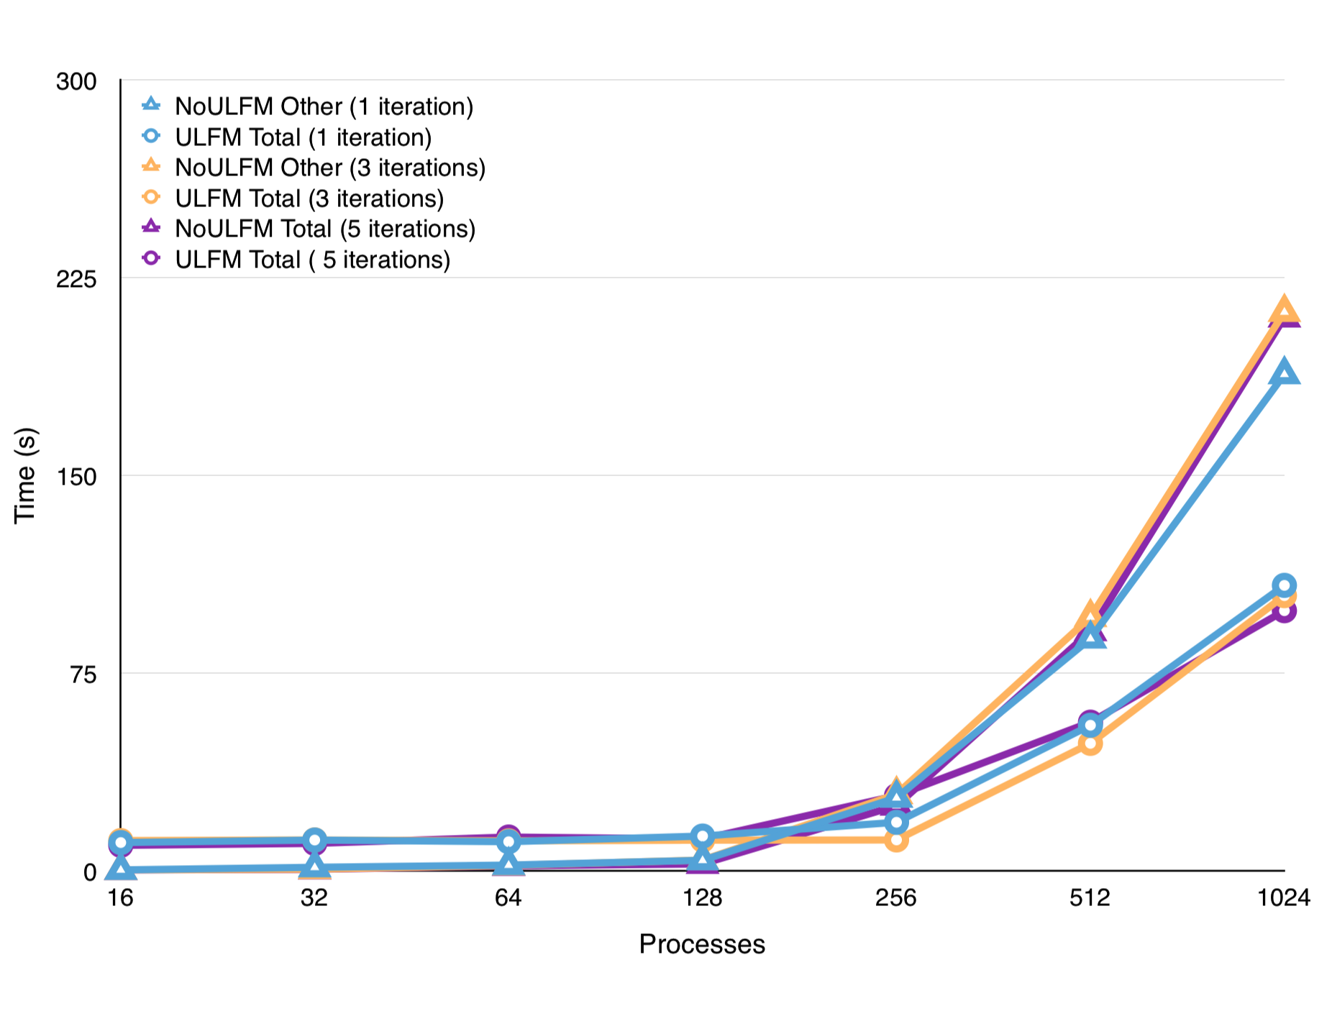
Overall Runtime

Slide 17
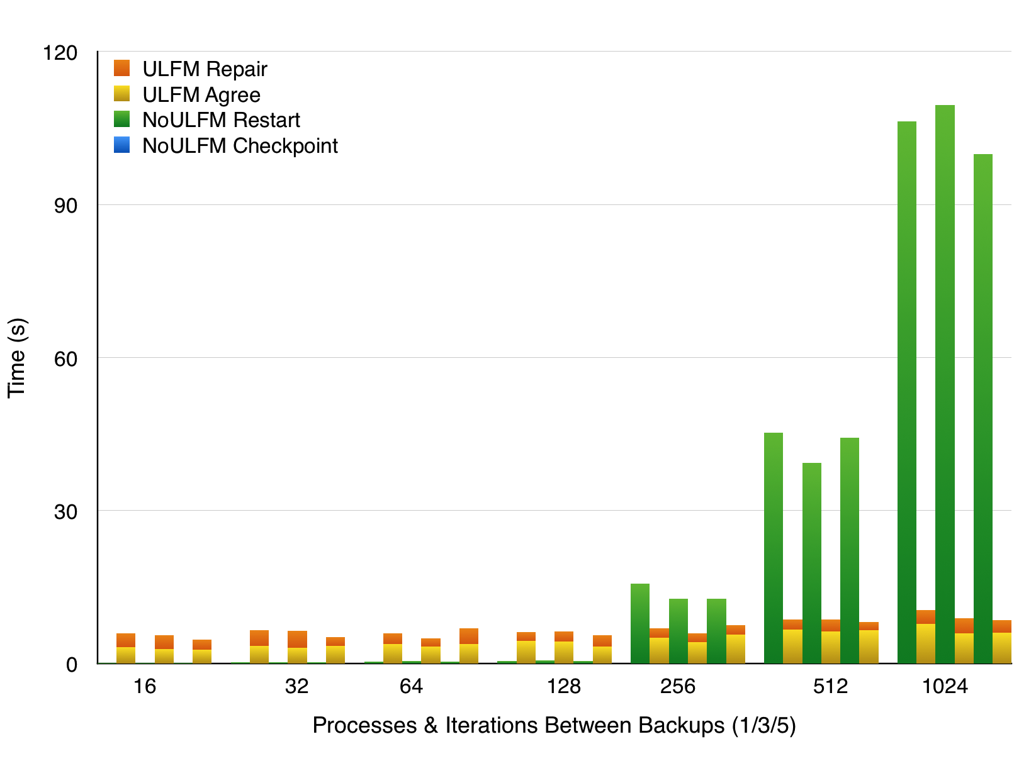
Overhead

Slide 18
What’s next for ULFM?
Fault tolerance libraries
Incorporate data & communication recovery
Abstract details from user applications
Working on standardization in MPI Forum

Slide 19
Questions?
MPICH BoF – Tuesday 5:30 PM – Room 386-87
MPI Forum BoF – Wednesday 5:30 PM – Room 293

