Slide 1
MT-MPI: Multithreaded MPI for Many-Core Environments
Min Si^{1,2} Antonio J. Peña² Pavan Balaji ²
Masamichi Takagi³ Yutaka Ishikawa¹
¹ University of Tokyo
² Argonne National Laboratory
³ NEC Corporation

Slide 2
Presentation Overview
Background and Motivation
Proposal and Challenges
Design and Implementation
OpenMP Runtime Extension
MPI Internal Parallelism
Evaluation
Conclusion

Slide 3
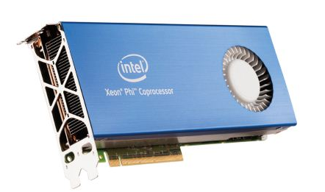

Many-core Architectures
Massively parallel environment
Intel® Xeon Phi co-processor
60 cores inside a single chip, 240 hardware threads
SELF-HOSTING in next generation, NATIVE mode in current version
Blue Gene/Q
16 cores per node, 64 hardware threads
Lots of “light-weight” cores is becoming a common model
Notes:
point : parallel massively
240 so far, even more
BG/Q, 64 thread/cores
current KNC, native mode similar to KNL
Since multicore processors are the norm today, the only way to improve the performance for high end processors is to add more threads and cores.
Many core architecture, such as Intel xeon phi and BG/Q, provides us such a massively parallel environment,
The latest Xeon Phi production provides 60 cores on a single chip, and delivered 240 available hardware threads;
Especially, the next generation is expected as self-hosting, which mean the apps could be completely executed on such many-core chip as running on host traditional CPU, but deliver massively parallelism.
The current production already provides us a similar research platform, called native mode, although it still need host assist.
On the other hand, the IBM BGQ also provides us such parallel env, 16 cores, delivers 64 hardware threads per node.
----- 会议笔记(14-5-30 19:38) -----
connect with MPI.
light
----- 会议笔记(14-6-6 18:32) -----
add slide numbers
add an outline

Slide 4
MPI programming on Many-Core Architectures
Thread Single mode
Funneled / Serialized mode
/* user computation */
MPI_Function ( );
/* user computation */
#pragma omp parallel
{ /* user computation */ }
MPI_Function ( );
#pragma omp parallel
{ /* user computation */ }
MPI Process
COMP.
MPI COMM.
COMP.
Multithreading mode
#pragma omp parallel
{
/* user computation */
MPI_Function ( );
/* user computation */
}
MPI Process
COMP.
MPI COMM.
COMP.
Notes:
To utilize such architectures, application programmers are increasingly looking at hybrid programming models, where multiple threads interact with MPI processes.
The most prominent of the threading models used in scientific computing today is OpenMP. The compiler translates these pragmas into semantic information, then the runtime system can use it to schedule the computational work units on multiple threads for parallel execution.
MPI defines four thread modes for working with threads.
The first one is thread single mode, every MPI process is running on different hardware core, no threads.
In the multiple threading mode, a lot of threads are created for user computation in each MPI process, all of them could issue MPI calls by sharing the communication resources
On the other hand, in the other two modes, the funneled & serialized mode, which are the most widely used in current user applications, still generates a large number of computation threads, but only 1 of them is allowed to issue MPI calls.
In this paper, we focuses on these two modes.
----- 会议笔记(14-5-30 19:38) -----
big jump! should connect. use threads->still use MPI for comm->
----- 会议笔记(14-6-6 18:32) -----
mention hybrid, mpi + threads keyworks
justfy funneled mode is the topic
maybe multithreading mode bigger is better
Semanticly different, eg.need separate messages into different threads

Slide 5
Problem in Funneled / Serialized mode
Funneled / Serialized mode
Multiple threads are created for user computation
Single thread issues MPI
MPI Process
#pragma omp parallel
{ /* user computation */ }
MPI_Function ( );
#pragma omp parallel
{ /* user computation */ }
COMP.
MPI COMM.
ISSUE
Many threads are IDLE !
Single lightweight core delivers poor performance
COMP.
Notes:
As we introduced, in the Funneled/serialized mode, a lot of threads are created, but only 1 thread is allowed to issue MPI calls, which means that, all the other threads are absolutely idle during MPI calls. Especially on many core architectures, these idle threads actually translate to underused hardware cores! it is a of wasted computational resources.
Moreover, since each single core of such many-core chips is much slower than CPU, even if we gain performance in computation by using multiple threads, however, we may also lose performance in MPI.
It is an urgent issue, if we want to use such massively parallel env more efficiently.
----- 会议笔记(14-6-6 18:32) -----
also write lightweight core in text(mark it)

Slide 6
Our Approach
Sharing Idle Threads with Application inside MPI
#pragma omp parallel
{ /* user computation */ }
MPI_Function ( ){
#pragma omp parallel
{
/* MPI internal task */
}
}
#pragma omp parallel
{ /* user computation */ }
MPI Process
COMP.
#pragma omp parallel
{
/* MPI internal task */
}
MPI COMM.
COMP.
MPI COMM.
Notes:
To solve this issue, we designed a mechanism that allow MPI to be able to share these idle threads from user applications. We utilize these threads inside MPI, to parallelize various internal tasks.

Slide 7
Challenges (1/2)
Some parallel algorithms are not efficient with insufficient threads, need tradeoff
But the number of available threads is UNKNOWN !
#pragma omp parallel
{
/* user computation */
#pragma omp single
{
/* MPI_Calls */
}
}
SINGLE SECTION
Barrier
Notes:
However, in practice, this approach has some challenges
1.we modified some algorithms for internal MPI processing, to achieve efficient OpenMP parallelism. But in some cases it is not as efficient for sequential processing. for example, data movement, fine-grained pipeline
However, the parallel version may perform worse than the traditional sequential implementation if the number of threads is not sufficient enough. Thus, we need tradeoff here.
However, at OpenMP runtime, the actual number of available threads is unknown (eg. omp single, when a single thread comes into this region, maybe some threads already arrived and blocked at the implied barrier at the end of single section, but some others may still be working in previous user computation).
----- 会议笔记(14-5-30 19:38) -----
do say example (shared comm)
----- 会议笔记(14-6-6 18:32) -----
less explaination for defination of available threads

Slide 8
Challenges (2/2)
Nested parallelism
Simply creates new Pthreads, and offloads thread scheduling to OS,
Causes threads OVERRUNNING issue
#pragma omp parallel
{
#pragma omp single
{
#pragma omp parallel
{ … }
}
}
Creates N Pthreads !
Creates N Pthreads !
ONLY use IDLE threads
Notes:
2. nested parallelism
The current openMP runtime system simply creates new pthreads for each nested parallel block
and allow the operating system to schedule them on top of the available cores.
However, this would result in creating additional threads than the available number of cores causing severe degradation in performance
----- 会议笔记(14-5-30 19:38) -----
Not for all, i.e. qthread, but it is not the point today. say different between nthreads and nparallel

Slide 9
Design and Implementation
OpenMP Runtime Extension
MPI Internal Parallelism
Implementation is based on Intel OpenMP runtime (version 20130412)
Notes:
already know #idle threads
expose in mpich.
then, how to use this info

Slide 10
Guaranteed Idle Threads VS Temporarily Idle Threads
Guaranteed Idle Threads
Guaranteed idle until Current thread exits
Temporarily Idle Threads
Current thread does not know when it may become active again
Example 1
#pragma omp parallel
{
#pragma omp single
{…
}
}
Example 3
#pragma omp parallel
{
#pragma omp single nowait
{…
}
#pragma omp critical
{…
}
}
Barrier
Example 2
#pragma omp parallel
{
#pragma omp critical
{…
}
}
Notes:
To workaround these limitations of OpenMP runtime,
we modified the Intel OpenMP runtime library to expose information about the idle threads to the MPI implementation.
We defines two kinds of idle threads.
For the threads which are guaranteed idle until current thread exist from MPI stack, we call them guranteed **
For example,**
There are some other threads, they are idle but the current thread does not know when they may become active again.
For example,
We call these threads temporarily available threads.
----- 会议笔记(14-5-30 19:38) -----
put 1 past thread in critical
time-dependent
...
no detail, read paper
add one slide here

Slide 11
Expose Guaranteed Idle Threads
MPI uses Guaranteed Idle Threads to schedule its internal parallelism efficiently (i.e. change algorithm, specify number of threads)
#pragma omp parallel
#pragma omp single
{
MPI_Function {
num_idle_threads = omp_get_num_guaranteed_idle_threads( );
if ( num_idle_threads < N ) {
/* Sequential algorithm */
} else {
#pragma omp parallel num_threads(num_idle_threads)
{ … }
}
}
}
Notes:
It can be risky if we utilize Temporarily Available Threads because their status can change to active at any time, hence hurt performance.
Therefore, we choose guaranteed idle threads to help MPI, we modified OpenMP runtime to count the number of these threads and expose it to MPI.
Such information also allows the MPI implementation to choose different algorithms that tradeoff between parallelism
and sequential execution to achieve the best performance in all cases.

Slide 12
Design and Implementation
OpenMP Runtime Extension
MPI Internal Parallelism
Derived Datatype Related Functions
Shared Memory Communication
Network-specific Optimizations
Implementation is based on MPICH v3.0.4
Notes:
already know #idle threads
expose in mpich.
then, how to use this info

Slide 13
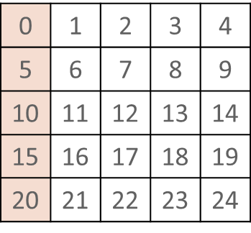
1. Derived Datatype Packing Processing
MPI_Pack / MPI_Unpack
Communication using Derived Datatype
Transfer non-contiguous data
Pack / unpack data internally
block_length
0 | 5 | 10 | 15 | 20
count
#pragma omp parallel for
for ( i=0; i<count; i++ ){
dest[i] = src[i * stride];
}
stride

Slide 14
2. Shared Memory Communication
Original sequential algorithm
Shared user space buffer between processes
Pipelining copy on both sender side and receiver side
Parallel algorithm
Get as many available cells as we can
Parallelize large data movement
Sender
Shared Buffer
Receiver
Sender
Receiver
Shared Buffer
User Buffer
Cell[0]
User Buffer
Cell[0]
Cell[1]
User Buffer
Cell[1]
Cell[2]
Cell[2]
User Buffer
Cell[3]
Cell[3]
(a) Sequential Pipelining
(b) Parallel pipelining
Notes:
……
However, the parallel version also has serious disadvantage for some cases. Let’s compare…

Slide 15
Sequential Pipelining VS Parallelism
Small Data transferring ( < 128K )
Threads synchronization overhead > parallel improvement
Large Data transferring
Data transferred using Sequential Fine-Grained Pipelining
Data transferred using Parallelism with only a few of threads (worse)
Data transferred using Parallelism with many threads (better)
Sender Buffer
Shared Buffer
Receiver Buffer

Slide 16
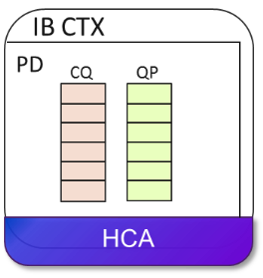
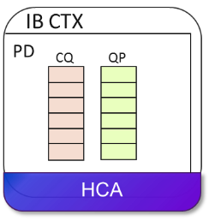
3. InfiniBand Communication
Structures
IB context
Protection Domain
Queue Pair
1 QP per connection
Completion Queue
Shared by 1 or more QPs
RDMA communication
Post RDMA operation to QP
Poll completion from CQ
OpenMP contention issue
ADI3
CH3
SHM
nemesis
(critical)
TCP
IB
…
(critical)
P0
P1
IB CTX
PD
CQ
QP
QP
P2
HCA
Notes:
MPI supports multiple internode networks through unified nemesis API.
Depending on the network implementation, some of them could also benefit from parallelism
Our practice focused on the IB network.
There are several IB resource structures provided for communication programming…
IB library internally support multi-threading. For some contentious resource, such as QP and CQ, they are protected by lock/unlock.
Ideally, the performance improvement is gained from the operations issued to different QPs/CQs, for the operations to the same QP/CQ, it is just equal to the sequential version.
contention issue in current openmp to the QP
However, current intel OpenMP has a contention issue, multi-threads access a critical region may cause very expensive sync overhead.
Although this problem should be solved in future, to workaround this issue, we decided to only parallelize the operations to send to different connections

Slide 17
Evaluation
Derived Datatype Related Functions
Shared Memory Communication
Network-specific Optimizations
All our experiments are executed on the Stampede supercomputer at the Texas Advanced Computing Center (https://www.tacc.utexas.edu/stampede/).

Slide 18
Derived Datatype Packing
X
Z
Vector
Block
Parallel packing 3D matrix of double
Y
Packing the X-Z plane with varying Z
Hvector
Vector
(Parallelize here)
Packing the Y-Z plane with varying Y
Graph Data:
Fixed matrix volume 1 GB
Fixed length of Y: 2 doubles
Length of Z: graph legend
Graph Data:
Fixed matrix volume 1 GB
Fixed length of X: 2 doubles
Length of Y: graph legend
Notes:
----- 会议笔记(14-5-30 19:38) -----
Mention:
Different numbers on different surface because using different datatypes
Get some worse perf in graph 2(less than 1), because compiler does inefficient prefetching, we discussed the details in paper

Slide 19
3D internode halo exchange using 64 MPI processes
Z
X
Cube 512*512*512 double
Y
Large X 16K*128*64 double
Large Y 64*16K*128 double
Large Z 64*128*16K double
Not strong scaling
BUT we are using IDLE RESOURCES !
Notes:
Most expensive communication cost is in Y-Z dimension halo, takes 85% of the time, therefore larger Y delivers greater speedup!
----- 会议笔记(14-5-30 19:38) -----
say worse scala, but still get performance, threads are idle

Slide 20
Hybrid MPI+OpenMP NAS Parallel MG benchmark
V-cycle multi-grid algorithm to solve a 3D discrete Poisson equation.
Halo exchanges with various dimension sizes from 2 to 514 doubles in class E with 64 MPI processes
Graph Data:
Class E using 64 MPI processes

Slide 21
Shared Memory Communication
OSU MPI micro-benchmark
P2P Bandwidth
Caused by poor sequential performance due to too small Eager/Rendezvous communication threshold on Xeon Phi.
Not by MT-MPI !
Similar results of Latency and Message rate
Poor pipelining but worse parallelism

Slide 22
One-sided Operations and IB netmod Optimization
Micro benchmark
One to All experiment using 65 processes
root sends many MPI_PUT operations to all the other 64 processes (64 IB QPs)
Profile of the experiment issuing
16000 operations
P1
Parallelized
QP
Nthreads | Time(s)
 | Total | SP | SP/Total
1 | 5.8 | 2.2 | 37.9%
P2
P0
QP
QP
QP
…
…
Ideal Speedup = 1.61
QP
P64
QP
Parallelized IB Communication
Notes:
----- 会议笔记(14-5-30 19:38) -----
put table here
** why sp/total become smaller ? Fix it, show we get less potentiality to parallelize.

Slide 23
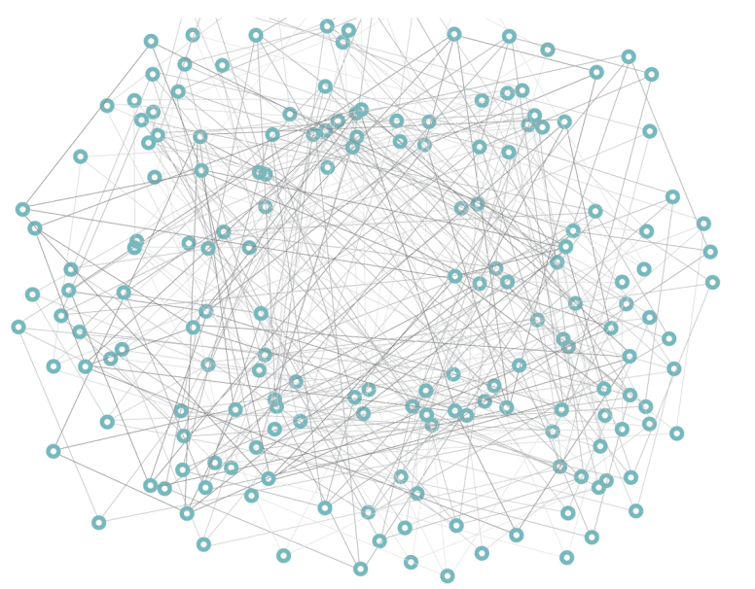
One-sided Graph500 benchmark
Every process issues many MPI_Accumulate operations to the other processes in every breadth first search iteration.
Scale 2²², 16 edge factor, 64 MPI processes
Notes:
----- 会议笔记(14-5-30 19:38) -----
2^22 format

Slide 24
Conclusion
Many-core Architectures
Most popular Funneled / Serialized mode in Hybrid MPI + threads programming model
Many threads parallelize user computation
Only single thread issues MPI calls
Threads are IDLE during MPI calls !
We utilize these IDLE threads to parallelize MPI internal tasks, and delivers better performance in various aspects
Derived datatype packing processing
Shared memory communication
IB network communication
Notes:
----- 会议笔记(14-6-6 18:32) -----
show numbers to summarize evaluation

Slide 25
Backup

Slide 26
OpenMP Runtime Extension 2
Waiting progress in barrier
SPIN LOOP until timeout !
May cause OVERSUBSCRIBING
Solution: Force waiting threads to enter in a passive wait mode inside MPI
set_fast_yield (sched_yield)
set_fast_sleep (pthread_cond_wait)
while (time < KMP_BLOCKTIME){
if (done) break;
/* spin loop */
}
pthread_cond_wait (…);
#pragma omp parallel
#pragma omp single
{
set_fast_yield (1);
#pragma omp parallel
{ … }
}
Notes:
However, in current implementation, to avoid overhead of sync in the case only waiting shortly, use spin loop instead of passive wait.
But want to use it asap
defined 2 func
mpi enable fast yield, then waiting threads yield. even if new pthreads, no overuse
Since fast_sleep cause more expensive overhead, we choose set fast_yield in our implementaion
----- 会议笔记(14-5-30 19:38) -----
the

Slide 27
OpenMP Runtime Extension 2
set_fast_sleep VS set_fast_yield
Test bed: Intel Xeon Phi cards (SE10P, 61 cores)
set_fast_sleep
set_fast_yield

Slide 28
Prefetching issue when compiler vectorized non-contiguous data
for (i=0; i<count; i++){
*dest++ = *src;
src += stride;
}
#pragma omp parallel for
for (i=0; i<count; i++){
dest[i] = src[i * stride];
}
(a) Sequential implementation (not vectorized)
(b) Parallel implementation (vectorized)

Slide 29
Intra-node Large Message Communication
Sequential pipelining LMT
Shared user space buffer
Pipelining copy on both sender side and receiver side
Sender
Get a EMTPY cell from shared buffer, and copies data into this cell, and marks the cell FULL; Then, fill next cell.
Sender
Receiver
Shared Buffer
User Buffer
Cell[0]
Cell[1]
User Buffer
Receiver
Get a FULL cell from shared buffer, then copies the data out, and marks the cell EMTPY ; Then, clear next cell.
Cell[2]
Cell[3]

Slide 30
Parallel InfiniBand communication
Two level parallel policies
Parallelize the operations to different IB CTXs
Parallelize the operations to different CQs / QPs
IB CTX
IB CTX
IB CTX
IB CTX
CQ
QP
CQ
QP
CQ
QP
CQ
CQ
CQ
QP
QP
QP
HCA
HCA
(a) Parallelism on different IB CTXs
(b) Parallelism on different CQs / QPs
Notes:
----- 会议笔记(14-5-30 19:38) -----
backup

Slide 31
Parallelize InfiniBand Small Data Transfer
3 parallelism experiments based on ib_write_bw:
IB contexts 1 process per node, 64 IB CTX per process, 1 QP + 1 CQ per IB CTX
QPs and CQs 1 process per node, 1 IB CTX per process, 64 QPs + 64 CQs per IB CTX
QPs only 1 process per node, 1 IB CTX per process, 64 QPs + 1 shared CQ per IB CTX
Test bed: Intel Intel Xeon Phi SE10P Coprocessor, InfiniBand FDR
Data size: 64 Bytes
Notes:
MPI implements often use 1 shared CQ for all the QPs, which is shown as the green line. improved less due to sequential execution during polling CQ.
Expected parallelized sending processing should deliver similar improvement.
----- 会议笔记(14-5-30 19:38) -----
back

Slide 32
Eager Message Transferring in IB netmod
When send many small messages
Limited IB resources
QP, CQ, remote RDMA buffer
Most of the messages are enqueued into SendQ
All sendQ messages are sent out in wait progress
Major steps in wait progress
Clean up issued requests
Receiving
Poll RDMA-buffer
Copy received messages out
Sending
Copy sending messages from user buffer
Issue RDMA op
P0
P1
Send some messages
immediately
wait progress start
Enqueue messages
into SendQ
Receive message
wait progress start
SYNC
Send messages in SendQ
Clean up request
Receive message
Send messages in SendQ
SYNC
Parallelizable
Clean up request
…
wait progress end
wait progress end
Parallelizable

Slide 33
Parallel Eager protocol in IB netmod
Parallel policy
Parallelize large set of messages sending to different connections
Different QPs : Sending processing
Copy sending messages from user buffer
Issue RDMA op
Different RDMA buffers : Receiving processing
Poll RDMA-buffer
Copy received messages out

Slide 34
Example: One-sided Communication
Feature
Large amount of small non-blocking RMA operations sending to many targets
Wait ALL the completion at the second synchronization call (MPI_Win_fence)
MPICH implementation
Issue all the operations in the second synchronization call
Origin
Process
Target
Process 1
Target
Process 2
MPI_Win_fence
Th 0
PUT 0
PUT 1
Th 1
PUT 2
PUT 3
Th 0
PUT 4
Th 1
PUT 5
MPI_Win_fence

Slide 35




Parallel One-sided communication
Challenges in parallelism
Global SendQ
Group messages by targets
Queue structures
Stored in [Ring Array + Head / Tail ptr]
Netmod internal messages (SYNC etc.)
Enqueue to another SendQ (SYNC-SendQ)
P0
Send-Arrays
IN
0
1
2
3
SYNC-SendQ
OUT

Slide 36


Parallel One-sided communication
Optimization
Every OP is issued through long critical section
Issue all Ops together
Create large number of Requests
Only create one request
ADI3
CH3
PUT
PUT
PUT
PUT
PUT
SHM
nemesis
Critical
IB
SendQ
Fig. Issue RMA operations from CH3 to IB netmod

Slide 37
Profiling
Measured the execution time of the netmod send-side communication processing at the root process (SP)
Copy from the user buffer to a preregistered chunk
Posting of the operations to the IB network.
Profile of the experiment issuing
16000 operations
Nthreads | Time |  |  | Speedup
 | Total | SP | SP/Total | Total | SP
1 | 5.8 | 2.2 | 37.9% | 1.0 | 1.0
4 | 4.7 | 1.3 | 27.3% | 1.2 | 1.7
16 | 4.0 | 0.4 | 9.8% | 1.4 | 5.0
64 | 4.0 | 0.3 | 8.0% | 1.4 | 6.9
Expected speedup but the percentage of time spent in SP becomes less and less

