Slide 1
A Framework for Tracking Memory Accesses in Scientific Applications
Antonio J. Peña Pavan Balaji
Argonne National Laboratory Argonne National Laboratory
apenya@anl.gov balaji@anl.gov

Slide 2

Motivation
Profiling is of great assistance in understanding and optimizing apps’ performance
Performance tools:
“Modern” profiling approaches:
Gprof – 1982
ATOM, OProfile – 2004
Perf – 2010
Hardware counters:
PAPI
Based on simulators:
CP$im
Valgrind tools (Callgrind)
PIN
Parallel profilers
HPC Toolkit
Becoming very important for large-scale systems

Slide 3
Motivation
Today’s profiling techniques help developers focus on troublesome lines of code
Data-oriented profiling complements the traditional algorithm-oriented analysis:
a[i] = b[j] * c[k];
b[l] = a[m] * 2;
c[n] += b[o];
c[i] = a[j] * b[k] + c[l];
a[i] = b[j] * c[k]; b[l] = a[m] * 2; c[n] += b[o];
Traditional profiler
c[i] = a [j]* b [k]+ c[l]; ← 15%
Traditional profiler
a[i] = b[j] * c[k]; b[l] = d[m] * 2; c[n] += b[o]; ← 15%
Traditional profiler
a[i] = b[j] * c[k]; ← 5%
b[l] = d[m] * 2; ← 5%
c[n] =+ b[o]; ← 5%
Data-oriented profiler
a ← 0%
b ← 15%
c ← 0%

Slide 4
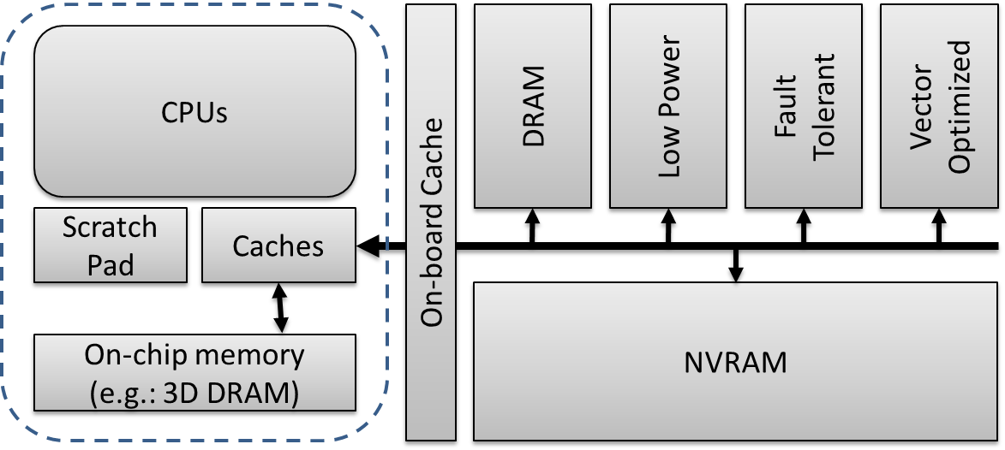
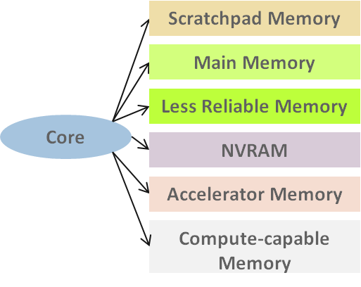
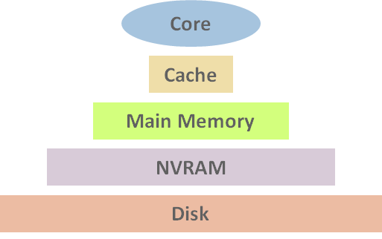
Motivation (2)
Multiple memory technologies within compute nodes:
Scratchpad, 3D-stacked, NVRAM, …
Different features:
Size, resilience, access patterns, energy
To efficiently exploit them:
Bring them as first-class citizens

Slide 5
Contents
Introduction
Background: Valgrind
Valgrind Core Extensions
Extending Valgrind Tools
Heterogeneous Memory
Conclusions

Slide 6
Introduction
Goals:
Pofiling-based – data oriented
Memory object granularity
Solution:
Valgrind core and tools extensions
Heterogeneous Memory:
Assess optimal distribution

Slide 7
Valgrind

Slide 8
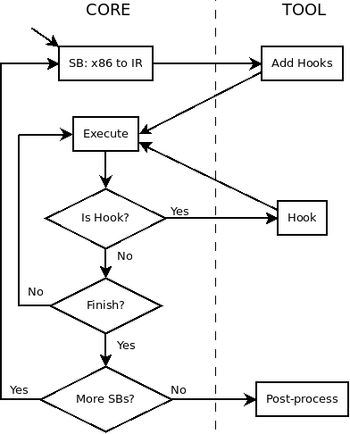
Valgrind
Generic instrumentation framework
Ecosystem: set of tools
Memcheck is just default
Virtual machine – JIT
Typically overhead around 4x-5x
Rich API to tools
Notify requested capabilities
Get debug information
Manage stack traces
Get information about thread status
High-level containers (arrays, sets, …)
Intercept memory management calls
Client request mechanism
Starting / stopping instrumentation from application’s code

Slide 9
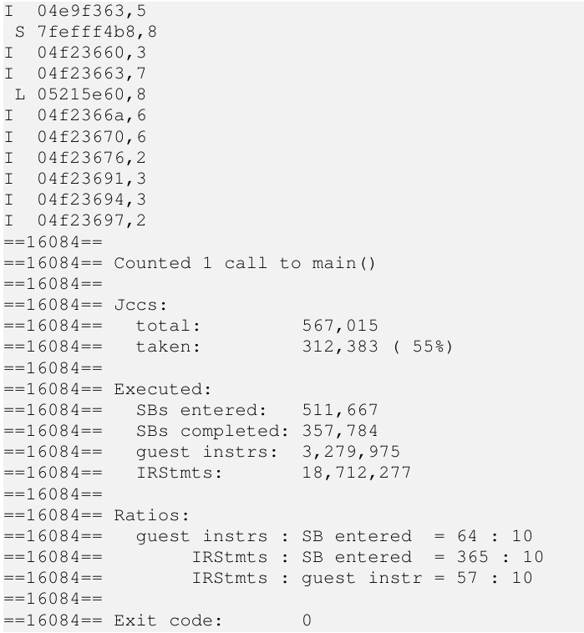
Valgrind: Lackey Tool
Example tool
Basic statistics:
# of calls per function
# of conditional branches
# of superblocks
# of guest instructions
# of load, store, & ALU operations
Memory tracing

Slide 10
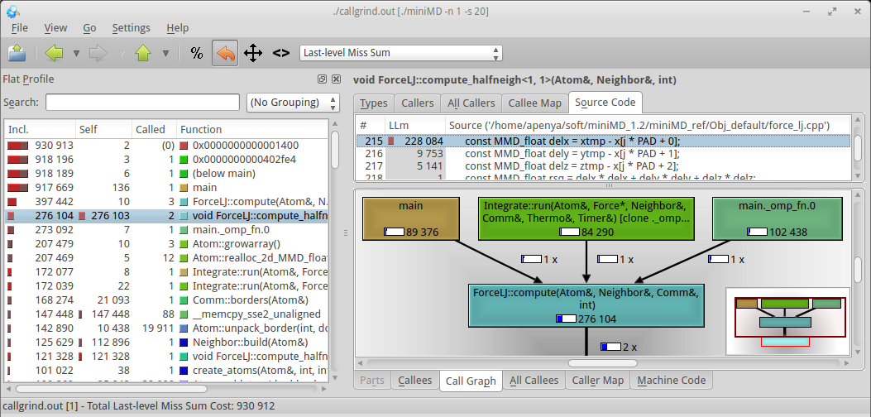
Valgrind: Callgrind Tool
“Call-graph generating cache and branch prediction profiler”
Purpose: profiling tool
Collects, by source line of code:
# of instructions
# of function calls
Caller-callee relationship among function calls (call graph)
If cache simulation is enabled:
Cache misses
Cache hierarchy modeled after the host’s one by default
Branch predictor
Hardware prefetcher
Kcachegrind integration: visualization

Slide 11
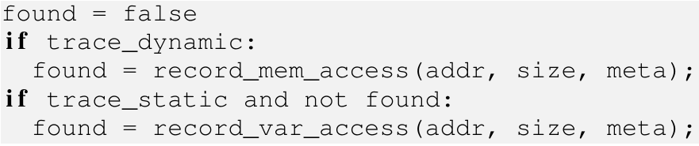
Core Extensions
To enable the differentiation of memory objects:
Locate the memory object comprising a given memory address
Store its associated access data
Added support to be used from tools
Statically (stack) and dynamically (heap) allocated memory objects require different approaches
Sample use from tools (pseudocode):

Slide 12
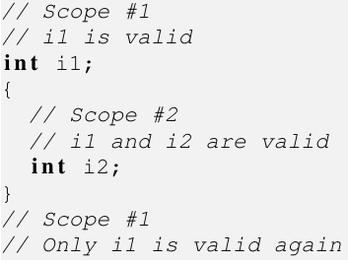
Core Extensions: Statically Allocated Memory Objects
Debug information (e.g. gcc -g)
Extended functionality:
Locate and record a variable access (if found)
Auxiliary functionality to handle the debug information objects
Get debug information from a variable handler
Retrieve/print gathered access info.
Trace user-defined set of variables
Associate tool-defined identifiers to the variable objects
Extended the variable data structure (load/store/modify counters, flags…)
Information distributed among the different binary objects of an application, including libraries
Internal Valgrind representation:
linked list
Different scopes determine whether the variables are valid or not depending on the IP

Slide 13
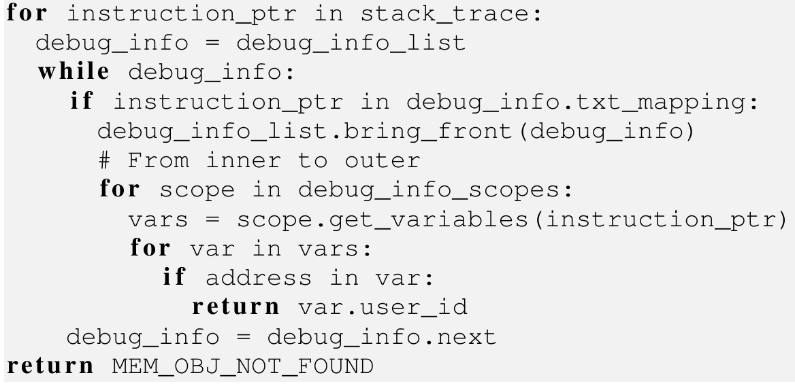
Core Extensions: Statically Allocated Memory Objects
To locate statically allocated variables (inspired on Memcheck’s algorithm):
Asymptotic computational cost: O(st x (dio + sao))
where st is the maximum stack trace depth
dio is the number of debug information objects
sao is the maximum number of statically allocated objects defined for a given IP
Variable’s addresses computed on demand, precluding binary search: future work
Time consuming: by default only consider debug information in the main’s object
Notes:
1.- Iterate through the stack trace, and get the instruction pointer (IP)
2.- Traverse the debug information object list to find that corresponding to IP
3.- Bring the found debug information object to the front of the list (optimization)
4.- Iterate through the debug information scopes, working outwards
5.- Extract the set of variables in the current scope (valid for the current program counter on the current stack trace level)
6.- Iterate over them until one is found comprising the target address

Slide 14
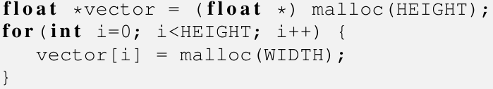
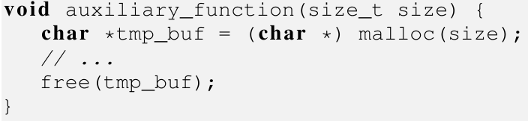
Core Extensions: Dynamically Allocated Memory Objects
Interception of application calls to memory management routines
Implemented on the tool side as a separate module
Exposed API similar to that of statically-allocated objects case
Ordered set using starting memory address as sorting index:
Possible since dynamically allocated objects reside in the global scope
Binary searches:
O(log dao)
where dao is # of dynamically allocated objects
Merge technique:
Merging accesses to different memory objects
If they were created featuring a common stack trace
These are likely to be considered as a single one from application level
Examples:
Loop allocating an array of lists as part of a matrix
Temporary object in a function
TODO: linked list detection

Slide 15
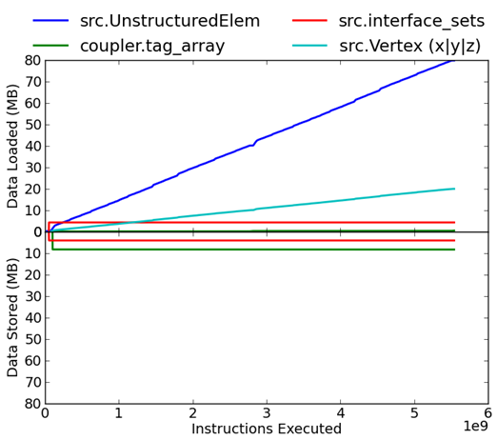
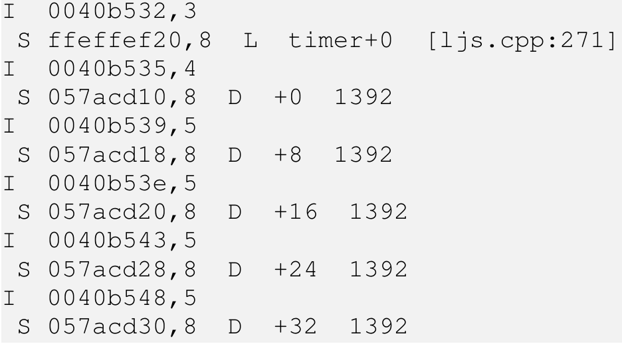
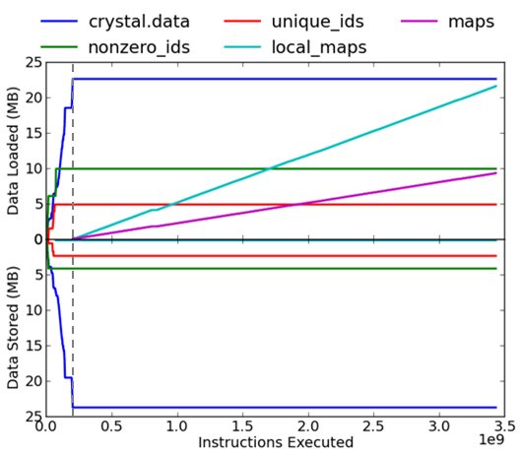
Extending Valgrind Tools: Lackey
Extended memory tracing capabilities to identify the accessed object
using the extended core functionality
Sample output excerpt (CSV available):
(G: global, L: local, D: dynamic)
G/L: variable name, access offset, name & line of the declaration file
D: ECU
Annotation from client request

Slide 16
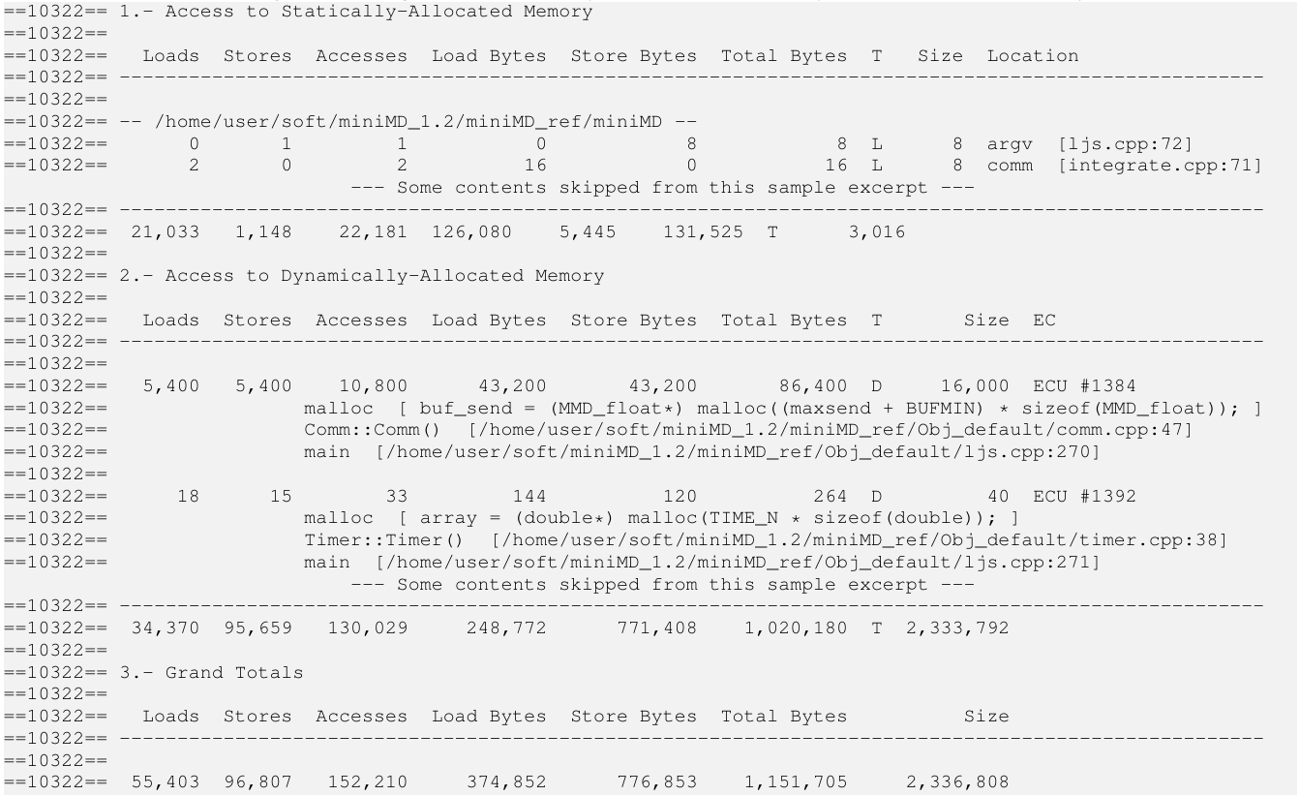
Extending Valgrind Tools: Lackey

Slide 17
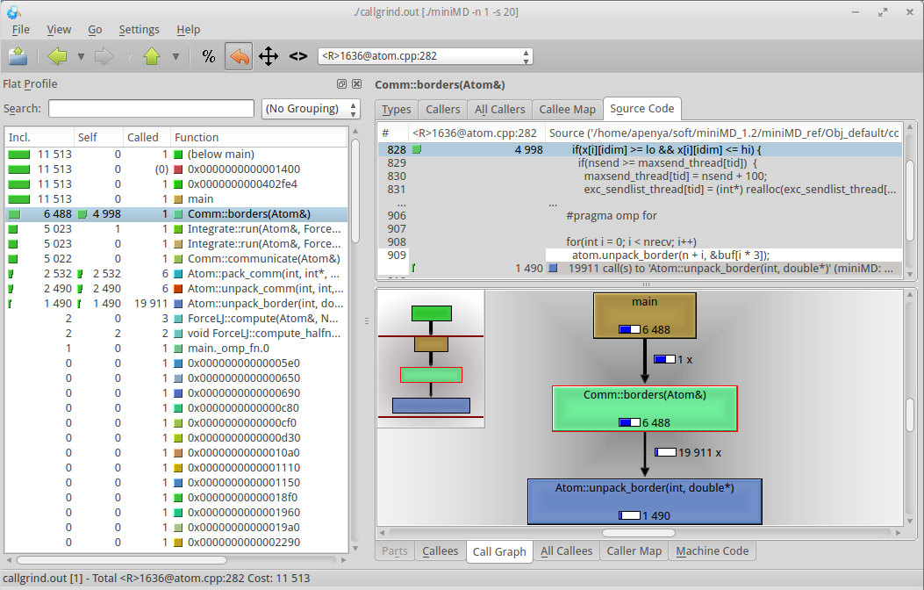
Extending Valgrind Tools: Callgrind
Similar approach as in Lackey to identify accesses to the different memory objects
Now targeting cache misses, i.e., accesses to the main memory
Per-object cache misses
Tracing capabilities
Kcachegrind integration
Heterogeneous memory…

Slide 18
Heterogeneous Memory

Slide 19
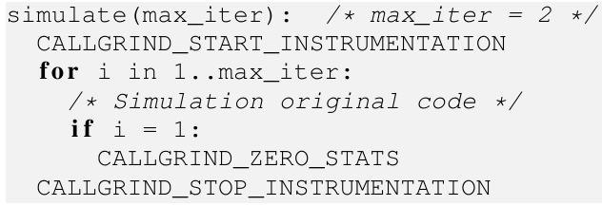
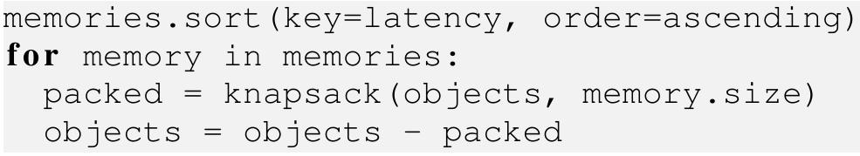
Heterogeneous Memory Methodology
Object-differentiated profiling (extended Callgrind) + distribution algorithm:
Profile to determine per-object last-level cache misses
Assess the optimal distribution of the different objects among the memory subsystems
Profiling procedure Object distribution algorithm
Assumptions and current known limitations:
Timeline is number of executed instructions
Write misses cause no stall cycles: buffered write-through with unlimited buffer size
Average latency estimations for the different memory subsystems
No memory migrations nor reuse of freed space (other than by the same memory obj.)

Slide 20
Heterogeneous Memory Possible Use
Compiler
Toolchain
Executable
Object
Memory
Profiler
2
3
1
4
Source
Code
Execution
Input
Profile
Data
7
5
Executable
Object
8
Compiler
Toolchain
7
Object
Distribution
6
Profile
Analyzer

Slide 21
Heterogeneous Memory Evaluation: System Setup
Cache Configuration
Description | Total Size | Assoc. | Line Size
L1 Instruction | 32 KB | 8 | 64 B
L1 Data | 32 KB | 8 | 64 B
L2 Unified | 8 MB | 16 | 64 B
Memory Configuration
Memory |  | Scenario
Description | Latency | Baseline | Scenario 1 | Scenario 2
L1 | 0 c | 32 KB + 32 KB
L2 | 20 c | 8 MB
SP | 20 c | 0 B | 8 MB | 8 MB
3D | 135 c | 0 B | 8 GB | 1 GB
Main | 200 c | 32 GB | 32 GB | 4 GB
NVRAM | 20,000 c | 0 B | 0 B | 32 GB

Slide 22
Heterogeneous Memory Test Cases: System Setup
Scenario 1
Scenario 2
CPUs
CPUs
MAIN
DRAM
MAIN
DRAM
NVRAM
L1 Instr.
L1 Data
L1 Instr.
L1 Data
SP
L2
SP
L2
3D DRAM
3D DRAM

Slide 23
Heterogeneous Memory Test Cases: Applications
MiniMD
HPCCG
“A simple proxy for the force computations in a typical molecular dynamics application”
Reduced version of the LAMMPS molecular dynamics simulator
Multiple large memory objects – different number of cache misses
Setup:
Reference implementation v1.2
LJ interactions among 2.9·10⁶ atoms
8 threads – 26 GB of memory
23% of cycles from cache misses
“A simple conjugate gradient venchmark code for a 3D chimney domain on an arbitrary number of processors”
Access pattern known to be highly memory demanding and sensitive to different memory architectures
Sensitivity to memory placement
Setup:
Reference version 1.0
400 x 400 x 400 node problem
8-threaded process – 26 GB memory
48% of cycles from cache misses

Slide 24
Heterogeneous Memory Experimental Results
Compute unoptimized distribution as:
Invert the “value” of objects with nonzero cache misses
Those featuring fewer misses are preferably allocated in the fastest memory subsystem
Discard memory objects not presenting cache misses
Unoptimized case not the worst possible case because objects without cache misses do not populate the fastest memories
Overall performance improvement with respect to unoptimized distribution:
Hardware | Test Case
 | MiniMD | HPCCG
Scenario 1 | 0.0% | 3.7%
Scenario 2 | 1,158.0% | 0.1%
A. J. Peña and P. Balaji. "Toward the efficient use of multiple explicitly managed memory subsystems", in IEEE Cluster 2014, Madrid, Spain, Sep. 2014. Accepted.

Slide 25
Conclusions

Slide 26
Conclusions
Design of tools providing object-differentiated profiling based on Valgrind
Lackey:
Raw access patterns
Detecting unexpected accesses
Callgrind:
Additional profiling view
Expose memory objects presenting consistently troublesome access patterns
Object-differentiated profiling useful for memory distribution in heterogeneous memory systems

Slide 27
Thank you
Questions?
apenya@mcs.anl.gov

