Slide 1


Portable, MPI-Interoperable Coarray Fortran
Chaoran Yang,¹ Wesley Bland,²
John Mellor-Crummey,¹ Pavan Balaji²
¹Department of Computer Science
Rice University
Houston, TX
²Mathematics and Computer Science Division
Argonne National Laboratory
Argonne, IL

Slide 2




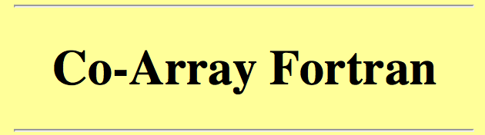
Partitioned Global Address Space
vs.
MPI
2

Slide 3
MPI-interoperability
Hard to adopt new programming models in existing applications incrementally
Interoperable problems in new programming models (examples later)
Error-prone
Duplicate runtime resources
Benefits of interoperable programming models
Leverage high-level libraries that are built with MPI
Hybrid programming models combine the strength of different models
3

Slide 4
Using multiple runtimes is error-prone
P0
P1
PROGRAM MAY_DEADLOCK
USE MPI
CALL MPI_INIT(IERR)
CALL MPI_COMM_RANK(MPI_COMM_WORLD, MY_RANK, IERR)
IF (MYRANK .EQ. 0) A(:)[1] = A(:)
CALL MPI_BARRIER(MPI_COMM_WORLD, IERR)
CALL MPI_FINALIZE(IERR)
END PROGRAM
blocking PUT
MPI_BARRIER
Implicit Response
4

Slide 5
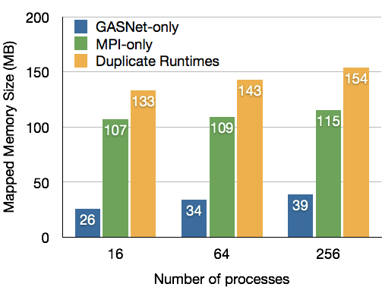
Using multiple runtimes duplicates resources
Memory usage is measured right after initialization
Memory usage per process increases as the number of processes increases
At larger scale, excessive memory use of duplicate runtimes will hurt scalability
5

Slide 6
How do we solve the problem?
Build PGAS runtime systems with MPI
Previously MPI was considered insufficient for this goal
MPI-2 RMA is portable but too strict
MPI-3 Remote Memory Access (RMA)
Separate model
Unified model
Public
MPI_Put
MPI_Put
Unified
Store
Store
Private
6

Slide 7
Build PGAS runtimes with MPI
Does this degrade performance?
Does this give us full interoperability?
7

Slide 8
Coarray Fortran (CAF)
What is Coarray Fortran?
added to the Fortran 2008 Standard
a PGAS Language, SPMD Model
What is a coarray?
extends array syntax with codimensions, e.g. REAL :: X(10,10)[*]
How to access a coarray?
Reference with [] mean data on specified image, e.g. X(1,:) = X(1,:)[p]
May be allocatable, structure components, dummy or actual arguments
8

Slide 9
Coarray Fortran 2.0 (CAF 2.0)
Teams (like MPI communicator) and collectives
Asynchronous operations
asynchronous copy, asynchronous collectives, and function shipping
Synchronization constructs
events, cofence, and finish
“A rich extension to Coarray Fortran developed at Rice University”
More details on CAF 2.0: http://caf.rice.edu and http://chaoran.me
9

Slide 10
Coarray and MPI-3 RMA
“standard CAF features”
Initialization
MPI_WIN_ALLOCATE, then MPI_WIN_LOCK_ALL
Remote Read & Write
MPI_RPUT & MPI_RGET
Synchronization
MPI_WIN_SYNC & MPI_WIN_FLUSH (_ALL)
Blue routine names are MPI-3 additions
10

Slide 11

Active Messages
“High performance low-level asynchronous remote procedure calls”
Many CAF 2.0 features are built on top of AM
Build AM on top of MPI’s send and receive routines
hurt performance - cannot overlap communication with AM handlers
hurt interoperability - could cause deadlock
spawn
wait
MPI_Reduce
DEADLOCK!
11

Slide 12
CAF 2.0 Events
“similar to counting semaphores”
event_notify
CALL event_notify(ev[p])
Need to ensure all previous asynchronous operations have completed before the notification
event_wait, event_trywait
CALL event_wait(ev)
Also serves as a compiler barrier
for each window
MPI_Win_sync(win)
for each dirty window
MPI_Win_flush_all(win)
AM_Request(…) // uses MPI_Isend
while (count < n)
for each window
MPI_Win_sync(win)
AM_Poll(…) // use MPI_Iprobe
12

Slide 13
CAF 2.0 Asynchronous Operations
copy_async(dest, src, dest_ev, src_ev, pred_ev)
pred_ev
copy_async
src_ev
dest_ev
Map copy_async to MPI_RPUT (or MPI_RGET)
when dest_ev should be notified? MPI_WIN_FLUSH is not useful
Map copy_async to Active Message
MPI does not have AM support
13

Slide 14
Evaluation
2 machines
Cluster (InfiniBand) and Cray XC30
3 benchmarks and 1 mini-app
RandomAccess, FFT, HPL, and CGPOP
2 implementations
CAF-MPI and CAF-GASNet
System | Nodes | Cores / Node | Memory / Node | Interconnect | MPI Version
Cluster (Fusion) | 320 | 2x4 | 32GB | InfiniBand QDR | MVAPICH2-1.9
Cray XC30 (Edison) | 5,200 | 2x12 | 64GB | Cray Aries | CRAY MPI-6.0.2
14

Slide 15
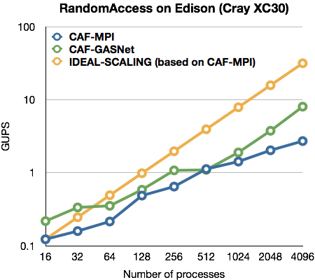
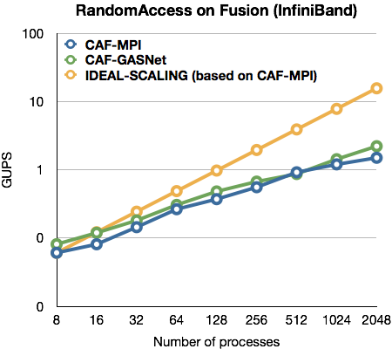
RandomAccess
“Measures worst case system throughput”
15

Slide 16
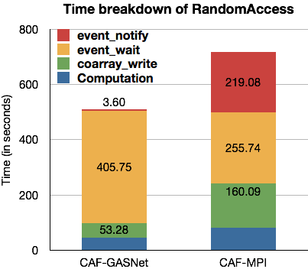
Performance Analysis of RandomAccess
The time spent in communication are about the same
event_notify is slower in CAF-MPI because of MPI_WIN_FLUSH_ALL
16

Slide 17
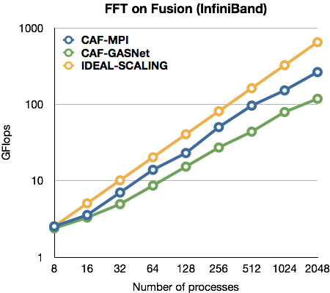
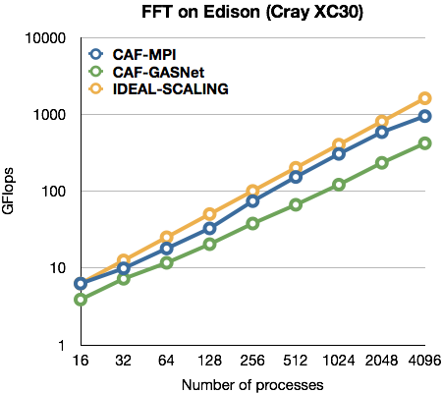
FFT
17

Slide 18
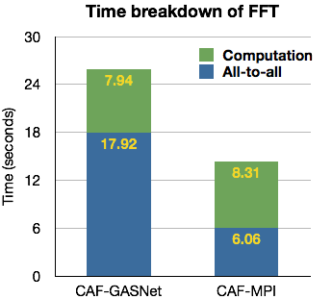
Performance Analysis of FFT
The CAF 2.0 version of FFT solely uses ALLtoALL for communication
CAF-MPI performs better because of fast all-to-all implementation
18

Slide 19
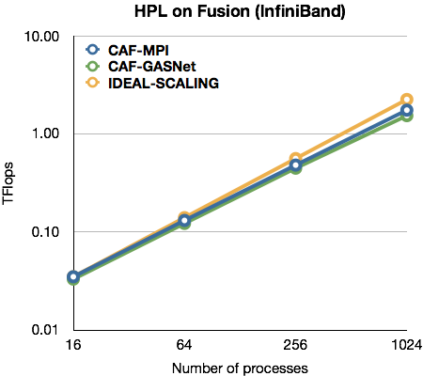
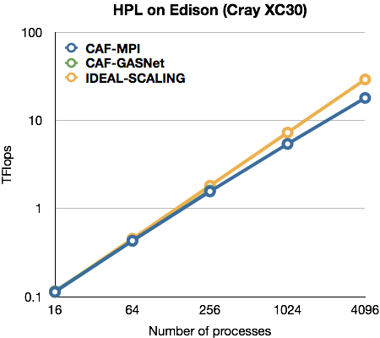
High Performance Linpack
“computation intensive”
19

Slide 20
CGPOP
“A CAF+MPI hybrid application”
The conjugate gradient solver from LANL Parallel Ocean Program (POP) 2.0
performance bottleneck of the full POP application
Performs linear algebra computation interspersed with two comm. steps:
GlobalSum: a 3-word vector sum (MPI_Reduce)
UpdateHalo: boundary exchange between neighboring subdomains (CAF)
Andrew I Stone, John M. Dennis, Michelle Mills Strout, “Evaluating Coarray Fortran with the CGPOP Miniapp"
20

Slide 21
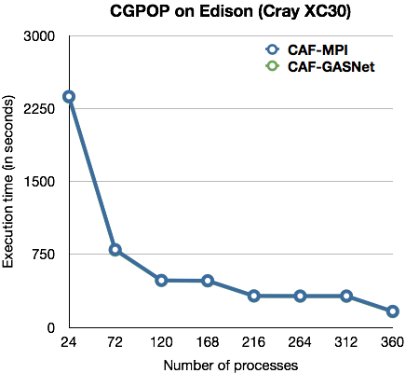
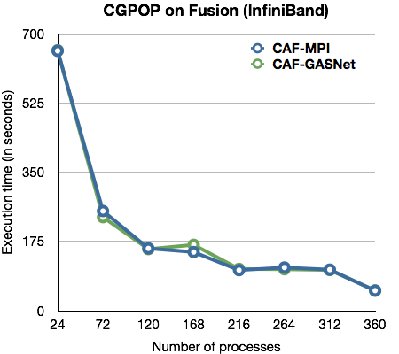
CGPOP
21

Slide 22
Conclusions
use MPI to build PGAS runtimes, good or bad?
The benefits of building runtime systems on top of MPI
Interoperability with numerous MPI based libraries
Remove resource duplication of using multiple runtimes
Deliver performance comparable to runtimes built with GASNet
MPI’s rich interface is time-saving
What current MPI RMA lacks
MPI_WIN_RFLUSH - overlap synchronization with computation
Active Messages - fully interoperability
22

Slide 23

Ongoing and Future Work
Optimizing intra-node communication with MPI shared memory windows
MPI_Win_create
MPI_Win_allocate_shared
MPI_Win_allocate_shared
Investigate applications that can benefit from a hybrid MPI+CAF framework, e.g. QMCPACK, GFMC
23

