Slide 1



Nonblocking Epochs in MPI One-Sided Communication
SC’14, New Orleans, LA, November 16-21 2014
Judicael A. Zounmevo, Xin Zhao, Pavan Balaji, William Gropp, Ahmad Afsahi
Queen’s University, Kingston, ON, Canada
University of Illinois at Urbana-Champaign
Argonne National Laboratory
November 19, 2014

Slide 2
Outline
MPI One-Sided: Epochs and Synchronizations
Synchronization Burden
Nonblocking Synchronizations
Semantics
Visualizing Improvements Scenarios
Design Notes
Evaluation
Conclusion

Slide 3
MPI One-Sided: Epoch and Synchronizations
Window
One-sided communications
Epoch
Synchronizations
Origin
Target
Origin
Blocking!
Target exposes memory for remote access
There are many kinds of epochs: Fence, GATS, lock, lock_all
Different synchronization routines lead to different epoch types
Figure adapted from Tipparaju, V.; Gropp, W.; Ritzdorf, H.; Thakur, R.; Traff, J.L., "Investigating High
Performance RMA Interfaces for the MPI-3 Standard," ICPP, pp.293,300, 22-25 Sept. 2009

Slide 4
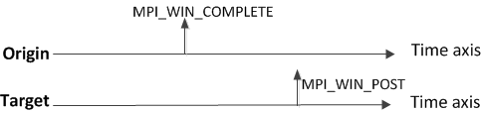
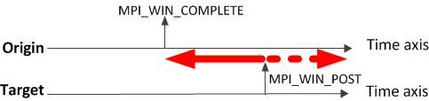
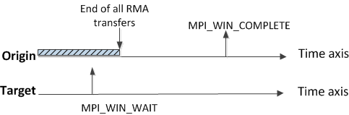
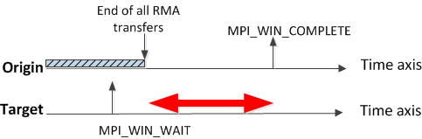
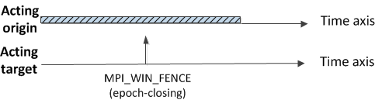
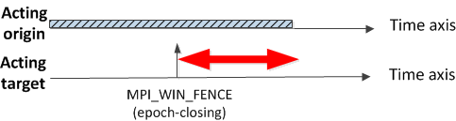
Synchronization Burden: Inefficiency Patterns
Late Post [1]
Late Complete [1]
Early Fence [1]
[1] M.-A. Hermanns, M. Geimer, B. Mohr, and F. Wolf, “Scalable Detection of MPI-2 Remote Memory Access Inefficiency Patterns,” in Recent Advances in Parallel Virtual Machine and Message Passing Interface, ser. Lecture Notes in Computer Science. Springer Berlin Heidelberg, 2009, vol. 5759, pp. 31–41

Slide 5
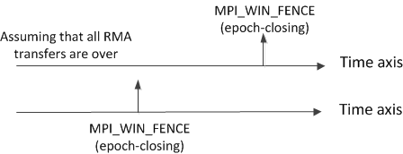
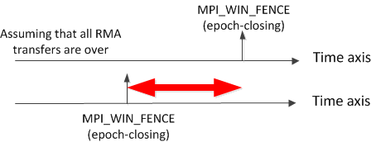
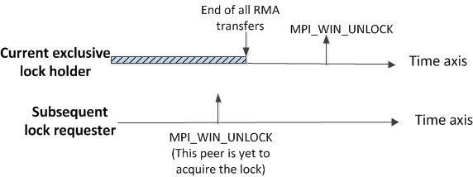
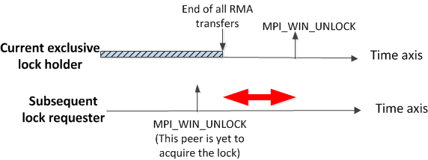
Synchronization Burden: Inefficiency Patterns
Wait at Fence [1]
Late Unlock
Late Unlock is introduced in this work

Slide 6
Synchronization Burden: Analysis
Critical section thinking
Tradeoff
Communication latency mitigation thinking
Ideal scenario … which is an utopia

Slide 7
Nonblocking Synchronizations
We proposed nonblocking synchronizations
… to completely remove the aforementioned tradeoff
All epoch-opening, epoch-closing and flush routines are covered
Split-phase epoch closing
MPI_WIN_ICOMPLETE
MPI_WAIT[ANY|SOME|ALL]
… and even the second phase does not have to block!
MPI_TEST[ANY|SOME|ALL]

Slide 8
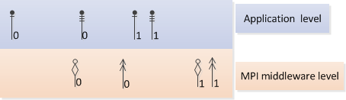
Default Semantics of Nonblocking Synchronizations
“Open” and “close” define the boundaries of the application-level lifetime of the epoch.
The epoch is said to be open inside these boundaries
Close epoch e₀
Open epoch e₀
Activate epoch e₀
Progression of e₀ starts
Complete epoch e₀.
e₀ is done being progressed
“Activation” and “completion” define the boundaries of the middleware-level lifetime of the epoch.
The epoch is said to be active inside these boundaries
Between opening and activation, the epoch is said to be deferred

Slide 9

Default Semantics of Nonblocking Synchronizations
Epoch closing is not completion
In active target, access epochs and exposure epochs are matched in a FIFO fashion.
Epochs for a given RMA window are always activated serially; in the order where they become pending inside the progress engine.
Epoch e_{k+1} is activated only after epoch e_{k} has completed.
Local access to RMA
buffer is unsafe
Local access to RMA
buffer is still unsafe
Local access to RMA
buffer is safe

Slide 10
Semantics of Nonblocking Synchronizations with Progress Engine Optimizations
One can do better than “activating e_{k+1} only after e_{k} completion”
We provide info object key-value to enable out-of-order message progression:
MPI_WIN_ACCESS_AFTER_ACCESS_REORDER (A_A_A_R)
MPI_WIN_ACCESS_AFTER_EXPOSURE_REORDER (A_A_E_R)
MPI_WIN_EXPOSURE_AFTER_EXPOSURE_REORDER (E_A_E_R)
MPI_WIN_EXPOSURE_AFTER_ACCESS_REORDER (E_A_A_R)
Fence and win_lock_all are currently not covered by the optimization flags

Slide 11
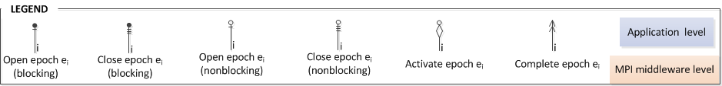
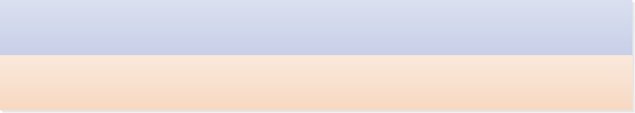
Visualizing Improvement Scenarios
Inflicted to oneself
MPI-3.0 RMA
Blocking epoch-closing
synchronization
Inflicted to remote peer
MPI_WAITALL (entrance)
Nonblocking synchronizations.
Default progress engine behavior.
MPI_WAITALL (exit)
MPI_WAITALL (entrance)
Nonblocking synchronizations.
Progress engine optimizations
enabled.
MPI_WAITALL (exit)
Notes:
DEFAULT PROGRESS ENGINE BEHAVIOUR:
The progress engine still progresses things in the same order as the MPI-3.0 case;
meaning that if buffer access restrictions are respected,
the reasoning is straightforward for an MPI-3.0 programmer. This is to say that the learning curve is a very reasonable one.

Slide 12
Design Notes
We had to redesign from scratch
MPI-3.0 RMA as a whole
along with the nonblocking synchronizations
and the new concepts.

Slide 13

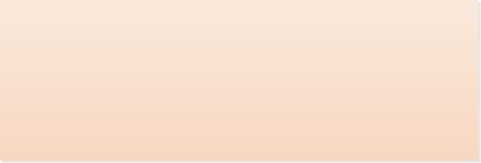
Design Notes: Deferring, Recording and Replaying Epochs
Epoch e₁ cannot be activated yet
rma,rma
…,rma
rma,rma
…,rma
Replayed when
activated
Deferred epoch
being recorded
Epoch e₁ is deferred

Slide 14
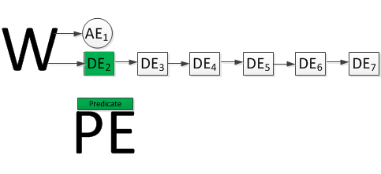
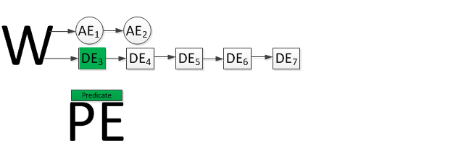
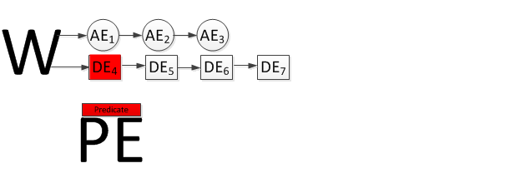
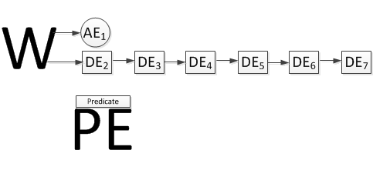
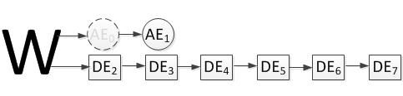
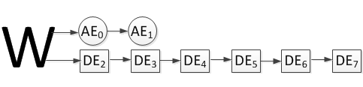
Design Notes: Deferring, Recording and Replaying Epochs
Active epoch
RMA window
Deferred epoch
Progress engine

Slide 15
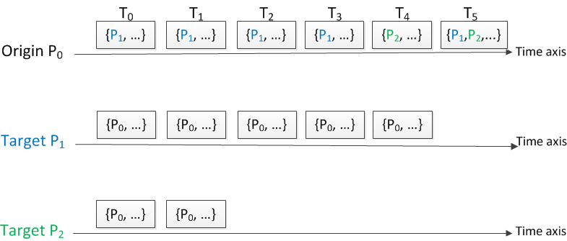
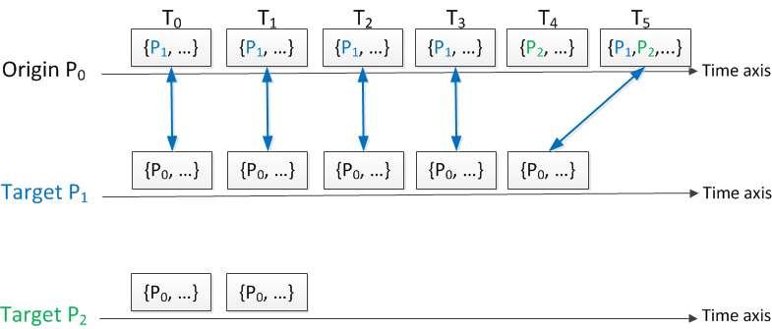
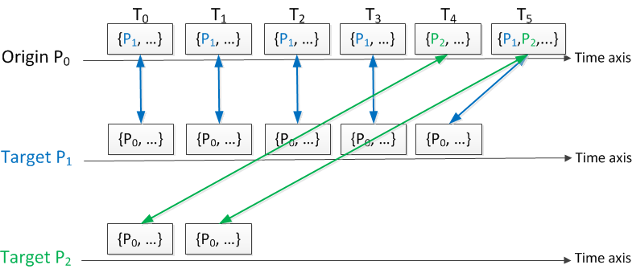
Design Notes: Epoch Matching
Need to keep history of granted accesses from targets to origins
Message queues again? …. Scalability?
We Achieved all epoch matching in O(1) for both time and space!

Slide 16
Evaluation: Setup
320 dual-socket quad-core 2.67GHz Intel Xeon x5550 processors (total of 2560CPU cores)
Cache:
4 x 32KB L1 instruction
4 x 32KB L1 data
4 x 256KB L2
8MB L3
36GB RAM /node
InfiniBand: Mellanox ConnectX QDR HCAs
Linux kernel 2.6.18
MVAPICH 2-1.9 (Vanilla)
MVAPICH 2-1.9 (with new RMA)

Slide 17
Evaluation: Fixing the Inefficiency Patterns
Late Post
Target is 1000μs late in exposing its epoch
Origin does 2 activities: Access epoch, then two-sided
All RMA are MPI_PUT (1MB)
The graph shows the origin latencies for the various activities
The nonblocking series overlaps the subsequent activity with the delay

Slide 18
Evaluation: Fixing the Inefficiency Patterns
Late Complete
Origin overlaps 1000μs of work inside its epoch.
The graph shows the target epoch length.
The nonblocking synchronization prevents the target from suffering the origin-side work latency.
Longer than data transfer time

Slide 19
Evaluation: Fixing the Inefficiency Patterns
Early fence
Target is 1000μs late in exposing its epoch
Acting target does 2 activities: Access epoch, then two-sided
The graph shows the cumulative latency of the acting origin for both activities
The nonblocking series overlaps the subsequent activity with the epoch latency.

Slide 20
Evaluation: Fixing the Inefficiency Patterns
Wait a Fence
Acting origin overlaps 1000μs of work inside its epoch.
The graph shows the acting target epoch length.
The nonblocking synchronization prevents the acting target from suffering the origin-side work latency.
Longer than data transfer time

Slide 21
Evaluation: Fixing the Inefficiency Patterns
Late Unlock
All RMA are MPI_PUT (1MB)
Origin O₀ asks for the lock first (exclusively).
Origin O₁ asks for the same lock … after O₀ did
Origin O₀ works for 1000μs before releasing the lock
The graph shows the epoch latency for each origin
The nonblocking series prevents the first lock holder from propagating its work latency to the subsequent requester

Slide 22
Evaluation: Out-of-Order Epoch Completion
A_A_A_R, GATS
All test series are nonblocking
A single origin O opens an access towards targets T₀ and T₁ in that order
T₀ is 1000μs late in exposing its epoch (Late Post)
The graph shows the epoch length of T₁ and the cumulative length of both origin epochs.
A_A_A_R prevents T₁ from suffering the delay of T₀. The origin completes faster overall as well.

Slide 23
Evaluation: Out-of-Order Epoch Completion
A_A_A_R, lock/unlock
All test series are nonblocking
Origin O₁ requests a lock from target T₀ right after O₀ gets it exclusively.
Origin O₁ then requests a subsequent lock from T₁.
Origin O₀ works for 1000μs before releasing the lock of T₀
The graph shows the cumulative epoch latency of O₁
The overall O₁ latency for both locks is lower when A_A_A_R is enabled.
Cumulative O₁ epoch latency

Slide 24
Evaluation: Out-of-Order Epoch Completion
A_A_E_R, GATS
All test series are nonblocking
P₀ is origin and P₁ is target
P₂ is target for P₀ and then origin for P₁
P₀ works 1000μs and is late for closing its access epoch.
The graph shows the latency of P₁ and the overall latency of P₂
A_A_E_R prevents P₁ from suffering the delay of P₀. P₂ completes faster overall as well.

Slide 25
Evaluation: Out-of-Order Epoch Completion
E_A_E_R, GATS
All test series are nonblocking
A single target opens an exposure epoch towards an origin O₀ and then towards another origin O₁
O₀ is 1000μs late in closing its access epoch.
The graph shows the latency of P₁ and the overall latency of P₂
E_A_E_R prevents O₁ from suffering the delay of O₀. The target completes faster overall as well.

Slide 26
Evaluation: Out-of-Order Epoch Completion
A_A_E_R, GATS
All test series are nonblocking
P₀ is target and P₁ is origin
P₂ is origin for P₀ and then target for P₁
P₀ exposes its epoch 1000μs late.
The graph shows the latency of P₁ and the overall latency of P₂
A_A_E_R prevents P₁ from suffering the delay of P₀. P₂ completes faster overall as well.

Slide 27
Evaluation: Application Pattern
Massive unstructured dynamic transactions.
Multiple rounds of a set {P_{i}} of peers atomically updating another (not necessarily disjoint) set {P_{j}} of peers.
… successions of lock_exclusive, accumulate, unlock
A_A_A_R removes contention between adjacent locks meant for disjoint targets!
A_A_A_R allows 184,422 (39%), 205,377(20%) and 339,359(16%) more trs/s than the
“New” series for 64, 128 and 256 CPU cores respectively.

Slide 28
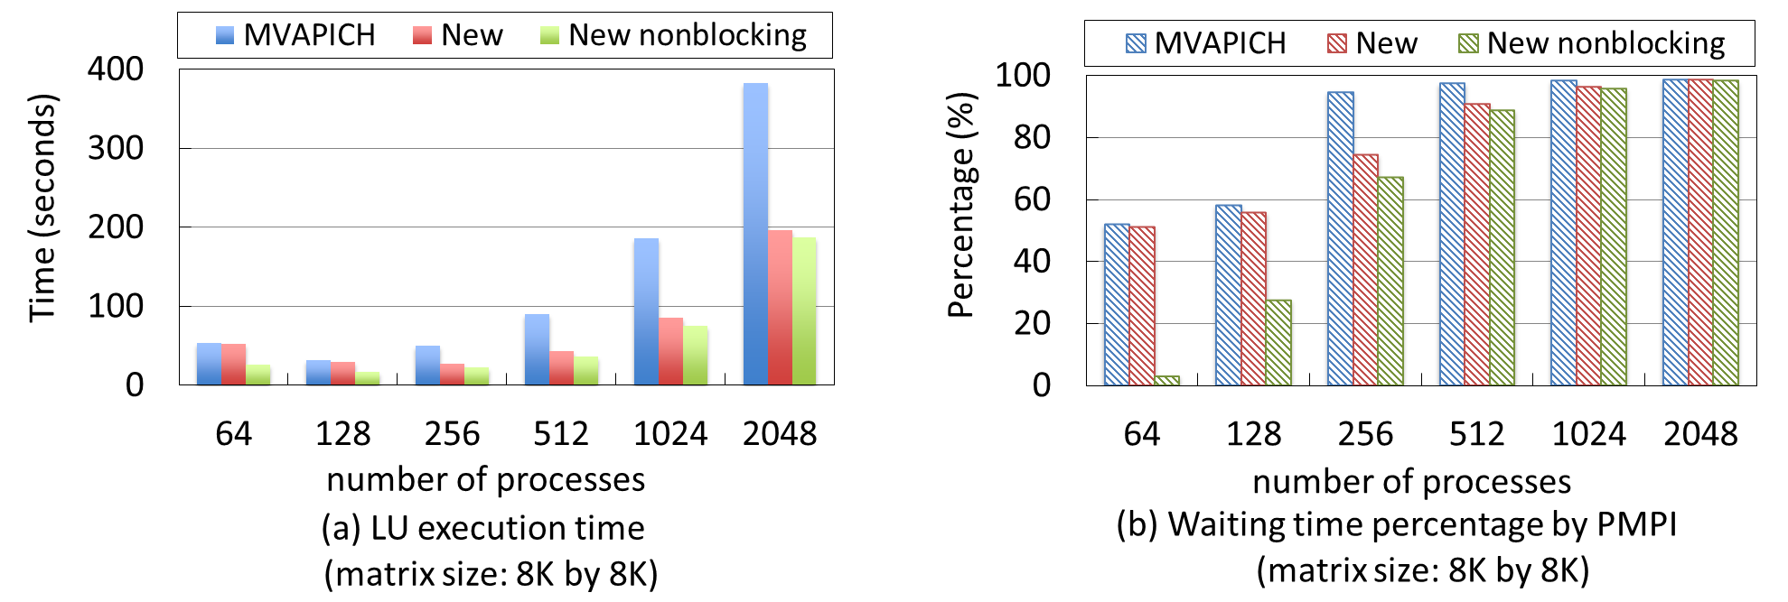
Evaluation: Application (One-Sided|GATS LU)
Matrix of 8,192 x 8,192
Performance improvement of up to 50% with nonblocking synchronizations

Slide 29
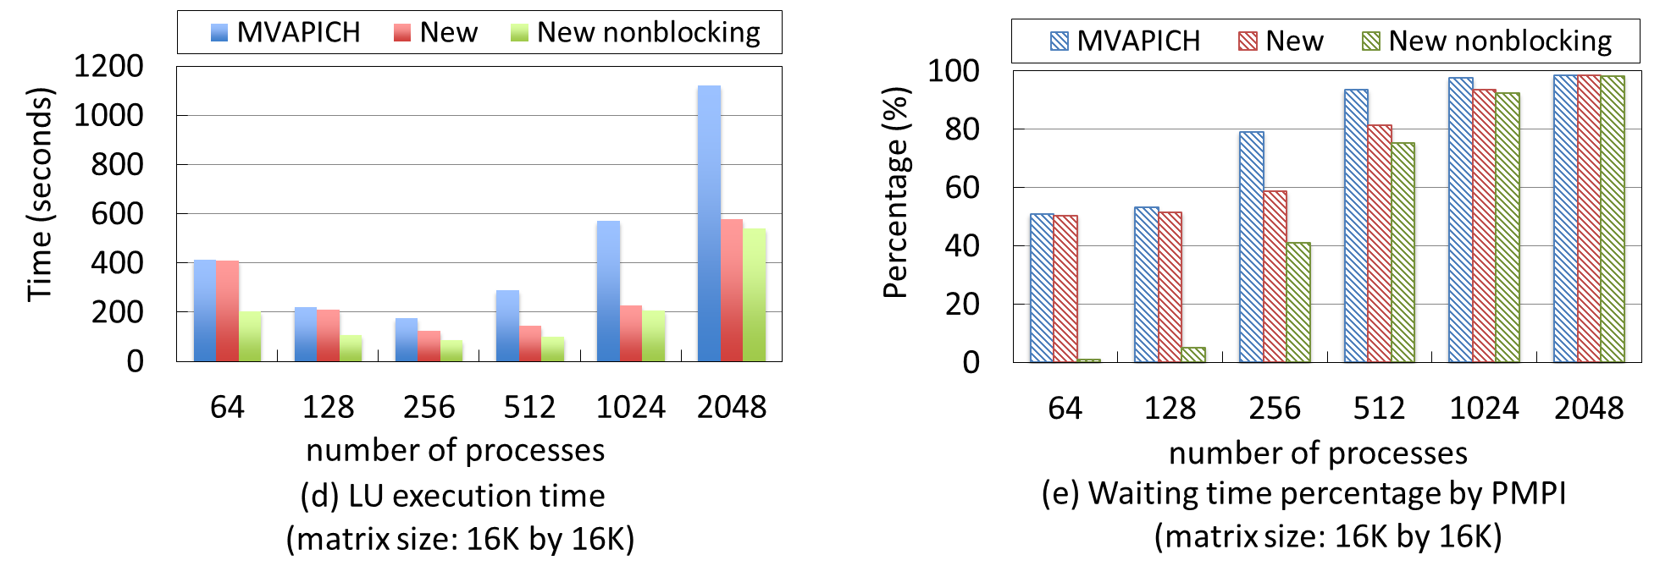
Evaluation: Application (One-Sided|GATS LU)
Matrix of 16,384 x 16,384
Performance improvement of up to 50% again with nonblocking synchronizations

Slide 30
Conclusion
We introduced entirely nonblocking epoch synchronizations with the following benefits:
All inefficiency patterns can now be avoided or mitigated
Flexible communication/computation overlapping
Communication/communication overlapping
Communication/delay overlapping
Contention avoidance
New use cases are made possible or performant
Future work:
Enable progress engine optimization for fence and lock_all
Investigate the use of nonblocking one-sided epochs in rule-based distributed engines.

Slide 31







Slide 32
Thank you
Questions?

