Slide 1
Understanding Data Access Patterns Using Object-Differentiated Memory Profiling
Antonio J. Peña Pavan Balaji
Argonne National Laboratory Argonne National Laboratory
apenya@anl.gov balaji@anl.gov

Slide 2
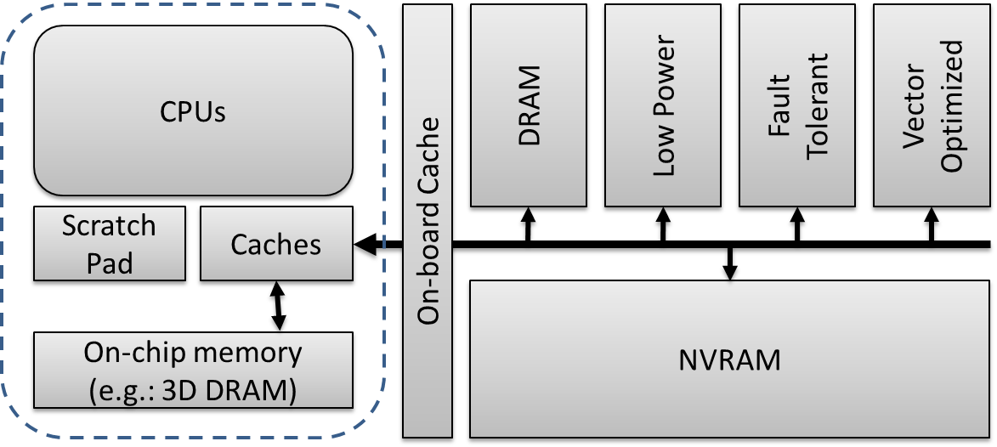
Motivation
Understanding data access patterns important for:
Software optimizations
Codesign
Data distribution in heterogeneous memory systems
Data-oriented profiling:
Complements traditional code-oriented profiling
We incorporated data-oriented profiling features to Valgrind:
EVOP: Extended Valgrind for Object-Differentiated Profiling
Raw: extended Lackey – Main memory: extended Callgrind
Available upon demand (apenya@anl.gov)
We analyzed US DOE miniapplications representative of different domains
Traditional profiler
c[i] = a [j]* b [k]+ c[l]; ← 15%
Data-oriented profiler
a ← 0% / b ← 15% / c ← 0%
A. J. Peña and P. Balaji. "A framework for tracking memory accesses in scientific applications", in P2S2 (ICPP Workshop), Minneapolis, MN, Sep. 2014.
A. J. Peña and P. Balaji. "Toward the efficient use of multiple explicitly managed memory subsystems", in IEEE Cluster, Madrid (Spain), Sep. 2014.

Slide 3
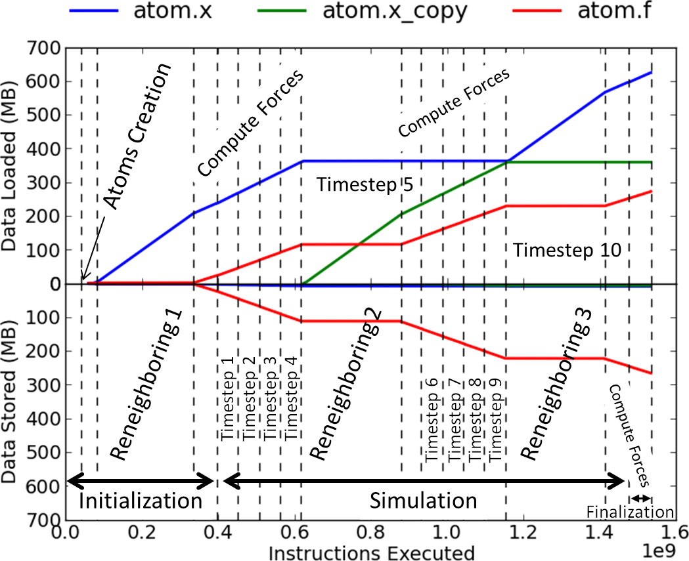
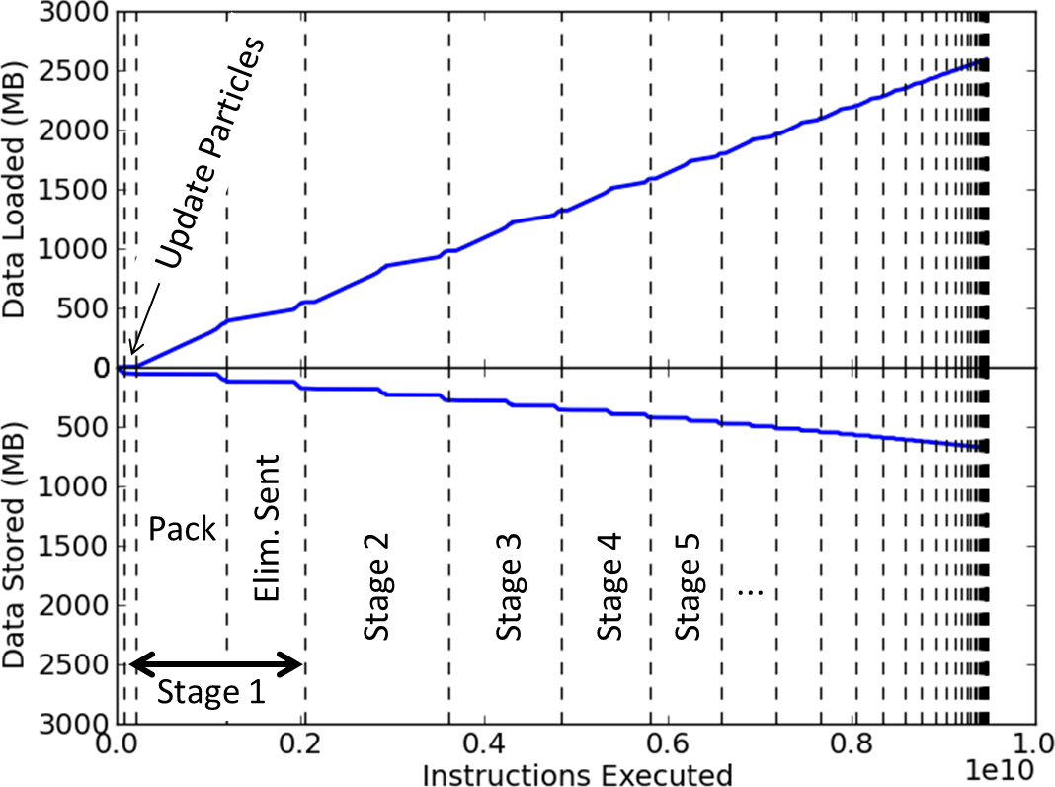
Some Results
MiniMD
MCCK

