Slide 1

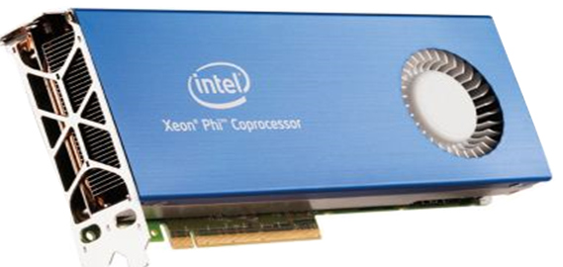

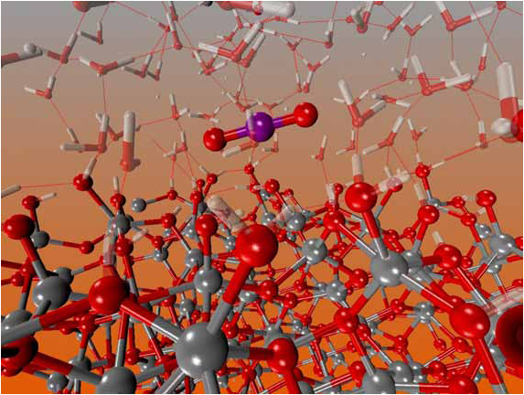
Techniques for Enabling Highly Efficient Message Passing on Many-Core Architectures
Min Si
University of Tokyo, JAPAN
msi@il.is.s.u-tokyo.ac.jp
Pavan Balaji (Co-advisor)
Argonne National Laboratory, USA
balaji@mcs.anl.gov
Yutaka Ishikawa (Advisor)
RIKEN AICS, JAPAN
yutaka.ishikawa@riken.jp
In this thesis, we investigate the characterist-ics of MPI on massively parallel many-core architectures and propose efficient strategies for two most popular programming models:
Improving core utilization and commu-nication for the hybrid MPI+thread model;
Efficient process-based asynchronous progress for the MPI one-sided communica-tion model.
Background
Many-Core
Massively parallel environment
Intel® Xeon Phi
Blue Gene/Q
Hardware Characteristics
Simple & low frequency core design
#core increases faster than other on-chip resources
Parallelism and Resource Sharing in Scientific Applications
Hybrid MPI+threads model
Massive parallelism in computation
On-chip resource sharing between threads
MPI RMA-based PGAS model
Memory sharing across nodes
Part I. Multithreaded MPI for Hybrid MPI+Threads Model
Problem in hybrid MPI + Threads
Solution: MT-MPI −− Sharing Idle Threads with Application inside MPI _{[1]}
Thread Funneled or Serialized mode
Multiple threads parallelize computation
Only one thread issues MPI calls
Most cores are IDLE during MPI Calls
#pragma omp parallel
{ /* User Computation */ }
MPI_Function( ){
#pragma omp parallel
{ /* Internal Processing */ }
}
OpenMP Runtime Extension
Expose number of IDLE threads
Hybrid NAS MG - class E using 64 MPI processes
MPI Internal Parallelism
Derived datatype processing
SHM communication
InfiniBand network
Funneled Mode
MPI Process
#pragma omp parallel
{ /* User Computation */ }
MPI_Function ( );
COMP.
Challenges
MPI COMM.
Algorithms tradeoff
Number of IDLE threads is unknown.
Nested parallelism
Creates new Pthreads and offloads scheduling to OS
Threads overrunning.
Correctness challenges
i.e. lock permission, self lock consistency,
simultaneous epochs…
Performance challenges
i.e. Memory locality
Part II. Process-based Asynchronous Progress Model for MPI RMA
Problem in MPI RMA-based PGAS
Solution: Casper −− Process-based Asynchronous Progress Model _{[2]}
Suitable for applications with large memory requirements. (i.e., NWChem)
MPI RMA is not truly asynchronous
Core concept
#cores is rapidly growing
Not all of the cores are always keeping busy
Dedicate small & user-specified number of cores to ghost processes
Ghost process intercepts all RMA operations to the user processes
Improve ASYNC progress for SW-handled operations without affecting HW-handled RMA
Computing Node 1
Computing Node 2
Socket 0
RMA Image
Socket 0
Socket 1
Process 0
Process 1
Helper
thread
Typical Get-Compute-Update
P
P
Socket 1
P
P
P
P
ACC(data)
Computation
P
P
+=
ACC
P
G
P
G
P
G
P
G
GET
GET
Process 0
Process 1
Ghost
Process
Local buffer
Computation
Three Primary Functionalities
Process 0
Process 1
ACC(data)
+=
MPI_Recv
MPI_COMM_WORLD COMM_USER_WORLD
Shared memory mapping between local user and ghost processes (MPI-3 MPI_Win_allocate_shared )
Redirect RMA operations to ghost processes.
ACC(data)
+=
No multithreading or interrupt overhead
Flexible core deployment
Portable PMPI* redirection
Delay
Computation
NWChem Quantum Chemistry Suite
NERSC Edison Cray XC30
Input tce_c20_triplet
Compute-intensive CCSD(T) simulation
MPI call
Correctness and Performance challenges
Traditional ASYNC Progress
Ensuring correctness
Lock permission for shared ghost processes
Managing multiple ghost processes
Self lock consistency
Multiple simultaneous epochs
Ensuring performance
Memory locality
Thread-based Approach
Per-MPI process background thread
Interrupt-based Approach
Per-operation hardware interrupts awaken kernel thread
Process 0
Process 1
Waste half cores or oversubscription
Multithreading overhead in MPI
Computation
ACC(data)
Helper
thread
+=
Interrupt
Overhead of frequent interrupts
Reference
[1] M.Si, A.J.Pena, P.Balaji, M.Takagi, and Y.Ishikawa, “MT-MPI: Multithreaded MPI for Many-Core Environments,” in Proceedings of the 28th ACM ICS, June 2014.
[2] M.Si, A.J.Pena, J.Hammond, P.Balaji ,M.Takagi, and Y.Ishikawa, “Casper: An Asynchronous Progress Model for MPI RMA on Many- Core Architectures,” in IPDPS 2015.
The experimental resources for this research were provided by the Texas Advanced Computing Center (TACC) on the Stampede supercomputer and by the National Energy Research Scientific Computing Center (NERSC) on the Edison Cray XC30 supercomputer. This material was based upon work supported by the U.S. Dept. of Energy, Office of Science, Advanced Scientific Computing Research (SC-21), under contract DE-AC02-06CH11357
Notes:
modify title: research 1/2/3
add changes from slides

