Slide 1

Techniques for Enabling Highly Efficient Message Passing on Many-Core Architectures
Min Si
PhD student at University of Tokyo, Tokyo, Japan
Advisor : Yutaka Ishikawa
Guest graduate student at Argonne National Laboratory, IL, USA
Mentor : Antonio J. Peña Supervisor : Pavan Balaji
Email: msi@il.is.s.u-tokyo.ac.jp, msi@anl.gov
Homepage: http://sudalab.is.s.u-tokyo.ac.jp/~msi
Notes:
Have worked at Argonne for 1 year,

Slide 2

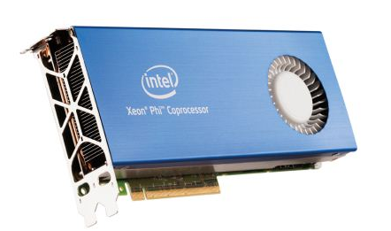
Scientific Programming on Many-Core Architectures
Massive Parallel Many-Core Environment
Intel® Xeon Phi co-processor, Blue Gene/Q
Hardware Characteristics
Simple and low frequency cores
Other on-chip resources are growing at a lower rate…
We need Parallelism and Resource Sharing !
Thus we are studying two popular programming models
1. Hybrid MPI+Threads model
2. MPI RMA-based PGAS model
MPI Process
Massive parallelism in computation
On-chip resource sharing between threads
Typical Get-Compute-Update
Global shared arrays
Memory sharing across nodes on distributed memory systems
OpenMP Threads
GET
GET
ACC
Local buffer

Slide 3
Communication Optimization in Hybrid MPI+threads Model
Problem Statement
Only single thread issues MPI
Most threads are IDLE during MPI calls
MT-MPI: Multi-threaded MPI^{[1]}
Sharing Idle Threads with application inside MPI
Optimizing MPI internal processing by massive parallelism
MPI Process
#pragma omp parallel
{ /* user computation */ }
MPI_Function ( );
COMP.
Hybrid NAS MG class E using 64 MPI processes
on TACC Stampede supercomputer
MPI COMM.
Many threads are IDLE !
Sharing IDLE threads inside MPI
MPI_Function( ){
#pragma omp parallel
{ /* Internal Processing */ }
}
MPI COMM.
[1] M. Si, A. J. Pena, P. Balaji, M. Takagi, and Y. Ishikawa, “MT-MPI: Multithreaded MPI for Many-Core Environments,” in Proceedings of the 28th ACM international conference on Supercomputing, ICS 2014.

Slide 4
Process-based Asynchronous Progress Model for MPI RMA
MPI RMA Communication
Not truly one-sided
Casper : Process-based ASYNC Progress^{[2]}
Flexible & Portable & Low overhead
Improve SW-handled RMA operations without affecting HW-handled RMA.
Process 0
Process 1
ACC(data)
+=
Computation
MPI call
NWChem CCSD(T) simulation for C₂₀
on NERSC Edison supercomputer
Communication Delay
Process-based Asynchronous Progress
Reduced 45%
Process 0
Process 1
Ghost
Process
Acc(data)
Computation
+=
MPI Recv
[2] M.Si, A.J.Pena, J.Hammond, P.Balaji, M.Takagi, and Y.Ishikawa, “Casper: An Asynchronous Progress Model for MPI RMA on Many-Core Architectures,” in Parallel and Distributed Processing, 2015. IPDPS 2015.

