Slide 1

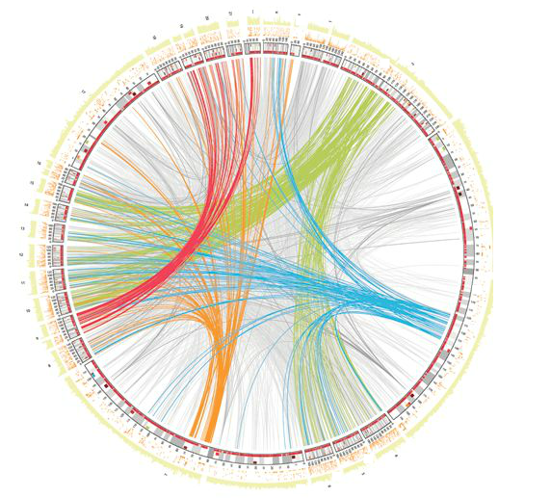

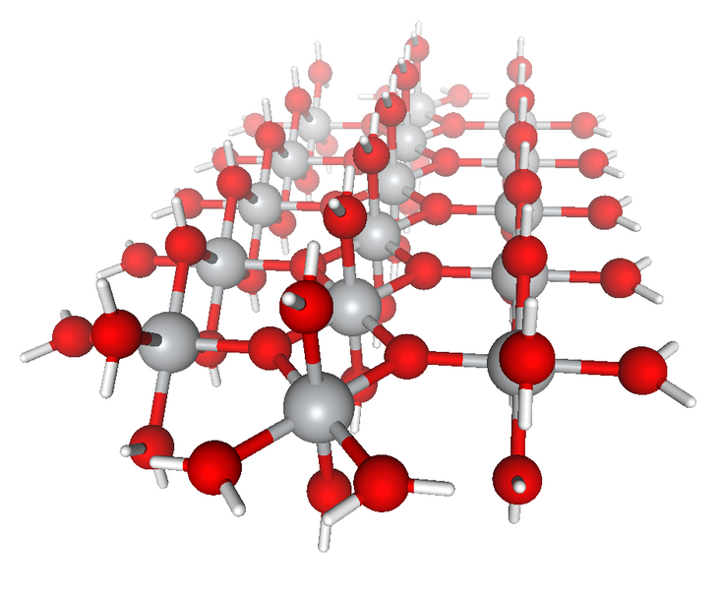


Runtime Support for Irregular Computation in MPI-Based Applications
Xin Zhao*, Pavan Balaji† (Co-advisor) and William Gropp* (Advisor) *University of Illinois at Urbana-Champaign, Champaign, IL, USA {xinzhao3, wgropp}@illinois.edu
†Argonne National Laboratory, Argonne, IL, USA balaji@mcs.anl.gov
(Doctoral Symposium Program)
Highlights
My PhD research focuses on studying the suitability of MPI to irregular applications.
The thesis is divided into two parts. In the first part, I will investigate scalability and performance challenges in MPI runtime and propose corresponding solutions; in the second part, I will explore how to improve MPI standard to support integration of data movement and computation by combining Active Messages (AM) with traditional MPI data movement patterns.
Irregular Computations
Some of them are organized around sparse data structures
Large amount of outstanding asynchronous messages involved
Data movement pattern is irregular and data-driven
Increasing trend of applications migrated from regular computation model to irregular computation model, due to reasons of computation complexity, power consumption, etc.
?
irregular applications
Research Goal
Plan of Study
Research Goal
Plan of Study
Addressing scalability and performance limitations in massive asynchronous communication
Tackling scalability challenges in MPI runtime
Optimizing MPI runtime for fine-grained operations
Study MPI’s suitability to irregular applications
Find out where MPI lies on the spectrum of suitability
Propose what if anything needs to change in MPI runtime and semantics to efficiently support irregular applications
MPI runtime
MPI?
Integrated data and computation management
Generalized MPI-interoperable Active Messages framework (MPI-AM)
Optimized MPI-AM
Asynchronous processing in MPI-AM
completely suitable
not suitable at all
irregular applications
Addressing Scalability and Performance Limitations in Massive Asynchronous Communication
MPI standard
Addressing Scalability and Performance Limitations in Massive Asynchronous Communication Communication
Integrated Data and Computation Management
Virtual connection (VC) objects
Problem: use O(P) memory per process to store VCs
Solution:
“Lazy” initialization: initialize corresponding VCs when communicating with peers
“On-demand” initialization: maintain fixed number of VCs that are recently used
Scalable data structure to store states of targets and operations
Integrated Data and Computation Management
MPI-AM: MPI-interoperable framework that can dynamically manage data movement and user-defined remote computation
Correctness semantics
Interoperability: in SEPARATE window model, if AM and RMA, or AM and AM, or AM and local STORE, update on the same window, either on overlapping or on non-overlapping locations, result is undefined
Memory consistency: MPI runtime must ensure memory consistency of RMA window
Ordering: three orderings are imposed by default -- AMs with different operations; AMs with the same operation; segments within AM
Concurrency: by default, MPI runtime behaves “as if” AMs are executed in sequential order
slot
active target
pending operation
origin input buffer
origin output buffer
issued but incomplete operation
AM
input data
AM
output data
window
private memory
private memory
slot 0
slot 1
rank 0
rank 7
rank 14
slot 2
target input buffer
target output buffer
slot 3
slot 4
AM handler
slot 5
RMA window information storage
Problem: use O(P) memory per process to store window information
Solution:
slot 6
rank 6
rank 13
rank 20
RMA window
Two-level resource pools: local pool and global pool
Make “aggressive” progress to restore resources
target persistent buffer
Streaming AMs: user-defined “segment” — minimum number of elements for AM execution
Graph500 benchmark
Buffer Management
System buffers: may not be available, use eager protocol
User buffers: use rendezvous protocol, shared by processes
rank 0
SHM
rank 2
SHM
Graph500 benchmark
node 0
rank 1
node 1
rank 3
Asynchronous processing
information sharing
shared memory
NODE 0
NODE 1
rank 0
rank 1
rank 2
rank 3
(#vertices=2^22)
network
cache
cache
cache
cache
mpich-3.1.3 ran out of
memory at small scale
information caching
rank 1 (origin)
rank 0 (target)
rank 2 (origin)
Publications
[1] Optimization Strategies for MPI-Interoperable Active Messages. Xin Zhao, Pavan Balaji, William Gropp, Rajeev Thakur. IEEE International Conference on Scalable Computing and Communications. Best Paper Award
[2] MPI-Interoperable Generalized Active Messages. Xin Zhao, Pavan Balaji, William Gropp, Rajeev Thakur. IEEE International Conference on Parallel and Distributed Systems
[3] Towards Asynchronous and MPI-Interoperable Active Messages. Xin Zhao, Darius Buntinas, Judicael Zounmevo, James Dinan, David Goodell, Pavan Balaji, Rajeev Thakur, Ahmad Afsahi, William Gropp. IEEE/ACM International Symposium on Cluster, Cloud and Grid Computing
[4] Adaptive Strategy for One-sided Communication in MPICH2. Xin Zhao, Gopalakrishnan Santhanaraman, William Gropp. European MPI Users’ Group Meeting
[5] Scalable Memory Use in MPI: A Case Study with MPICH2. David Goodell, William Gropp, Xin Zhao, Rajeev Thakur. European MPI Users’ Group Meeting
Acknowledgements
This material was based upon work supported by the U.S. Department of Energy, Office of Science, Office of Advanced Scientific Computing Research, under Contracts DE-AC02-06CH11357, DE-FG02-08ER25835, and DE-SC0004131.

