Slide 1


Runtime Support for Irregular Computations in MPI-Based Applications
- CCGrid 2015 Doctoral Symposium -
Xin Zhao*, Pavan Balaji† (Co-advisor), William Gropp* (Advisor)
*University of Illinois at Urbana-Champaign, {xinzhao3, wgropp}@illinois.edu
†Argonne National Laboratory, balaji@mcs.anl.gov

Slide 2
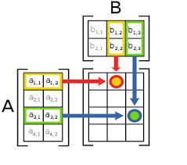
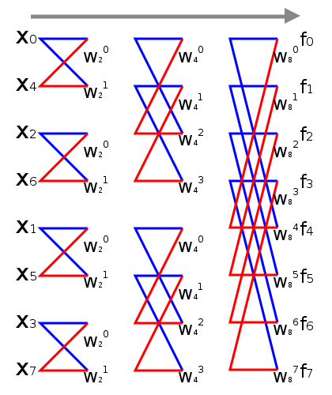
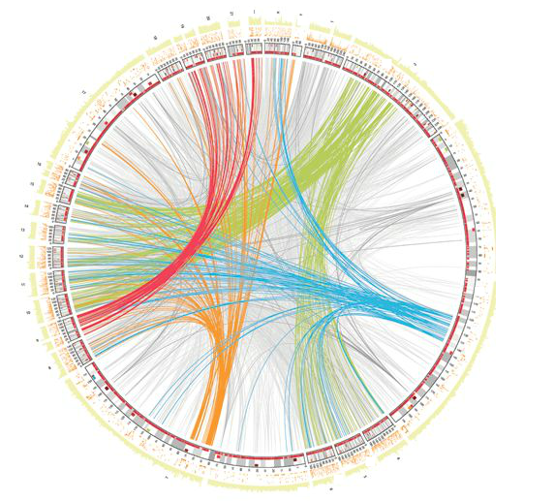
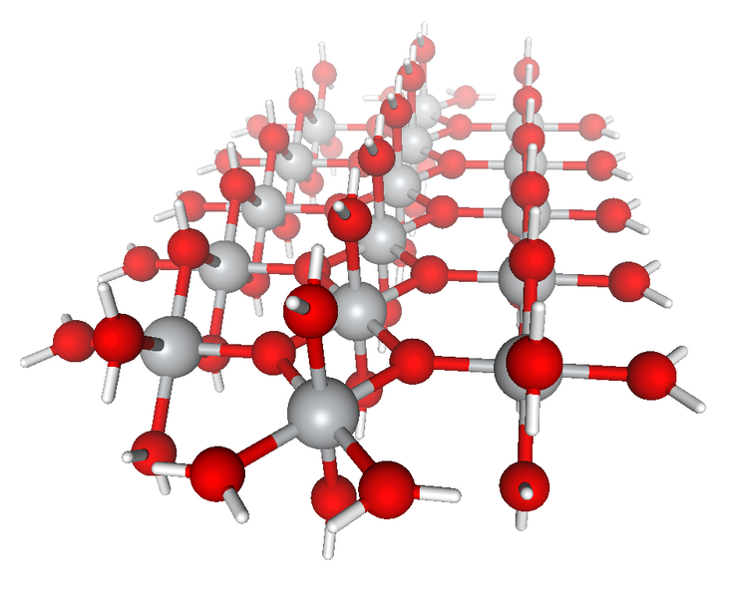
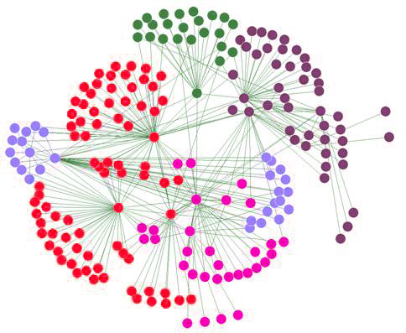
Irregular Applications
“Traditional” applications
Organized around regular data structures: dense vectors or matrices
Regular data movement pattern, use MPI SEND/RECV or collectives
Irregular applications
Organized around graphs, sparse vectors, more “data driven” in nature
Data movement pattern is irregular and data-dependent
Research goal
Answer the question: where MPI would lie on “the spectrum of suitability”?
Propose what if anything needs to change to efficiently support irregular applications
MPI?
completely suitable
not suitable at all
Notes:
Regular applications: matrix multiplication, FFT
Irregular applications: graph algorithm in social network analysis, genome assembly application in bioinformatics, computational chemistry application…
People rise the question that, if MPI would be suitable to irregular applications?
The research goal of this thesis work is that,

Slide 3
Main Concerns of MPI with Irregular Applications
Scalability
Can MPI runtime be scalable when running irregular application with large problem size and on large scale?
Performance of fine-grained operations
Can MPI runtime be lightweight enough to handle massive fine-grained data movements commonly used in irregular applications?
MPI communication semantics
Can MPI library absorb a mechanism of integrating data movement and computation?
data process
execution process
rank 0
rank 1
data and execution process
data
node 2
SEND
RECEIVE
RECEIVE
data
SEND
node 0
node 1
node 0
node 1
node 0
node 1
two-sided communication
integrating data and computation

Slide 4
Plan of Study
MPI runtime
MPI standard
Addressing scalability and performance limitations in massive asynchronous communication
Tackling scalability challenges in MPI runtime
Optimizing MPI runtime for fine-grained operations
Integrated data and computation management
Generalized MPI-interoperable Active Messages framework (MPI-AM)
Optimizing MPI-AM for different application scenarios
Asynchronous processing in MPI-AM
Scalable resource management
MPI-AM workflow
Scalable and sustainable resource supply
Tradeoff between scalability and performance
Support hardware-based RMA operations
Algorithmic choices for RMA synchronization
origin input buffer
origin output buffer
Correctness semantics
Streaming AMs
AM
input data
AM output data
private memory
private memory
Buffer management
Asynchronous processing
Compatible with MPI-3
target input buffer
target output buffer
AM handler
RMA window
target persistent buffer
mpich-3.1.3 ran out of
memory at small scale

Slide 5
Thanks!
[In process of PPOPP’16] Addressing Scalability Limitations in MPI RMA Infrastructure. Xin Zhao, Pavan Balaji, William Gropp
[SC’14] Nonblocking Epochs in MPI One-Sided Communication. Judicael Zounmevo, Xin Zhao, Pavan Balaji, William Gropp, Ahmad Afsahi. Best Paper Finalist
[EuroMPI’12] Adaptive Strategy for One-sided Communication in MPICH2. Xin Zhao, Gopalakrishnan Santhanaraman, William Gropp
[EuroMPI’11] Scalable Memory Use in MPI: A Case Study with MPICH2. David Goodell, William Gropp, Xin Zhao, Rajeev Thakur
[ICPADS’13] MPI-Interoperable Generalized Active Messages. Xin Zhao, Pavan Balaji, William Gropp, Rajeev Thakur
[ScalCom’13] Optimization Strategies for MPI-Interoperable Active Messages. Xin Zhao, Pavan Balaji, William Gropp, Rajeev Thakur. Best Paper Award
[CCGrid’13] Towards Asynchronous and MPI-Interoperable Active Messages. Xin Zhao, Darius Buntinas, Judicael Zounmevo, James Dinan, David Goodell, Pavan Balaji, Rajeev Thakur, Ahmad Afsahi, William Gropp

