Slide 1
Automatic Command Queue Scheduling for Task-Parallel Workloads in OpenCL
Ashwin M. Aji, Antonio J. Pena, Pavan Balaji and Wu-Chun Feng
Virginia Tech and Argonne National Lab.

Slide 2
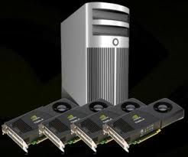


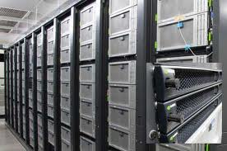
Accelerator Trends in HPC Systems
Top 32 “greenest” supercomputers use accelerators (June 2015)
Source(s): top500.org, green500.org
Notes:
It is important to understand how the accelerators, such as GPUs, inter-operate with CPUs in cluster environments. How easy is it to program them? What will be the performance?

Slide 3
Top500: Diversity Among Accelerators and Performance Shares
Source(s): top500.org

Slide 4
Challenge: Complex Node Architectures
CPUs + accelerator devices
E.g.: GPUs, MICs and FPGAs
Explicitly managed memory and compute cores
NUMA node topology
Varying types and degrees of parallelism
Accelerator
Device
Accelerator
Device
Accelerator
Device
CPU
CPU
NIC

Slide 5
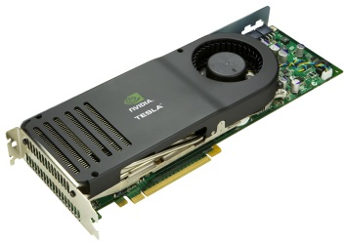
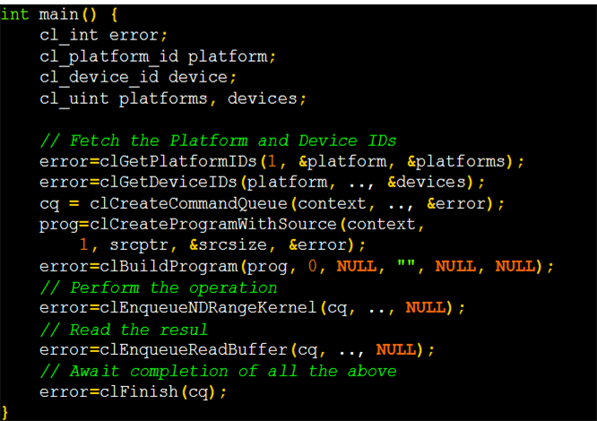
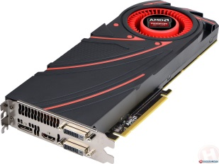
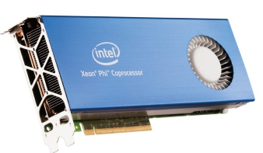
The OpenCL Programming Model
A unified programming model for “all” accelerators
CPUs, GPUs, FPGAs, DSPs
Challenge: task-device mapping
?
CPU
OpenCL Program

Slide 6
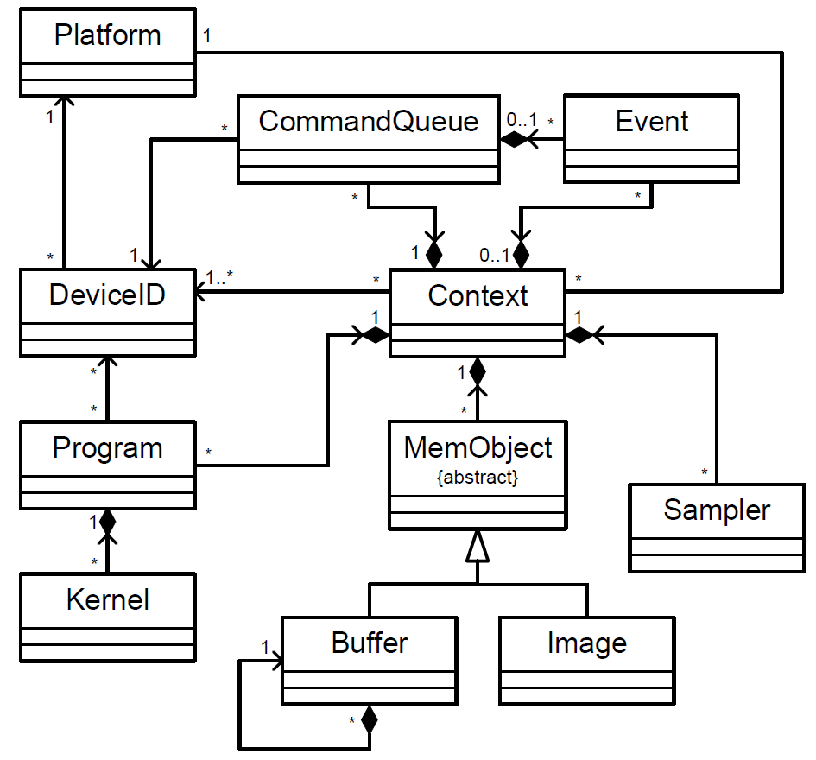
OpenCL Class Diagram
Source(s): OpenCL 1.2 Specification

Slide 7
OpenCL Issue: Queue-Device Binding
/* Program beginning */
command_queue_1 = clCreateCommandQueue(context, dev?,...);
command_queue_2 = clCreateCommandQueue(context, dev?,...);
...
/* Rest of the program */
...
/* Kernel Launch */
clEnqueueNDRangeKernel(command_queue_1, kernel_r1, ...);
clEnqueueNDRangeKernel(command_queue_2, kernel_r2, ...);
CPU

Slide 8

OpenCL Queue-Device Binding
OpenCL Command Queues
?
CPU

Slide 9
Our Contributions
We propose simple OpenCL API extensions to decouple queues and devices
We design an example runtime system that automatically schedules queues across devices
We call it MultiCL
We evaluate our programming model and runtime on
SNU-NPB OpenCL benchmarks
A seismology simulation application

Slide 10
Goal
Command Queue
Scheduler
OpenCL Command Queues
CPU

Slide 11
Goals of a Command Queue Scheduling System
Programmability
Familiar programming interface (OpenCL)
Automatic scheduler options for beginner/intermediate users
Explicit queue-device binding for advanced users
Performance
Dynamic workload characterization and accelerator mapping
Fast and accurate

Slide 12
OpenCL API Extensions for Task Scheduling
Hierarchical Scheduling at Context and Command Queue
Source(s): OpenCL 1.2 Specification

Slide 13
OpenCL API Extensions for Task Scheduling
clGetDeviceIDs(_platform, DEV_TYPE, num_devices, _devices, NULL);
cl_context_properties props[5] = {
CL_CONTEXT_PLATFORM,
(cl_context_properties) _platform,
CL_CONTEXT_SCHEDULER,
CL_CONTEXT_SCHED_AUTO_FIT,
0};
_context = clCreateContext(props, num_devices, _devices, ...);
_command_queue = clCreateCommandQueue(_context,
_devices[0],
CL_QUEUE_SCHED_AUTO |
CL_QUEUE_SCHED_ITERATIVE |
CL_QUEUE_SCHED_COMPUTE_BOUND |
CL_QUEUE_PROFILING_ENABLE, NULL);
clEnqueueWriteBuffer(_command_queue, ...);
clEnqueueNDRangeKernel(_command_queue, _kernel, ...);
Global Scheduler Type
Local Scheduling Choice
Local Scheduling Hints

Slide 14
OpenCL API Extensions for Task Scheduling
Queues
CL_QUEUE_SCHED_AUTO
CL_QUEUE_SCHED_OFF
AUTO_FIT Scheduler
?
?
Static Mapping
D₀
D₁
D₂
…
D_{n}
Device Pool
D₀
D₁
D₂
…
D_{n}

Slide 15
New API: clSetCommandQueueSchedProperty
Explicit scheduling regions
Scheduling type may change depending on workload type for that region
clSetCommandQueueSchedProperty(_queue,
CL_QUEUE_SCHED_AUTO |
CL_QUEUE_SCHED_ITERATIVE);
// program code...
clEnqueueWriteBuffer(...);
clEnqueueNDRangeKernel(...);
clEnqueueNDRangeKernel(...);
clEnqueueNDRangeKernel(...);
clEnqueueReadBuffer(...);
clSetCommandQueueSchedProperty(_queue,
CL_QUEUE_SCHED_OFF);

Slide 16
Kernel Launch API
cl_int clEnqueueNDRangeKernel(cl_command_queue queue,
cl_kernel kernel,
cl_uint work_dim,
const size_t *global_work_offset,
const size_t *global_work_size,
const size_t *local_work_size,
cl_uint num_events_in_wait_list,
const cl_event *event_wait_list,
cl_event *event)
We just decoupled queue and device
Optimal work size may differ for different architectures
Some work sizes may not even work for certain devices
Need to decouple work size assignment from the command queue
Our approach: new per-device work size assignment

Slide 17
New API: clSetKernelWorkGroupInfo
GPU 1
cl_int clSetKernelWorkGroupInfo( cl_kernel kernel,
cl_device_id *devices,
cl_uint num_devices,
cl_uint work_dim,
const size_t *global_work_offset,
const size_t *global_work_size,
const size_t *local_work_size)
cl_int clEnqueueNDRangeKernel(cl_command_queue queue,
cl_kernel kernel,
cl_uint work_dim,
const size_t *global_work_offset,
const size_t *global_work_size,
const size_t *local_work_size,
cl_uint num_events_in_wait_list,
const cl_event *event_wait_list,
cl_event *event)
GPU 1
GPU 1
Kernel
GPU 1
clSetKernelWorkGroupInfo
GPU 1
GPU 2
GPU 1
CPU
Params. may be ignored by the runtime

Slide 18
CL Function | Parameter Names
clCreateContext | CL_CONTEXT_SCHEDULER
clCreateCommandQueue | CL_QUEUE_SCHED_OFF CL_QUEUE_SCHED_AUTO CL_QUEUE_SCHED_KERNEL_EPOCH CL_QUEUE_SCHED_EXPLICIT_REGION CL_QUEUE_SCHED_ITERATIVE CL_QUEUE_SCHED_COMPUTE_BOUND CL_QUEUE_SCHED_IO_BOUND CL_QUEUE_SCHED_MEMORY_BOUND
clSetCommandQueueSchedProperty
clSetKernelWorkGroupInfo | N/A

Slide 19
Another Approach
Kernel Splitter
OpenCL Command Queue

Slide 20
Coarse-grained Scheduling
Command Queue
Scheduler
Fine-grained Scheduling
Kernel Splitter

Slide 21
Related Work for Task Scheduling
Intra-Application Scheduling | Data/Loop Level Parallelism (Fine Grained Scheduling) | OpenMP-like: CoreTSAR [IPDPS12], Kaleem[PACT14], OmpSs [IPDPS12] Custom API: Qilin [MICRO09] OpenCL-based: FluidiCL [CGO14], Kim [PPoPP11], de la Lama [ISPA12], Maestro [EuroPar10]
 | Task/Kernel Level Parallelism (Coarse Grained Scheduling) | MultiCL (This Talk), StarPU [JCC11] (SOCL[EuroPar14])
Inter-Application Scheduling | Wen[HiPC14], Ravi [HPDC13,FGCS13], VOCL [InPar12, CCGrid12], rCUDA [HiPC12]

Slide 22
Related Work: SOCL (with StarPU)
Our Approach
SOCL (with StarPU)
Scheduling at synchronization epoch granularity
Auto-scheduling can be controlled for portions of the queue’s lifetime
Kernels are tasks
Work sizes decoupled from the launch function
Scheduling at kernel granularity
Auto-scheduling for entire lifetime of the queue
Optionally uses “divide functions” to create tasks
Work sizes cannot be changed

Slide 23
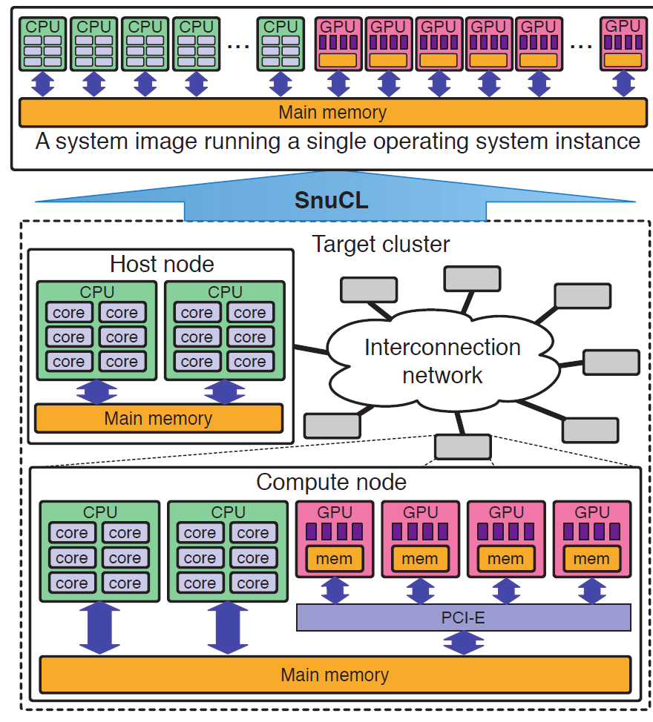
Implementation of Runtime using SnuCL
SnuCL aggregates multiple vendor platforms within a node
“SnuCL: an OpenCL framework for heterogeneous CPU/GPU clusters.” Jungwon Kim et.al., 26th ACM international conference on Supercomputing (ICS '12).

Slide 24
Implementation of Runtime using SnuCL
SnuCL aggregates multiple vendor platforms within a node
Data sharing
Synchronization
SnuCL is a super-platform on top of existing OpenCL platforms
SnuCL extensions → MultiCL
Programming model extensions for scheduler options and per-device work size assignment
Scheduler addition to map command queues to devices

Slide 25
Runtime Modules in MultiCL
Device profiler
Command queue/kernel profiler
Queue-Device mapper
clGetPlatformIds
Device profiling (static)
clCreateProgramWithSource
clBuildProgram
Kernel profiling (static)
Synchronization Epoch
(clEnqueue*)*
Kernel profiling (dynamic)
clWaitForEvents/clFinish
Device mapping(dynamic)
End of Program

Slide 26
Command Queue Profiling Optimizations
Kernel Profile Caching
Reuse kernel runtime estimates
Best for iterative workloads
Tunable profiling frequency
Data caching
Cache buffers after profiling
Avoids D2D data movement if target device changes
Best for I/O intensive workloads
Mini-kernel Profiling
Transform kernel source to run just a single workgroup
Best for compute-intensive and non-iterative workloads
clCreateCommandQueue(context, dev,
CL_QUEUE_SCHED_AUTO |
CL_QUEUE_SCHED_ITERATIVE, ...);
clCreateCommandQueue(context, dev,
CL_QUEUE_SCHED_AUTO |
CL_QUEUE_SCHED_IO_BOUND, ...);
clCreateCommandQueue(context, dev,
CL_QUEUE_SCHED_AUTO |
CL_QUEUE_SCHED_COMPUTE_BOUND, ...);

Slide 27
Mini-kernel Transformation
// Actual kernel code
__kernel void foo (...) {
/* kernel code */
}
// Mini - kernel code for profiling only
__kernel void foo (...) {
/* return if this is not first workgroup */
if( get_group_id(0)+get_group_id(1)+get_group_id(2)!=0) return ;
/* kernel code */
}
clCreateCommandQueue(context, dev,
CL_QUEUE_SCHED_AUTO |
CL_QUEUE_SCHED_COMPUTE_BOUND, ...);

Slide 28
Runtime Modules in MultiCL
Device profiler
H2D, D2D, D2H benchmarks store all-to-all device distances
Compute capabilities stored from H/W specifications
Command queue/kernel profiler
Dynamic profiling by running workloads on actual devices
Optimizations to reduce runtime overhead
Queue-Device mapper policies
Greedy
Dynamic Programming

Slide 29
Evaluation
Experimental Platform
Dual-socket Oct-core AMD Opteron 6134 CPU
AMD OpenCL v1.2
AMD APP SDK 2.9
Two NVIDIA Tesla C2050 GPUs
NVIDIA OpenCL v1.1
CUDA toolkit v5.0 and driver v313
SnuCL aggregates above platforms to 3 devices
FDM-Seismology Simulation
SNU-NPB Benchmarks
Accelerator
Device (G0)
Accelerator
Device (G1)
CPU
Device (C)
CPU
CPU
NIC

Slide 30
FDM-Seismology
Models the propagation of seismological waves using the finite difference method
Iterative OpenCL kernels to compute velocity and stress
7 kernels for velocity
25 kernels for stress

Slide 31
FDM-Seismology
GPU
CPU
Net I/O
gpuMemcpy
Velocity Kernels
gpuMemcpy
Data
Marshaling
MPI
gpuMemcpy
Stress Kernels
gpuMemcpy
Data
Marshaling
MPI
Write Results

Slide 32
FDM-Seismology
Models the propagation of seismological waves using the finite difference method
Iterative OpenCL kernels to compute velocity and stress
7 kernels for velocity
25 kernels for stress
Kernels divided into two independent regions → two independent command queues
Data structure representations
Column major
Row major

Slide 33
GPU
CPU
Net I/O
gpuMemcpy
Velocity Kernels
R1
R2
gpuMemcpy
Data
Marshaling
MPI
gpuMemcpy
Stress Kernels
R1
R2
gpuMemcpy
Data
Marshaling
MPI
Write Results

Slide 34
// Initialize the context
cl_context_properties prop[]={...,CL_CONTEXT_SCHEDULER,CL_CONTEXT_SCHED_AUTO_FIT,0};
context = clCreateContext(prop, ...);
// Initialize all command queues
cl_command_queue q1, q2;
cl_event event;
q1 = clCreateCommandQueue(context, dev,
CL_QUEUE_AUTO | CL_QUEUE_SCHED_ITERATIVE
...);
// Main application loop
for (...) {
// Velocity Computations
compute_velocity_region_1(q1);
compute_velocity_region_2(q2);
sync(q1); sync(q2);
copy_to_host();
marshal_velocity_data();
// MPI Communication
MPI_Isend(buf, type, neighbor, ...);
MPI_Irecv(buf, type, neighbor, ...);
MPI_Waitall(...);
q2 = clCreateCommandQueue(context, dev,
CL_QUEUE_AUTO | CL_QUEUE_SCHED_ITERATIVE
...);
// Stress Computations
compute_stress_region_1(q1);
compute_stress_region_2(q2);
sync(q1); sync(q2);
copy_to_host();
marshal_stress_data();
// MPI Communication
MPI_Isend(buf, type, neighbor, ...);
MPI_Irecv(buf, type, neighbor, ...);
MPI_Waitall(...);
}

Slide 35
FDM-Seismology Performance

Slide 36
FDM-Seismology Iteration Details

Slide 37
FDM-Seismology Kernel Distribution

Slide 38
SNU-NPB Benchmarks for Multiple OpenCL Devices
Benchmark | Classes | Cmd. Queues | Scheduler Options
BT | S,W,A,B | Square: 1,4 | CL_SCHED_EXPLICIT_REGION, clSetKernelWorkGroupInfo
CG | S,W,A,B,C | Power of 2: 1,2,4 | CL_SCHED_EXPLICIT_REGION
EP | S,W,A,B,C,D | Any: 1,2,4 | CL_SCHED_KERNEL_EPOCH, CL_SCHED_COMPUTE_BOUND
FT | S,W,A | Power of 2: 1,2,4 | CL_SCHED_EXPLICIT_REGION, clSetKernelWorkGroupInfo
MG | S,W,A,B | Power of 2: 1,2,4 | CL_SCHED_EXPLICIT_REGION
SP | S,W,A,B,C | Square: 1,4 | CL_SCHED_EXPLICIT_REGION

Slide 39
SNU-NPB Relative Performances (Single Command Queue)

Slide 40
SNU-NPB Kernel-Device Distribution (Command Queue Count = 4)

Slide 41
SNU-NPB (Command Queue Count = 4)
Geometric Mean of Profiling Overhead = 10.1%

Slide 42
Profiling Overhead in FT
Data transfer overhead only once per device
Amortized over command queues

Slide 43
Effect of Data Caching

Slide 44
Mini-kernel Profiling Impact with EP
Mini-kernel profiling overhead is a constant

Slide 45
Conclusions
We decouple queues and devices in OpenCL to enable automatic scheduling
Custom flags to context and command queue
New API for device-specific work size assignment
New API for explicit scheduler regions
Extremely minimal changes to existing OpenCL codes
We designed an example fast and accurate runtime system for command queue scheduling
Different runtime modules and optimizations
Evaluation
FDM-Seismology
SNU-NPB
Questions?
Ashwin Aji (aaji@cs.vt.edu)
Pavan Balaji (balaji@mcs.anl.gov)

Slide 46
Future Work
Device Queues
If devices enqueue themselves, then the nested kernel tree can be treated as a single large kernel from the perspective of our profiler
Shared Virtual Memory (SVM)
Create device profiles based on peer-to-peer costs as well as SVM costs

