Slide 1


Exploring the Suitability of Remote GPGPU Virtualization
for the OpenACC Programming Model Using rCUDA
Adrián Castelló, Antonio J. Peña, Rafael Mayo, Pavan Balaji and Enrique S. Quintana-Ortí
Cluster 2015, September 9th – Chicago, USA

Slide 2
Exploring the Suitability of Remote GPGPU Virtualization
for the OpenACC Programming Model Using rCUDA
Adrián Castelló, Antonio J. Peña, Rafael Mayo, Pavan Balaji and Enrique S. Quintana-Ortí
Cluster 2015, September 9th – Chicago, USA

Slide 3


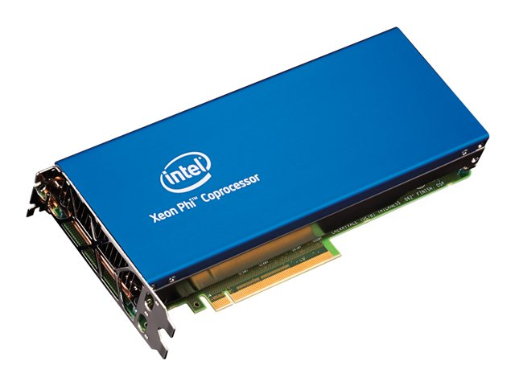
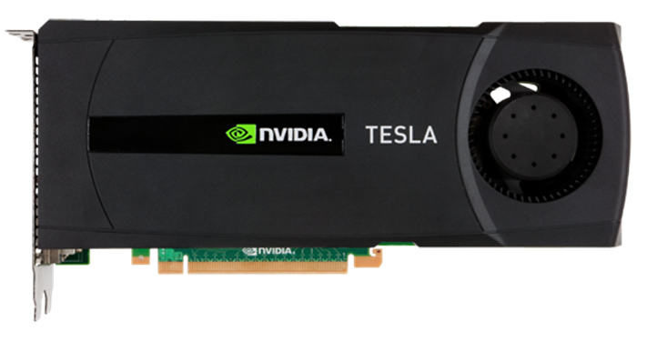


Slide 4
GPU computing: Why?
Moderate Price
High performance
Favorable throughput-per-Watt
Powerful and simple APIs
CUDA
OpenCL

Slide 5
From the programming point of view:
- A collection of nodes, each with:
- one or more CPUs (with several cores per CPU)
- one or more GPUs (1-4)
- An interconnection network
GPU
GPU
GPU
GPU
GPU
GPU
GPU
mem
GPU
mem
GPU
mem
GPU
mem
GPU
mem
GPU
mem
GPU
GPU
GPU
GPU
GPU
GPU
GPU
mem
GPU
mem
GPU
mem
GPU
mem
GPU
mem
GPU
mem
PCI-e
PCI-e
PCI-e
PCI-e
PCI-e
PCI-e
CPU
Main Memory
CPU
Main Memory
CPU
Main Memory
CPU
Main Memory
CPU
Main Memory
CPU
Main Memory
Network
Network
Network
Network
Network
Network
Interconnection Network

Slide 6
Physical configuration
GPU
GPU
GPU
GPU
mem
GPU
mem
GPU
mem
GPU
GPU
GPU
GPU
mem
GPU
mem
GPU
mem
PCI-e
PCI-e
PCI-e
CPU
Main Memory
CPU
Main Memory
CPU
Main Memory
CPU
Main Memory
CPU
Main Memory
CPU
Main Memory
PCI-e
PCI-e
PCI-e
Network
Network
Network
Network
Network
Network
Interconnection Network

Slide 7
Physical configuration
GPU
GPU
GPU
GPU
mem
GPU
mem
GPU
mem
GPU
GPU
GPU
GPU
mem
GPU
mem
GPU
mem
PCI-e
PCI-e
PCI-e
CPU
Main Memory
CPU
Main Memory
CPU
Main Memory
CPU
Main Memory
CPU
Main Memory
CPU
Main Memory
PCI-e
PCI-e
PCI-e
Network
Network
Network
Network
Network
Network
Interconnection Network
GPU
GPU
GPU
GPU
mem
GPU
mem
GPU
mem
Logical configuration
GPU
GPU
GPU
GPU
mem
GPU
mem
GPU
mem
CPU
Main Memory
CPU
Main Memory
CPU
Main Memory
CPU
Main Memory
CPU
Main Memory
CPU
Main Memory
PCI-e
PCI-e
PCI-e
PCI-e
PCI-e
PCI-e
Network
Network
Network
Network
Network
Network
Interconnection Network

Slide 8
Remote GPU virtualization
All cluster nodes can use all the GPUs
A single node can use more GPUs than it has installed
A GPU can be shared between nodes
GPU
GPU
GPU
GPU
mem
GPU
mem
GPU
mem
GPU
GPU
GPU
GPU
mem
GPU
mem
GPU
mem
CPU
Main Memory
CPU
Main Memory
CPU
Main Memory
CPU
Main Memory
CPU
Main Memory
CPU
Main Memory
PCI-e
PCI-e
PCI-e
PCI-e
PCI-e
PCI-e
Network
Network
Network
Network
Network
Network
Interconnection Network

Slide 9

Grant a CUDA-based application running in one node access
GPUs in other nodes
Moderate level of data parallelism
Applications for multi GPU computing
Compatible with CUDA

Slide 10
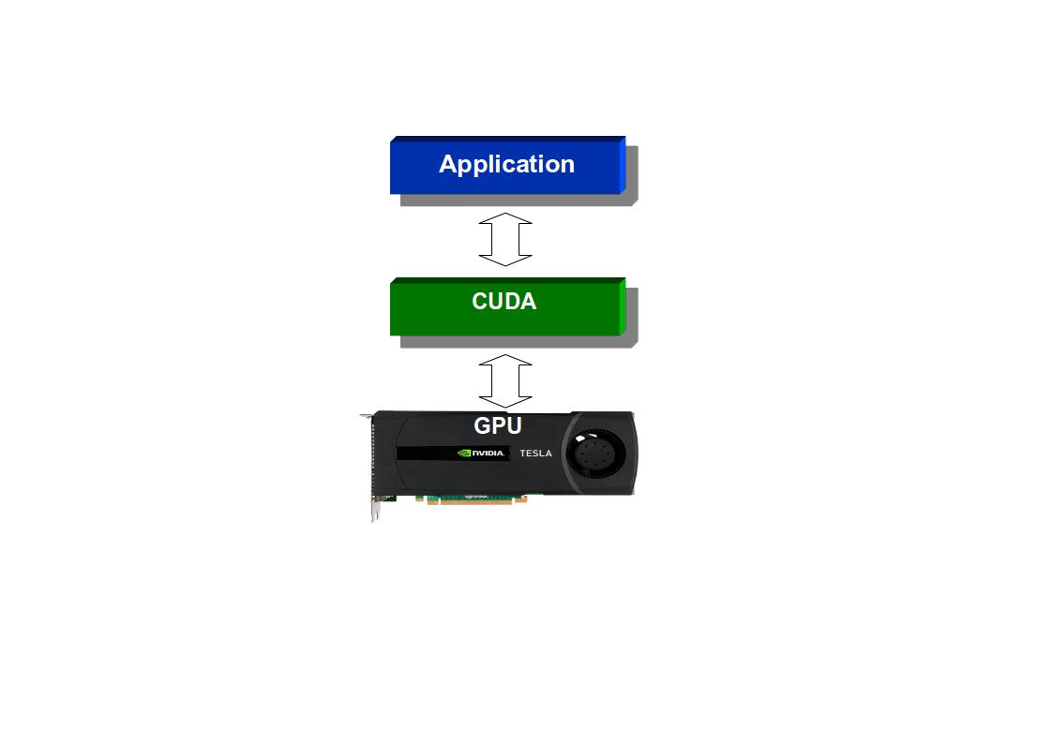

Slide 11
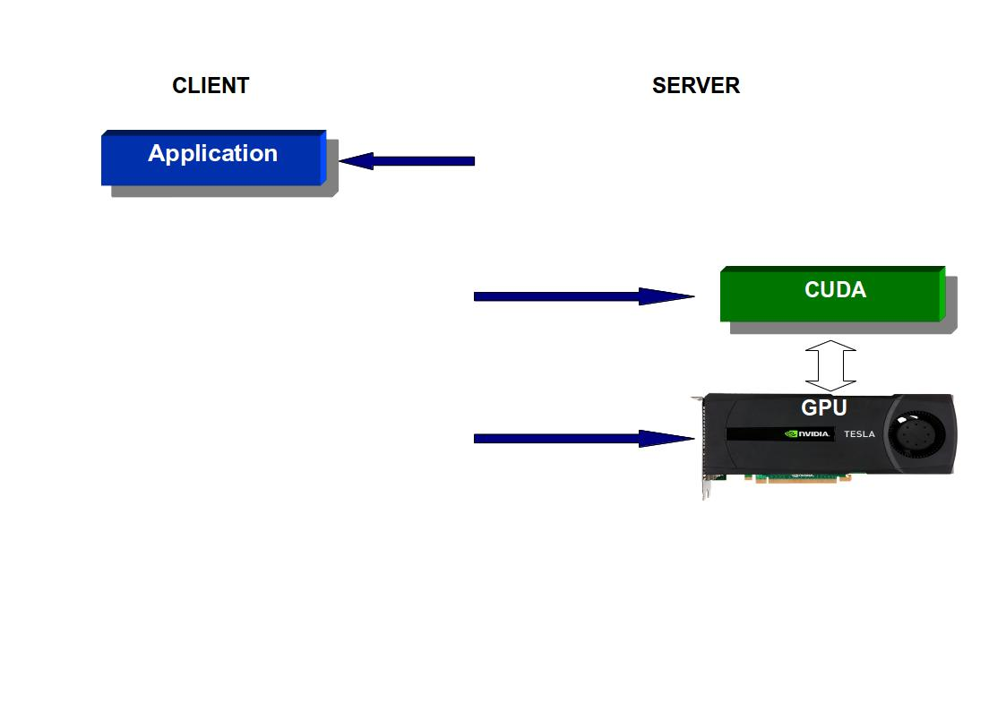

Slide 12
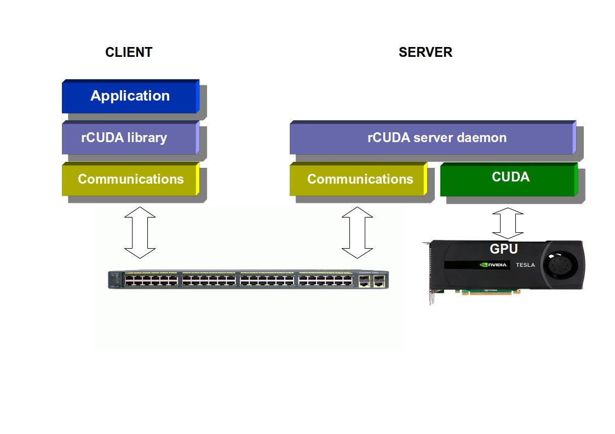

Slide 13
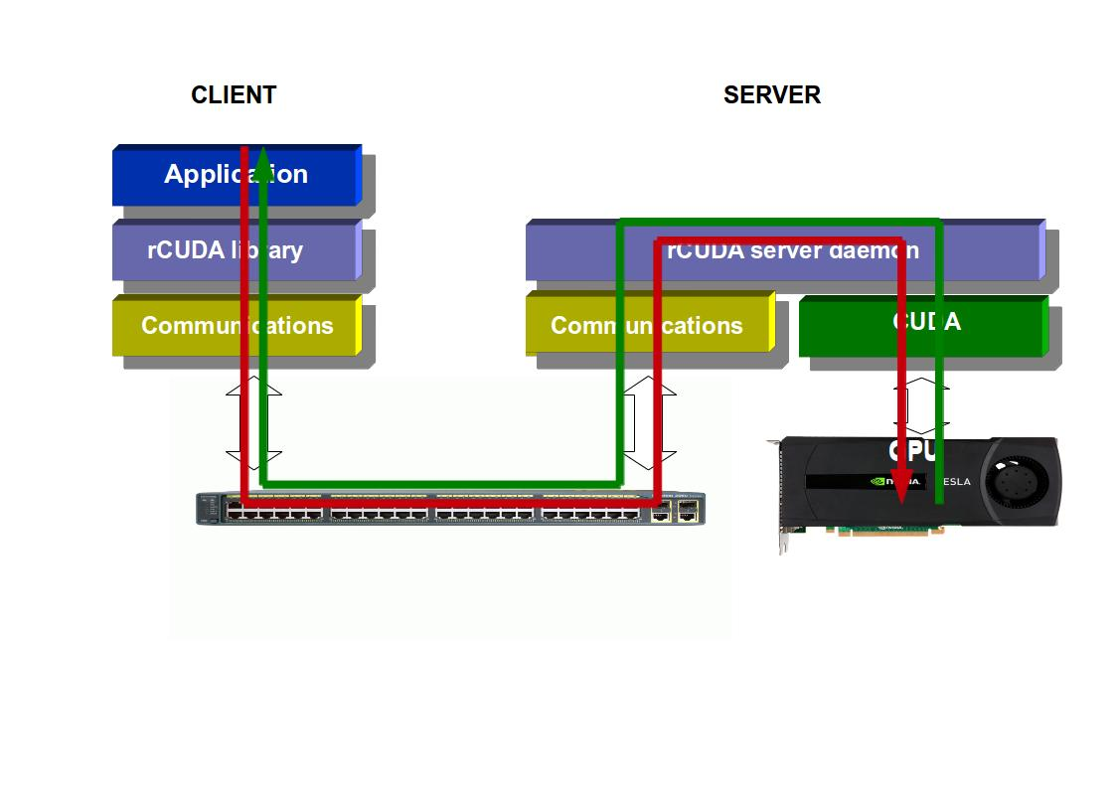

Slide 14
OpenACC programming model
High level GPU programming model
Developed by PGI, NVIDIA and Cray,
Based on compiler directives
OpenACC 2.0

Slide 15

OpenACC programming model
High level GPU programming model
Developed by PGI, NVIDIA and Cray,
Based on compiler directives
OpenACC 2.0
+

Slide 16
Integration
Compilation:
Compilation using keepptx flag is needed
Low-level source code
Compiled just in time in the GPGPU server
Implementation:
cuModuleLoadData
cuModuleGetFunction
Improvement:
cuModuleLoadData loads all the ptx files instead one by one and
stores the data in contiguous memory addresses
cuModuleGetFunction iterates over these memory addresses

Slide 17
Hardware
Tintorrum: 2-node system
2 x Intel Xeon E5520 (quad-core) at 2.27 GHz
24 GB of DDR3-1866 RAM memory.
NVIDIA C2050 GPUs.
Inter- node communications employ an InfiniBand (IB) QDR fabric.
Argonne: 2-node system
2 x Intel Xeon E52687W v2 (8 cores) at 3.4 GHz
64 GB od DDR3-1866 RAM
NVIDIA Tesla K40m GPU
Infniband FDR cluster network
Software
Own microbenchmarks
rCUDA 5.0
PGI 14.9

Slide 18
Scenarios
cudaMemcpyHostToDevice()
CPU
#pragma acc data copyin

Slide 19
Scenarios
Kernel<<<grid,block>>>()
CPU
#pragma acc (kernels|parallel) loop

Slide 20
Scenarios
cudaMemcpyDeviceToHost()
CPU
#pragma acc data copyout

Slide 21
OpenACC double buffer
Buffers
MAIN MEMORY
GPU MEMORY
16MB pinned memory by default

Slide 22
OpenACC double buffer
Buffers
MAIN MEMORY
GPU MEMORY
16MB pinned memory by default

Slide 23
OpenACC double buffer
Buffers
MAIN MEMORY
GPU MEMORY
16MB pinned memory by default

Slide 24
OpenACC double buffer
Buffers
MAIN MEMORY
GPU MEMORY
16MB pinned memory by default
Pinned memory performs better than pageable one!!

Slide 25
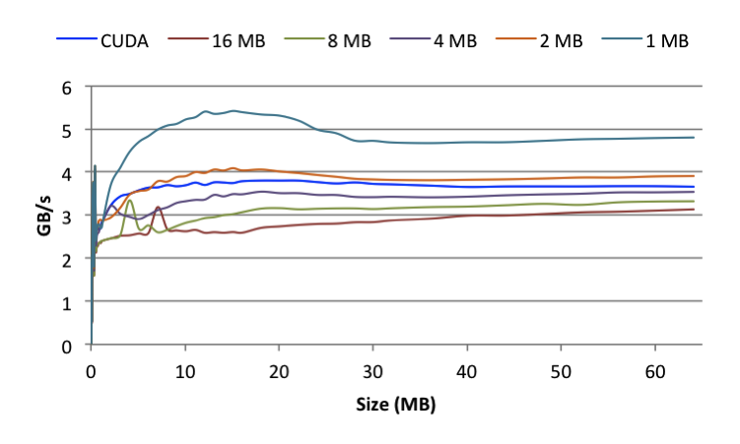
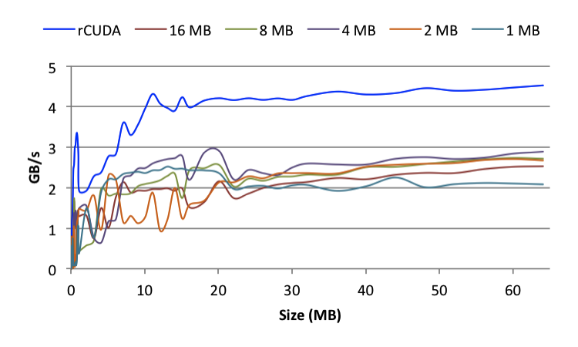
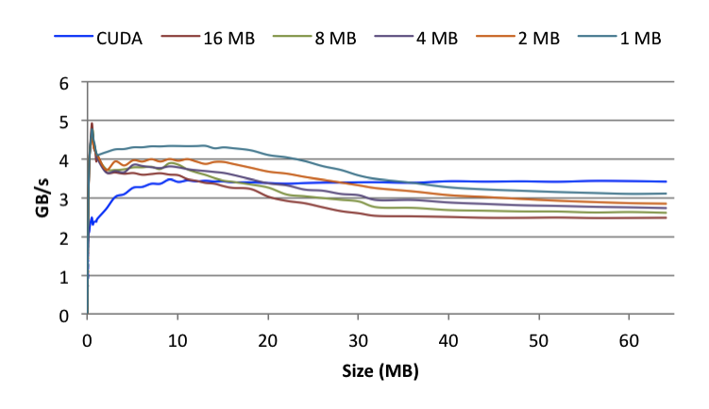
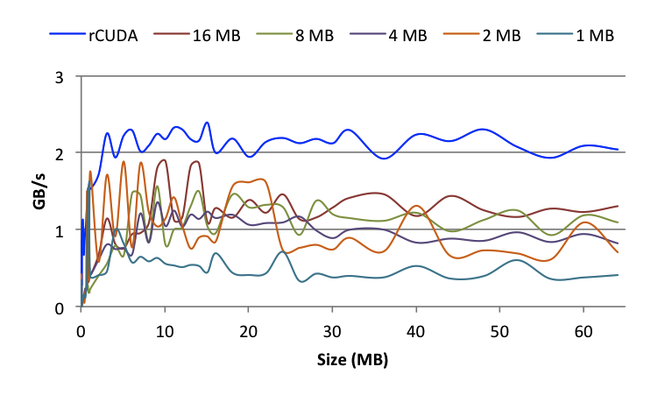
Data transfers (K40 + IB FDR)
OpenACC+CUDA
OpenACC+rCUDA
Host to Device
Device to Host

Slide 26
Data transfers (K40 + IB FDR)
OpenACC+CUDA
OpenACC+rCUDA
Host to Device
Device to Host

Slide 27
Data transfers (K40 + IB FDR)
OpenACC+CUDA
OpenACC+rCUDA
Host to Device
Device to Host

Slide 28
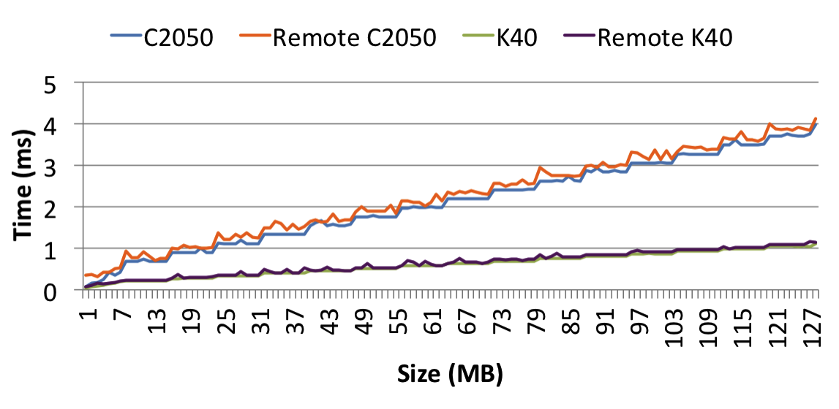
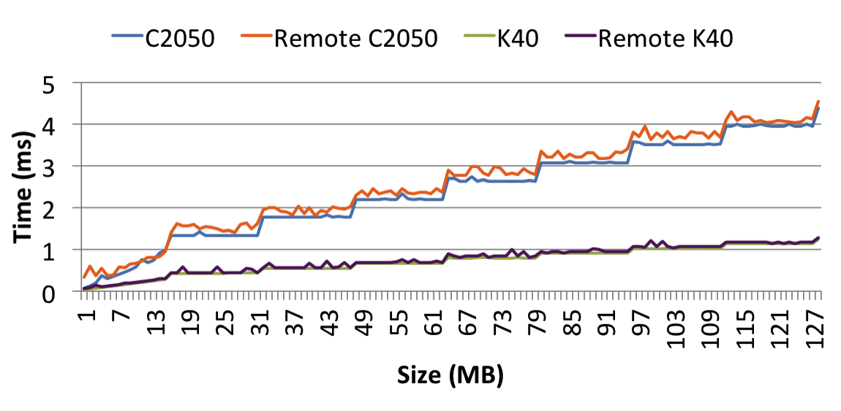
Kernel execution
Kernel directive
#pragma acc (kernels|parallel) loop
for (i=0;i<N;i++){
a[i]=a[i]*value;
}
Parallel directive

Slide 29
Kernel execution
Kernel directive
#pragma acc (kernels|parallel) loop
for (i=0;i<N;i++){
a[i]=a[i]*value;
}
128 threads per block
Parallel directive
256 threads per block

Slide 30
Conclusions
A high level GPU programming model on top of a GPU
virtualization framework is possible
New features have been added to rCUDA
First results of performance are promising

Slide 31
Conclusions
A high level GPU programming model on top of a GPU
virtualization framework is possible
New features have been added to rCUDA
First results of performance are promising
Future work
Extend this study with more completed OpenACC benchmarks
Analyze results using single and multi GPU applications

Slide 32
Q&A

