Slide 1
MPI+ULT: Overlapping Communication and Computation with User-Level Threads
Huiwei Lu, Sangmin Seo, Pavan Balaji
Mathematics and Computer Science Division
Argonne National Laboratory
Aug 25, 2015
huiweilu@anl.gov, sseo@anl.gov, balaji@anl.gov
17th IEEE International Conference on High Performance Computing and Communications (HPCC 2015)

Slide 2
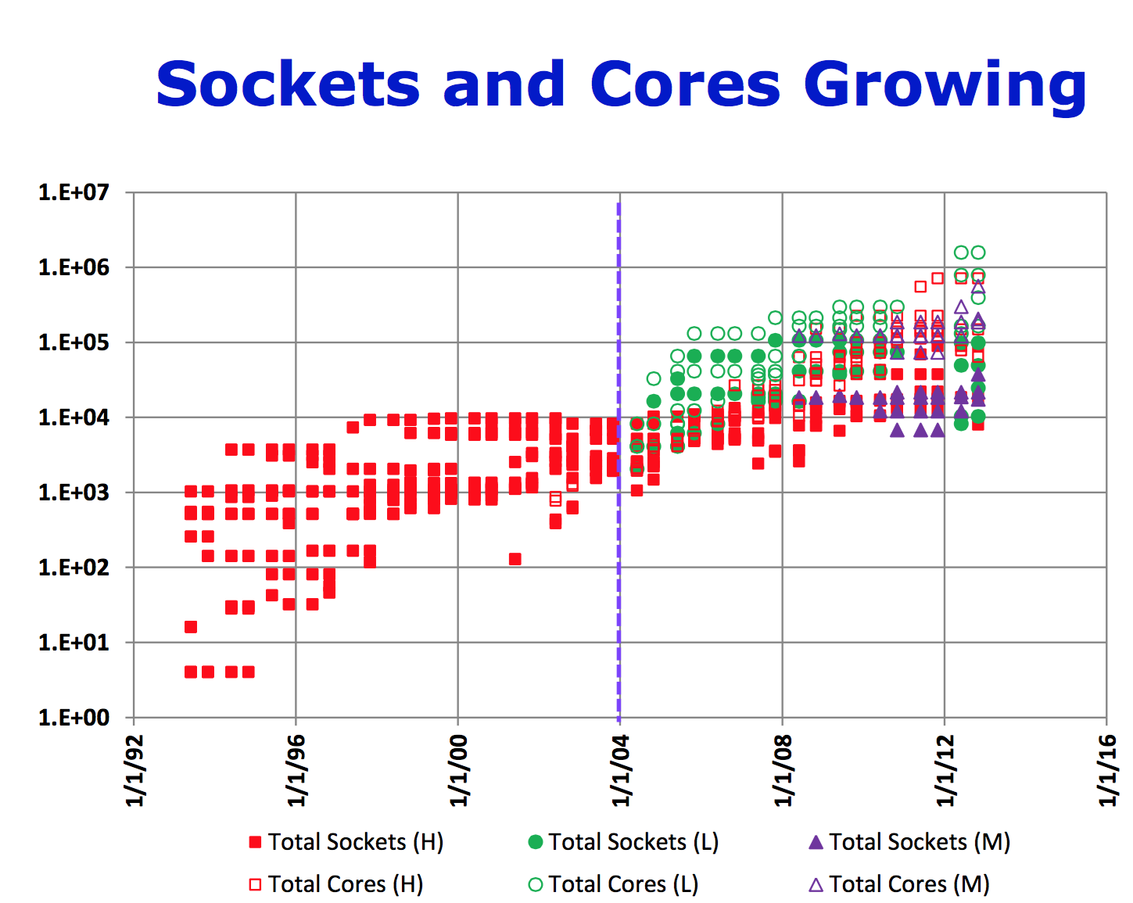
Hardware Trends in Supercomputing
Exponentially increasing core number on a single CPU chip
Intel® Knights Landing: > 60 cores
#Network ports / #Cores decreases exponentially
Latency lags bandwidth
Limited latency improvement during the past decades
Need latency hiding for extreme-scale computing
Fig. Total Number of socket and cores in the TOP500 [Kogge 13]
[Kogge 13] Peter Kogge. Reading the Tea-Leaves: How Architecture Will Evolve. Thirty Years of Parallel Computing at Argonne: A Symposium, May 14, 2013

Slide 3
Software Trends in Supercomputing
MPI+X becomes a promising programming model
X: Pthreads, OpenMP, TBB, MPI shared memory…
Better memory sharing within the node
Better parallelism within the node
However, most “X” only considers intra-node optimization
Need another “X” for optimizing inter-node communication

Slide 4
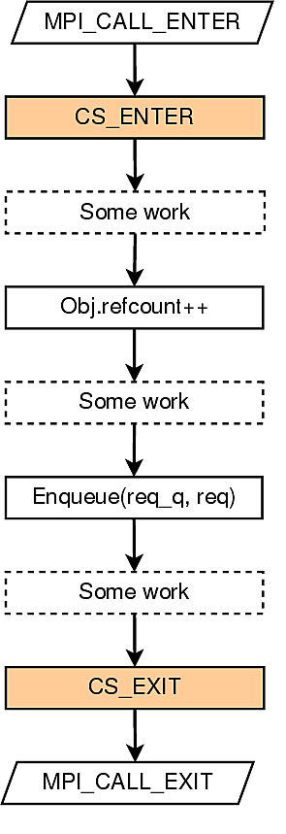
Latency Hiding in MPI with Existing Methods
MPI Nonblocking functions
Low overhead
Overlap each function one at a time
Provide for nonblocking pt2pt functions and collectives, but does not support some MPI one-sided functions like MPI_Win_Flush
MPI+Threads using Pthreads or OpenMP
Modulized, able to overlap several blocking communication functions at the same time
High thread overhead from the locks [Amer 15]
Need lightweight thread mechanism for latency hiding!
Fig. Global lock to support thread safety in MPI [Amer 15]
[Amer 15] Abdelhalim Amer, Huiwei Lu, Yanjie Wei, Pavan Balaji, Satoshi Matsuoka. MPI+Threads: Runtime Contention and Remedies. PPoPP’15

Slide 5
Outline
Introduction and Motivation
MPI+ULT Design and Implementation
Micro-Benchmarks
Applications
Conclusion

Slide 6
User-level Thread (ULT)
What is User-level Thread (ULT)
Provides thread semantics in user space.
Execution model: cooperative timesharing
More than one ULT can be mapped to a single kernel thread
ULTs on the same OS thread do not execute concurrently
Can be implemented with coroutines
enable explicit suspend and resume of its progress by preserving execution state
some languages such as Python and Go use coroutines for asynchrnous I/O
Why ULT?
Kernel threads (e.g., pthreads) are too expensive for computation/communication overlap
Where to use?
To better overlap computation and communication/IO
ULT₁
Context switch
ULT₂
Context switch
timeline

Slide 7
Providing communication/computation overlap w/ ULT
Lightweight
ULT does not execute concurrently using additional hardware resource, but takes turn to run by context switching
No lock needed between two ULTs in the same kernel thread
Asynchronous
Helps turn a MPI blocking call to a nonblocking one
Decouples the operation of “send start” and “send complete”
Modularized
Provide thread abstraction
ULT₁ do computation, start a
MPI send
ULT₁
Context switch to ULT₂, ULT₁ communication
in background
ULT₂
Context switch back to ULT₁, ULT₂ communicate in background
timeline
CPU
NIC

Slide 8
Proposing a new thread level: MPI_THREAD_ULT
The current MPI standard support 4 thread levels
MPI_THREAD_SINGLE: only one thread will execute
MPI_THREAD_FUNNELED: multithreaded, only the main thread will make MPI calls
MPI_THREAD_SERIALIZED: multithreaded, multiple threads may make MPI calls one at a time
MPI_THREAD_MULTIPLE: multiple threads may call MPI with no restrictions
Proposing MPI_THREAD_ULT:
Only one kernel thread will execute but multiple ULTs may call MPI functions with no restrictions.
vs. MPI_THREAD_SERIALIZED: can overlap different MPI calls
vs. MPI_THREAD_MULTIPLE: only one kernel thread allowed in MPI_THREAD_ULT

Slide 9
Timeline of MPI_Send with ULT-aware MPI runtime
User Code
Runtime
User Code
Runtime
MPI_Send
ULT₁ MPI_Send
starts send request
ULT₁ starts send request
ULT₁ polls the progress engine
Time
polls the progress engine
ULT₁ context switch
polling time
ULT₂ computation
No
utilizing polling time
w/ ULT
request finished?
ULT₂ context switch
Yes
ULT₁ polls the progress engine
finishes send request
ULT₁ finishes send request
finishes MPI_Send
ULT₁ finishes MPI_Send
MPI Blocking Send
ULT-aware MPI runtime

Slide 10
Outline
Introduction and Motivation
MPI+ULT Design and Implementation
Micro-Benchmarks
Applications
Conclusion

Slide 11
Experiment Setup
Intel x86_64 cluster named “Blues” at ANL
each node has two Intel Sandy Bridge Pentium Xeon processor
each node has 64 GB RAM
310 nodes connected with QLogic inter-connect
MPICH 3.1.3 compiled with GCC 4.7.2
ULT library uses Qthreads (developed at Sandia National Laboratory)

Slide 12
Overhead of Kernel Threads vs. ULT in MPI
Measuring the aggregate message rate of MPI_Send with destination MPI_PROC_NULL
The overhead of MPI_THREAD_ULT is very small; for Pthreads, the message rate drop significantly because of lock contention
Notes:
slightly drop in #ULT=1/2 is because qthreads runtime cost

Slide 13
Overhead of Point-to-Point Communication
potential overlap for computation
The overhead of communicating with ULT is close to nonblocking MPI functions
The overhead for ULT is from ULT creation and yielding. When the data size becomes bigger, the cost becomes relatively small.

Slide 14
Overhead of Collective Communication
potential overlap for computation
Notes:
NOTE: The reason why MPI_Alltoall w/ ULT is because the MPI_Ialltoall is not optimized as it is newly added after MPI-3, while MPI_Alltoall optimize the algorithm for different data sizes.

Slide 15
Overlap in One-Sided Communication
For each ULT:
for i = 0 to NUM_ITER:
MPI_Get
MPI_Win_flush
computation
MPI_Accumulate
MPI_Win_flush
The MPI one-sided synchronization call (MPI_Win_flush) can almost be fully overlapped with computation
For #ULT=16, 90% of RMA time is overlapped

Slide 16
Outline
Introduction and Motivation
MPI+ULT Design and Implementation
Micro-Benchmarks
Applications
Conclusion

Slide 17
Application: HPCG
High Performance Conjugate Gradient (HPCG)
Solves Ax=b, large and sparse matrix
Hiding Global Collective Communication
at end of each iteration, do DDOT to calculate tolerance (vector multiplication + MPI_Allreduce)
overlap communication and computation (overlap DDOT with MG in the next iteration)
fork a ULT to do ult_ddot and join in the next iteration
internal
external
(i,j,k)
A x = y
for k = [1: max_iter]:
MG(A, r, z);
if k > 1:
ult_join (thread);
if (normr <= tolerance) break;
……
ult_fork(ult_ddot, &param, &thread)
HPCG
MG: preconditioner of CG
DDOT: dot product follow by MPI_Allreduce
Notes:
Models 3D PDE. 27-point stencil, communicate with up to 26 neighbors

Slide 18
Application: SpMV in HPCG
Hiding Neighborhood Communication
for each neighbor, fork a ULT to do halo exchange and a small part of SpMV (communication)
main ULT computes local spmv (computation)
internal
external
(i,j,k)
A x = y
SpMV(A, x, &y):
for each neighbor:
ult_fork(es, ult_spmv, &t[i]);
for i in [0: nRows]:
ult_yield();
for each j in row i:
y[i] += val[j] * x[idx[j]];
for each neighbor i:
ult_join(t[i]);
SpMV
Notes:
Models 3D PDE. 27-point stencil, communicate with up to 26 neighbors

Slide 19
HPCG Performance
With small #cores, HPCG w/ MPI+ULT shows little improvement, as DDOT time is small so there is not much to overlap
With 2K cores, HPCG w/ MPI+ULT improved 19.8% compared to MPI-only, benefit from overlapping DDOT with MG

Slide 20
HPCG Time Breakdown
time breakdown
reduce 56.8%
DDOT is overlapped with MG
DDOT time reduced 56.8% (37.2 s), while MG time increased 8.7% (8 s)

Slide 21
HPCG SpMV
Compared to MPI-only SpMV, MPI+ULT SpMV improve performance by 14.8% with 4K cores

Slide 22
Application: SWAP-assembler
SWAP Genome Assembler [Meng 14]
data partitioned on distributed memory systems
server thread provide data access for other processes
client thread request data from other processes
both server/client thread can call MPI calls independently
[Meng 14]
[Meng 14] J. Meng, B. Wang, Y. Wei, S. Feng, and P. Balaji, “SWAP-assembler: scalable and efficient genome assembly towards thousands of cores,” BMC Bioinformatics, 2014

Slide 23
Application: SWAP-assembler
Process
Kernel Thread
ULT
server
server
client
client
MPI_THREAD_MULTIPLE
server
server
client
client
MPI_THREAD_ULT
[Meng 14]
Replacing MPI_THREAD_MULTIPLE with MPI_THREAD_ULT in communication intensive applications to reduce thread overhead

Slide 24
SWAP Performance
Benefits comes from two parts
1. remove locks in SWAP in user code
2. avoid locks in MPI runtime
For smaller #cores, the user space improvement is more significant; for large #cores, still get a decent improvement of 2x

Slide 25
Conclusion
MPI+ULT: a new approach to overlap communication and computation in MPI with user-level threads (ULTs)
nonblocking, low overhead and modularized
Extensively supports hiding the communication of
MPI point-to-point calls
MPI collective calls
MPI one-sided synchronization calls.
Enables communication hiding in various applications
Improves HPCG up to 19.8% on 2K cores
Improves SWAP-assembler by 2 to 6.3 times with different configurations

Slide 26
MPI+ULT: Overlapping Communication and Computation with User-Level Threads
Huiwei Lu, Sangmin Seo, Pavan Balaji
Mathematics and Computer Science Division
Argonne National Laboratory
Aug 25, 2015
huiweilu@anl.gov, sseo@anl.gov, balaji@anl.gov
17th IEEE International Conference on High Performance Computing and Communications (HPCC 2015)

