Slide 1
Understanding the ‘+’ in MPI+OpenMP
Pavan Balaji
Computer Scientist and Group Lead
Argonne National Laboratory
2nd International High Performance Computing Forum
Tianjin, China
May 20-22, 2015

Slide 2


MPI+X for effective programming?
MPI is only for inter-address-space (node) communication
Within an address space, we need OpenMP, OpenACC, CUDA, etc.
Hybrid programming vs. a single unified programming model
The number of models we program to should not be too large, but a small collection of standardized programming models which interoperate with each other is not a bad thing
MPI+OpenMP has demonstrated this successfully
Why is this:
better than this?

Slide 3
MPI+Threads Programming
Interoperability requires the right semantics
Neither MPI nor OpenMP meet these requirements just yet
But they can be fixed
As of MPI-3 and OpenMP-4, interaction semantics were limited
MPI semantics required sharing of MPI object information across all threads in the address space
Sharing data structures across the entire node is expensive
Memory consistency is expensive
OpenMP semantics do not expose concurrency
Execution in two “threads” does not mean concurrent execution

Slide 4
State of Hybrid MPI+OpenMP Programming
MPI+OpenMP interoperability can happen in multiple ways
Funneled and Serialized modes are most common where a single thread makes MPI calls at a time
THREAD_MULTIPLE is becoming increasingly common where multiple threads can make MPI calls simultaneously (“fully multi-threaded”)
Functional implementation provided by almost all implementations
What’s missing?
Performance of fully multi-threaded communication is not entirely optimized
Some research has already made its way into production supercomputers
MPI specification needs new capabilities
Threading and tasking models need new capabilities

Slide 5
MPI Implementation Optimizations

Slide 6
Contention in a Multithreaded MPI Model
MPI_Init_thread(…,MPI_THREAD_MULTIPLE,…);
.
.
#pragma omp parallel
{
/* Do Work */
MPI_Put();
/* Do Work */
}
Multithreaded MPI
Threads can make MPI calls concurrently
Thread-safety is necessary
MPI Process
Thread1
Thread2
Thread-safety can be ensured by:
Critical Sections (Locks)
→ Possible Contention !
Using Lock-Free algorithms
Non trivial !
Still does memory barriers
MPI_Put()
MPI_Put()
Thread Sleeping/
Polling
ENTER_CS()
ENTER_CS()
CONTENTION
EXIT_CS()
EXIT_CS()

Slide 7

Aspects to Consider
MPI_Call(...)
{
CS_ENTER;
...
...
CS_EXIT;
}
Local state
Critical Section Granularity
Static code-level granularity
Dynamic runtime granularity (for blocking calls)
Critical Section Arbitration
Hardware induced bias (NUCA)
Lack of correlation between messages and CS arbitration
Shared state
Global Read-only
Threads
Arbitration
Critical
Section
Length

Slide 8
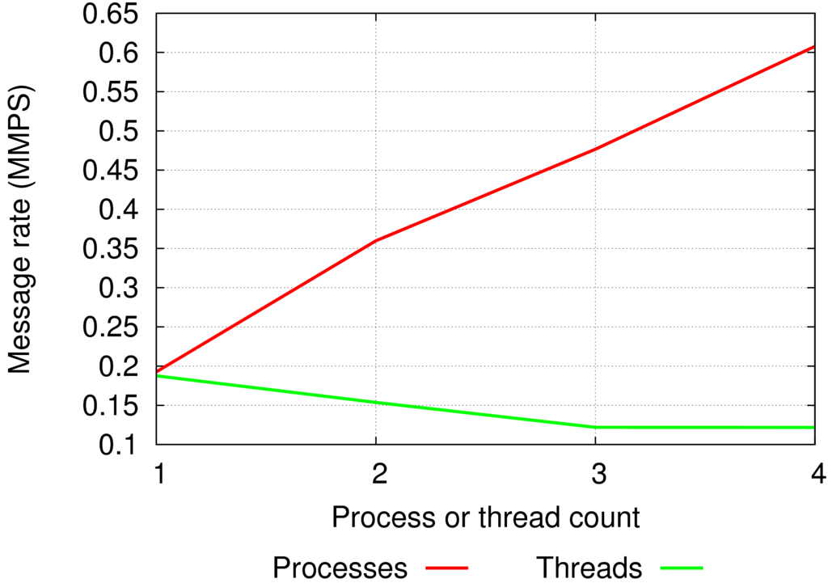
Coarse Grained Locking
Single global mutex
Mutex is held between entry and exit of most MPI_ functions
No concurrency in communication

Slide 9
Lock Granularity
Using mutexes can affect concurrency between threads
Coarser granularity → less concurrency
Finer granularity → more concurrency
Fine grained locking
Decreasing size of critical sections increases concurrency
Only hold mutex when you need it
Using multiple mutexes can also increase concurrency
Use separate mutexes for different critical sections
Acquiring and releasing mutexes has overhead
Increasing granularity increases overhead
Shrinking CS, using multiple mutexes increases complexity
Checking for races is more difficult
Need to worry about deadlocks

Slide 10
Levels of Granularity
Global
Use a single global mutex, held from function enter to exit
Existing implementation
Brief Global
Use a single global mutex, but reduce the size of the critical section as much as possible
Per-Object
Use one mutex per data object: lock data not code sections
Lock-Free
Use no mutexes
Use lock-free algorithms
Future work

Slide 11
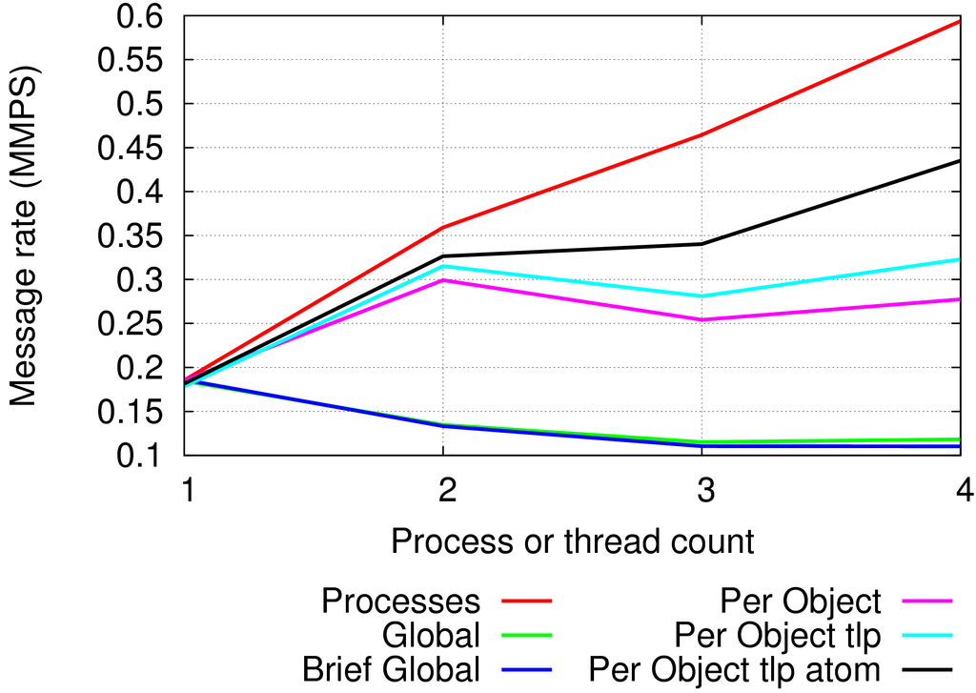
Fine-grained Multi-threaded Communication
Non-blocking sends access global data
Requests are allocated from a global request pool
Alloc and free of req requires updating reference count on communicator
Per-object tlp: thread-local request pool
Per-object tlp atom: use tlp and atomic ref count updates
Still some contention exists

Slide 12
CS Granularity Dynamic Optimizations: Adaptive Critical Section Length
PMPI_Wait(...)
{
CS_ENTER;
...
/*Check progress*/
poll_count=0;
do{
...
poll(); /*=30~300cyc*/
...
if(poll_count>=10)
{
poll_count=0;
CS_EXIT;
CS_YIELD;
CS_ENTER;
}
poll_count++;
...
}
while(!request_complete)
...
CS_EXIT;
}
PMPI_Wait(...)
{
CS_ENTER;
...
/*Check progress*/
do{
...
poll();
...
if(num_threads_waiting)
{
CS_EXIT;
CS_YIELD;
CS_ENTER;
}
...
}
while(!request_complete)
...
CS_EXIT;
}
CS Length
>= 300~3000
cycles
Fast path (no contention)
No need to yield
Low thread-safety overhead
Contended case
Short critical section
Low contention

Slide 13
Hardware Induced Bias
Flat memory
Hierarchical Memory
Mutex
Mutex
L2
L2
Core
Core
Core
Core
L1
L1
L1
L1
Core
Core
Core
Core
T0
T1
T2
T3
T0
T1
T2
T3
Spin
Access should be random
Access biased by the proximity to
the cache containing the mutex

Slide 14
Graph500 BFS
Compact
Single Node
Scatter
Weak Scaling

Slide 15
SWAP-Assembler
Blocking Send/Recv
Two threads per process
One sending
The other receiving
Strong scaling with 1 millions reads, each with 36 nucleotides

Slide 16
Message-driven Thread Activation
Lock
Acquisition
Message
Arrival
Bias Lock
Acquisition
New Lock
Acquisition
Message
Arrival
T4
T1
T4
T4
T1
Time
Penalty
T2
T2
T1
Penalty
T3
T3
T2
T1
T3
T1
T3
T3
Message-oblivious thread activation
Message-aware thread activation
Requires
Flexible and adaptive CS
Changes in the request data structure (will include waiting thread id)
Fall-back message-oblivious lock in case no threads are waiting for messages or target thread not waiting for the CS

Slide 17
MPI and OpenMP Specification Changes (proposed)

Slide 18
Endpoints Proposal Status
Endpoints is proposed for MPI 4.0
Hybrid WG has completed formal proposal
Formal reading scheduled for December ‘14 meeting
Then on to voting!
Further reading:
https://svn.mpi-forum.org/trac/mpi-forum-web/ticket/380
[SC ’14] Enabling Efficient Multithreaded MPI Communication Through a Library-Based Implementation of MPI Endpoints. S. Sridharan et al.
[ExaMPI ’14] Context id allocation for end-points communicators. D. Holmes.
[IJHPCA ’14] Enabling Communication Concurrency Through Flexible MPI Endpoints. J. Dinan et al.
[EuroMPI ’13] Enabling MPI Interoperability Through Flexible Communication Endpoints. J. Dinan et al.

Slide 19
MPI Endpoints Semantics
Parent Comm
Parent MPI Process
Parent MPI Process
Parent MPI Process
E.P. Comm
Rank
Rank
Rank
Rank
Rank
Rank
Rank
M
T
T
M
T
T
M
T
T
MPI_Comm_create_endpoints(MPI_Comm parent_comm, int my_num_ep, MPI_Info info, MPI_Comm out_comm_handles[])
Creates new MPI ranks from existing ranks in parent communicator
Each process in parent comm. requests a number of endpoints
Array of output handles, one per local rank (i.e. endpoint) in endpoints communicator
Endpoints have MPI process semantics (e.g. progress, matching, collectives, …)
Threads using endpoints behave like MPI processes
Provide per-thread communication state/resources
Allows implementation to provide process-like performance for threads
Notes:
“M” is the master thread. Not really an important detail, but potentially useful to point out when comparing with MPI+OpenMP

Slide 20
OpenMP threads vs. concurrency
OpenMP does not expose the difference between “threads” and “concurrent execution units” (for good reasons)
Two OpenMP threads might or might not execute concurrently
MPI has to assume the worst case: any two threads might execute concurrently
Needs appropriate locking and memory barriers to play safe
Concurrent execution streams and work-stealing handlers
Ability to reason about what threads/tasks can execute concurrently and ability for a library (such as MPI) to correct itself when that changes

Slide 21
MPI in ULT and Tasking Environments (MPI-5?)
THREAD_MULTIPLE mode requires MPI to do two things
Locking (for thread safety)
Yielding (for deadlock avoidance)
In ULT environments, if concurrency of threads/tasks (or lack of it) is exposed to the MPI library, locking is unnecessary
pthreads
Everything is concurrent
qthreads/MassiveThreads
Don’t know what is concurrent
Need a new threading/tasking library (or more information exposed from current threading/tasking libraries) to make this effective

Slide 22
New Threading/Tasking Libraries and Dynamic Runtime Systems

Slide 23
User-level Threads (ULTs) and Tasks
User-level Thread (ULT)
Lightweight thread with low context-switch overhead
More than one ULT can be mapped to a single OS thread
May not be executed concurrently
Why ULTs?
Conventional threads (e.g., pthreads) are too expensive to express massive parallelism
If we create pthreads more than # of cores (i.e., oversubscription):
context-switch and synchronization overhead will increase dramatically
ULTs can mitigate high overhead of pthreads but need explicit control
Where to use?
To better overlap computation and communication/IO
Low context-switching overhead of ULTs can give more opportunities to hide communication/IO latency
To exploit fine-grained task parallelism
Lightweight ULTs are more suitable to express massive task parallelism

Slide 24
Motivation Message Passing with User-level Threads
Overlap communication with computation using ULT
Lightweight
ULT does not execute concurrently using additional hardware resource, but takes turn to run by context switching
No lock needed between two ULTs in the same kernel thread
Asynchronous communication
Helps turn a MPI blocking call to a nonblocking one
Decouples the operation of “send start” and “send complete”
Dynamic Tasking
Providing automatic overlap based on task-graph dependencies
ULT₁ do computation, start a
MPI send
ULT₁
Context switch to ULT₂, ULT₁ communication
in background
ULT₂
Context switch back to ULT₁, ULT₂ communicate in background
timeline
CPU
NIC

Slide 25
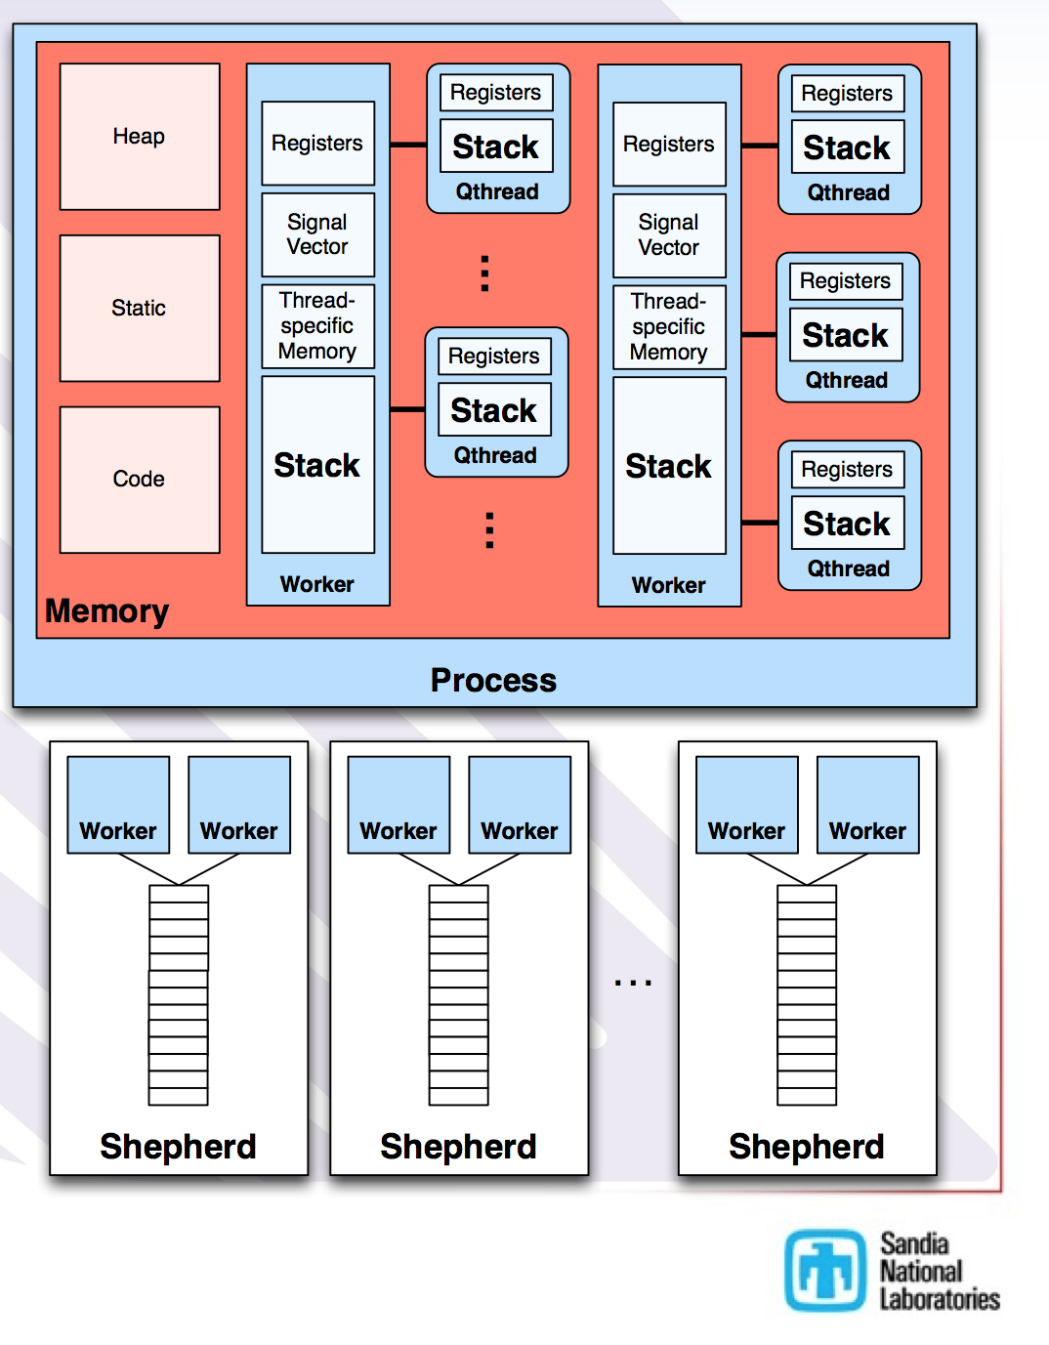
Qthreads
Lightweight portable ULT library
Locality-aware workstealing scheduler
Supports multiple programming models: Chapel, OpenMP
Pros and cons when integrated with MPI:
Pros: provides an easy interface to use ULT
Cons: lacks an explicit semantic for parallelism. All ULTs can potentially run in parallel thus lock is needed everywhere
Qthreads Architecture
Source: [Friar Tuck’s Chapel]

Slide 26
Argobots
Execution Streams (ES)
Sequential instruction stream
Can consist of one or more work units
Mapped efficiently to a hardware resource
Implicitly managed progress semantics
One blocked ES cannot block other ESs
Work Units
User-level Threads (ULTs)
Tasklets
Scheduler
Synchronization primitives
Mutex
Condition variable
Future
Barrier
ES₁
Sched
ES_{n}
S
Scheduler
Pool
U
S
E
...
U
ULT
T
U
E
T
T
S
E
T
Tasklet
U
T
T
E
E
Event

Slide 27
MPI+Argobots: Data Movement in Distributed Memory Systems with Lightweight Threads
Process
Process
Hybrid runtime of MPI and Argobots
lightweight and dynamically adapt to the hardware resources
Two level of threads provide an explicit semantic for concurrency
Execution Stream (ES) provides concurrent execution
User Level Thread (ULT) provides fast context switch
vs. MPI+Qthreads
Qthreads share its ULT among workers, so it can not specify which ULTs run in parallel. Argobots binds ULT to ES for explicit scheduling
Highly optimized context switch in Argobots
ULT
ULT
ULT
ULT
ES
ES
ES
ES
MPI
MPI
Worker
Worker
Qthreads
ULT (qthread)
ULT
ULT
ES
ES
Argobots

Slide 28
Application: HPCG
internal
external
High Performance Conjugate Gradient (HPCG)
Solves Ax=b, large and sparse matrix
Models 3D PDE. 27-point stencil, communicate with up to 26 neighbors
Key Communication Patterns
Global collective communication
MPI_Allreduce of local dot product
Neighborhood communication
halo exchange with neighbors
(i,j,k)
A x = y
for k = [1: max_iter] && normr > tolerance:
MG(A, r, z);
if k == 1:
WAXPBY(1.0, z, 0.0, z, p);
DDOT(r, z, rtz);
else
DDOT(r, z, rtz);
WAXPBY(1.0, z, beta, p, p);
SpMV(A, p, Ap);
DDOT(p, Ap, pAp);
WAXPBY(1.0, x, alpha, p, x);
WAXPBY(1,0, r, -alpha, Ap, r);
DDOT(r, r, normr);
normr = sqrt(normr);
HPCG
Simplified main loop in HPCG
Notes:
PDE=Partial differential equation

Slide 29
Overlapping Communication and Computation using ULT
Hiding Global Collective Communication
ult_ddot: a wrapper of DDOT
overlap communication and computation between iterations: ult_ddot (in iteration i) and MG (in iteration i+1)
fork a ULT to do ult_ddot and join in the next iteration
Hiding Neighborhood Communication
ult_spmv: spmv for one neighbor
for each neighbor, fork a ULT to do halo exchange and a small part of SpMV (communication)
main ULT computes local spmv (computation)
for k = [1: max_iter]:
MG(A, r, z);
if k > 1:
ult_join (thread);
if (normr <= tolerance) break;
……
ult_fork(ult_ddot, &param, &thread)
HPCG
SpMV(A, x, &y):
for each neighbor:
ult_fork(es, ult_spmv, &t[i]);
for i in [0: nRows]:
ult_yield();
for each j in row i:
y[i] += val[j] * x[idx[j]];
for each neighbor i:
ult_join(t[i]);
SpMV

Slide 30
Preliminary Results: HPCG w/ MPI+Qthreads
On 2,048 cores, HPCG using MPI+Qthreads shows performance improvement of 19.8% over MPI-only version, or 34.9% over MPI+Pthreads version.
As core number increases, the benefit of communication hiding begins to reveal. DDOT% increases from 0.62% on 16 cores to 36.8% on 2,048 cores.
Notes:
There are three DDOT operation in HPCG loop. The third one costs most of the time, and is overlapped with MG.

Slide 31
Preliminary Results: SpMV w/ MPI+Argobots
On 1,024 cores (grid size=64^3 per process), MPI+Argobots shows an improvement of 51.3% while MPI+Qthreads shows 27.7% compared against MPI-only version.
Notes:
Note the dataset used is small.

Slide 32
Take Away
MPI+X is becoming an increasingly popular model
The big problem is neither “MPI” nor “X”, but rather the “+”
MPI+X is an evolving model
Far from perfect, but changes are underway for both the implementations of “MPI” and “X”, as well as the standards to make “MPI+X” bigger than the sum of the parts
The work is not done, still a long way to go
New “complementary” programming models are needed in some cases, but they must not ignore the pieces that MPI has gotten right
Orthogonal technologies that work with MPI (MPI+X) are important

