Slide 1

Casper An Asynchronous Progress Model for MPI RMA on Many-core Architectures
Min Si^{[1][2]}, Antonio J. Peña^{[1]}, Jeff Hammond^{[3]}, Pavan Balaji^{[1]},
Masamichi Takagi^{[4]}, Yutaka Ishikawa^{[4]}
[1] Argonne National Laboratory, USA
{msi, apenya, balaji}@mcs.anl.gov
[3] Intel Labs, USA
jeff_hammond@acm.org
[2] University of Tokyo, Japan
msi@il.is.s.u-tokyo.ac.jp
[4] RIKEN AICS, Japan
{masamichi.takagi ,yutaka.ishikawa}@riken.jp
Notes:
Have worked at Argonne for 1 year,

Slide 2
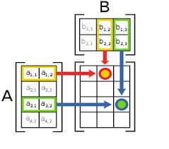
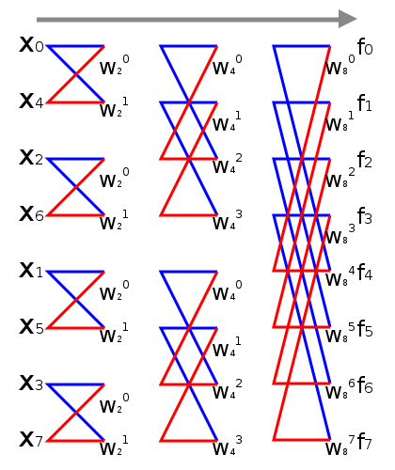
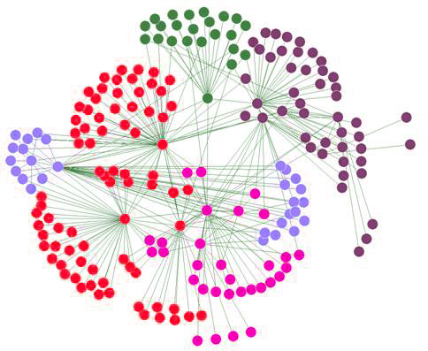
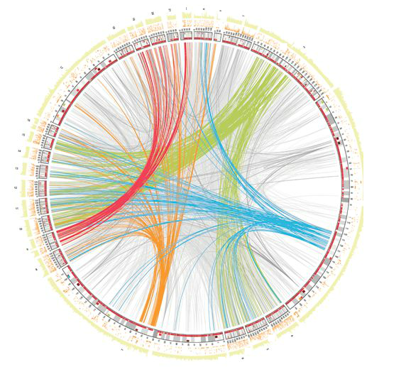
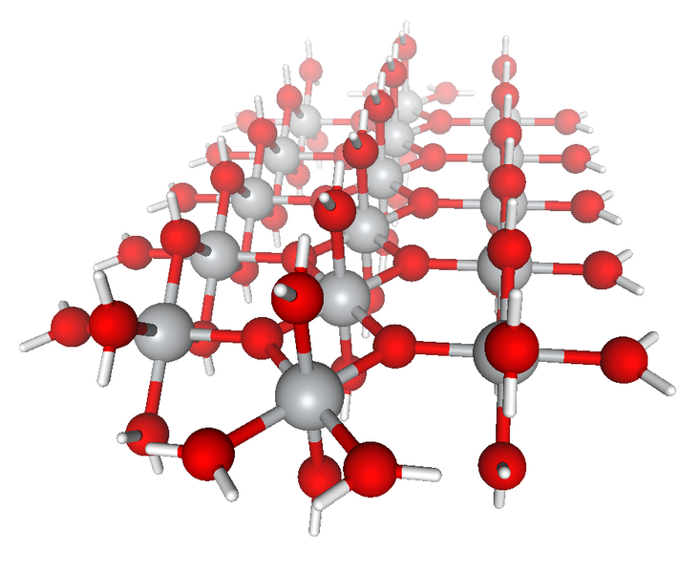
Irregular Computations
Regular computations
Organized around dense vectors or matrices
Regular data movement pattern, use MPI SEND/RECV or collectives
More local computation, less data movement
Example: stencil computation, matrix multiplication, FFT*
Irregular computations
Organized around graphs, sparse vectors, more “data driven” in nature
Data movement pattern is irregular and data-dependent
Growth rate of data movement is much faster than computation
Example: social network analysis, bioinformatics
Increasing trend of applications are moving to irregular computation models
Need more dynamic communication model
* FFT : Fast Fourier Transform
* The primary contents of this slide are contributed by Xin Zhao.

Slide 3
Message Passing Models
Two-sided communication
One-sided communication (Remote Memory Access)
Process 0
Process 1
Process 0
Process 1
Send (data)
Put (data)
Receive (data)
Computation
Get (data)
Receive (data)
Send (data)
Acc (data)
+=
Feature:
Origin (P0) specifies all communication parameters
Target (P1) does not explicitly receive or process message
Is communication always asynchronous ?

Slide 4
Problems in Asynchronous Progress
One-sided operations are not truly one-sided
In most platforms (e.g., InfiniBand, Cray)
Some operations are hardware supported (e.g., contiguous PUT/GET)
Other operations have to be done in software (e.g., 3D accumulates of double precision data)
Process 0
Process 1
Software implementation of one-sided operations means that the target process has to make an MPI call to make progress.
Acc(data)
+=
Computation
Delay
MPI call
Not TRULY asynchronous !
* RDMA : Remote Direct Memory Access

Slide 5
Traditional Approach of ASYNC Progress (1)
Thread-based approach
Every MPI process has a communication dedicated background thread
Background thread polls MPI progress in order to handle incoming messages for this process
Example: MPICH default asynchronous thread, SWAP-bioinformatics
Cons:
Waste half of computing cores or oversubscribe cores
Overhead of Multithreading safety of MPI
Process 0
Process 1
Helper
thread
Acc(data)
Computation
+=
P0
T0
P1
T1
P2
T2
P3
T3

Slide 6
Traditional Approach of ASYNC Progress (2)
Interrupt-based approach
Assume all hardware resources are busy with user computation on target processes
Utilize hardware interrupts to awaken a kernel thread and process the incoming RMA messages
i.e., Cray MPI, IBM MPI on Blue Gene/P
Cons:
Overhead of frequent interrupts
Process 0
Process 1
Computation
Helper
thread
Acc(data)
+=
Interrupt
DMMAP-based ASYNC overhead on Cray XC30

Slide 7
Outline
Background & Problem statement
Existing Approaches
Our solution : CASPER
Ensuring Correctness and Performance
Evaluation

Slide 8
Casper Process-based ASYNC Progress
Multi- and many-core architectures
Rapidly growing number of cores
Not all of the cores are always keeping busy
Process-based asynchronous progress
Dedicating arbitrary number of cores to “ghost processes”
Ghost process intercepts all RMA operations to the user processes
P0
P1
P2
…
PN
G0
G1
Pros:
No overhead caused by multithreading safety or frequent interrupts
Flexible core deployment
Portable PMPI* redirection
Process 0
Process 1
Ghost Process
Process 0
Process 1
Acc(data)
Computation
+=
Acc(data)
+=
Computation
MPI call
Original communication
Communication with Casper
* PMPI : name-shifted profiling interface of MPI
Notes:
Infinite cores, do not need interrupt

Slide 9
Basic Design of Casper
Three primary functionalities
Transparently replace MPI_COMM_WORLD by COMM_USER_WORLD
Shared memory mapping between local user and ghost processes by using MPI-3 MPI_Win_allocate_shared*
MPI_COMM_WORLD
0 1 2 3 4
G
G
0 1 2
COMM_USER_WORLD
Redirect RMA operations to ghost processes
Internal Memory mapping
P0
P1
Ghost Process
for P1
Ghost Process
P1
P2
Lock(P1)
P1 offset
Recv
Lock(G0)
lock
P2 offset
ACC(P1, disp, user_win)
Computation
ACC(G0, P1_offset + disp,
internal_win)
+=
* MPI_WIN_ALLOCATE_SHARED : Allocates window that is shared among all processes in the window’s group, usually specified with MPI_COMM_TYPE_SHARED communicator.

Slide 10
Ensuring Correctness and Performance
MPICH
Correctness challenges
Lock Permission Management
Self Lock Consistency
Managing Multiple Ghost Processes
Multiple Simultaneous Epochs
Casper
CrayMPI
Applications
MVAPICH
…
Asynchronous progress
Correctness
Performance

Slide 11
RMA synchronization modes
Active-target mode
Both origin and target issue synchronization
Fence (like a global barrier)
PSCW (subgroup of Fence)
Passive-target mode
Only origin issues synchronization
Lock_all (shared)
Lock (shared or exclusive)
P0
P1
P2
P0
P1
P2
Fence(win)
Fence(win)
Lock_all(win)
PUT
PUT
PUT
PUT
PUT
Fence(win)
Fence(win)
Unlock_all(win)
P0
P1
P2
P0
P1
P2
Post(P0 & P2, win)
Lock(P1)
Lock(P1)
Start(P1, win)
Start(P1, win)
PUT
PUT
PUT
Unlock(P1)
Comp(P1, win)
Comp(P1, win)
PUT
Wait(P0 & P2, win)
Unlock(P1)

Slide 12
[Correctness Challenge 1] Lock Permission Management for Shared Ghost Processes (1)
Two origins access two targets sharing the same ghost process
An origin accesses two targets sharing the same ghost process
[POOR PERF.] Two concurrent lock epochs have to be serialized
P0
P1
G0
P2
P3
P2
Lock (P0, win)
Unlock(P0, win)
Lock (P1, win)
Unlock(P1, win)
Lock (G0, win)
Unlock(G0, win)
P2
P3
G1
P3
Serialized
Lock (G0, win)
Unlock(G0, win)
[INCORRECT] Nested locks to the same target
P0
P1
G0
Lock (P0, win)
Lock (P1, win)
Unlock(P0, win)
Unlock(P1, win)
Lock (G0, win)
Lock (G0, win)
…
MPI standard:
An origin cannot nest locks to the same target
P2
P3
G1

Slide 13
[Correctness Challenge 1] Lock Permission Management for Shared Ghost Processes (2)
Solution
N Windows
N = max number of processes on every node
COMM. to i_{th} user process on each node goes to i_{th} window
User hint optimization
Window info “epochs_used” (fence|pscw|lock|lockall by default)
If “epochs_used” contains “lock”, create N windows
Otherwise, only create a single window
WIN[0]
WIN[1]
0
1
2
0
1
2
P0
P1
G0
P0
P1
G0
P0
P1
G0
P2
P3
G1
P2
P3
G1
P2
P3
G1
Notes:
Such overlapping windows allow Casper to carefully bypass the lock permission management in MPI when accessing different target processes, but still take advantage of them while accessing the same target.
While this approach ensures correctness, it can be expensive both for resource usage and performance.

Slide 14
[Correctness Challenge 2] Self Lock Consistency (1)
P0
MPI standard:
Local lock must be acquired immediately
P0
P1
G0
Lock (P0, win)
x=1
y=2
…
Unlock(P0, win)
Lock (G0, win)
Unlock(G0, win)
MPI standard:
Remote lock may be delayed..

Slide 15
[Correctness Challenge 2] Self Lock Consistency (2)
Solution (2 steps)
Force-lock with HIDDEN BYTES*
Lock self
User hint optimization
Window info no_local_loadstore
Do not need both 2 steps
Epoch assert MPI_MODE_NOCHECK
Only need the 2_{nd} step
Lock (G0, win)
Get (G0, win)
Flush (G0, win)
// Lock is acquired
Lock (P0, win)
// memory barrier for managing
// memory consistency
* MPI standard defines unnecessary restriction on concurrent GET and accumulate.
See MPI Standard Version 3.0 , page page 456, line 39.

Slide 16
[Correctness Challenge 3] Managing Multiple Ghost Processes (1)
Lock permission among multiple ghost processes
[INCORRECT] Two EXCLUSIVE locks to the same target may be concurrently acquired
P2
Lock (EXCLUSIVE, P0, win)
PUT(P0)
Unlock(P0, win)
P0
P1
G0
G1
P3
Serialized
Lock (EXCLUSIVE, P0, win)
PUT(P0)
Unlock(P0, win)
P2
P3
G2
G3
P2
P3
Lock (EXCLUSIVE, G0, win)
Lock (EXCLUSIVE, G1, win)
// get G0
G = randomly_pick_ghost();
PUT(G)
…
Lock (EXCLUSIVE, G0, win)
Lock (EXCLUSIVE, G1, win)
// get G1
G = randomly_pick_ghost();
PUT(G)
…
Empty lock can be ignored,
P2 and P3 may concurrently acquire lock on G0 and G1
Notes:
MPI implementation is allowed to ignore the lock if target does not receive any operation.

Slide 17
[Correctness Challenge 3] Managing Multiple Ghost Processes (2)
Ordering and Atomicity constraints for Accumulate operations
[INCORRECT] Ordering and Atomicity cannot be maintained by MPI among multiple ghost processes
P0
P1
G0
G1
GET_ACC (x, y, P1)
x = 2
ACC (x, P1)
MPI standard:
Same origin && same target location accumulates must be ordered
x += 2
x += 1
y=4
(correct result is 2)
ACC (x, P1)
MPI standard:
Concurrent accumulates to the same target location must be atomic per basic datatype element.
ACC (x, P1)
read x = 5
x=5+1
read x = 5
x=5+2

Slide 18
[Correctness Challenge 3] Managing Multiple Ghost Processes (3)
Solution (2 phases)
Static-Binding Phase
Rank binding model
Each user process binds to a single ghost process
Segment binding model
Segment total exposed memory on each node into N_{G} chunks
Each chunk binds to a single ghost process
Only redirect RMA operations to the bound ghost process
Fixed lock and ACC ordering & atomicity issues
But only suitable for balanced communication patterns
Static-Binding-Free Phase
After operation + flush issued, “main lock” is acquired
Dynamically select target ghost process
Accumulate operations can not be “binding free”
G0
G1
P0
P1
P2
P3
Static-rank-binding
G0
G1
P0
P1
P3
Static-segment-binding
P1
G0
G1
Optimization for dynamic communication patterns
Lock(G0, G1)
PUT(G0)
Flush(G0)
Acquired main lock
Binding Free
Unlock(G0, G1)

Slide 19
[Correctness Challenge 4] Multiple Simultaneous Epochs – Active Epochs (1)
Simultaneous fence epochs on disjoint sets of processes sharing the same ghost processes
[INCORRECT] Deadlock !
P0
P1
P2
P3
Fence(win0)
Epoch 1
Fence(win1)
Fence(win0)
Epoch 2
Fence(win1)
P0
P1
G0
P2
P3
G1
Fence(win0)
Blocked
Fence(win1)
Blocked
DEADLOCK !

Slide 20
[Correctness Challenge 4] Multiple Simultaneous Epochs - Active Epochs (2)
Solution
Every user window has an internal “global window”
Translate to passive-target mode
Fence
PSCW Flush + Send-Receive
Performed on user processes
Win_allocate
Fence(win0)
PUT(P)
…
Fence(win)
Win_free
Win_allocate
Lock_all (global win)
Flush_all (global win) + Barrier(COMM_USER_WORLD) + Win_sync
PUT(G)
…
Flush_all (global win) + Barrier(COMM_USER_WORLD) + Win_sync
Unlock_all (global win)
Win_free
[Performance issue 1]
[Performance issue 3]
User hint
MPI_MODE_NOPRECEDE avoids it
[Performance issue 2]
User hint (NOSTORE & NOPUT & NOPRECEDE) avoids it
Notes:
Only say translation, and have perf issues but solved by user hints

Slide 21

Evaluation
Asynchronous Progress Microbenchmark
NWChem Quantum Chemistry Application
Experimental Environment
NERSC's newest supercomputer *
Cray XC30
* https://www.nersc.gov/users/computational-systems/edison/configuration/

Slide 22
Asynchronous Progress Microbenchmark
RMA implementation in Cray MPI v6.3.1
Test scenario
Lock_all (win);
for (dst=0; dst<nproc; dst++) {
OP(dst, double, cnt = 1, win);
Flush(dst, win);
busy wait 100us; /*computing*/
}
Unlock_all (win)
 | HW-handled OP | ASYNC. mode
Original mode | NONE | Thread
DMAPP mode | Contig. PUT/GET | Interrupt
Accumulate on Cray XC30 (SW)
PUT on Cray XC30 (HW in DMAPP mode)
DMAPP (Interrupt-based async)
DMAPP (HW PUT)
Casper provides asynchronous progress for SW-handled ACC.
Casper does not affect the performance of HW PUT
Notes:
Focus on cray

Slide 23
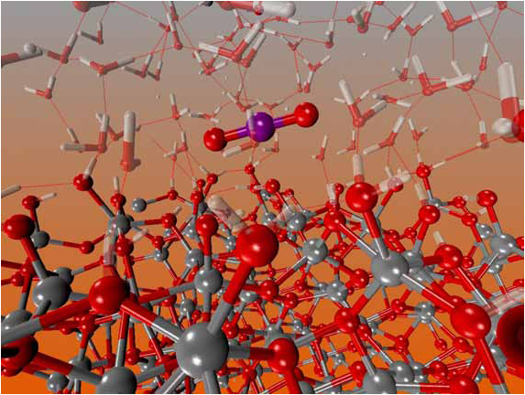
NWChem Quantum Chemistry Application (1)
Computational chemistry application suite composed of many types of simulation capabilities.
ARMCI-MPI (Portable implementation of Global Arrays over MPI RMA)
Focus on most common used CC (coupled-cluster) simulations in a C₂₀ molecules
for i in I blocks:
for j in J blocks:
for k in K blocks:
GET block a from A
GET block b from B
c += a * b /*computing*/
end do
ACC block c to C
end do
end do
GET block a
GET
block b
Accumulate block c
Perform DGEMM in local buffer
Get-Compute-Update model
Notes:
Real user application -> production application

Slide 24
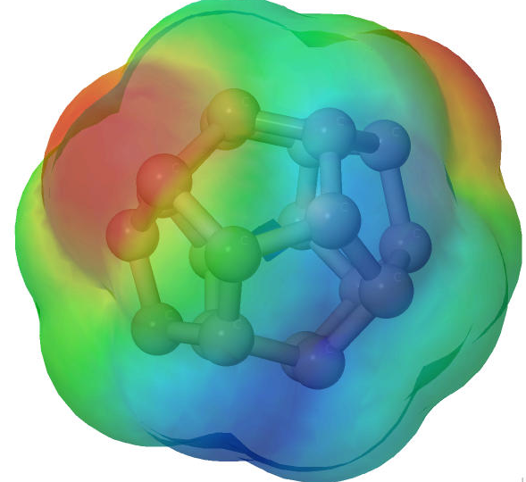
Evaluation 2. NWChem Quantum Chemistry Application (2)
Input data file : tce_c20_triplet
Platform Configuration:
12-core Intel "Ivy Bridge" (24 cores per node)
CCSD iteration in CCSD task
Carbon C₂₀
Core deployment
Casper ASYNC. Progress helps CCSD performance
 | # COMP. | # ASYNC.
Original MPI | 24 | 0
Casper | 20 | 4
Thread-ASYNC (oversubscribed) | 24 | 24
Thread-ASYNC (dedicated ) | 12 | 12
(T) portion in CCSD (T) task
More compute-intensive than CCSD, more improvement

Slide 25
Summary
MPI RMA communication is not truly one-sided
Still need asynchronous progress
Additional overhead in thread / interrupt-based approaches
Multi- / Many-Core architectures
Number of cores is growing rapidly, some cores are not always busy
Casper: a process-based asynchronous progress model
Dedicating arbitrary number of cores to ghost processes
Mapping window regions from user processes to ghost processes
Redirecting all RMA SYNC. & operations to ghost processes
Linking to various MPI implementation through PMPI transparent redirection
Download slides: http://sudalab.is.s.u-tokyo.ac.jp/~msi/pdf/ipdps2015-casper-slides.pdf

Slide 26
Backup slides

Slide 27
[Correctness Challenge 4] Multiple Simultaneous Epochs – Lock_all (1)
Lock_all only
Same translation as that for Fence
lock_all in win_allocate, flush_all in unlock_all
[INCORRECT] Lock_all and EXCLUSIVE lock on the same window may be concurrently acquired
P2
P0
P1
G0
Lock_all (win)
PUT(P0)
Unlock_all(win)
P3
P2
P3
G1
Serialized
Lock (EXCLUSIVE, P0, win)
PUT(P0)
Unlock(P0, win)
P2
P3
Lock_all (global win)
PUT(G0)
Unlock_all(global win)
Lock (EXCLUSIVE, G0, win[0])
PUT(G0)
…
Locks may be acquired concurrently

Slide 28
[Correctness Challenge 3] Multiple Simultaneous Epochs – Lock_all (2)
Solution
Translate lock_all to a series of locks to all ghost processes
P0
P1
G0
P2
P2
Lock_all (win)
…
Lock (SHARED, G0, win[0])
Lock (SHARED, G0, win[1])
Lock (SHARED, G1, win[0])
Lock (SHARED, G1, win[1])
…
P2
P3
G1
// lock P0
// lock P1
// lock P2
// lock P3

Slide 29
[Performance Challenge] Memory Locality
Casper internally detects the location of the user processes
Only bind the closest ghost processes
i.e., P0-2 are bound to G0, P3-5 are bound to G1
Node
Node
Socket 0
Socket 1
Socket 0
Socket 1
P0
P1
P4
G0
P0
G0
P3
G1
P2
P3
P5
G1
P1
P2
P4
P5
Memory
Memory
Memory
Memory

Slide 30
Performance Issues and optimizations in Fence
Win_allocate
Fence(win0)
PUT(P)
…
Fence(win)
…
Win_allocate
Lockall(global win)
Flushall(global win) + MPI_barrier + Win_sync
PUT(G)
…
Flushall(global win) + MPI_barrier + Win_sync
[Performance issue 1]
Fence: local completion of operations issued by this process (as an origin)
Flushall + MPI_barrier : remote completion of
all operations issued by all processes
[Performance issue 3]
Memory consistency management
User hint MPI_MODE_NOPRECEDE avoid flushall
[Performance issue 2]
Always need sync between processes for
Remote update before fence with local read after fence
Local write before fence with remote get after fence
P0
P1
PUT y
Write x
Fence
Get x
Read y
User hint (NOSTORE & NOPUT & NOPRECEDE) avoid barrier

Slide 31
Evaluation. Asynchronous Progress Microbenchmark
One-sided communication on InfiniBand cluster
(Contiguous PUT/GET are handled in hardware)
Accumulate (SW)
PUT (HW)

