Slide 1

Characterizing MPI and Hybrid MPI+Threads Applications at Scale: Case Study with BFS
Abdelhalim Amer*, Huiwei Lu*, Pavan Balaji*, Satoshi Matsuoka⁺
*Argonne National Laboratory, IL, USA
+Tokyo Institute of Technology, Tokyo, Japan
PPMM’15, in conjunction with CCGRID’15, May 4-7, 2015, Shenzhen, Guangdong, China

Slide 2

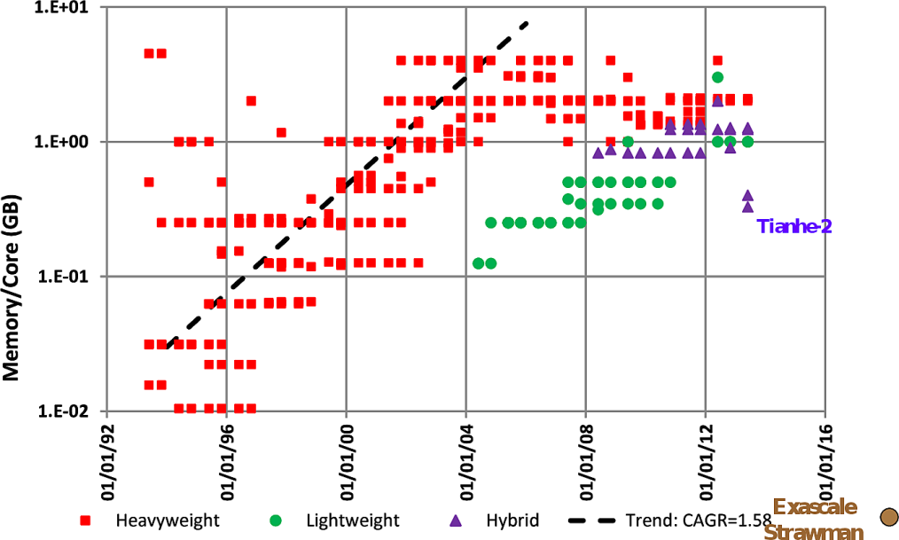
Evolution of High-End Systems
Systems with massive core counts already in production
Tianhe-2: 3,120,000 cores
Mira: 3,145,728 HW threads
Core density is increasing
Other resources do not scale at the same rate
Memory per core is reducing
Network endpoints
Evolution of the memory capacity per core in the Top500 list [1]
[1] Peter Kogge. Pim & memory: The need for a revolution in architecture. The Argonne Training Program on Extreme-Scale Computing (ATPESC), 2013.

Slide 3
Parallelism with Message Passing
ß
Core0 | Core1 |  | Core0 | Core1
Core2 | Core3 |  | Core2 | Core3
Node 0 |  |  | Node 1
Core0 | Core1 |  | Core0 | Core1
Core2 | Core3 |  | Core2 | Core3
Node 2 |  |  | Node3
Problem Domain
Target Architecture

Slide 4
Domain Decomposition with MPI vs. MPI+X
Process
Threads
Process
Communication
MPI-only = Core Granularity Domain Decomposition
MPI+X = Node Granularity Domain Decomposition

Slide 5
MPI vs. MPI+X
Process
Threads
Communication (single copy)
Process
Shared Data
Boundary Data (extra memory)
MPI-only = Core Granularity Domain Decomposition
MPI+X = Node Granularity Domain Decomposition

Slide 6
Process Model vs. Threading Model with MPI
Processes | Threads
Data all private | Global data all shared
Sharing requires extra work (e.g. MPI-3 shared memory) | Sharing is given, consistency is not and implies protection
Communication fine-grained (core-to-core) | Communication coarse-grained (typically node-to-node)
Space overhead is high (buffers, boundary data, MPI runtime, etc) | Space overhead is reduced
Contention only for system resources | Contention for system resources and shared data
No thread-safety overheads | Magnitude of thread-safety overheads depend on the application and MPI runtime
The process model has inherent limitations
Sharing is becoming a requirement
Using threads needs careful thread-safety implementations

Slide 7
MPI + Threads Interoperation by the Standard
An MPI process is allowed to spawn multiple threads
Threads share the same rank
A thread blocking for communication must not block other threads
Applications can specify the way threads interoperate with MPI
Restriction
Low Thread-Safety Costs
MPI_THREAD_SINGLE
No additional threads
MPI_THREAD_FUNNELED
Master thread communication only
MPI_THREAD_SERIALIZED
Threaded communication serialized
MPI_THREAD_MULTIPLE
No restrictions
Flexibility
High Thread-Safety Costs

Slide 8

Breadth First Search and Graph500
0
Search in graph
Neighbors first
Solves many problems in graph theory
1
2
3
4
5
6
Graph500 benchmark BFS kernel
Kronecker graph as input
Communication
Two-sided nonblocking
This small, synthetic graph was generated by a method called Kronecker multiplication. Larger versions of this generator, modeling real-world graphs, are used in the Graph500 benchmark. (Courtesy of Jeremiah Willcock, Indiana University) [Sandia National Laboratory]

Slide 9
Breadth First Search Baseline Implementation
0
While(1)
{
Process_Current_Level();
Synchronize();
MPI_Allreduce(QLength);
if(QueueLenth == 0)
break;
}
Sync()
1
2
3
Sync()
4
5
6

Slide 10
MPI only to Hybrid BFS
MPI Only
Hybrid MPI + OpenMP
While(1)
{
Process_Current_Level();
Synchronize();
MPI_Allreduce(QLength);
if(QueueLenth == 0)
break;
}
While(1)
{
#pragma omp parallel
{
Process_Current_Level();
Synchronize();
}
MPI_Allreduce(QLength);
if(QueueLenth == 0)
break;
}
MPI_THREAD_MULTIPLE
Shared read queue
Private temp write queues
Private buffers
Lock-Free/Atomic-Free

Slide 11
Communication Characterization
Problem size = 2²⁶ vertices (SCALE = 26)
Communication Volume (GB)
Message Count

Slide 12

Target Platform
Architecture | Blue Gene/Q
Processor | PowerPC A2
Clock frequency | 1.6 GHz
Cores per node | 16
HW threads/Core | 4
Number of nodes | 49152
Memory/node | 1GB
Interconnect | Proprietary
Topology | 5D Torus
Compiler | GCC 4.4.7
MPI library | MPICH 3.1.1
Network driver | BG/Q V1R2M1
Memory/HW thread = 256 MB!
We use in the following 1 rank/thread per core
MPICH: global critical section

Slide 13
Baseline Weak Scaling Performance

Slide 14
Main Sources of Overhead
MPI-only
MPI+Threads

Slide 15
Non-Scalable Sub-Routines
Make_Progress()
{
MPI_Test(recvreq,flag)
if(flag) compute();
for(each process P){
MPI_Test(sendreq[P],flag)
if(flag)
buffer_free[P] = 1;
}
}
Synchronize()
{
for(each process P)
MPI_Isend(buf,0,P,
sendreq[P]);
while(!all_procs_done)
Check_Incom_Msgs();
}
O(P)
O(P²) Empty Messages
Eager polling for communication progress
Global synchronization (2.75G messages for 512K cores)

Slide 16
Fixing the Scalability Issues
Use a lazy polling (LP) policy
Use the MPI 3 nonblocking barrier (IB)
Weak Scaling Results

Slide 17
Thread Contention in the MPI Runtime
Default: global critical section to avoid extra overheads in uncontended cases
Fine-grained critical section can be used for highly contented scenarios
MPI_Test Latency

Slide 18
Performance with Fine-Grained Concurrency
Weak Scaling Performance
Profiling with 1K Nodes

Slide 19
Summary
The coarse-grained MPI+X communication model is generally more scalable
In BFS, MPI+X reduced for example the
O(P) polling overhead
O(P²) empty messages for global sync
The model does not fix root scalability issues
Thread-safety overheads can be significant source
It is not a fatality:
Various techniques can be used thread contention and safety overheads
We are actively working on improving multhreading support in MPICH (MPICH derivatives can benefit from it)
Characterizing MPI+shared-memory vs. MPI+threads models is being considered for a future study

