Slide 1



MPI+Threads: Runtime Contention and Remedies
Abdelhalim Amer*, Huiwei Lu+, Yanjie Wei#, Pavan Balaji+, Satoshi Matsuoka*
*Tokyo Institute of Technology
⁺Argonne National Laboratory
#Shenzhen Institute of Advanced Technologies, Chinese Academy of Sciences
PPoPP’15, February 7–11, 2015, San Francisco, CA, USA.

Slide 2
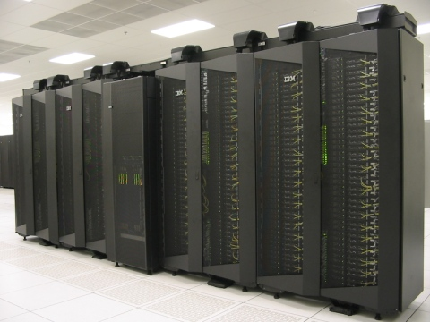
The Message Passing Interface (MPI)
Standard library specification (not a language)
Several implementations
MPICH and derivatives
MVAPICH
Intel-MPI
Cray-MPI
…
OpenMPI
Large portion of legacy HPC applications use MPI
Not just message passing:
Remote Memory Access (RMA)

Slide 3
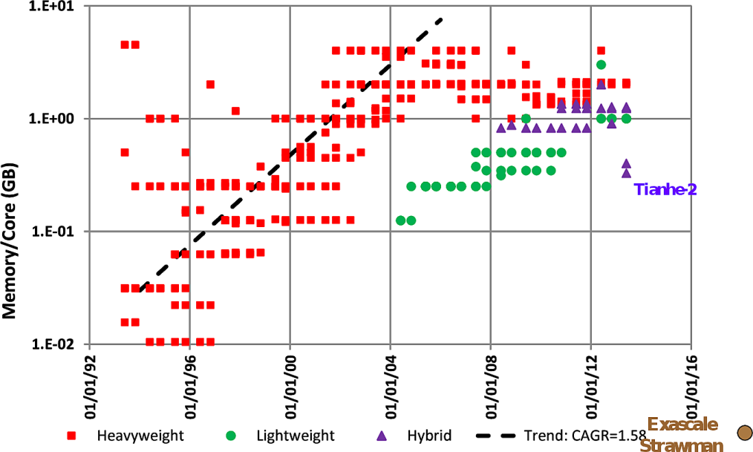
Why MPI + X ?
Core density is increasing
Other resources do not scale at the same rate
Memory per core is reducing
Network endpoint
Sharing resources within nodes is a becoming necessary
X : shared-memory programming
Threads: OpenMP, TBB, …
MPI shared memory !
PGAS
Evolution of the memory capacity per core in the Top500 list [1]
[1] Peter Kogge. Pim & memory: The need for a revolution in architecture. The Argonne Training Program on Extreme-Scale Computing (ATPESC), 2013.

Slide 4
MPI +Threads Interoperation
MPI_Init_thread (…, required, …)
Restriction
Low Thread-Safety Costs
Flexibility
High Thread-Safety Costs
MPI_THREAD_SINGLE
No additional threads
MPI_THREAD_FUNNELED
Master thread communication only
MPI_THREAD_SERIALIZED
Multithreaded communication serialized
MPI_THREAD_MULTIPLE
No restrictions

Slide 5
Test Environement
Architecture | Nehalem
Processor | Xeon E5540
Clock frequency | 2.6 GHz
Number of Sockets | 2
Cores per Socket | 4
L3 Size | 8192 KB
L2 Size | 256 KB
Number of nodes | 310
Interconnect | Mellanox QDR
MPI Library Network Module | MPICH Nemesis:MXM
Fusion cluster at Argonne National Laboratory

Slide 6
Contention in Multithreaded Communication
P0
P1
P0
P4
P1
P5
P2
P6
P3
P7
Multi-process Point-to-Point BW
Multithreaded Point-to-Point BW

Slide 7

Dimensions of Thread-Safety
Critical Section Granularity
Shorter is better but more complex
Synchronization Mechanism
How to hand-off to the next thread?
Atomic ops, memory barriers, system calls, NUMA-awareness
Arbitration: Who enters the CS?
Fairness
Random, FIFO, Priority
Threads
Arbitration
Critical
Section
Length
Hand-Off

Slide 8
Dimensions of Thread-Safety
Critical Section Granularity
Shorter is better but more complex
Synchronization Mechanism
How to hand-off to the next thread?
Atomic ops, memory barriers, system calls, NUMA-awareness
Arbitration: Who enters the CS?
Fairness
Random, FIFO, Priority
Threads
Arbitration
Critical
Section
Length
Hand-Off

Slide 9
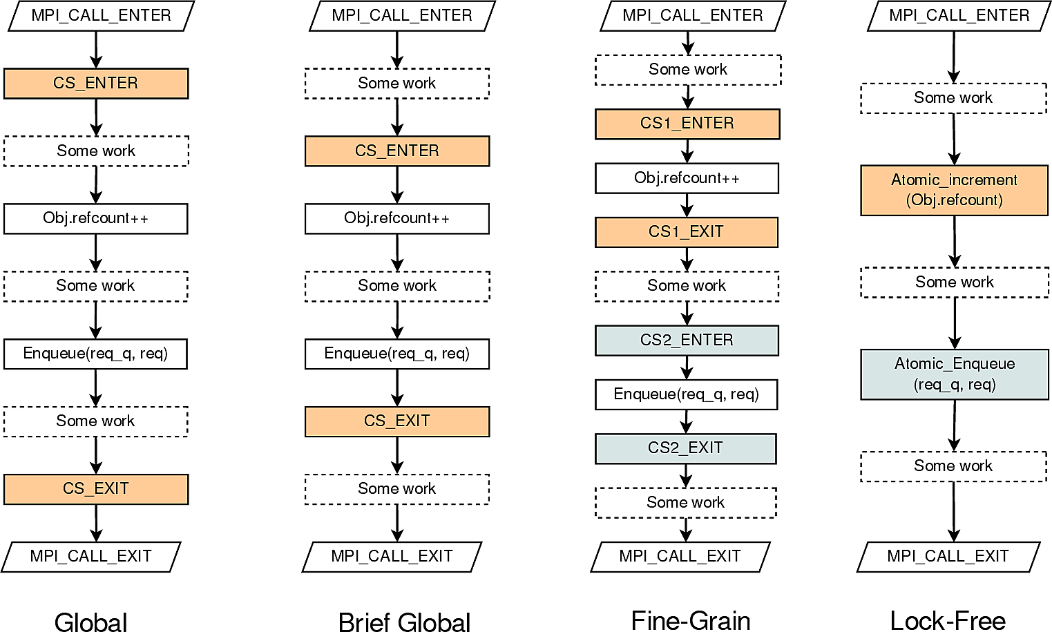
Reducing Contention by Refining Critical Section Granularity
Balaji, Pavan, et al. "Fine-grained multithreading support for hybrid threaded MPI programming." International Journal of High Performance Computing Applications 24.1 (2010): 49-57.

Slide 10
Thread-Safety in MPICH
Supports a 1:1 threading model: only sees kernel threads
MPICH
MPI
MPID
Headers
PAMID
CH3
Thread
MRail
PSM
Nemesis
Sock
BlueGene
(POCS)
IB
MXM
TCP
…
POCS
MVAPICH
(GCS)
Current Work
(GCS)
GCS: Global CS only
POCS: Per-Object CS supported

Slide 11
Baseline Thread-Safety in MPICH:Nemesis: Pthread Mutex
Global critical section
Implementation: NPTL Pthread mutex
Pthread mutex
CAS in the user-space
Futex wait/wake in contended cases
Arbitration: Fastest thread first
→ Possible unfainess
pthread_mutex_lock
CAS
FUTEX_WAIT
User-Space
Sleep
Kernel-Space
FUTEX_WAKE
CAS
FUTEX_WAIT
Sleep
FUTEX_WAKE
CAS
Go inside the critical section

Slide 12
Unfairness May Occur!
Flat memory
Hierarchical Memory
Mutex
Mutex
L2
L2
Core
Core
Core
Core
L1
L1
L1
L1
Core
Core
Core
Core
T0
T1
T2
T3
CAS
CAS
CAS
CAS
T0
T1
T2
T3
User Space
CAS
CAS
CAS
CAS
User Space
Access should be random
Access biased by the proximity to
the cache containing the mutex

Slide 13
Fairness Analysis
Bandwidth benchmark
Unfairness levels
Core Level : A single thread is monopolizing the lock
Socket Level : Threads on the same socket are monopolizing the lock
Bias factor
How much a fair arbitration is biased
Bias factor = 1 = fair arbitration
Fairness analysis of the BW benchmark with 8 threads

Slide 14
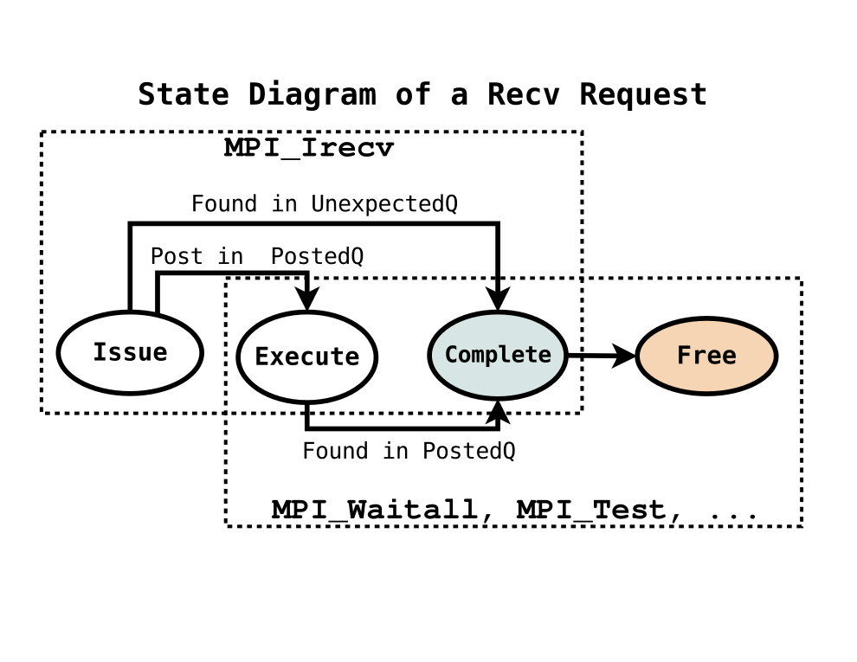
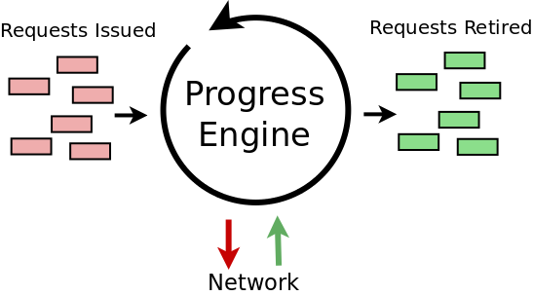
Internals of an MPI Runtime and Mutex
Communication Progress Engine
Time
Penalty
Work availability sequence
Thread resource acquisition sequence
Threads
Resource
Hand-off
Wasting resource acquisition with mutex

Slide 15
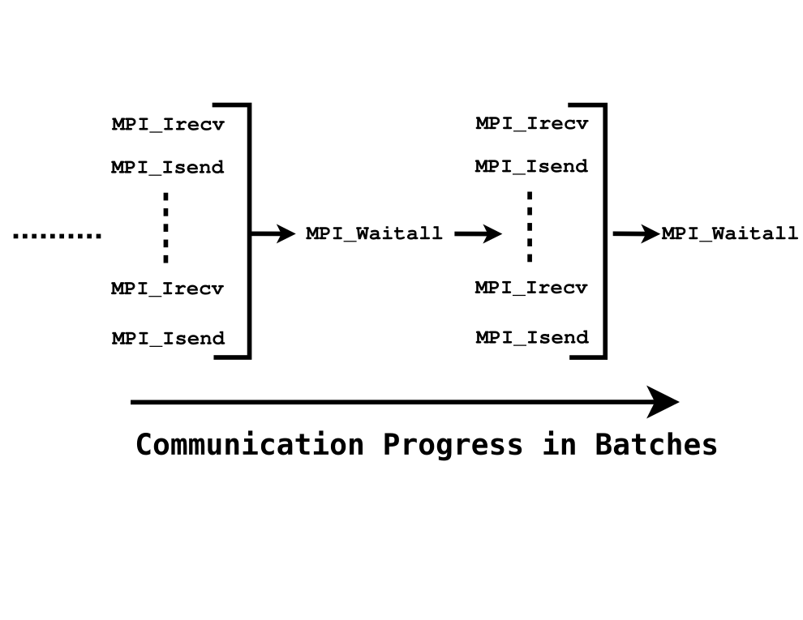
Consequences of Unfair Arbitration
40% of the maximum
DR: Dangling requests
Completed but not free’d
Want to keep low this number

Slide 16
Simple Solution: Force FIFO
Ticket Lock
Busy waiting
FIFO arbitration
Mutex
Time
Penalty
Ticket
Time
Penalty
Fairness (FIFO) reduces wasted resource acquisitions

Slide 17
Preliminary Throughput Results
Compact Binding
Scatter Binding
8 cores/node

Slide 18
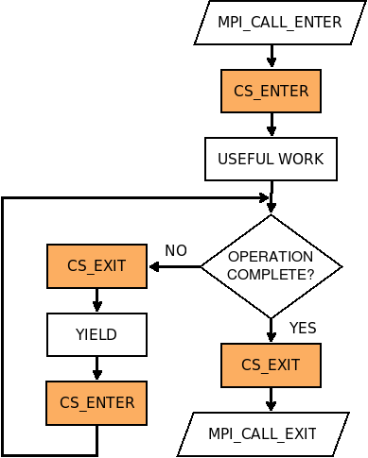
Can we do better?
Critical section constrains
Threads have to yield when blocking in the progress engine
To respect MPI progress semantics
Observations
Most MPI calls do useful work the first time they enter the runtime
Thread starts polling if the operation is not completed
Simplified Execution flow of a Thead-safe MPI implementation with critical sections

Slide 19
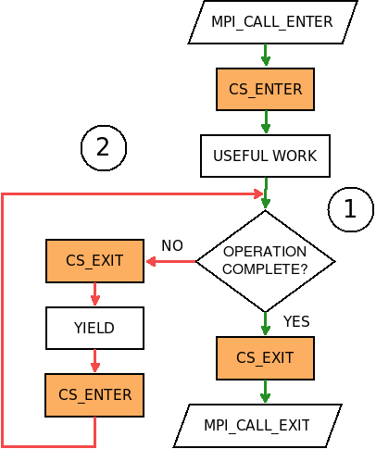
Can we do better?
Idea:
Two priority levels: High and Low
All threads start with a high priority (1)
Fall to low priority (2) if the operation is
Blocking
Failed to complete immediately
3 Ticket-Locks:
One for mutual exclusion in each priority level
Another for high priority threads to block lower ones
Simplified Execution flow of a Thead-safe MPI implementation with critical sections

Slide 20
Preliminary Throughput Results
N2N Benchmark

Slide 21
Evaluation

Slide 22
Two-Sided Pt2Pt with 32 cores
~ 8x
Throughput
Latency

Slide 23
ARMCI-MPI + Async. Progress
Put
P
Progress Thread
MPI_Put()
Get
Accumulate

Slide 24
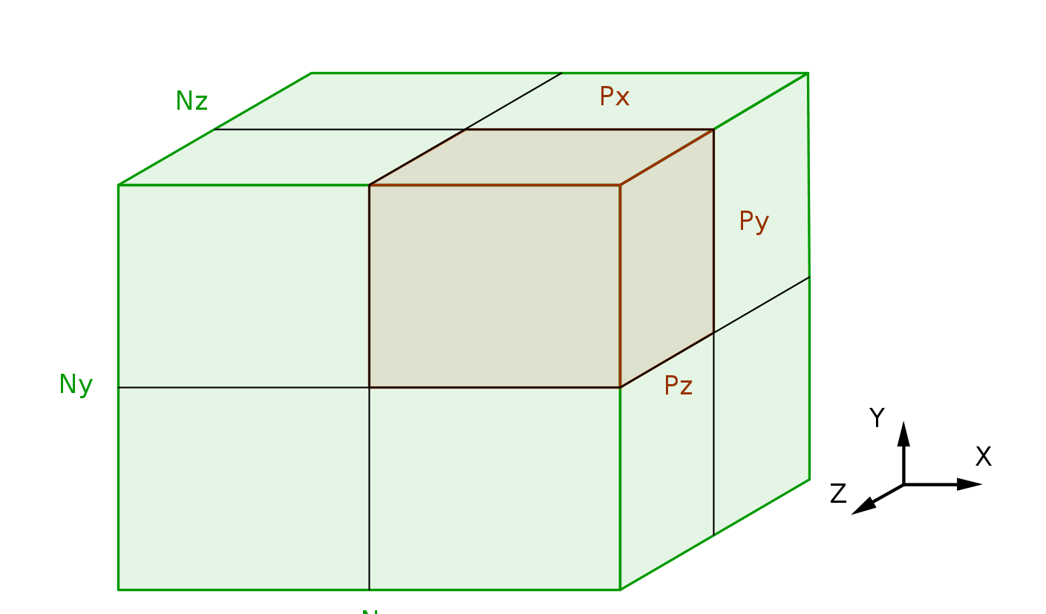
3D 7-Pt Stencil
Domain Decomposition
Strong Scaling with 64 Nodes
Execution Breakdown

Slide 25

MPI+OpenMP Graph500 BFS
16 Nodes and Compact Binding
While(1)
{
#pragma omp parallel
{
Process_Current_Level();
Synchronize();
}
MPI_Allreduce(QLength);
if(QueueLenth == 0)
break;
}
Weak Scaling

Slide 26
SWAP-Assembler
Blocking Send/Recv
Two threads per process
One sending
The other receiving
Strong scaling with 1 millions reads, each with 36 nucleotides
Strong scaling results
Genome Assembly : SWAP-Assembler

Slide 27
Summary and Future Directions
Critical section arbitration plays an important role in communication performance
By changing the arbitration, substantial improvements were observed
Further improvement requires a synergy of all the dimensions of thread-safety
Smarter arbitration
Message-driven to further reduce resource waste
Low latency hand-off (NUMA-aware synchronization)
Reduce serialization thhrough finer-grained critical sections

