Slide 1
Fault Tolerant MapReduce-MPI for HPC Clusters
Yanfei Guo*, Wesley Bland⁺, Pavan Balaji⁺, Xiaobo Zhou*
*Dept. of Computer Science, University of Colorado, Colorado Springs
⁺Mathematics and Computer Science Division, Argonne National Laboratory

Slide 2
Outline
Overview
Backgrounds
Challenges
FT-MRMPI
Design
Checkpoint-Restart
Detect-Resume
Evaluation
Conclusion

Slide 3
MapReduce on HPC Clusters
What MapReduce Provides
Write serial code and run parallelly
Reliable execution with detect-restart fault tolerance model
HPC Clusters
High Performance CPU, Storage, Network
MapReduce on HPC Clusters
High Performance Big Data Analytics
Reduced Data Movements between Systems
 | Mira | Hadoop
CPU | 16 1.6GHz PPC A2 cores | 16 2.4GHz Intel Xeon cores
Memory | 16 GB (1 GB/core) | 64-128 GB (4-8 GB/core)
Storage | Local: N/A Shared: 24 PB SAN | Local: 500 GB x 8 Shared: N/A
Network | 5D Torus | 10/40 Gbps Ethernet
Software Env | MPI, … | Java, …
File System | GPFS | HDFS
Scheduler | Cobalt | Hadoop
MapReduce Lib | MapReduce-MPI | Hadoop
MapReduce on HPC software stack
With Fault Tolerance

Slide 4
Fault Tolerance Model of MapReduce
Master/Worker Model
Detect: Master monitors the all workers
Restart: Affect tasks are rescheduled to another worker
Worker
Job
…
Worker
Master
Scheduler
Worker
MapTask
Map Slot
Reduce Slot
MapTask
ReduceTask
MapTask
ReduceTask
MapTask
ReduceTask
MapTask

Slide 5
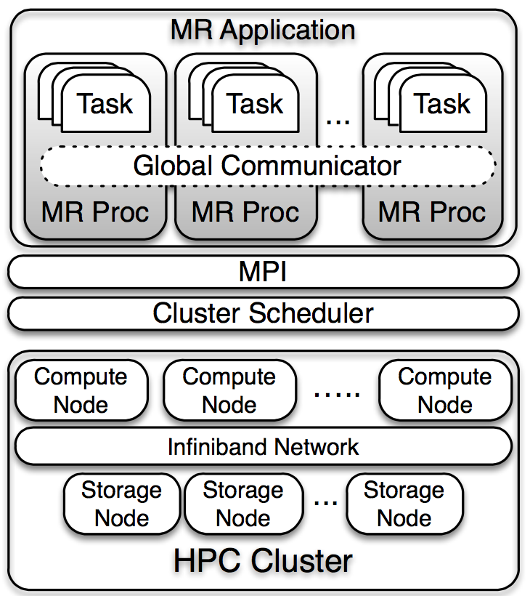
No Fault Tolerance in MPI
MPI: Message Passing Interface
Inter-process Communication
Communicator (COMM)
Frequent Failures at Large Scale
MTTF=4.2 hr (NCSA Blue Waters)
MTTF<1 hr in future
MPI Standard 3.1
Custom Error Handler
No guarantee that all processes go into the error handler
No fix for a broken COMM

Slide 6
Scheduling Restrictions
Gang Scheduling
Scheduler all processes at the same time
Preferred by HPC application with extensive synchronizations
MapReduce Scheduling
Per-task scheduling
Schedule each task as early as possible
Compatible with the detect-restart fault tolerance model
Resizing a Running Job
Many platform does not support
Large overhead (re-queueing)
The detect-restart fault tolerance model is not compatible with HPC schedulers

Slide 7
Overall Design
Fault Tolerant MapReduce using MPI
Reliable Failure Detection and Propagation
Compatible Fault Tolerance Model
FT-MRMPI
Task Runner
Distributed Master & Load Balancer
Failure Handler
Features
Tracable Job Interfaces
HPC Scheduler Compatible Fault Tolerance Models
Checkpoint-Restart
Detect-Resume
MapReduce Job
MapReduce Processs
MapReduce Processs
Task
Runner
Distributed
Master
Task
Runner
Distributed
Master
Load
Balancer
…
Load
Balancer
Failure Hldr
Failure Hldr
MPI

Slide 8
Task Runner
User Program
MR-MPI
Tracing, Establish Consistent States
Delegating Operations to the Library
New Interface
Highly Extensible
Embedded Tracing
Record Level Consistency
Map()
RD record
Call (*func)()
Process
WR KV
template <typename K, typename V> class RecordReader
template <typename K, typename V> class RecordWriter
class WordRecordReader : public RecordReader<int, string>
template <typename K, typename V> class Mapper
template <typename K, typename V> class Reducer
void Mapper::map(int& key, string& value,
BaseRecordWriter* out, void* param) {
out->add(value, 1);
}
int main(int narg, char** args) {
MPI_Init(&narg,&args);
<***snip***>
mr->map(new WCMapper(),
new WCReader(),
NULL, NULL);
mr->collate(NULL);
mr->reduce(new WCReducer(), NULL,
new WCWriter(), NULL);
<***snip***>
}

Slide 9
Distributed Master & Load Balancer
Task Dispatching
Global Task Pool
Job Init
Recovery
Global Consistent State
Shuffle Buffer Tracing
Load Balancing
Monitoring Processing Speed of Tasks
Linear Job Performance Model
MapReduce Job
Task Pool
Task
Task
Task
Task
Task
Task
Task
Task
Task
Task
Task
Task
MapReduce Processs
MapReduce Processs
Task
Runner
Distributed
Master
Task
Runner
Distributed
Master
…
Load
Balancer
Load
Balancer
Failure Hldr
Failure Hldr

Slide 10
Fault Tolerance Model: Checkpoint-Restart
RD record
Custom Error Handler
Save and exit gracefully
Propagate failure event with MPI_Abort()
Checkpoint
Asynchronous in phase
Saved locally
Multiple granularity
Restart to Recover
Resubmit w/ -recover
Pickup from where it left
Failed Process
Normal Process
Other Processes
Err Hldr
Save States
MPI_Abort()
Map
Shuffle
Reduce

Slide 11
Where to Write Checkpoint
Write to GPFS
Performance issue due to small I/O
Interferences on shared hardware
Write to Node Local Disk
Fast, no interferences
Global availability in recovery?
Background Data Copier
Write local
Sync to GPFS in background
Overlapping I/O w/ computation
Wordcount 100GB, 256 procs, ppn=8
Notes:
GPFS more than 1200, write local ~240, small overhead of copier

Slide 12
Recover Point
Recover to Last File (ft-file)
Less frequent checkpoint
Need reprocess when recover, lost some work
Recover to Last Record (ft-rec)
Require fine grained checkpoint
Skipping records than reprocessing
wordcount
pagerank

Slide 13
Drawbacks of Checkpoint-Restart
Checkpoint-Restart works, but not perfect
Large Overhead due to Read/Write Checkpoints
Requires Human intervention
Failure in Recovery

Slide 14
Fault Tolerance Model: Detect-Resume
Detect
Global knowledge of failure
Identify failed processes by comparing groups
Resume
Fix COMM by excluding failed processes
Balanced distribution of affected tasks
Work-Conserving vs. Non-Work-Conserving
User Level Failure Mitigation (ULFM)
MPIX_Comm_revoke()
MPIX_Comm_shrink()
Failed Process
Normal Process
Other Processes
Err Hldr
Revoke()
Shrink()
Map
Shuffle
Reduce

Slide 15
Evaluation Setup
LCRC Fusion Cluster^{[1]}
256 nodes
CPU: 2-way 8-core Intel Xeon X5550
Memory: 36GB
Local Disk: 250 GB
Network: Mellanox Infiniband QDR
Benchmarks
Wordcount, BFS, Pagerank
mrmpiBLAST
[1] http://www.lcrc.anl.gov

Slide 16
Job Performance
10%-13% overhead of checkpointing
Up to 39% shorter completion time with failure
Notes:
128 GB input data

Slide 17
Checkpoint Overhead
Factors
Granularity: number of records per checkpoint
Size of records

Slide 18
Time Decomposition
Performance with failure and recovery
Wordcount, All processes together
Detect-Recover has less data that needed to be recovered

Slide 19
Continuous Failures
Pagerank
256 processes, randomly kill 1 process every 5 secs

Slide 20
Conclusion
First Fault Tolerant MapReduce Implementation in MPI
Redesign MR-MPI to provide fault tolerance
Highly extensible while providing the essential features for FT
Two Fault Tolerance Model
Checkpoint-Restart
Detect-Resume

Slide 21
Thank you!
Q & A

Slide 22
Backup Slides

Slide 23
Prefetching Data Copier
Recover from GPFS
Reading everything from GPFS
Processes wait for I/O
Prefetching in Recovery
Move from GPFS to local disk
Overlapping I/O with computation

Slide 24
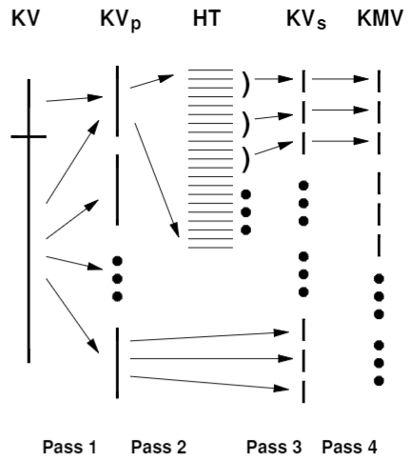
2-Pass KV-KMV Conversion
4-Pass in MR-MPI
Excessive disk I/O when shuffle
Hard to make checkpoints
2-Pass KV-KMV Conversion
Log-Structure File System
KV->Sketch, Sketch->KMV

Slide 25
Recover Time
Recover from local, GPFS, GPFS w/ prefetching

